Slide 1
Session 2
Supporting children and adolescents with perinatal HIV exposure to thrive
Ute Feucht, University of Pretoria and Tshwane District Health Services

Slide 2
Please note
This event is being recorded.
Participation in the event signals your consent to have the recording posted.
Recordings will be available on the conference portal and on IAS+ soon after the event.
Participants joining online are muted.
We welcome your questions.
  For those joining online, please use the Q&A function
  If you are in the room, we welcome you to use one of the microphones along the aisles

Slide 3



Presenters
Christina Laurenzi, Stellenbosch University
Building momentum towards enabling caregiving environments for children affected by HIV
Ceri Evans, University of Liverpool
Ensuring food security for school age children with perinatal HIV exposure
Kathryn Roberts, University College London
Double vulnerability - Child development among children with perinatal HIV exposure born to adolescent mothers
Notes:
During the panel

Slide 4
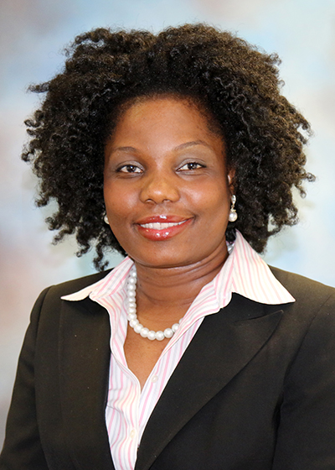

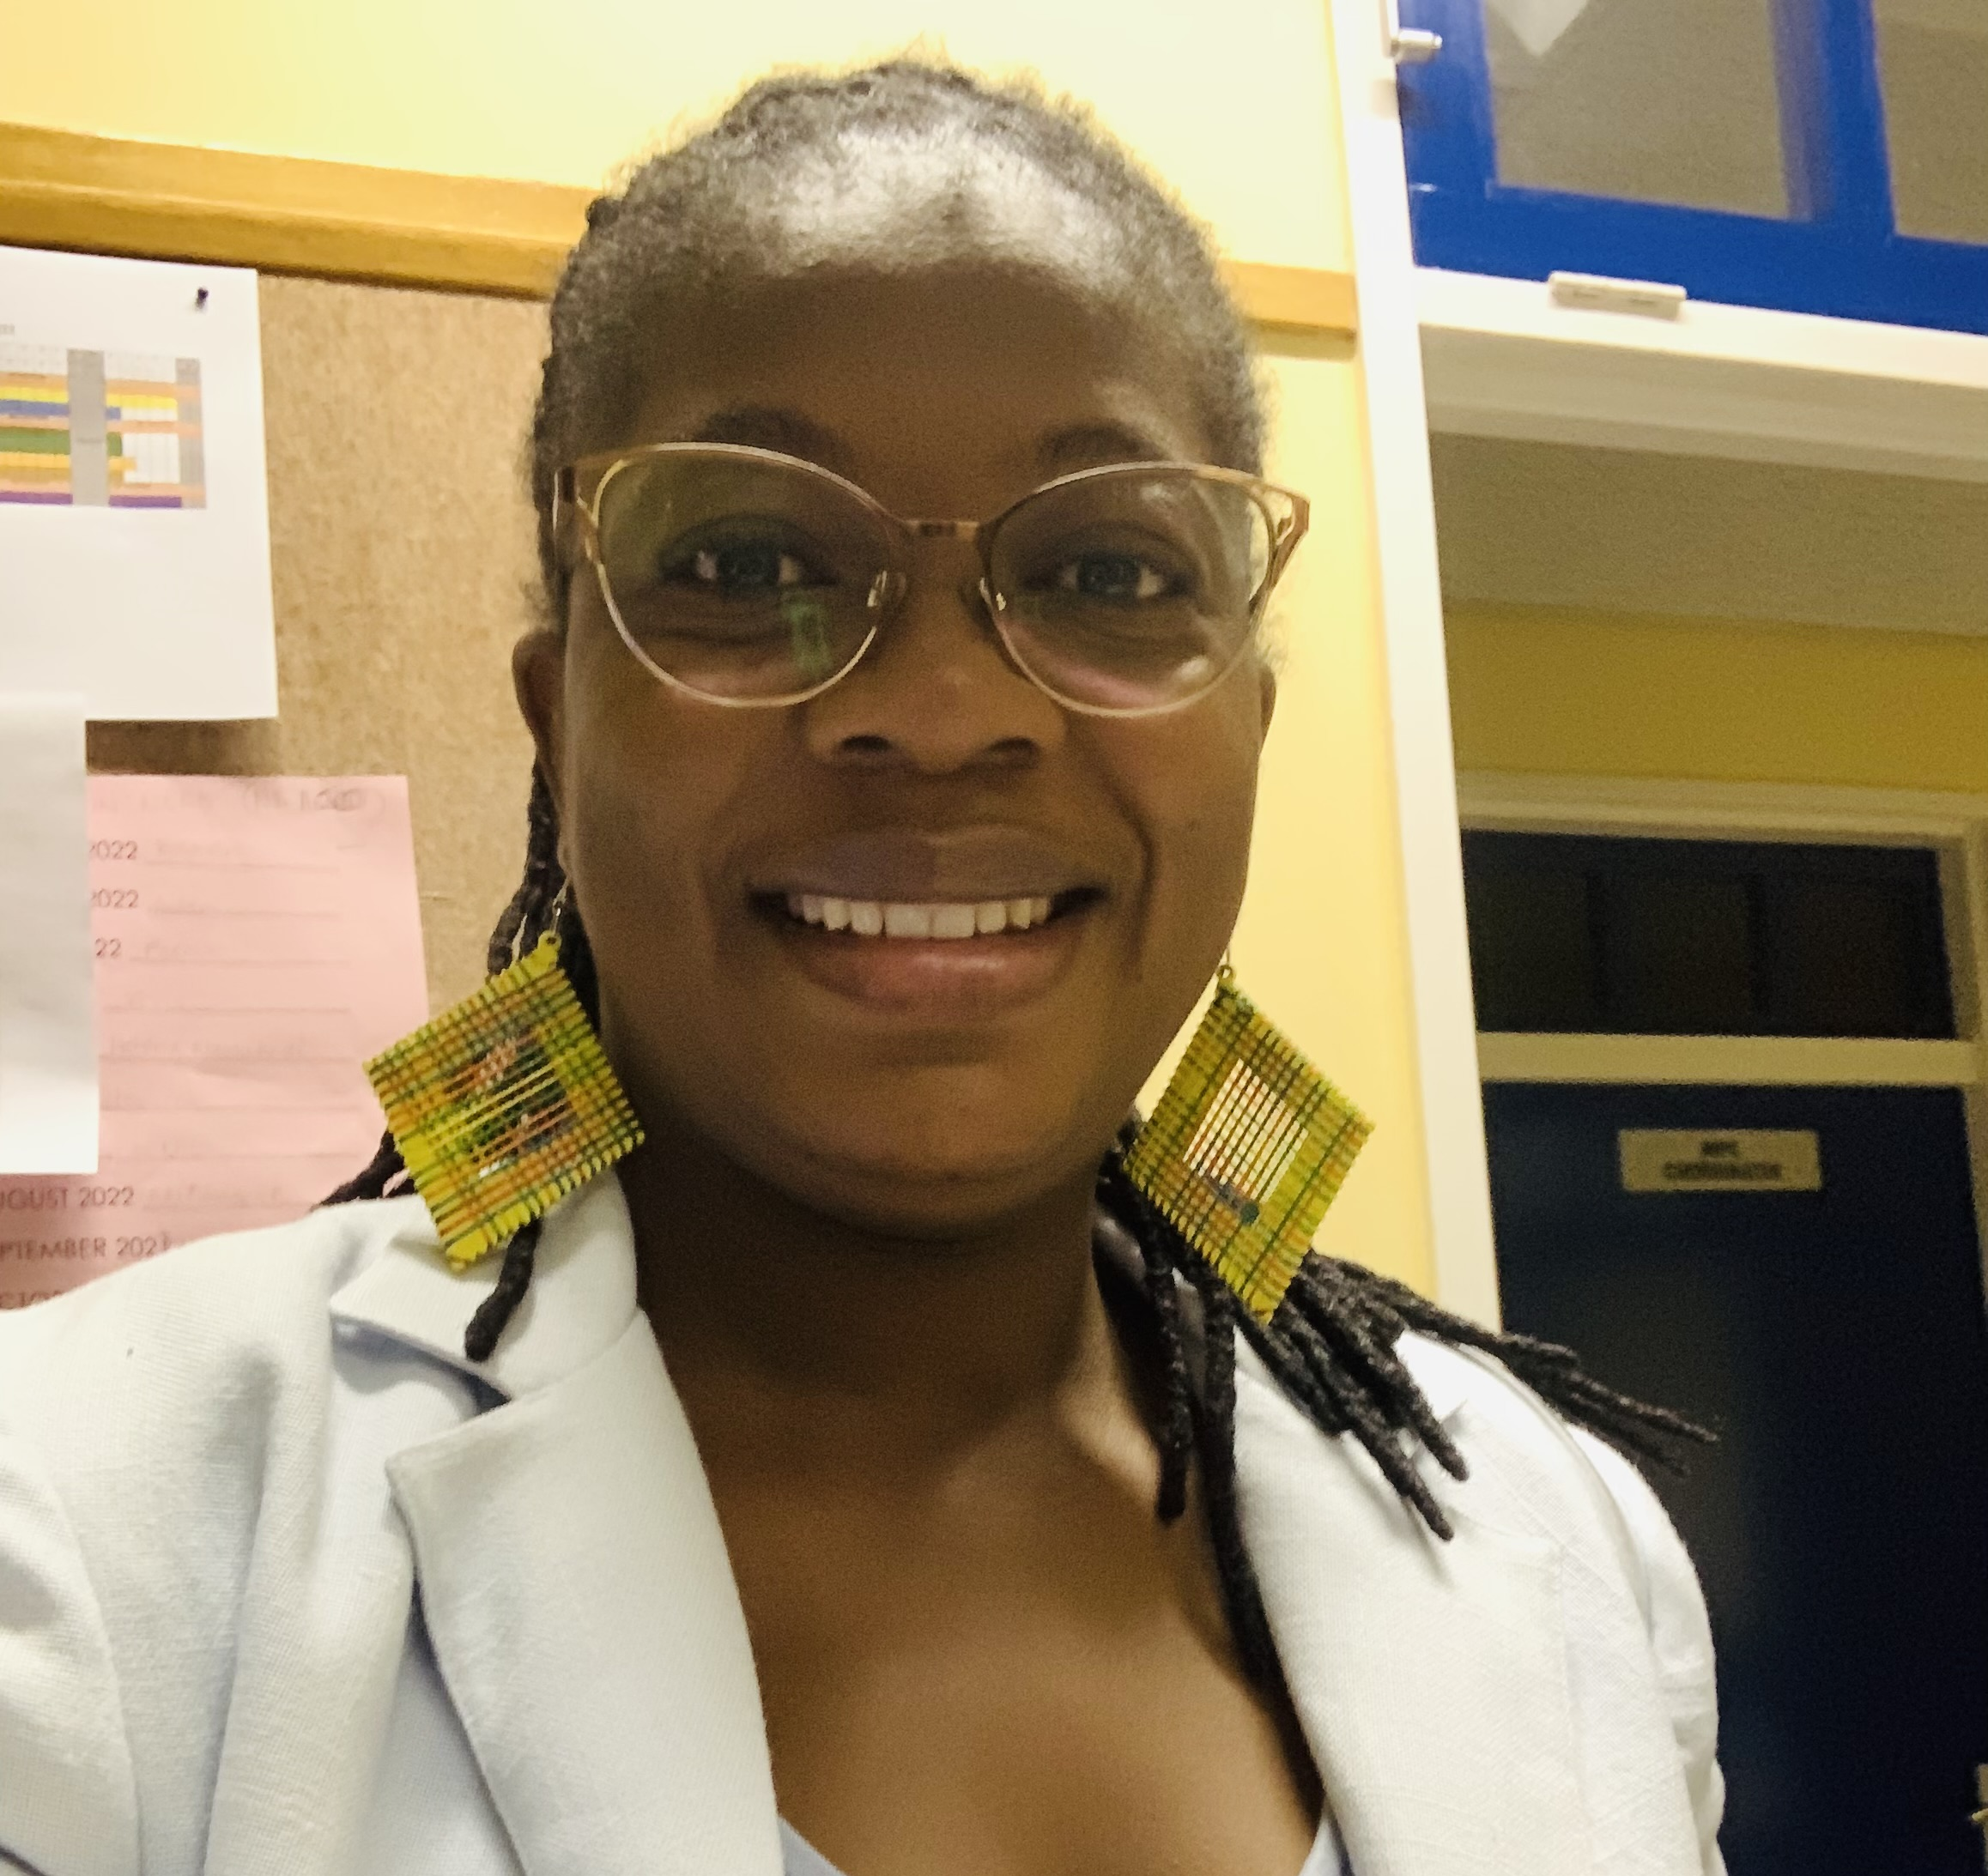

Presenters
Amara Ezeamama, Michigan State University
Sharing HIV Exposure Status with Children – Relationships with Anxiety, Depressive symptoms, Stress and Overall wellbeing of children affected by HIV in Uganda
Agnes Ronan, Paediatric-Adolescent Treatment Africa
Facilitator
Helena Nangombe, Young Women Empowerment Network
Navigating Life with Perinatal HIV Exposure: Perspectives from a parent
Daddicky Sauyere
Navigating Life with Perinatal HIV Exposure: Perspectives from a young person
Notes:
During the panel

