Slide 1



Q&A
Christina Laurenzi, Stellenbosch University
Building momentum towards enabling caregiving environments for children affected by HIV
Ceri Evans, University of Liverpool
Ensuring food security for school age children with perinatal HIV exposure
Kathryn Roberts, University College London
Double vulnerability - Child development among children with perinatal HIV exposure born to adolescent mothers
Notes:
During the panel

Slide 2
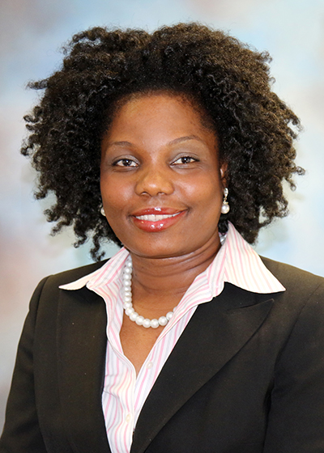
Presenter
Amara Ezeamama, Michigan State University
Sharing HIV Exposure Status with Children – Relationships with Anxiety, Depressive symptoms, Stress and Overall wellbeing of children affected by HIV in Uganda
Notes:
During the panel

