Slide 1
Session 3
Research to inform the care agenda for children and adolescents with perinatal HIV exposure
Renata Sanders, Children’s Hospital of Philadelphia

Slide 2
Please note
This event is being recorded.
Participation in the event signals your consent to have the recording posted.
Recordings will be available on the conference portal and on IAS+ soon after the event.
Participants joining online are muted.
We welcome your questions.
  For those joining online, please use the Q&A function
  If you are in the room, we welcome you to use one of the microphones along the aisles

Slide 3

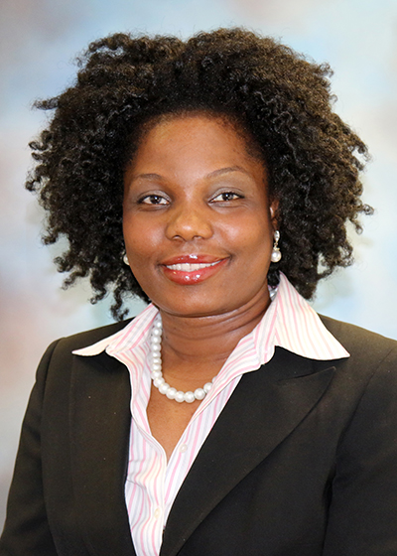
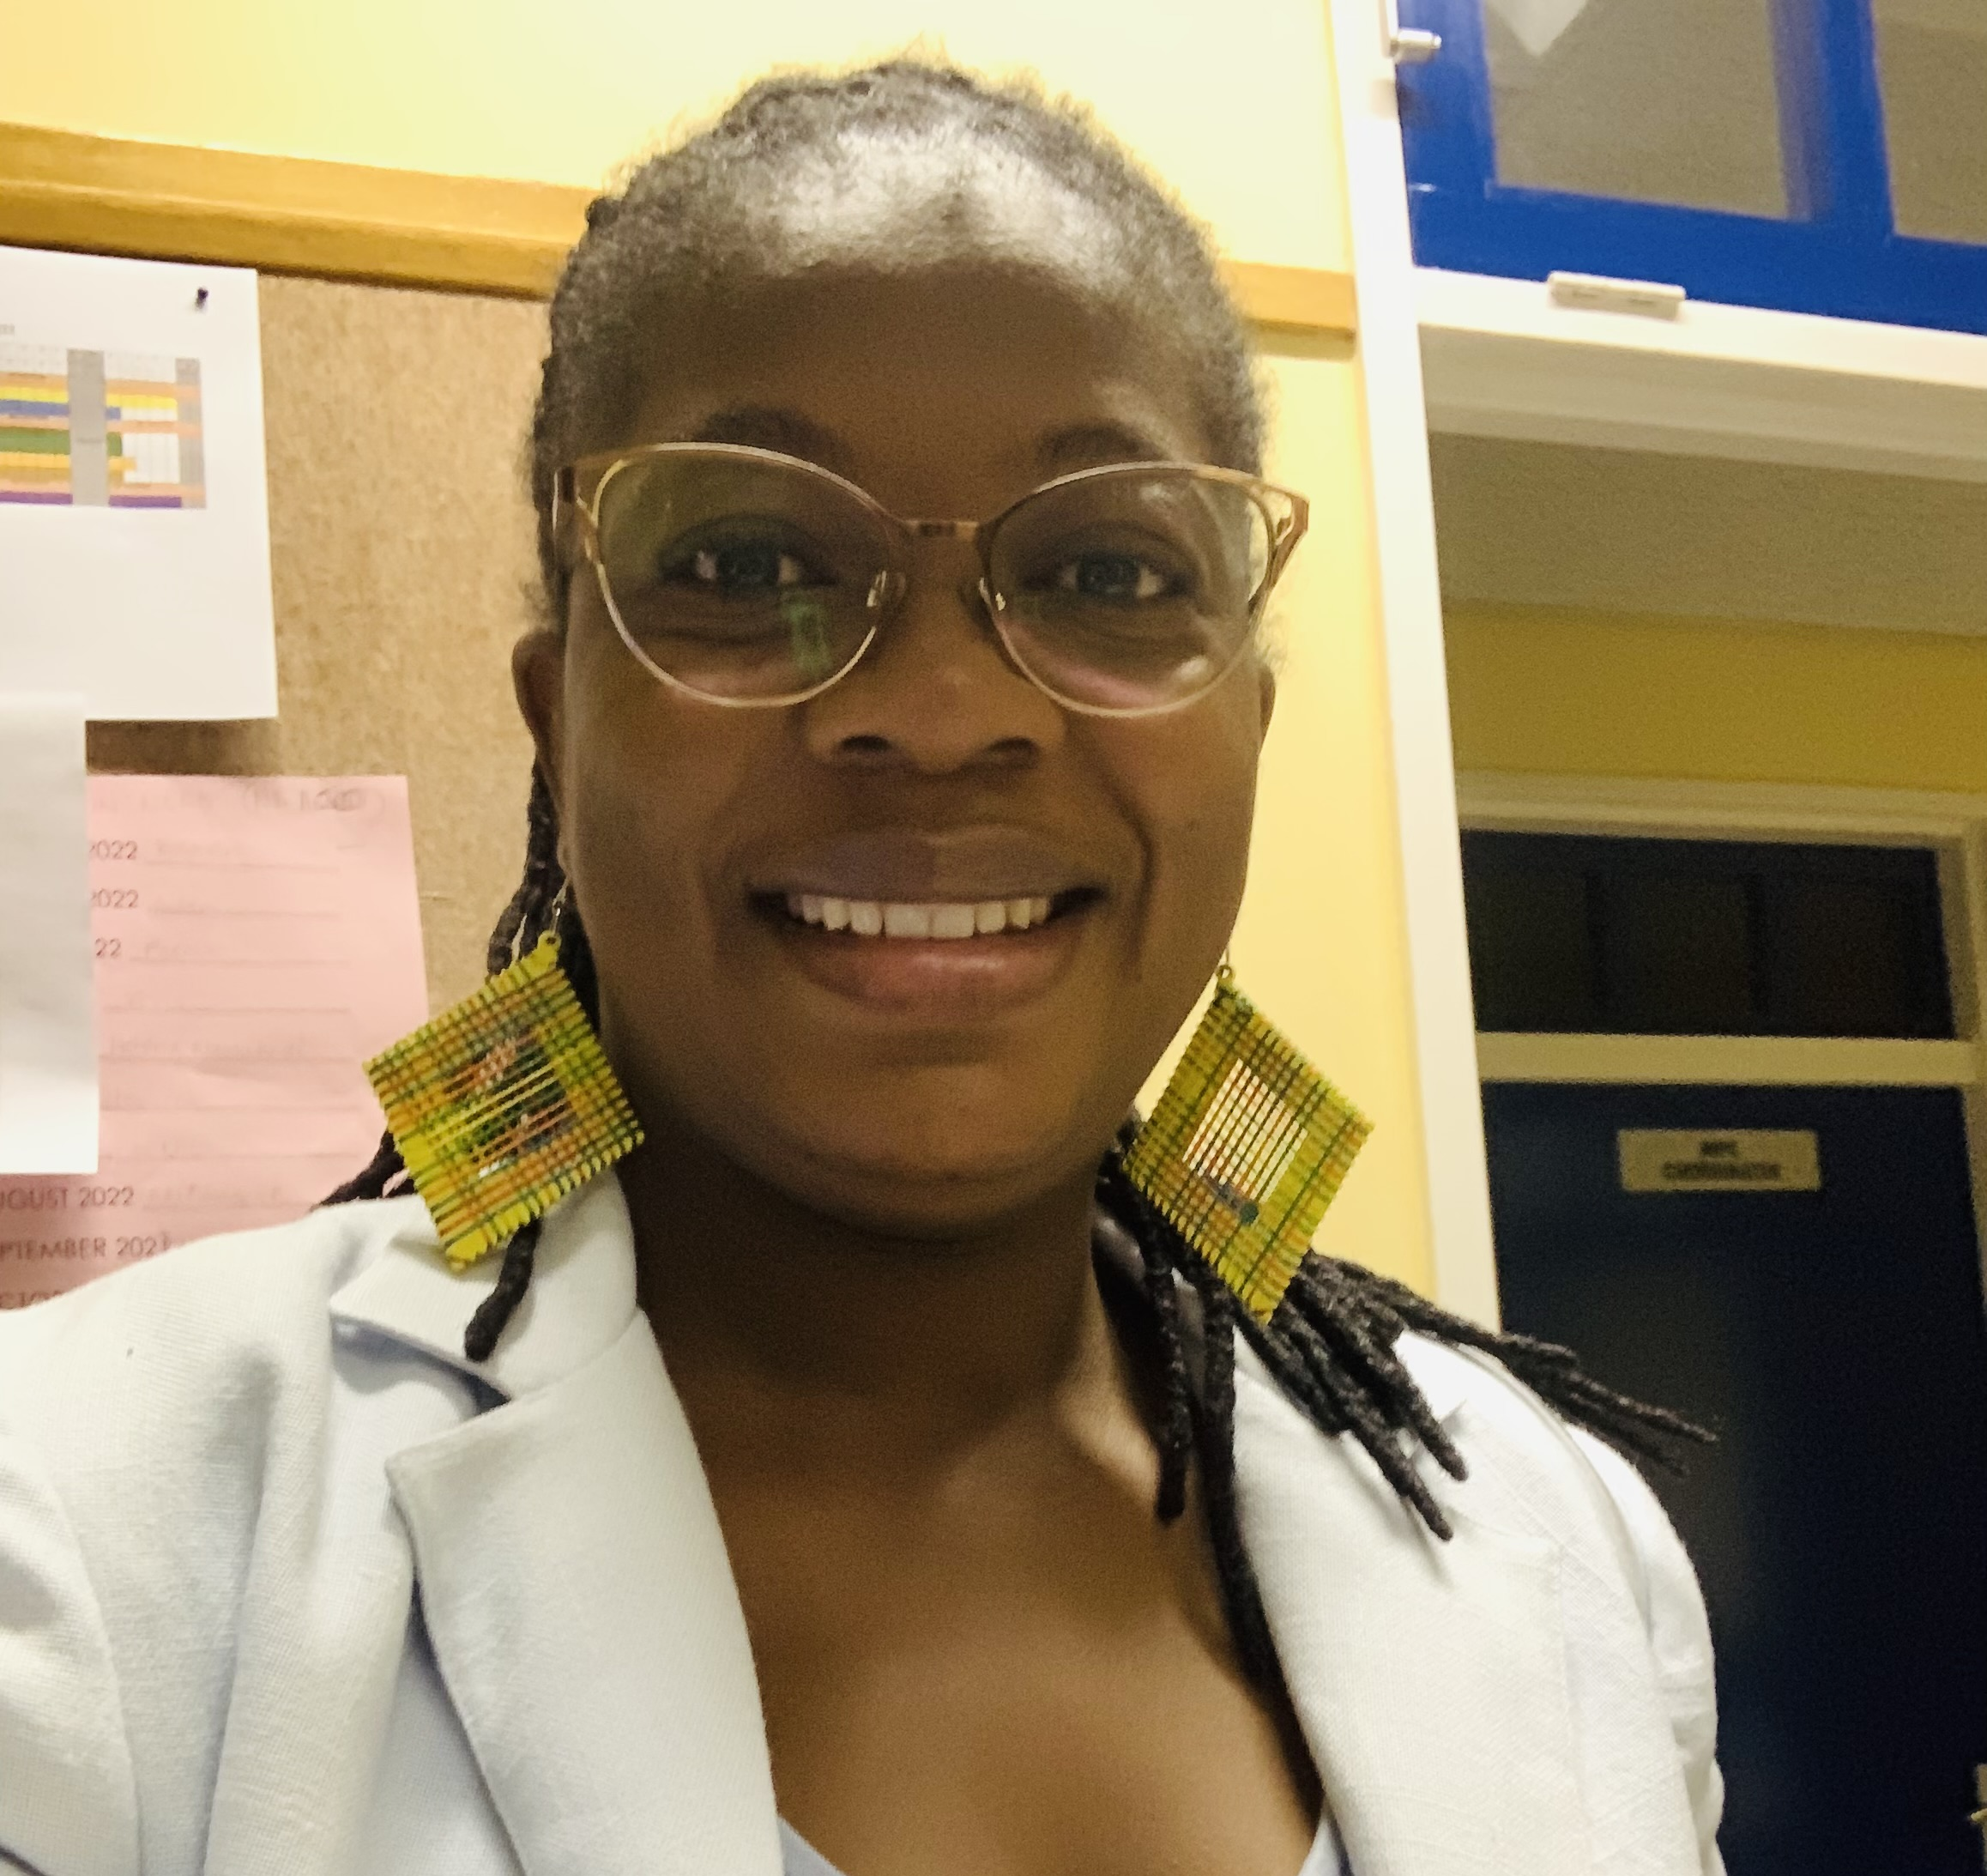

Panel discussion
Renata Sanders, Children’s Hospital of Philadelphia
Facilitator
Amara Ezeamama, Michigan State University
Helena Nangombe, Young Women Empowerment Network
Daddicky Sauyere

Slide 4


Young investigators
Michelle A. Bulterys, University of Washington
Father engagement and caregiver relationship dynamics impact early child neurodevelopment
Fatima Kakkar, Université de Montréal
Inadequate serologic response following vaccination against hepatitis B virus in children who were exposed to HIV

Slide 5


Presenters
Shaffiq Essajee, UNICEF
Research, programming and implementation gaps on children and adolescents with perinatal HIV exposure
Sonia Lee, NIH
Closing remarks

