Slide 1
Increased biomarkers of cardiovascular disease in a long-term survivor cohort of young adults living with perinatal HIV with virologic non-suppression or metabolic syndrome
Linda Aurpibul,¹ Pagakrong Lumbiganon,² Pradthana Ounchanum,³ Kulkanya Chokephaibulkit,⁴ Tavitiya Sudjaritruk,^{5,6} Pope Kosalaraksa,² Supattra Rungmaitree,⁴ Wipaporn Natalie Songtaweesin,^{7,8} Tulathip Suwanlerk,⁹ Surinda Kawichai,⁷ Jeremy L. Ross,⁹ and Thanyawee Puthanakit,⁷ on behalf of the Thai PAPAYA study team
¹Research Institute for Health Sciences, Chiang Mai University, Chiang Mai, Thailand, ²Department of Pediatrics, Faculty of Medicine, Srinagarind Hospital, Khon Kaen University, Khon Kean, Thailand, ³Department of Pediatrics, Chiangrai Prachanukroh Hospital, Chiang Rai, Thailand, ⁴Department of Pediatrics, Faculty of Medicine Siriraj Hospital, Mahidol University, Bangkok, Thailand, ⁵Department of Pediatrics, Faculty of Medicine, Chiang Mai University, Chiang Mai, Thailand, ⁶Clinical and Molecular Epidemiology of Emerging and Re-emerging Infectious Diseases Research Cluster, Faculty of Medicine, Chiang Mai University, Chiang Mai, Thailand, ⁷Department of Pediatrics, Faculty of Medicine, Chulalongkorn University, Bangkok, Thailand, ⁸School of Global Health, Faculty of Medicine, Chulalongkorn University, Bangkok, Thailand, ⁹TREAT Asia/amfAR – The Foundation for AIDS Research, Bangkok, Thailand
Session: Young people age too!

Slide 2
Summary
The main question
Are there differences in biomarkers of cardiovascular disease among young adults with perinatally-acquired HIV (YA-PHIV) based on viral non-suppression or metabolic syndrome?
The findings
YA-PHIV with viral non-suppression had increases in three biomarkers of cardiovascular disease that were tested (hs-CRP, sCD-163, and IL-18) when compared to those with virologic suppression.
YA-PHIV with metabolic syndrome had higher hs-CRP and sCD163 levels than those without.
Why is it important?
As YA-PHIV continue to age, cardiovascular risk is likely to rise.
Maintaining viral suppression and minimizing other modifiable metabolic risks through changes in lifestyle are warranted.

Slide 3
Background
With age and duration on antiretroviral therapy (ART), young adults with perinatally acquired HIV (YA-PHIV) are at risk for cardiovascular disease.
In post-ART era, symptomatic cardiac disease associated with HIV infection has shifted to a mild or asymptomatic condition [1].
It is difficult to detect cardiac dysfunction at an early stage. Higher intima-media thickness, low ejection fraction and fractional shortening in adolescents with PHIV on ART were demonstrated from echocardiography [2].
Elevated serum levels of proinflammatory cytokines were reported as associated with increased cardiovascular morbidity and mortality in people living with HIV across a wide age range [3-5].
Detectable viral load has been associated with increased cardiovascular risk score in youth living with HIV [6].
References
1 Lipshultz SE et al., JAMA Pediatr 2013; 167: 520-527.
2 Sainz T et al., PIDJ 2015; 34: e125-e131.
3.Vasan RS et al. Circulation 2003; 107: 1486-91.
4. Miller TL et al. J Pediatr 2008; 153: 491-7.
5. Moselepe M et al. Plos One 2017; e0179994.
6 Gurung S et al., Interact J Med Res 2023; 12: e41574.

Slide 4
Objectives
We assessed three selected biomarker levels and their association with HIV viremia and metabolic syndrome in a long-term cohort of YA-PHIV.
Biomarkers | Inflammatory pathway
High sensitivity C-reactive protein (hs-CRP) | Systemic inflammation
Soluble CD163 (sCD163) | Innate immune activation
Interleukin (IL)-18 | Microbial translocation

Slide 5
Methods (1)
The study was conducted in 2021 at five research sites in Bangkok, Chiang Mai, and Khon Kaen, Thailand.
YA-PHIV aged between 18-25 years who were initiated on ART in pediatric clinics were recruited as they attended routine care visits. For those who were transitioned out, they were invited to clinic to join the study.
At entry, we performed clinical assessment and a single blood collection for biomarkers.
HIV-related biomarkers and blood chemistries were extracted from the medical record.
Biomarker testing for sCD163 and IL-18 were performed at the biochemistry laboratory utilizing ELISA kits (TFS Protein Detec. & Quant, USA) and hs-CRP was tested using a commercial kit (Abbott®) at the research site laboratory in Chiang Mai, Thailand.

Slide 6
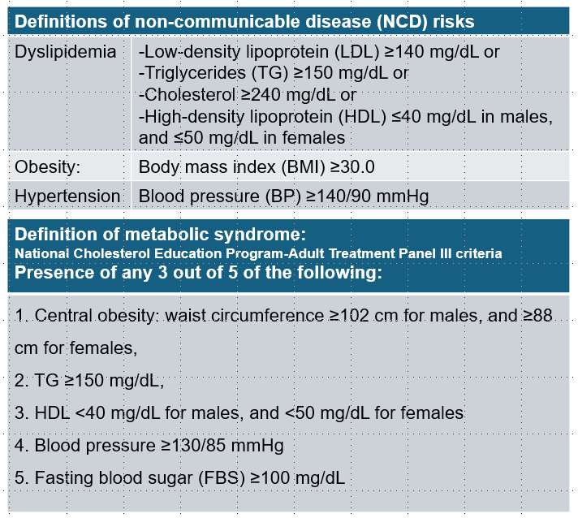
Methods (2)
The hs-CRP levels between 1.0 to <3.0 and ≥3 mg/L were defined as intermediate and high risk for cardiovascular disease, respectively.
Viral non-suppression was defined as HIV viral load >1,000 copies/mL
Metabolic syndrome was defined using US National Cholesterol Education Program-Adult Treatment Panel III criteria.
Biomarker association with HIV viremia and metabolic syndrome were assessed using Mood's median non-parametric test.
Notes:
BULLET 1: MOVE TO PREVIOUS SLIDE

Slide 7
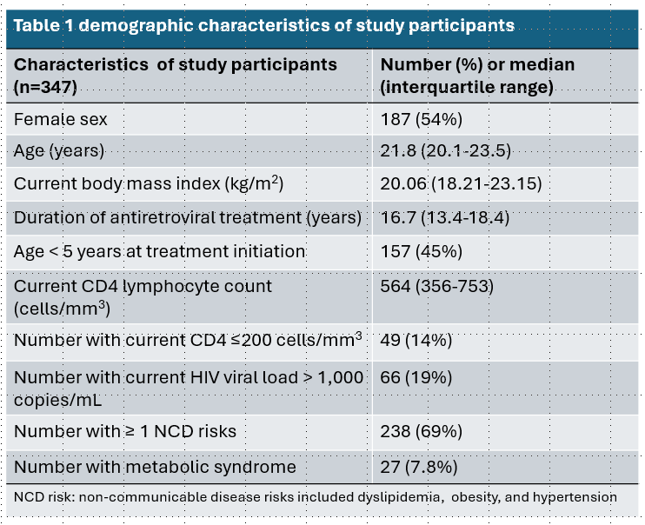
Results (1)
From November 2020-July 2021, we enrolled 347 participants into the study.

Slide 8
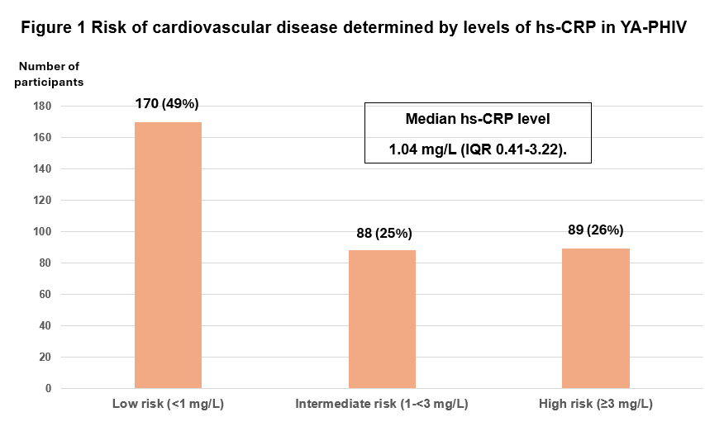
Results (2)
YA-PHIV with viral non-suppression had significantly higher hs-CRP than those with viral suppression (2.0 vs. 0.8, p=0.001).
YA-PHIV with metabolic syndrome had a significantly higher median hs-CRP than those without (2.7 vs. 1.0, p=0.008).

Slide 9
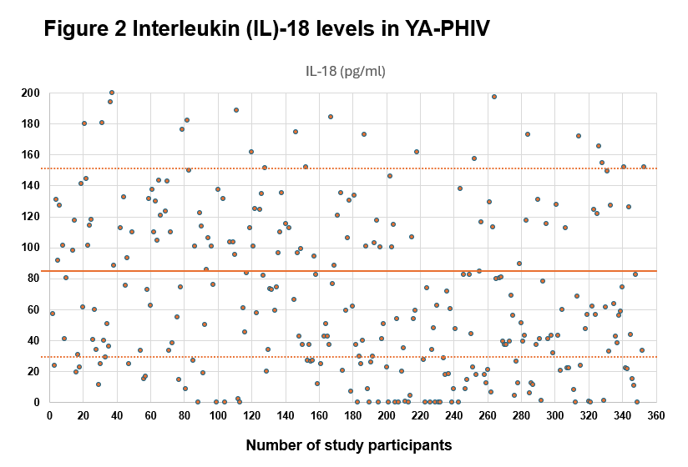
Results (3)
The median serum IL-18 level was 82.4 pg/mL (IQR 33.8-151.9).
Significantly higher median IL-18 levels were observed in male YA-PHIV (111.2 vs. 62.9 pg/mL, p <0.001), those with CD4 count <500 cells/mm3 (111.2 vs. 62.9 pg/mL, p=0.002), or viral non-suppression (129.1 vs. 74.0 pg/mL, p=0.003).
No significant difference was observed in median IL-18 levels between YA-PHIV with metabolic syndrome and those without (106.7 vs. 80.6 pg/mL, p=0.31).
Notes:
TEXT IS A BIT SMALL.
BULLET 1: WHY DO YOU NEED THE TEXT IN BLUE? AVOID TOO MANY COLOURS AS IT MAKES SLIDES LOOK TOO ‘BUSY’

Slide 10
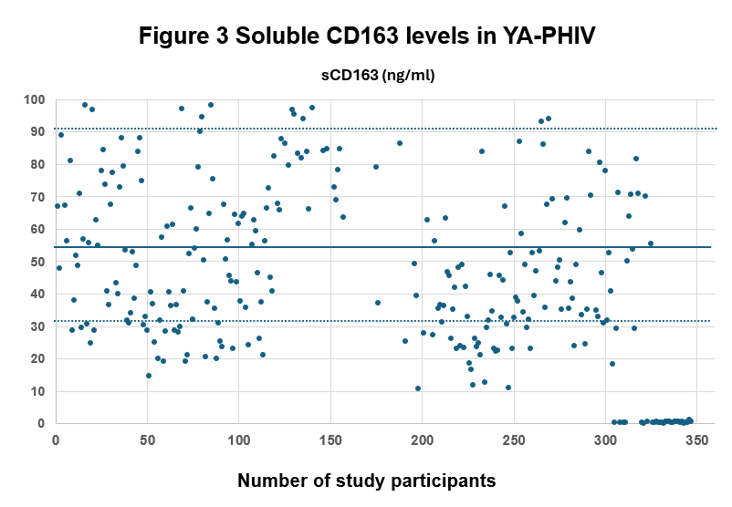
Results (4)
The median sCD163 level was 53.6 ng/mL (IQR 31.1-90.1).
Higher median sCD163 levels were observed in the group of YA-PHIV with CD4 count <500 cells/mm³ (64.2 vs. 45.9 ng/mL, p=0.004), or viral non-suppression (71.8 vs. 46.4 ng/mL, p <0.001).
Those with metabolic syndrome had a trend towards higher median sCD163 levels (61.5 vs. 52.5 ng/mL, p=0.07), although this did not reach statistical significance.

Slide 11
Discussion
Around half of YA-PHIV in this cohort had increased hs-CRP which is one of the most widely used inflammatory markers and a predictor of cardiovascular events [1].
The increased IL-18 level of YA-PHIV in our study was most likely related to chronic HIV infection. However, it was identified as a strong predictor of cardiovascular death in adult patients with coronary artery disease [2].
The persistent increased sCD163 in our cohort after ART was like that previously reported in an adult study [3]. They documented its being an independent marker of cardiovascular and all-cause mortality.
The study limitation included small sample size, and a cross-sectional design. With many causalities and effects, biomarkers at a single time point could not provide information about their clinical significance, or potential changes over time.
References
Rosenson et al. Curr Opin Cardiol. 2002; 17(4):325-31.
Blankenberg et al. Circulation. 2002; 106:24-30
Knudsen et al. The journal of infectious disease 2016; 214(8):1198-204.
Notes:
I THINK THERE IS TOO MUCH TO TAKE IN ON THIS SLIDE. CAN YOU TRY AND SUMMARISE BETTER?
DO YOU NEED TO MENTION ANY KEY LIMITATIONS?
AS: agree with Jeremy and did not revise for clarity

Slide 12
Conclusions
Increases in biomarkers of cardiovascular disease in a long-term cohort of YA-PHIV might indicate on-going inflammation and disease progression.
HIV care for YA-PHIV should include focusing on virologic control, alleviating other modifiable metabolic risk factors, and monitoring for cardiovascular risk progression.
Further research on the predictive value of these biomarkers on long-term outcomes in aging YA-PHIV is warranted.

Slide 13
Acknowledgement
This study is supported by grants to amfAR from ViiV Healthcare, and the U.S. National Institutes of Health’s National Institute of Allergy and Infectious Diseases, the Eunice Kennedy Shriver National Institute of Child Health and Human Development, the National Cancer Institute, the National Institute of Mental Health, the National Institute on Drug Abuse, the National Heart, Lung, and Blood Institute, the National Institute on Alcohol Abuse and Alcoholism, the National Institute of Diabetes and Digestive and Kidney Diseases, and the Fogarty International Center, as part of the International Epidemiology Databases to Evaluate AIDS (IeDEA; U01AI069907).
This work is solely the responsibility of the authors and does not necessarily represent the official views of any of the institutions mentioned above.
We thank all YA-PHIV who took part in this study, site investigators and study team at all Thai PAPAYA sites.
L Aurpibul, C Detsakunathiwatchara, S Masurin, R Khampun. Research Institute for Health Sciences, Chiang Mai University, Chiang Mai, Thailand; T Sudjaritruk, O Mueangmo, W Wongjak, J Saheng, T Chaito, Department of Pediatrics and Clinical and Molecular Epidemiology of Emerging and Re-emerging Infectious Diseases Research Cluster, Faculty of Medicine, Chiang Mai University, Chiang Mai, Thailand; P Ounchanum, R Hansudewechakul, S Denjanta, A Kongphonoi, Chiangrai Prachanukroh Hospital, Chiang Rai, Thailand; P Lumbiganon, P Kosalaraksa, P Tharnprisan, T Udomphanit, Division of Infectious Diseases, Department of Pediatrics, Faculty of Medicine, Khon Kaen University, Khon Kaen, Thailand; T Puthanakit, WN Songtaweesin, S Anugulruengkitt, W Jantarabenjakul, K Pornpaisalsakul, R Nadsasarn, S Kawichai, Department of Pediatrics and Center of Excellence for Pediatric Infectious Diseases and Vaccines, Faculty of Medicine, Chulalongkorn University, Bangkok, Thailand; S Rungmaitree, K Chokephaibulkit, V Lertpanalai ,W Lermankul, A Maleesatharn, B Khumcha, Department of Pediatrics, Faculty of Medicine Siriraj Hospital, Mahidol University, Bangkok, Thailand; AH Sohn, JL Ross, T Suwanlerk, TREAT Asia/amfAR - The Foundation for AIDS Research, Bangkok, Thailand.
Notes:
CHANGE THE PURPLE TEXT TO BLACK TEXT

