Slide 1
Malawi Path to Scale study and programmatic considerations that are guiding the country program
Rose Nyirenda, Ministry of Health, Malawi
Welcome to the era of PrEP choice

Slide 2
Background
HIV burden in Malawi (2023)
Declining HIV incidence: 0.1% (15-49 years)
Generalized epidemic: distribution of 14,000 new infections
  70% in general population (excl. AGYW)
  20% in AGYW
  10% in KP
75% of new infections in southern region and major cities
Challenges
  Most new infections are dispersed in a large population
  Identification of high-risk subpopulations
  Suboptimal uptake, adherence and persistence of oral PrEP limits effectiveness

Slide 3
Background
Injectable PrEP Implementation Science
Builds on district systems investments in two major cities (Blantyre and Lilongwe)
Iterative adaptive learning:
  Data use
  Quality improvement
  Community engagement
  Demand creation
  Health communication
Objectives
  Generate evidence for the path to scale in Malawi
  Pave the way for population level impact

Slide 4
Path2Scale Study Objectives
Objective 2
Testing, adaptive learning (6-month lead in phase)
Introduce CAB-LA for priority populations
Optimize delivery models
Objective 1
Provider and client values and preferences
Empirical development of demand-generation strategies: “attract, engage and enable”
Objective 3
Evaluate effectiveness of strategies
Understand comprehensive scale-up through cluster randomized comparison (enhanced continuation support vs. standard of care)
Objective 4a
Establish systems
Objective 4b
Develop and test scale-up plan: Path to scale
Dec 2022-Nov 2023: IRB protocol submissions, tool development for study 2
Sep 2023-Mar 2026: CAB-LA implementation
Notes:
Charles will present

Slide 5
Programmatic Context
National Strategic Framework
Malawi Health Sector Strategic Plan III (2023-2030)
  Focus on integrated platforms of care
  Transition from HIV verticalization to service integration
  HIV Combination Prevention being integrated into SRHR & Maternal Health services
  Injectable PrEP integrated into Family planning & Antenatal services

Slide 6
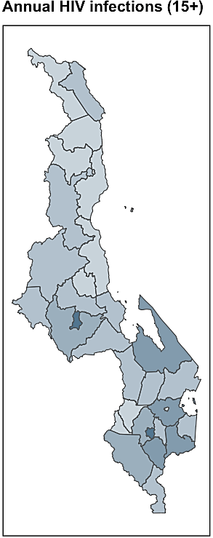
Programmatic Context
Implementation guided by epidemiological estimates
Blantyre and Lilongwe City prioritized for early implementation
Existing oral PrEP services in public, private and faith-based facilities
Selection of 40 largest facilities for Path2Scale
Lilongwe City
1,100 new infections
Blantyre City
1,000 new infections
Source: 2024 Naomi model estimates

Slide 7
Preliminary Results: Formative study
Provider and client preferences and values
Mixed methods study
In-depth interviews: 69 KVP members and 20 health workers
Questionnaire: 550 KVP members with / without prior PrEP use
  Demand workshops: convenience sample from KP-led orgs.
  Preferences – key themes
    Injectable PrEP will increase uptake and adherence
    Convenience: no pill burden, one shot every 2 months, no adherence counseling
    Privacy: use without partner knowledge, no ARV stigma
    Confidence: high-level long-acting protection
    Delivery place: Drop In Centre (DIC) for all KP, public hospital for others

Slide 8
Preliminary Results
Provider and client preferences and values
  Concerns – key themes
  Side effects? Pain, headache, weight gain, lipodystrophy, impotence, infertility, harm for baby
  Stigma: promiscuity associated with PrEP use
  Confusion: CAB-LA thought to be vaccine, mixed messages (condoms and contraception still needed for prevention of STI and unwanted pregnancies)
  Concerns about continuous availability of CAB-LA

Slide 9

Programmatic Preparations
1. Policies, Guidelines
Malawi PrEP Service Delivery Guideline (2020)
Revised to incorporate injectable PrEP
Revised eligibility screening for PrEP (Job Aid)
Focus on client education and choice
HIV Rapid testing using 3 test algorithm
Special considerations: PrEP options in pregnant and breastfeeding women
Revised Standard Operating Procedures & Job Aids

Slide 10
Programmatic Preparations
2. Training materials, job aids, M&E tools
  Training materials and other tools adapted for injectable PrEP (CAB-LA)
  Realistic case studies for application of theory
  Targeted education and counselling on injectable PrEP
  New PrEP clinic register and PrEP visit cards
    Accommodates continuous oral, ED oral, CAB-LA with/without oral bridge
    Customized for ScanForm® for easy digitizing of complete paper records from simple smartphone photo (already rolled out for testing services)
    Individually linked to ScanForm® testing records (HIV, syphilis, hep B) and STI clinic register (under development)

Slide 11
Programmatic Preparations
3. Service provider training
Certified and experienced oral PrEP providers selected for new guideline training
  Only certified state registered and enrolled nurses, medical officers and clinical officers can prescribe injectable PrEP
Training supported by on site mentorship including digital tools

Slide 12
Programmatic Preparations
4. HIV testing
Malawi adopted HIV rapid Tesing using a 3 test algorithm in the National Integrated Testing Guidelines (2023)
  To minimize risk of misdiagnosis (false positive) due to low positivity among clients getting tested for HIVs
  Scaled up to >600 health facilities across the country including path to scale sites
Professional, quality-assured, blood-based tests are needed to confirm negative status at PrEP initiation and follow-up
  No test – no PrEP

Slide 13
Programmatic Preparations
5. Differentiated service models
Public, private, Faith based health facilities implementing path to scale study
  Rural vs urban health facilities (hot spots)
Deliberately targeting diverse entry points and populations
  Drop-in centres: Key Populations
  ANC clinic: pregnant women
  Outpatient consultation rooms
  Sexually Transmitted Infection Clinics

Slide 14
Programmatic Preparations
6. Supply management
CAB-LA vials and consumables incorporated in existing supply chain management and distribution system for HIV program
  Use of existing toll-free hotline for stock challenges
  Dedicated weekly inventory forms submitted by pharmacies and clinic rooms using ScanForm®
CAB-LA demand outstrips available supply
  No deliberate demand creation
  MoH and implementing partners define client enrolment caps for each facility

Slide 15
Conclusion
CAB-LA may overcome adherence challenges with oral PrEP
Implementation within constraints of national prevention program
  Additional data collection to understand what works / doesn’t work
  Adaption of policies and tools based on learnings
Ongoing mentorship key in early stages of implementation
Investment in simple, scalable, cost-effective tools for digitization of routine health records (ScanForm®)
  Integrated testing (HIV, syphilis, hepB), PrEP, STI (under development)
  Suitable for implementation study needs
  Suitable for routine M&E and efficient quality assurance when rolled out
No demand creation (yet) due to limited CAB-LA supplies
PrEP persistence challenged by high client mobility

Slide 16





Acknowledgements

