Slide 1
Factors Associated with
HIV Acquisition in the Context of Humanitarian Crises:
A Scoping Review
Dini Harsono, Center for Interdisciplinary Research on AIDS at Yale University
OAF11 The HIV Response in the Context of Political Instability and Emergency
Wednesday, 24 July 2024, 10:30 am-11:30 am

Slide 2
Disclosure
No conflicts of interest
Funding:
  MacMillan Center for International and Area Studies at Yale University (Kempf Memorial Fund, Principal Investigators: Drs. Kaveh Khoshnood and Luke Davis)
  National Institute of Mental Health (Center for Interdisciplinary Research on AIDS at Yale University, P30MH062294, Principal Investigator: Dr. Trace Kershaw)

Slide 3
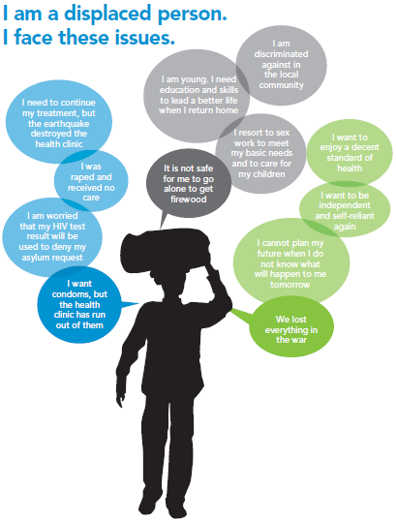
Presentation Summary
“What is the global evidence on factors associated with
HIV acquisition among individuals affected by humanitarian crises?”
Findings
49 studies published between 1990 and 2022
5 non-modifiable and 60 modifiable factors
Lack of intervention studies
Recommendations for future HIV prevention programs and research
Why is it important?
In 2024, nearly 300 million people globally are impacted by humanitarian crises due to conflicts, climate emergencies and other drivers
Complexity in assessing the impact of crises on the HIV epidemiology
Importance to address multilevel risk factors to optimize HIV prevention
UNAIDS Gap Report 2014

Slide 4
Impact of Humanitarian Crisis on HIV Epidemiology
Direction and scale of the impact on HIV epidemiology
Context specificity and complexity (e.g., natural disaster vs. armed conflict) ^{1,2}
Prevalence of HIV before, during, and after crisis ^{3,4}
Risk factors →
individual vs. multilevel ^{5,6}
¹Mishra AIDS Rev 2021, ²Mock Emerg Themes Epidemiol 2004, ³Bennett PLoS One 2015, ⁴Spiegel Lancet 2007, ⁵Vasylyeva J Int AIDS Soc 2022, ⁶Baral BMC Public Health 2013

Slide 5
Scoping Review
Protocol: Harsono JBI Evid Synth 2022
“What is the global evidence on factors associated with
HIV acquisition among individuals affected by humanitarian crises?”
Aims
Summarize research on HIV risk factors among people affected by humanitarian crises
Identify recommendations for future programs and research

Slide 6
Methods
Sources
Databases: MEDLINE, Embase, Global Health, Scopus
Grey literature: websites of organizations involved in humanitarian assistance (e.g., UN agencies), relevant non-government organizations (e.g., Elrha), research networks (e.g., Refugee Research Network), and the International AIDS Society’s conference abstract databases and abstract books (2006-2021), Google Scholar
Inclusion Criteria
Involving participants identified as people affected by humanitarian crises (UNHCR definition)
Including empirical data on factors influencing the risk of acquiring HIV as a main/substantial focus
Conducted in the context of humanitarian crises (i.e., natural and human-caused disasters, UN definition)
Published in English in January 1990-March 2022
Exclusion Criteria
Did not include humanitarian settings or participants
Did not report original data (e.g., reviews or opinion pieces
Did not address HIV (e.g., focused on sexually transmitted infections (STI) excluding HIV)
No full-text available

Slide 7
Search Strategy
Conducted October 2021-March 2022
Participant: people affected by humanitarian crises | Individuals in need of protection and/or assistance based on humanitarian grounds (UNHCR) Example terms: refugees, asylum seekers, internally displaced persons (IDP)
Concept: factors associated with HIV acquisition | Determinants that may increase or decrease an individual’s risk of HIV acquisition, and contribute to HIV prevalence or incidence Example terms: HIV infection or transmission, risk factor, sexual behavior, needle sharing
Context: humanitarian crises | Natural disasters or environmental events; complex emergencies associated with areas of conflict or fragile states Example terms: disaster, flood, tsunami, war, displacement, armed conflict, humanitarian

Slide 8
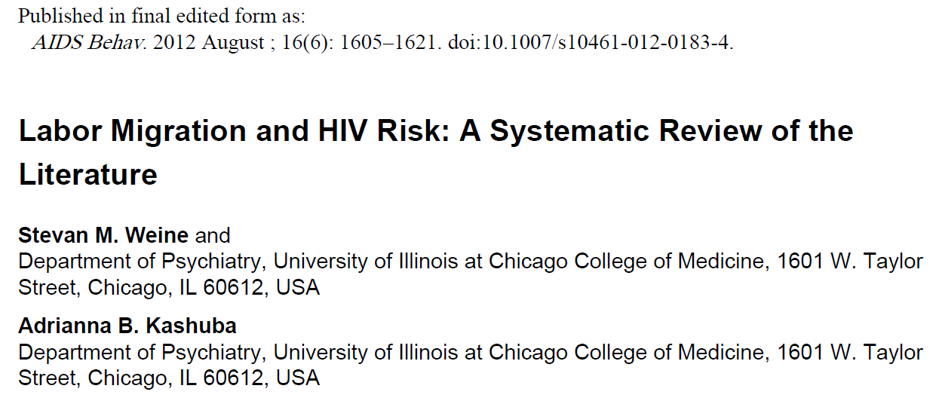
Data Synthesis
Non-modifiable factors for HIV acquisition: age, gender, ethnicity, location, and place of birth or origin
Modifiable factors for HIV acquisition: factors that are not biologically or socially determined and can potentially be modified through policy or intervention
  Policy and structural
  Sociocultural
  Health and mental health
  Sexual practices
  Exposure to humanitarian crises-related traumatic events
Implications for future research and practice reported in the studies.

Slide 9
Results
Search results
18477 references identified from databases, 118 from other sources
8191 titles and abstracts screened
184 full-text articles screened
49 studies included in the analysis
  43 (87.8%) quantitative
  4 (8.2%) qualitative
  2 (4.1%) mixed methods
*Only 1 (2%) was an intervention study (HIV screening program)

Slide 10
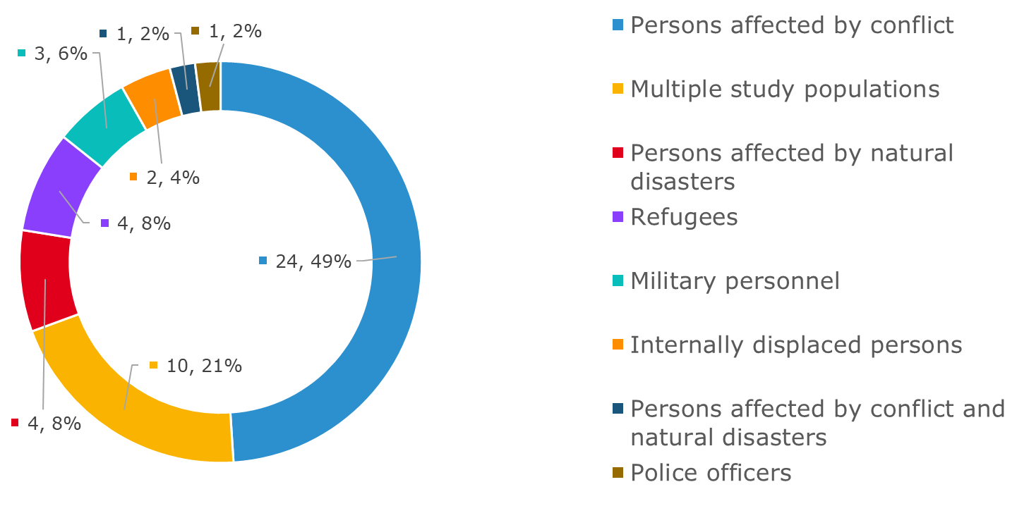
Characteristics of Studies
Main objectives of studies
Prevalence of HIV and risk behaviors (n=27, 55.1%)
Prevalence and correlates of HIV and other infectious diseases (n=12, 24.5%)
Mathematical modeling of potential impact of humanitarian crises on HIV prevalence or incidence (n=8, 16.3%)
Prevalence of mental health problems and HIV (n=2, 4.1%)
Study Populations

Slide 11
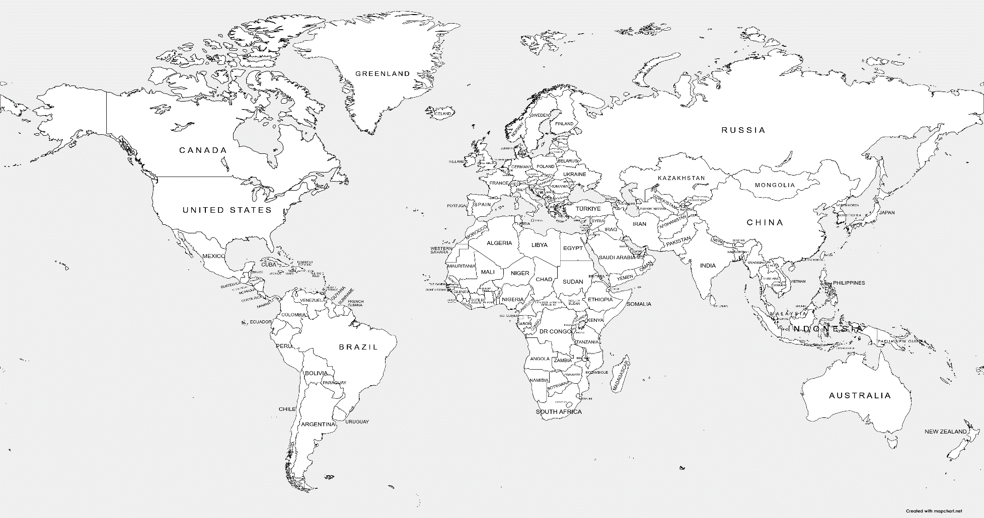
Regions of Included Studies
Of 49 studies, most were single-country studies (n=43)
The majority was conducted in SSA (n=31), specifically in Uganda (n=13)
Europe, n=2
North America, n=3
Middle East, n=1
Asia, n=4
Africa, n=31
South/Latin America, n=2

Slide 12
Non-modifiable Factors for HIV Acquisition
(5 Factors)
Non-modifiable factors (36 studies, 73.5%) | N (%)
Age (older vs. younger) | 28 (57.1)
Gender (females vs. males) | 24 (49)
Location (e.g., urban vs. rural) | 16 (32.7)
Place of birth or origin (e.g., SSA origins) | 8 (16.3)
Ethnicity (e.g., ethnic heterogeneity) | 4 (8.2)

Slide 13
Modifiable Factors for HIV Acquisition
(60 Factors)
Modifiable factors (47 studies, 95.9%) | Number of factors
Policy and structural | 18
Sociocultural | 9
Health and mental health | 11
Sexual practice | 16
Exposure to humanitarian crisis-related traumatic events | 6
Total | 60

Slide 14
Modifiable Factors for HIV Acquisition:
Policy and Structural (18 Factors)
Policy and structural factors (35 studies, 71.4%) | N (%)
Education level (e.g., school attendance, level of completion) | 14 (28.6)
Mobility status (e.g., refugee or non-refugee; permanent, transient, displaced) | 13 (26.5)
Access to health care (e.g., access to health facilities, distance to clinic) | 8 (16.3)
Employment and occupation status | 7 (14.3)
Income level (i.e., individual-, household-, country-level) | 7 (14.3)

Slide 15
Modifiable Factors for HIV Acquisition:
Sociocultural (9 Factors)
Sociocultural factors (24 studies, 49%) | N (%)
Marital status | 18 (36.7)
Religious beliefs | 4 (8.2)
Female-headed household | 3 (6.1)
Family separation | 2 (4.1)
Disruption of social networks | 2 (4.1)

Slide 16
Modifiable Factors for HIV Acquisition:
Health and Mental Health (11 Factors)
Health and mental health factors (29 studies, 59.2%) | N (%)
STI diagnosis (e.g., syphilis, genital ulcers) | 18 (36.7)
Substance use (e.g., illicit drug use, injecting drug use) | 11 (22.4)
Alcohol use | 7 (14.3)
Mental health conditions (e.g., PTSD, depression, suicide ideation) | 7 (14.3)

Slide 17
Modifiable Factors for HIV Acquisition:
Sexual Practices (16 Factors)
Sexual practice factors (29 studies, 59.2%) | N (%)
Condom use | 14 (28.6)
Exchanging sex for money or nonmonetary items | 14 (28.6)
Number of sex partners | 14 (28.6)
Age of sexual debut (e.g., <18 or ≥18 years) | 6 (12.2)
Buying or purchasing sex | 6 (12.2)

Slide 18
Modifiable Factors for HIV Acquisition:
Exposure to Humanitarian Crisis-Related
Traumatic Events (6 Factors)
Exposure to humanitarian crisis-related traumatic events factors (19 studies, 38.8%) | N (%)
Experience of rape, sexual violence, or other sexual trauma | 14 (28.6)
Experience of abduction or kidnapping | 7 (14.3)
Experience of traumatic events (e.g., ≥12 traumatic events) | 4 (8.2)
Night-commuting | 2 (4.1)
Experience of torture | 1 (2)
Military recruitment | 1 (2)

Slide 19
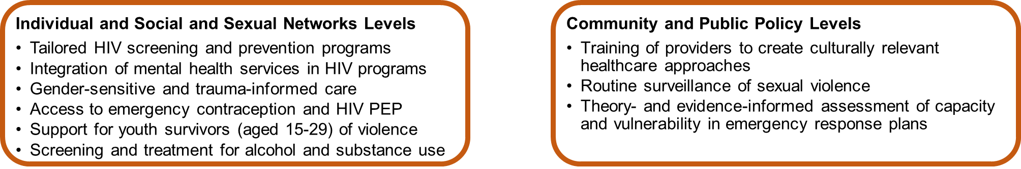
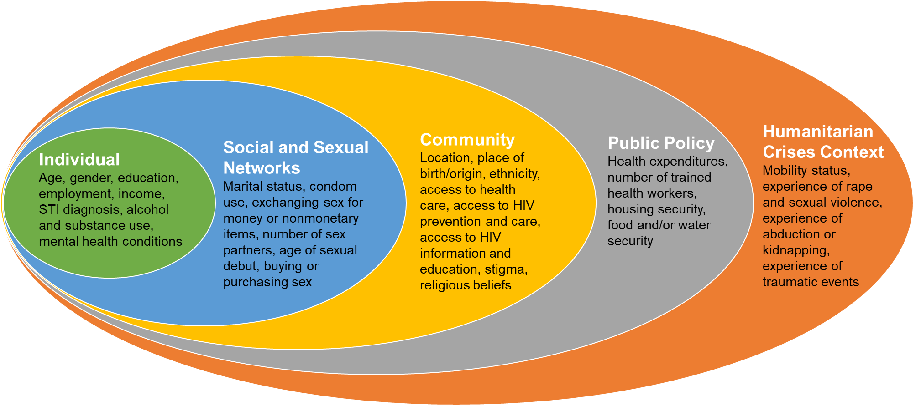
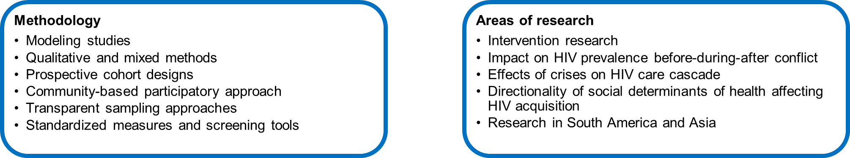
Recommendations for programming
Social-ecological model of HIV acquisition in humanitarian crises
Opportunities for research

Slide 20
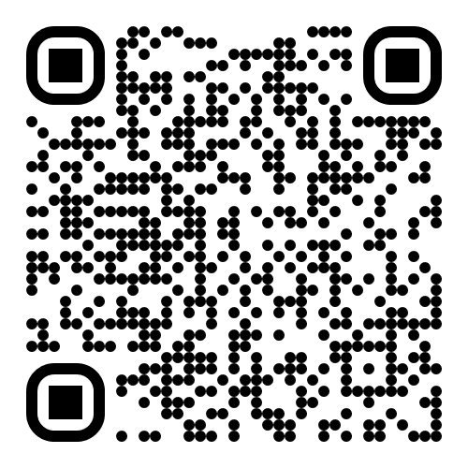

Acknowledgments
Study Team
Contact
Swarali Atre
Hanna Peterson
Kate Nyhan
Dina Garmroudi
J. Lucian Davis
Winnie Ho
Kaveh Khoshnood
Dini Harsono
dini.harsono@yale.edu

