Slide 1
Assessing the Disruption of HIV Testing and Treatment in Nepal During the COVID-19 Pandemic: An Interrupted Time Series Analysis
Keshab Deuba ^{1,2*} Saroj Bhandari³ Lok Raj Pandey⁴ Rajya Shree Kunwar³ Man Bahadur KC⁴
1 Public Health and Environment Research Centre (PERC), Lalitpur, Nepal (deuba4k@gmail.com)
2 Department of Global Public Health, Karolinska Institutet, Stockholm, Sweden
3 Save the Children, Kathmandu, Nepal
4 National Centre for AIDS & STD Control, Ministry of Health and Population, Kathmandu, Nepal
The HIV response in the context of political instability and emergencies

Slide 2
Summary
What is your main question?
Nepal's response to COVID-19, involving public gathering bans and nationwide lockdowns, significantly impacted routine health services. This study evaluates the effect of these measures on HIV testing and treatment services.
What did you find?
The study found that the COVID-19 pandemic caused significant disruptions to HIV services in Nepal, with a 34% reduction in HIV testing, a 47% decrease in positive diagnoses, and a 36% decline in new ART enrollments.
Why is it important?
These findings underscore the critical need for resilient health systems in low- and middle-income countries to maintain HIV control efforts during health crises.

Slide 3

Nepal Overview
Location and economy: South Asia, nestled between China to the north and India to the south, belongs to the lower middle-income category.
Terrain: Predominantly mountainous with some flat plains or hill regions; home to part of the Himalayan range and Mount Everest, the world's highest peak.
Population: Approximately 30 million people.
125 Ethnic groups and 124 languages
Major Religions: Hinduism (predominant religion, practiced by about 81.2% of the population); Buddhism: 8.2%; Islam: 5.1% and Christianity and other religions make up the rest.
Experiencing concentrated HIV epidemic.

Slide 4
Background
First Case Reported: January 2020
  Total COVID-19 Diagnosed: 1,003,450 individuals
  Reported Deaths: 12,089
  Estimated Total Deaths (Including Unreported): 109,236 (https://covid19.healthdata.org/nepal?view=cumulative-deaths&tab=trend)
Government Actions to Contain the COVID-19
Closure of Public Places: (Major public spaces including schools; Restrictions on gatherings (>25 individuals); Travel restrictions for foreign citizens from high-case countries
Nationwide Shelter-in-Place: March 24, 2020
Notes:
Reported deaths are the number of deaths officially reported as due to COVID-19.
This measure aimed to prevent the large-scale spread of COVID-19 by limiting movement and social interactions across the country.

Slide 5
Methods
Study Design
Analysis
Data Source:
  National routine health facility data from all HIV testing and treatment centers in Nepal.
  Time Frame: January 2019 to December 2021.
Study Periods:
  Pre-Pandemic Phase: January 2019 to March 2020.
  Pandemic Phase: Marked by three COVID-19 waves from the April 2020 to December 2021.
Data Analysis:
  Monthly data on: HIV Testing; Positive Diagnoses; New Antiretroviral Therapy Enrollments
Statistical Method:
  Applied the Poisson regression model.
  Compared rates pre- and post-COVID-19 outbreak.
  Results: Yielded relative risk (RR) estimates with 95% confidence intervals (CI).

Slide 6
Results
Total Individuals Tested for HIV: 675,939
Diagnosed with HIV: 7,926
Commenced ART: 7,189
Impact of the COVID-19 Pandemic
Reduction in HIV Testing: 34% decrease
(RR: 0.657; 95% CI: 0.651-0.663)
Decrease in Positive Diagnoses: 47% decrease
(RR: 0.529; 95% CI: 0.482-0.579)
Decline in New ART Enrollments: 36% decrease
(RR: 0.641; 95% CI: 0.585-0.705)

Slide 7
Conclusions
These findings highlight the urgent need for resilient health systems in low- and middle-income countries to sustain HIV control efforts amidst pandemic-related disruptions.
  Best practices for ensuring the uninterrupted delivery of services should be adapted to various contexts during both regular times and the emergencies.
  Assess the perspectives of the community and health workers to identify effective measures for such situations and prepare guidelines and response mechanisms.
Notes:
(such as home delivery of antiretroviral drugs)

Slide 8
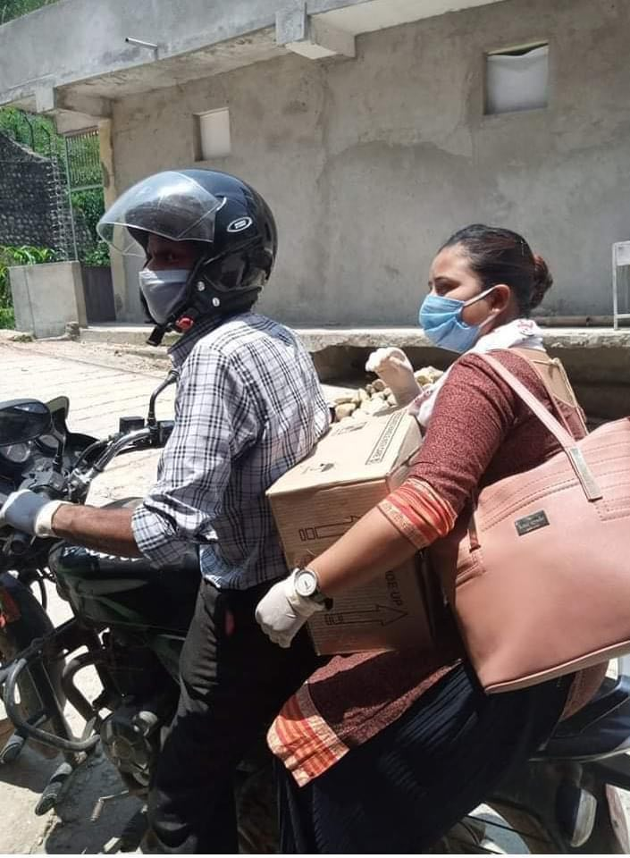
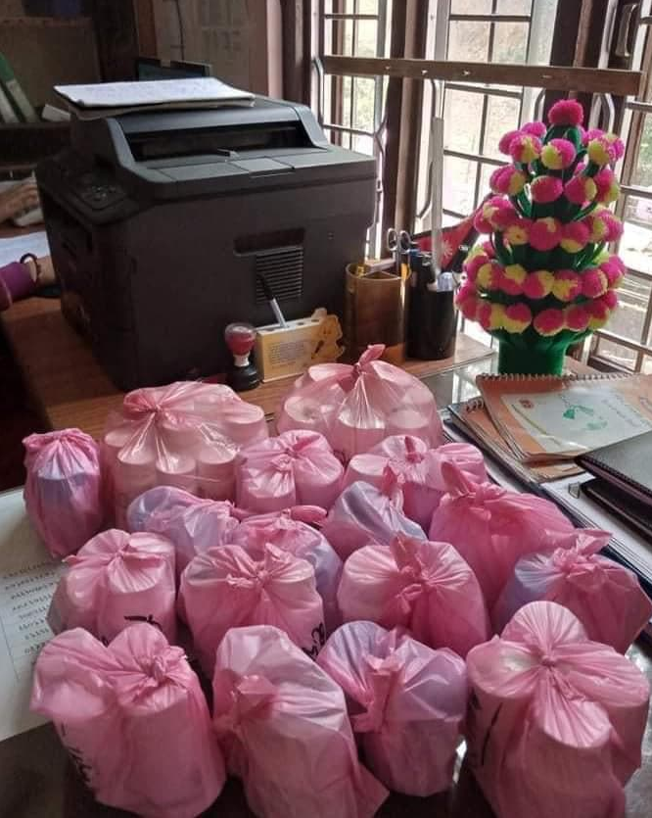
Acknowledgements
We would like to thank the health workers, community representatives, and local authorities for ensuring the continuous delivery of various services, such as the uninterrupted supply of ARVs to the homes of PLHIV, during the pandemic period.
This is just one example of the many efforts made.

Slide 9

Thank You

