Slide 1
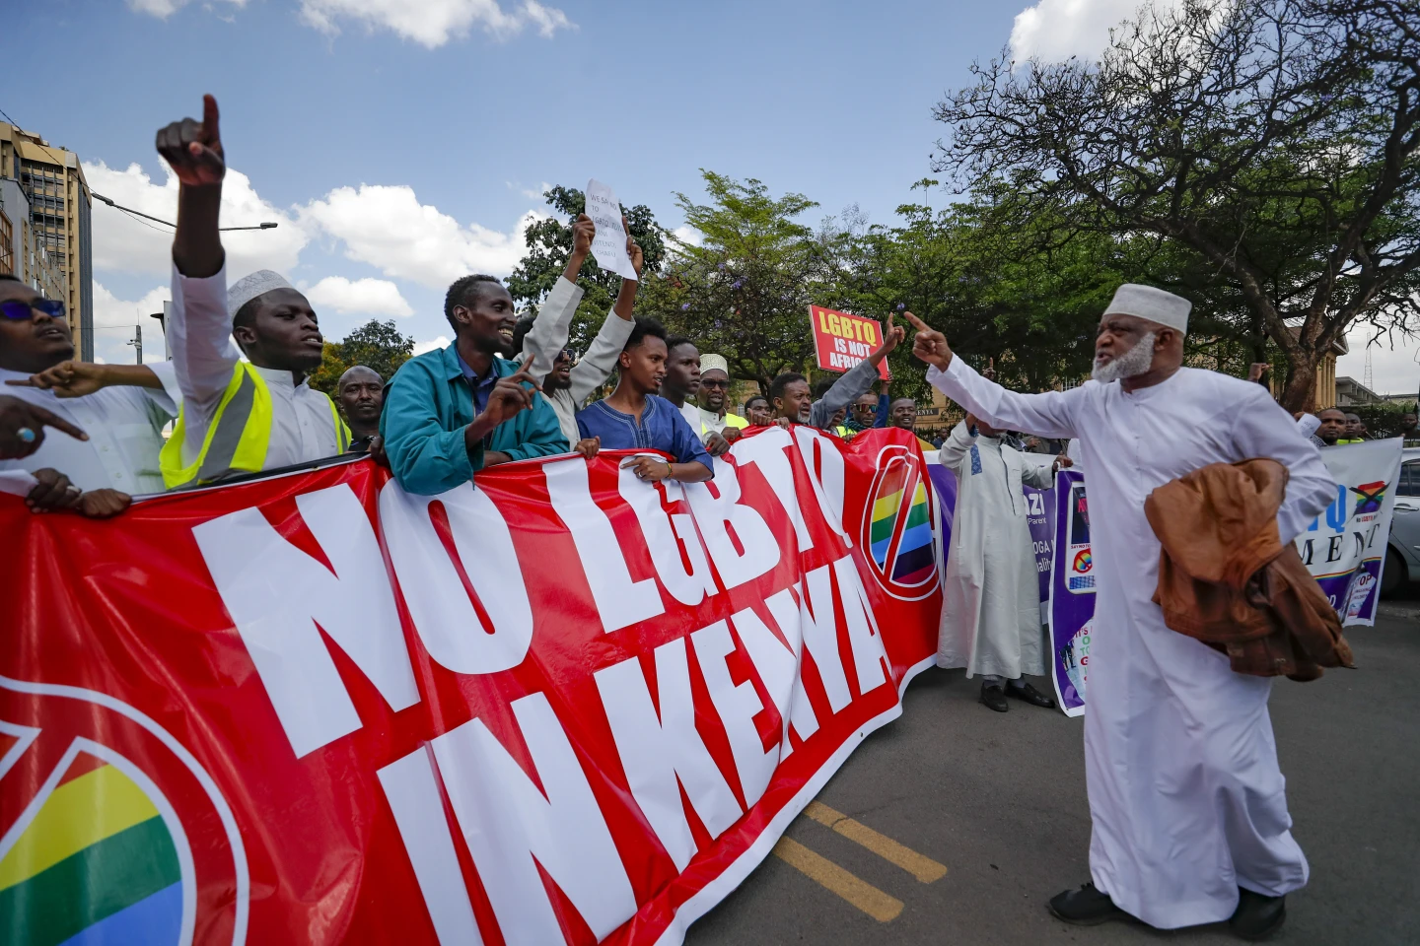
Scaling Up and Drafting of Risk Mitigation Strategies for Key Population Programs in The Context of Complex and Changing Legal, Social & Political Environment in Kenya
Authors: Robert N Josphine^{1,2,} Martin Jamal Kyana^{3,} Ezekiel Amenya⁴
Affiliation: 1Community Health Advocacy and Learning Initiative, Public Health Consultant, Kilifi, Kenya, 2USAID Stawisha Pwani, LVCT Health, Prevention and Key Population Program, Kilifi, Kenya, 3HIV & AIDS People's Alliance of Kenya, Mombasa, Kenya, 4 WACHA Health, Programmes, Mombasa, Kenya.
OAF11 The HIV response in the context of political instability and emergencies
Dr. Robert N. Josphine, DVM, MSc.
Community Health Officer, USAID Stawisha Pwani – LVCT Health & Team lead, Community Heath Advocacy and Learning Initiative

Slide 2
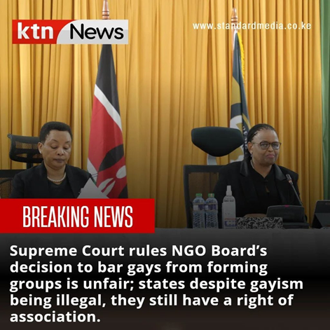
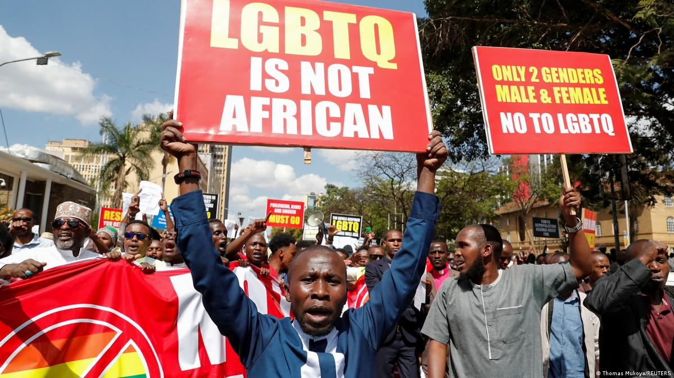
Summary
What is your main question?
How can we effectively scale up and implement risk mitigation strategies for key population programs in hostile and volatile legal and socio-political environments?
What did you find?
  Brutal and sustained violence and anti-LGBTIQ campaign in Kenya
  Proactive community-led response with support by partners for health services but limited advocacy & legal support
  There is a critical need for a comprehensive regional strategy to sustain programs and advocate for the rights of key populations
  This strategy must address legal gaps, violence, evictions, mental health issues, and crisis response.
Why is it important?
  Protection of Human Rights and Lives
  Sustainability of Community-Led Initiatives
  Strengthening Community Resilience
  Improving Health Outcomes

Slide 3
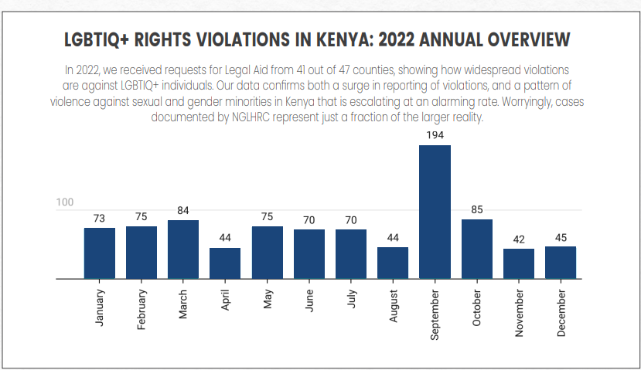
Violence against LGBTIQ persons: The hidden epidemic in Kenya
Violence against LGBTIQ+ & sex workers is endemic in Kenya and the E.A. region
Ranges from exclusion and discrimination, arbitrary arrest to anti-LGBTIQ hate crimes including torture and killing
  SEARCH – 56 % of SGM in Southern and Eastern Africa have experienced violence, 73% for TG & GNC¹
Why is it prevalent?
  Cis-heteronormative cultural and religious beliefs
  Criminalization and anti-LGBTIQ legislation
    Penal code section 162, 163 & 165
    Family protection bill (Kaluma Bill)
    Lack of explicit legal protections for SGM & SW
  Media fueled stigmatization and discrimination
  Poverty, unemployment and lack of education
NGLHRC, 2022
1. Müller, A., Daskilewicz, K., Kabwe, M.L. et al, BMC Public Health 21, 357 (2021)

Slide 4
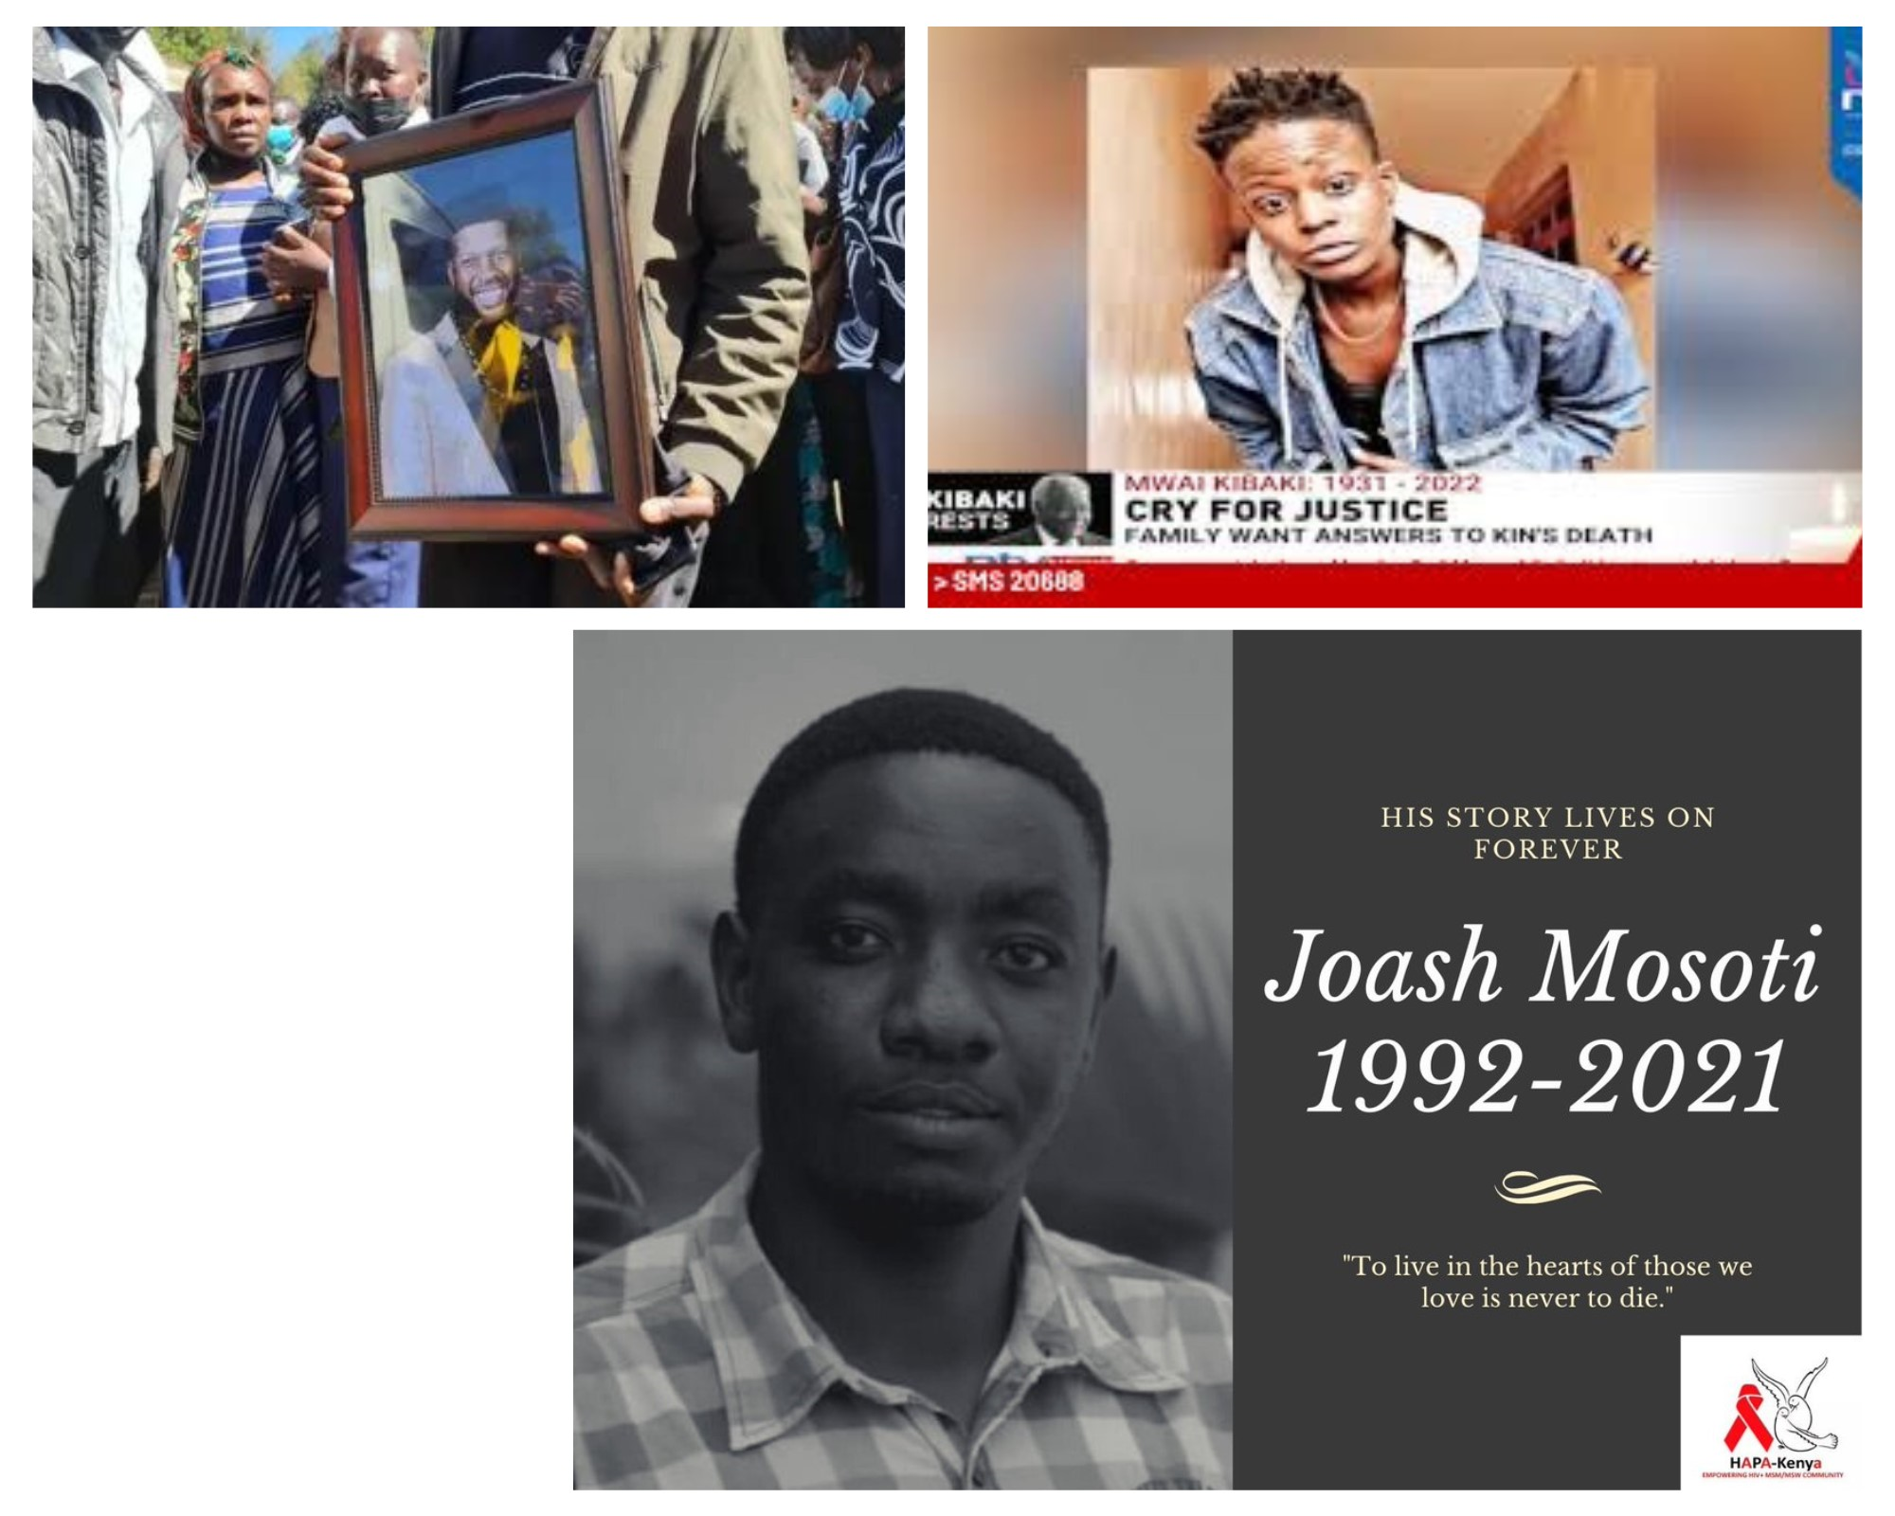
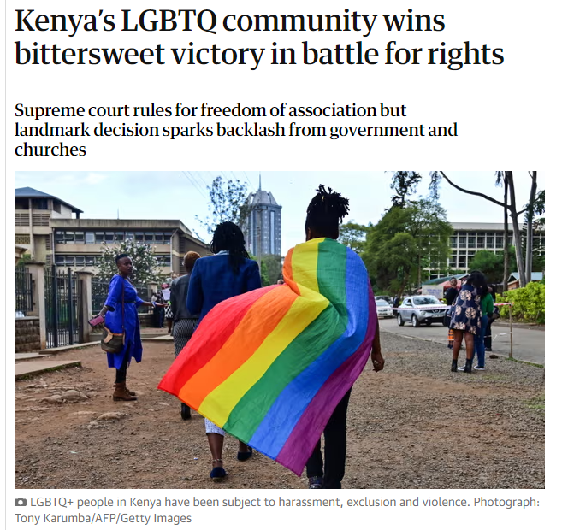
2023 Anti-LGBTIQ campaign
Surge in Violence Against LGBTQ Community:
  2021- Feb 2023 → 3 LGBTIQ activists murdered
Regional Anti-Rights Movement & legislations
  Anti-homosexuality bills/laws in Uganda, Tanzania & Ghana
  Anti-rights conferences by Family Watch, Nairobi Kenya, Feb 2023
  Family protection bill (Kaluma Bill) – death penalty for aggravated homosexuality & criminalization of promotion of LGBTIQ activities
Supreme court ruling in Kenya – March 2023
Massive online anti-LGBTIQ mobilization → WhatsApp groups, facebook-groups & Twitter threads
Public protests in Nairobi & Mombasa – calling for attacks on LGBTIQ persons & allies

Slide 5
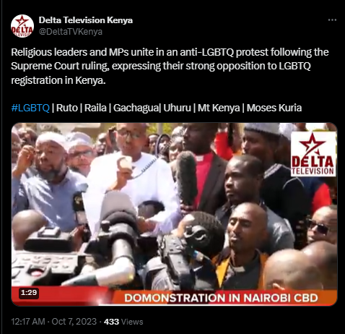
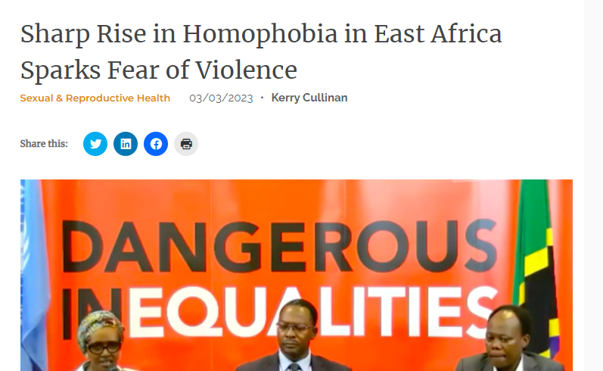
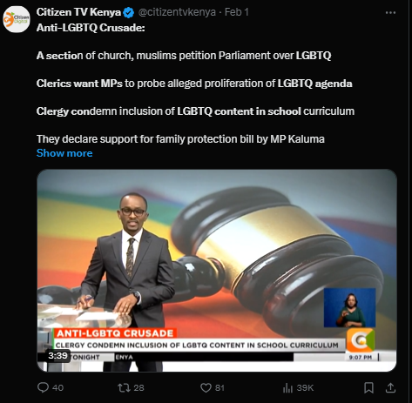
Immediate impact and response
Increased in cases of anti-LGBTIQ hate crimes – physical & online attacks, evictions, blackmailing and doxing & displacement
Activation of local and national security and violence response plans through the community networks
  Regional - Coast KP and SOGIE Alliance
  National – GALCK+ & NGLHRC
Suspension of community programmes, centres and social spaces
  Drop in Centres, clinics and community centres closed for 2- 6 months, some never reopened
Overwhelmed security response and support system

Slide 6
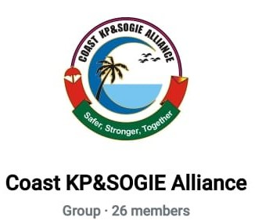
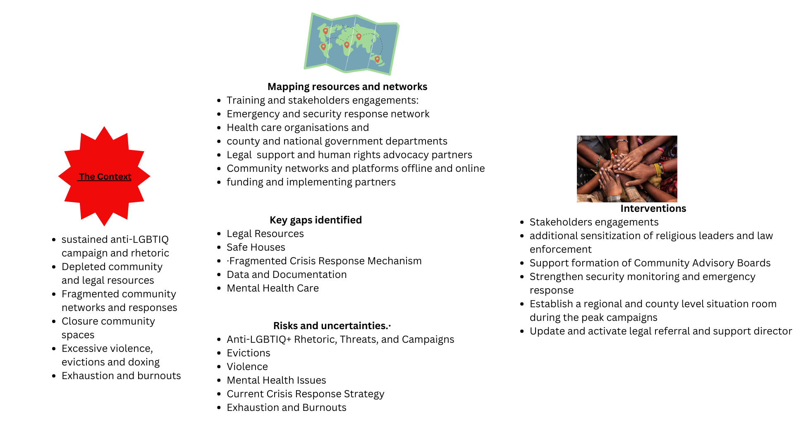
Towards an effective community response strategy
August 2023 – a new wave emerged on WhatsApp
Strong push for anti-LGBTIQ legislation
Planned National demonstration in 15th Sept, 2023
Targeted attacks – businesses, homes, social spaces
Lessons from COVID-19

Slide 7
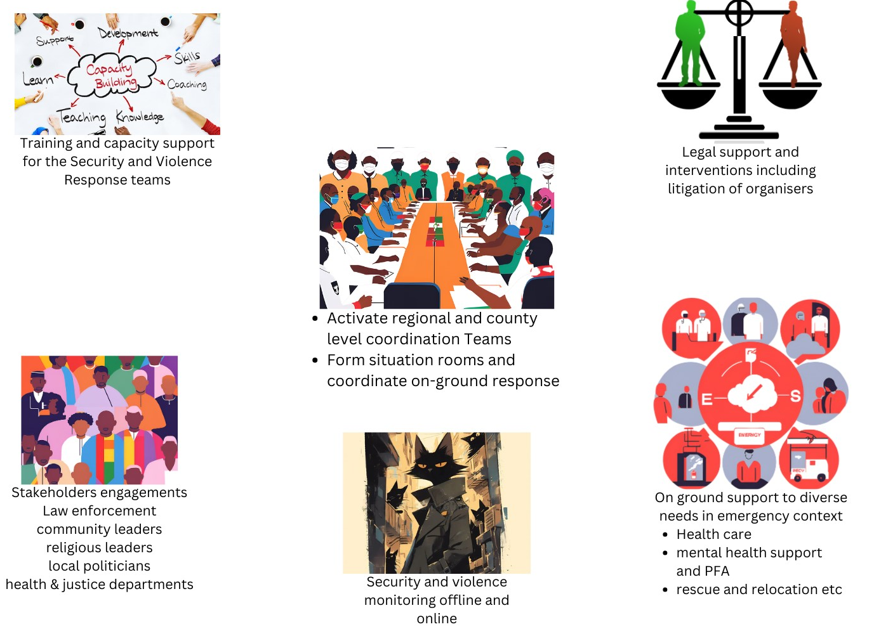
Collective Action to Protect community welfare and resources
Paralegal & SRT training and support
  Refresher training online
  Mapping and security monitoring
  Daily and weekly Check-ins
  Community sensitization
Emergency Rescue, safe-housings & relocation of displaced person
Stakeholder engagements – law enforcement, MoH, judiciary, community leaders & allies
Health services including mental health
  Virtual consultations
  Peer navigation & community level dispensing
  Strengthening community outreaches
Data tracking and security monitoring
Legal resources and support
Livelihood protection and post-displacement recovery & support

Slide 8
Impact on Program performance – Kilifi county
Similar trends were observed in Mombasa, Kwale and Taita Taveta counties
Data source: KHIS

Slide 9
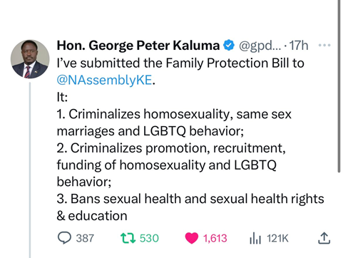
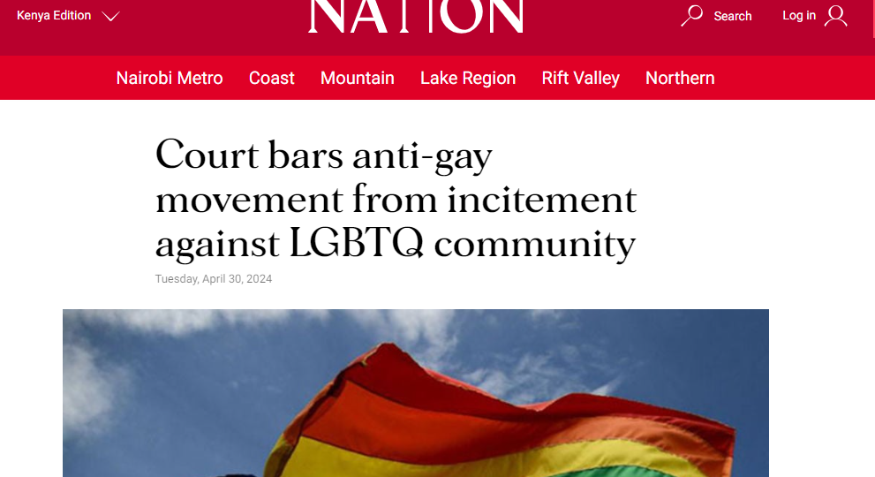
One year later: We soldier on
The Risk mitigation strategy is still a draft! – lack of resources to support development and implementation
Programmes are yet to recover; 2 community centres have not re-opened – Kilifi & Taita
Stigma and anti-LGBTIQ sentiment strife in the public health system
  Kilifi County – 1 facility rejected integrate KP services
  Mombasa County – an IBBS Study site had to be closed down
Enhanced relationship with the public health system& allies→ opportunity for integration of KP services in Kilifi and Taita Taveta counties
  NASCOP, NSDCC & County MoH
  USAID Stawisha Pwani
  KRC Global Fund
  MSF –Kenya
Litigation and temporary order restraining anti-LGBTQ groups from inciting violence against community and the organisations
Kaluma Bill still looms

Slide 10
The fight for equality and inclusion is still on……….
Our general context
Criminalization of same sex practices & sex work
Sustained anti-LGBTIQ rhetoric and emerging legislations → National and county assemblies
Strife stigma and violence from family, communities and society
Lack of social and legal protections of sexual and gender minorities
Gaps in the mitigation strategy
Fragmented Crisis Response Mechanism
Legal Resources
Safe Houses
Data and Documentation
Mental Health Care
Capacity strengthening of community networks and organizations

Slide 11














Acknowledgement
Funders and implementing partners
Community-led partners

