Slide 1




F3: HUMAN RIGHTS AND RESPONSES TO HIV
Providing legal information through the chatbot "Legal Bot 100% LIFE" during full-scale war and martial law on the territory of Ukraine
M. Ignatushyna, K. Rivera, CO "100 PERCENT LIFE",
Kyiv, Ukraine

Slide 2

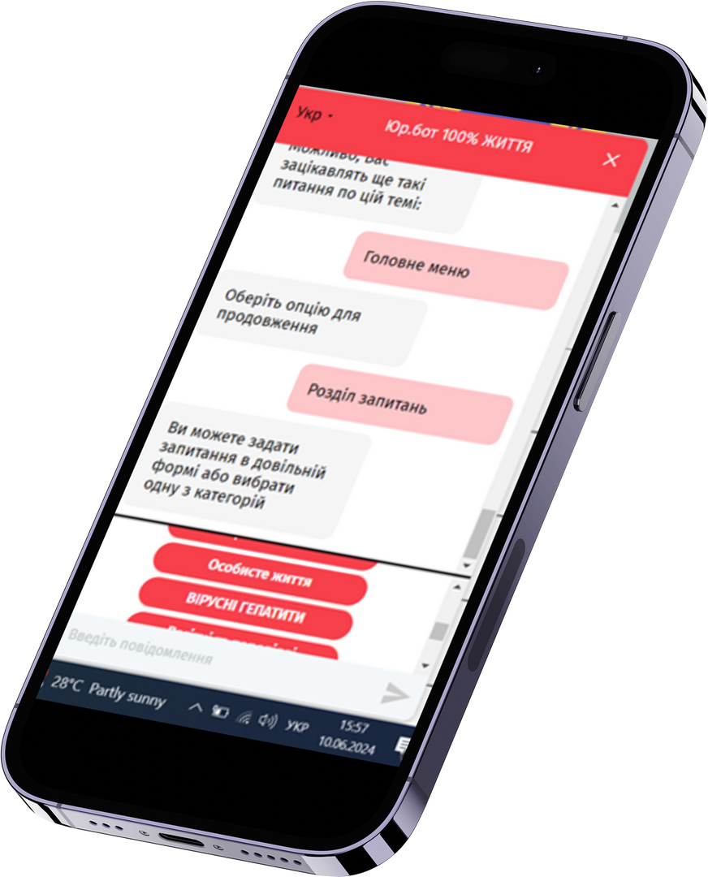

SUMMARY
What is your main question?
Convenient, mobile, anonymous and free of charge access to legal information using the chatbot "Legal Bot 100% LIFE" (hereinafter the Legal Bot)

Slide 3
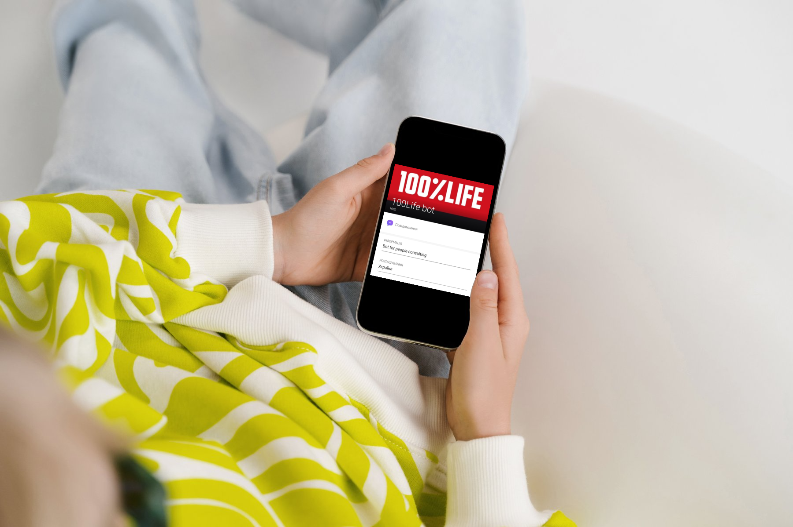
SUMMARY
What did you find?
The Legal Bot provides sustainability of legal services (consultation on the most relevant legal issues) and online information about the possibility of receiving other services of social assistance etc. It closes the gap when people can't get legal advice offline due to quarantine, military action, lack of money or other obstacles.

Slide 4
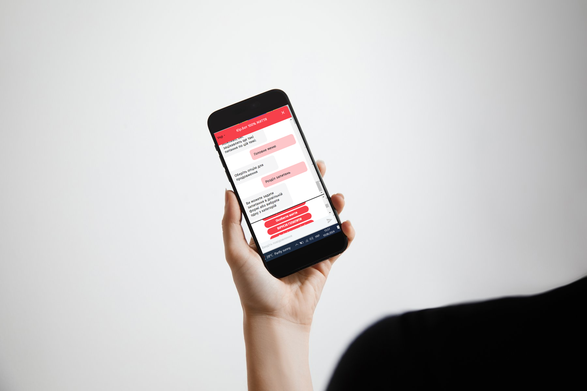
SUMMARY
Why is it important?
The Legal Bot helps representatives of target groups to receive answers to their legal questions, if their requests do not require individual consideration of the case.
The Legal Bot provides access to legal answers online through mobile applications (Viber, Telegram, Facebook messenger) and two websites of the human rights organization and CO "100 PERCENT LIFE“ so that people can get answers wherever they are, as long as they have a mobile phone or computer.

Slide 5

The target groups of the Legal Bot:
people living with HIV
people who inject drugs
people with TB
people in prisons and other closed settings
gay men and other men who have sex with men
social workers
sex workers
paralegals
trans people
other people who needs legal information
Hereinafter The Clients.

Slide 6
REASONS FOR THE LEGAL BOT
Background
What the Legal Bot does
With the beginning of a full-scale war on the territory of Ukraine, providing services for the prevention, testing, and treatment of HIV became complicated.
Around 6 000 cases of AIDS were diagnosed according to statistics by the Public Health Center of the MOH of Ukraine for that period.
Many people who became the Clients of the Legal Bot do not have access to services, medicines, and information due to hostilities.
The Legal Bot consists of 5 different services:
  Legal Offices;
  Social organizations;
  Call back;
  News and links;
  Questions.
Questions consists of 10 sections of answers now, including: HIV+, How to get HIV treatment; Pregnant women and women in labor; Social issues; Privacy; Replacement therapy; Tuberculosis; Discrimination; Viral hepatitis and Martial Law (the last two was supplemented in response to the challenges of war in 2022-2023).

Slide 7
Structure of Legal Bot
"LEGAL BOT 100% LIFE"
QUEStions
SOCIAL
organizations
Legal
Offices
NEWS AND LINKS
CALL BACK
Pregnant
women and women in labor
Privacy
Tuberculosis
Martial Law
HIV+
Social issues
Replacement
therapy
Discrimination
Viral
hepatitis
How to get HIV treatment

Slide 8
ADVANTAGES
OF THE LEGAL BOT:
The Legal Bot:
gives quick access to the necessary information at any time and in any place;
guarantees absence of financial expenses for obtaining legal assistance;
provides anonymity and confidentiality of data;
gives the possibility of redirecting Clients to partner organizations (which provide social or legal services), if it is necessary;
includes legal and other information which is carefully checked, updated and verified by qualified lawyers, therefore such information is reliable and legal;
removes obstacles in obtaining legal aid during hostilities, quarantine, other extraordinary events;
works without personal contact, which guarantees the absence of stigma and discrimination.

Slide 9
Results and conclusions
10,000
about
Such a large number of requests and the interest of clients in receiving free legal aid is due to the presence of obstacles related to the war in the country, as well as the lack of an opportunity to receive free legal aid from the state (unfortunately, representatives of the target groups still do not belong to the categories who are provided with free legal aid from the state in Ukraine).
The Legal Bot has become a tool that solves these problems. It ensures the continuity of the provision of legal services and information using modern digital technologies, as the situation in Ukraine requires the implementation of new digital solutions to overcome modern challenges.
chatbot sessions took place
from 2022 to July 1, 2024

Slide 10
F3: HUMAN RIGHTS AND RESPONSES TO HIV
Thank you for your attention!
M. Ignatushyna, K. Rivera, CO "100 PERCENT LIFE",
Kyiv, Ukraine

