Slide 1

Community-level HIV stigma and discrimination’s impact on HIV testing, treatment uptake, and viral load suppression in Africa: A pooled analysis of nationally representative surveys
Salome Kuchukhidze, PhD
McGill University, Department of Epidemiology and Biostatistics
The HIV response in the context of political instability and emergencies
Notes:
Thank you for your time today, I will be talking about my project on…

Slide 2
I have no relevant financial relationships with ineligible companies to disclose.

Slide 3

Background
To end AIDS, UNAIDS committed to reaching the 10-10-10 targets.
  <10% PLHIV experiencing stigma/discrimination by 2025.
Stigma is a “mark”, a negatively valued difference ascribed to those seen to depart from the socially acceptable (Goffman).
Several decades of research on the impact of stigma.
  Mostly qualitative or descriptive studies.
  Among those quantitative, a variety of survey instruments were used, often in single-country analyses.
Credit: Zero HIV Stigma Day campaign materials
Notes:
To end AIDS by 2030, The UNAIDS has committed to reaching 10-10-10 targets. This calls for ensuring that < 10% of PLHIV experiencing stigma/discrimination
Let’s define stigma:
Stigma and discrimination are structural factors that could undermine all steps of the HIV care cascade.
Our work is informed by several decades of research on the impact of stigma on HIV outcomes
Most of the existing studies are qualitative or descriptive
Those that are quantitative focus on single county and use a wide variety of survey instruments which makes is difficult to systematically measure the impact of stigma

Slide 4
Objective
Quantify the impact of HIV stigma and discrimination on the engagement in the HIV care cascade: 1) HIV testing, 2) antiretroviral treatment (ART) coverage, and 3) viral load suppression (VLS).
  Setting: Countries in Africa with available population-based surveys (DHS, PHIA, BAIS, KAIS, NAIIS, SABSSM).
  Time horizon: 2000-2023.
DHS= Demographic and Health Surveys KAIS = Kenya AIDS Indicator Survey
PHIA = Population-based HIV Impact Assessment BAIS = Botswana AIDS Impact Survey
NAIIS = Nigeria HIV/AIDS Indicator and Impact Survey SABBSM = South African National HIV Prevalence Survey
Notes:
Surveys included in the study were DHS, PHIA as well as country-specific surveys from nigeria, botswana, kenya and south AFrica

Slide 5
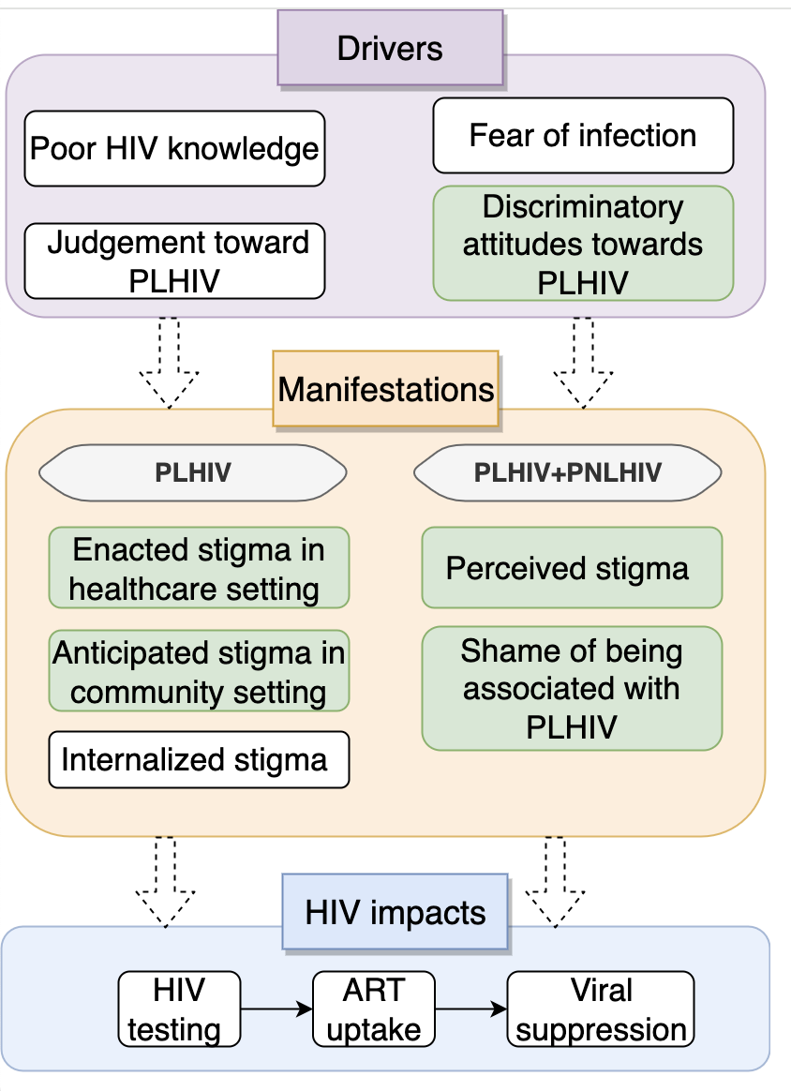
Methods: Overview
Exposures
Community-level (continuous, average of the primarily sampling unit)
    Discriminatory attitudes.
    Perceived stigma.
    Shame of association.
  Individual (among PLHIV; binary)
    Anticipated stigma in healthcare.
    Experienced stigma in healthcare.
Outcomes
HIV testing (past-year, self-reported).
ART uptake (biomarker).
Viral load suppression (biomarker).
GEE=Generalized Estimating Equations
5
Notes:
Stigma is a complex process that can be divided into its drivers and manifestations, as we see here in the figure.
These drivers and manifestations of stigma encompass different dimensions of stigma that operate at community level, as well as at individual level
We have 3 community level exposures (list them) are continuous measures that are averaged at a survey’s PSU level
We also have 2 individual levels (list) which are binary and are asked to individual PLHIV about their experienced or anticipated stigma
These stigma dimensions might eventually impact HIV outcomes
Which in our cases are: ….
ART and VLS and biomarker-based outcomes and HIV testing is self-reported

Slide 6
Methods: Statistical analysis
Poisson regression (based on GEE) models:
Confounder adjustments vary by exposures
  Selected using Directed Acyclic Graphs (DAG).
  All analyses adjusted for: sex, age, HIV prevalence (admin 1), education, rural/urban, marital status, survey fixed effects.
Community-level stigma was modelled via segmented regression.
  Knots placed at median community-level stigma values.
GEE=Generalized Estimating Equations
6
Notes:
For our analysis we used poission regression based on GEE models
The confounders we adjusted for varied by exposure and the outcome and were based on DAGs
For community-level stigma we did not want to assume that the relationship is linear so we included a segmented regression

Slide 7
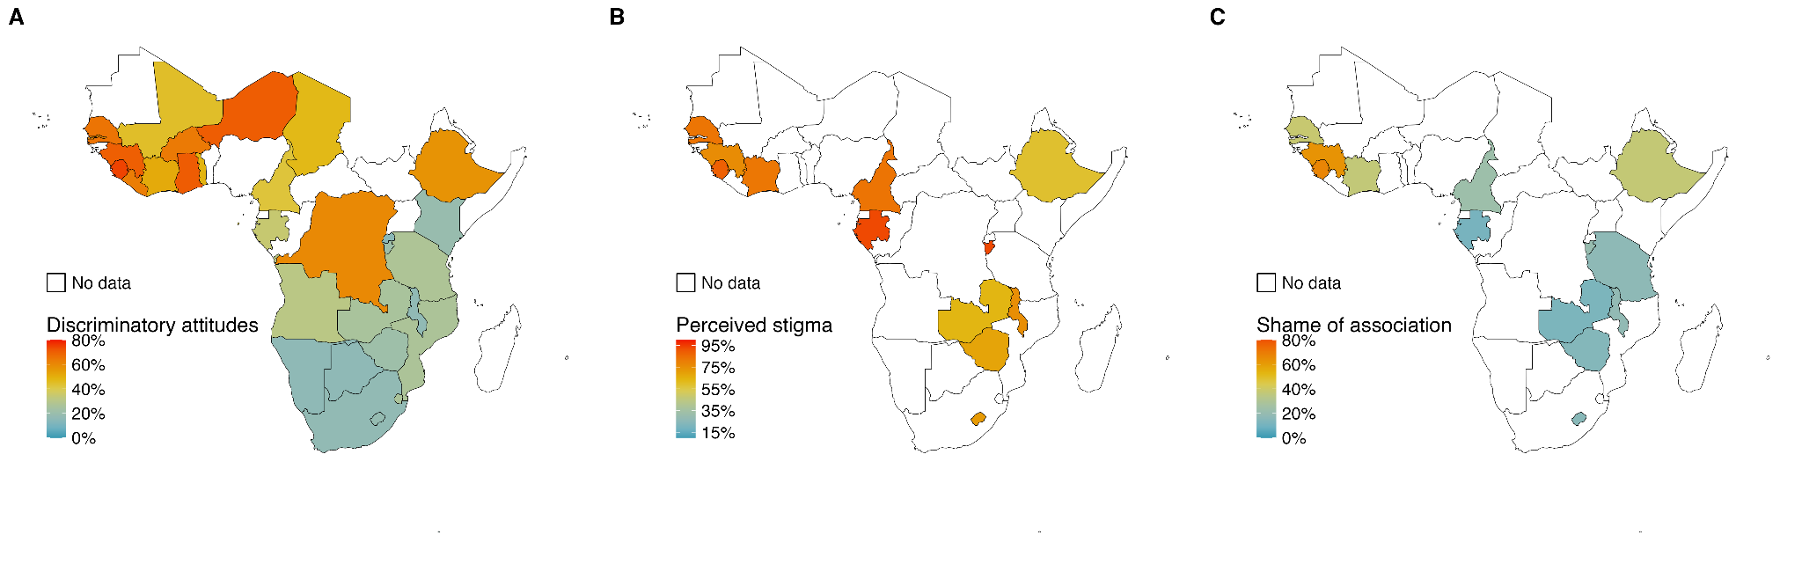
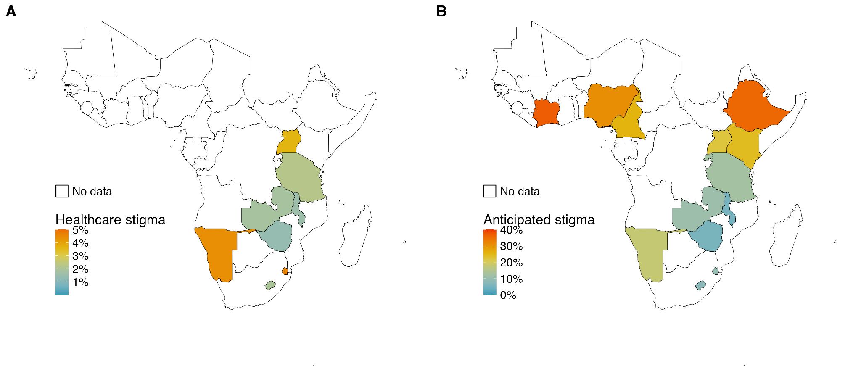
Results - Prevalence
Higher prevalence of stigma in western and central Africa
Up to 76 surveys included.
High prevalence of discriminatory attitudes.
Up to 5% of PLHIV were denied health care because of their HIV status.
Up to 40% of PLHIV felt the need to hide their HIV status.
Community-level
Discriminatory attitudes
Perceived stigma
Shame of association
Individual (among PLHIV)
Experienced healthcare stigma
Anticipated healthcare stigma
Notes:
We included 76 total surveys, but not all collected data on ART uptake and VLS
Plots showing prevalence of community level stigma, and individual-experienced stigma among PLHIV. This is prevalence is based on the most recent available survey in each country.
Main things to note is that levels of discriminatory attitude are high, especially in Western and Central africa
Among PLHIV who sought care in the past year, up to 40% felt the need to hide their HIV status in a healthcare setting but only 5% experienced discrimination

Slide 8
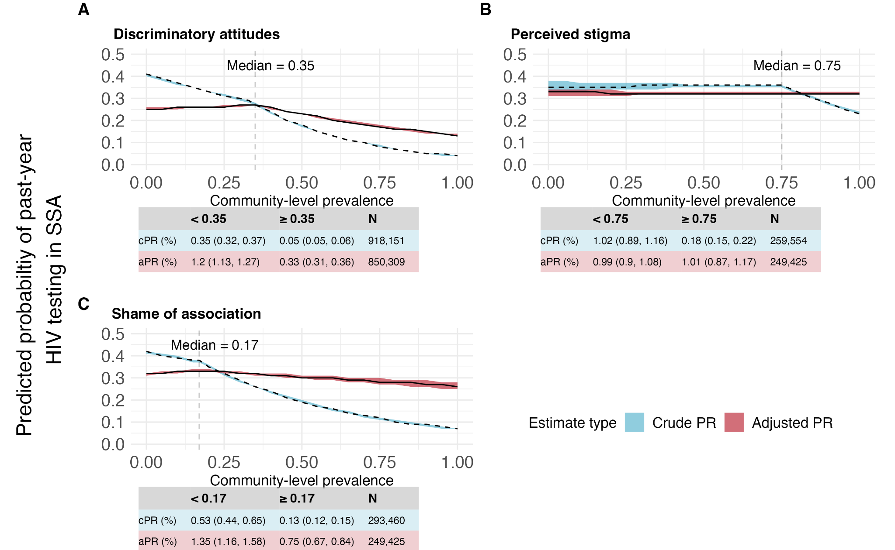
Results - HIV testing
High community discriminatory attitudes reduce HIV testing
At high levels, discriminatory attitudes, and shame of association could hamper HIV testing in the past year.
Perceived stigma does not seem to have a strong impact on HIV testing.
PR = prevalence ratio
Notes:
Now let’s move to HIV testing results.
Lots going on in these plots so let me describe what we are presenting
The blue color represents crude prevalence ratio and red color is adjusted estimates.
The lines represent the predicted probability of having tested in the past year at each stigma prevalence level.
And you see the knot at the median prevalence point which, in case is 35%.
We are seeing that at high prevalence levels, community discriminatory attitudes and shame of association (top left and bottom left) could hamper HIV testing in the past year. However perceived stigma (top right) does not seem to have a strong impact on HIV testing

Slide 9
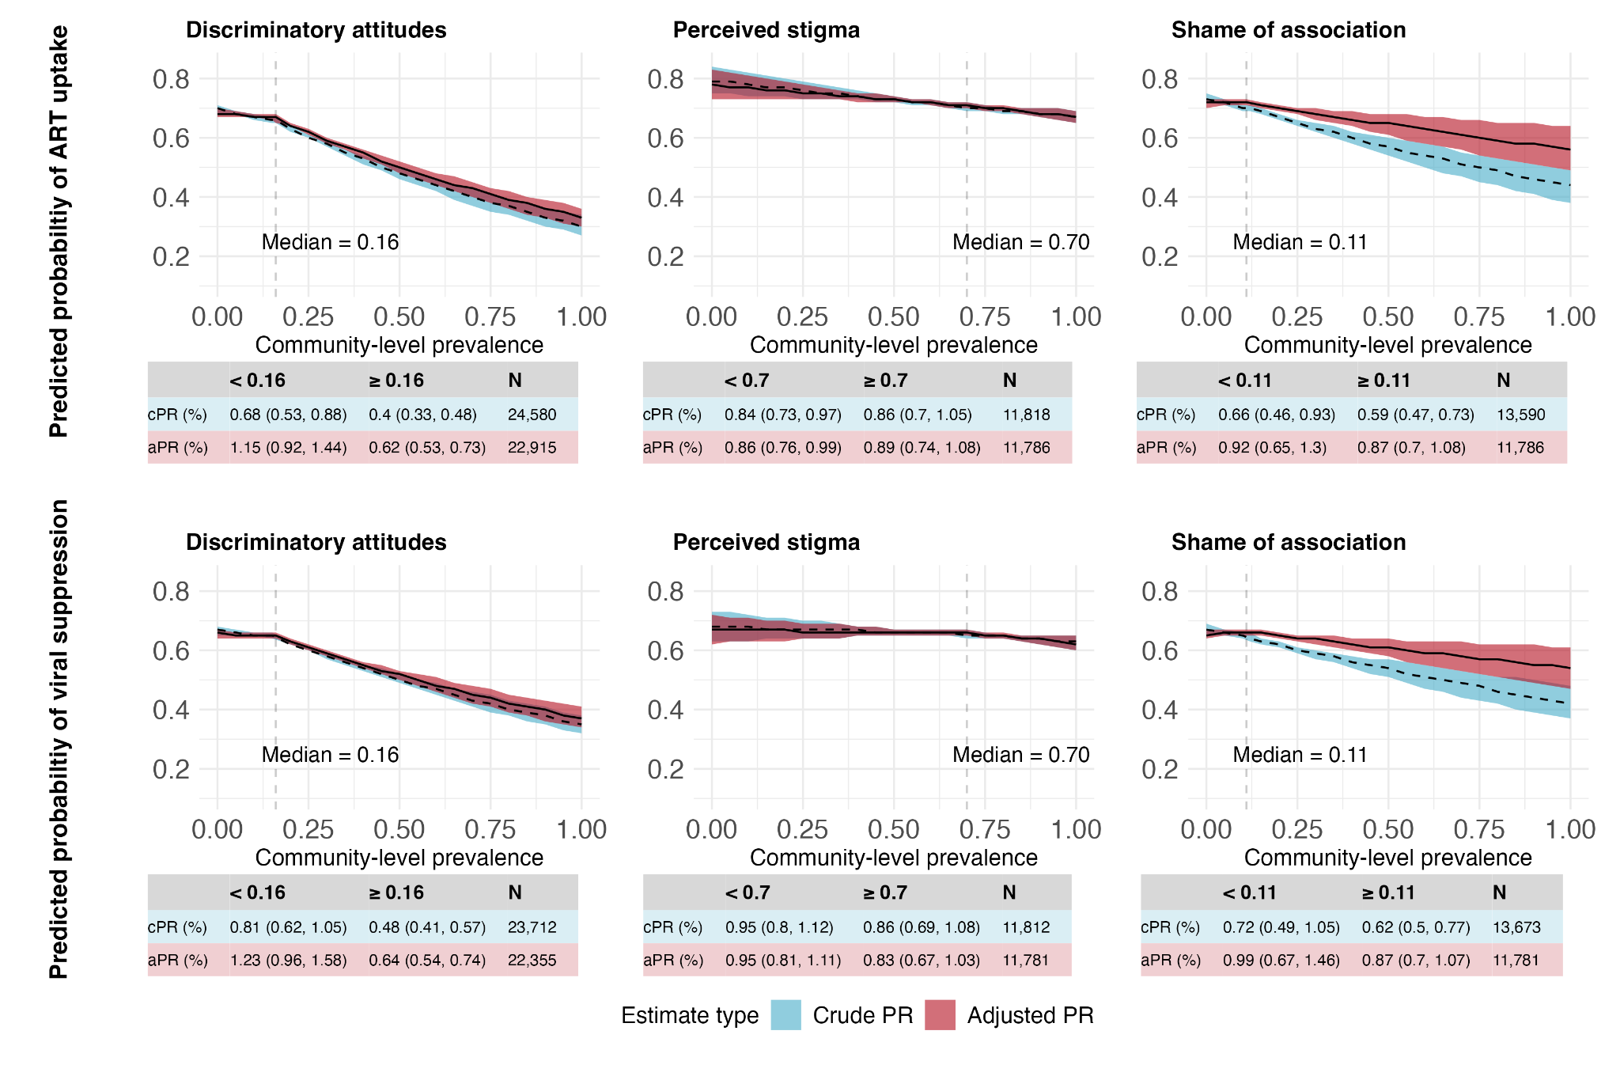
Results - ART uptake and VLS
High community discriminatory attitudes reduces ART & VLS
Discriminatory attitudes are associated with lower ART uptake and VLS among PLHIV.
Estimates for perceived stigma and shame of association are not precise.
Notes:
Now let’s talk about ART uptake and VLS
Community discriminatory attitudes at high levels are associated (first panel here) with lower ART uptake and VLS in high stigma burden settings
However the estimates for perceived stigma and shame of association are not precise

Slide 10
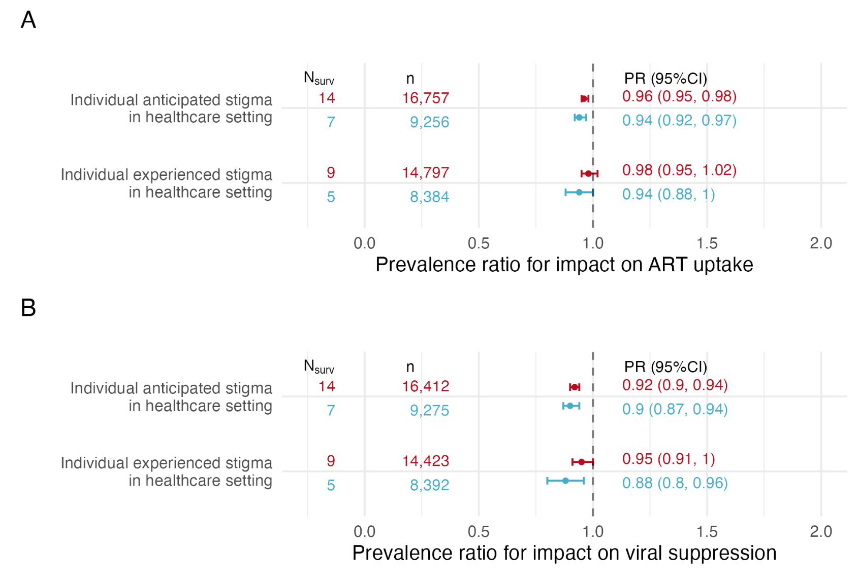
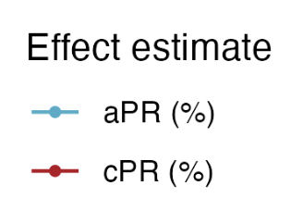
Results - ART uptake and VLS
Anticipated/experienced stigma in healthcare reduce ART & VLS
PLHIV who felt the need to hide their HIV status from their health provider are less likely to be on ART (6%) and VLS (6%).
PLHIV who were denied care because of their HIV status have lower ART uptake (10%) and VLS (12%).
Notes:
Now let’s look at the impact of individually experienced stigma among PLHIV on ART uptake (top panel) and viral suppression (bottom panel).
Note that here the exposure is binary and refers to individual experience of stigma
The adverse impact of experienced stigma was larger
PLHIV who were denied care have 10% lower ART uptake and 12% lower VLS

Slide 11
Strengths and Limitations
Limitations
Strengths
Observational, cross-sectional data.
  Collider-stratification bias (ART, VLS).
  Residual confounding.
  Reverse causation (HIV testing).
Large sample size.
Examination of the full treatment and care continuum.
Biomarker-based outcome measures (ART, VLS).
Adjustment for HIV prevalence (admin 1) and stigma domain-specific confounders.
11
Notes:
Some of the limitations of our work is that we are working with observational, cross sectional data such that making causal associations is more difficult

Slide 12
Key messages
Using data from up to 76 surveys (+800,000 respondents, +16,000 PLHIV), we found that:
    Different forms of community-level stigma are associated with poorer HIV testing, treatment, and VLS outcomes.
    PLHIV who have felt the need to hide their HIV status or who were denied healthcare because of their HIV status are less likely to be virally suppressed.
Confronting stigma and discrimination could have a key role in the fight against HIV/AIDS!
12

Slide 13



Thank You!
Merci!
Danke!
Co-authors: Flores Anato JL, Doyle C, Xia Y, Boily MC, Niangoran S, Platt L, Terris-Prestholt F, Saliuk T, Singh A, Vickerman P, Artenie A, Stone J, Maheu-Giroux M

Slide 14
Supplemental slides

Slide 15
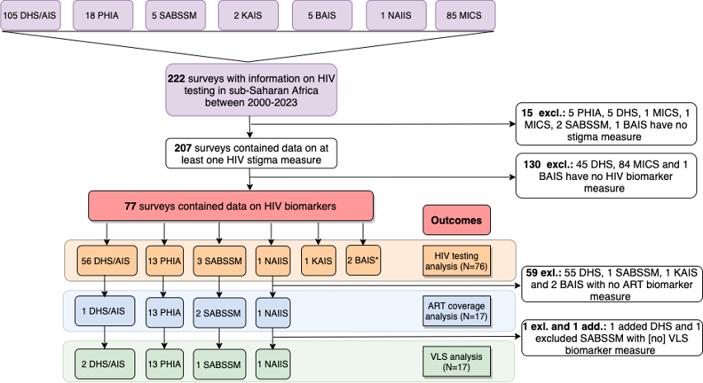
Results: Included surveys

Slide 16
Methods: Exposure definitions
Domains | Stigma measure | Survey questions
HIV-related stigma | Community discriminatory attitudes towards PLHIV | Would you buy fresh vegetables from a shopkeeper or vendor if you knew that this person had HIV? OR Do you think children (or female teacher) living with HIV should be allowed to attend school with children who do not have HIV?
Anticipated HIV stigma | Community shame of association with PLHIV | Do you agree or disagree with the following statement: I would be ashamed if someone in my family had HIV?
Perceived HIV stigma | Community perceived stigma | Do people talk badly about people living with HIV or who are thought to be living with HIV? AND Do people living with HIV, or thought to be living with HIV, lose the respect of other people?
Anticipated stigma | Individual (PLHIV) anticipated stigma in a healthcare settings | In the last 12 months, when you sought health care in a facility where your HIV status is not known, did you feel you needed to hide your HIV status?
Discrimination (enacted stigma) | Individual (PLHIV) experienced stigma in healthcare settings | In the last 12 months, have you been denied health services including dental care, because of your HIV status?

Slide 17
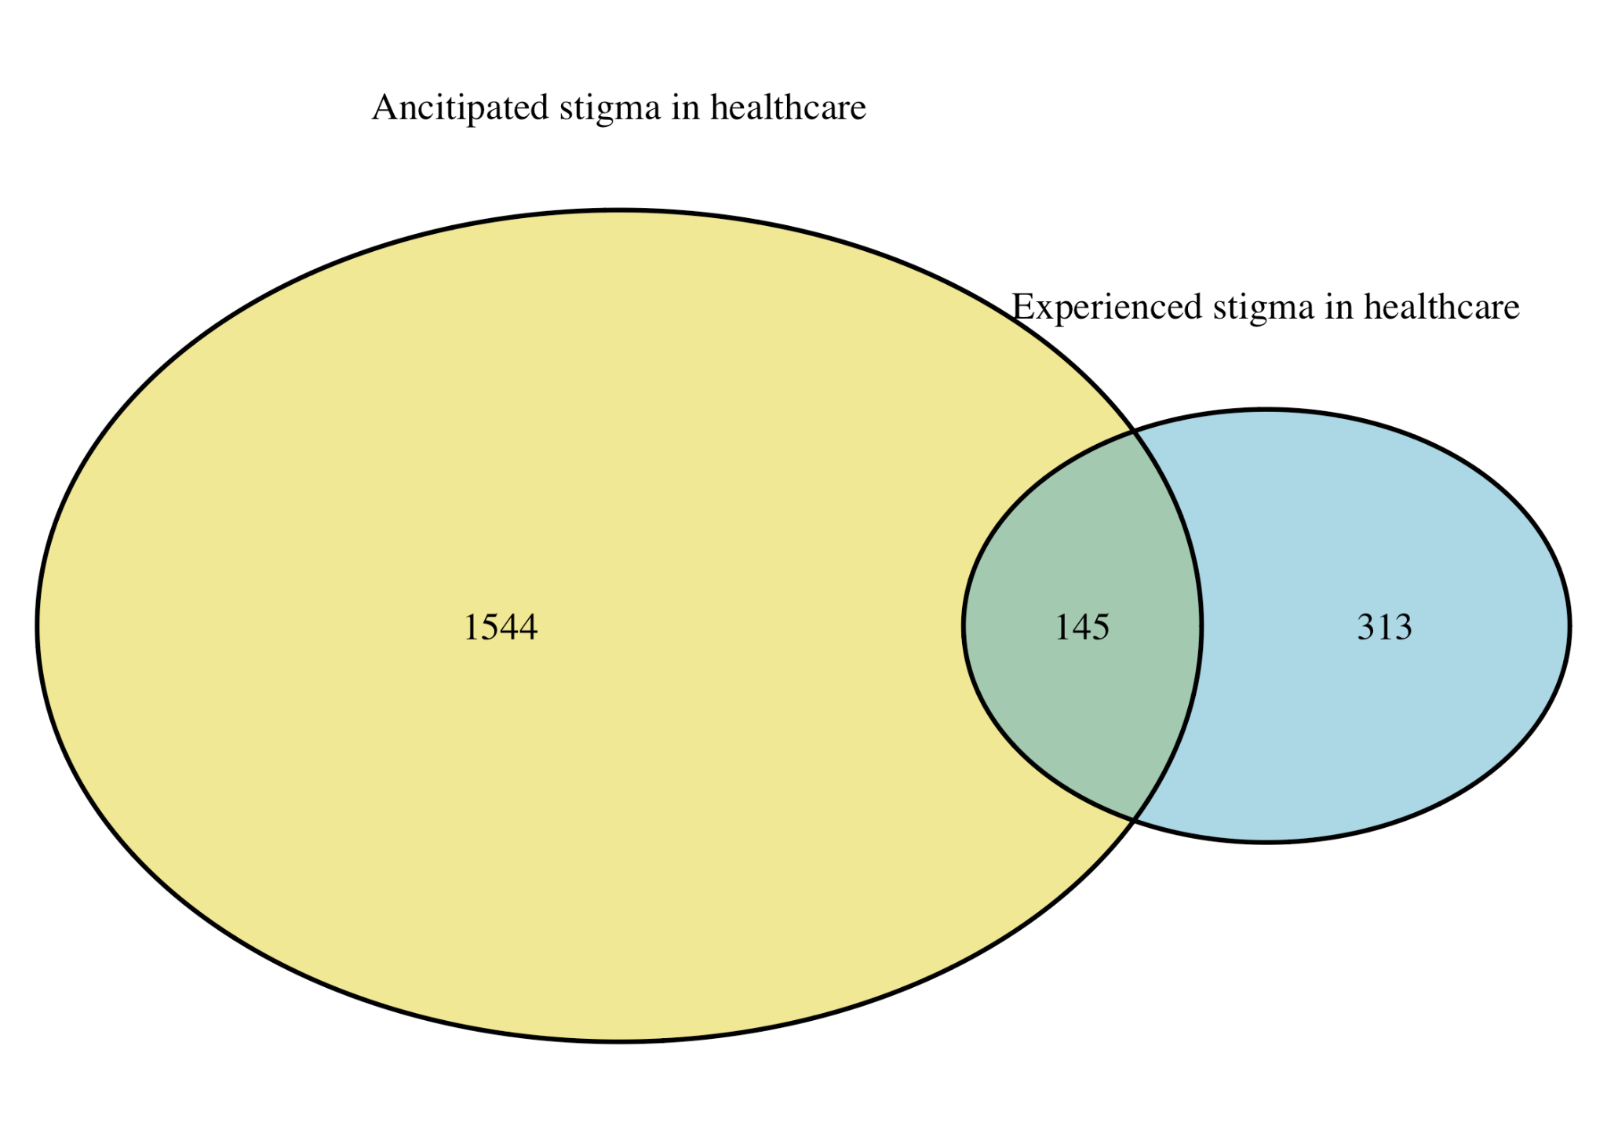
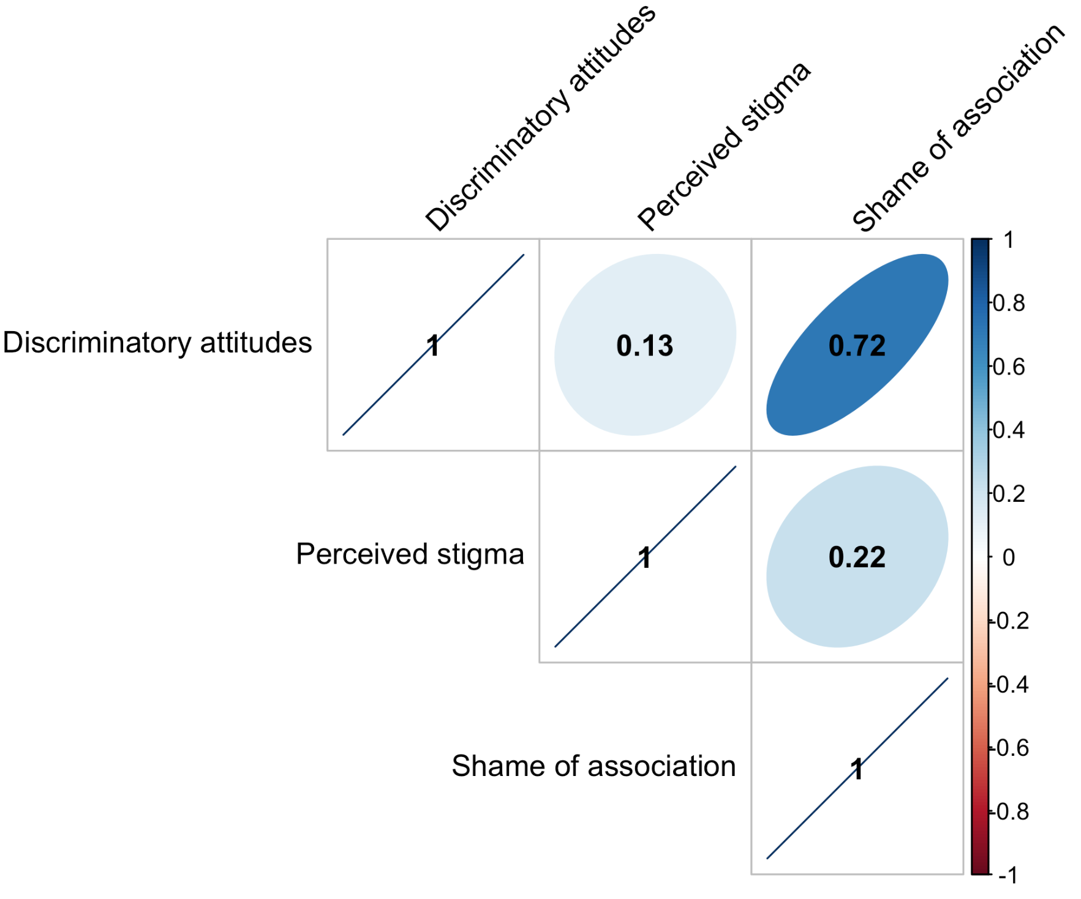
Correlation between stigma variables
Overlap between anticipated stigma and experienced of stigma in healthcare settings by PLHIV who reported their status and sought care
Correlation between community-level stigma variables

Slide 18
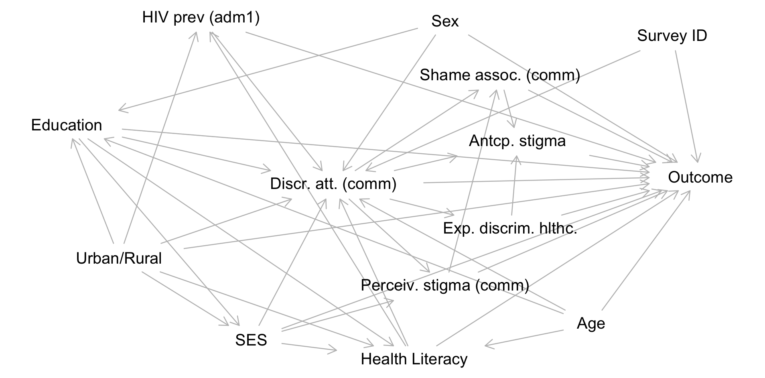
Directed Acyclic Graph (DAG)

Slide 19
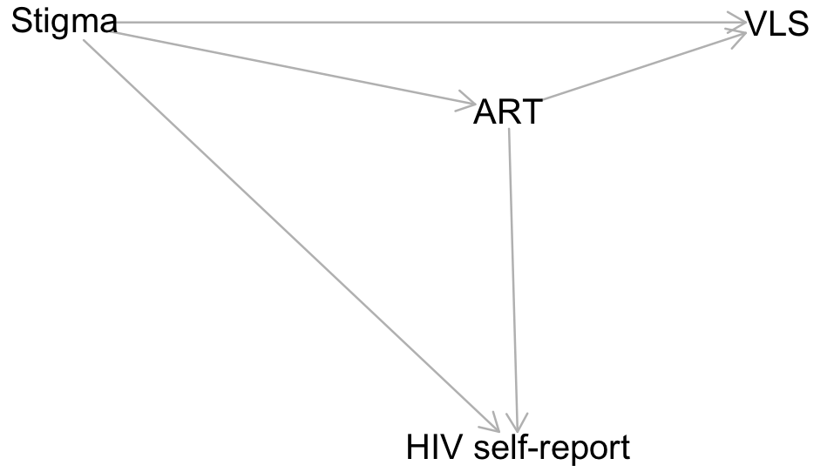
Directed Acyclic Graph (DAG) showing potential collider-stratification bias
Questions about anticipated and experienced HIV stigma (healthcare) only asked to PLHIV who reported their status and sought care in the last 12 months.
This selection could lead to collider-stratification bias:
  Resulting in attenuation of effect sizes if stigma makes it less likely to self report but being on ART/VLS makes it more likely.
−
+

