Slide 1


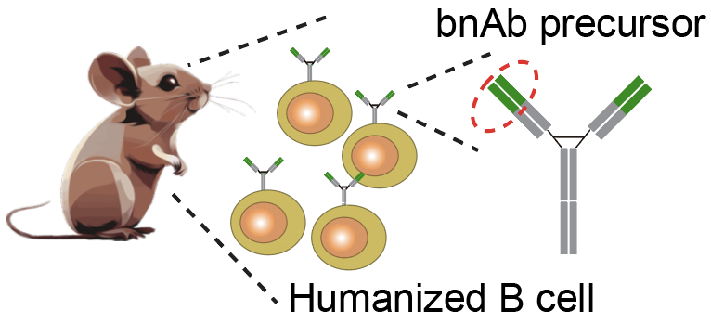
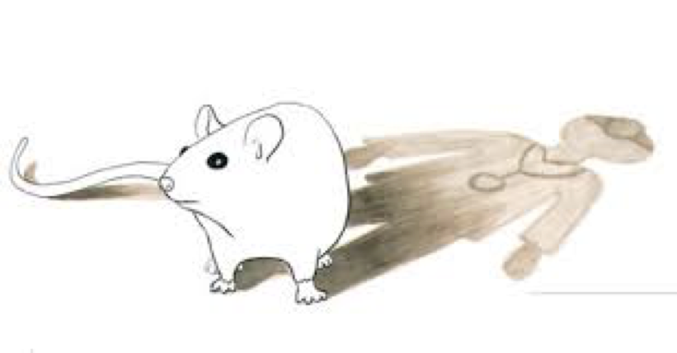

HIV-1 trimer boosters elicit precursors to broadly neutralizing antibodies targeting V3-glycan
Zhenfei Xie
Research Scientist
Batista lab
Schief lab
Ward lab
Oct 1, 2024

Slide 2
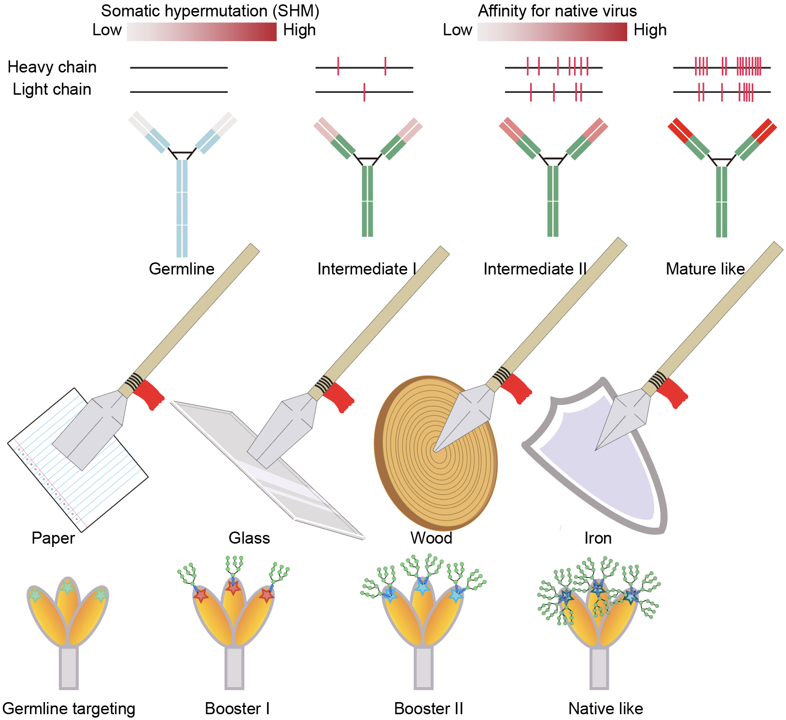
Germline targeting and sequential immunization

Slide 3
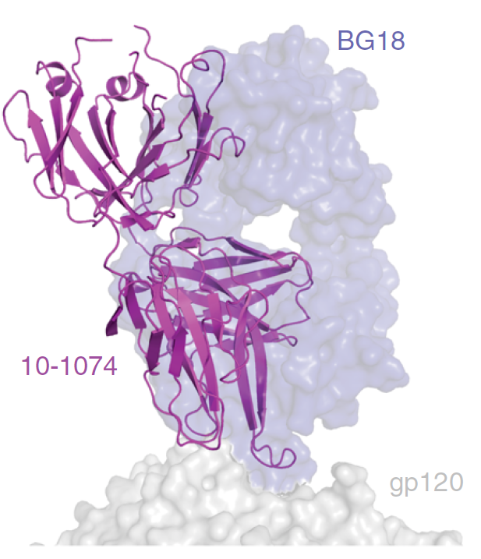
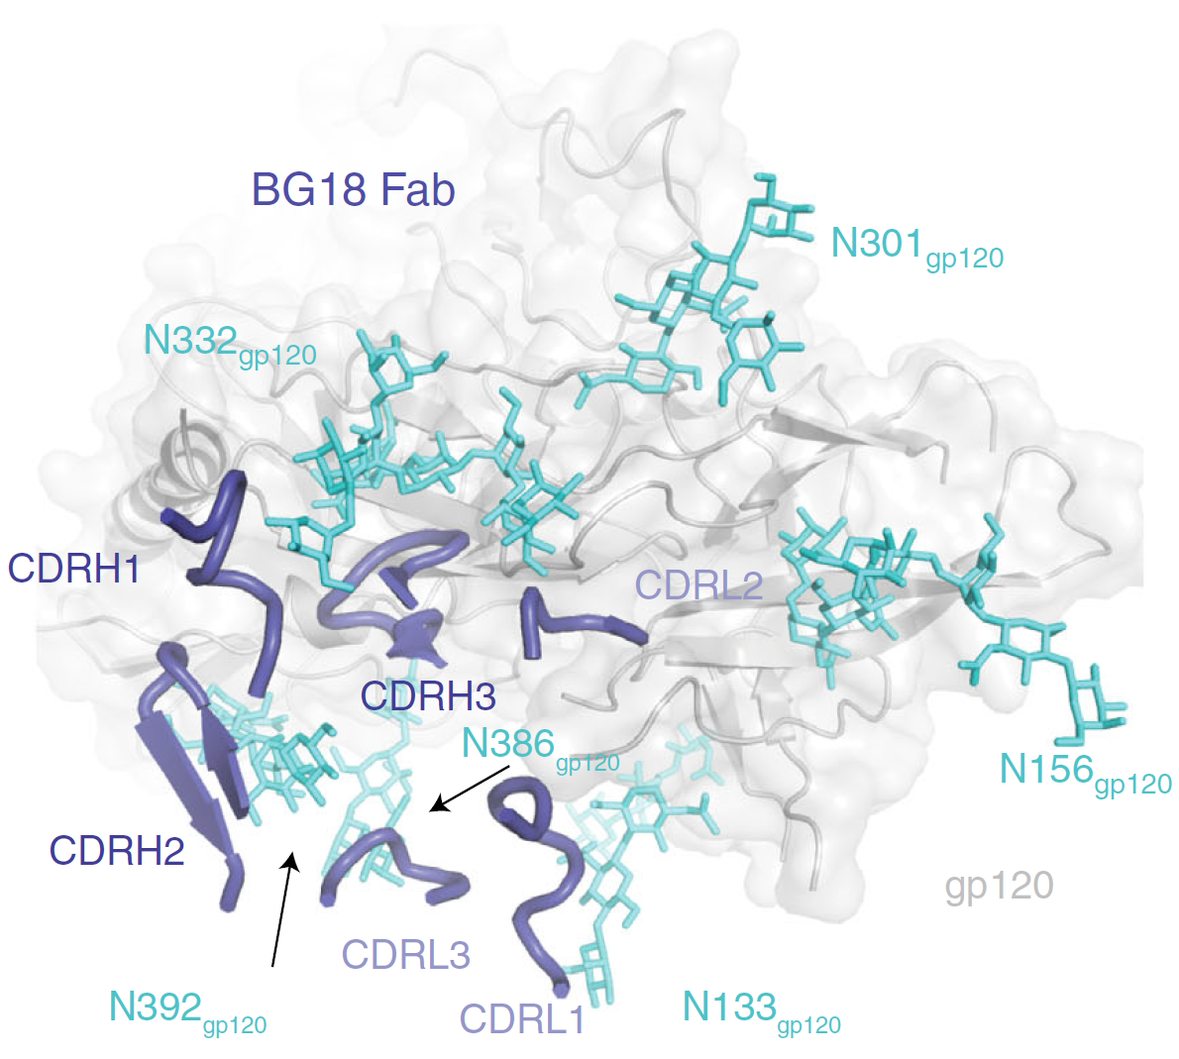
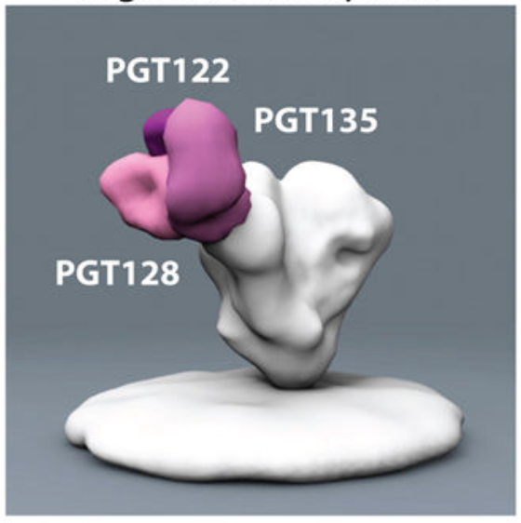
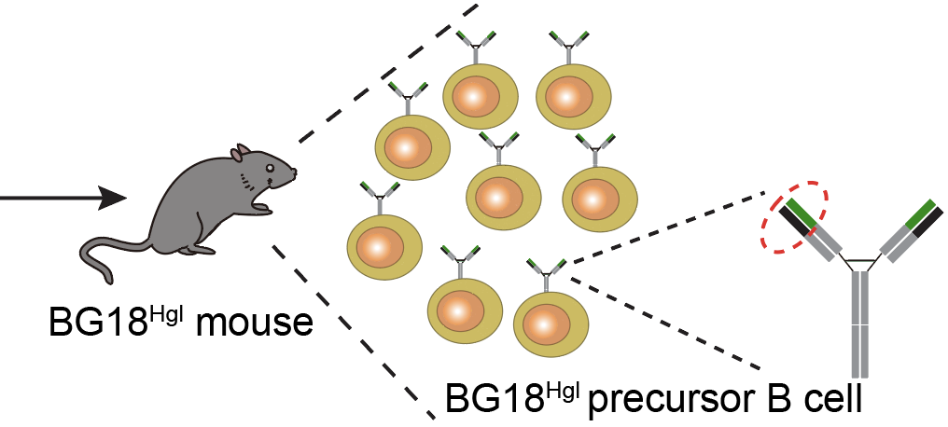
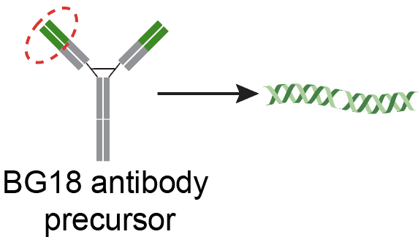
BG18 bNAb is a good model for V3-glycan supersite-based HIV vaccine study
(Burton and Hangartner. Annu.Rev.Immunol, 2016)
(Freund, et al. Sci.Trans.Med, 2017)
(Barnes, et al. Nature Communications, 2018)
(Steichen, et al. Science, 2019)

Slide 4
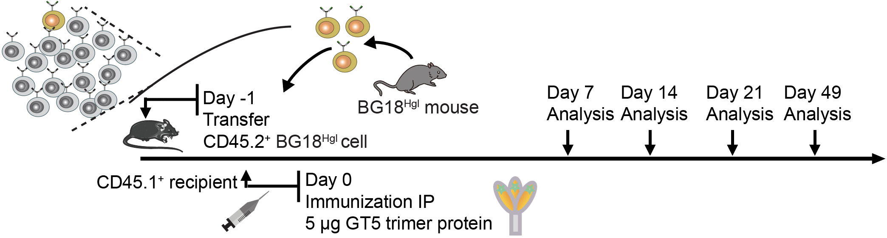

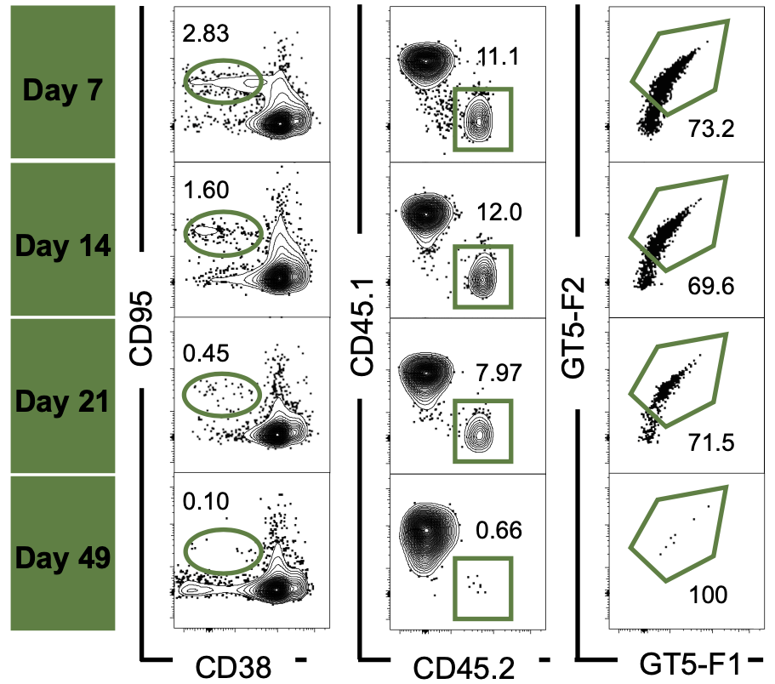
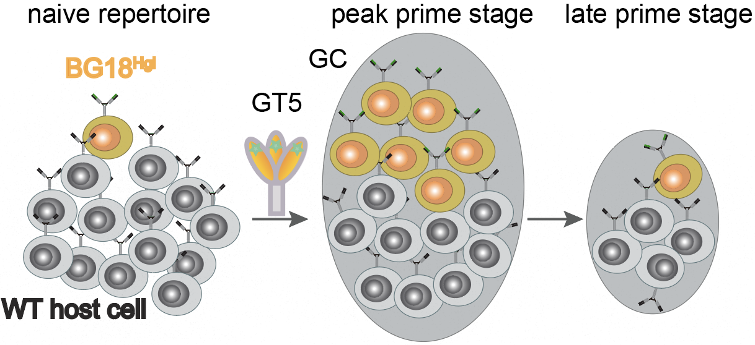

N332-GT5 trimer protein can efficiently activate BG18^{Hgl} B cells
(Xie, et al. Science, 2024)

Slide 5
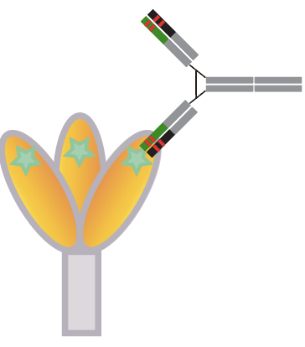
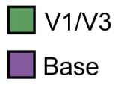
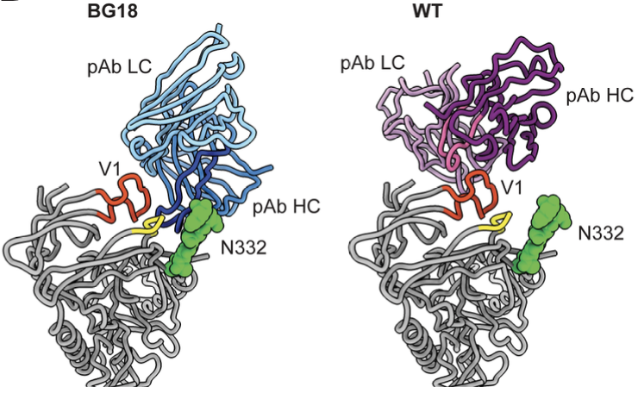
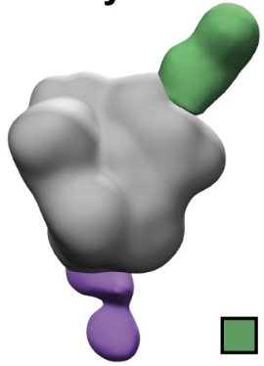
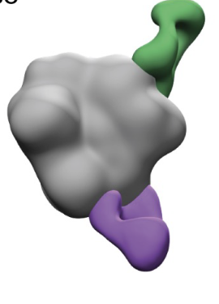
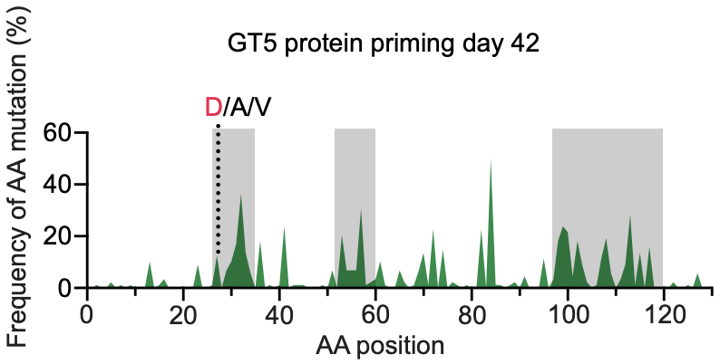
The activation of BG18^{Hgl} B cells by GT5 protein generates somatic hypermutation (SHM) and affinity maturation toward V3-glycan epitope
BG18^{Hgl}
WT
(Xie, et al. Science, 2024)

Slide 6
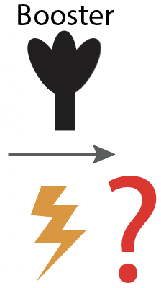


Slide 7
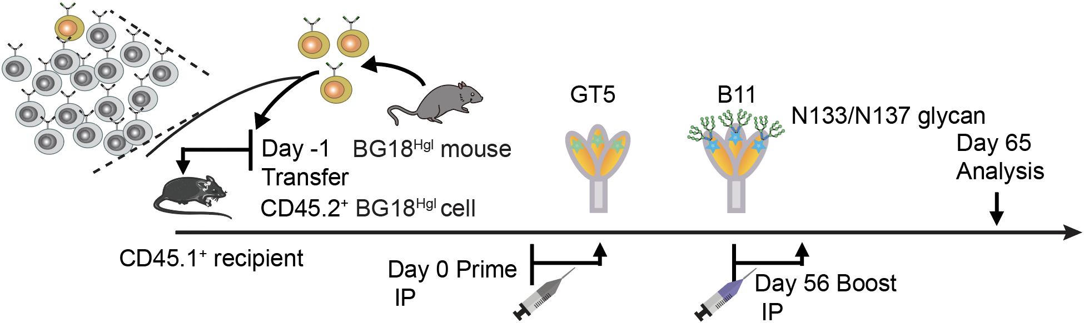

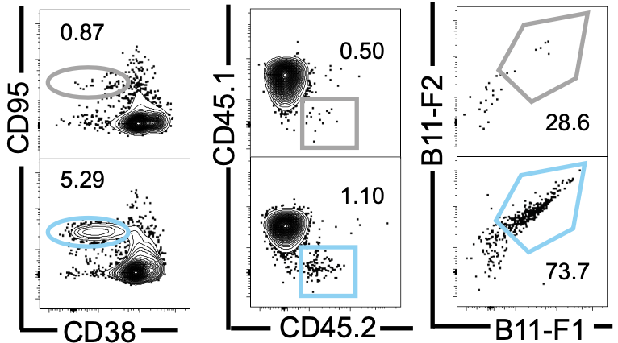
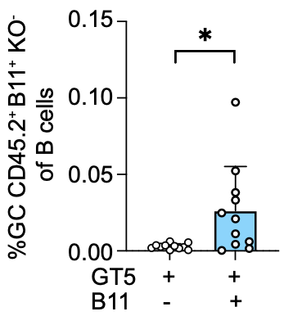


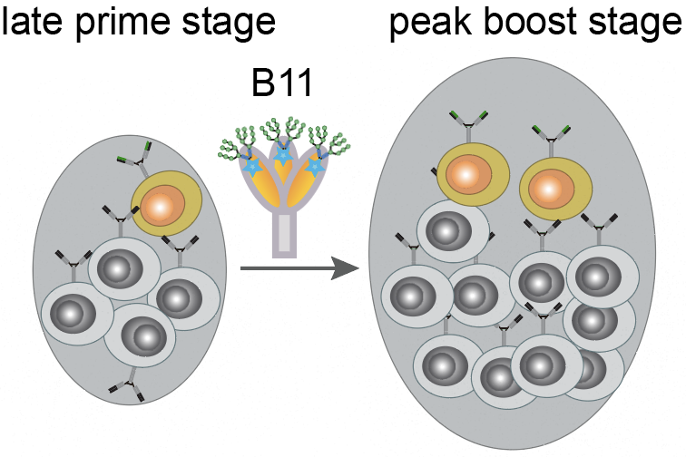
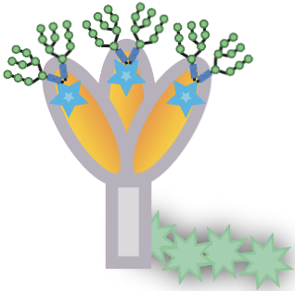
Boosting with B11 trimer protein increase GC- resident BG18^{Hgl} cells
+
(Xie, et al. Science, 2024)

Slide 8
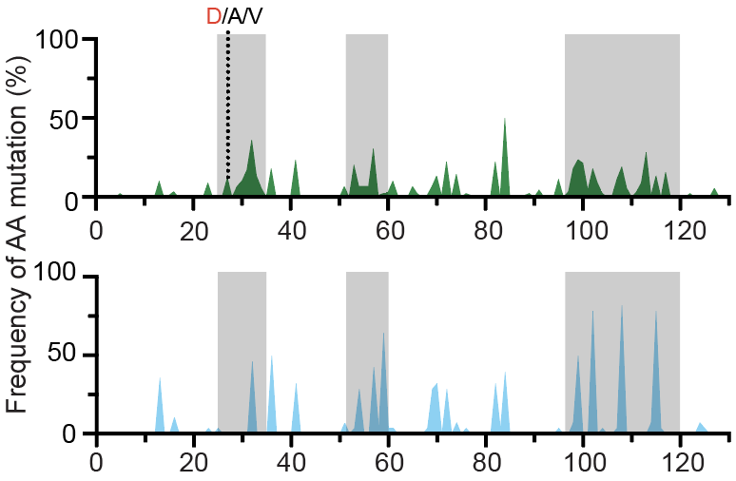
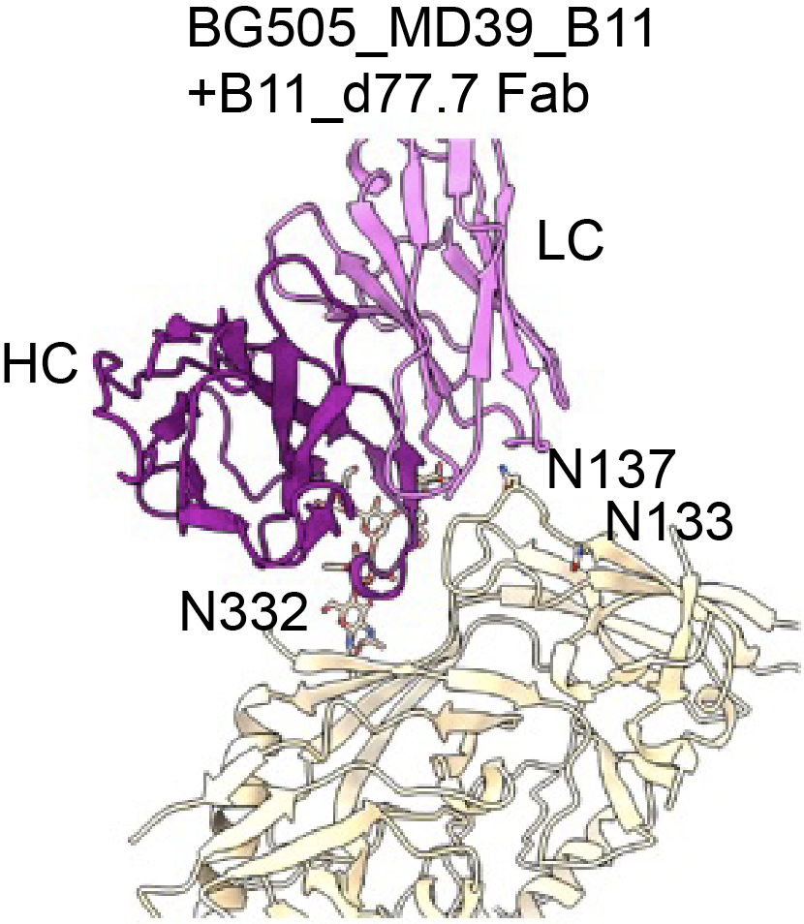
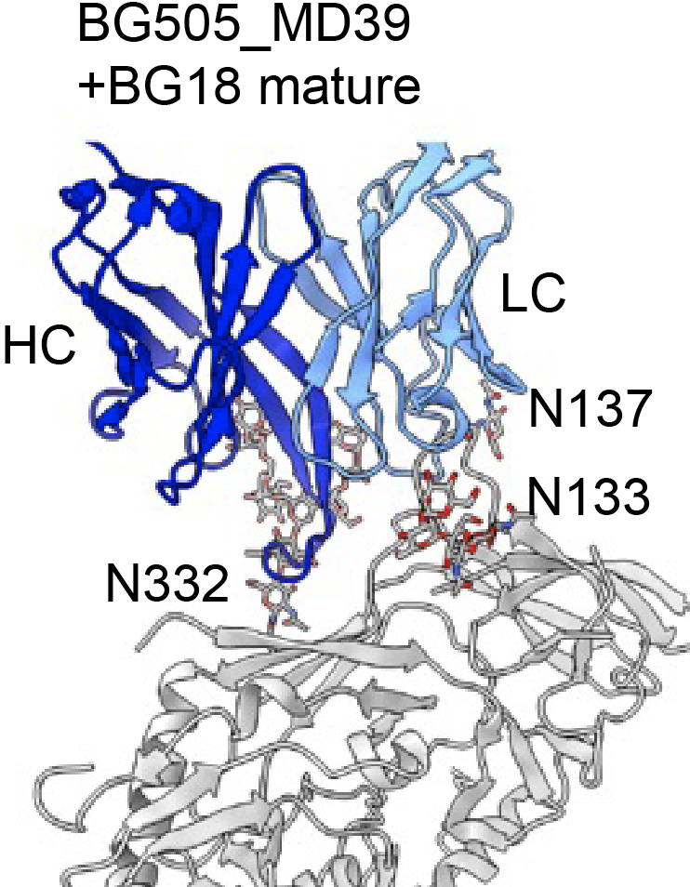
Boosting with B11 trimer proteins further increases BG18^{Hgl} B cell SHM and affinity maturation
+
(Xie, et al. Science, 2024)

Slide 9
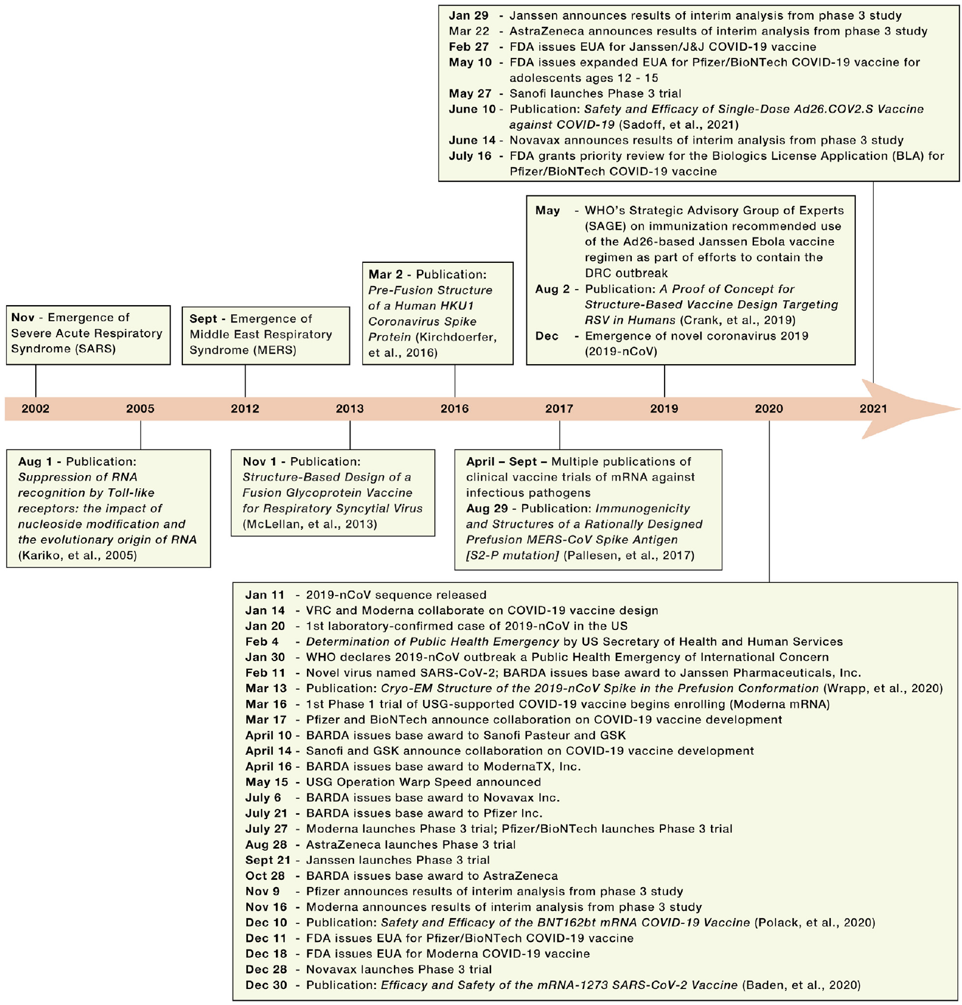
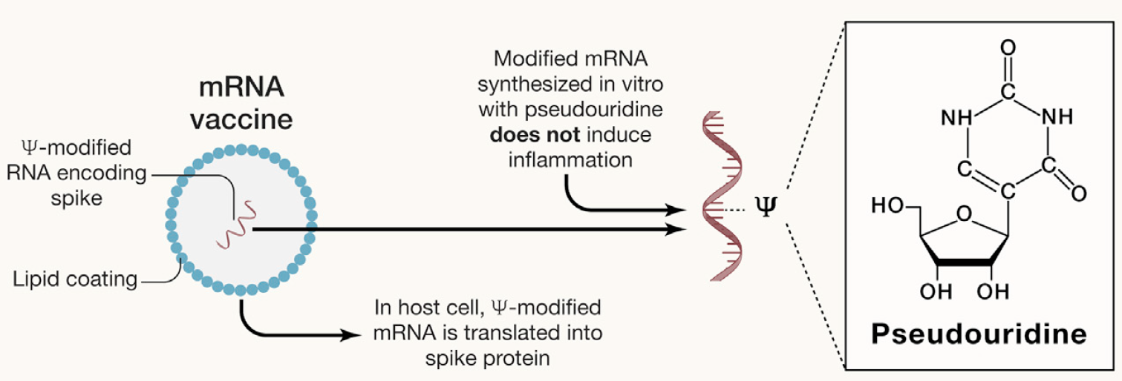
COVID-19 mRNA vaccine provides a new paradigm for rapid vaccine development
(Shapiro, et al. Cell, 2021)
(Bok, et al. Immunity, 2021)

Slide 10
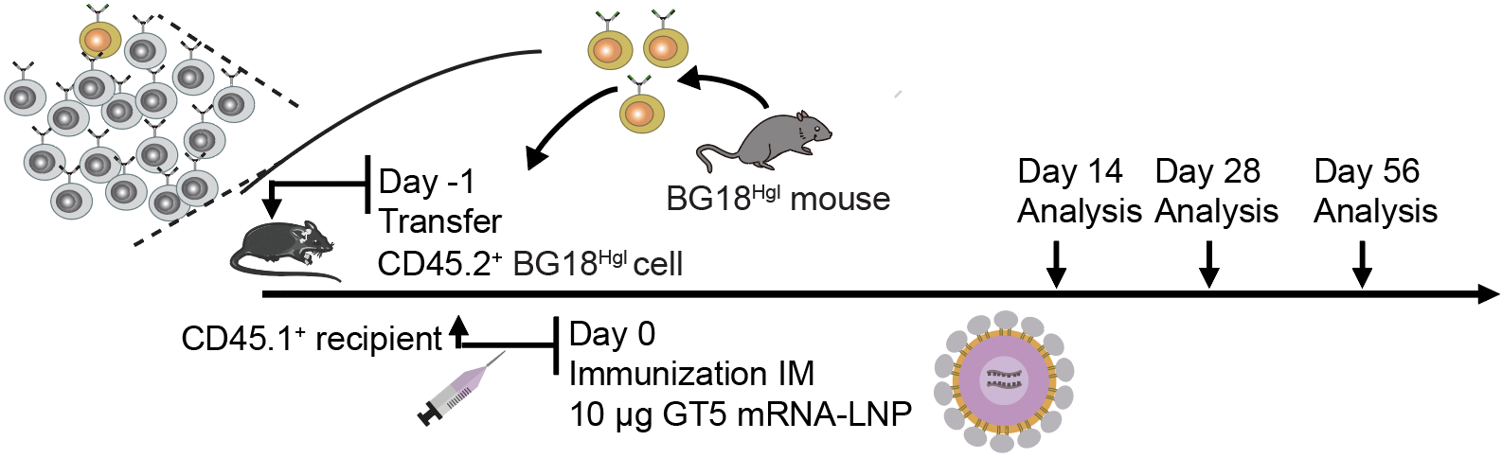
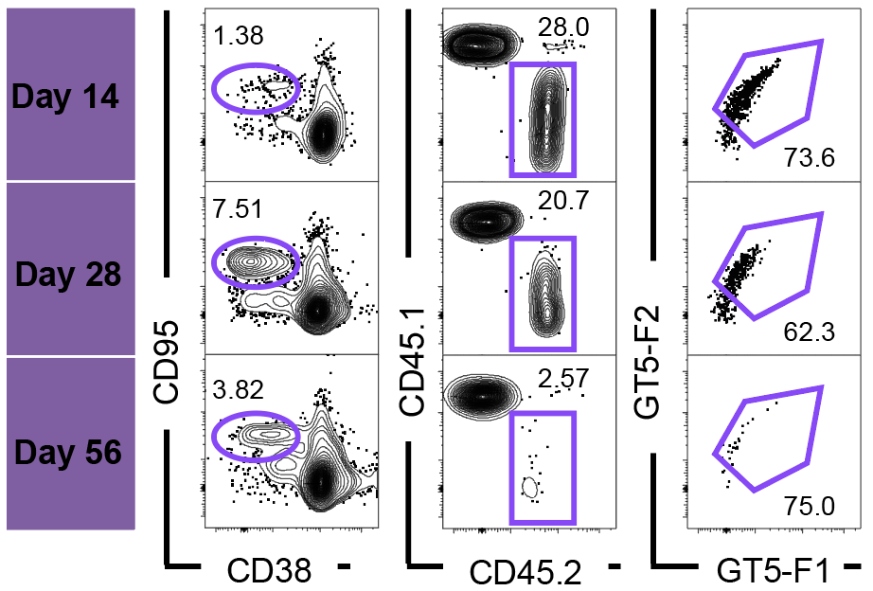
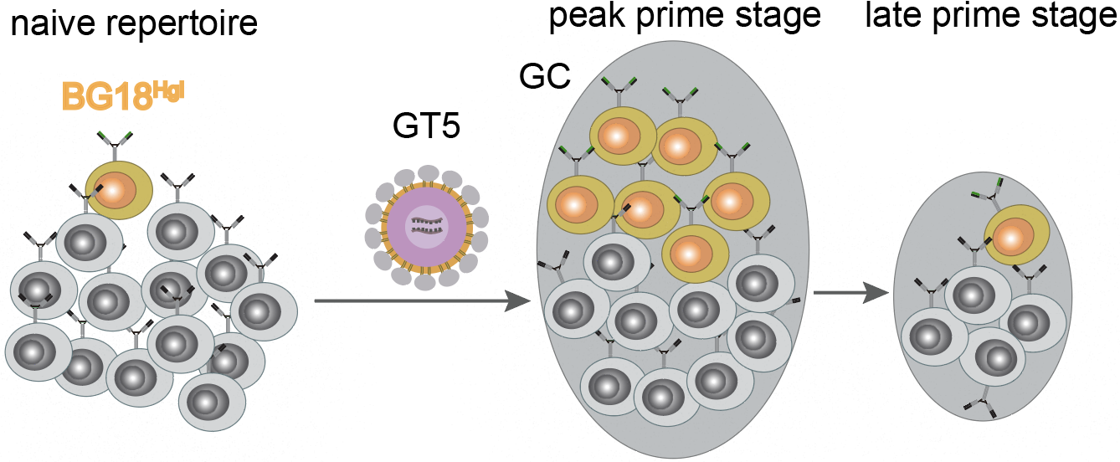
Membrane-anchored N332-GT5 mRNA-LNP induces robust and durable BG18^{Hgl} B cell response
(Xie, et al. Science, 2024)

Slide 11
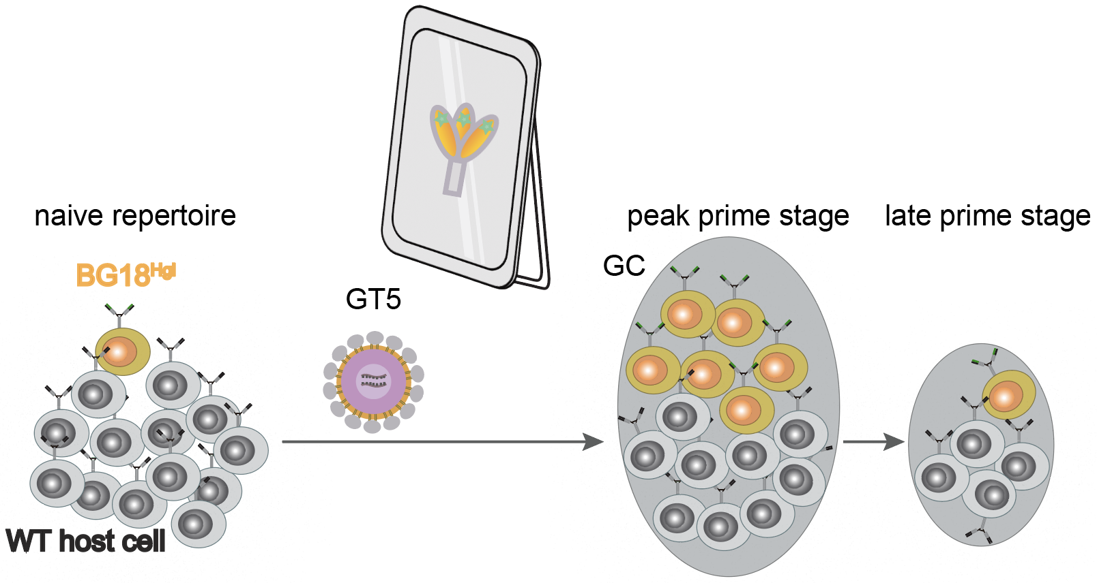
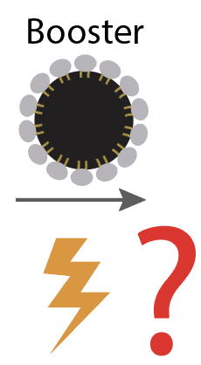

Slide 12
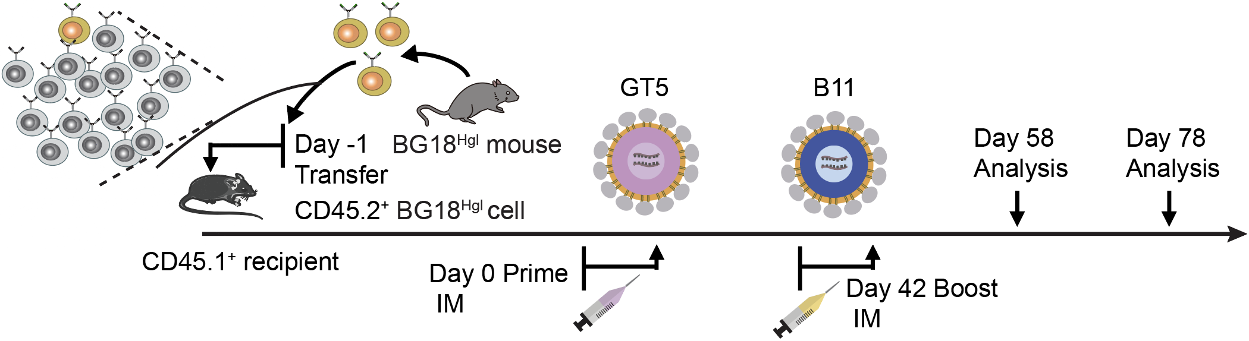
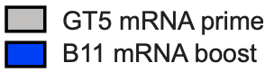
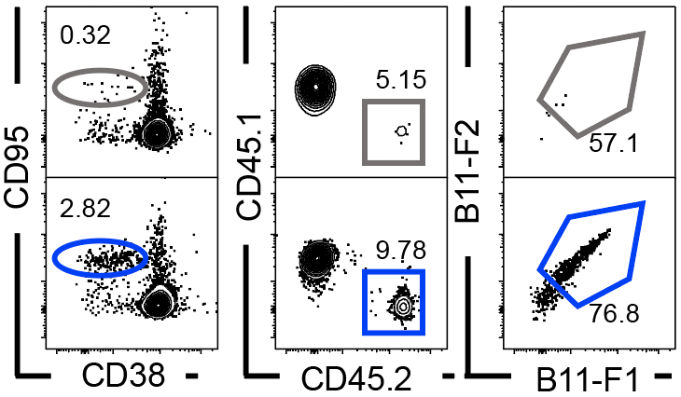
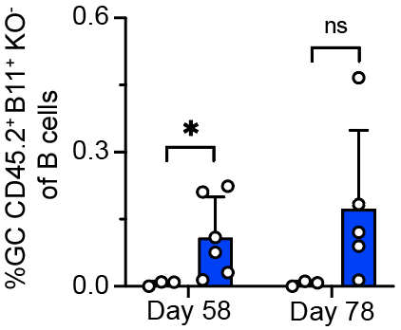


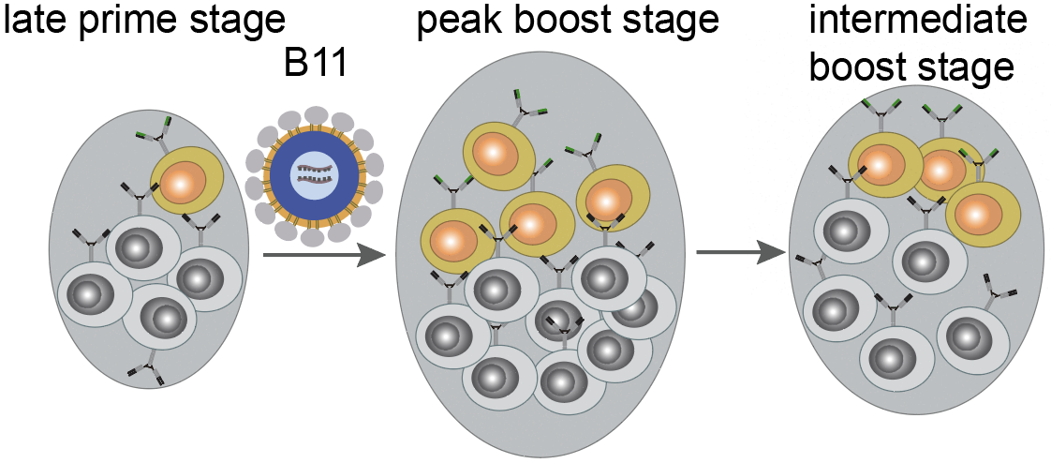
mRNA-LNP prime and boost regimen generates long lasting BG18^{Hgl} GC response
+
(Xie, et al. Science, 2024)

Slide 13
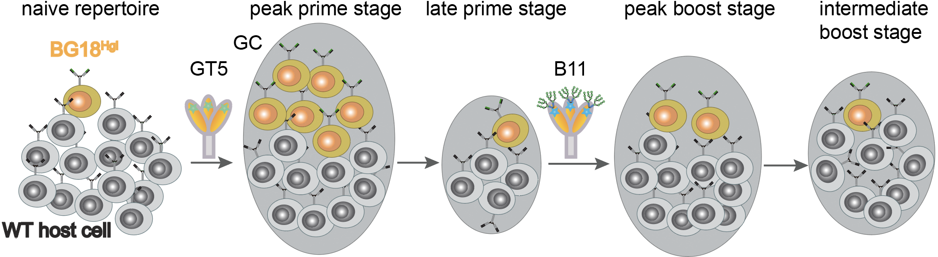
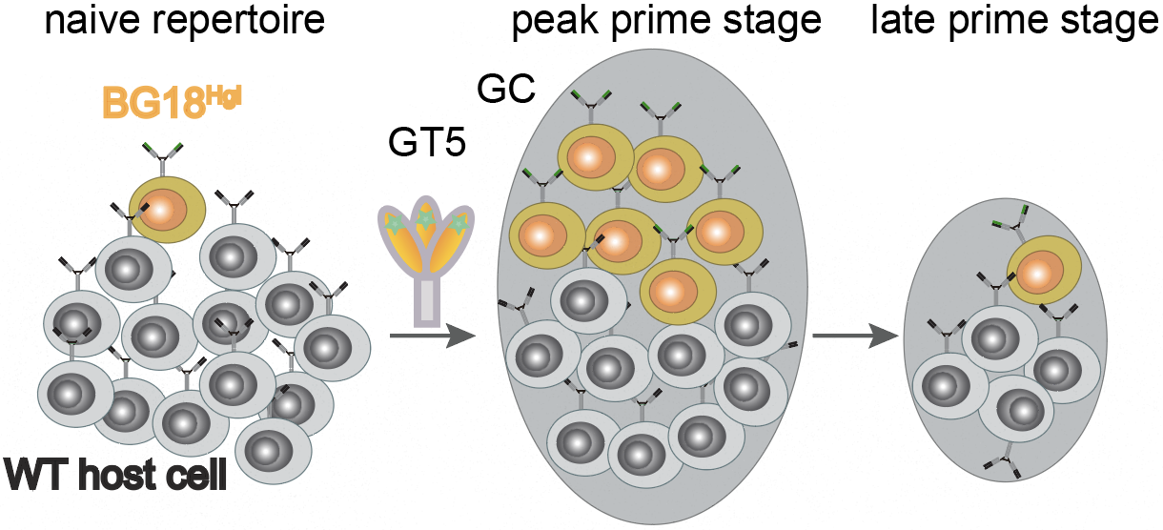
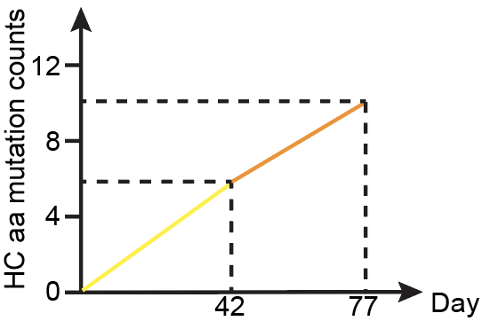
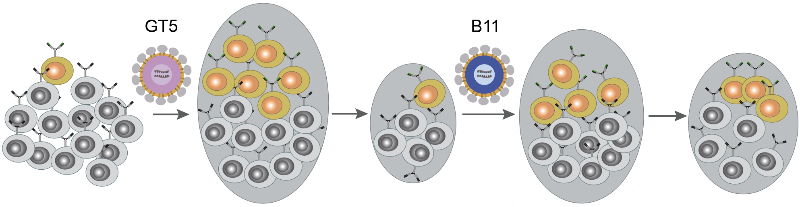
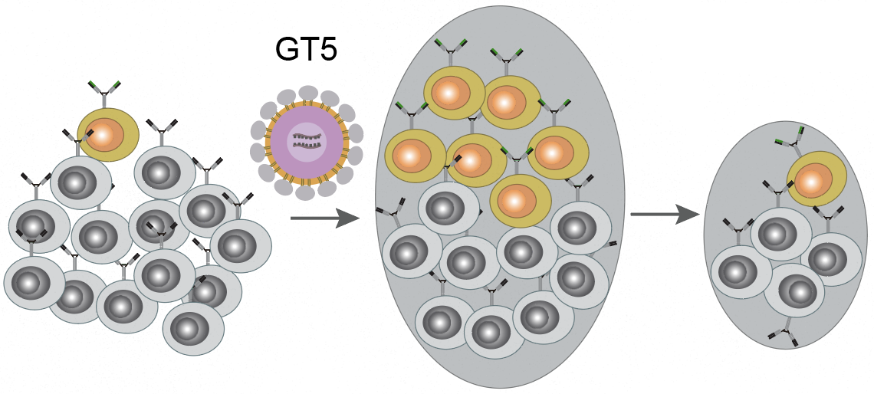
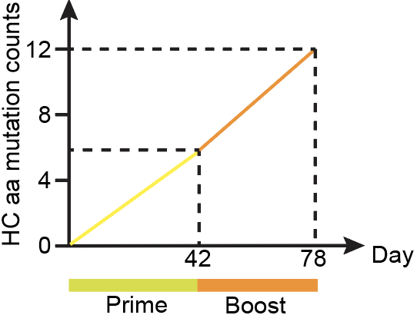
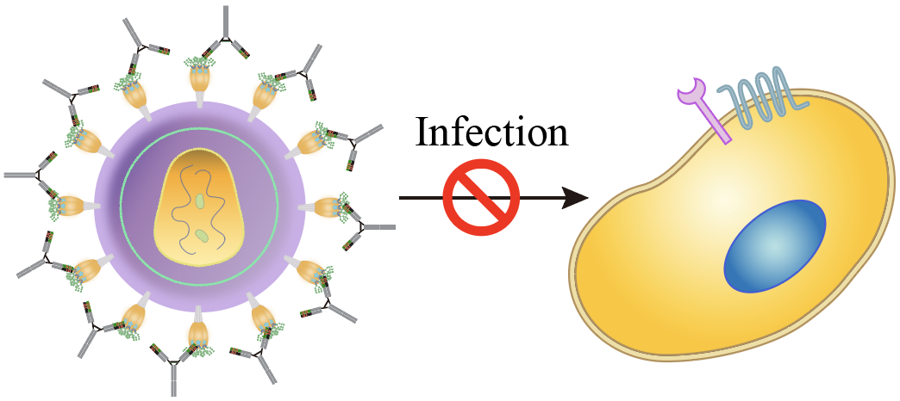
Conclusions
Preclinical germline targeting immunogen N332-GT5 trimer protein (entering GMP manufacturing) is capable of efficiently activating BG18 class naïve precursors to V3 glycan epitope.
N332-GT5 mRNA-LNP can recapitulate the activation and maturation process of BG18 precursors as with the GT5 trimer protein.
B11 protein booster can further fuel the activated BG18 precursors to undergo SHM and affinity maturation.
The mRNA prime-mRNA boost regimen can work at least as efficiently as protein immunization, if not better.
(Xie, et al. Science, 2024)

Slide 14

Take-home message
Credits
Christina Corbaci and Lars Hangartner

Slide 15





Acknowledgement
Batista lab
Facundo Batista
Ying-Cing Lin
Sven Kratochvil
Rashmi Ray
Xuesong Wang
John Warner
Stephanie Weldon
Usha Nair
Kathrin H. Kirsch
Thavaleak Prum
Gordon Dale
Maria Bottermann
Paula Maldonado
Yu Yan
Eleonora Melze
Amrit Raj Ghosh
Ja-Hyun Koo
Schief lab (Scripps/IAVI)
William Schief
Jon Steichen
Oleksandr Kalyuzhniy
Erik Georgeson
Yumiko Adachi
Michael Kubitz
Bettina Groschel
Moderna
Andrea Cari
Sunny Himansu
NIH/NIAID
Angela Malaspina
Cesar Boggiano
Stuart Shapiro
Ward lab (Scripps/IAVI)
Andrew Ward
Gabriel Ozorowski
Jonathan L. Torres
BMGF
Thandi Onami
Pervin Anklesaria
Nina Russell
Sok lab (Scripps/IAVI)
Devin Sok
Jeong Hyun Lee

