Slide 1
AIDS 2024 Knowledge Toolkit
Highlights of the 25th International AIDS Conference

Slide 2
Contents
3 Remission, cure and vaccines >
33 Antiretroviral therapy (ART) >
49 HIV and STI prevention >
69 Gaps, access and resources >
79 Improving HIV care >
95 Structural factors and social determinants of health >
105 Criminalization, discrimination and stigma >

Slide 3
Remission, cure and vaccines
4 Latest cures using stem-cell transplants >
8 Cure approaches using broadly neutralizing antibodies (bNAbs) >
13 Cure approaches in children >
16 Cure approaches using genetic engineering >
21 Cure approaches using transcription inhibition >
25 The search for an HIV vaccine >

Slide 4
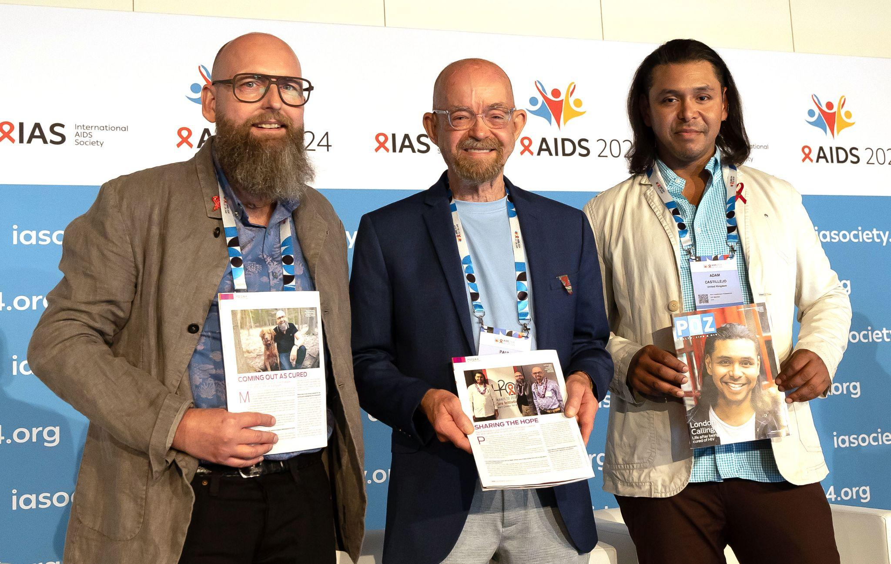
Remission, cure and vaccines | Latest cures using stem-cell transplants
Latest cures using stem-cell transplants
The case of the “next Berlin patient”, the seventh person cured of HIV using a stem-cell transplant, was presented at AIDS 2024.
Three of the seven people known to be cured spoke at the conference: Marc Franke, Paul Edmonds and Adam Castillejo (the “Düsseldorf, City of Hope and London patients”).
Marc Franke, Paul Edmonds, Adam Castillejo.© Gonzalo Bell / IAS
Gabler SS0402LB
Notes:
Abstract: https://programme.aids2024.org/Abstract/Abstract/?abstractid=12163

Slide 5
Remission, cure and vaccines | Latest cures using stem-cell transplants
The “next Berlin patient” is the first person to be cured with transplant of stem cells that were not CCR5-negative homozygous, i.e., not naturally 99% resistant to HIV.
The donor has one copy of CCR5-negative gene out of two (heterozygous); this confers a degree of slower disease progression but little extra resistance to infection.
He has been aviremic off ART for nearly six years.
“Next Berlin patient”: Viral load and T-cell counts since 2010
Gabler SS0402LB
Notes:
Apart from the “Geneva patient” (see next slide) the other five people so far cured of HIV received stem cells that had a mutation called CCR5-delta-32. This means that 32 amino acids are deleted from the gene that encodes for a T-cell surface receptor called CCR5. This disables the gene and people with it lack CCR5. This receptor has a part to play in immunity against some conditions like cancer, but the health of people without it is not badly affected.
HIV has evolved to use the CCR5 receptor as one of the two co-receptors (the other being CD4) that it attaches to in the process of infecting cells. There is another type of HIV that attaches to a different receptor, CXCR4, but this generally develops during later-stage infection and is rarely transmitted.
People receive one copy each of genes from their mother and their father. If both parents’ genes carry the same mutation, then this is called homozygosity. About 1% of people with northern European ancestry (fewer if they are of other ethnicities) are homozygous for the CCR5-delta-32 mutation, which confers almost complete immunity to HIV infection. The first five cured patients announced received stem cells from CCR5-delta-32 homozygous donors.
If the CCR5-delta-32 mutation is only inherited from one parent, then this is called heterozygosity. The “next Berlin patient” received cells from a CCR5-delta-32 heterozygous donor. About 10% of northern European ethnicity are heterozygous. This may confer a degree of slower progression to immunodeficiency in HIV infection but does not appear to confer significant resistance to infection. The case of the “Geneva patient” was presented at IAS 2023. There are more details on the next slide. This patient received cells where both parents carried the unmutated CCR5 gene and had the normal complement of CCR5 receptors – they were “CCR5 homozygous”.
Abstract: https://programme.aids2024.org/Abstract/Abstract/?abstractid=12163

Slide 6
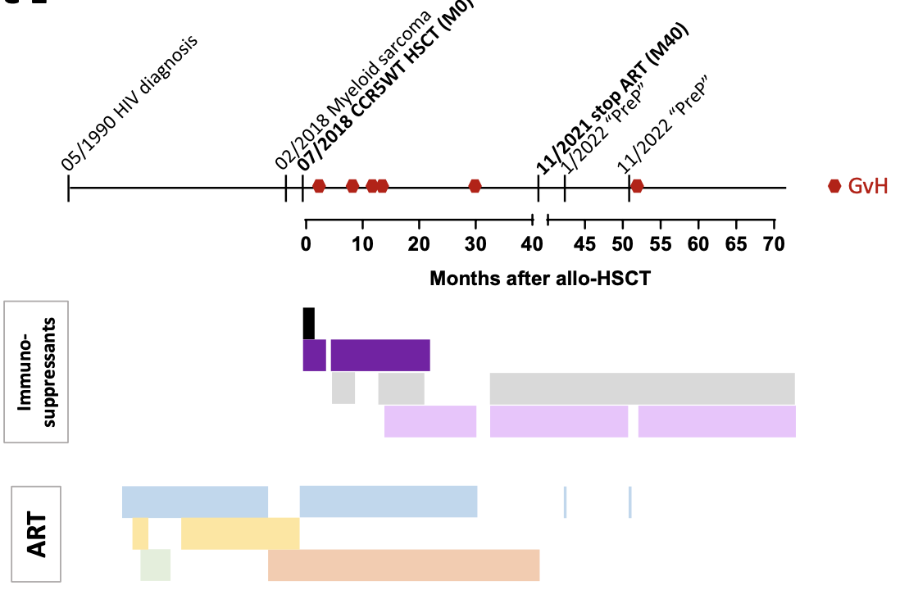
Remission, cure and vaccines | Latest cures using stem-cell transplants
The “Geneva patient” has now been aviremic off ART for nearly three years.
Unlike the “next Berlin patient”, he has both copies of CCR5 genes present (homozygous). The genes lack any resistance to HIV acquisition/proliferation.
“Geneva patient”: ART and immunotherapy timeline
Avettand-Fenoel SAT11005
Notes:
The case of the “Geneva patient” was first reported at the 12th International AIDS Society Conference on HIV Science (IAS 2023) in Brisbane, Australia. (https://programme.ias2023.org/Abstract/Abstract/?abstractid=5819)
Unusual features: six episodes of graft-versus-host (GvH) disease after ART stopped: intermittent doses of immune modulator (ruxolitinib) which still continue – see graph.
Ruxolitinib is used to treat graft-versus-host disease: it has also been found to reduce HIV-reservoir proviral DNA and to reverse HIV-related immune dysregulation.

Slide 7
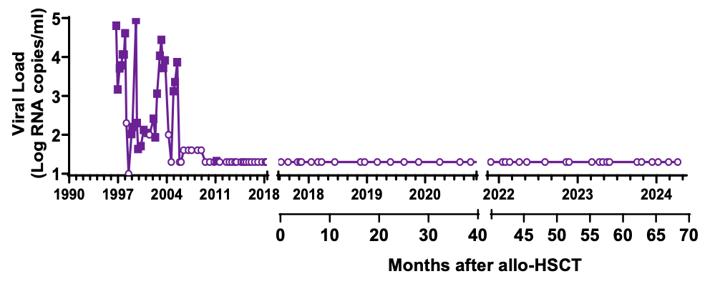
Remission, cure and vaccines | Latest cures using stem-cell transplants
Very low levels of defective HIV RNA (not replication-competent) remained in the blood until 57 weeks after ART was stopped. Since then, no HIV RNA has been detected.
Antibodies to HIV continue to decline, suggesting there is no virus to stimulate them.
“Geneva patient”: HIV RNA and DNA
Avettand-Fenoel SAT11005
Notes:
Unusual features: six episodes of graft-versus-host disease after ART stopped: intermittent doses of immune modulator (ruxolitinib) which still continue – see bottom graph.
Session: https://programme.aids2024.org/Programme/Session/247

Slide 8
Remission, cure and vaccines | Cure approaches using broadly neutralizing antibodies (bNAbs)
Cure approaches using broadly neutralizing antibodies (bNAbs)
Several ongoing studies are investigating bNAb combinations in both lower- and higher-income settings.
However, not all studies are screening participants for pre-existing bNAb resistance.
Geographic broadening of adult HIV-cure related research in low- and middle-income countries
Persaud PC120103
Notes:
Table adapted by Deborah Persaud from Pipeline report 2024; Research toward a Cure and Immune-based Therapies; Richard Jeffries, TAG.
Several ongoing studies are investigating bNAb combinations, in both lower- and higher-income settings.
Studies are being conducted in more diverse settings.
However, not all studies are screening participants for pre-existing bNAb resistance.
Some participants at the conference questioned whether failing to pre-screen participants for antibody sensitivity was ethical, as people with no sensitivity would have no chance of responding.
A counter-argument is that antibody sensitivity screens are themselves rather insensitive and in several cases have failed to detect pre-existing resistance in a proportion of the antibodies people carry.
Session: https://programme.aids2024.org/Programme/Session/616

Slide 9
Remission, cure and vaccines | Cure approaches using broadly neutralizing antibodies (bNAbs)
Could episomal viral DNA be a potential functional cure strategy?
Viral vectors can produce bNAbs over a prolonged period (although tested only in monkeys so far).
Genes to produce bNAbs are inserted into viral vector AAV (adeno-associated virus).
AAV is a common, non-pathogenic and asymptomatic virus.
AAV does not integrate into cell DNA like HIV but forms “episomal” DNA circles that are eliminated when a cell divides.
Injected into muscle: muscle cells are long-lived and rarely divide. They harbour bNAb-producing AAV indefinitely.
Delivery of potent neutralizing antibodies
using AAV
Stevenson SAT00704
Notes:
See https://www.aidsmap.com/news/oct-2018/miami-monkey-cured-two-antibodies for the first phase of this study in 2018

Slide 10
Remission, cure and vaccines | Cure approaches using broadly neutralizing antibodies (bNAbs)
AAV-delivered bNAbs achieve sustained, ART-free viral remission in (some) macaques.
SIV remission on bNAbs alone was for five to eight years.
Not a full cure: SIV RNA and integrated DNA are recoverable at low levels.
At least two bNAbs were delivered at therapeutic levels.
Macaques were not on ART at any point before, during or after AAV administration.
Viral load and antibody levels in two of the macaques
Stevenson SAT00704
Notes:
Different antibodies were used in two phases of this trial. In the first, the antibodies 10-1074 (teropavimab), 3BNC117 (zinlirvimab), and 10E8 were used, leading to sustained viral suppression in one out of five monkeys given this combination, even though therapeutic levels of one of the antibodies (10E8) were not achieved.
Four antibodies were used: PGT128, N6, PGT145, and 35O22. Viral suppression off ART, now for over five years, was achieved in two monkeys. Sustained levels of the first two antibodies were not as high as in the first phase but appeared to be sufficient for viral suppression. Note the varying level of 35O22 in monkey no r14097 – possibly an indication of a dynamic interaction between the antibodies and anti-antibodies (see next slide).

Slide 11
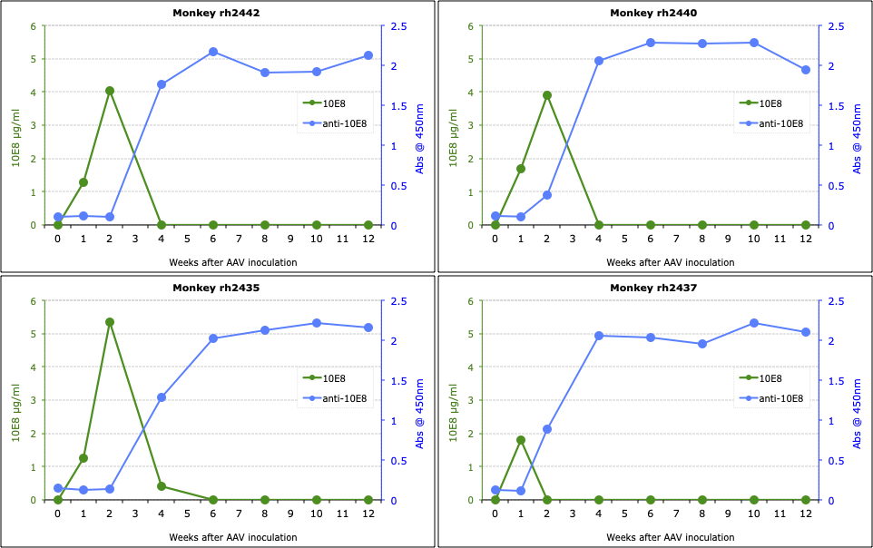
Remission, cure and vaccines | Cure approaches using broadly neutralizing antibodies (bNAbs)
These four monkeys did not achieve ART-free remission.
The immune system can perceive bNAbs as foreign – and produce anti-drug antibodies (ADAs) to them.
ADA responses emerge nine times out of 10 and are the main obstacle to consistent bNAb delivery.
ADA and antibody levels in four of the macaques
Stevenson SAT00704
Notes:
The ADAs shown were to the 10E8 bNAb and effectively suppressed it.
These four monkeys received the same 3 bNAbs as the animal that has achieved long-term viral suppression (see top row of the previous slide (rh2438). This too had undetectable levels of 10E8.
Session: https://programme.aids2024.org/Programme/Session/298

Slide 12
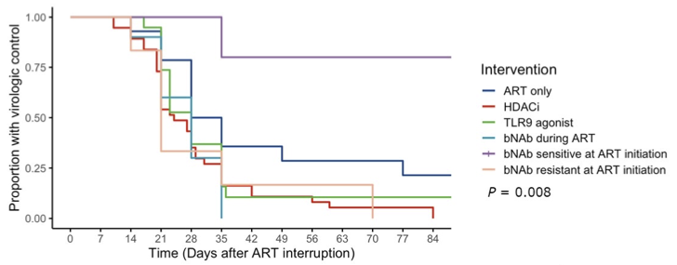
Remission, cure and vaccines | Cure approaches using broadly neutralizing antibodies (bNAbs)
A meta-analysis of six cure studies using bNAbs, with or without immune-modulating drugs, examined factors associated with loss of virologic control.
Interventions were effective only if participants were sensitive to bNAbs in pre-screening for resistance.
Time to loss of virologic control
Klastrup OAA0206LB
Notes:
Loss of virologic control was defined as restart of ART or two consecutive plasma HIV RNAs ≥5,000.
Abstract: https://programme.aids2024.org/Abstract/Abstract/?abstractid=11963
Session: https://programme.aids2024.org/Programme/Session/212

Slide 13
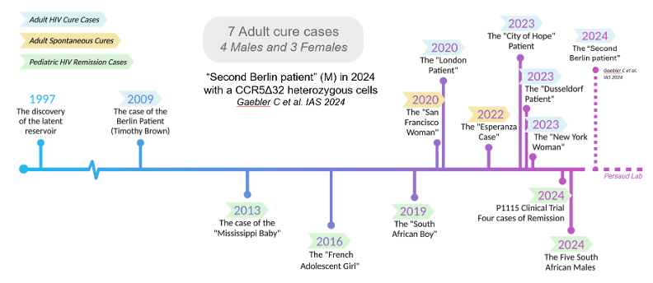
Remission, cure and vaccines | Cure approaches in children
Cure approaches in children
Several cases of cured children are a reminder that infants may have advantages when it comes to long-term viral suppression.
Timeline of HIV remission and cure cases
Persaud PC120103
Notes:
26 studies published between 2000 and 2023.
Session: https://programme.aids2024.org/Programme/Session/616

Slide 14
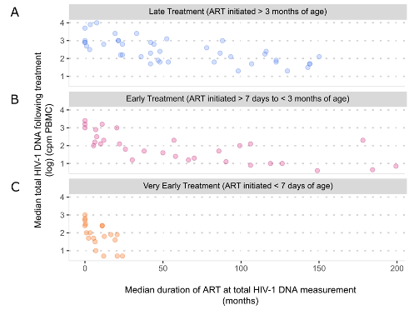
Remission, cure and vaccines | Cure approaches in children
Age at ART initiation and duration of virologic suppression influences proviral reservoir size in children with perinatally acquired HIV.
Studies highlight differences in reservoir dynamics:
In children compared with adults
By age at ART initiation
By duration of ART
HIV DNA levels in infants given ART
Persaud PC120103
Notes:
Graph: Bekka, S. et al. Current Opinion HIV/AIDS 2024.
Session: https://programme.aids2024.org/Programme/Session/616

Slide 15
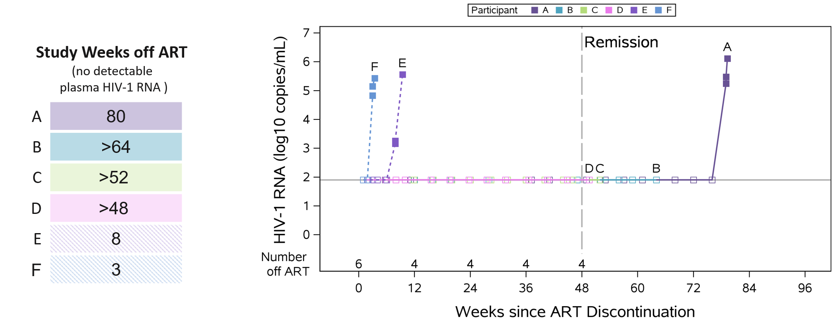
Remission, cure and vaccines | Cure approaches in children
IMPAACT P1115 study: four of six very-early-treated children, with durable virologic suppression, achieved ART-free remission with no viremic rebound for ≥48 weeks.
Sustained aviremia off ART (ART-free remission)
Presti SY20603
Notes:
See https://www.impaactnetwork.org/studies/p1115 for this study and https://www.thelancet.com/journals/lanhiv/article/PIIS2352-3018(23)00236-9/abstract for a journal article.
The study gave an intensive three-class ART regimen, starting within 48 hours of birth, to babies who had acquired HIV in the womb.
Infants who at age two had had undetectable RNA for over a year, were HIV-antibody negative, had no detectable HIV reservoir DNA, and normal CD4 counts and percentages, were eligible for an analytical treatment interruption (ATI). Six children underwent ATI after meeting the eligibility criteria. Four achieved ART-free remission.
This chart shows that two out of six cited here experienced rapid viral rebounds, one eventually rebounded after 80 weeks of viral suppression off ART, and three more have so far maintained viral suppression for at least 48 weeks without viral rebound.

Slide 16
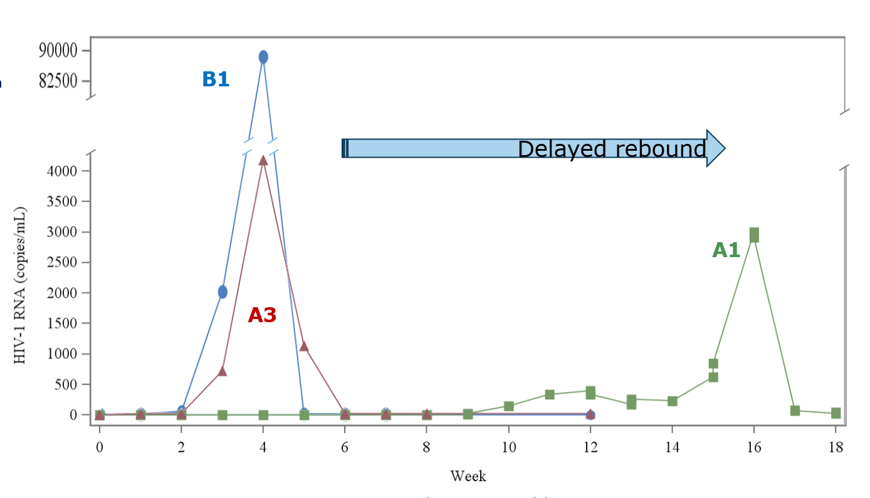
Remission, cure and vaccines | Cure approaches using genetic engineering
Cure approaches using genetic engineering
EBT-101 is the first human study using CRISPR/Cas9 technology to excise HIV proviral DNA from reservoir cells.
Following an analytic treatment interruption (ATI), one of four participants has had a delayed rebound. There is no data yet on two of the participants.
ATI results for HIV RNA levels off ART
Presti SY20603
Notes:
Results, Cohort A:
A1: delayed viral rebound for 16 weeks
A3 rebound at 4 weeks
B1 rebound at 3.5 weeks
Interpretation:
In historical comparison to other ATI studies (N > 280), ~87% of participants rebound by 6 weeks.
A1 is an outlier in that less than 2% of non-elite controllers have delayed viral rebound for > 16 weeks.

Slide 17
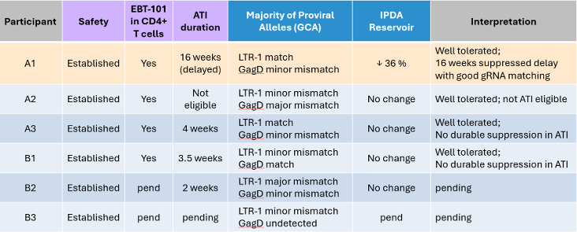
Remission, cure and vaccines | Cure approaches using genetic engineering
Results illustrate the difficulty of exactly matching the CRISPR/Cas9 gene probe with the host’s proviral DNA.
Two of six participants are probably not eligible for ATI due to mismatch.
Summary of results for each
EBT-101 study participant
Presti SY20603
Notes:
This slide shows that it is difficult to excise the exact piece of HIV genetic material. Two had major mismatches between what needed to be excised and what was. This made them ineligible for an ATI.
Minor mismatches do not so far seem to reduce the likelihood of subsequent viral suppression.
Of the others, only one out of six so far had a delay in virological rebound, of about three months, while two rebounded within a month. Results are still pending in the other two.
Session: https://programme.aids2024.org/Programme/Session/29

Slide 18
Remission, cure and vaccines | Cure approaches using genetic engineering
Caution is needed with CRISPR/Cas9 approaches.
CRISPR-Cas editing yields intended lesions (indels, excision) but also unintended large deletions in cellular DNA.
These large deletions have previously not been easy to detect.
Possible consequences of large deletions are:
Inactivation of HIV (what is desired)
Loss of cellular gene function
Activation of proto-oncogene (cancer induction – remote chance)
Inactivation tumor-suppressor gene (cancer induction – more likely)
CRISPR/Cas9 can lead to larger deletions than intended
Berkhout SY2602
title?
Notes:
Indel = insertion/deletion, i.e. the intended result

Slide 19
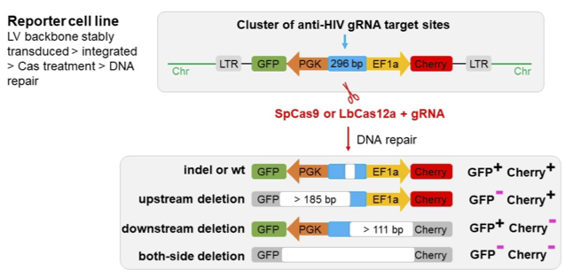
Remission, cure and vaccines | Cure approaches using genetic engineering
A new assay detected large deletions by inactivation of detector genes (GFP and cherry) inserted alongside Cas9.
New assay used to detect large deletions
Berkhout SY2602
Notes:
This slide shows the assay used to detect large deletions.
As well as the CRISP/Cas9 excision therapy, genetic engineering is also used to insert two indicator genes called GFP and cherry* at some distance from the HIV excision site.
In the first line (of four), the desired deletion is achieved and GFP and cherry remain active. Indel = insertion/deletion, i.e. the intended result.. Wt = unaltered viral DNA.
In the next three lines, a large deletion has reached as far as the indicator genes and thus inactivated one or both of them.
*The genes are named after the fluorescent proteins they produce, which glow under ultraviolet light (GFP = green fluorescent protein).

Slide 20
Remission, cure and vaccines | Cure approaches using genetic engineering
Assay showed that for every two intended editing events, there is one large deletion.
Robust results in different cell types:
For different clonal HIV cell lines (different integration site)
For Cas9 (blunt ends) and Cas12a (sticky ends) and all gRNAs
What’s needed?
Better CRISPR-Cas systems, which only result in excision, without any large deletions
Mouse oncogenesis studies to assess the risk of cancer
Close and long-term participant monitoring in all gene-editing trials
Berkhout SY2602

Slide 21
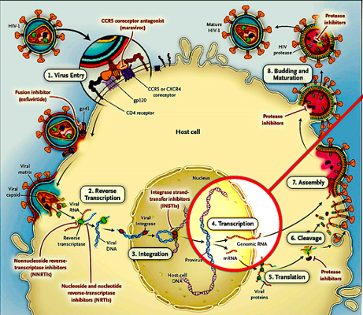
Remission, cure and vaccines | Cure approaches using transcription inhibition
Cure approaches using transcription inhibition
The latest research direction is transcription inhibition.
Findings from “block and lock” studies were presented at AIDS 2024.
HIV lifecycle
Ott PL0402
Notes:
First presented compilation of work from the HOPE collaboratory – see https://hopeforhivcure.org/ – which seeks to cure HIV through a novel “block, lock and excise” strategy. Essentially this involves developing therapies to target the one step in the HIV viral lifecycle that has so far not been targeted by inhibitory drugs – transcription, where new viral RNA is transcribed from the proviral DNA and this is then the template for new HIV proteins.
Session: https://programme.aids2024.org/Programme/Session/86

Slide 22
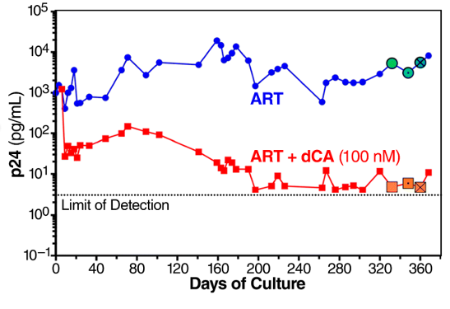
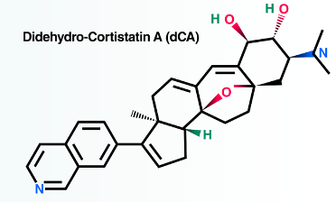
Remission, cure and vaccines | Cure approaches using transcription inhibition
Strategy 1: Tat inhibition with drugs
Tat protein turbocharges replication – dCA stops tat
Didehydro-cortistatin A (dCA)
Adding DCA to cell culture reduces HIV replication by 3 logs
Ott PL0402
Notes:
The tat protein is expressed very early on in HIV’s lifecycle and binds to host proteins that regulate cell division in order to tremendously accelerate the transcription of HIV, which otherwise happens very slowly.
Didehydro-cortistatin A (dCA) is a tat inhibitor that has been investigated since 2012 and which reduces HIV replication in cell cultures 100-fold better than ART alone.
Unfortunately, it is a natural product, found in an Indonesian sponge, and very hard to synthesise.
Session: https://programme.aids2024.org/Programme/Session/86

Slide 23
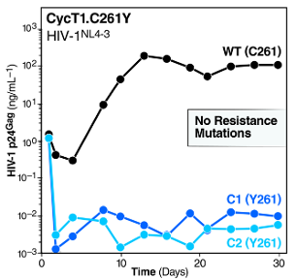
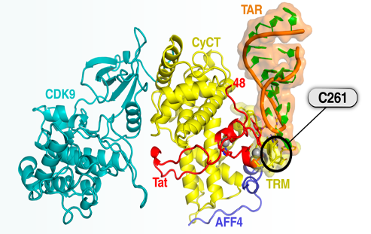
Remission, cure and vaccines | Cure approaches using transcription inhibition
Strategy 2: Genetic engineering to alter host protein to become non-receptive to tat
Focus on Cyclin T1 within the SEC (superelongation complex of host proteins that regulate gene transcription and cell division)
A crucial cysteine amino acid (C261) is essential for tat binding to the SEC. Mice have tyrosine (Y261) in this position instead and are insensitive to tat.
Genetic engineering alters host protein to become non-receptive to tat
Y261 reduces HIV replication in cell cultures by over 4 logs
Ott PL0402
Notes:
SEC = superelongation complex of host proteins that regulate gene transcription and cell division.
A crucial cysteine amino acid (C261) in the human cyclin protein, which regulates cell division, is essential for tat binding. Mice have tyrosine (Y261) in this position instead and are insensitive to tat. Genetic engineering could make cells resistant to transcription, in the same way as deleting CCR5 makes them resistant to infection.
Session: https://programme.aids2024.org/Programme/Session/86

Slide 24
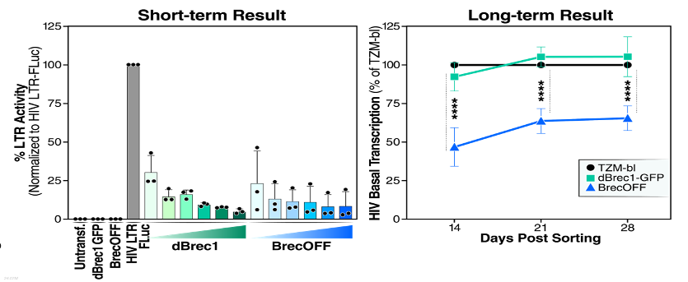
Remission, cure and vaccines | Cure approaches using transcription inhibition
Strategy 3: Epigenetic engineering to induce the same long-term changes in genome conformation seen in “fossil retroviruses” and some post-treatment controllers
Inserting BrecOFF leads to inhibition of HIV transcription.
Gene activation with different concentrations of dBrec1 and BrecOFF
Gene activation at weeks 2, 3 and 4
Ott PL0402
Notes:
BREC1 is a ’tagging’ protein that induces short-term histone acetylisation, locking host chromosomal DNA into a non-receptive conformation (the opposite of what HDAC inhibitors do).
Adding various other components turns it into BrecOFF. Inserting BrecOFF leads to inhibition of HIV transcription.
So far transcription of HIV RNA has been reduced by over 40% for a month after BrecOFF therapy was discontinued, with no sign of a fall-off in its effect yet.
Session: https://programme.aids2024.org/Programme/Session/86

Slide 25
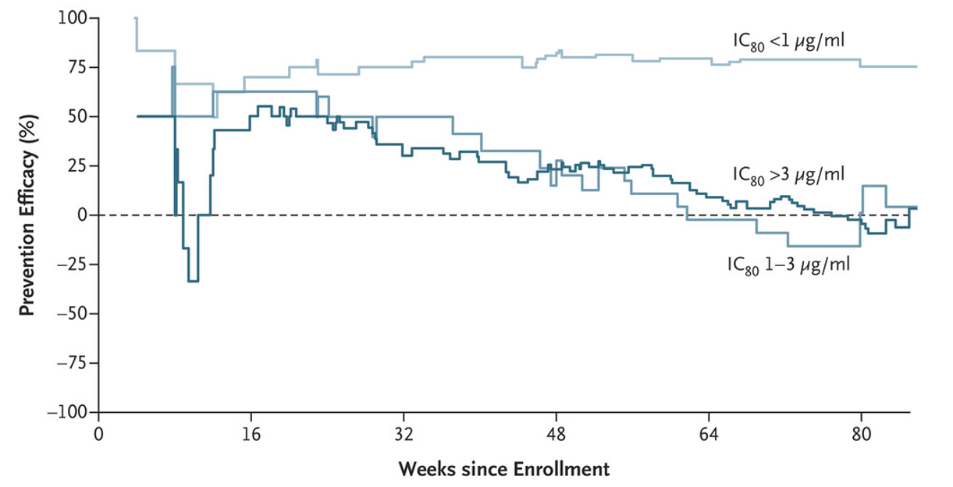
Remission, cure and vaccines | The search for an HIV vaccine
The search for an HIV vaccine
The Antibody Mediated Prevention (AMP) trial showed that broadly neutralizing antibodies (bNAbs) can prevent HIV acquisition – with 75% efficacy – but only against viruses that were sensitive to the particular bNAb used (VRC01).
Antibody Mediated Prevention (AMP) trial results
Sok PL0302
Notes:
The recently completed AMP trial showed 75% protective efficacy for individuals who received the broadly neutralizing antibody VRC01 and were exposed to viruses that were sensitive to that neutralizing antibody. Sensitive means the antibody is able to neutralize (or prevent the virus from infecting target cells) at low concentrations.

Slide 26
Remission, cure and vaccines | The search for an HIV vaccine
Key takeaways from AMP:
bNAbs can protect against HIV.
Relatively high amounts of bNAbs are needed to be elicited by vaccination.
bNAbs need to be present for a long time to ensure durable protection.
Multiple bNAbs targeting different epitopes are needed to increase neutralization coverage.
Antibodies need to be produced before infection occurs (before proviral DNA integration).
This would imply a vaccine that can produce true “sterilizing immunity” – no infection – as opposed to most vaccines, which enhance the immune response to an infection.
Sok PL0302
Notes:
This summary is from the notes in Devin Sok’s presentation and from conversation with him afterwards.

Slide 27
Remission, cure and vaccines | The search for an HIV vaccine
Germline targeting involves “training” cells to have the capacity to produce the right antibodies, in the right concentration, fast enough, in response to HIV.
The germline challenge: Selecting for something specific and rare
Sok PL0302
Notes:
Devin Sok used the metaphor of training immature cells with the capacity to produce bNAbs with repeated immunogens to turn them into “elite athletes”.

Slide 28
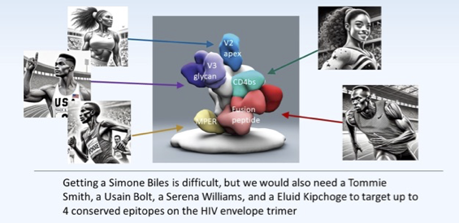
Remission, cure and vaccines | The search for an HIV vaccine
An elite team of bNAbs will be needed for an efficacious vaccine.
Vaccines need to elicit bNAbs to different parts of the HIV envelope – not just the CD4 binding site, which is the epitope (immunogenic sequence) targeted by VRC01.
An elite team of bNAbs
Sok PL0302
Notes:
Sok’s notes: “We also can’t stop at Simone Biles.
“We similar need to identify and cultivate bnAbs against multiple epitopes on HIV.
“We anticipate needing up to 4 different bnAbs elicited by vaccination for an efficacious vaccine.
“Having any one of these elite athletes is already a major accomplishment, but we need a whole team – that hopefully highlights the magnitude of the challenge ahead of us.”

Slide 29
Remission, cure and vaccines | The search for an HIV vaccine
IAVI G002 trial asked if VRC01-class B cells can be primed using mRNA and if those responses can be boosted.
Main takeaways:
mRNA responses look better (higher numbers of VRC01-class and greater resemblance to VRC01) than protein in G001.
The study demonstrated clinical proof of principle for boosting responses.
IAVI C101 trial asked if VRCO1-class B cells can be primed using a recombinant trimer.
Main takeaways:
Serum antibodies targeting the right epitope were detected in 72% of high-dose recipients.
Monoclonal antibodies from B cells of selected participants can neutralize HIV.
Sok PL0302 / Caniels SY4102
Notes:
IAVI G002: Unpublished data from the IAVI G002 trial show that a second round of boosting elicits B-cells with stronger and more specific capacity to produce the VRC01 bNAb.
See https://www.aidsmap.com/news/dec-2022/revolutionary-hiv-vaccine-trains-immune-system-passes-its-first-hurdle for a summary of the G001 trial.
The G003 trial is also underway in Rwanda and South Africa and shows evidence that similar responses can be elicited in African populations. The G002 was a follow-on trial to test two things: 1) can delivery by mRNA work as well as by a protein, and 2) can we start boosting those responses to become bNAbs?
IAVI C101: The kind of germline-targeting repeated immunogens used in the germline-targeting approach are not the only one under trial: the IAVI C101 study (presented in more detail by Tom Caniels at AIDS 2024:
https://programme.aids2024.org/Programme/Session/717) involves using a recombinant trimer – the whole gp120 HIV envelope protein presented in a stabilized form.
Session (Caniels): https://programme.aids2024.org/Programme/Session/717

Slide 30
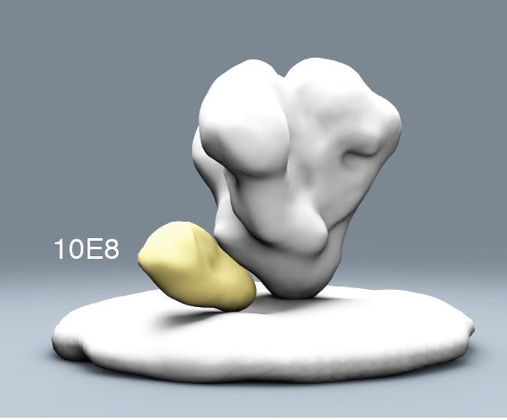
Remission, cure and vaccines | The search for an HIV vaccine
HVTN133 asked if bNAbs can be primed and boosted to the membrane-proximal external region (MPER).
Main takeaways:
Monoclonal antibodies from B-cells showed neutralization of HIV (15% cross-clade breadth).
There was evidence of bNAb lineage after two immunizations.
Membrane-proximal external region (MPER)
Sok PL0302
Notes:
The HVTN 133 study shows evidence of similar progress with a vaccine eliciting antibodies against another part of the HIV envelope – the membrane-proximal external region (MPER). See https://www.aidsmap.com/news/sep-2023/antibodies-wait-and-pounce-generated-promising-hiv-vaccine-candidate for report on HVTN 133.

Slide 31
Remission, cure and vaccines | The search for an HIV vaccine
T-cell vaccine development: We will likely need both B- and T-cell responses as part of an efficacious vaccine.
Incorporate artificial intelligence/machine learning to guide vaccine development.
Invest in new platforms and approaches for T-cell vaccine development.
Integrate T- and B-cell vaccine trials.
Devin Sok. © Marcus Rose / IAS
Sok PL0302
Notes:
This note added from a conversation with Devin Sok after his plenary talk:
A completely effective vaccine that stops infection – that induces “sterilizing immunity” – is uncommon (one example is the HPV vaccine). Even the best bNAb-inducing vaccines may let some HIV strains through.
We may also need to develop vaccines that develop T-cell immunity. These induce T-cell (CD8) responses that kill off the few cells that HIV may succeed in infecting, but these will need to be far more prompt, effective, specific and varied than natural T-cell responses.
T-cell vaccine science is at an earlier stage of development than bNAb-inducing vaccines but a partially effective vaccine was developed for monkeys back in 2011 (see https://www.nature.com/articles/nature10003).
Although results were not presented at AIDS 2024, there is ongoing collaborative work between IAVI, the Ragon institute, the Gates Foundation and others to develop a T-cell vaccine and phase I trials in humans are ongoing.
See, for examples:
https://www.nature.com/articles/s41541-024-00818-y
https://www.iavi.org/press-release/reithera-srl-the-ragon-institute-and-iavi-announce-collaboration-to-advance-highly-networked-t-cell-hiv-vaccine-candidate-towards-phase-i-clinical-evaluation/

Slide 32
Remission, cure and vaccines | The search for an HIV vaccine
While we may seem no nearer to an HIV vaccine than we were 10 years ago, we now have the knowledge, experience and tools to accelerate vaccine research and pursue multiple strategies in a way we never could before.
Innovation as the engine for acceleration to a vaccine
Sok PL0302

Slide 33
Antiretroviral therapy
(ART)
34 Bictegravir + lenacapavir >
38 Cabotegravir + rilpivirine for adolescents >
41 Abacavir and cardiovascular health >
44 Weight gain >
47 Switching to reduce sleep problems >

Slide 34
Antiretroviral therapy (ART) | Bictegravir + lenacapavir
Bictegravir + lenacapavir
A randomized controlled trial evaluated the novel combination of daily oral bictegravir + lenacapavir compared to remaining on a stable, complex baseline regimen.
At baseline, all participants were virally suppressed on “complex” ART regimens.
Bictegravir and lenacapavir both have a high barrier to resistance, limited potential for drug interactions and no food requirements.
NewAfrica/Depositphotos
Segal-Maurer OAB2602
Notes:
This study is known as ARTISTRY-1.
Abstract: https://programme.aids2024.org/Abstract/Abstract/?abstractid=1
Session: https://programme.aids2024.org/Programme/Session/229

Slide 35
Antiretroviral therapy (ART) | Bictegravir + lenacapavir
This Phase II randomized, open-label study included two different bictegravir and lenacapavir regimens.
The primary outcome was HIV-1 RNA <50 copies/mL at week 48.
The study had 128 participants in 15 countries: 19% female, 65% White.
It was an older cohort (median age 60), with significant experience of ART (median 27 years, median six previous regimens) and a high prevalence of co-morbidities.
Study design
Segal-Maurer OAB2602
Notes:
The participants were randomly assigned in a 2:2:1 ratio.
24-week outcome data were presented at CROI 2024 (#642).
While lenacapavir is better known as a long-acting injectable, it was taken as a daily oral medication in this study.
92 study locations in United States, Canada, Australia, western Europe (France, Germany, Italy, Spain, United Kingdom), Asia (Japan, Korea, Taiwan), Argentina, Dominican Republic, Puerto Rico, South Africa.
Common co-morbidities included dyslipidemia (75%), diabetes mellitus (69%), hypertension (61%) and chronic kidney disease (23%).
Abstract: https://programme.aids2024.org/Abstract/Abstract/?abstractid=1
Session: https://programme.aids2024.org/Programme/Session/229

Slide 36
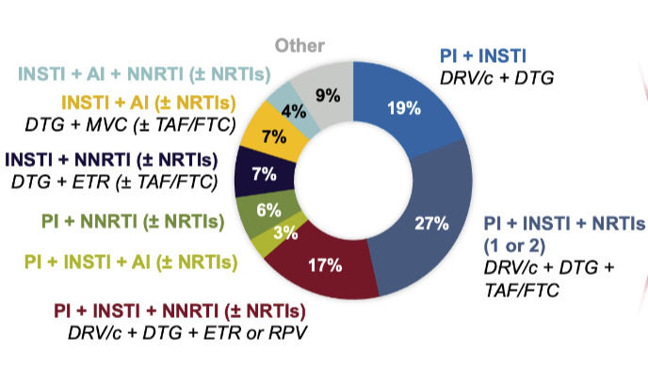
Antiretroviral therapy (ART) | Bictegravir + lenacapavir
The study participants were taking complex ART regimens:
38% were taking four or more pills a day.
41% were taking ART twice daily.
72% were taking boosted protease inhibitors, often in combination with an integrase inhibitor.
Historical resistance mutations were common: 52% to NNRTIs, 64% to NRTIs, 36% to protease inhibitors, but 0% to integrase inhibitors.
Baseline ART regimens
Segal-Maurer OAB2602
Notes:
Eligible participants had achieved viral suppression on “complex regimens”. These were defined as two or more pills per day, more than once-daily dosing, a boosted protease inhibitor or NNRTI with one or more additional drugs besides NRTIs, or a combination that included both injectable and oral drugs.
Bictegravir and lenacapavir both have a high barrier to resistance. Lenacapavir is a first-in-class capsid inhibitor.
Abstract: https://programme.aids2024.org/Abstract/Abstract/?abstractid=1
Session: https://programme.aids2024.org/Programme/Session/229

Slide 37
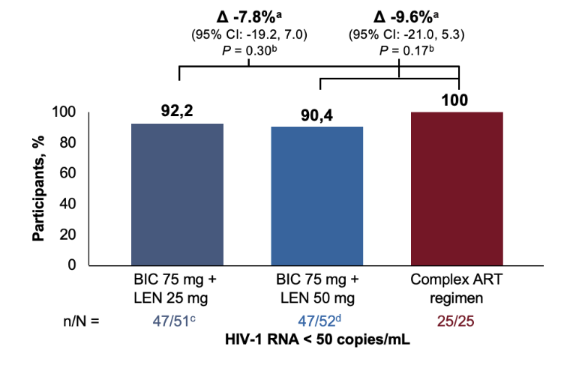
Antiretroviral therapy (ART) | Bictegravir + lenacapavir
There were no statistically significant differences in virological suppression between study arms at Week 48.
Bictegravir + lenacapavir was generally safe and well tolerated.
A larger Phase III study is now evaluating a single-tablet regimen of bictegravir 75mg + lenacapavir 50mg.
Virologic suppression at Week 48
Segal-Maurer OAB2602
Notes:
Efficacy: 47 of the 51 people (92%) in the 75mg bictegravir plus 25mg lenacapavir group and 47 of the 52 people (90%) in the 75mg bictegravir plus 50mg lenacapavir group had a viral load below 50, as did everyone who stayed on their baseline regimen. Two people taking the lower lenacapavir dose and one person taking the higher lenacapavir dose had HIV RNA above this threshold but regained viral suppression without changing treatment.
Changes in CD4 counts were comparable across the three groups.
Adverse events: Proportion with one or more grade 3 or higher treatment-emergent adverse events were 13.7% in the lenacapavir 25mg arm, 7.7% in the lenacapavir 50mg arm, and 4.0% in the complex-regimen arm. Proportions with one or more such events leading to stopping a drug early were 2.0%, 1.9%, and 0%, respectively.
The most common adverse events after starting treatment were COVID-19, upper respiratory tract infections, diarrhoea, joint pain and cough.
The phase 3 ARTISTRY-2 study is recruiting people who are virally suppressed on bictegravir triple therapy (Biktarvy), who will either continue their current regimen or switch to bictegravir 75mg + lenacapavir 50mg.
Abstract: https://programme.aids2024.org/Abstract/Abstract/?abstractid=1
Session: https://programme.aids2024.org/Programme/Session/229

Slide 38
Antiretroviral therapy (ART) | Cabotegravir + rilpivirine for adolescents
Cabotegravir + rilpivirine for adolescents
Injectable cabotegravir + rilpivirine is the first long-acting combination ART approved, but data on use by adolescents are limited.
As some adolescents living with HIV face challenges with adherence and stigma, a long-acting regimen could have benefits.
This single-arm Phase I/II trial reported outcome data among 144 virologically suppressed adolescents who switched to the regimen and were followed for 48 weeks.
Study sites were in Botswana, South Africa, Uganda, Thailand and the United States.
The median age was 15 (range: 12-17), 51% were female and 92% had acquired HIV vertically.
Gaur OAB2606LB
Notes:
Approval by the US Food & Drug Administration (FDA) was based on findings from an earlier cohort from this study with 23 participants and 16-week data. A submission to the European Medicines Agency (EMA) will include the new data.
This study is known as IMPAACT 2017 or MOCHA (More Options for Children and Adolescents).
144 adolescents switched from an oral antiretroviral combination to oral cabotegravir + rilpivirine for four weeks, then received injected adult doses from week 4, every eight weeks.
Average BMI 20kg/m2 and weight 48kg.
Abstract: https://programme.aids2024.org/Abstract/Abstract/?abstractid=12058
Session: https://programme.aids2024.org/Programme/Session/229

Slide 39
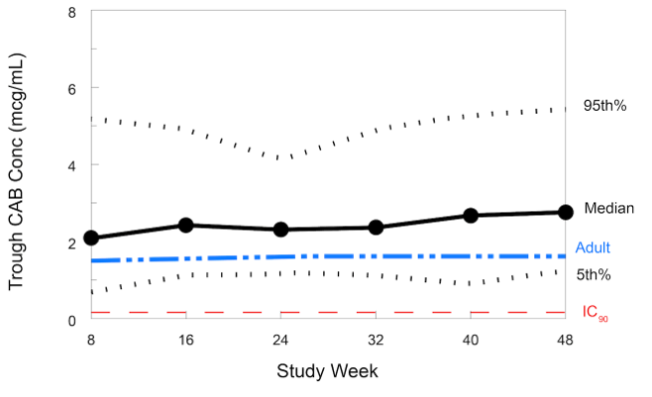
Antiretroviral therapy (ART) | Cabotegravir + rilpivirine for adolescents
At week 48, 97% of participants had received all planned injections.
97% had HIV RNA <50 copies/mL, with no confirmed virologic failures.
Pharmacokinetics: trough levels were similar to those in adults.
Pharmacokinetics
Gaur OAB2606LB
Notes:
All participants whose viral load was measured at week 48 were <50 copies/mL. The 97% figure reflects the fact that not all participants attended at week 48.
Abstract: https://programme.aids2024.org/Abstract/Abstract/?abstractid=12058
Session: https://programme.aids2024.org/Programme/Session/229

Slide 40
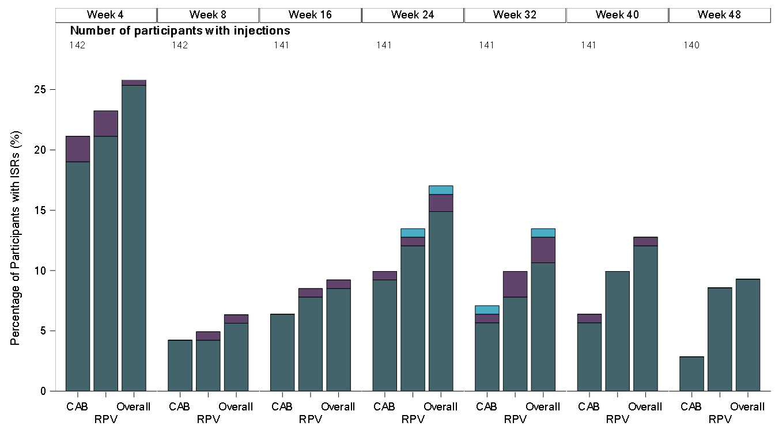
Antiretroviral therapy (ART) | Cabotegravir + rilpivirine for adolescents
There were no unexpected safety events or drug-related serious adverse events.
34% had injection site reactions (mostly Grade 1 and mostly resolving within seven days).
While pain was commonly reported following injection, 100% of participants preferred the long-acting injectable regimen over oral ART.
Injection site reactions
Gaur OAB2606LB
Notes:
No drug-related serious adverse events. 34% had injection site reactions (mostly grade 1 and mostly resolving within seven days). No deaths or life-threatening events.
The study will continue to collect data up to 96 weeks.
Abstract: https://programme.aids2024.org/Abstract/Abstract/?abstractid=12058
Session: https://programme.aids2024.org/Programme/Session/229

Slide 41
Antiretroviral therapy (ART) | Abacavir and cardiovascular health
Abacavir and cardiovascular health
Data from the REPRIEVE study evaluated the role of prior and current use of ART on development of major cardiovascular events (MACE).
Some previous studies have linked recent and cumulative use of abacavir with cardiovascular disease, but it remains a preferred regimen in some guidelines.
REPRIEVE recruited a diverse, global cohort of people with HIV aged 40-75:
Participants were at low to moderate risk of cardiovascular disease.
Participants were taking a range of contemporary antiretroviral regimens.
Incidence of cardiovascular events was carefully monitored.
Fichtenbaum OAB3406LB
Notes:
REPRIEVE was a randomized, double-blind study that demonstrated a 36% reduction in major adverse cardiovascular events (MACE) in people living with HIV assigned to pitavastatin compared to placebo. Results were first reported at IAS 2023. The study provides a unique opportunity to assess the impact of ART on cardiovascular disease.
Abstract: https://programme.aids2024.org/Abstract/Abstract/?abstractid=11856

Slide 42
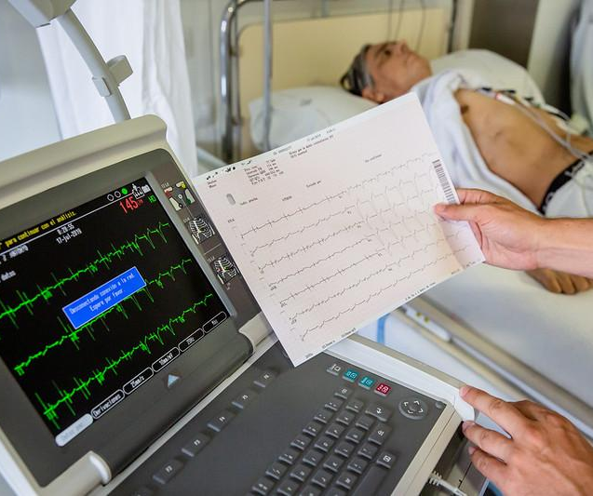
Antiretroviral therapy (ART) | Abacavir and cardiovascular health
The study included 7,769 participants, 88% virally suppressed, median 50 years, 31% female and 35% White.
The outcome of interest was major adverse cardiovascular events (MACE), including myocardial infarction, stroke, revascularization, peripheral artery disease and cardiovascular death.
The median follow-up was 5.6 years with a median duration of ART use of 9.5 years.
22% of participants had taken abacavir: 9% previously (median three years) and 13% at baseline (median 1.5 years).
Image to come
Ariadna Creus i Àngel García. CC BY-NC-ND 2.0
Fichtenbaum OAB3406LB
Notes:
Abstract: https://programme.aids2024.org/Abstract/Abstract/?abstractid=11856

Slide 43
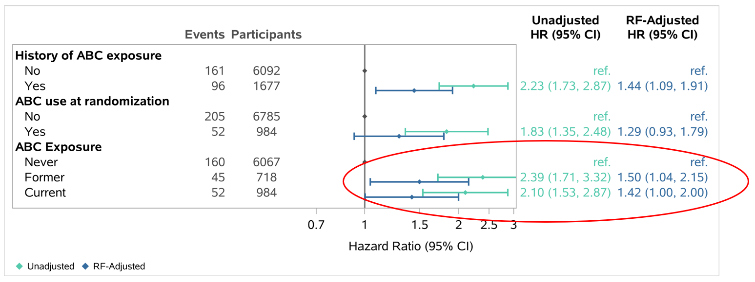
Antiretroviral therapy (ART) | Abacavir and cardiovascular health
Participants with prior and current use of abacavir had a 50% and 42% increased incidence of MACE, respectively, compared with participants with no abacavir exposure, after adjustment.
Cardiovascular events were not associated with exposure to other selected antiretrovirals:
Protease inhibitors
Tenofovir disoproxil
Zidovudine or stavudine (thymidine analogues)
Abacavir exposure and MACE
RF= Risk factor
Fichtenbaum OAB3406LB
Notes:
Abstract: https://programme.aids2024.org/Abstract/Abstract/?abstractid=11856

Slide 44
Antiretroviral therapy (ART) | Weight gain
Weight gain
New insights into weight gain came from a randomized study comparing two switch strategies:
Dolutegravir/lamivudine (Dovato)
Bictegravir/emtricitabine/tenofovir alafenamide (Biktarvy)
These are preferred regimens in some guidelines – but until now, no large trials have compared them.
This multicentre Spanish study recruited 533 virologically suppressed individuals whose current regimen included efavirenz, tenofovir disoproxil, cobicistat or more than one pill.
People with hepatitis B, previous virological failure, resistance, and previous dolutegravir or bictegravir use were excluded.
The median age was 50, 27% were female and 73% White, with a median 11 years on ART.
Baseline median BMI was 25kg/m².
Martinez OAB3606LB
Notes:
The study is known as PASO-DOBLE.
Dolutegravir, bictegravir and tenofovir alafenamide (TAF) have each been associated with weight gain, but their role remains controversial.
Abstract: https://programme.aids2024.org/Abstract/Abstract/?abstractid=12253

Slide 45
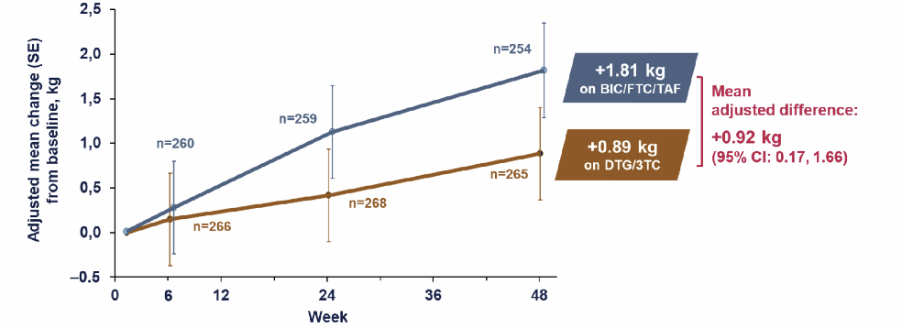
Antiretroviral therapy (ART) | Weight gain
In terms of virologic efficacy at 48 weeks, dolutegravir/lamivudine (DTG/3TC) was non-inferior to bictegravir/emtricitabine/ tenofovir alafenamide (BIC/FTC/TAF).
At 48 weeks, there was more weight gain (0.92kg) with the bictegravir-based regimen compared to dolutegravir/lamivudine.
Weight change from baseline at week 48
Martinez OAB3606LB
Notes:
More details on virological efficacy (the study’s primary outcome): in the DTG/3TC arm 2.2% HIV RNA >50 copies/mL; in the BIC/FTC/TAF arm 0.7% HIV RNA >50 copies/mL. Risk difference: 1.4%, 95%CI -0.5 to 3.4.
The evidence that TAF causes more weight gain than other ARVs remains indirect, since the intervention also was a switch away from TDF.
Abstract: https://programme.aids2024.org/Abstract/Abstract/?abstractid=12253

Slide 46
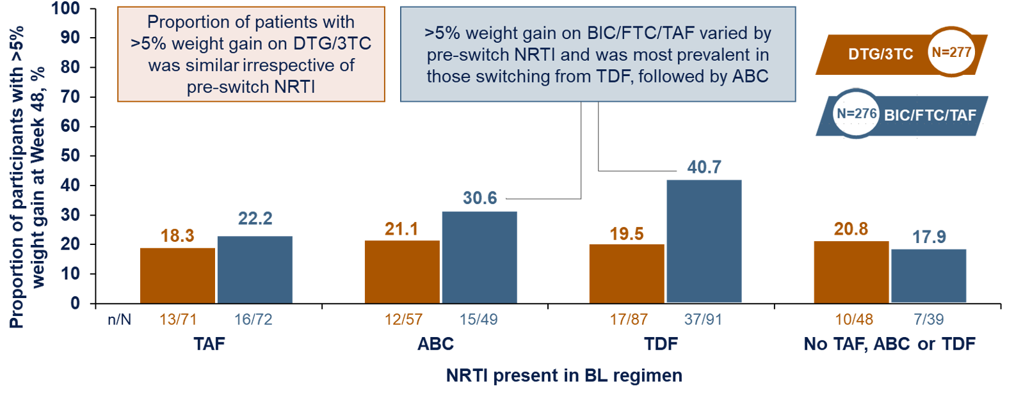
Antiretroviral therapy (ART) | Weight gain
Weight gain was influenced by the NRTIs in previous regimens.
The proportion of participants with >5% weight gain at week 48 was:
20% on DTG/3TC vs 30% on BIC/FTC/TAF (all participants)
20% on DTG/3TC vs 41% on BIC/FTC/TAF (participants previously taking TDF)
21% on DTG/3TC vs 31% on BIC/FTC/TAF (participants previously taking abacavir)
Proportion of participants with weight gain >5%, stratified by BL NRTI
Martinez OAB3606LB
Notes:
The evidence that TAF causes more weight gain than other ARVs remains indirect, since the intervention also was a switch away from TDF.
DTG/3TC = dolutegravir / lamivudine.
BIC/FTC/TAF = bictegravir / emtricitabine / tenofovir alafenamide.
Abstract: https://programme.aids2024.org/Abstract/Abstract/?abstractid=12253

Slide 47
Antiretroviral therapy (ART) | Switching to reduce sleep problems
Switching to reduce sleep problems
The use of integrase inhibitors has been associated with sleep disturbances in people living with HIV.
This exploratory pilot study assessed changes in brain activity when switching integrase inhibitors from dolutegravir to bictegravir.
This open-label, pilot study in the UK had 19 male participants.
All participants were virally suppressed on a dolutegravir-based regimen and had symptoms of insomnia.
Participants were randomized to remain on dolutegravir (12 people) or switch to bictegravir (seven people).
Outcomes were assessed at baseline and after 120 days.
Henderson OAB3605
Notes:
United Kingdom study with 100% male participants, 89% White, median age 55, median 11 years with diagnosed HIV.
For more information on how insomnia was assessed, see https://www.ons.org/sites/default/files/InsomniaSeverityIndex_ISI.pdf
To be eligible, participants had a score of 8 or above.
The results should be interpreted with caution, due to the small sample size, being open label (risk of bias, especially in patient-reported outcomes) and lack of diversity in study population.
Abstract: https://programme.aids2024.org/Abstract/Abstract/?abstractid=822

Slide 48
Antiretroviral therapy (ART) | Switching to reduce sleep problems
There were improvements in sleep and quality of life in bictegravir arm compared with the dolutegravir arm, according to some (but not all) measures.
Resting state cerebral functional MRI (provides information on how brain regions interact with each other): increased functional connectivity.
Inflammatory biomarkers associated with neuronal activation and inflammation: no significant changes.
Findings suggest improved sleep in those switching to a bictegravir-based regimen, but should be interpreted with caution.
Enhanced functional connectivity in those switched to bictegravir
Henderson OAB3605
Notes:
Patient-reported outcomes assessed sleep, quality of life and food cravings. 3 of 8 questionnaires showed an improvement in the bictegravir arm.
Cerebral functional MRI measures brain activity through changes in blood oxygenation which can be detected by MRI as a signal. These signals allow researchers to create brain activation maps which provides information on how brain regions interact with each other, called functional connectivity.
As demonstrated in the figure, switching to the bictegravir regimen was associated with increased functional connectivity in the default mode network, which was most pronounced in the middle temporal and superior frontal gyri. The areas of orange indicate the location of the default mode network and the yellow indicates areas of increased functional connectivity.
The findings should be interpreted with caution:
Small sample, not evenly matched
Open label – potential bias in patient reported outcomes
Lack of diversity in sample
Abstract: https://programme.aids2024.org/Abstract/Abstract/?abstractid=822

Slide 49
HIV and STI prevention
50 Long-acting lenacapavir PrEP >
59 HIV testing for people taking cabotegravir PrEP >
61 Cabotegravir PrEP in pregnancy >
64 DoxyPrEP >
67 STI testing frequency in PrEP users >

Slide 50
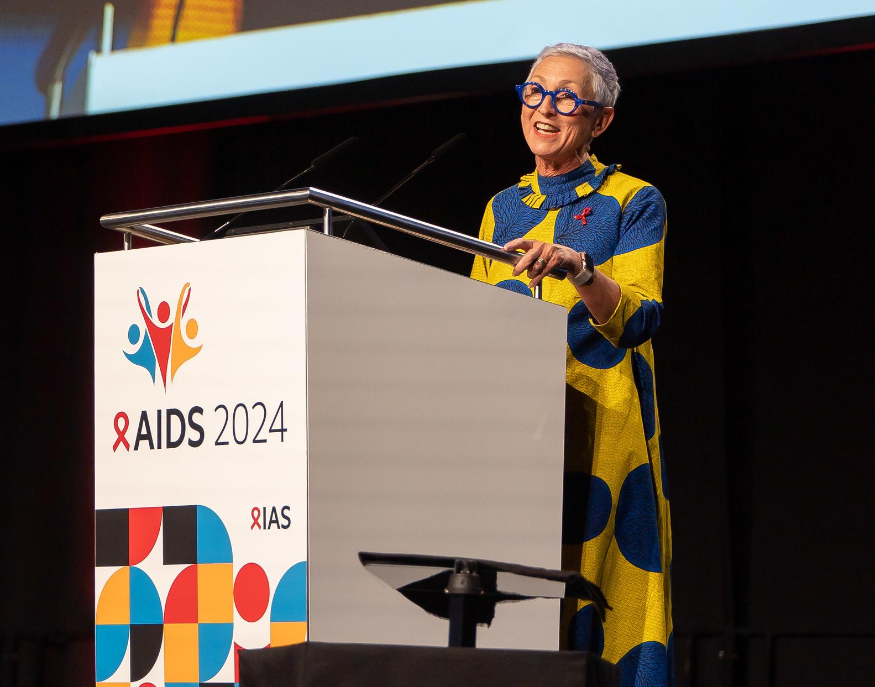
HIV and STI prevention | Long-acting lenacapavir PrEP
Long-acting lenacapavir PrEP
A double-blinded randomized control trial evaluated three PrEP options, including long-acting lenacapavir.
Lenacapavir is a novel capsid inhibitor with a long half-life, administered by subcutaneous injection every six months.
The study recruited 5,338 young women aged 16-25 in South Africa and Uganda.
Women report challenges maintaining consistent adherence to daily oral PrEP.
Linda-Gail Bekker. © Gonzalo Bell / IAS
Bekker SS0407
Notes:
This study is known as PURPOSE 1.
Results were simultaneously published in The New England Journal of Medicine: https://www.nejm.org/doi/10.1056/NEJMoa2407001

Slide 51
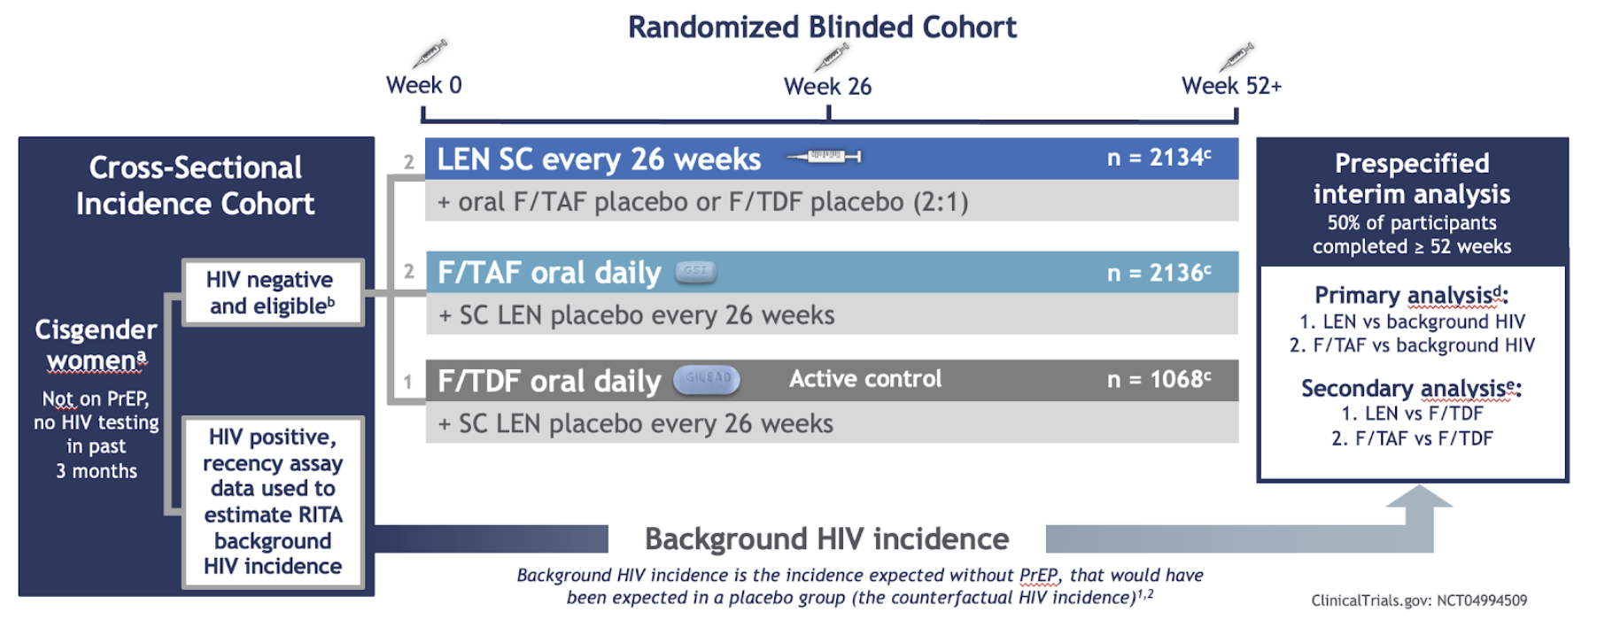
HIV and STI prevention | Long-acting lenacapavir PrEP
Participants were randomized 2:2:1 to receive either:
Lenacapavir injections every six months (LEN SC)
Daily oral emtricitabine and tenofovir alafenamide (F/TAF)
Daily oral emtricitabine and tenofovir disoproxil fumarate (F/TDF)
Study design
Bekker SS0407
Notes:
All participants also received an injectable placebo or an oral placebo. No participants received only a placebo.
Results were simultaneously published in The New England Journal of Medicine: https://www.nejm.org/doi/10.1056/NEJMoa2407001

Slide 52
HIV and STI prevention | Long-acting lenacapavir PrEP
Due to efficacy of oral PrEP, it would have been unethical for some participants to receive only a placebo.
The primary analysis compared HIV incidence with the estimated background incidence in the screened population.
Potential participants who tested HIV positive at screening were assessed for recency of acquisition; these data were used to estimate the background HIV incidence.
The secondary analysis compared HIV incidence with incidence in participants receiving F/TDF.
Bekker SS0407
Notes:
Results were simultaneously published in The New England Journal of Medicine: https://www.nejm.org/doi/10.1056/NEJMoa2407001

Slide 53
HIV and STI prevention | Long-acting lenacapavir PrEP
As well as evaluating lenacapavir, this is the first study to provide data on daily oral emtricitabine and tenofovir alafenamide (F/TAF) in women.
This PrEP option has been previously tested only in men who have sex with men and trans women.
Study design
Bekker SS0407
Notes:
Results were simultaneously published in The New England Journal of Medicine: https://www.nejm.org/doi/10.1056/NEJMoa2407001

Slide 54
HIV and STI prevention | Long-acting lenacapavir PrEP
There were 5,338 participants in the study: median age was 21, 99.9% were Black, 92% single.
The group was vulnerable to HIV acquisition:
Over a third tested positive for a sexually transmitted infections at study entry.
Background HIV incidence was 2.41 per 100 person-years.
Global Fund. CC BY 2.0.
Bekker SS0407
Notes:
The interim analysis occurred in May 2024 when 50% of the randomly assigned participants had completed at least 52 weeks of follow-up.
Results were simultaneously published in The New England Journal of Medicine: https://www.nejm.org/doi/10.1056/NEJMoa2407001

Slide 55
HIV and STI prevention | Long-acting lenacapavir PrEP
55 study participants acquired HIV – but none were in the lenacapavir arm.
Lenacapavir reduced HIV incidence by:
100% as compared with background HIV incidence
100% as compared with F/TDF
However, HIV incidence with F/TAF was not significantly different from background HIV incidence or from incidence with F/TDF.
HIV incidence
Bekker SS0407
Notes:
The graphic shows that after a year on their assigned PrEP regimen, there were zero new infections among the 2,134 women who received lenacapavir, 39 among the 2,136 women who received F/TAF and 16 among the 1,068 participants assigned to F/TDF. The corresponding HIV incidence rates were 0.00, 2.02 and 1.69 per 100 person-years, respectively.
The numerical differences in the number of infections in F/TAF and F/TDF arms were not statistically significant – in other words, are likely due to chance.
The study helps fill the data gap on F/TAF PrEP for cisgender women and others exposed to HIV via vaginal sex.
Results were simultaneously published in The New England Journal of Medicine: https://www.nejm.org/doi/10.1056/NEJMoa2407001

Slide 56
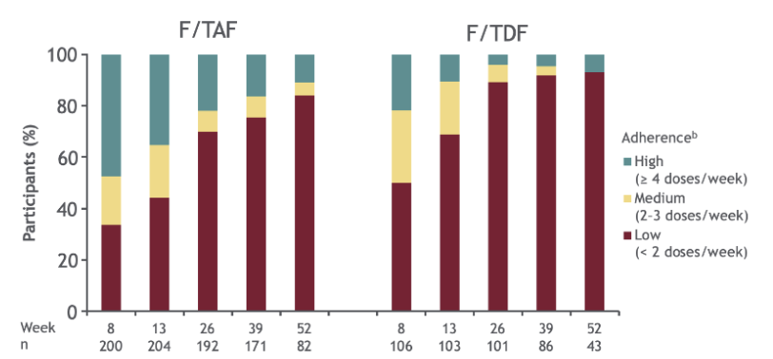
HIV and STI prevention | Long-acting lenacapavir PrEP
92% of lenacapavir injections were on time.
In contrast, adherence to oral PrEP was low and decreased over time.
Poor adherence explains the poor results for the two oral PrEP arms.
Participants with medium or high adherence to oral PrEP were less likely to acquire HIV than those with low adherence.
Adherence to tenofovir
Bekker SS0407
Notes:
Injections were on time for 91.5% (4545/4967) at week 26 and 92.8% (2025/2181) at week 52.
In the F/TAF arm, there was a lower likelihood of HIV infection in participants with medium or high adherence to F/TAF (>2 doses/week) compared with low adherence (odds ratio 0.11; 95% CI 0.012-0.49; P = 0.0006). Adherence was estimated by analysis of drug levels in dried blood spot samples in 10% of participants assigned F/TAF.
Results were simultaneously published in The New England Journal of Medicine: https://www.nejm.org/doi/10.1056/NEJMoa2407001

Slide 57
HIV and STI prevention | Long-acting lenacapavir PrEP
The products used were safe and well tolerated: less than 5% of participants in each group experienced severe (grade 3) adverse events.
Injection site reactions (ISRs) were experienced by 69% of lenacapavir recipients:
Frequency decreased with subsequent doses.
Among 25,329 injections, only four ISRs led to discontinuation.
Nodules (harmless, usually invisible, small lumps under the skin) were the most common ISR.
Participants were not required to use contraception.
There were 510 pregnancies (including 193 in the lenacapavir group).
Available pregnancy outcomes were similar to those expected in the population.
Bekker SS0407
Notes:
Across all groups, the most common adverse events – not necessarily attributable to the drugs – were headache, urinary tract infections, chlamydia and upper respiratory tract infections. Rates of these were similar in the three study arms. Women assigned to oral PrEP were more likely to experience nausea and vomiting than those who received lenacapavir.
Pregnancy rates were similar across the three PrEP groups, and there were no notable differences in pregnancy outcomes between the groups or compared with the background rate.
Results were simultaneously published in The New England Journal of Medicine: https://www.nejm.org/doi/10.1056/NEJMoa2407001

Slide 58
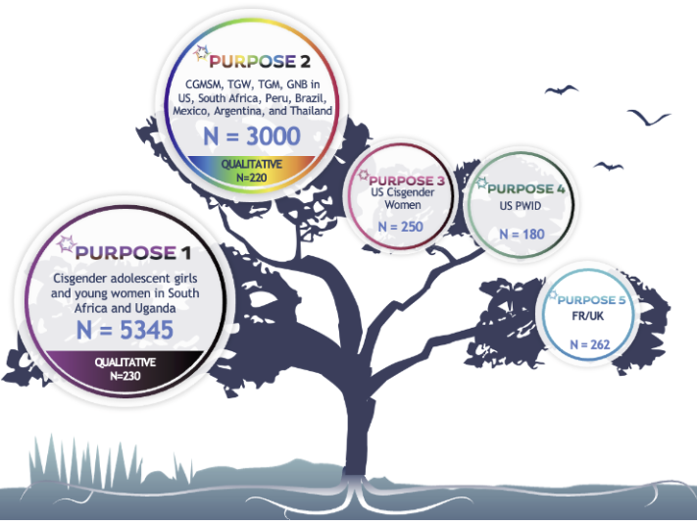
HIV and STI prevention | Long-acting lenacapavir PrEP
As a result of these interim results, the study was stopped early. All trial participants are now being offered open-label lenacapavir.
Principal investigator Linda-Gail Bekker described the results as “beyond wonderful” and received a standing ovation.
After the conference, on 12 September 2024, very high efficacy was also reported in the PURPOSE 2 study of long-acting lenacapavir PrEP in a different population (predominantly men who have sex with men).
Work is underway to ensure access to lenacapavir PrEP where need is greatest.
Studies of long-acting lenacapavir for PrEP
Bekker SS0407
Notes:
More detail on PURPOSE 2.
PURPOSE 2 is a phase 3 study which enrolled cisgender men who have sex with men (CGMSM) as well as transgender women (TGW), transgender men (TGM) and gender non-binary (GNB) individuals who have sex with partners assigned male at birth. Lenacapavir reduced HIV infections by 96% compared to background HIV incidence (bHIV).
There were 2 incident cases among 2,180 participants in the lenacapavir group (incidence 0.10 per 100 person-years); 99.9% of participants did not acquire HIV in the lenacapavir group. The results demonstrated superiority of twice-yearly lenacapavir over bHIV (incidence 2.37 per 100 person-years), with 96% relative risk reduction (incidence rate ratio 0.04, p<0.0001). There were 9 incident cases among 1,087 individuals in the Truvada group (incidence 0.93 per 100 person-years). Twice-yearly lenacapavir was 89% more effective than once-daily Truvada (incidence rate ratio 0.11, p=0.00245).
In the trial, lenacapavir and Truvada were generally well-tolerated and no significant or new safety concerns were identified.
PURPOSE 2 press release: https://www.gilead.com/news-and-press/press-room/press-releases/2024/9/gileads-twiceyearly-lenacapavir-for-hiv-prevention-reduced-hiv-infections-by-96-and-demonstrated-superiority-to-daily-truvada-in-second-pivotal-ph
Results were simultaneously published in The New England Journal of Medicine: https://www.nejm.org/doi/10.1056/NEJMoa2407001

Slide 59
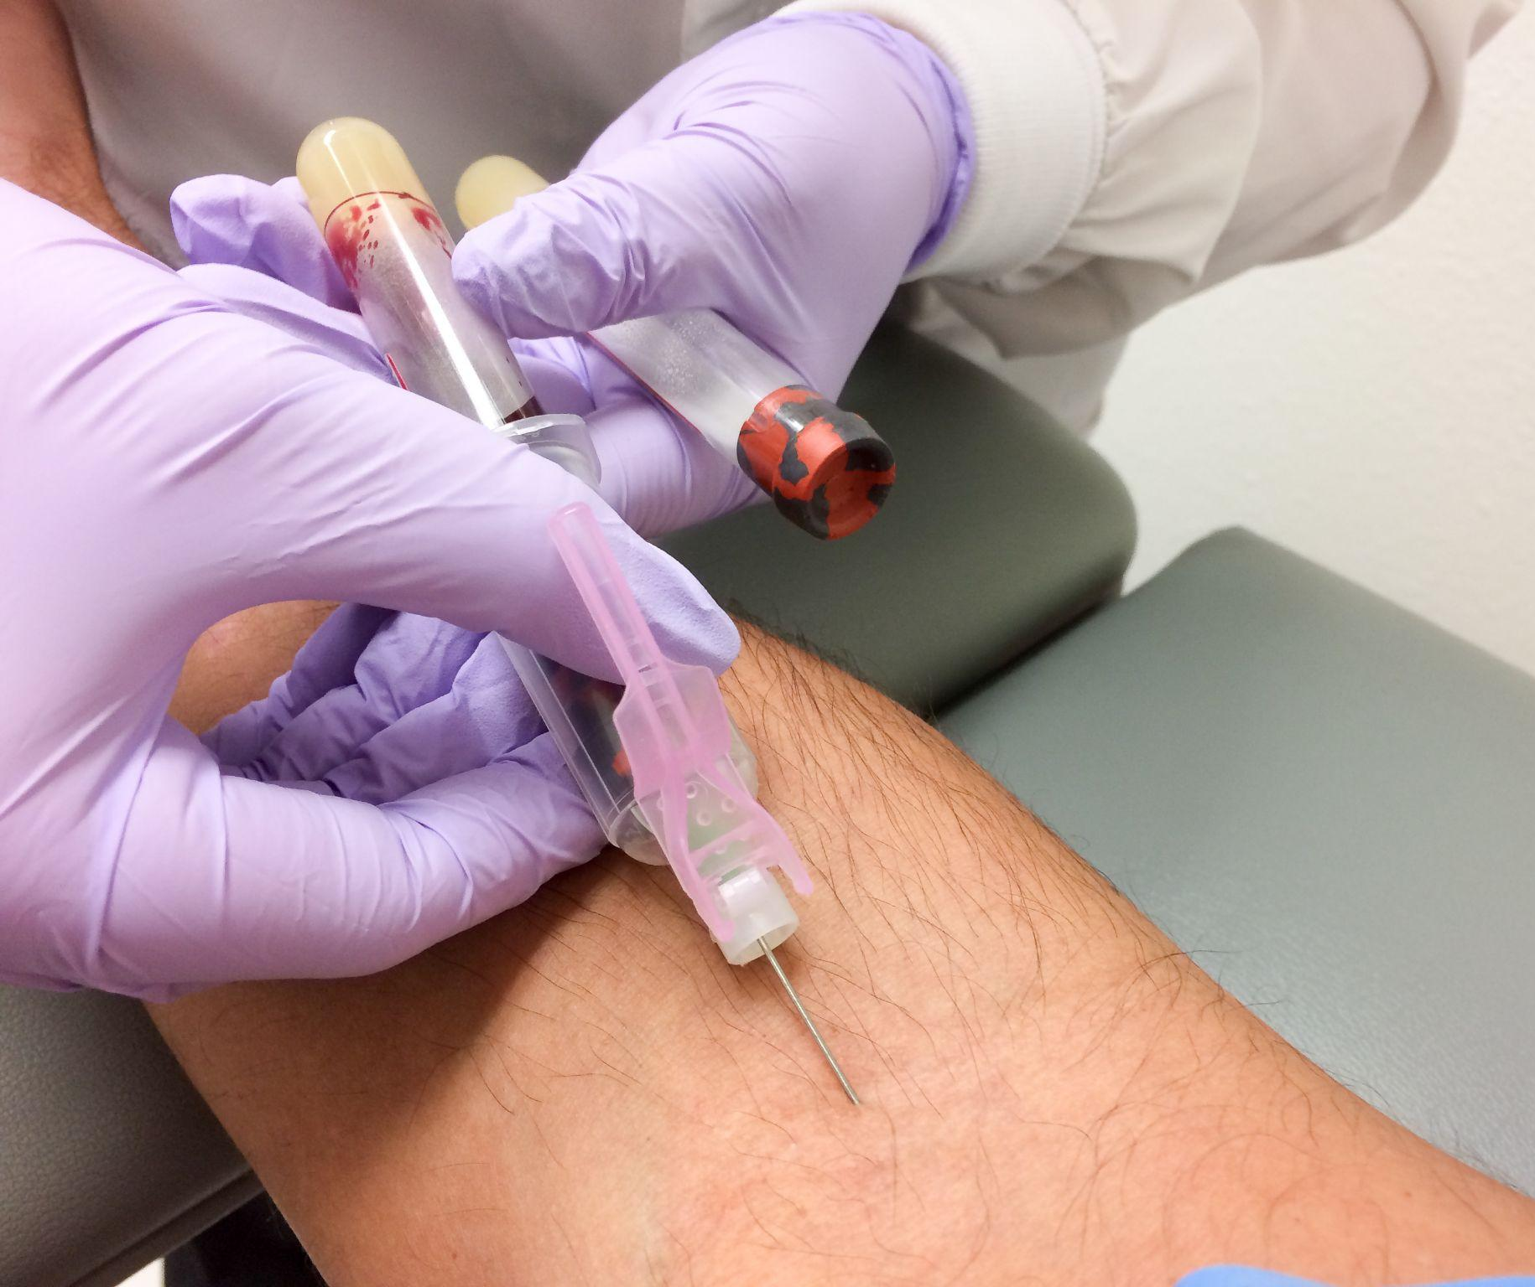
HIV and STI prevention | HIV testing for people taking cabotegravir PrEP
HIV testing for people taking cabotegravir PrEP
Long-acting cabotegravir can suppress HIV antibodies following HIV acquisition, so they might not be detected on an antibody-based test.
This presents a challenge to monitoring people using cabotegravir.
The performance of HIV RNA (viral load) screening was assessed among men who have sex with men and trans women using cabotegravir PrEP.
Quitesimplystock/Depositphotos
Landovitz OAE0406LB
Notes:
US guidelines currently recommend that people starting or taking cabotegravir receive an HIV RNA test. In World Health Organization guidelines for PrEP, HIV testing can be completed in accordance with the WHO testing strategy for HIV diagnosis using the full national testing algorithm – in most countries, this does not include HIV RNA testing.
Abstract: https://programme.aids2024.org/Abstract/Abstract/?abstractid=12267

Slide 60
HIV and STI prevention | HIV testing for people taking cabotegravir PrEP
A single, positive HIV RNA result alone performed poorly for detecting HIV.
51 of 26,528 RNA screening tests were positive.
27 of 51 were single isolated positive results.
22 of 27 were false positives.
However, in all cases, a second viral load test with a new blood sample was able to distinguish true positives from false positives.
Clinical consequences of false positive results are PrEP discontinuations and delayed injections, raising vulnerability to HIV acquisition.
Landovitz OAE0406LB
Notes:
Data come from the open-label extension (OLE) of the HPTN 083 study among MSM and transgender women.
“Single positive HIV RNA result” – in other words, previous tests were not positive, a non-RNA test (such as an antibody test) done at the same time was not positive.
In people whose last cabotegravir injection was within six months, a single positive viral load test alone had a 9.1% positive predictive value.
However, in people whose last cabotegravir injection was more than six months ago, a single positive viral load test alone had a 60% positive predictive value.
Abstract: https://programme.aids2024.org/Abstract/Abstract/?abstractid=12267

Slide 61
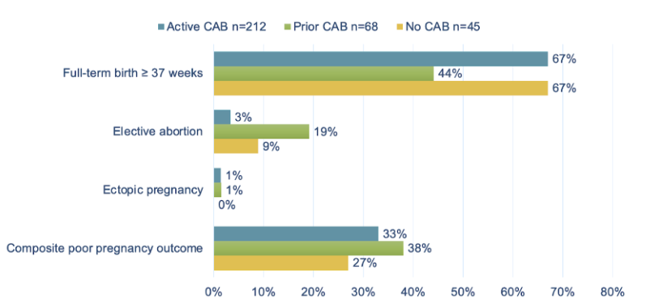
HIV and STI prevention | Cabotegravir PrEP in pregnancy
Cabotegravir PrEP in pregnancy
In an open-label study, participants chose either injectable cabotegravir or oral PrEP (F/TDF).
Participants were not required to use contraception and could choose to continue to take PrEP during pregnancy.
325 pregnancies were included in a safety analysis:
212 received cabotegravir during pregnancy.
68 had used it before pregnancy.
45 had never taken cabotegravir.
The demographics and pregnancy history were generally similar between exposure groups.
Pregnancy outcomes
Delany-Moretlwe SY2503
Notes:
Data come from the open-label extension (OLE) of the HPTN 084 study among cisgender women.
Participants who became pregnant were monitored for pregnancy-related adverse events including gestational hypertension, pre-eclampsia, and weight gain, as well as infant outcomes, such as miscarriage, intrauterine fetal death or stillbirth, premature birth, or low birthweight.
The composite poor pregnancy outcome = occurrence of either spontaneous abortion, stillbirth, premature birth or small for gestational age.
Abstract: https://programme.aids2024.org/Abstract/Abstract/?abstractid=12420
Session: https://programme.aids2024.org/Programme/Session/349

Slide 62
HIV and STI prevention | Cabotegravir PrEP in pregnancy
There were no maternal deaths or HIV acquisitions.
There were similar rates of poor pregnancy outcomes across PrEP exposure groups.
Infant growth parameters were similar across groups.
Pregnancy-related adverse event rates were similar across groups.
Gestational hypertension rates were similar to background rates.
Weight gain was similar across groups and within normal range for pregnancy.
However, there is no breastfeeding data yet.
Delany-Moretlwe SY2503
Notes:
Gestational hypertension and weight gain are of particular interest as they have been associated with use of integrase inhibitors in pregnancy. Cabotegravir is an integrase inhibitor.
Infant outcomes including growth parameters, median gestational age at deliver, and median birth weight.
The PK sub-study evaluated 50 participants who took CAB-LA for PrEP before and during pregnancy. 100% of participants in 1st and 2nd trimesters, and 98% of participants in 3rd trimester, had concentrations above the protocol-defined target concentration.
Abstract: https://programme.aids2024.org/Abstract/Abstract/?abstractid=12420

Slide 63
HIV and STI prevention | Cabotegravir PrEP in pregnancy
Pharmacokinetic data from 50 pregnancies show:
There was a decline in cabotegravir concentrations from the first to the third trimester.
In the first and second trimesters, all participants had average cabotegravir concentrations above the target concentration.
In the third trimester, 98% of participants had average cabotegravir concentrations above the target concentration.
Dose adjustment is probably unnecessary during pregnancy, but additional analyses are required.
Marzinke SY2504
Notes:
Abstract: https://programme.aids2024.org/Abstract/Abstract/?abstractid=12032
Session: https://programme.aids2024.org/Programme/Session/349

Slide 64
HIV and STI prevention | DoxyPrEP
DoxyPrEP
Recently, several studies have shown the potential of doxycycline post-exposure prophylaxis (DoxyPEP) to prevent chlamydia and syphilis.
AIDS 2024 included two pilot studies of doxycycline pre-exposure prophylaxis (DoxyPrEP).
A randomized study of daily DoxyPrEP for gay and bisexual men living with HIV with previous syphilis, compared to placebo, took place in Canada:
52 participants had a median age of 43, 60% were White, with a median eight partners in the past three months.
79% completed the study protocol.
77% had >85% adherence to study medication.
Adverse events were mostly mild, and their frequency was similar in both groups.
Grennan LB11
Notes:
DoxyPEP is a single 200 milligram dose of doxycycline taken within 72 hours after anal, vaginal or oral sex. It can be taken on consecutive days if sex is repeated, but no more than one dose in a 24-hour period.
In both studies here, DoxyPrEP involved taking half the dose of doxycycline (100 mg) every day. Among people who have frequent sex, those who take 100 mg doxycycline daily may end up using less of the drug than those who take the 200 mg PEP dose multiples times per week. Ongoing, daily adherence may be easier to manage.
Adherence was assessed by pill counts.
Abstract: https://programme.aids2024.org/Abstract/Abstract/?abstractid=11987

Slide 65
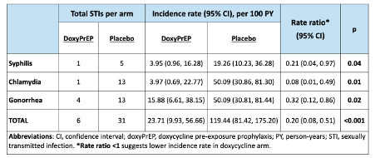
HIV and STI prevention | DoxyPrEP
There was a substantial reduction in the incidence of syphilis (-79%), chlamydia (-92%) and gonorrhoea (-68%) in the DoxyPrEP arm compared with the placebo arm.
Reduction in gonorrhoea, although doxycycline-resistant gonorrhea is common in Canada.
There were no differences between adherence or sexual behaviours between arms.
A larger study comparing DoxyPrEP with DoxyPEP in gay and bisexual men in Canada is ongoing.
STI incidence at 48 weeks
Grennan LB11
Notes:
There were no differences between the two groups in terms of sexual behaviour.
Abstract: https://programme.aids2024.org/Abstract/Abstract/?abstractid=11987

Slide 66
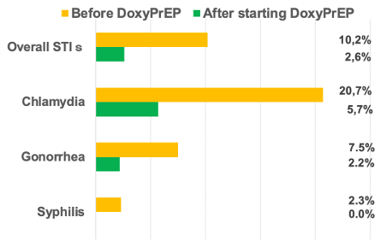
HIV and STI prevention | DoxyPrEP
The second study evaluated DoxyPrEP in cisgender female sex workers in Japan.
40 participants had a median age of 29, 100% were Asian, 83% were also taking HIV PrEP.
There was a 67% decline in STI incidence in this single-arm study (before and after analysis).
STI positivity rate (incidence / number of tests)
Abe OAC0803
Notes:
Abstract: https://programme.aids2024.org/Abstract/Abstract/?abstractid=7497

Slide 67
HIV and STI prevention | Frequency of STI testing in PrEP users
Frequency of STI testing in PrEP users
448 participants contributed 560 person-years of follow-up, 99% were men who have sex with men, and the median age was 36 years.
In many high-income countries, people who use PrEP are tested for sexually transmitted infections (STIs) every three months.
A randomized controlled trial in the Netherlands assessed the impact of STI testing every six months compared with the standard of care (every three months).
All participants could get tested for STIs in between regular visits, if needed.
Groot Bruinderink OAE3902
Notes:
The study is known as EZI-PrEP. Further analyses will compare online and face-to-face appointments.
Abstract: https://programme.aids2024.org/Abstract/Abstract/?abstractid=3295

Slide 68
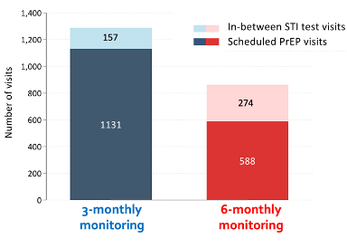
HIV and STI prevention | Frequency of STI testing in PrEP users
There were fewer visits overall in the six-monthly monitoring arm (32% reduction) than in the three-monthly arm.
Those in the six-monthly arm had 78% more unscheduled in-between STI visits than the three-monthly arm.
There were similar rates of STIs: 29.1 vs 25.6 per 100 visits (p=0.11) in the six-monthly arm and three-monthly arm, respectively.
The Netherlands has now updated its PrEP guidelines to recommend a six-monthly monitoring schedule.
Number of visits
Groot Bruinderink OAE3902
Notes:
Abstract: https://programme.aids2024.org/Abstract/Abstract/?abstractid=3295

Slide 69
Gaps, access and resources
70 The cost of inaction >
73 Gaps in paediatric coverage >
75 Access to lenacapavir >
77 Political leadership >

Slide 70
Gaps, access and resources | The cost of inaction
The cost of inaction
The latest data from UNAIDS highlights that in 2023:
Against the 95-95-95 targets, the global figures are 86-89-93.
Almost a quarter of people living with HIV, 9.3 million people, still do not receive treatment.
There were 1.3 million new HIV acquisitions – three times higher than the 2025 target.
Incidence is rising in the Middle East and North Africa, eastern Europe and central Asia, and Latin America.
2.6% of total HIV spending was for interventions for key populations – the UNAIDS target is 20%.
There were 630,000 AIDS-related deaths – more than double the 2025 target.
Winnie
Winnie Byanyima, UNAIDS. © Steve Forrest / IAS
Notes:
Data came from UNAIDS’ latest report, released to coincide with the conference.
At the end of December 2023, 30.7 million [27-31.9 million] people were accessing antiretroviral therapy, up from 7.7 million [6.7-8 million] in 2010, but still short of the 34 million target for 2025.
https://www.unaids.org/en/resources/presscentre/pressreleaseandstatementarchive/2024/july/20240722_global-aids-update

Slide 71
Gaps, access and resources | The cost of inaction
A cost-benefit analysis assessed the human and economic cost of failing to meet 95-95-95 targets in 114 low- and middle-income countries.
It took into account social benefits of preventing mortality – for example, economic and social contributions of people receiving ART.
It compared the incremental costs, benefits and economic returns of two scenarios:
Scenario 1: “Business-as-usual” – maintaining coverage of HIV-related services at 2020 levels every year until 2050
Scenario 2: Fulfilling the 95-95-95 targets
Lamontagne WEPEE579
Notes:
Abstract: https://programme.aids2024.org/Abstract/Abstract/?abstractid=11028

Slide 72
Gaps, access and resources | The cost of inaction
In Scenario 1, failing to meet global targets would entail tremendous human and economic consequences.
The human cost: there are an estimated 34.9 million new HIV acquisitions and 17.7 million AIDS-related deaths between 2021 and 2050.
The economic cost: for all people living in low- and middle-income countries, the cumulated cost of inaction by 2050 was estimated to be USD 7,383 million, with a cumulated average cost of inaction of USD 847 [566-1259] per capita.
But for every dollar invested, there would be a net return on investment of USD 14.80 per capita.
Lamontagne WEPEE579
Notes:
Abstract: https://programme.aids2024.org/Abstract/Abstract/?abstractid=11028

Slide 73
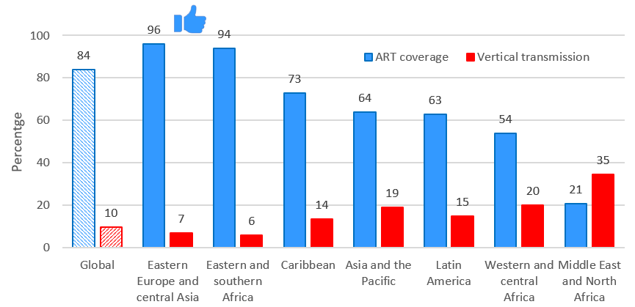
Gaps, access and resources | Gaps in paediatric coverage
Gaps in paediatric coverage
ART coverage in pregnancy has plateaued over the past decade: 81% in 2014 and 84% in 2023.
The 1.4 million children living with HIV have poorer outcomes across the care cascade compared to adults:
Knowledge of HIV status: 66% in children compared to 87% in adults
Receiving ART: 57% of children compared to 77% of adults
ART coverage in pregnancy and vertical transmission in 2023
Turkova PL01
Notes:
As well as showing varying ART coverage by region, the graphic shows that 10% of infants exposed to HIV acquire HIV.
47% of new cases of HIV in infants are due to mothers not starting ART during pregnancy or breastfeeding. Overall, 43% of infant infections occur during breastfeeding. Turkova said that these data call for better programmes for mothers to be tested, diagnosed and receive ART during pregnancy and breastfeeding.
Session: https://programme.aids2024.org/Programme/Session/81

Slide 74
Gaps, access and resources | Gaps in paediatric coverage
Alternatives to daily oral drugs are needed, for both prevention of vertical transmission and for paediatric treatment.
Could long-acting injectables be a game changer?
There are data gaps, especially for prevention.
Plans for access to generic long-acting injectables for treatment in low- and middle-income countries are unclear.
But medicines alone are not enough.
Psychosocial and peer support and community involvement are crucial to ensure that services reach children and adolescents and that we don’t leave them behind.
Turkova PL01

Slide 75
Gaps, access and resources | Access to lenacapavir
Access to lenacapavir
Lenacapavir PrEP could be a game changer – if it is accessible and affordable.
Gilead Sciences says it is developing “a strategy to enable broad, sustainable access globally”.
However, there are questions about pricing, timelines, access in middle-income countries, engagement with the Medicines Patent Pool, etc.
Lenacapavir is currently available only for treatment in high-income countries – at a cost of around USD 40,000 per person per year.
Notes:
Results from the PURPOSE 1 study, showing the efficacy of lenacapavir for PrEP, are in the section on HIV and STI prevention. Lenacapavir is administered by subcutaneous injection every six months.
After the conference, on 2 October 2024, Gilead Sciences announced the licensing of lenacapavir to six generic manufacturers. While this announcement was welcomed, there has also been criticism of some aspects, especially a number of middle-income countries that are not included and continuing uncertainty about price. For more information:
https://www.gilead.com/news/news-details/2024/gilead-signs-royalty-free-voluntary-licensing-agreements-with-six-generic-manufacturers-to-increase-access-to-lenacapavir-for-hiv-prevention-in-high-incidence-resource-limited-countries
https://www.nytimes.com/2024/10/02/health/lenacapavir-hiv-shot-prep.html

Slide 76
Gaps, access and resources | Access to lenacapavir
Researchers assessed if lenacapavir costs could be reduced if generic manufacturers obtain voluntary licences.
The analysis considered the cost of active pharmaceutical ingredients and production processes and allow for 30% profit.
Estimates assume competition between generic companies, investment in research and development, and guaranteed purchases of large volumes.
At volumes sufficient for one million people per year, the cost could drop to USD 93 per person per year.
At volumes sufficient for 10 million people, cost could go as low as USD 40 per person per year.
Hill LB40
Notes:
Abstract: https://programme.aids2024.org/Abstract/Abstract/?abstractid=12306

Slide 77
Gaps, access and resources | Political leadership
Political leadership
Parliamentarians from Argentina, Germany, the United Kingdom and Zimbabwe spoke about their role in bolstering political support for the HIV response.
This is especially urgent in the face of the global anti-rights movement.
Recently, in several African countries, parliamentarians have challenged anti-LGBTI legislation and supported the rights of key populations.
Ruth Mafoko Labode, Zimbabwean MP. © Marcus Rose / IAS
SY16
Notes:
Session: https://programme.aids2024.org/Programme/Session/352

Slide 78
Gaps, access and resources | Political leadership
Parliamentarians are often “natural” advocates who can be important allies to civil society organizations.
Civil society must build relationships with parliamentarians and help them understand the issues.
Parliamentarians in wealthy countries can put pressure on their governments to support global health investment, international co-operation and human rights.
They can also educate the general public in their countries about why HIV remains a political priority.
National, regional and global networks of parliamentarians focused on HIV and human rights play a crucial role in sharing knowledge and coordinating responses.
SY16
Notes:
Session: https://programme.aids2024.org/Programme/Session/352

Slide 79
Improving HIV care
80 Diagnosis of advanced HIV >
87 Integrated healthcare systems >
93 Moral injury among healthcare workers >

Slide 80
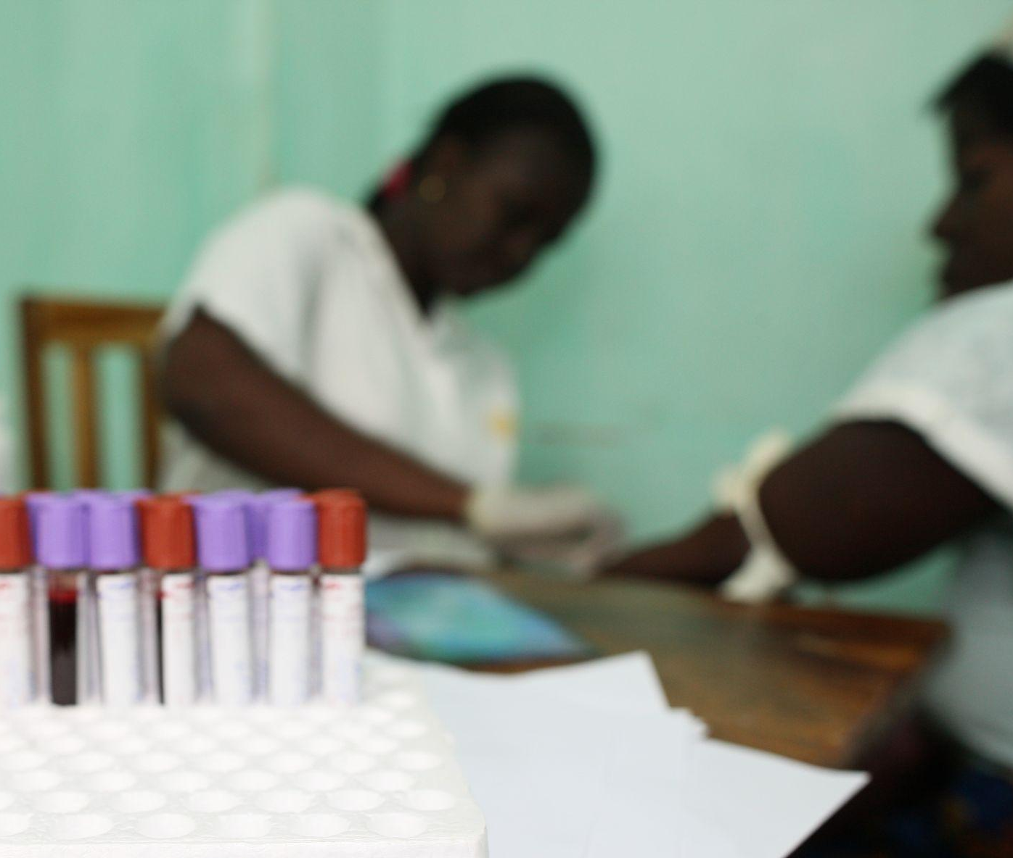
Improving HIV care | Diagnosis of advanced HIV
Diagnosis of advanced HIV
CD4 testing is key to identify people living with advanced HIV disease (AHD).
WHO supports CD4 testing for people newly diagnosed with HIV, people re-engaging in care and in instances of suspected treatment failure.
In Uganda:
Rates of CD4 testing are lower for treatment-experienced, non-suppressed clients (56%) than for new clients (79%).
Around 10% of people living with HIV in care are virally unsuppressed – this group is vulnerable to AHD.
godongphoto/Depositphotos
Nuwagira / Nabitaka OAE0402
Notes:
The use of CD4 testing declined with the introduction and scaling up of the recommendation to treat all people living with HIV, regardless of CD4 cell count, and the shift to using viral load alone for treatment monitoring. However, CD4 testing remains important to identify people with advanced HIV disease and to link them to life-saving interventions.
In Uganda, ~25% of PLHIV returning to care after treatment interruption return with AHD.
PLHIV with AHD are particularly at high risk of death, even after initiating ART, with this risk increasing with decreasing CD4 cell count. Early identification through CD4+ testing can promote swift linkage to care to avert mortality.
Abstract: https://programme.aids2024.org/Abstract/Abstract/?abstractid=10236

Slide 81
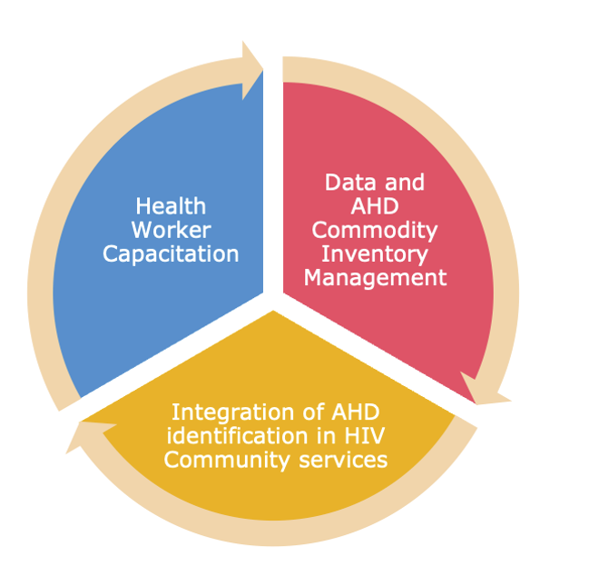
Improving HIV care | Diagnosis of advanced HIV
To enhance AHD identification among people with failing ART, the Ministry of Health launched a quality improvement initiative:
Additional training for healthcare workers on identifying and treating AHD
Optimizing the availability of AHD commodities
More support for data management and reporting
AHD focal teams at the facility level
CD4 testing integrated into community HIV services providing differentiated services
Quality improvement initiative
Nuwagira / Nabitaka OAE0402
Notes:
Abstract: https://programme.aids2024.org/Abstract/Abstract/?abstractid=10236

Slide 82
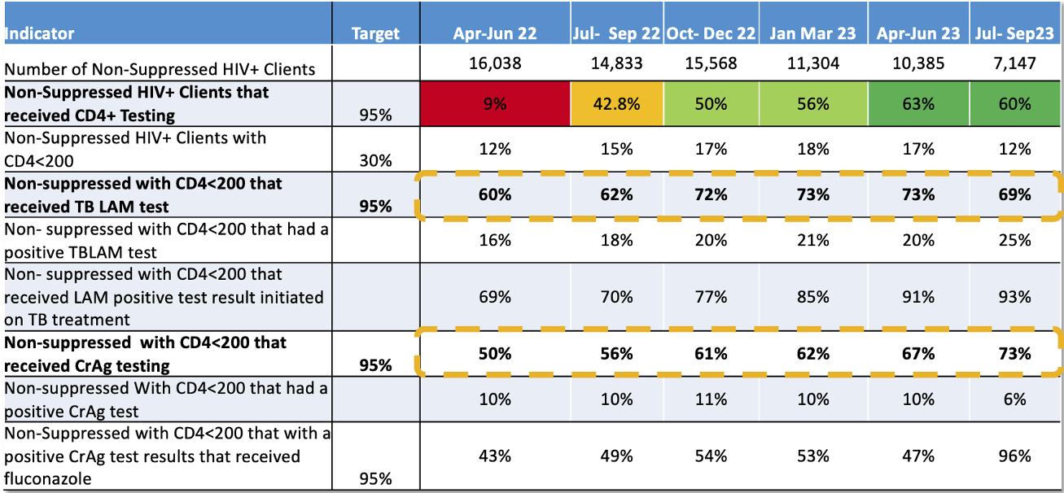
Improving HIV care | Diagnosis of advanced HIV
This initiative has enabled the identification of AHD among treatment-experienced, non-suppressed clients.
Other indicators, such as TB-LAM and Cr Ag testing access, have also improved.
AHD cascade indicators improved over the quarters
Nuwagira / Nabitaka OAE0402
Notes:
The reduction in testing access in the last quarter was attributed to CD4 diagnostics supply shortages in the country at the time.
WHO recommends a package of interventions that should be offered to everyone presenting with advanced HIV disease. The indicators in the table reflect several elements of the package concerning the screening, treatment and/or prophylaxis for major opportunistic infections.
Findings suggest that targeted diagnostic strategies can enhance advanced HIV disease, though further research is needed to assess long-term outcomes and clinical efficacy.
Abstract: https://programme.aids2024.org/Abstract/Abstract/?abstractid=10236

Slide 83
Improving HIV care | Diagnosis of advanced HIV
A separate economic analysis investigated the costs of AHD diagnostics in Mexico.
In Mexico, half of AHD deaths are due to tuberculosis (TB), disseminated histoplasmosis (DH) and cryptococcal disease (CD).
Diagnosis of these diseases is currently expensive, time consuming and often delayed.
Could healthcare costs be reduced by providing point-of-care testing to all people newly diagnosed with HIV?
Lateral flow tests for urinary lipoarabinomannan, urinary Histoplasma antigen and serum Cryptococcus antigen
Camiro-Zúñiga OAE0403
Notes:
The analysis identified potential savings on spared hospitalization days and diagnostic assays that would not have been necessary had opportunistic infections (OIs) been diagnosed at the beginning of care. They also assessed differences in time to OI treatment initiation.
Abstract: https://programme.aids2024.org/Abstract/Abstract/?abstractid=5057

Slide 84
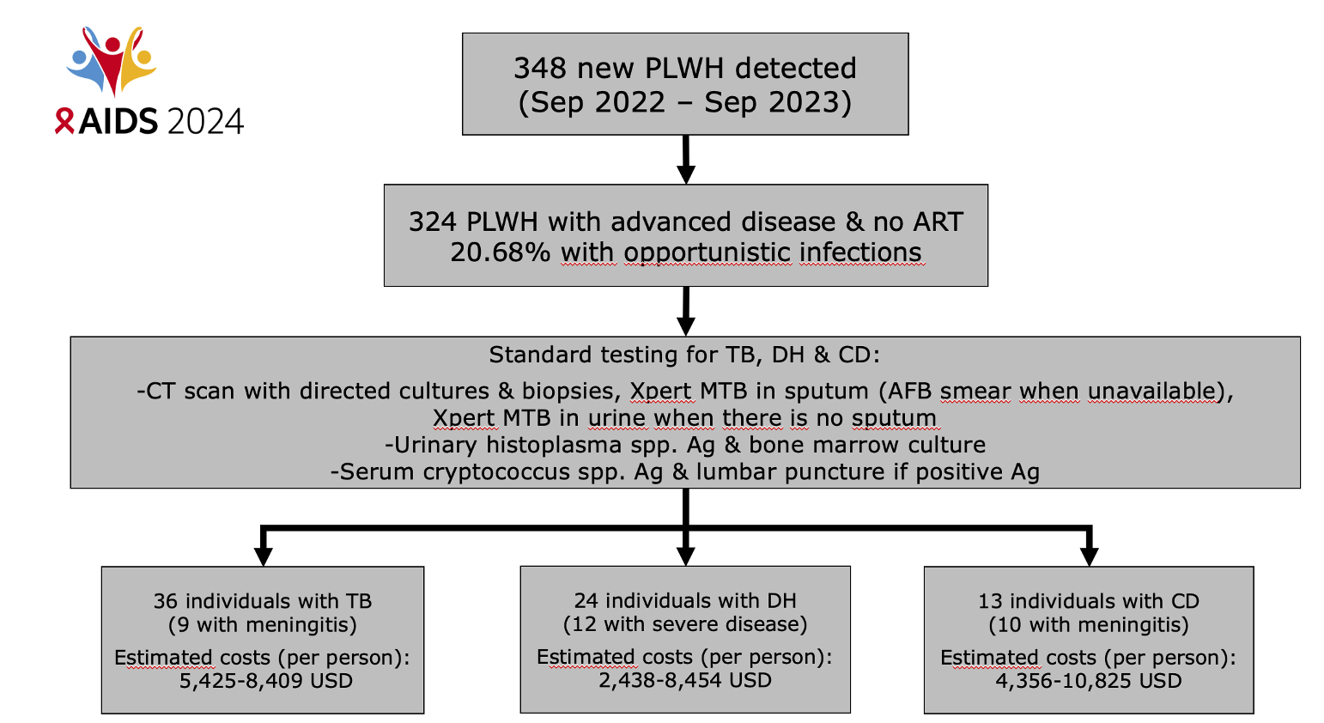
Improving HIV care | Diagnosis of advanced HIV
The retrospective analysis looked at 324 people living with advanced HIV attending four centres over a 12-month period.
Flow diagram
Camiro-Zúñiga OAE0403
Notes:
The costs per person include the costs of patient care and diagnostic assays.
Abstract: https://programme.aids2024.org/Abstract/Abstract/?abstractid=5057

Slide 85
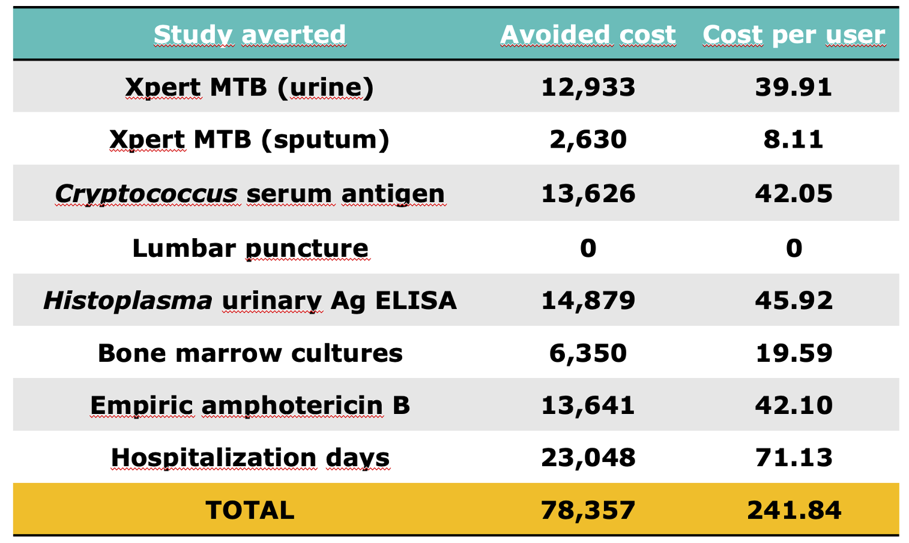
Improving HIV care | Diagnosis of advanced HIV
Had all clients been tested for opportunistic infections at entry to care, further testing and empiric treatment would not have been necessary.
For example, people with a positive TB-LAM result do not need screening with AFB sputum smear or Xpert MTB in urine or sputum.
For example, people with negative H UAg and Cr Ag results do not need empiric amphotericin B.
Avoided costs
Camiro-Zúñiga OAE0403
Notes:
Costs are in USD.
Abstract: https://programme.aids2024.org/Abstract/Abstract/?abstractid=5057

Slide 86
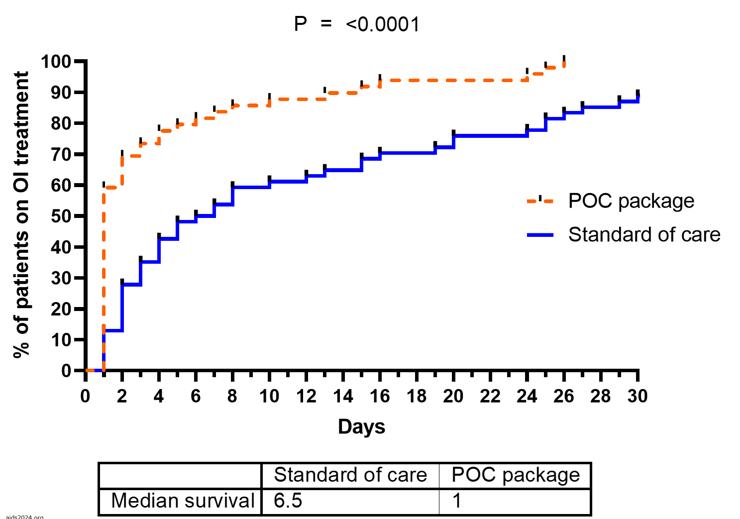
Improving HIV care | Diagnosis of advanced HIV
On average, standard client care costs of advanced HIV disease would be reduced by USD 241 per person (approximately USD 80,000 per year) if testing was done at entry to care.
USD 80,000 is approximate cost of treating 40 people with TB or 100 people with cryptococcal meningitis.
Median time to opportunistic infection treatment initiation would be reduced by five days (from 6.5 to 1, p<0.001) by testing at entry to care.
Median time to initiation of OI treatment
Camiro-Zúñiga OAE0403
Notes:
Abstract: https://programme.aids2024.org/Abstract/Abstract/?abstractid=5057

Slide 87
Improving HIV care | Integrated healthcare systems
Integrated healthcare systems
People living with HIV are disproportionately affected by non-communicable diseases (NCDs), including hypertension, diabetes and cancer.
AIDS-related deaths are declining while the proportion of deaths due to NCDs is increasing.
Potential benefits of integrating NCD screening and treatment into services providing HIV care include:
Reducing the number of clinic appointments
Promoting early diagnosis and treatment of co-morbidities
Less duplication of services and lower costs to health system
The provision of holistic, person-centred care
SAT036

Slide 88
Improving HIV care | Integrated healthcare systems
In Zambia, an intervention aimed to improve detection and management of cardio-metabolic complications, including hypertension, diabetes and dyslipidemia, in routine HIV clinical practice settings.
The package of integrated HIV/NCD services included:
“One stop shop” for NCD/HIV services
WHO-PEN protocols, algorithm and training materials adapted for Zambia
NCD clinical information added to HIV electronic medical records
Access to screening and laboratory monitoring for diabetes and hyperlipidemia
Strengthened NCD medication supply chain, with multi-month dispensing
Clinic workflows were re-organized, using task-shifting (to nurses and community health workers) and task-sharing (team-based care and referrals).
Pry OAC4003
Notes:
WHO-PEN = World Health Organization Package of Essential Noncommunicable Disease Interventions
Abstract: https://programme.aids2024.org/Abstract/Abstract/?abstractid=4235

Slide 89
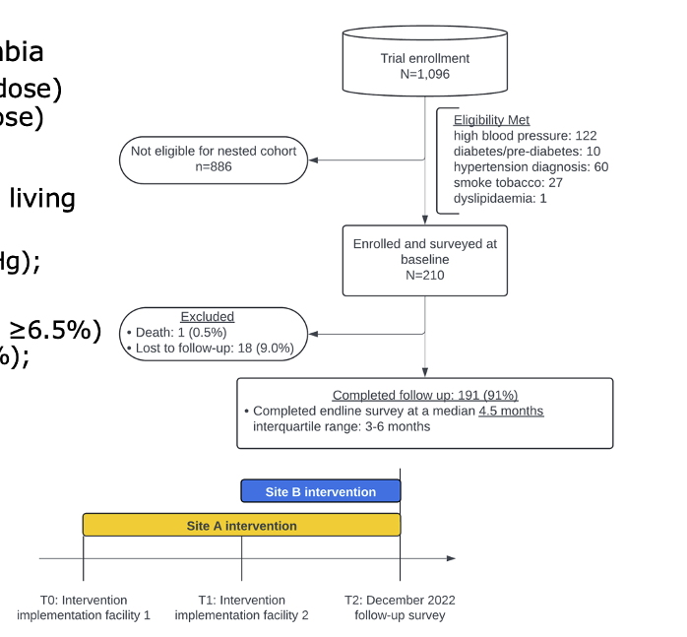
Improving HIV care | Integrated healthcare systems
The study evaluated whether the package improved blood pressure control without compromising HIV viral suppression.
“Dual control” of both blood pressure and HIV was assessed in participants with cardiometabolic NCDs or risk factors.
191 of 1,096 participants were eligible (had hypertension, pre-diabetes, diabetes or dislipidemia, or smoked).
The cohort was 70% female, median age 49, with a median 12 years since their HIV diagnosis.
Study design
Pry OAC4003
Notes:
At the time of the follow-up assessment, the intervention had been provided at site A for six months, and at site B for three months.
Abstract: https://programme.aids2024.org/Abstract/Abstract/?abstractid=4235
Session: https://programme.aids2024.org/Programme/Session/224

Slide 90
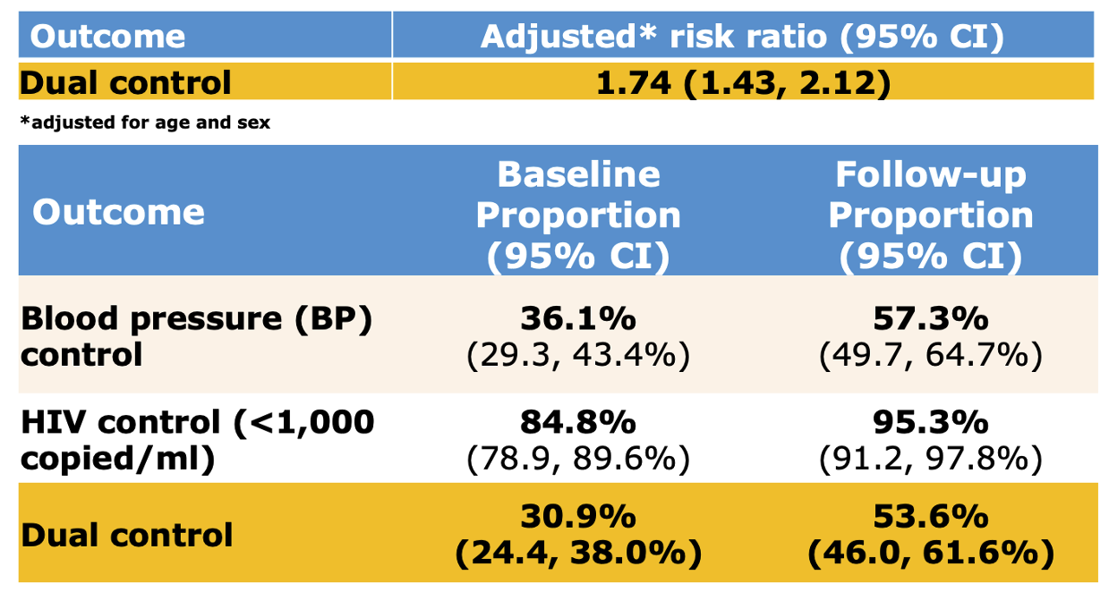
Improving HIV care | Integrated healthcare systems
There was improvement in blood pressure control, defined as systolic blood pressure <140mmHg and diastolic blood pressure <90mmHg.
There was also a 74% increase in the rate of dual (blood pressure and HIV) control.
Control of blood pressure and HIV
Pry OAC4003
Notes:
At the time of the follow-up assessment, the intervention had been provided at site A for six months, and at site B for three months.
Abstract: https://programme.aids2024.org/Abstract/Abstract/?abstractid=4235
Session: https://programme.aids2024.org/Programme/Session/224

Slide 91
Improving HIV care | Integrated healthcare systems
Mental healthcare can also be integrated into HIV programmes.
Due to the shortage of mental health professionals in most low- and middle-income countries, many people will never be screened if there is no integration and task-shifting.
At a trans-led sexual health clinic in Thailand, depression screening by peer providers was highly acceptable to clients.
At a hospital-based clinic for adolescents and young adults with HIV in Thailand, physiatrists supported HIV providers to offer basic mental healthcare.
Capacity building included training, care protocols and case management meetings.
Young people wanted to receive care from clinicians they knew and trusted.
Sohn SY40
Notes:
At a conference symposium, Annette Sohn reviewed examples of good practice.
The transgender example: Janamnuaysook R, APACC 2023, abstract 95. Will also be presented at HIV R4P 2024.
The youth example: Songtaweesin W, APACC 2024, abstract 16.

Slide 92
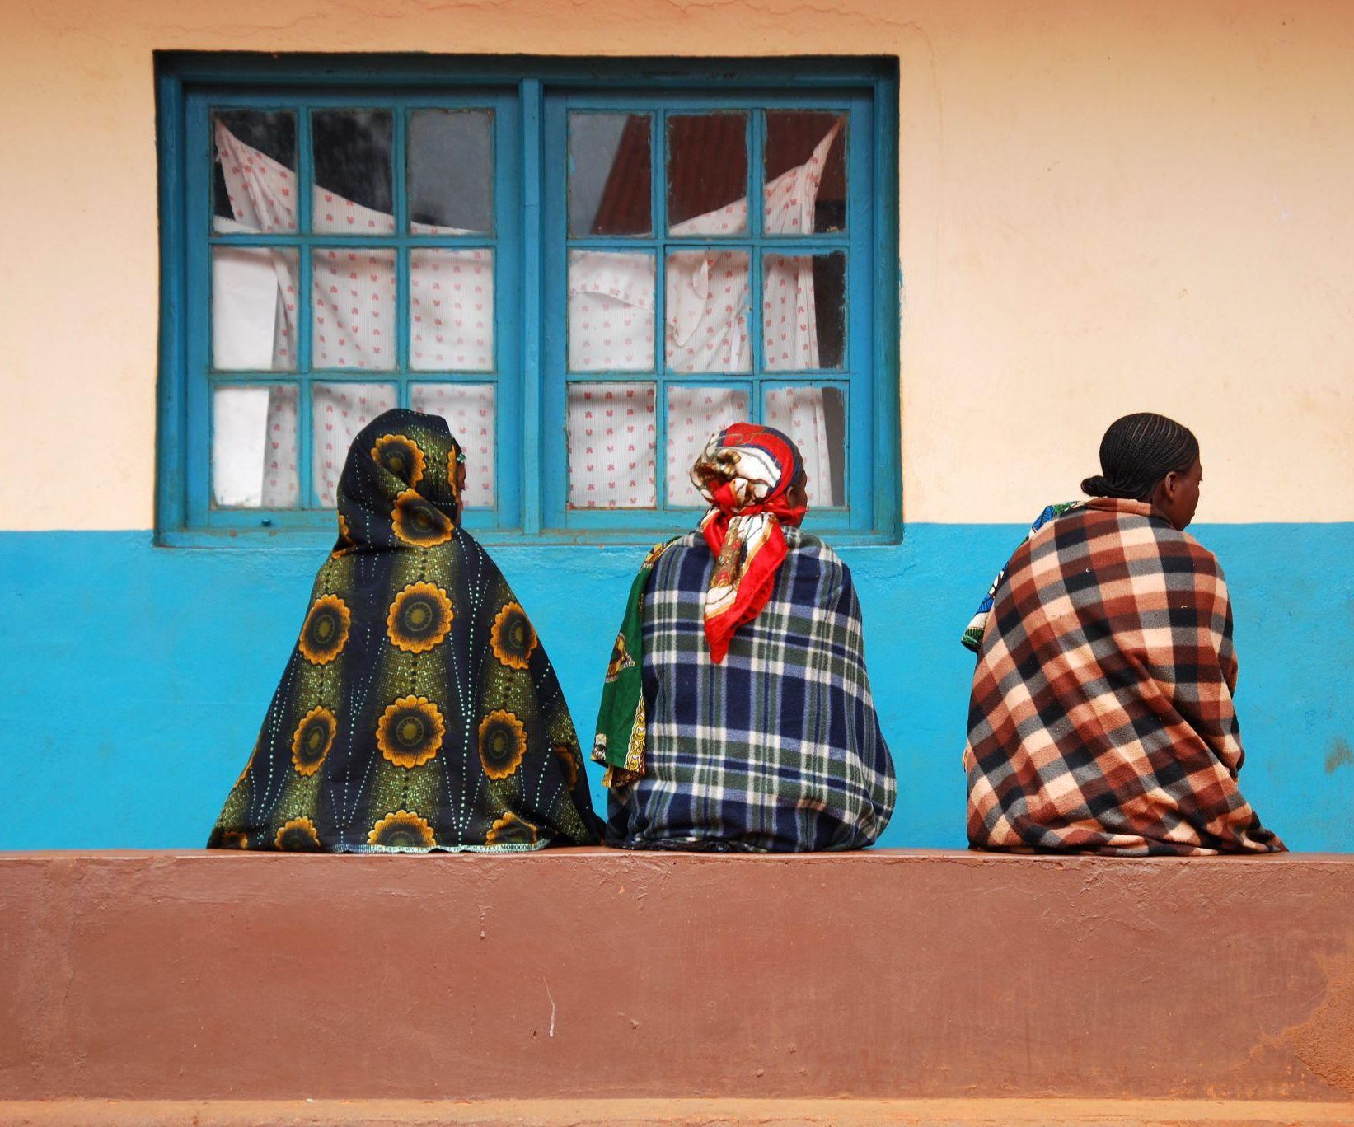
Improving HIV care | Integrated healthcare systems
In Senegal, group interpersonal therapy was provided for people living with HIV and depression:
Therapy was facilitated by social workers and community health workers.
Staff had five-day intensive training, supervised practice sessions and ongoing supervision by clinical psychologist.
People living with HIV received one individual session + eight group sessions.
The approach was feasible and acceptable to clients, and there was a large reduction in depressive symptoms.
francofox/Depositphotos
Sohn SY40
Notes:
Senegal study: https://pubmed.ncbi.nlm.nih.gov/37854409/

Slide 93
Improving HIV care | Moral injury among healthcare workers
Moral injury among healthcare workers
People living with HIV in Mozambique report being treated with disrespect by healthcare workers (HCWs).
HCWs’ negative behaviour towards clients may be a reflection of burnout, compassion fatigue and moral injury associated with delivering care in a resource-constrained setting.
Data came from surveys with 100 HCWs in Mozambique (63% female), including 23 doctors or nurses, 21 technicians and 29 counsellors.
HCWs had been healthcare providers for a median of 6.5 years.
Only one participant reported burnout.
Audet OAE3006LB
Notes:
Median resilience score: 32/40 (Early Warning Resilience Survey). This assessed both activation (e.g. The work I do makes a real difference) and decompression (e.g. I can enjoy my personal time without focusing on work matters).
Abstract: https://programme.aids2024.org/Abstract/Abstract/?abstractid=12212

Slide 94
Improving HIV care | Moral injury among healthcare workers
However, moral injury (moderate to severe) was identified among 36% of participants.
Moral injury can occur when the resources needed to provide appropriate care are not available.
For example, participants reported feeling guilty when a patient died, acting in a way that violated their own morals, and feeling betrayed by other healthcare professionals.
Moral injury
Audet OAE3006LB
Notes:
Moral injury is identified with a score of 36 or higher on the Moral Injury Symptom Scale: Healthcare Professionals Version (MISS-HF).
Abstract: https://programme.aids2024.org/Abstract/Abstract/?abstractid=12212

Slide 95
Structural factors and social determinants of health
96 The health of displaced people in wartime >
98 Opioid agonist treatment in Ukraine >
101 Climate change >

Slide 96
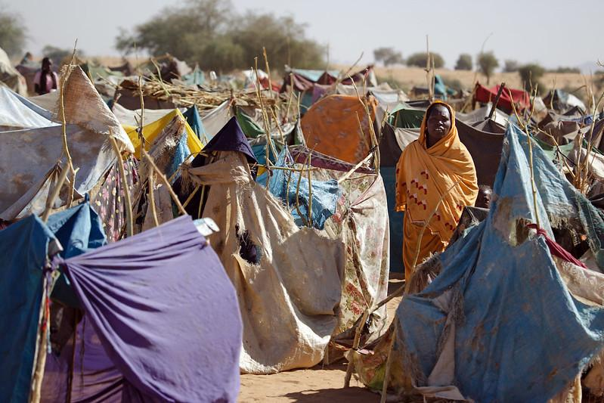
Structural factors and social determinants of health | The health of displaced people in wartime
The health of displaced people in wartime
A session on the needs of refugees and displaced people began with harrowing testimonials from ongoing crises.
In Gaza, civilians face shortages of water, food and medicine.
In Sudan, 10 million people, primarily women and children, are displaced within the country (and six million to neighbouring countries).
In Ukraine, ongoing Russian shelling forces people to prioritize their safety over medical needs, such as accessing medication.
Zam Zam, Sudan. UN Photo/Olivier Chassot. CC BY-NC-ND 2.0
SY07

Slide 97
Structural factors and social determinants of health | The health of displaced people in wartime
Panellists working in refugee health services discussed how to ease the burden of navigating confusing services for those already suffering from displacement.
A people-centred approach is needed
Integrated services are needed
Governments and international stakeholders should plan and prepare emergency responses in advance.
Communities should be involved in shaping plans and response strategies.
HIV services for displaced people must include:
Social and mental support
Tailored services for the specific needs of women, girls and the most marginalized populations
SY07
Notes:
Session: https://programme.aids2024.org/Programme/Session/42

Slide 98
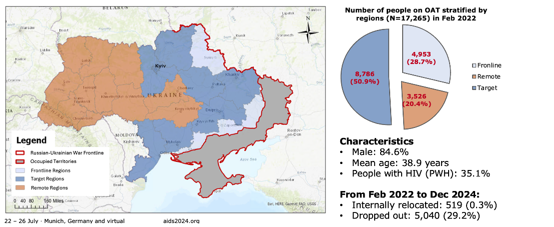
Structural factors and social determinants of health | Opioid agonist treatment in Ukraine
Opioid agonist treatment in Ukraine
Ukraine continued to expand opioid agonist treatment (OAT) after Russia’s full-scale invasion in February 2022.
OAT is the most effective form of HIV prevention for people who inject drugs.
However, 29% of people receiving OAT have discontinued treatment since the invasion.
This analysis sought to understand associations with treatment discontinuation.
Regions of Ukraine, people receiving OAT
Ivasiy OAC2906LB
Notes:
In January 2021, there were approximately 14,500 people on OAT and the figure had reached 16,997 at the time of the invasion. By July 2023, 20,413 had initiated OAT.
The map shows the regions used in the analysis:
Frontline regions had high numbers of explosions, air raids and artillery threats, and low numbers of internally displaced people (IDP).
Target regions had high numbers of explosions, air raids and artillery threats, and high numbers of IDP.
Remote regions had low numbers of explosions, air raids and artillery threats, and moderate numbers of IDP.
Abstract: https://programme.aids2024.org/Abstract/Abstract/?abstractid=12425

Slide 99
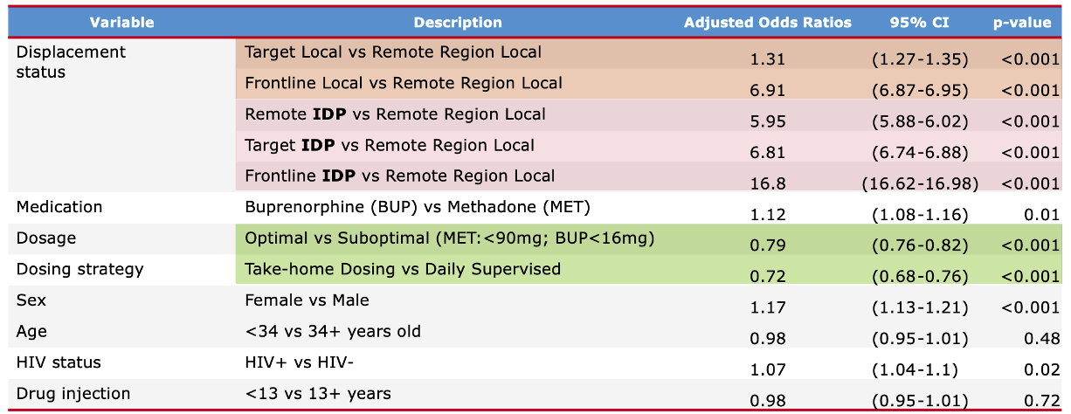
Structural factors and social determinants of health | Opioid agonist treatment in Ukraine
Compared to local people in ‘remote’ regions, internally displaced people (IDP) experienced the highest rate of dropout.
Especially IDP in frontline regions
Take-home dosing (e.g., 30 days of medication) and receiving optimal doses were protective of dropout.
Women and people with HIV were at increased risk of dropout.
Factors associated with treatment discontinuation
Ivasiy OAC2906LB
Notes:
Take-home dosing: Daily supervised dosing is the norm, but is especially challenging in wartime. Exceptionally, 30 days of take home dosing was permitted after the full-scale invasion.
Abstract: https://programme.aids2024.org/Abstract/Abstract/?abstractid=12425

Slide 100
Structural factors and social determinants of health | Opioid agonist treatment in Ukraine
The findings highlight that in wartime, implementation strategies must be adapted based on proximity to the conflict.
Clinics remote from the conflict should be prepared to rapidly increase provision to support continuity of care.
Clinics close to the conflict should optimize dosage and expand take-home dosing.
Preparedness plans are crucial for ensuring uninterrupted care during conflicts and other emergencies.
Ivasiy OAC2906LB
Notes:
Abstract: https://programme.aids2024.org/Abstract/Abstract/?abstractid=12425

Slide 101
Structural factors and social determinants of health | Climate change
Climate change
A qualitative study explored links between climate change events, scarcities and HIV vulnerabilities in Kenya.
Children and elders reported that drought and flooding exacerbated pre-existing food insecurity, water insecurity and sanitation insecurity.
The study was conducted in six diverse ecological contexts in Kenya, including an urban slum, a fishing community, a refugee settlement and a pastoralist community.
Interviews were conducted with 60 children aged 10-14 years (mean age 13.4) and 50% female.
Workshops were held with 119 children aged 10-14 years.
Focus groups were held with 119 elders, with a mean age of 61 and 57% female.
Logie OAD2403
Notes:
Sanitation insecurity refers to not having appropriate facilitations for urination, defecation and menstruation. The study highlighted links between challenges managing menstruation and transactional sex.
The study was conducted in six diverse ecological contexts: 1) informal settlements in Mathare, Nairobi; 2) rural and peri-urban areas outside of Kisumu on Lake Victoria, Africa’s largest lake; 3) nomadic and pastoralist communities in Isiolo; 4) Kalobeyei Refugee Settlement; 5) flower farm workers and internally displaced families on Lake Naivasha; and 6) small-scale coastal farming families in Kilifi.
Abstract: https://programme.aids2024.org/Abstract/Abstract/?abstractid=5711

Slide 102
Structural factors and social determinants of health | Climate change
“When there is a lot of sun, we cannot get healthy things. Sometimes, the sun dries up our fruits and vegetables and when there are floods or a lot of rains, the floods carry away our food and we are left hungry.” 11-year-old girl
Links between climate change, scarcities and HIV vulnerabilities.
Logie OAD2403
Notes:
Abstract: https://programme.aids2024.org/Abstract/Abstract/?abstractid=5711

Slide 103
Structural factors and social determinants of health | Climate change
“The girls will skip school and go to a man’s house – a man old enough to be their grandfather. And why? Poverty. Just 20 shillings to buy chips is enough to keep her going and satisfy her hunger.” Elder woman
Links between climate change, scarcities and HIV vulnerabilities.
“They can’t shower because they don’t have water, and so they sell themselves so they get water.” 12-year-old girl
Logie OAD2403
Notes:
Abstract: https://programme.aids2024.org/Abstract/Abstract/?abstractid=5711

Slide 104
Structural factors and social determinants of health | Climate change
A literature review focused on identifying patterns and trends related to climate-induced migration and HIV vulnerability in Africa.
Findings from epidemiological studies, migration reports and public health databases were summarized.
There were a limited number of studies.
Preliminary analysis suggests that regions experiencing climate-related stressors often experience increased migration.
The impact of migrations on HIV prevalence and vulnerability is complex and varies across different contexts.
Implications for public health:
Need for more targeted research on the relationship between climate-induced migration and HIV vulnerability in Africa.
Future work will benefit from interdisciplinary collaborations to develop comprehensive strategies that integrate HIV prevention and treatment services into climate-related migration policies.
Ekerin OAD2402
Notes:
Abstract: https://programme.aids2024.org/Abstract/Abstract/?abstractid=11555

Slide 105
Criminalization, discrimination and stigma
106 Anti-LGBTQ+ laws in Africa >
109 Repeal of HIV criminalization in Zimbabwe >
111 Stigma among healthcare workers >
114 Stigma and engagement in care >
116 Paralegals in Thailand >

Slide 106
Criminalization, discrimination and stigma | Anti-LGBTQ+ laws in Africa
Anti-LGBTQ+ laws in Africa
In February 2024, Ghana’s parliament passed one of Africa’s harshest anti-LGBTQ+ laws.
The law has not yet been signed into law by the president.
Provisions include three years prison for anyone convicted of identifying as LGBTQ+ and five years for forming or funding LGBTQ+ groups.
Qualitative interviews were held with 46 sexual minority, trans and gender diverse people living with HIV, with a mean age 29 years, in Accra, Ghana.
Gyamerah OAD3706LB
Notes:
Abstract: https://programme.aids2024.org/Abstract/Abstract/?abstractid=12337

Slide 107
Criminalization, discrimination and stigma | Anti-LGBTQ+ laws in Africa
The bill has already negatively impacted participants, through increased violence, stigma and discrimination, material insecurities and homophobic blackmail.
Nearly half indicated the bill has impacted, or will impact, their HIV treatment and care. Some have already stopped going for care or taking ART.
Gyamerah OAD3706LB
Notes:
Abstract: https://programme.aids2024.org/Abstract/Abstract/?abstractid=12337

Slide 108
Criminalization, discrimination and stigma | Anti-LGBTQ+ laws in Africa
In Uganda, there has been a drastic reduction in the uptake of services following the passing of the Anti-Homosexuality Act in 2023.
Alternative strategies are needed to ensure that services are accessible and provided with dignity, respect and privacy.
A key population-led organization engaged clients 15-24 years old by phone and online to:
Enrol individuals in virtual adherence clubs
Provide mental health support and information on PrEP
Order condoms and lubricant (delivery service)
Provide referrals to clinics staffed by supportive healthcare workers
Atuhura OAD1903
Notes:
Abstract: https://programme.aids2024.org/Abstract/Abstract/?abstractid=5521

Slide 109
Criminalization, discrimination and stigma | Repeal of HIV criminalization in Zimbabwe
Repeal of HIV criminalization in Zimbabwe
In 2022, Zimbabwe was the second African country to ever repeal an HIV-specific law criminalizing HIV transmission.
Ruth Labode, a parliamentarian who had previously supported the law (intended to protect women), was closely involved in the campaign to repeal it.
She changed her stance, persuaded by evidence that such laws do not reduce HIV incidence or protect women, but discourage HIV testing and engagement with HIV care.
Labode OAF3105
Notes:
In 2018, the Democratic Republic of Congo was the first African country to repeal an HIV-specific criminal law.
Zimbabwe was the first African country to introduce an HIV-specific law (in 2001) and is reported to have the highest number of prosecutions in Africa. The law was originally supported by women’s rights groups who sought to address violence against women, but the law in fact had a disproportionate impact on women with HIV.
Repeal was part of the Marriage Bill, which was controversial for other reasons than the repeal of HIV criminalization (measures in relation to child marriage, dowry payments, polygamy, etc).
As noted, the law was repealed in 2022. In 2024, there was an abortive attempt to re-introduce HIV-specific provisions in Zimbabwean law, but this was eventually withdrawn.
Abstract: https://programme.aids2024.org/Abstract/Abstract/?abstractid=1564

Slide 110
Criminalization, discrimination and stigma | Repeal of HIV criminalization in Zimbabwe
Key strategies/lessons learnt:
Civil society worked with parliamentarians to improve understanding of the issues.
Partnerships were built between parliamentarians, National AIDS Council, civil society, development agencies.
Parliamentarians closely engaged with the minister of justice (responsible for the law).
Repeal of law was embedded in a wider bill – other provisions attracted more attention than the HIV change.
People living with HIV spoke at public hearings on the bill.
Roadmap towards decriminalizing HIV transmission in Zimbabwe
Labode OAF3105
Notes:
Abstract: https://programme.aids2024.org/Abstract/Abstract/?abstractid=1564

Slide 111
Criminalization, discrimination and stigma | Stigma among healthcare workers
Stigma among healthcare workers
A survey was conducted of 18,430 healthcare workers in 54 countries across Europe and central Asia.
74% of respondents were female and included doctors (44%), nurses (22%) and others, working in hospitals (58%), primary care (17%) and other settings.
45% were not aware of having ever treated a person living with HIV.
orestligetka.ukr.net/Depositphotos
Noori OAD3206
Notes:
One of the UNAIDS targets for 2025 is that less than 10% of people living with HIV experience stigma and discrimination.
A survey, translated into 38 languages, was developed and conducted from 15 September to 5 December 2023, targeting clinical and non-clinical professionals in healthcare settings. A non-probability sample was recruited via a multi-channel campaign, leveraging national healthcare professional networks and social media.
The survey measured respondents’ HIV-related knowledge and training, personal attitudes and behaviours towards people living with HIV.
Abstract: https://programme.aids2024.org/Abstract/Abstract/?abstractid=12450

Slide 112
Criminalization, discrimination and stigma | Stigma among healthcare workers
Many had gaps in knowledge about undetectable = untransmittable (U=U), post-exposure prophylaxis (PEP) and pre-exposure prophylaxis (PrEP).
Gaps in knowledge were associated with:
Higher levels of worry when providing care to people living with HIV
More use of excessive infection control measures
Correct knowledge by geographical region
Noori OAD3206
Notes:
Infection control measures are outlined on the following slide.
Abstract: https://programme.aids2024.org/Abstract/Abstract/?abstractid=12450

Slide 113
Criminalization, discrimination and stigma | Stigma among healthcare workers
57% would be worried if drawing blood from a person living with HIV.
53% would be worried if dressing the wound of a person living with HIV.
8% avoided physical contact with people living with HIV.
26% wore double gloves when caring for people living with HIV.
12% would prefer not to provide care for people who inject drugs.
6% would prefer not to provide care for men who have sex with men, sex workers, or trans people.
Level of worry when providing care to people living with HIV
Noori OAD3206
Notes:
Not providing care to MSM, sex workers or transgender people – questions were asked separately. For each population, 6% strongly preferred to not provide care to this group.
Discriminatory practices were also reported, with 22% having witnessed unwillingness to provide care, 19% having witnessed disclosure of HIV status without consent, 18% poorer quality of care, and 30% discriminatory remarks or talking badly about people living with HIV.
Abstract: https://programme.aids2024.org/Abstract/Abstract/?abstractid=12450

Slide 114
Criminalization, discrimination and stigma | Stigma and engagement in care
Stigma and engagement in care
An analysis of 76 nationally representative surveys from 33 African countries assessed the relationships between stigma and discrimination and HIV outcomes.
There were 842,169 respondents, including over 16,000 people living with HIV.
All respondents were asked about discriminatory attitudes, perceived stigma and shame of association.
People with HIV were asked about anticipated and experienced stigma in healthcare.
Prevalence of stigma
Kuchukhidze OAF1106
Notes:
Setting: Countries in Africa with available population-based surveys (DHS, PHIA, BAIS, KAIS, NAIIS, SABSSM) between 2000 and 2023.
The graphic shows that there was a high prevalence of discriminatory attitudes, especially in in western and central Africa. Up to 5% of PLHIV were denied health care because of their HIV status. Up to 40% of PLHIV felt the need to hide their HIV status.
Survey questions are listed below.
Community discriminatory attitudes towards PLHIV
Would you buy fresh vegetables from a shopkeeper or vendor if you knew that this
person had HIV? OR
Do you think children (or female teacher) living with HIV should be allowed to attend
school with children who do not have HIV?
Community shame of association with PLHIV
Do you agree or disagree with the following statement: I would be ashamed if
someone in my family had HIV?
Community perceived stigma
Do people talk badly about people living with HIV or who are thought to be living with
HIV? AND
Do people living with HIV, or thought to be living with HIV, lose the respect of other
People?
Individual (PLHIV) anticipated stigma in a healthcare settings
In the last 12 months, when you sought health care in a facility where your HIV
status is not known, did you feel you needed to hide your HIV status?
Individual (PLHIV) experienced stigma in healthcare settings
In the last 12 months, have you been denied health services including dental care,
because of your HIV status?
Abstract: https://programme.aids2024.org/Abstract/Abstract/?abstractid=11774

Slide 115
Criminalization, discrimination and stigma | Stigma and engagement in care
Stigma was associated with reduced engagement at every stage of HIV care testing, ART uptake and viral load suppression.
People living with HIV who felt they needed to hide their HIV status from healthcare providers were less likely to be on ART (6%) and virally suppressed (6%).
People who were denied care because of their HIV status had lower ART uptake (10%) and viral suppression (12%).
Probability of ART uptake and the prevalence of stigma
Probability of viral suppression and the prevalence of stigma
Kuchukhidze OAF1106
Notes:
HIV testing was self-reported, in the previous year. ART uptake and viral suppression were assessed with biomarkers.
To explain the graphs:
The blue colour represents crude prevalence ratio and red colour is adjusted estimates.
The lines represent the predicted probability of having tested in the past year at each stigma prevalence level.
Higher levels of stigma were associated with lower levels of engagement with care.
HIV testing (not shown): At high levels, discriminatory attitudes and shame of association were associated with lower prevalence of testing. However, perceived stigma did not have a strong impact on HIV testing.
Abstract: https://programme.aids2024.org/Abstract/Abstract/?abstractid=11774
Session: https://programme.aids2024.org/Programme/Session/211

Slide 116
Criminalization, discrimination and stigma | Paralegals in Thailand
Paralegals in Thailand
Paralegals have some legal training but are not fully qualified as lawyers.
Civil society organizations identified individuals with the potential to become a paralegal – trusted by communities and keen to empower their peers on human rights.
Many people in Thailand lack legal and human rights knowledge, so do not know their rights, do not challenge discriminatory experiences and do not seek legal services.
The Foundation for Action on Inclusion Rights trained 64 community paralegals to promote and protect human rights for people with intersectional vulnerabilities.
Siriphan OAF3104
Notes:
Abstract: https://programme.aids2024.org/Abstract/Abstract/?abstractid=3320

Slide 117
Criminalization, discrimination and stigma | Paralegals in Thailand
Training included:
The concept of respect in human dignity and diversity
Knowledge of human rights basics and the Thai justice system
Fact finding and case analysis skills
Paralegals empowered communities with rights literacy and provided individual case management.
Human rights violations and discriminatory incidents were documented through Thailand’s Crisis Response System.
192 HIV-related incidents – including compulsory HIV testing in the workplace, involuntary HIV status disclosure and denial of services
Data were used for advocacy towards the establishment of an Anti-Discrimination Act in Thailand.
Training curriculum has now been expanded and tailored for paralegals serving migrants and people who use drugs.
Siriphan OAF3104
Notes:
Abstract: https://programme.aids2024.org/Abstract/Abstract/?abstractid=3320

Slide 118
Thank you
Produced by IAS – the International AIDS Society Leading collective action on every front of the global HIV response through its membership base, scientific authority and convening power. www.iasociety.org
In collaboration with:
Gus Cairns, Amelia Jones, Roger Pebody, Beth Tunnicliffe
The images used in this toolkit are for illustrative purposes only.

