Slide 1
Broadly Neutralizing Antibodies (bnAbs) For HIV Prevention
Hyman Scott, MD MPH San Francisco Department of Public Health
New Tools: New challenges
Notes:
I’d like to thank the organizers for inviting me to present on

Slide 2
Summary
What is your main question?
What is the potential role of Broadly Neutralizing Antibodies (bnAbs) for HIV prevention in our evolving HIV prevention landscape?
What did you find?
bnAbs are safe and in combination may provide a new option for PrEP to expand choice.
Why is it important?
New HIV PrEP options will be important to increase PrEP uptake and overall PrEP coverage.
Notes:
The main question I like to address today is the potential role of bnAbs for HIV prevention in our evolving HIV prevention landscape what I'd like to demonstrate is that being labs are safe and in combination may provide a new option for prep to expand choice for those who might benefit most and that as we have new HIV prevention options they will be important for increasing prep uptake and overall prep coverage to achieve our goals of getting to zero

Slide 3
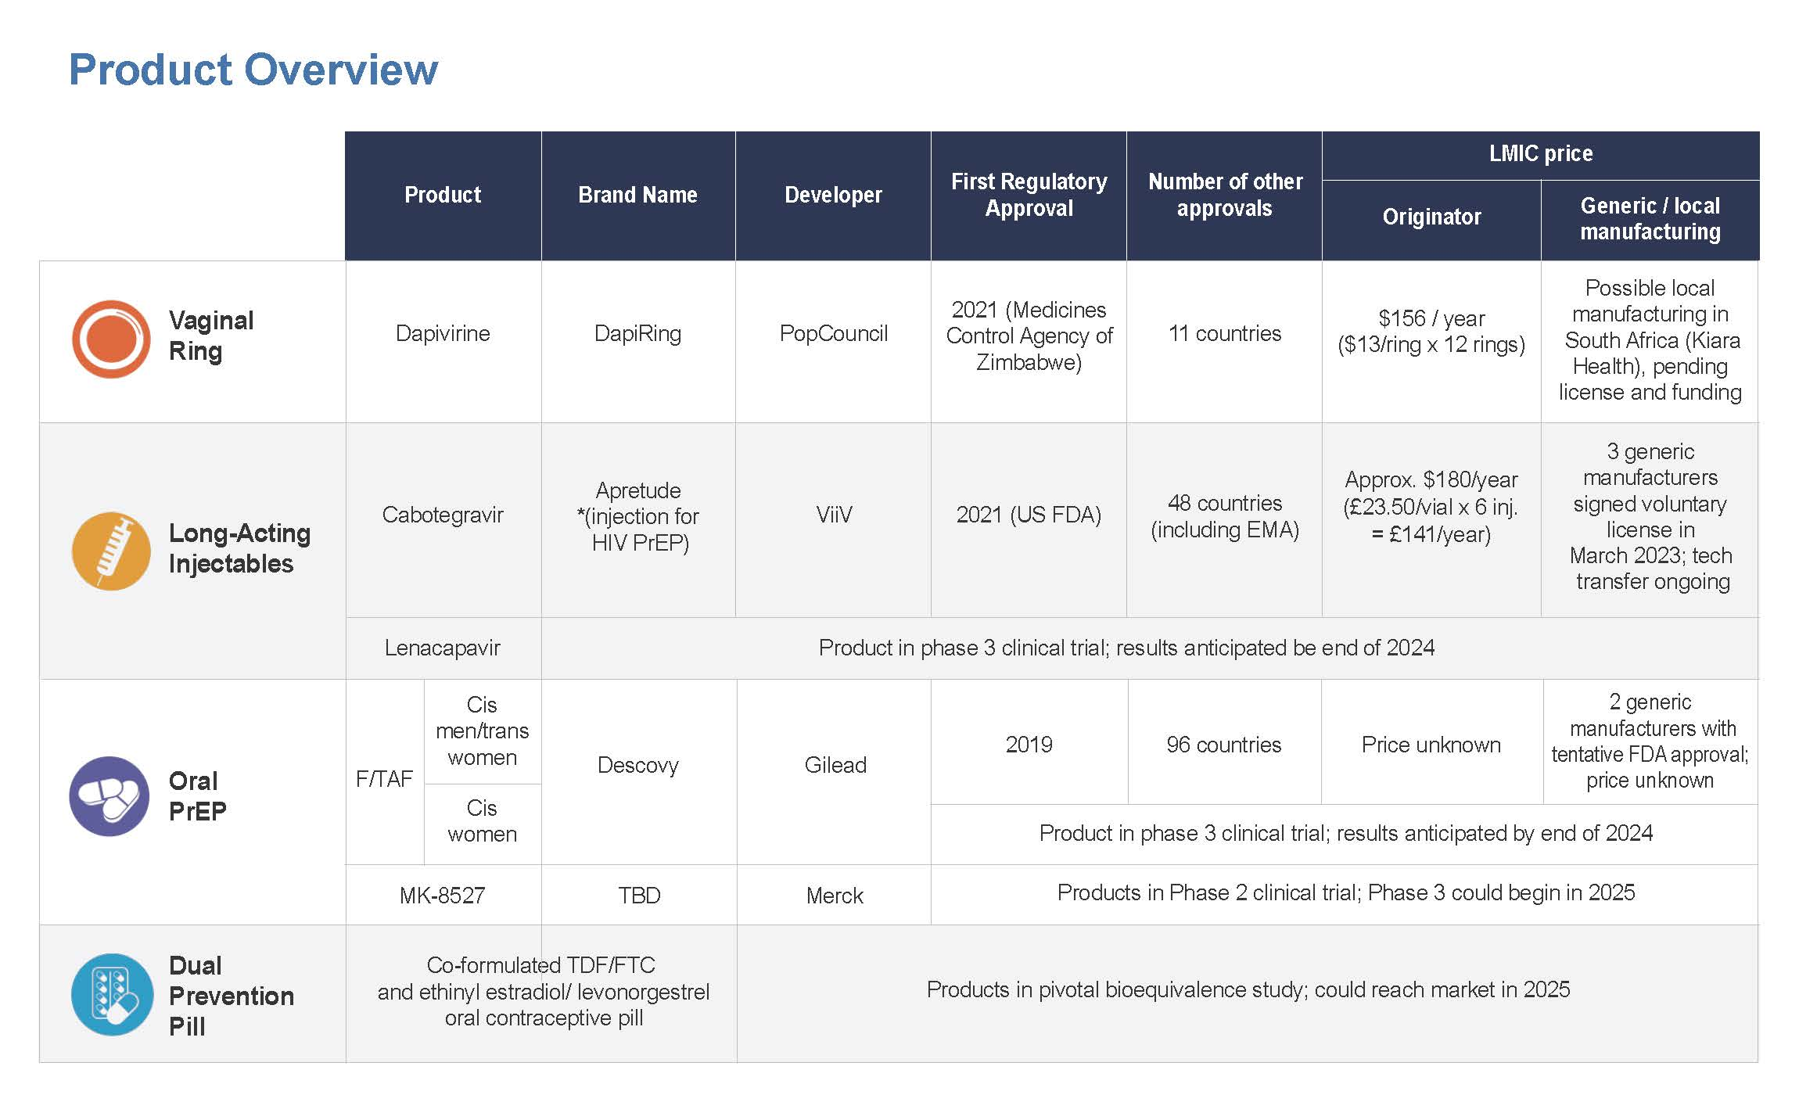
https://www.prepwatch.org/products/
Notes:
we currently have several biomedical options available for prep including daily oral on demand and injectable options as well as other prevention options that are still in development either recommended like the vaginal ring but not yet available and other products including D nabs HPV vaccines and implants in development I'm gonna focus on uh be nabs as an option for HIV prevention

Slide 4
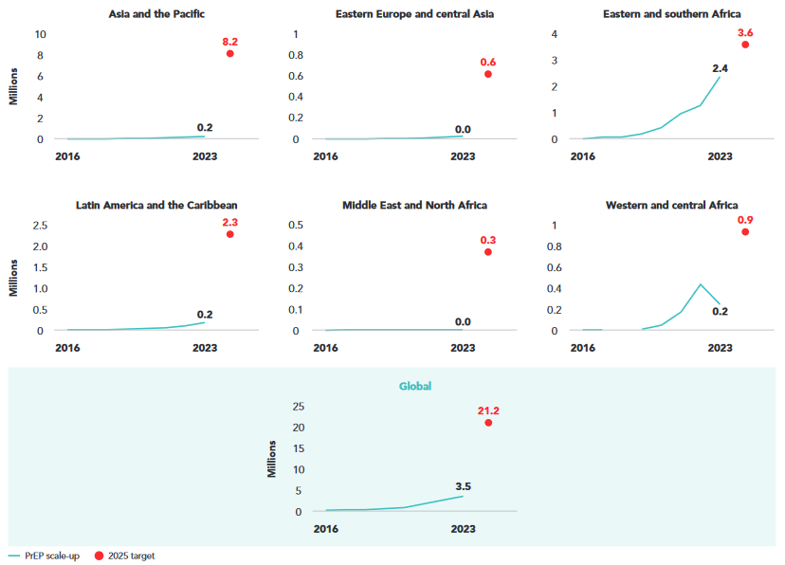
Number of People Who Have Used PrEP at Least Once
The urgency of now: AIDS at a crossroads. Geneva: Joint United Nations Programme on HIV/AIDS; 2024
Notes:
According to the UN 2024 report we are very far from our target of and having over 21 million globally access prep. We are also far away in all of our regional targets clearly demonstrating that we have a lot of ground to make up for increasing prep use
Note: In the global model to estimate PrEP need to achieve 2025 targets, PrEP need was defined as ‘person-years of PrEP’ meaning use for a period of 12 months. Country reporting, however, is done using the indicator ‘people who used PrEP at least once in the past 12 months’. For the purpose of this chart it was assumed that average duration of PrEP use was 6 months. Based on this assumption, the global target of 10.6 million person years of PrEP use was translated into an indicative target of 21.2 million PrEP users. The same logic was applied to regional targets.

Slide 5

The Impact of Supporting PrEP Choice
SEARCH Dynamic Choice Intervention
  Client choice of PrEP or PEP product, service location (clinic or out-of-clinic) and HIV testing modality (self-test or rapid test;
  A structured assessment of patient barriers and development of a personalized support plan;
  Phone access to a clinician 24/7
Product Use (ever) | Dynamic Choice | Standard of Care
CAB-LA | 56% | 0%
Oral PrEP | 53% | 19%
PEP | 2% | 1%
2+ products | 28% | 0.4%
HIV prevention Coverage was 56.4% higher (p<0.001) (DCP: 69.7% vs SoC: 13.3%)
  Significant increases across all subgroups (CGW, CGM, 15-24years, 25+ years)
>50% choose CAB-LA when offered. Many (42%) hadn’t used PrEP in the prior month.
HIV Incidence: DCP: 0% vs SoC: 1.8%
Moses, et al. CROI 2024 #172
Notes:
These options now give us the ability to provide make choice of prep options we have significant evidence from the contraceptive literature that giving more choice allows increased uptake of contraception overall and we now have data from the search dynamic choice intervention that this is also true for prep in the setting of HIV prevention as you heard about yesterday at the plenary session of the endemic choice intervention provided a users a choice of pepper prep product and also support for use of that preferred option including um where people receive um prep how they how they undergo testing support for addressing barriers and a support plan and access to a on call clinician. With this intervention they the observed increase um use of all the prep options including more than half choosing cabotegravir pro prep relatively low amounts of pepper use but nearly 30% using two or more products during the study. Coverage was close to 70% compared with standard of care and much higher across all subgroups including cisgender women cisgender men um and age groups from 15 to 24 and 25 and older interestingly many of those who chose uh injectable prep with cavallet um had not used prep in the last month. And with this dynamic choice prevention intervention they saw zero HIV infections in the follow up. Compared to 7 or 1.8% than the standard of care arm really demonstrating that impact the high impact of offering choice of in particular with long acting agents on HIV incidence

Slide 6
Long History of Passive Immunization with Abs
INFECTION | INDICATION | PRODUCT | YEAR
Tetanus | Prevention, Treatment | Equine antitoxin | 1890
 |  | Human tetanus immune globulin (TIG) | 1960
Measles | Prevention | Concentrated human gamma globulin | 1944
Hepatitis A | Prevention (travel), post exposure | Immune serum globulin (ISG) | 1945
Polio | Prevention | Concentrated human gamma globulin | 1951
Rabies | Post exposure | Rabies Immune Globulin | 1954
Varicella Zoster | Post exposure | Varicella Zoster Immune Globulin | 1978
Hepatitis B | Post exposure | Hepatitis B Immune Globulin | 1984
Cytomegalovirus | Prevention | Cytomegalovirus Immune Globulin | 1987
RSV | Prevention | Pooled human Immune Globulin | 1995
 |  | Monoclonal antibody (palivizumab) | 1998
 |  | Monoclonal antibody (nirsevimab) | 2022
Ebola virus | Treatment | Monoclonal antibodies | 2020
SARS-CoV-2 | Prevention, Treatment | Monoclonal antibodies | 2020
HIV | Prevention, treatment | Monoclonal antibodies | 2021
Malaria | Prevention | Monoclonal antibody | 2022
Notes:
As we consider bnAbs for HIV prevention it's important to consider context that we have used antibodies for passive immunization for more than 100 years across multiple infectious disease states from tetanus in the late 1800s through RSVP um monoclonal antibodies approved in 2022

Slide 7
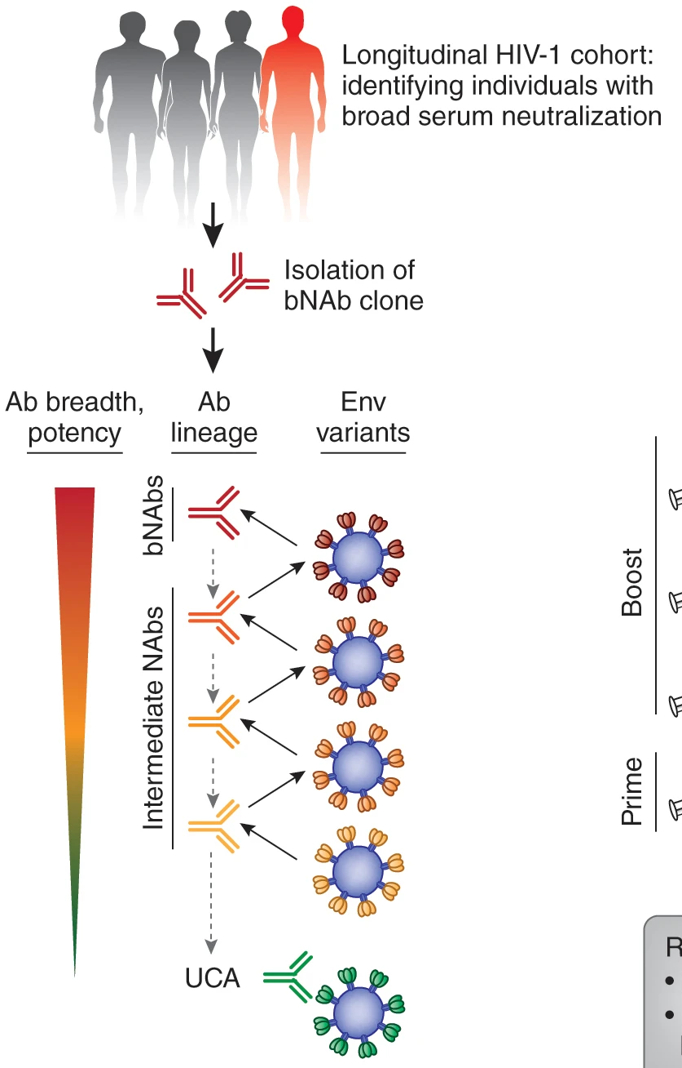
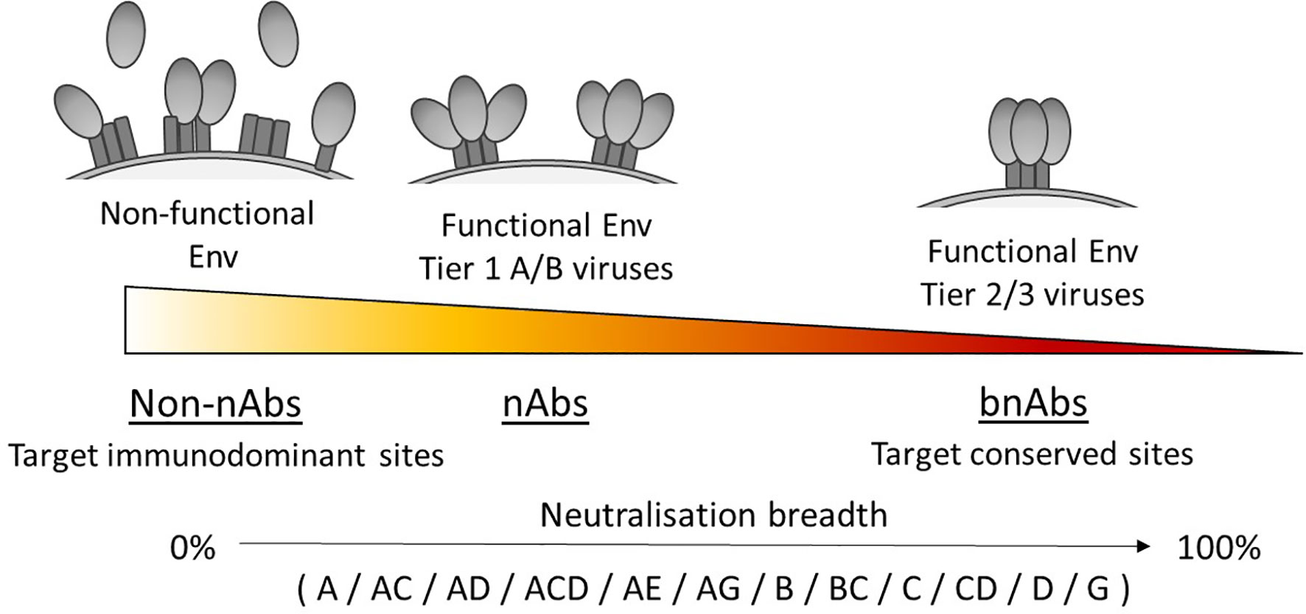
bnAbs for HIV Prevention
>300 different HIV bnAbs have been isolated from people living with HIV
Target various conserved sites on the HIV Envelope (Env)
Gruell et al Nature Med 2014, Yoon et al Nucleic Acids Res 2015, Griffith et al Front Immol 2021
Notes:
HIV bnAbs really represent a very rare group of antibodies identified in cohorts of people living with HIV. Only approximately 10% of people develop bnAbs, and only 1% of these bnAbs have high neutralization activity. Currently there are more than 300 of these antibodies which target various conserved sites on the HIV envelope that have broad neutralization of different HIV clades

Slide 8
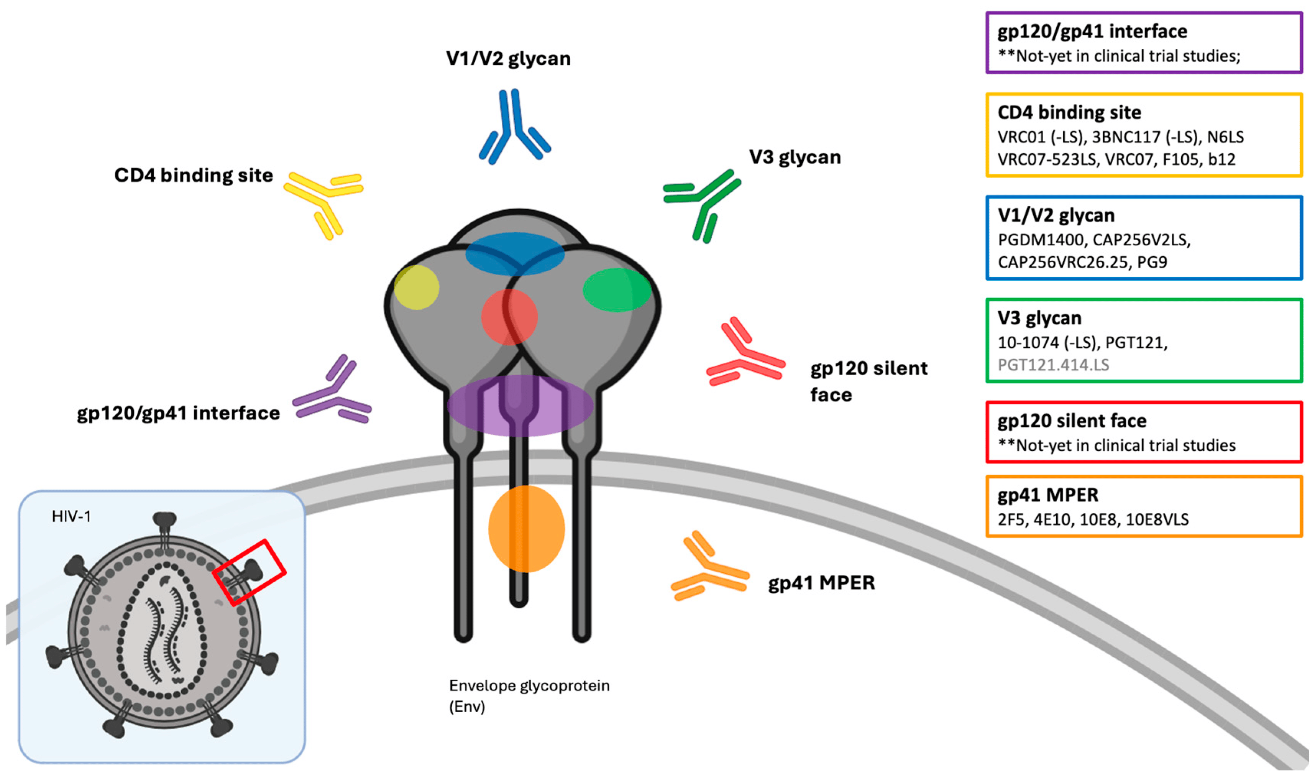

bnAbs in Clinical Development
V1/V2 apex
V1/V2 apex
Thavarajah et al Viruses 2024
Notes:
bnAbs moving through clinical development target various conserved sites on the HIV env including the membrane proximal region, the CD 4 binding site, the V1V2 apex, and the V3 glycan. Each of these targets have have several antibodies including VRC 01 targeting the CD 4 binding site PGDM 1400 uh targeting the V1V2 apex VG PGT 121 target V3 glycan and 10E8 targeting the MPER region

Slide 9
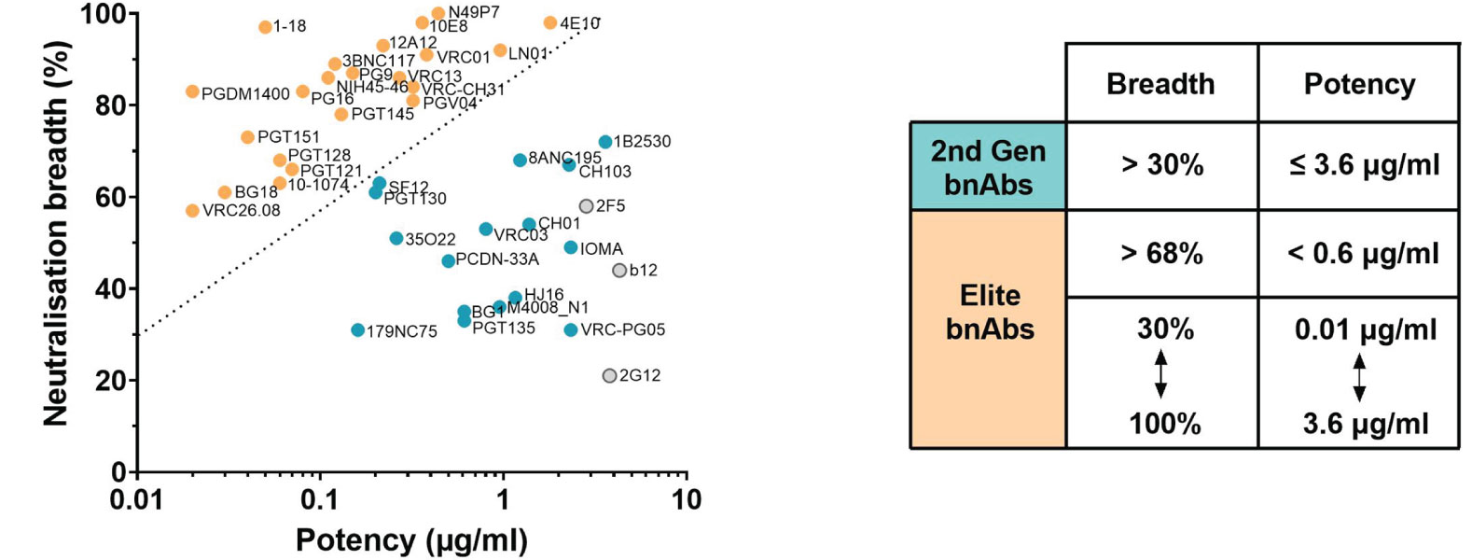
Some bnAbs are “Elite”
Griffith et al Front Immol 2021
Notes:
Not all of these antibodies are created equal and some of these antibodies are quote elite with increased breadth and potency allowing lowered amount to the antibody to neutralize um a wide breadth of of HIV viruses these include the antibodies that are shown in the yellow on the upper left of the graph including the ones that I mentioned VC VRC 01 PGDM 1400 and PDT 121 but there are multiple antibodies that are have this these characteristics that make them appealing to move forward through clinical development

Slide 10
HIV bnAb clinical trials in adults without HIV – HVTN/HPTN & VRC
 | 2013 | 2014 | 2015 | 2016 | 2017 | 2018 | 2019 | 2020 | 2021 | 2022 | 2023 | 2024 | 2025 | 2026 | 2027 | 2028 | 2029
VRC
HVTN / HPTN
VRC 602 – VRC01
VRC 606 – VRC01LS
Legend
VRC 605 – VRC07-523LS
Single antibodies
VRC 609* – N6LS
Single antibodies, LS versions
VRC 610* – 10E8VLS, VRC07-523LS
TERMINATED 3/2019
VRC 611 – CAP256V2LS
Antibody combinations
VRC 615 – VRC01.23LS
Next-generation ebnAbs
Phase 1 = black font
HVTN 104 – VRC01
Phase 2-3 = red font
HVTN 703 / HPTN 081 – VRC01
HVTN 704 / HPTN 085 – VRC01
HVTN 116 – VRC01, VRC01LS
HVTN 127 – VRC07-523LS
HVTN 128 / HPTN 087 – VRC07-523LS
HVTN 130 / HPTN 089 – PGT121, PGDM1400, 10-1074, VRC07-523LS
combo-AMP 1 – VRC07-523LS, PGT121.414.LS, PGDM1400LS
HVTN 136 / HPTN 092 – PGT121.414.LS, VRC07-523LS
combo-AMP 2 – VRC07-523LS, PGT121.414.LS, PGDM1400LS
HVTN/HPTN
> 4900 participants
> 50 sites
11 countries
HVTN 140 / HPTN 101 – VRC07-523LS, PGT212.414.LS, PGDM1400LS
Notes:
The CD4 binding site bnAb VRC01 was the first antibody to move forward through clinical development 1st through the vaccine Research Center study 602 and then the Phase 1 two trial HVTN 104 should evaluate its safety and was followed by the synergized AMP studies.

Slide 11
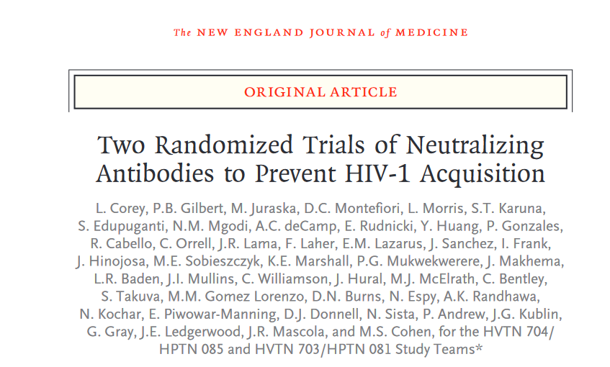
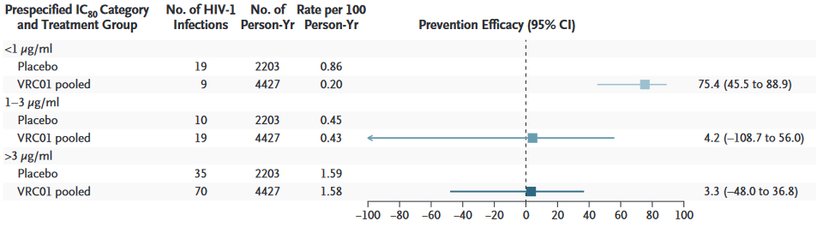
Antibody Mediated Prevention (AMP) Trials
HVTN 703/HPTN 081 & HVTN 704/HPTN 085
Corey et al NEJM 2021
Notes:
The proof of concept AMP studies showed that while there was no overall prevention efficacy that among a subset of sensitive viruses prevention efficacy was approximately 75% And that this prevention efficacy declined with the increasing resistance of viruses to VRC 01 really highlighting the importance of the combination being up strategy for HIV prevention in many ways similar to the multiple drug ARV strategy used for HIV treatment

Slide 12
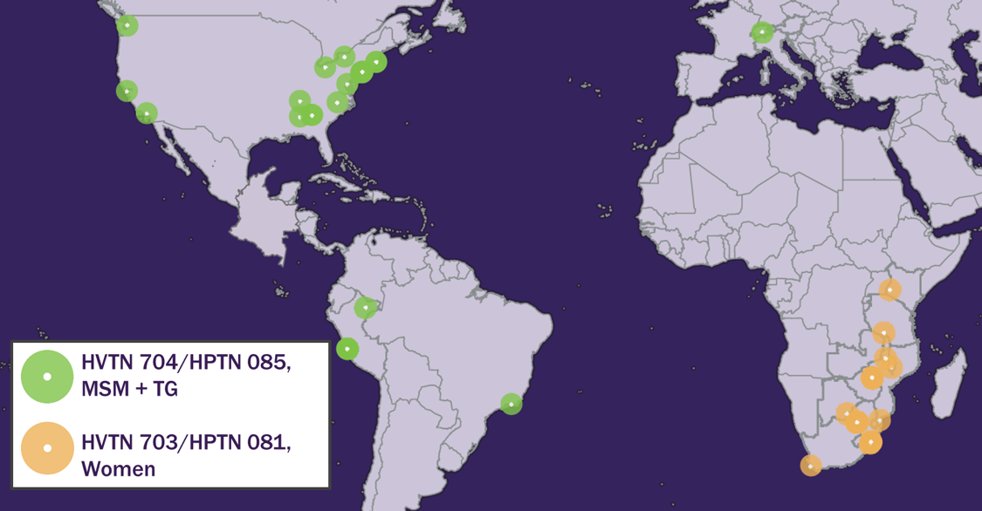
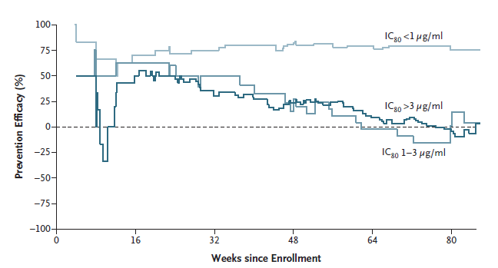
AMP studies gave a roadmap for bnAbs for HIV Prevention
HIV prevention with 1 bnAb (VRC01) is possible
  VRC01 protected only against acquisition of highly neutralization-sensitive viruses
  Provided correlate of protection
HIV bnAbs are safe and well tolerated
  Most participants have no solicited AEs
  AE rates saline placebo ~ active product
Large scale IV administration in a clinical trial is possible in Africa & Americas
  Enrollment: 4,625 participants
  Retention: 95% of 97,458 visits
  Adherence: 99% of 41,116 infusions
AMP used to develop the blueprint and define the PK targets for achieving >90% HIV prevention efficacy in future bnAb trials
Corey et al NEJM 2021
Notes:
The amp studies really demonstrated did HIV prevention with U MB nabs is possible and that these be nabs as tested are safe and well tolerated and in the amp study most participants had no solicited AE's and that the AE rates were similar between the active product and placebo importantly large scale Ivy administration and clinical trial is possible with enrollment of over 4000 participants with 95% retention and 99% adherence to over 41,000 infusions during these two trials. The data from amp has been used to define PT80 goal which is being used as a target for achieving greater than 90% HIV prevention efficacy in future B nab trials.

Slide 13
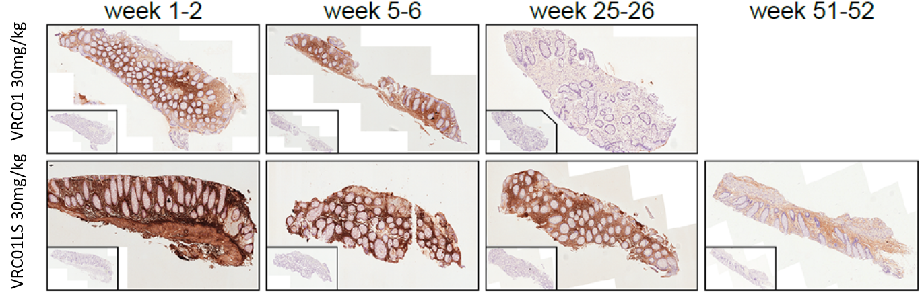
Improved PK with “LS” Mutation
Extends serum half-life
  Amino acid mutation in Fc region of improves affinity for neonatal FC receptor (FcRn), increases concentration in mucosa, triples half-life from ~20 to ~60 days - allowing dosing every 6 months
Facilitates concentration in the mucosa
Image: M. Lemos, R. Astronomo, HVTN 116 Study Team.
Astronomo J Clin Invest. 2021 Aug 16; 131(16); Guadenski et al Lancet HIV 2019
Notes:
Since the AMP trials there have also been modifications made to several antibodies including the addition of the LS mutation which is an amino acid mutation in the FC region which increases concentrations in mucosa, concentrating the bnAb at the sites of exposure, and tripling the half life from approximately 20 to 60 days allowing extended dosing intervals and more favorable dosing frequency of every 6 months.

Slide 14
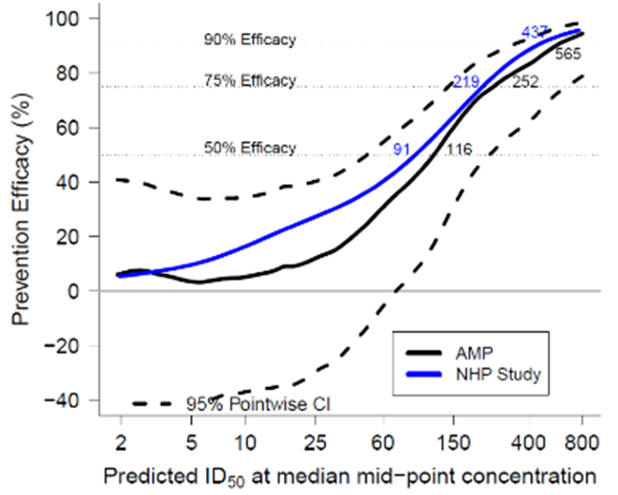
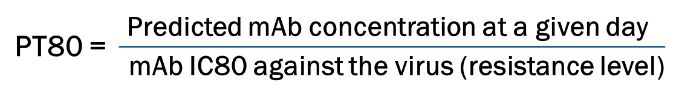
Designing the next bnAb Trial(s)
ARV-based PrEP has set the bar for prevention efficacy targets.
Correlates of protection developed from NHP and AMP
PT80:
  Predicted serum inhibitory dilution 80% titer (ID80) of a bnAb or combination bnAb regimen against a specific virus
  Improve mAb regimens by increasing the numerator and/or decreasing the denominator
Goal to apply the PT80 marker for design of the next bnAb clinical trials (Goal PT80 >200)
Gilbert et al. Nat Med 2022; 28:1924-1932
Notes:
ARV-base PrEP has set the bar for prevention efficacy and using the correlates of protection developed from non human primates in the amp study including the PT 80 which accounts for the predicted concentration of the antibody on any given day as well as the resistance of the virus to estimate prevention efficacy level in choosing a combination antibody it's really focused on improving regimens by buy two thing target antibody concentrations and maintaining potency and activity live in individual antibody or combination against circulating viruses this PTSD marker is used to design set targets for serum concentrations likely to achieve >90% effiacy for the next efficacy trial

Slide 15
Improved Breadth and Potency of a Triple bnAb Combination
50x
Triple bnAb combination is predicted to neutralize nearly 100% of clade C viruses with potency ~50x greater than VRC01.
David Montefiori
Notes:
The combination of the three antibodies VRCO7_523LS PGDM 1400 PGT 121 is thought to have at least 50 fold greater potency than VRC 01 alone and neutralize nearly 100% of Clade C viruses demonstrating

Slide 16
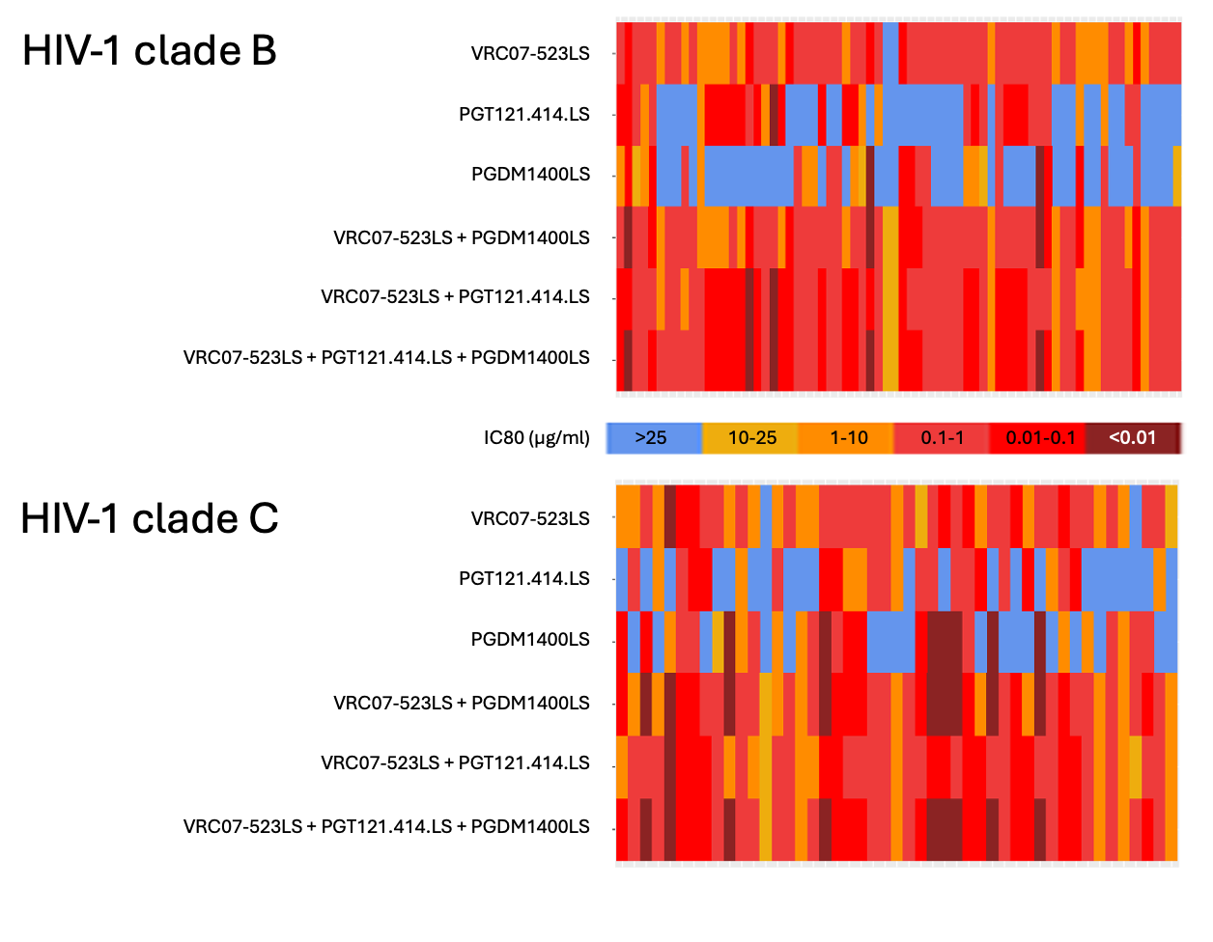
Complementary Coverage of HIV Isolates from AMP
Notes:
Since no one antibody has 100 coverage, each has “holes” in coverage. This combination of antibodies cover the gaps in breadth. Viruses are most likely to be sensitive to at least one of the bnAbs in the combination providing the highest likelihood that they will be resistant to all bnAbs.

Slide 17
bnABs in Clinical Development for Likely Efficacy Trial
PGDM1400LS
V1/V2 apex
VRC07-523LS
PGT121.414.LS
V1/V2 apex
Notes:
The three antibodies moving forward through clinical development or like the efficacy trial targeting 3 separate sites including the CD 4 binding site for the VRC07-523LS the V2/V2 apex for PGDM 1400 LS and the V3 glycan for PGT 121414 LS
VRC07-523LS
VRC07-523LS is a human mAb targeting the HIV-1 CD4 binding site, developed by NIAID-NIH at the VRC. VRC07-523LS was isolated from donor 45 from the US. VRC01 was also isolated from donor 45. At the time of isolation of these bnAbs, donor 45 had been infected with HIV-1 for more than 15 years, controlling the virus without ART (32, 33). (34). The VRC07 (wild-type) heavy chain was identified by 454 deep sequencing and was then engineered to pair it with the VRC01 (wild-type) light chain to form VRC07-523LS.
PGT121.414.LS
PGT121.414.LS is an engineered variant of PGT121, which is a bnAb identified from donor 17 from Rwanda in the International AIDS Vaccine Initiative (IAVI) Protocol G cohort. PGT121 targets the V3 glycan-dependent epitope region of the HIV-1 Env (2). Compared to the parental PGT121, PGT121.414.LS contains 8 amino acid mutations, 2 in the light chain and 6 in the heavy chain, to improve various aspects of manufacturing, stability and in vivo elimination half-life (LS mutation ) (35, 36).
PGDM1400LS
PGDM1400LS is a modified version of PGDM1400, which is a bnAb identified from donor 84 from Zambia in the IAVI Protocol G cohort. PGDM1400 targets a V2 apex epitope region of HIV-1 Env (37). Compared to the parental PGDM1400, PGDM1400LS contains 2 amino acid mutations, the LS mutation, and no other mutations (35) .

Slide 18
Three Leading LS-bnAbs with Safety, Pharmacokinetics and Neutralization Data
mAb (dose range) | HIV-1 epitope specificity | Total participants | Studies**
VRC07-523LS (5-40 mg/kg) | CD4 binding site | 496 | First-in-human: VRC605 (n=25) HVTN127/HPTN087 (n=120) HVTN128 (n=24) HVTN130/HPTN089 (n=27) HVTN136/HPTN092 (n=20) HVTN140/HPTN101 (n=80)* HVTN206/HPTN 114 (n=200)*
PGDM1400LS (5-40 mg/kg) | V1V2 Apex | 295 | First-in-human: HVTN140/HPTN101 (n=95)* HVTN206/HPTN114 (n=200)*
PGT121.414.LS (5-40 mg/kg) | V3 Glycan | 312 | First-in-human: HVTN136/HPTN092 (n=32) HVTN140/HPTN101 (n=80)* HVTN206/HPTN114 (n=200)*
*PK data from 140/101 Part B are not yet available as of April 2024;** Studies not conducted by VRC or HVTN/HPTN are not included.
Notes:
Summary table shows that both all three of these antibodies have been evaluated in multiple studies at this point um at range of doses from 5 milligrams per kilograms to 40 milligrams per kilogram with favorable safety PK and neutralization data.

Slide 19
6 Phase 1 HIV bnAb trials since AMP by HVTN/HPTN Partnership
 | LS versions with extended half-life for dosing Q6M |  |  | Combinations of 2 or 3 bnAbs for increased Prevention Efficacy
Study | HVTN 116 | HVTN 127 / HPTN 087 | HVTN 128 | HVTN 130 / HPTN 089 | HVTN 136 / HPTN 092 | HVTN 140 / HPTN 101
Products | VRC01, VRC01LS | VRC07-523LS | VRC07-523LS | VRC07-523LS + PGT121 + PGDM1400 | VRC07-523LS + PGT121.414.LS | VRC07-523LS + PGT121.414.LS + PGDM1400LS
N = Dose range | N = 74 10-30 mg/kg | N = 120 2.5-20 mg/kg | N = 24 10-30 mg/kg | N = 27 20 mg/kg | N = 33 3-30 mg/kg | N = 95 5-40 mg/kg
Is it safe? | Yes | Yes | Yes | Yes | Yes | Yes
Was there interference between multiple bnAbs? | NA | NA | NA | No | No | No
Were PK predictions accurate? | Yes | Yes | Yes | Yes | Yes | Yes
Do bnAbs retain neutralizing activity 6 months after administration? | Yes | Yes | Yes | Yes | Yes | Yes
Do neutralizing titers correlate to serum concentrations 6 months after administration? | Yes | Yes | Yes | Yes | Yes | Yes
Where the neutralization predictions accurate? | Yes | Yes | Yes | Yes | Yes | Yes
Can we give a fixed dose? | NA | NA | NA | NA | NA | Yes
Where there any clinically relevant ADA? | No | No | No | No | No | No
Notes:
These data across studies have really shown that these antibodies are safe there does not appear to be interference between the multi multiple bnAbs When administered together that the PK predictions are accurate and that these antibodies remain retain affiliation activity for at least six months after administration the neutralization titers do correlate with serum concentrations in all of these studies um and these predictions the predicted neutralization um patterns were accurate only studies evaluated a a fixed dose that was a V 10140 HP 10101 study um which showed that this can be given in as a fixed dose as opposed to weight based dose which should be more complicated to implement um there is also no evidence of anti drug antibodies developed after administration with any of these bnAbs
All objectives for combo-AMP candidate bnAbs VRC07-523LS + PGT121.414.LS + PGDM1400LS have been met:
Safety
Pharmacokinetics
LS versions allow Q6M dosing
No interference between 3 bnAbs
Pharmacokinetics predictions are accurate
Neutralization
bnAbs retain neutralizing activity up to 6 months after dosing
Neutralizing titers correlate to serum levels 6 up to months after dosing
Neutralization predictions are accurate
Fixed dose comparable to weight-based dose
No clinically relevant ADA
We can give 3 bnAbs at the same time once every 6 months in a fixed dose combination in combo-AMP
Next step: HVTN 206 / HPTN 2XX, more safety data (n=200) for intended combo-AMP combinations VRC07-523LS + PGT121.414.LS + PGDM1400LS 3200 + 1600 + 1600 mg & 400 + 400 + 400 mg before we start combo-AMP efficacy trial

Slide 20
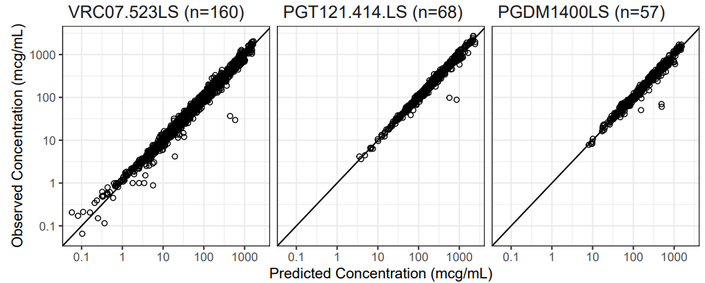
PK model fits observed concentration data for each bnAb
Data from HVTN 140 / HPTN 101, HVTN 136 / HPTN 092, HVTN 130 / HPTN 089
Notes:
Data show that In general, the population PK models fit the concentration-time curves well for PGDM1400LS, PGT121.414.LS and VRC07-523LS, with most observed concentrations lying in the 90% prediction intervals.
Figure 2 PK Model fits observed concentration data well. Top panels, data from HVTN 140 / HPTN 101 part B, selected data copied from PK report Figure 4 (PGDM1400LS), Figure 9 (PGT121.414.LS) and Figure 14 (VRC07-523LS). Bottom panels, data from HVTN 140 / HPTN 101, HVTN 136 / HPTN 092, HVTN 130 / HPTN 089. Serum bnAb levels measured by BAMA. In general, the population PK models fit the concentration-time curves well for PGDM1400LS, PGT121.414.LS and VRC07-523LS, with most observed concentrations lying in the 90% prediction intervals. The point here is to show that we can accurately predict PK.

Slide 21
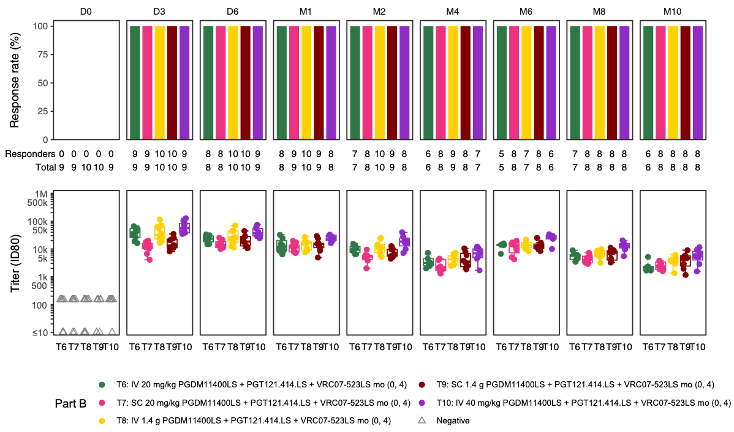
Neutralization up to 6 months post bnAb administration (Data from HVTN 140 / HPTN 101 part B)
2nd dose
Notes:
Figure 8 Neutralization data up to 6 months post bnAb administration
Data from HVTN 140 / HPTN 101 part B. nAb response rate and titer to bnAb- specific viruses (this example CH505TF.N334S.N160A.N280D.1) across treatment arms by visit. The point here is to show that with the exact 3 bnAbs combination that we want to take into combo-AMP there is neutralization up to 6 months post product administration (M10 on the right is 6 months post 2nd product administration), assessed with serum samples from participants.

Slide 22
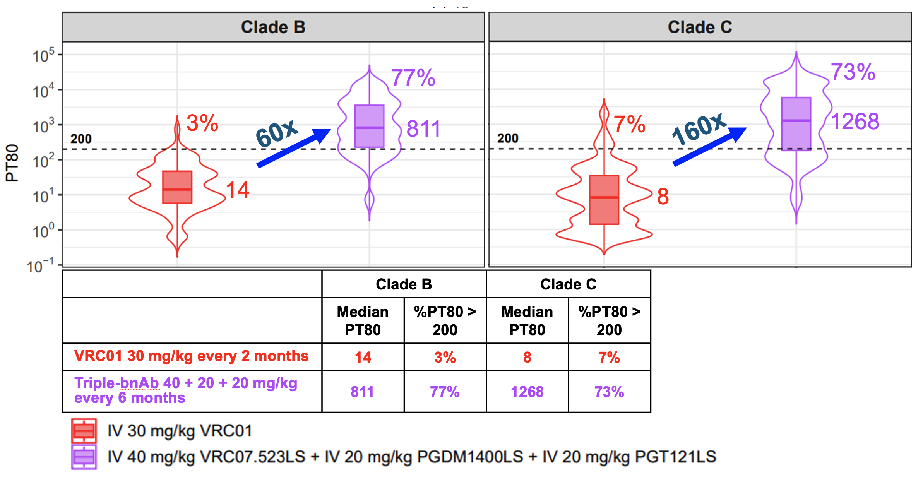
Time-averaged (median) PT80 across individuals and viruses
Data from HVTN 140 / HPTN 101, HVTN 136 / HPTN 092, HVTN 703 / HPTN 081 (AMP) and HVTN 704 / HPTN 085 (AMP)
Notes:
This triple bnAb regimen shows increased potency and breadth compared to a single bnAb (VRC01). The median PT80 is 60 time higher for Clade B viruses and 160 times higher for Clade C viruses.
Figure 14 Time-averaged (median) PT80 across individuals and viruses
Data from HVTN 140 / HPTN 101, HVTN 136 / HPTN 092, HVTN 703 / HPTN 081 (AMP) and HVTN 704 / HPTN 085 (AMP). The median PT for triple-combination doses 40 + 20 + 20 every 6 months compared to VRC01 30 mg/kg every 2 months is 60 times higher for clade B viruses and 160 times higher for clade C viruses. The point here is to show the improved potency and breadth of the triple-bnAb combination compared to a single bnAb.

Slide 23
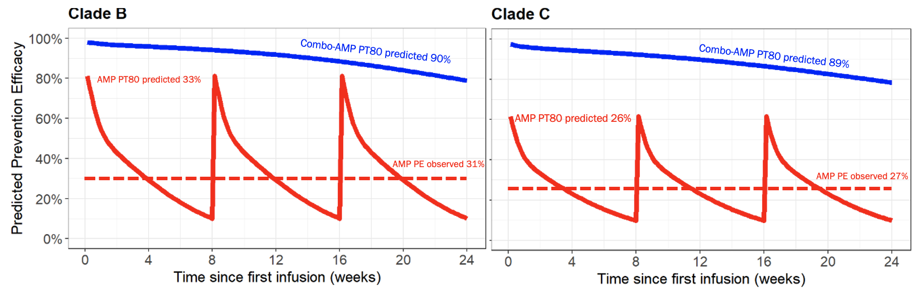
Triple-bnAb combination predicted PT80 efficacy compared to single bnAb in AMP
Notes:
Using the PT80 target of 200, the predicted prevention efficacy this combination regimen is approximately 90%, compared to overall approximately 30% observed in the AMP trials.
Figure 11 Triple-bnAb combination predicted PT80 efficacy compared to single bnAb in AMP
Predicted PT80 of VRC07-523LS 40 mg/kg + PGT121.414.LS 20 mg/kg + PGDM1400LS 20 mg/kg IV every 6 months (solid blue line). Predicted PT80 for VRC01 30 mg/kg IV every 2 months (solid red line). Prevention efficacy observed in AMP for VRC01 30 mg/kg IV every 2 months (dotted red line).

Slide 24
bnAb Efficacy Trial Design Considerations
The next efficacy trial design will include planned community, stakeholder, and regulator convenings for input and feedback BEFORE finalized.
Some PrEP consideration for trial designs:​
  Participant selection: Should interest and/or use of PrEP prior to enrollment in a bnAb efficacy trial be an eligibility criteria.​
  Placebo arm inclusion: Ethical and community considerations of a placebo arm in the era of PrEP.​
  PrEP: Management of PrEP as part of a standard prevention package.​
Notes:
And of course these trials are now occurring in the context of highly efficacious PrEP options so the trial design will require discussion with community, stakeholders, and regulators for input and feedback prior to finalization. There are considerations for PrEP including participant, selection. Inclusion of a placebo arm, and how PrEP is managed throughout the study.

Slide 25
PrEP Product level Considerations
Oral PrEP
  Pros
    Daily and on-demand options
    Implementation Flexibility
    Minimal clinical monitoring for most patients
    Efficacy data in all populations
    Quarterly HIV testing
    Cost – Generic TDF/FTC available
  Cons
    Daily adherence or complex regimen
    Pills may not be acceptable or preferred for all populations.
Injectable PrEP
  Pros
    Superior efficacy
    Daily adherence not required
    Injections every 6 months (LEN)
    Discretion in use
  Cons
    Increased visits (CAB)
    HIV testing requirements
    Cost and access
    Breakthrough HIV infections (CAB)
bNABs (Theoretical)
  Pros
    Efficacy?
    Infusion frequency (every 6 months?)
    Discretion in use
    No concern for ARV resistance
  Cons
    Administration route
    Visit duration?
    Cost and access?
Notes:
There are important pros and cons for each of the PrEP options. With oral PrEP allowing daily and on-demand options, flexible implementation, data across multiple populations, and favorable cost. But requires daily adherence. Injectable PrEP has shown superior efficacy in clinical trials with description and preference among multiple populations; but requires administration by a healthcare provider, and for CAB-LA more frequent visits and both CAB and LEN higher cost compared with oral PrEP. And bnAbs would have similar set of pros and cons to long acting injectable PrEP, but the with an additional con of IV administration for the formulations currently being evaluated.

Slide 26
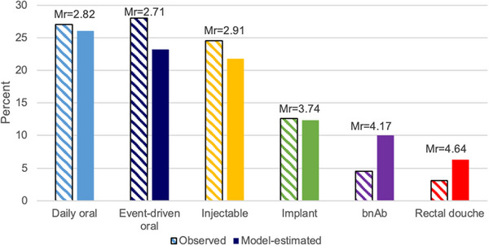
Product Preferences among Young MSM in the US
4th ranked preference among YMSM compared to Daily Oral PrEP
bnAbs preferred among YMSM who had prior HIV testing and PrEP experience
Highest Endorsed Reasons:
  Not worried about remembering to take it
  Ease of use
  Privacy
  Perceived protection against HIV
Biello JIAS 2023
Notes:
We heard about PrEP choice in the plenary yesterday and in this conjoit analysis of Product preferences among young MSM in the US – it’s clear that no product is overwhelmingly favored; and that bnAbs, didn’t require daily use, offered ease of use, privacy, and perceived protection from HIV

Slide 27
Summary
Passive immunization with Ab has a long history for infectious disease prevention and treatment.
The AMP trials have provided the blueprint for the next combination of bnAb trials
Several bnAbs are moving through the clinical development pipeline and have shown favorable safety, PK, and neutralization characteristics.
Combination HIV Prevention bnAb trial(s) will require broad input from community and stakeholders.
bnAbs could provide a new PrEP option to expand PrEP choice.

Slide 28
HVTN/HPTN bnAb Trials Protocol Team Acknowledgements
Chairs
Christopher Hurt
Colleen Kelley
Cynthia Gay
Erica Lazarus
Hong VanTieu
Hyman Scott
Julie McElrath
Katharine Bar
Kathryn Stephenson
Kelly Seaton
Kenneth Mayer
Larry Corey
Linda-Gail Bekker
Magda Sobieszczyk
Marc Siegel
Maria Lemos
Mike Cohen
Nyaradzo Mgodi
Sharana Mahomed
Sharon Mannheimer
Shelly Karuna
Simba Takuva
Srilatha Edupuganti
Stephen Walsh
Protocol Team Leaders
Carmen Paez
Nicole Grunenberg
Phil Andrew
Philipp Mann
Shelly Karuna
Theresa Gamble
Will Hahn
Statisticians
Allan DeCamp
Brett Hanscom
Chenchen Yu
Deborah Donnell
Michal Juraska
Ollivier Hyrien
Peter Gilbert
Sahar Zangeneh
Timothy Skalland
Ying Chen
Youyi Fong
Yunda Huang
Medical Officers
Catherine Yen
Chuka Anude
David Burns
Jane Baumblatt
Laura Polakowski
Margarita Gomez
Mary Allen
Peggy Yacovone
Randy Tressler
Wairimu Chege
Laboratory Leads
David Montefiori
Estelle Piwowar-Manning
Maria Lemos
John Hural
Notes:
HVTNs 104, 116, 127/087, 128, 129/088, 130/089, 131/090, 136/092, 703/081, 704/085, 804/095, 805/096

Slide 29
HVTN/HPTN bnAb Trials Protocol Team Acknowledgements
Data Management
Alison Ayers
April Randhawa
Carik Tranfaglia
Claire Chapdu
Gina Escamilla
Ingrid Durrenberger
Kris Donaty
Lisa Sunner
Lisel Koepl
Lynda Emel
Melissa Cummings
Nate Holm
Statistics
Abby Isaacs
Doug Grove
Erika Rudnicki
Fei Gao
Hua Zheng
Kyle Marshall
Mengshu Shao
Nidhi Kochar
Xue Han
Lab Representatives
Amber Moser
Denni Lennon
Eva Chung
Jen Hanke
Lisa Sanders
Mary Gross
On Ho
Paul Richardson
Rena Astronomo
Robert Coombs
Susan Eshleman
Vanessa Cummings
Notes:
HVTNs 104, 116, 127/087, 128, 129/088, 130/089, 131/090, 136/092, 703/081, 704/085, 804/095, 805/096

Slide 30
HVTN/HPTN bnAb Trials Protocol Team Acknowledgements
CAB Members
Dana Atkins
David Crawford
Derrick Mapp
Ebony Gordon
Gary Daffin
Hakeem White
Jamel Young
Jim Wick
Kyle Warren
Lenka Tswenyana
Likhapha Faku
Mark Hubbard
Melissa Turner
Naiymah Sanchez
Paul Marcelin
Ray Allmond
Richard Laboy
Selena-Leyla Chavez
Steve Csipke
Tasia Baldwin
W Scott Cooley
CERs
Brian Kanyemba
Chelsea Greer
Christie Lyn Costanza
DaShawn Usher
Eddie Bravo
Hugo Sanchez
Jorge Benitez
Kim Louis
Lenka Tswenyana
Luciana Kamel
Machel Hunt
Melissa Turner
Noshima Darden-Tabb
Ntando Yola
Rafael Gonzalez
Samuel Cohen
Yi-Hao Jacki Wu
HVTN CEU Representatives
Gail Broder
Stephaun Wallace
Clinic Coordinators
Ana Patricia Rimachi
Brett Gray
Charlie Gregor
Christie Heiberg
Debbie Lucy
Debora Dunbar
Elvin Fontana-Martinez
Geoffrey Kamau
Hannah Yellin
Julie Czartoski
Jun Avelino Loquere
Megan Henry
Maureen Rattley
Milagros Sabaduche
Miriam Chicurel-Bayard
Renata Dennis
Rotrease Regan
Social Behavioral Scientists
Michele Andrasik
HPTN Community Program Assoc.
Abraham Johnson
Jonathan Lucas
Jontraye Davis
Marcus Bolton
Consultants/CERs
Bette Korber
Chelsea Greer
Erica Lazarus
Jorge Gallardo Cartagena
Ken Mayer
Kshitij Wagh
LaRon Nelson
Lucio Gama
Michael Sneller
Tae-Wook Chun
Ethics Consultants
Danielle Wenner
Mark Barnes
Robert Klitzman
Stuart Rennie
Ames Dhai
Notes:
HVTNs 104, 116, 127/087, 128, 129/088, 130/089, 131/090, 136/092, 703/081, 704/085, 804/095, 805/096

Slide 31
HVTN/HPTN bnAb Trials Protocol Team Acknowledgements
CSS
Maija Anderson
Megan Jones
Regional Medical Liaisons
Robert De La Grecca
Azwi Takalani
CTMs/CRMs
Bonnie Dye
Carissa Karg
Carrie Sopher
Dhevium Govender
Elizabeth Greene
India Tindale
Lori Proulx-Burns
Marianne Gildea
Phil Andrew
Shelly Ramirez
Developer Representatives
Boris Julg, BIDMC
Dan Barouch, BIDMC
Kathryn Stephenson, BIDMC
Jennifer Grossman, DAIDS
Nandini Sane, DAIDS
Barney Graham, VRC
John Mascola, VRC
Julie Ledgerwood, VRC
Lucio Gama, VRC
Martin Gaudinski, VRC
Mary E. Enama, VRC
Marina Caskey, Rockefeller
Michael Pensiero, DAIDS
Michel Nussenzweig, Rockefeller
Antoine Deslandes, Sanofi
Carla Lawendowski, Sanofi
Gary Nabel, Sanofi
Jooyun Lee, Sanofi
Editors
Adi Ferrara
Erik Schwab
Richa Chaturvedi
PDMs
Carter Bentley
Daciana Margineantu
Kajari Mondal
Meg Trahey
Ramey Fair
Ryan Jensen
Regulatory Affairs
Meg Brandon
Laurie Rinn
Liz Briesemeister
HPTN LOC Director
Nirupama Sista
Project Coordinators
Anders McConachie
Haven Wilvich
Michelle Robinson
Pharmacists
Irene Rwakazina
Justine Beck
Katherine Shin
Kelly Parsons
Lynette Purdue
Oladapo Alli
Scharla Estep
Shawn Chiambah
Pharmacologist
Julie Dumond
CRS Pharmacist
Kinara Yang
Notes:
HVTNs 104, 116, 127/087, 128, 129/088, 130/089, 131/090, 136/092, 703/081, 704/085, 804/095, 805/096

Slide 32
Thank you to all the site investigators, clinic coordinators, and pharmacists.
Atlanta – Hope Clinic
Atlanta – Ponce de Leon
Blantyre
Birmingham
Boston – Brigham
Boston – Fenway
Cape Town - Groote Schurr
Chapel Hill
Cleveland
Durban – Botha’s Hill
Durban – Chatsworth
Durban – eThekwini
Gaborone
Harare – Milton Park
Harare – Parirenyatwa
Harare – Seke South
Harare – Spilhaus
Hillbrow/Johannesburg – Ward 21
Iquitos
Kericho - KEMRI
Kisumu
Klerksdorp
Lausanne
Lilongwe
Lima – Barranco
Lima – San Marcos
Lima – San Miguel
Lima – Via Libre
Los Angeles – Vine Street
Mamelodi
Maputo
Mbeya
Nashville
Newark
New York – Bronx Prevention
New York – Harlem Prevention
New York – NYBC
New York – Physicians & Surgeons
Philadelphia
Rio de Janeiro – Fiocruz
Rochester
Rustenburg
San Francisco
Seattle
Soweto – Bara
Tembisa – Clinic 3
Vulindlela
Washington DC – GWU

Slide 33
Thank You

Slide 34
Extra Slides

Slide 35
HIV bnAb clinical trials in adults without HIV
 | 2013 | 2014 | 2015 | 2016 | 2017 | 2018 | 2019 | 2020 | 2021 | 2022 | 2023 | 2024 | 2025 | 2026 | 2027 | 2028 | 2029
VRC
HVTN / HPTN
VRC 602 – VRC01
VRC 606 – VRC01LS
VRC 605 – VRC07-523LS
VRC 609* – N6LS
VRC 610* – 10E8VLS, VRC07-523LS
TERMINATED 3/2019
VRC 611 – CAP256V2LS
VRC 615 – VRC01.23LS
HVTN 104 – VRC01
HVTN 703 / HPTN 081 – VRC01
HVTN/HPTN
> 4900 participants
> 50 sites
11 countries
HVTN 704 / HPTN 085 – VRC01
HVTN 116 – VRC01, VRC01LS
HVTN 127 – VRC07-523LS
HVTN 128 / HPTN 087 – VRC07-523LS
HVTN 130 / HPTN 089 – PGT121, PGDM1400, 10-1074, VRC07-523LS
HVTN 136 / HPTN 092 – PGT121.414.LS, VRC07-523LS
HVTN 140 / HPTN 101 – VRC07-523LS, PGT212.414.LS, PGDM1400LS
HVTN 206 / HPTN 114 – VRC07-523LS, PGT121.414.LS, PGDM1400LS
combo-AMP 1 – VRC07-523LS, PGT121.414.LS, PGDM1400LS
combo-AMP 2 – VRC07-523LS, PGT121.414.LS, PGDM1400LS
HVTN 141 / HPTN 105 – VRC07-523LS, ePGT121v1LS, PGDM1400LS
Legend
Single antibodies
Single antibodies, LS versions
Antibody combinations
Next-generation ebnAbs
Phase 1 = black font
Phase 2-3 = red font
combo-AMP antibodies

Slide 36
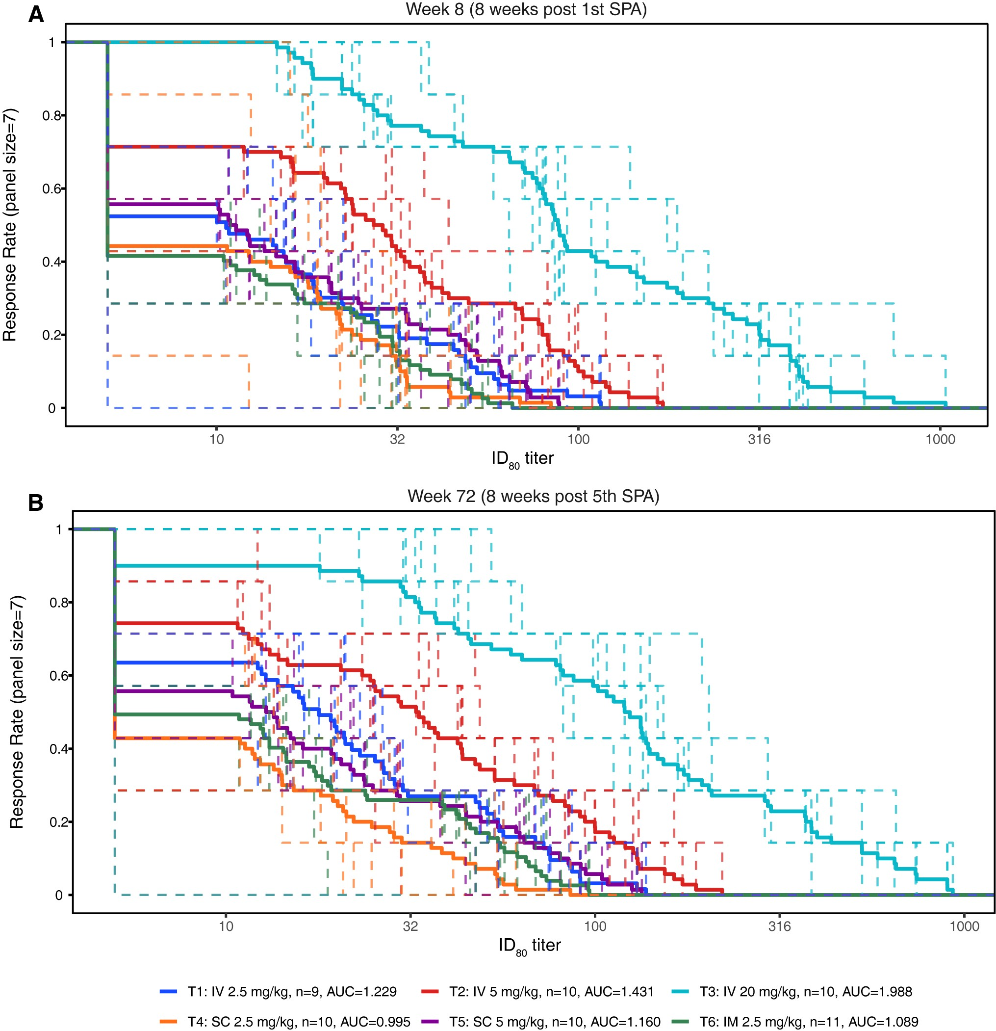

Slide 37
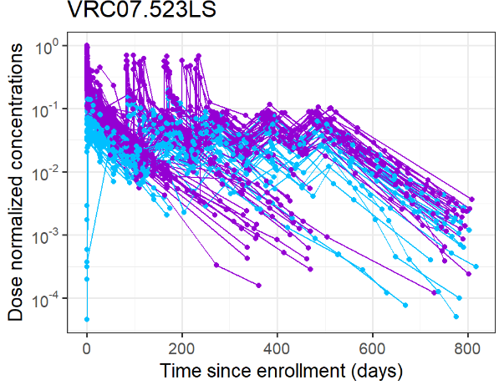
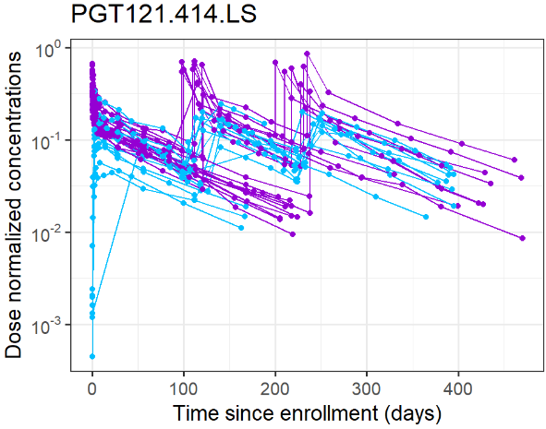
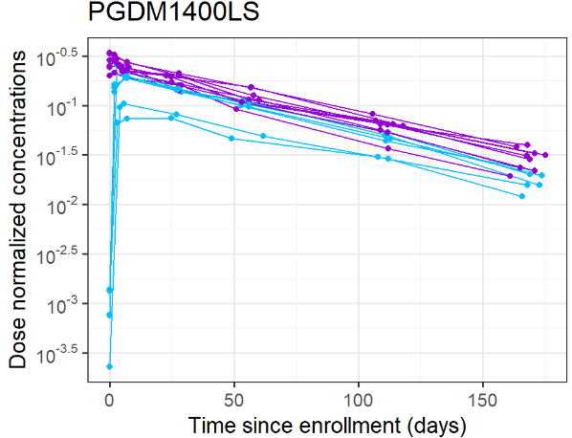
Observed Serum Concentrations of LS-bnAbs
(n=187)
(n=32)
(n=15)
Notes:
This is a visual display of the observed serum concentration data that we have collected for each of the three bnAbs from the phase 1 trials listed on the earlier slide, after a single or repeated IV or SC administrations. These data show consistent PK patterns across individuals and across bnAbs.

Slide 38
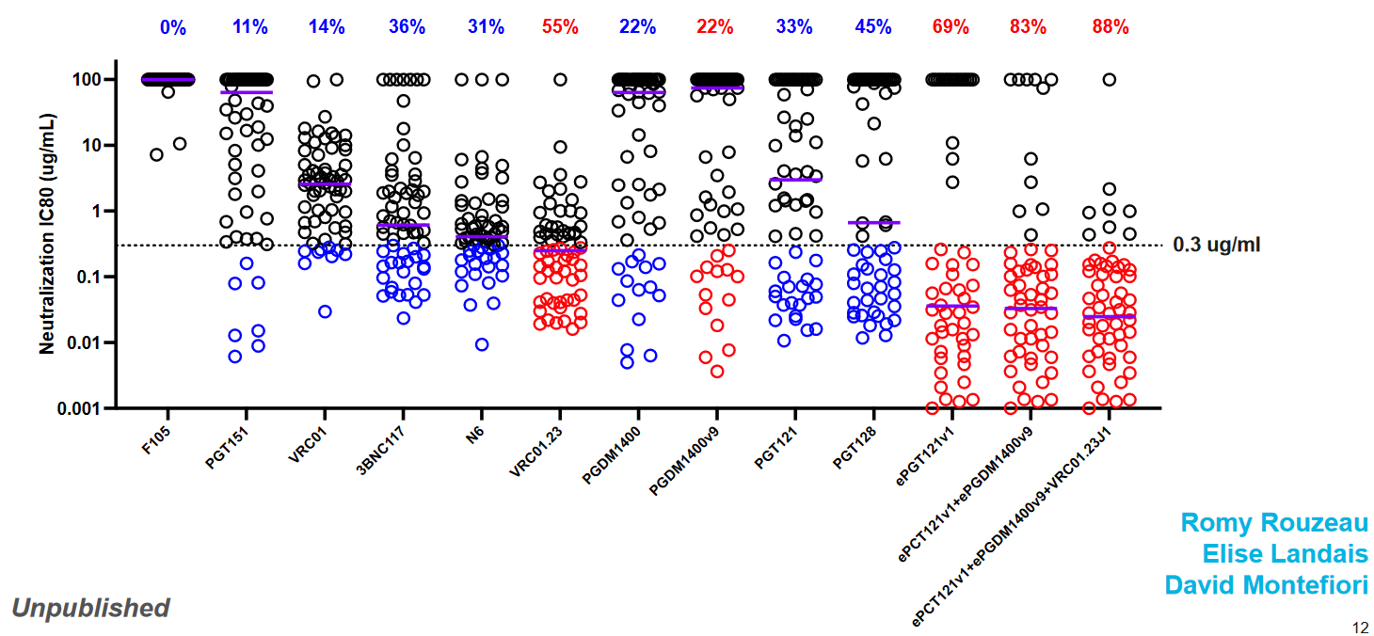
Improved neutralization with new and “enhanced” bnAbs

Slide 39
WHO Preferred Product Characteristics of bnAbs for HIV Prevention
Parameter | Characteristic
Indication | Prevention among confirmed HIV-1 negative individuals & neonates and infants with HIV exposure
Target Populations | People with HIV risk and their sexual partners
Access and Affordability | Affordable and Cost-effective in LMIC
Delivery Strategies | Integration and alignment with existing infrastructure
Safety | Safe for all target pop. with favorable reactogenicity
Efficacy | Efficacy with repeated use and clinical benefit from standard of care
Formulation | Single vial product is preferred
Dose Regimen | Dosing every 3 months or longer; fixed dosing; coformulation
Co-administration | Favorable safety with coadministration with other bnAbs
Route of Administration | SC or IM preferred in LMICs
Stability and Storage | 2-8C preferred with minimal storage footprint
Sustainability | WHO pre-qualifications preferred

Slide 40
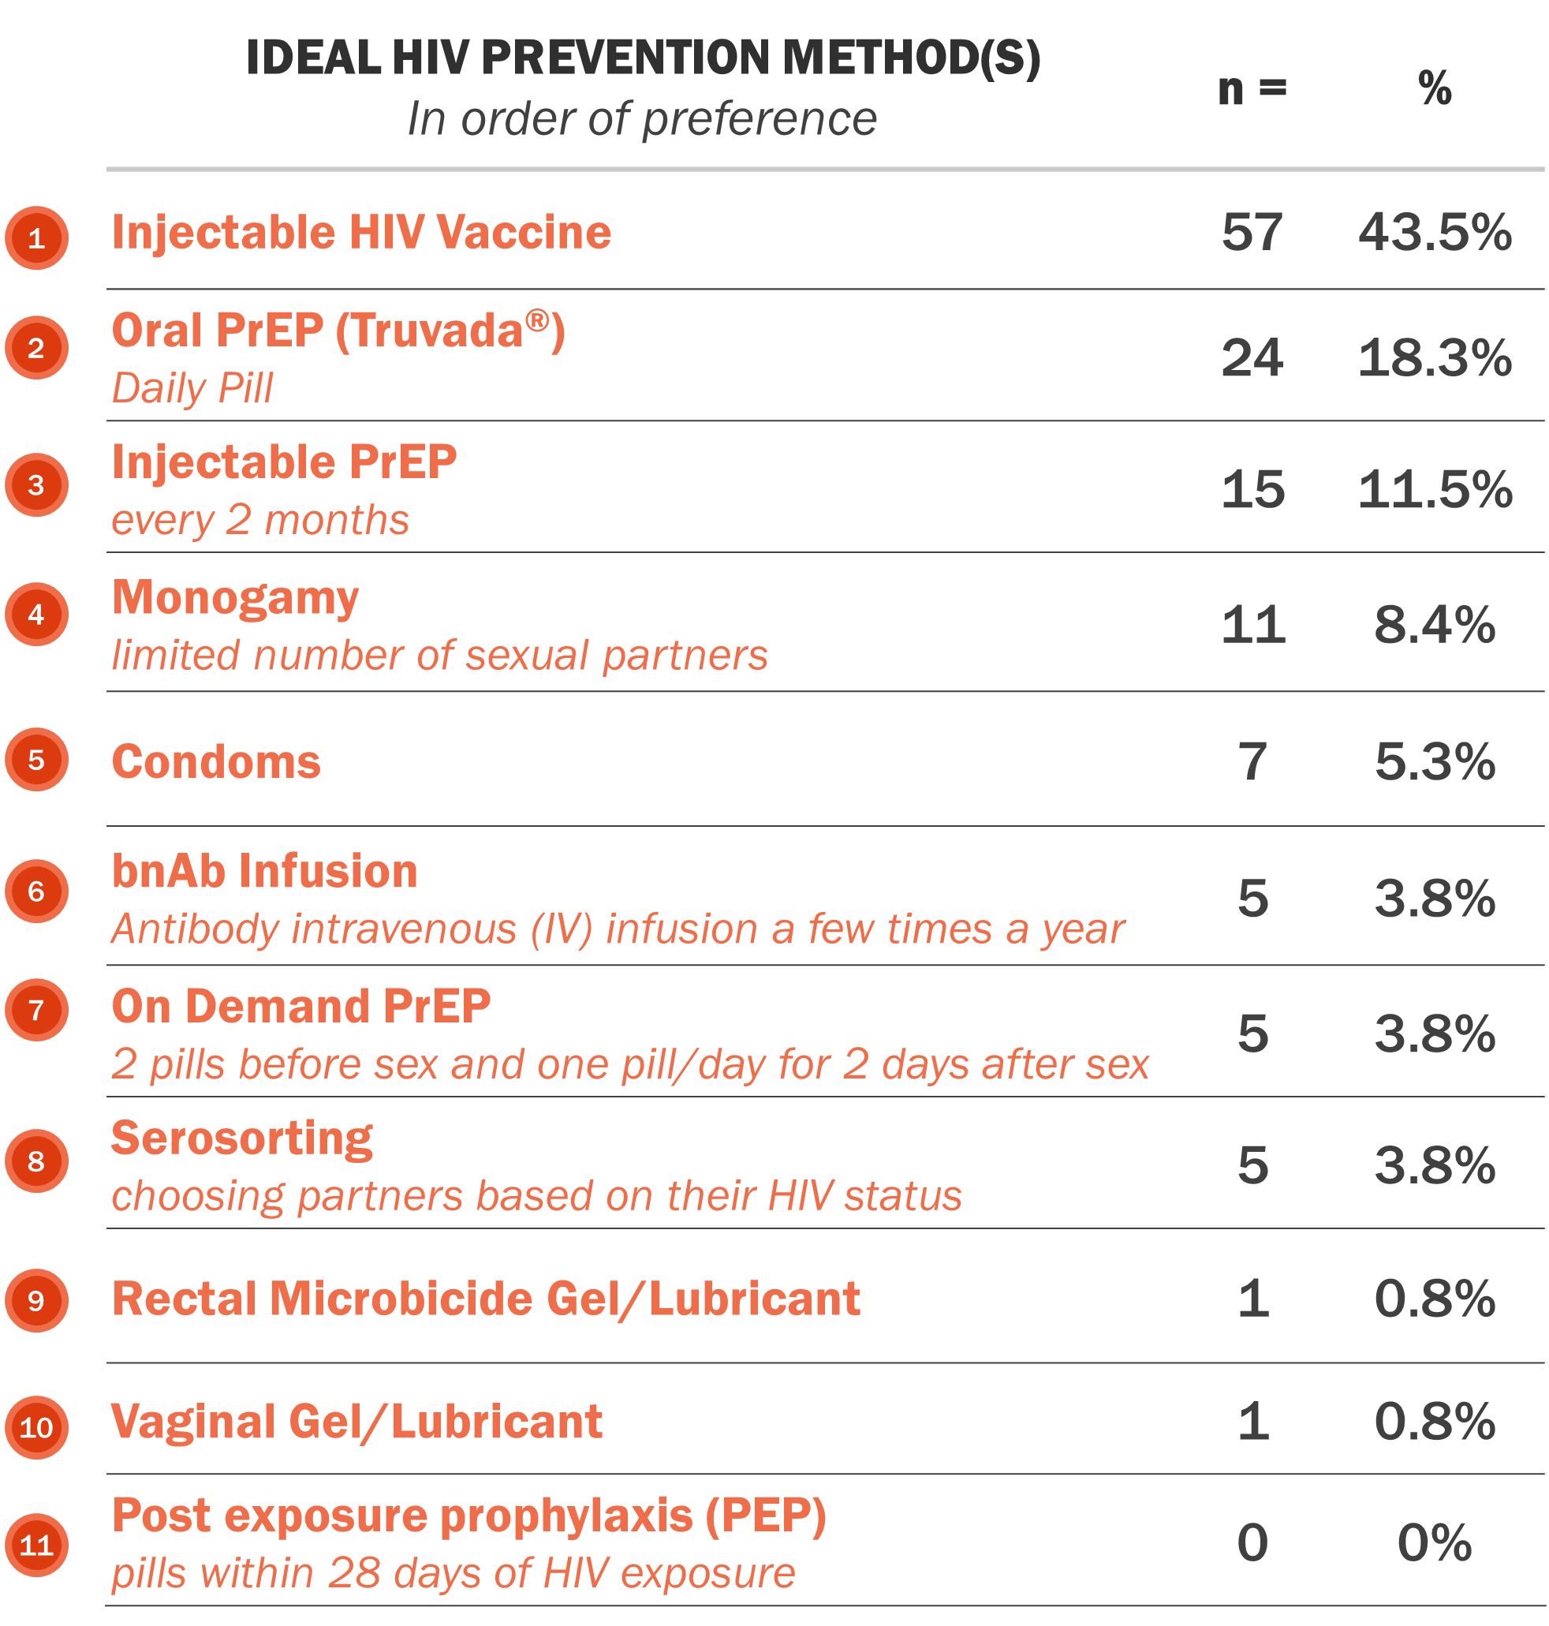
Product Preference Among US AMP Participants
Mixed methods study of 131 participants in AMP between 2018-2019.
The main factors that influenced choice were:
  Convenience
  Ease of use
  Familiarity
Gonzalez et al AIDS 2020

Slide 41
Preferred Product Characteristics
Parameter | Preferred characteristic
Indication for use | Prevention of HIV-1 infection
Target populations | People at risk of HIV-1 infection
Access and affordability | Product and delivery costs should be affordable in LMIC
Delivery strategies | Integration with HIV and STD prevention programs, harm reduction services, other Q6M delivered services (family planning) School-based delivery (similar to mass vaccination & mass-drug administration) Delivery outside health care settings (spas, barbershops, pharmacies, etc) Tailored programs & integration with HIV prevention programs and other sexual and reproductive health services for populations with high likelihood of HIV acquisition Pregnancy: Consider providing to all HIV-1 negative pregnant women (may also protect infant after birth up to 3-4 months)
Safety | Should have a favorable and acceptable safety profile.
Efficacy | Efficacy trial with local standard of prevention offered/incorporated Demonstrated clinical benefit or equivalence, and benefits compared to standard of care Evidence of broad coverage for relevant local HIV-1 strains Efficacy maintained with repeated use
Formulation/ presentation | Separate vials for each antibody, fixed dose, several to be injected into 1 or more 100-150 ml IV bags for IV administration
Dose regimen | Administration every 6 months Fixed (non-weight-based) dose
Route of administration | IV because IM and SC not feasible yet for adults (volume to be injected > 10ml possibly 60ml)
Product stability and storage | Stable at refrigerated condition (2–8°C) preferably for 2–3 years Minimal storage footprint.
Registration, prequalification and programmatic suitability | WHO prequalification preferred

Slide 42
Filling in the Biomedical HIV Prevention Mosaic
Daily Oral
PrEP
On-Demand
PrEP
Injectable
PrEP
Vaginal
Ring
Condoms
STI Testing
&
Treatment
HIV Vaccine
PrEP
Implants
bnAbs

Slide 43
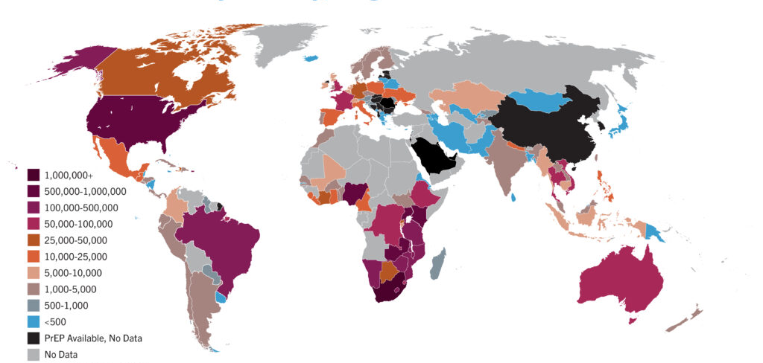
PrEP Initiations by Country, August 2024
AVAC Global PrEP Tracker, Q2 2024
https://avac.org/resource/infographic/prep-initiations-by-country-worldwide

Slide 44
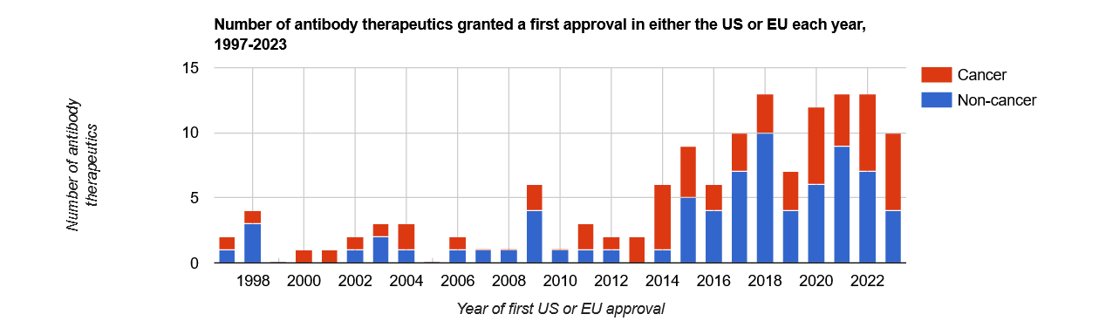
Antibodies Approved by EMA and FDA - 1997-2023
www.antibodysociety.org/resources/approved-antibodies/
Notes:
Antibodies approved for clinical uses increased since about 2008 for both cancer and non cancer indications with therapeutic antibodies being approved by the EMA and the FDA

Slide 45
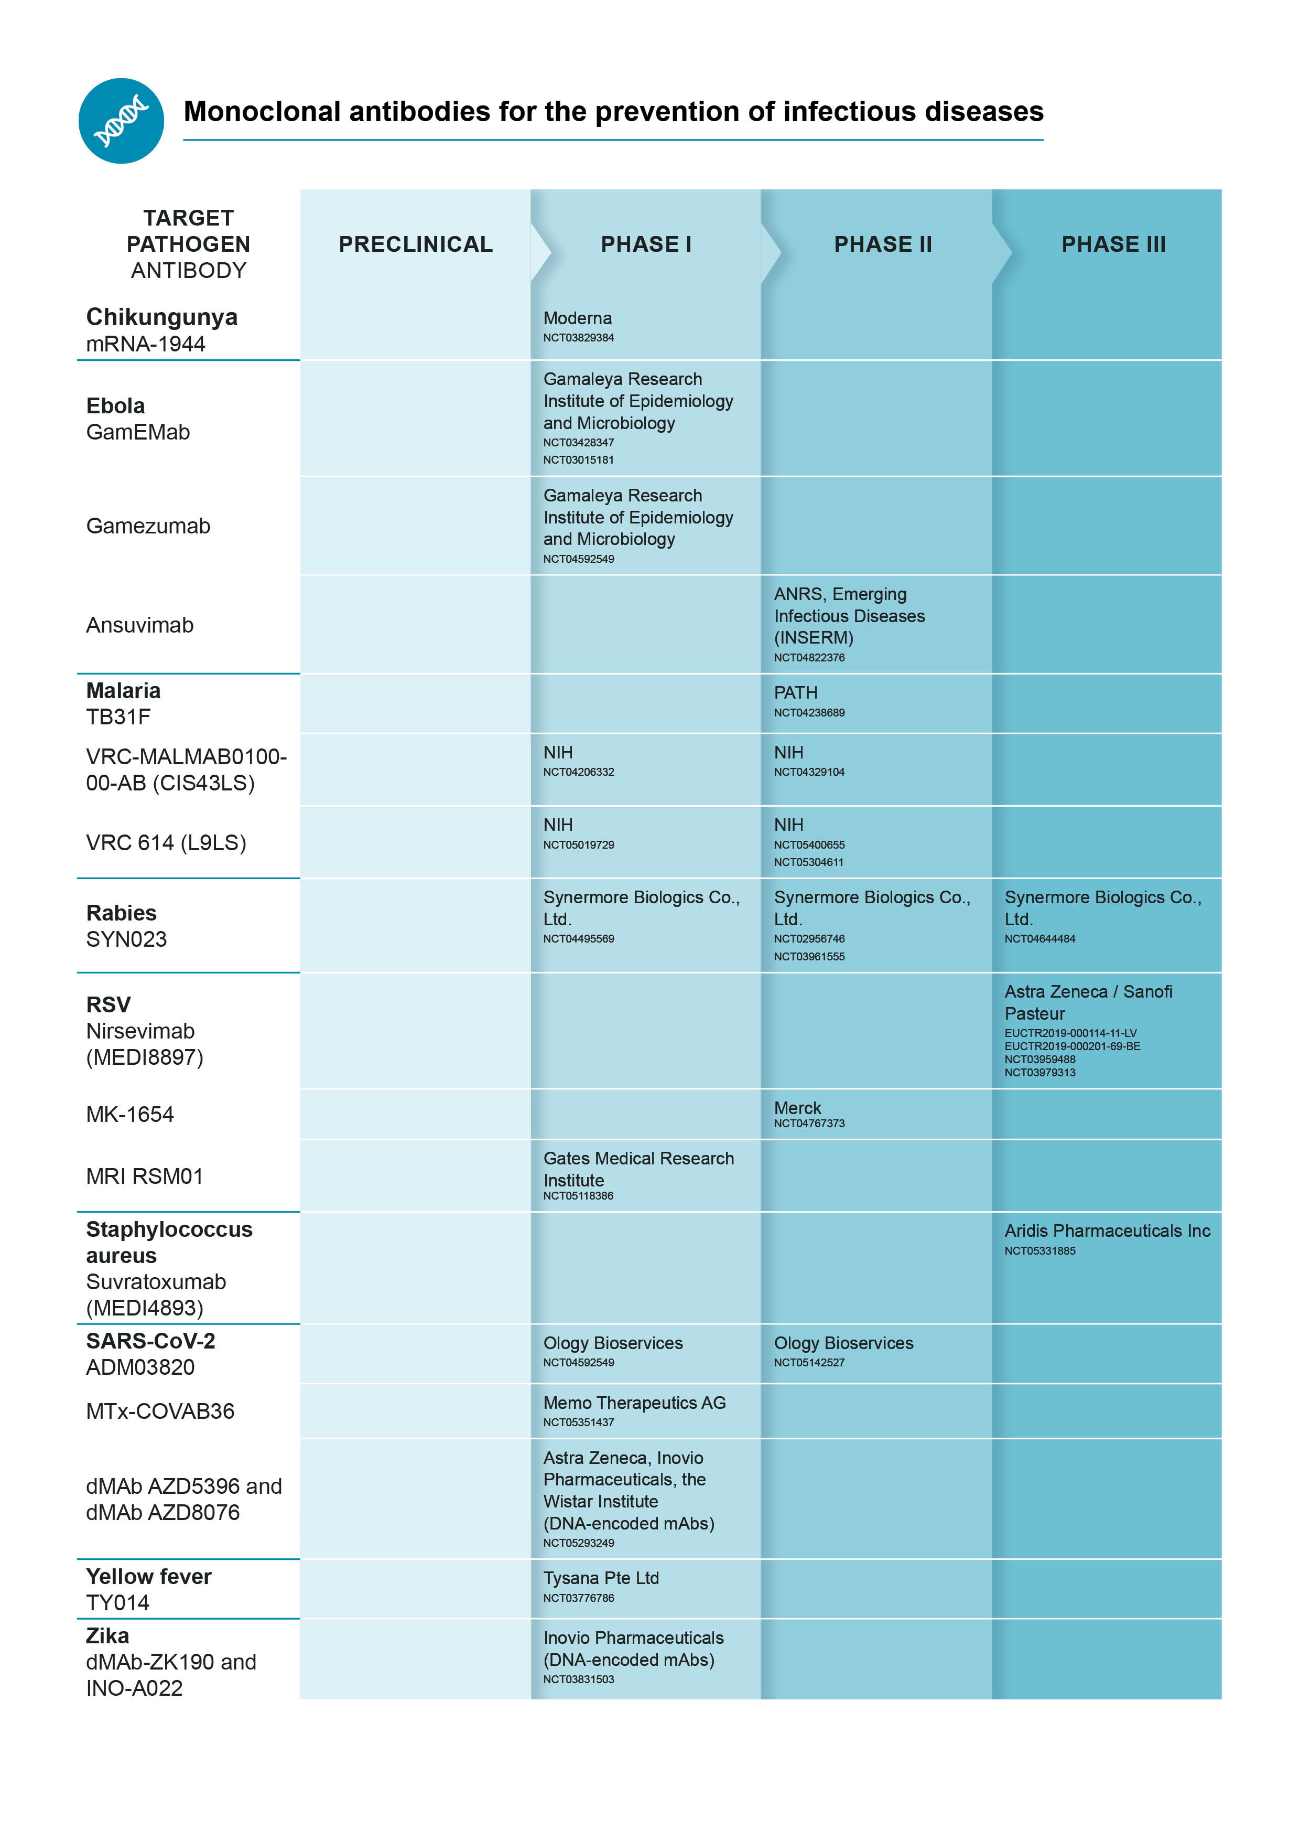
Antibodies in Development for Prevention of Infectious Diseases
Notes:
Antibodies in development for infectious diseases including chicken gunia and Bola measles rabies RSV staff warriors SARS Co V2 yellow fever and zika really highlighting that beat beat naps for HIV prevention are in context of antibodies being developed for other infectious diseases for therapeutic and preventative purposes

Slide 46
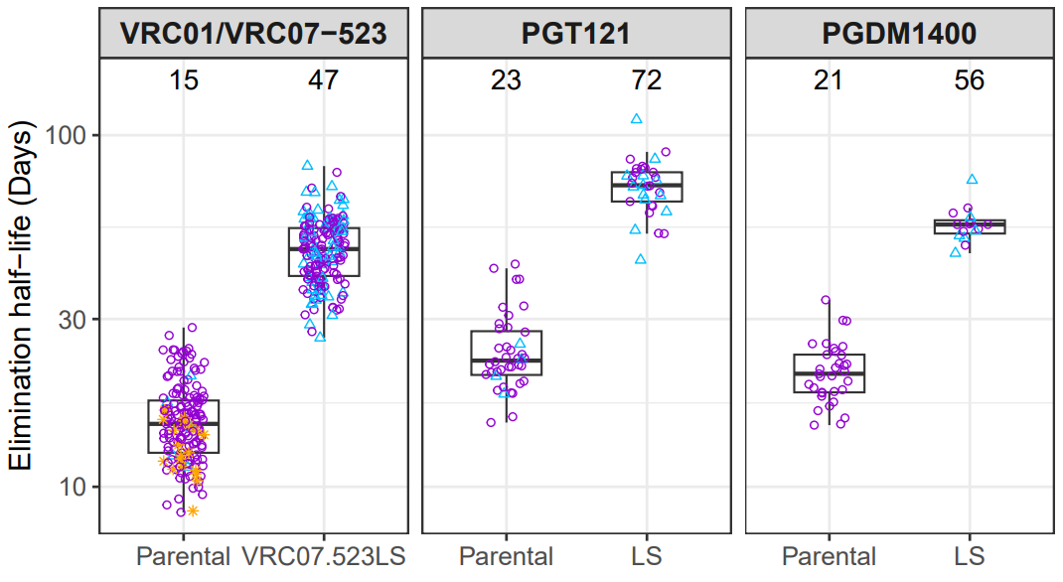
Improved (LS vs. Parental) PK with ~3-fold Longer Elimination Half-life, Enabling 6-Monthly Administrations
Elimination half-life of LS-mAbs:
50 to 70 days
Elimination half-life of parental-mAbs: 15 to 20 days
*Mayer B, Zhang L et al, Under Revision.
Notes:
These are data comparing VRC 01 PGT 121 and PGT M 1400 parental versus LS antibodies demonstrating the extended half life in the range of 50 to 70 days. These 3B nabs are there been abs most plan to move forward into to a planned efficacy trial refer to as combo AMP.
Compared to the parental bnAbs, these LS bnAbs demonstrated 3-5 times longer elimination half-life, in the range of 50-70 days, enabling 6-monthly administration of these bnAbs.

