Slide 1


Multiple needs – one technology: The promise and pitfalls of multiple purpose prevention technology
Nelly Rwamba Mugo
MBChB, MMed Ob/Gyn; MPH
Kenya Medical Research Institute (KEMRI)
University of Washington, Department of Global Health
HIVR4P 2024
6 – 10th October Lima, PERU
HIVR4P Abstracts
PL02

Slide 2

In memory of Dr. Kawango Agot, MPH, PhD Renowned Kenya researcher
Founder, Director and CEO of Impact Research and Development Organization
Her research and community work in HIV prevention has changed the HIV prevention landscape in Kenya and beyond
A true warrior who cared deeply for communities and the well being of young women
Notes:
In memory of a friend and colleague
Whose contributions to HIV prevention field, and MPTs has touched womens lives in Kenya and beyond
Kawango was a true warrior who cared deeply for communities and the well being of young women

Slide 3
Disclosure
Member of the MATRIX USAID project to advance the research and development of innovative HIV prevention products for women
www.matrix4prevention.org
Merck Funded Investigator Initiated Study on HPV Vaccination
Notes:
I am a member of the MATRIX Consortium, a project that is advancing research and development of innovative HIV prevention products for women

Slide 4
Outline
Defining MPT
Why we still need MPTs
The MPT journey from the old to the current products
What we have learnt from previous trials
Vital considerations for successful and impactful MPT R&D
Current MPT product development pipeline
What MPT R & D requires going forward
Voices of young women
Notes:
In my talk today, I will discuss

Slide 5
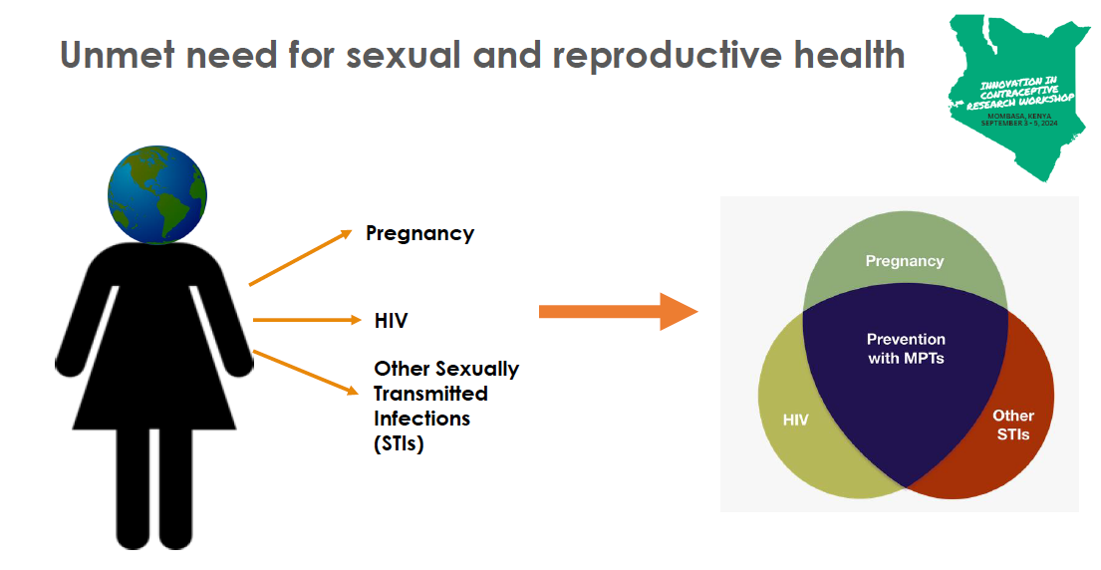
Multipurpose Prevention Technologies (MPT)
MPTs designed to simultaneously address more than one sexual and reproductive health concerns​​
Notes:
The HIV/sexually transmitted infection (STI) syndemics and the unmet need for modern contraceptive methods continue to pose significant health risks for women and other people worldwide.
All three are interlinked risks, bringing forth the need for new technologies that combine protection against unintended pregnancy, HIV and other STIs as a research priority.
Multipurpose Prevention Technologies (MPTs) are products that simultaneously prevent HIV, other STIs, and/or unintended pregnancy.

Slide 6

Global daily burden of new HIV infections, maternal deaths and curable STIs
3600
New HIV infections daily in 2023
44% among women
810
Women die daily from preventable pregnancy related complications
1,000,000
Curable STIs acquired daily
Women face dual risks of unintended pregnancy, HIV and other STIs
https://www.unaids.org/en/resources/fact-sheet
https://www.unicef.org/health/maternal-and-newborn-health
https://www.who.int/news-room/fact-sheets/detail/sexually-transmitted-infections-(stis)
Notes:
Globally the burden of HIV, unintended pregnancies and STIs is large
Each day 3600 people die from HIV infection, 44% of them women, majority from LMIC
Sexually Transmitted Infections
Michael Ray Garcia; Stephen W. Leslie; Anton A. Wray.
Author Information and Affiliations
Last Update: April 20, 2024.

Slide 7
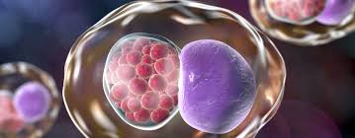
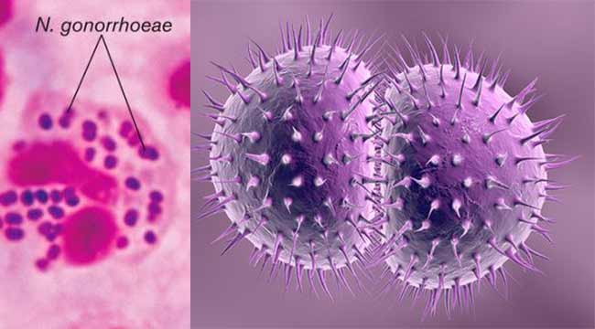

Women are at the epicenter of STI epidemic
SY03: Improving STI prevention and management in conjunction with increasing uptake of HIV prevention products
Across recent clinical trials conducted among young women of reproductive age in sub-Sahara Africa, STI prevalence has been markedly high
  Chlamydia Trachomatis (12 -30%)
  Neisseria Gonorrhoeae (3 – 20%)
  Trichomatis Vaginalis (7 – 10%)
  Herpes Simplex (38 - 46%)
Chlamydia Trachomatis & Neisseria Gonorrhoeae are often asymptomatic in women
The world lacks access to diagnostic tool for common STI s
Diagnosis is mostly syndromic
  Leading to undertreatment and risk for adverse sequalae:
  tubal factor infertility,
  adverse maternal and neonatal outcomes,
  fueling the antimicrobial resistance epidemic
  and concurrent increased risk for HIV acquisition
Bekker LG NEJM 2024
Stewart J. NEMJ 2023
Delany-Moretlwe STI 2023
Thesla Palanee PLoS One 2022
ECHO Lancet 2019
Marrazzo J. NEJM 2015
Chlamydia trachomatis
Neisseria Gonorrhoea
Trichomonas vaginalis
SY03: Improving STI prevention and management in conjunction with increasing uptake of HIV prevention products:L Haddad
Notes:
The world lacks access to diagnostic tools for common sexually transmitted infections

Slide 8
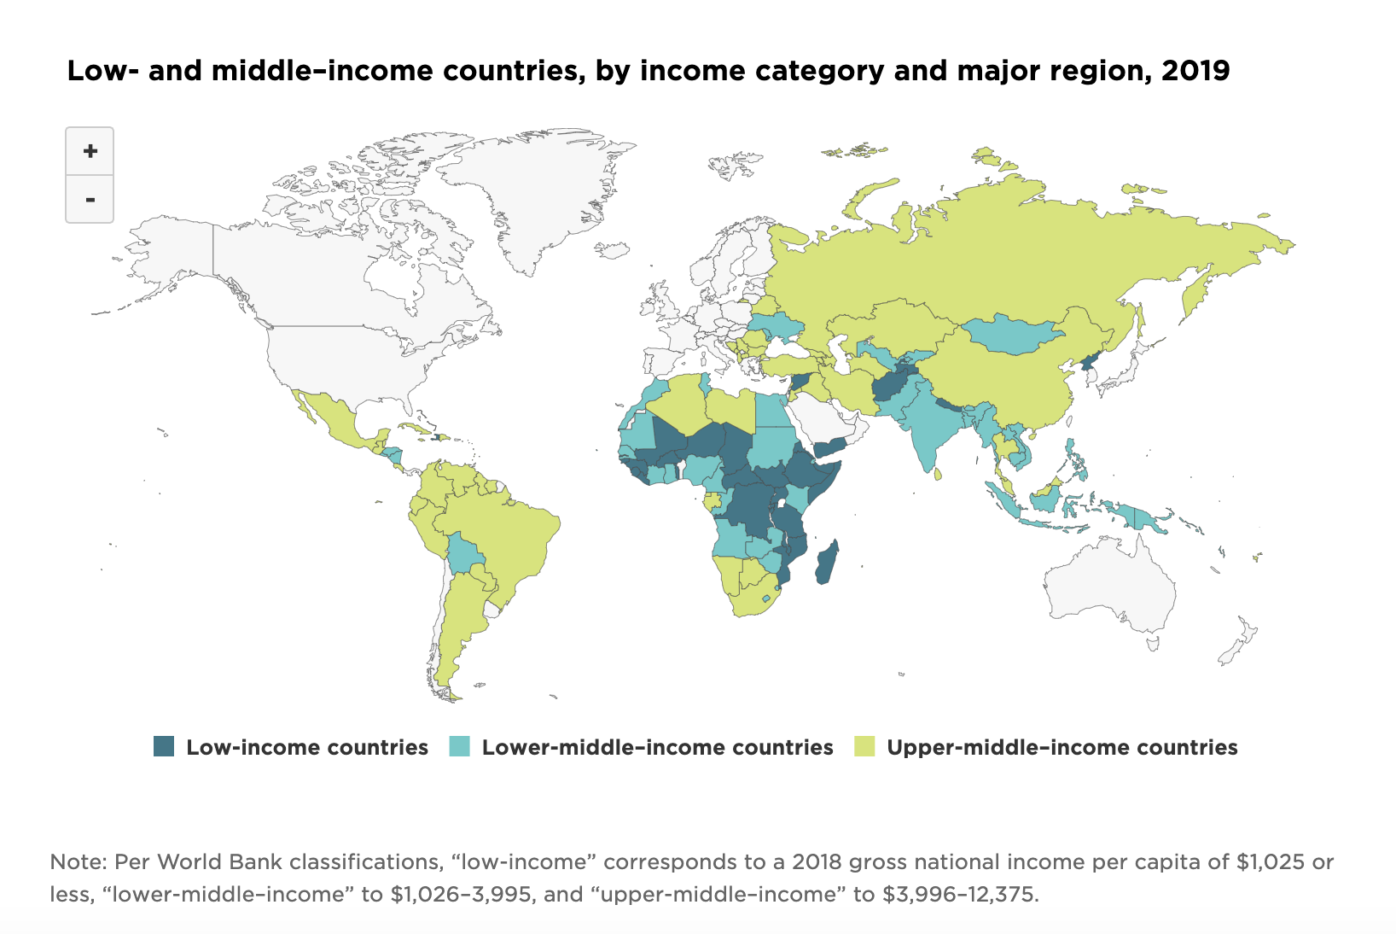
Global Unmet need contraception
Among women aged 15-19 years who want to avoid pregnancy: with an unmet need for modern contraception, 2019
250 million women have an unmet need for contraception
Meeting unmet need for contraception would
Reduce maternal mortality by 62%
Unsafe abortion by 72%
Unintended pregnancies by 68%
Source: Guttmacher , 2019

Slide 9

To address the unmet needs, we must consider interventions that address the social constructs of end users
                Accessible
                Affordable
                Scalable
                Deliverable
                Acceptable
At different times of life, in different ecosystems and geography
That meet different desires and the multiple reproductive health needs
This Photo by Unknown Author is licensed under CC BY-NC-ND
Notes:
Find a photo of women and people of different races
Plus LGBT
Social constructs of intervention

Slide 10

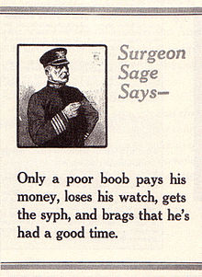
The condom was the first MPT:
(patented in 1844)
Condoms have faced historical challenges similar to modern day HIV prevention interventions
  Legal barriers
    Illegal in 19th century Germany and Italy and only allowed for disease prevention
    The USA did not allow distribution through mail (Comstock Act 1873)
  Implications on morality are part of its long history
    Concerns about pleasure, efficacy & safety
  Gender dynamics
    Labelled “male shield/rubber gold” “a little something for the weekend” and often distributed through barber shops
    Women activists distrusted a ‘male controlled method’ and advocated for diagphram and spermicide douches
The world war II and upsurge in STI s and the HIV epidemic changed the public health perspectives on condom use

Slide 11


Slide 12

Pitfalls
Courtesy Jim Turpin (Summit IMPT 2024 Meeting)
Product Development
Basic Science
Drug
Discovery
Translational
Research
Clinical Trials
Clinical
Practice
First
In
Human
Licensure
I
II
III
Safety
Efficacy
Valley
Of
Death
Safety Signals
  IND enabling
  Initial clinical trials
Regulatory failure
Manufacturing Issues
Funding
Etc.
Costly
Last mile/distribution issues
End users do not like
Insurers won’t cover
Resistance by Health Care Providers
Ministries of Health do not support
Etc.

Slide 13
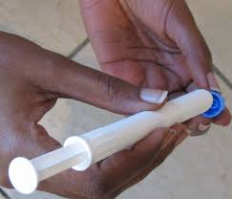
Intravaginal gels 2002 to 2015 Phase III Trials
Year | Gel-Products (@ coitus) | N | HIV Outcome | Adherence | Comment
2002 | Nonoxynol-9
2004 - 2006 | 1.0% C31G (SAVVY) | 2142 | HR 0.88 (95% CI 0.33, 2.27) |  | SAVVY group reported reproductive tract adverse events than in the placebo group (13.0% versus 9.4%
Skoler-Karpoff S. Lancet 2008 | Carraguard Gel (derivative of sea weed) | 6202 | No difference in HIV incidence | 42% by actual use 96% by self-report
Van Damme NEJM 2008 2005 -2007 | 6% Cellulose sulphate | 1398 | Stopped for possible harm | 87% 46% with condoms | Chlamydia T. RR 0.70 [95% CI 0.49, 0.99]
2005 - 2008 | PRO2000 vaginal gel | 9404 | No difference in HIV incidence |  | not effective in protection against HIV, NG,
FACT – 001 2011 - 2014 | 1% Tenofovir gel | 2059 | 4% in active arm 4% in placebo | 19% | Reduced HIV incidence with gel use HR 0.48 ( 95% CI 0.26 – 0.89)
CAPRISA – 004 | 1% Tenofovir gel | 889 | 39% reduction in HIV |  | HIV reduction 53% with >80% adherence
Held great promise from pre-clinical animal studies BUT did not prevent HIV infection during clinical trial evaluation
Low adherence likely played an important role in trials unable to accurately characterize biological efficacy of products
Obiero J. et al Cochrane Database Syst Rev 2021
Notes:
Low adherence has likely played an important role in many of these trials being unable to accurately characterize the biological efficacy of the candidate products
Obiero J, Ogongo P, Mwethera PG, Wiysonge CS. Topical microbicides for preventing sexually transmitted infections. Cochrane Database Syst Rev. 2021 Mar 13;3(3):CD007961. doi: 10.1002/14651858.CD007961.pub3. PMID: 33719075; PMCID: PMC8092571.
All 12 trials were conducted in sub-Saharan Africa, with one having a study site in the USA, and another having a site in India. Vaginal microbicides tested were BufferGel and PRO 2000 (1 trial, 3101 women), Carraguard (1 trial, 6202 women), cellulose sulphate (2 trials, 3069 women), dapivirine (2 trials, 4588 women), PRO 2000 (1 trial, 9385 women), C31G (SAVVY) (2 trials, 4295 women), and tenofovir (3 trials, 4958 women). All microbicides were compared to placebo and all trials had low risk of bias
Compared with placebo, the rate of HIV infection was lower in the group that took vaginal inserts containing the antiretroviral drug known as dapivirine, but other STIs occurred at similar rates in dapivirine and placebo groups.
Tenofovir gel may also reduce the rates of herpes simplex virus infection, but not other STIs.
In addition, the cellulose sulphate gel resulted in lower rates of chlamydia infection, compared to placebo.
Certainiy of evidence: Low

Slide 14
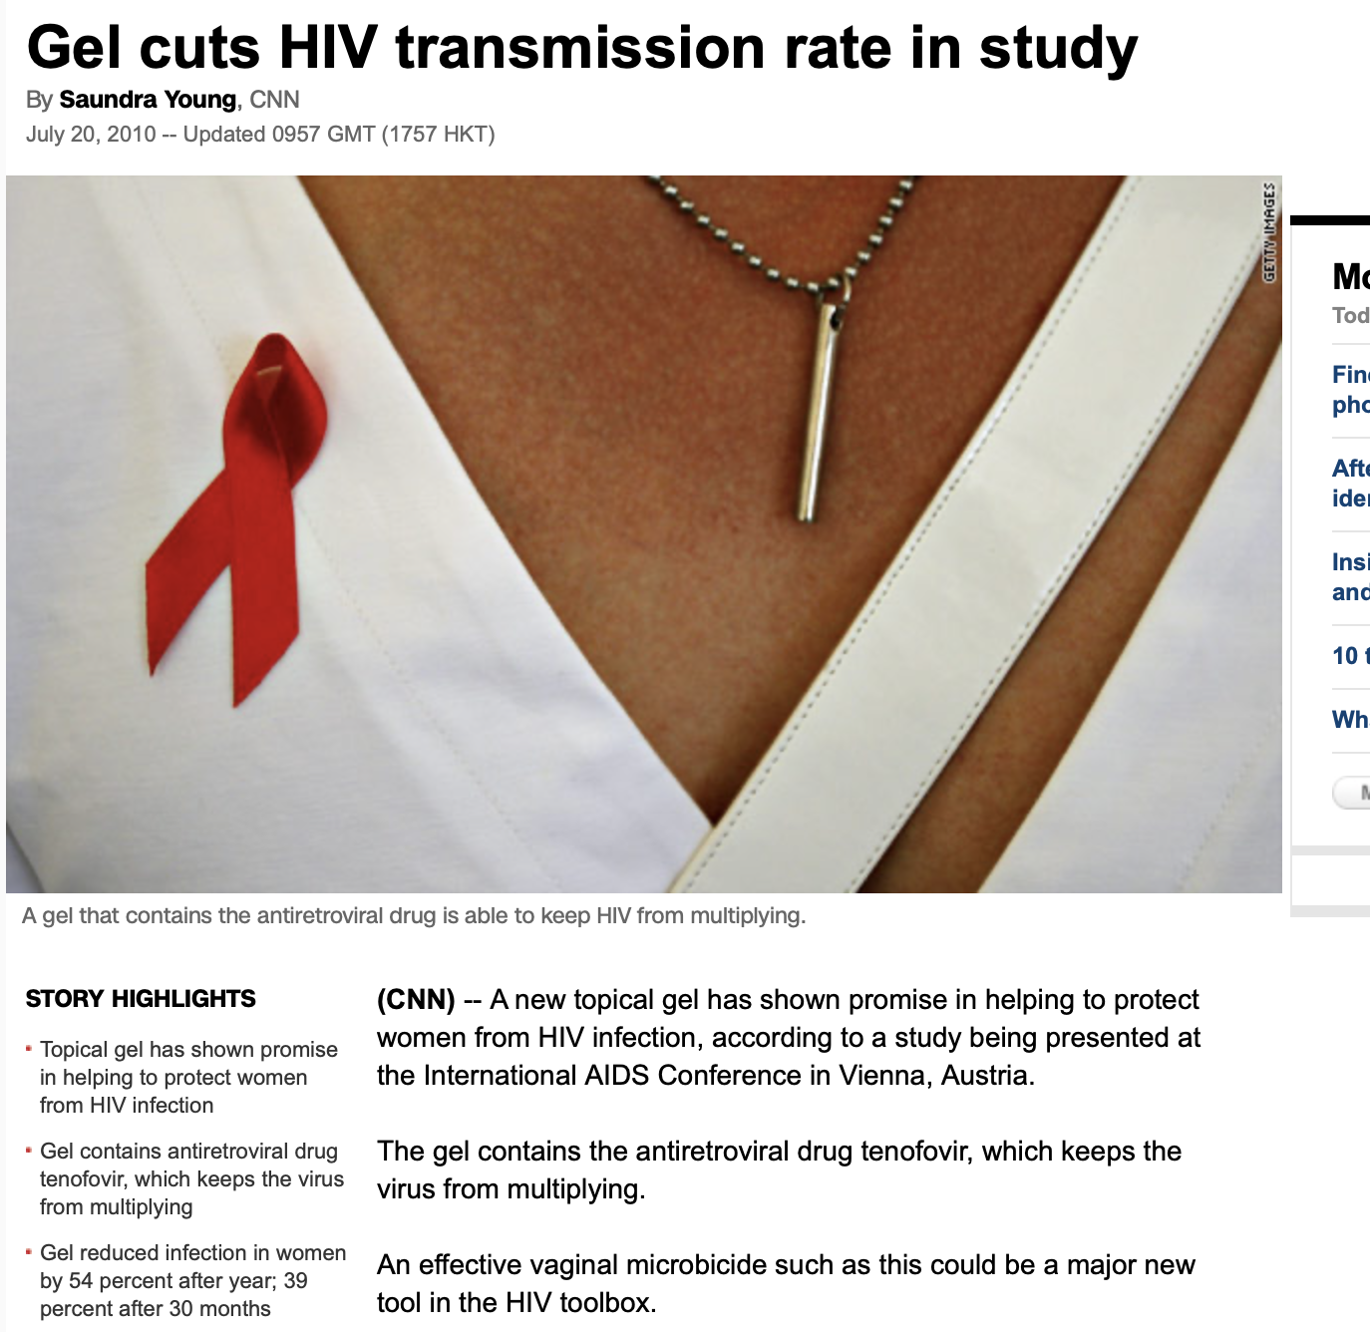
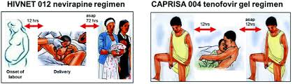
Tenofovir gel: Adherence impact CAPRISA 004 & FACTS 001
1% Tenofovir (TFV) diphosphate gel has concentration 100-fold higher concentration than oral dosing
Effective prevention of HIV-1: CAPRISA 004 demonstrated reduction in HIV-1 acquisition (39%) & HSV-2 (51%) (Karim QA. Science 2010, Karim A. NEJM 2015)
  Efficacy increased with use (Kashuba JAIDS 2015)
    54% when gel was detected
    76% with regular use
Not effective in prevention of HIV-1: FACTS-001 (Sinead Delany-Moretlwe, Lancet Infect Dis 2018)
    BUT among users – evidence of impact on HIV prevention
Oral tenofovir is effective in HSV-2 prevention : evidence from studies among heterosexual couples, and young women and genital ulcers in MSM (Celum C. Ann Intern Med 2014, Marrazzo M JID 2019, Marcus JL PLoS One 2014)
Notes:
Hope with CAPRISA results not realized in FACT 001
(Celum C. Ann Intern Med 2014, Marrazzo M JID 2019, Marcus JL PLoS One 2014)

Slide 15
Why great ideas don’t always turn to meaningful solutions
If we build it, will they use it?

Slide 16
Uncovering the adherence dilemma social behavioural studies
Interviews with prior study participants
Miller L, et al. PLoS One 2022,
Miller L. et al JAIDS 2020
Desire for on-demand topical HIV prevention products prevailed and was driven by
    Concerns regarding partner fidelity and HIV risk
    Male partners decline to use condoms
Need for Choice
    No one size fits all: The same reason one person did not like a product, was given as a reason for liking the product by someone else
Notes:
¹Miller L, Prieto Merino D, Baisley K, Hayes R. Hidden heterogeneity: Uncovering patterns of adherence in microbicide trials for HIV prevention. PLoS One. 2022 May 12;17(5):e0267011. doi: 10.1371/journal.pone.0267011. PMID: 35551324; PMCID: PMC9098085.
²Miller L, Morar N, Kapiga S, Ramjee G, Hayes R. Prevention, Partners, and Power Imbalances: Women's Views on How Male Partners Affected Their Adherence to Vaginal Microbicide Gels During HIV Prevention Trials in Africa. J Acquir Immune Defic Syndr. 2020 Dec 1;85(4):458-465. doi: 10.1097/QAI.0000000000002463. PMID: 33136745; PMCID: PMC7993915.
imbalance of power in intimate relationships affects the ability of women to use microbicides as directed
.

Slide 17
Uncovering the adherence dilemma social behavioural studies
Impediments to product use
Miller L, et al. PLoS One 2022,
Miller L. et al JAIDS 2020
    Gel attributes
      Leaky wet gel
      Inserts difficult to use discretely
    Coitally dependent products
      Social environment that lack privacy
      Sex on demand does not allow for before and use products
      Applicators difficult to conceal
Notes:
¹Miller L, Prieto Merino D, Baisley K, Hayes R. Hidden heterogeneity: Uncovering patterns of adherence in microbicide trials for HIV prevention. PLoS One. 2022 May 12;17(5):e0267011. doi: 10.1371/journal.pone.0267011. PMID: 35551324; PMCID: PMC9098085.
²Miller L, Morar N, Kapiga S, Ramjee G, Hayes R. Prevention, Partners, and Power Imbalances: Women's Views on How Male Partners Affected Their Adherence to Vaginal Microbicide Gels During HIV Prevention Trials in Africa. J Acquir Immune Defic Syndr. 2020 Dec 1;85(4):458-465. doi: 10.1097/QAI.0000000000002463. PMID: 33136745; PMCID: PMC7993915.
imbalance of power in intimate relationships affects the ability of women to use microbicides as directed
.

Slide 18
Uncovering the adherence dilemma social behavioural studies
Gender dynamics
Miller L, et al. PLoS One 2022,
Miller L. et al JAIDS 2020
Partners
    Sexual male partners desired to be educated on the products their partners' use
    Desired to be part of the decision-making process
    They had great influence on their partners decision to use and adhere to product use
Sexual experience
    Preference for products that do not influence libido or sexual encounter
Notes:
¹Miller L, Prieto Merino D, Baisley K, Hayes R. Hidden heterogeneity: Uncovering patterns of adherence in microbicide trials for HIV prevention. PLoS One. 2022 May 12;17(5):e0267011. doi: 10.1371/journal.pone.0267011. PMID: 35551324; PMCID: PMC9098085.
²Miller L, Morar N, Kapiga S, Ramjee G, Hayes R. Prevention, Partners, and Power Imbalances: Women's Views on How Male Partners Affected Their Adherence to Vaginal Microbicide Gels During HIV Prevention Trials in Africa. J Acquir Immune Defic Syndr. 2020 Dec 1;85(4):458-465. doi: 10.1097/QAI.0000000000002463. PMID: 33136745; PMCID: PMC7993915.
imbalance of power in intimate relationships affects the ability of women to use microbicides as directed
.

Slide 19
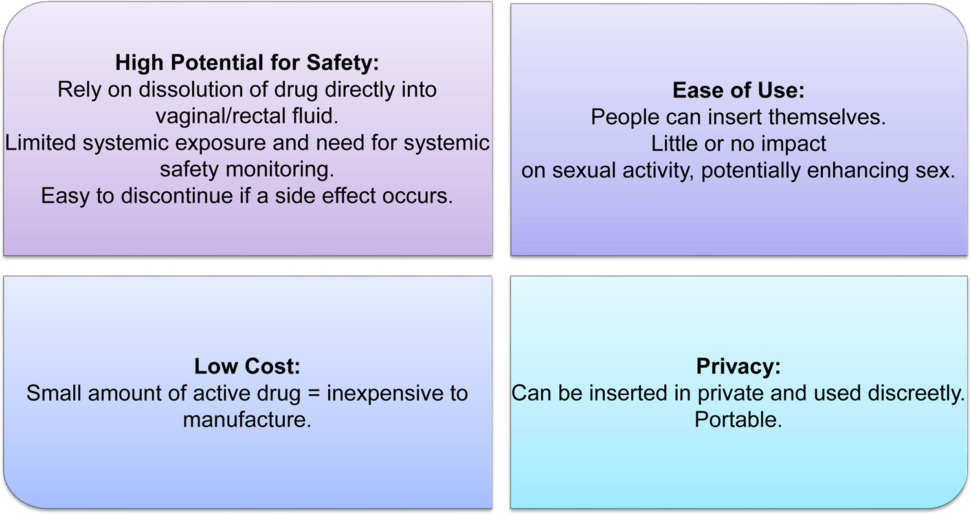
Preferred characteristics of gel formulation and use
Topical microbicide of choice should
Baeten JM, Annu Rev Med 2020
Notes:
Baeten JM, Hendrix CW, Hillier SL. Topical Microbicides in HIV Prevention: State of the Promise. Annu Rev Med. 2020 Jan 27;71:361-377. doi: 10.1146/annurev-med-090518-093731. Epub 2019 Oct 15. PMID: 31613684; PMCID: PMC8038211.

Slide 20
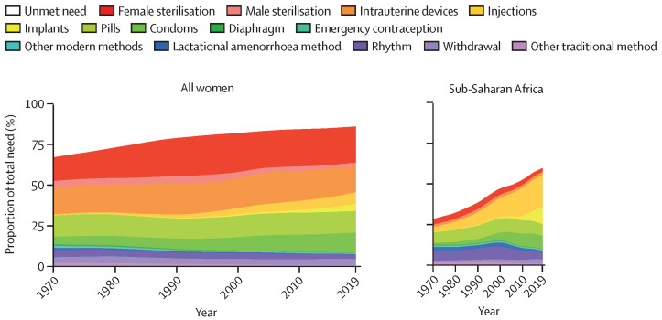
The need for choice:
Lessons from contraceptive field
  72% of women use more than one type of contraception in their lifetime;
  on average, women use 3.4 different contraceptive methods throughout their lifetime (US)
Women need a variety of methods to suit their preferences and lifestyles even when the market has highly effective products

Slide 21
Decision making process around prevention product use
Emotional
  Intuitive processes
  Perceptions, stigma, experience
Cognitive
  Cost, efficacy, access
There is not one product or attribute preferable to all groups
Prevention products will need to be developed and promoted to reflect diversity
Bauermeister JA et. al. Curr HIV/AIDS 2022
Notes:
There is not one product or attribute preferable to all groups. Prevention products will need to be developed and promoted to reflect that diversity. Given that PrEP technologies have been solely informed by System 2 attributes, efforts to integrate System 1 attributes into ongoing and future PrEP choice experiments are pivotal to advance PrEP acceptability research and interventions to support their implementation
Bauermeister JA, Downs JS, Krakower DS. PrEP Product Acceptability and Dual Process Decision-Making Among Men Who Have Sex with Men. Curr HIV/AIDS Rep. 2020 Jun;17(3):161-170. doi: 10.1007/s11904-020-00497-z. PMID: 32297220; PMCID: PMC7260091.

Slide 22
Decision making process around prevention product use
MPTs are more likely to be used by people who need them when
  Preferences
  Pleasure
  Environment
  Beliefs
  Needs &
  Motivations are solicited and incorporated into product research and development
  With a people centered mindset
Bauermeister JA et. al. Curr HIV/AIDS 2022
Notes:
There is not one product or attribute preferable to all groups. Prevention products will need to be developed and promoted to reflect that diversity. Given that PrEP technologies have been solely informed by System 2 attributes, efforts to integrate System 1 attributes into ongoing and future PrEP choice experiments are pivotal to advance PrEP acceptability research and interventions to support their implementation
Bauermeister JA, Downs JS, Krakower DS. PrEP Product Acceptability and Dual Process Decision-Making Among Men Who Have Sex with Men. Curr HIV/AIDS Rep. 2020 Jun;17(3):161-170. doi: 10.1007/s11904-020-00497-z. PMID: 32297220; PMCID: PMC7260091.

Slide 23
Globally, MPTs are preferred to single indication products
In 6 geographically diverse studies with CGW, direct elicitation of preferences indicated that >80% of respondents prefer a MPT
Percent women preferring 2-in-1 vs single indication prevention product
US survey (n=xx)
Implant S. (n=600)
CUPID (n=400)
QUATRO (n=200)
Risk of unintended pregnancy often outweighs concerns about HIV
83% of women prefer HIV/STI products with contraception vs HIV/STI products alone
TRIO (n=248)
IPSOS survey (n=XX)
0
10
20
30
40
prefers MPT
50
60
70
80
90
100
Source: A. Van der Straten, STD Prevention Conference 2022
E Browne 2021, Minnis, A. 2019; 2022 Little, AIBE, 2022, Hynes 2018, IPSOS report 2012, Friedland BA et al. AIDS Behav. 2023; Shapley-Quinn Int J Womens Health 2019

Slide 24
Status of Multipurpose Technologies Product Development Products

Slide 25
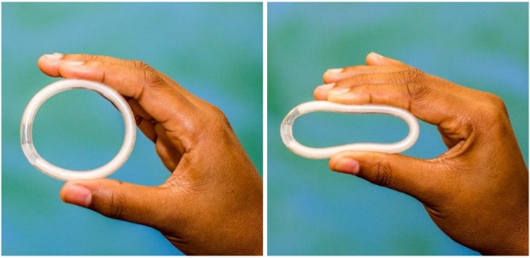
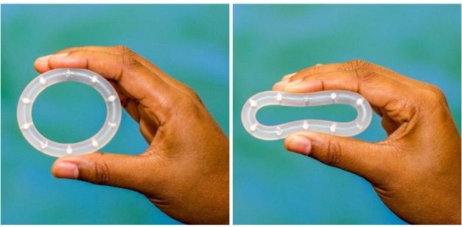
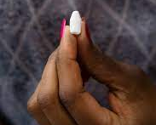
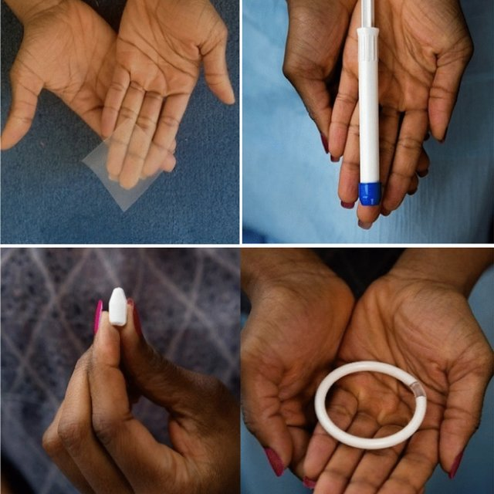
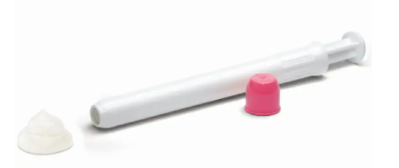
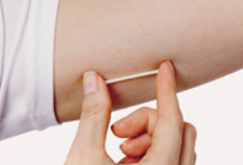
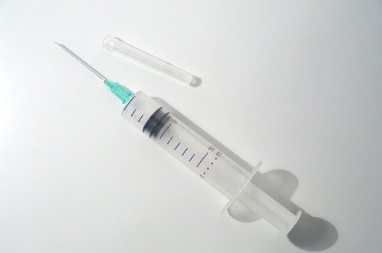

Multipurpose Prevention Technologies (MPTs) in
R&D Pipeline
Examples of MPTs in Development
Topical MPT Candidates
Systemic MPT Candidates
Segmented dual-reservoir ring
Vaginal
films
Vaginal and Rectal gels
Implants
    Long-acting injectables
Oral pills
(DPP)
Pod ring
Fast dissolving inserts
Image source: MTN. (2018). MTN 036 In-depth interview topic guide: Ring Comparison Tool [Photograph]. https://www.mtnstopshiv.org/sites/default/files/mtn_036_idiguide_v1.1_19feb18.pdf
Source: IMPT database | mpts101.org
Notes:
So lets now look at what is in the MPT R&D pipeline
This slide illustrate the diversity of delivery types of MPTs in the pipeline that can fit the different needs of diverse users
These include topical candidates including intravaginal rings, fast dissolving inserts, vaginal films and vaginal and rectal inserts.
Other MPT candidates aim to provide systemic protection, including implants, long-acting injectables, oral pills (also referred to as dual prevention pills),

Slide 26
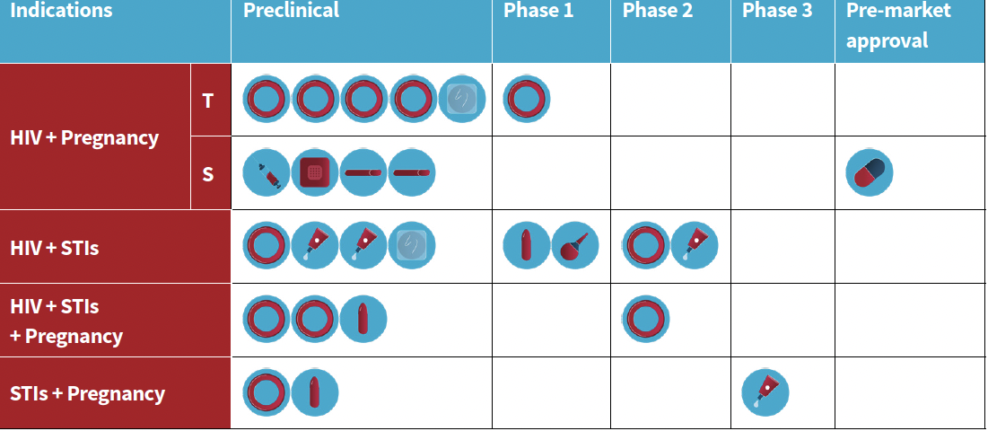
State of the science
Topical & Systematic MPTs
Short acting and long acting (sustained release)
Contraceptives – hormonal & non hormonal
HIV prevention – Antiretroviral (ART) and none ART based products
Majority are female initiated
Topical products include vaginal and rectal use
Majority of products are in pre-clinical stage of R & D
Source: MPT Product Development Database (mpts101.org)
Guide to Multipurpose Prevention Technologies (AVAC Jul 18 2024)

Slide 27
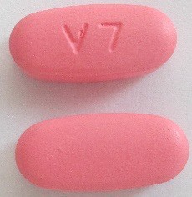
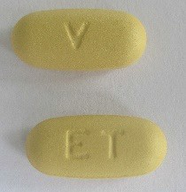
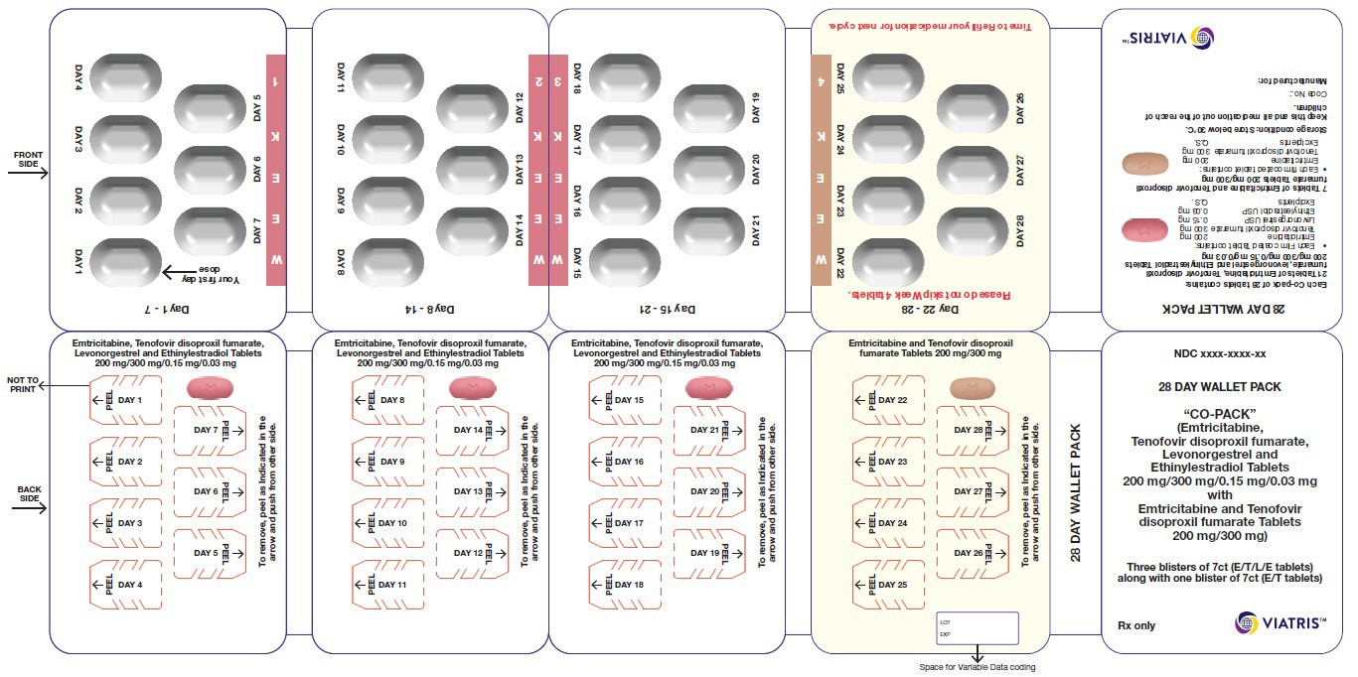
The Dual Prevention Pill (DPP) is the MPT furthest along in the pipeline
Figure 1: Proposed DPP tablet colors
Viatris developing co-formulated tablet with 28-day regimen (TDF/FTC, oral PrEP + LNG/EE, combined oral contraception (COC))
Different color pills for 21 vs. 7 days (dark pink and light peach, respectively)
Branding/secondary packaging will have women’s lifestyle feel
Figure 2: Illustrative mock-up of DPP packaging by Viatris
User waiver for FDA applications that apply to ART may not apply to combination products
Viatris filed for regulatory approval with US Food & Drug Administration in 2024
Notes:
PDUFA Waivers

Slide 28
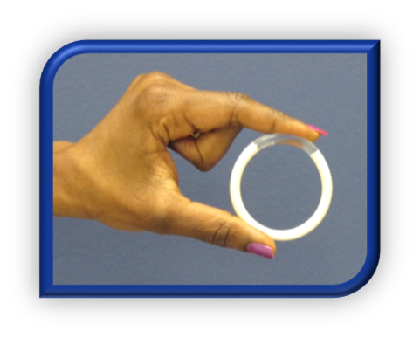

Tenofovir & Tenofovir/Levonorgestrel Intravaginal Rings
3-month IVR for protection against HIV, HSV (TFV-only) & pregnancy (TFV/LNG)
Most advanced MPT IVRs in the field (6 clinical trials completed)
Pharmacologically forgiving if removed for 3 days
  Promotes increased adherence
  Supports end-user needs and use patterns
Clinical proof-of-concept demonstrated for safety, acceptability, TFV & LNG pharmacokinetics & pharmacodynamics
Mugo NR, Mudhune V.et al Front Reprod. Health 2023
Notes:
This is the first study conducted among women in Africa to evaluate two IVRs releasing TFV and TFV/LNG. Data showed the IVRs were acceptable, safe and well tolerated in this small sample of selected Kenyan women. High vaginal TFV and serum LNG concentrations for the median duration of use and consistent PK profile and surrogates of protection against HIV-1, HSV-2 and pregnancy suggest good potential for these vaginal rings as multipurpose prevention technologies, expanding choice and prevention tools among adolescent girls and women.

Slide 29

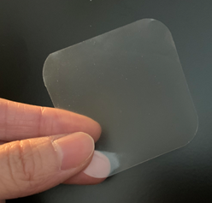
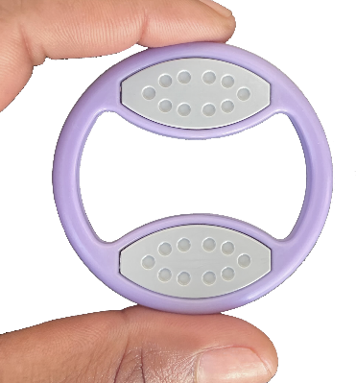
MATRIX (Advancing R&D of Innovative HIV Prevention Products for Women)
www.matrix4prevention.org
Monthly Dapivirine and levonorgestrel dual-purpose vaginal film vaginal film
(HIV/Pregnancy)
TAF/EVG fast dissolving intravaginal Insert
On-demand use
Non-ARV/non hormonal dual-purpose monthly vaginal ring
(pre-clinical phase of development) (HIV/Pregnancy)

Slide 30


Clinical Proof-of-Concept in FIH TAF/EVG Studies
CONRAD 146 (single vaginal dose), MTN 039 (single or double rectal dose)
Findings consistent across both studies:
TAF/EVG insert was safe, acceptable and well-tolerated
High local concentrations of TFV/TFV-DP, TAF and EVG in CV or rectal fluids and tissues
Low plasma exposure compared to oral dosing
Modeled pharmacodynamics supports antiviral activity against HIV-1 and HSV-2 (vaginal) for up to 24 (vaginal) or 72 hours (rectal) compared to baseline
  Discrete – small, user-friendly shape for ease of application, insertion at home
Thurman et al., Front. Cell. Infect. Microbiol. 2023; Riddler et al. J. Infect Dis. 2024

Slide 31
Monthly Dapivirine Dual-Purpose 30-day Film
Designed to provide protection from HIV and unintended pregnancy for 1 month
Dapivirine
Levonorgestrel
Non-nucleoside reverse transcriptase inhibitor (NNRTI)
Hormonal contraceptive
Ease of Use & Privacy:
Women control use and insertion of film
Can be used discreetly and inserted anytime in private
Not expected to impact sex
Unique & Convenient Platform:
Removal not required
Complete drug release
Small and portable
Low Cost:
Inexpensive to manufacture
No applicator required
Safe with No Messiness:
Minimal impact on vaginal health
Minimal to no additional vaginal discharge
    Currently being evaluated in pigtail macaque model

Slide 32
Potential challenges to MPT
Regulatory processes for products from different departments is often in different regulatory offices
Funding, policy, regulation and delivery of STIs, contraceptive and HIV prevention services is mostly in Silos: integration of services has not yet been achieved
To attain synergy with contraceptive services, dual products with contraception should retain the efficacy of current contraceptive
Inclusion of STI in MPTs is vital to managing the current STI epidemic and its unavoidable reproductive health sequelae
Funding for reproductive health has been on gradual decline, yet products will need to move from pre-clinical to end users
None of these challenges are insurmountable,

Slide 33
Promise of MPTs
Key Benefits of MPTs as Perceived by End Users
Can be transformational
Improved sexual reproductive health outcomes globally if merging products are accessible, affordable, fit-for purpose to meet the needs of diverse populations in a range of context
As perceived by end users:
Potential reduction in clinic visits
Alleviation of stigma associated with sexual activity & HIV

Slide 34

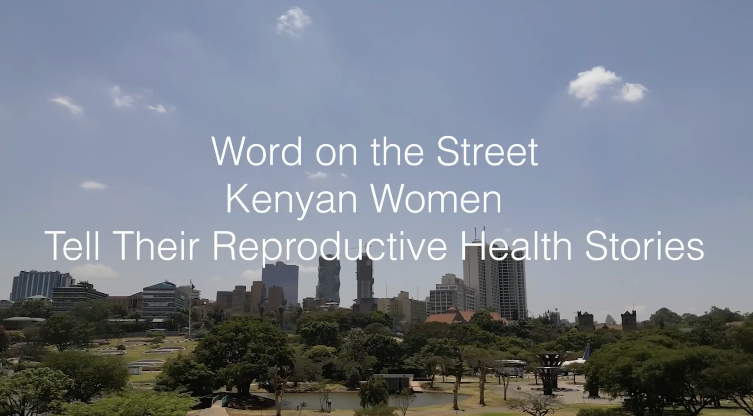
Notes:
I ll get a link that actually works, just need to figure it out

Slide 35
Acknowledgements
Slides heavily borrowed from CONRAD, CAMI Health, AVAC & MATRIX
Bethany Young Holt – CAMI Health
Kenneth Ngure – Jomo Kenyatta University of Agriculture and Technology (JKUAT)
Gustavo Doncel – CONRAD, East Virginia Medical School
Iana Simeonov – CAMI Health
Connie Celum – University of Washington
Nicholas Thuo – PHRD-CCR-KEMRI
All study participants
Funders
PHRD - Kenya Medical Research Institute (KEMRI)
University of Washington
Notes:
Add insititutions next to individual names

