Slide 1
THE INTERSECTION OF HIV ACQUSITION AND UNINTENDED PREGNANCY UNDERSTANDING THE CURRENT LANDSCAPE
Jerop Limo, AYARHEP
Delivering on the promise: Defining optimal implementation strategies and service delivery packages for the Dual Prevention Pill

Slide 2
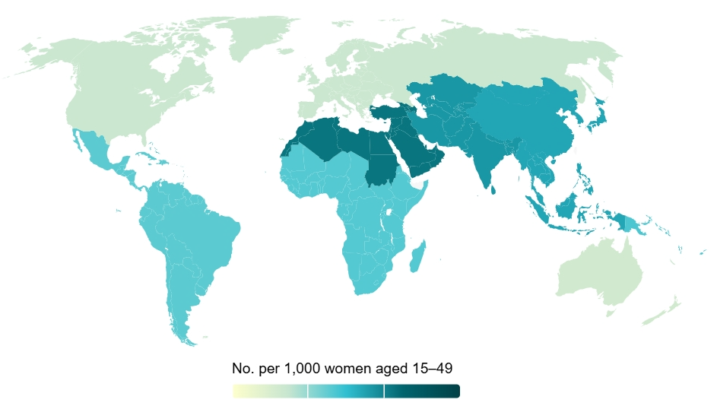
The Data Speaks!
Approx. 121 million unintended pregnancies occurred each year between 2015 and 2019
1.3 million people newly acquired HIV in 2023.
44% were among women and girls

Slide 3
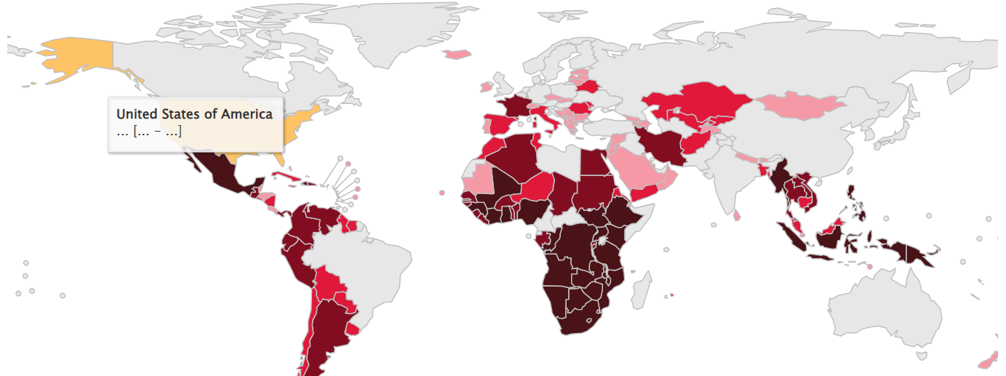
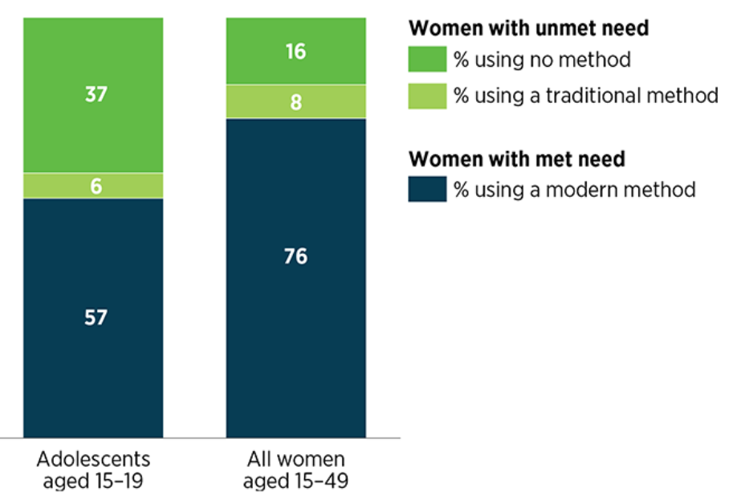
Adolescent Girls & Young Women in Greatest Need
Unmet need for modern contraception disproportionally high among adolescents wanting to avoid pregnancy
Every week, 4000 adolescent girls and young women aged 15–24 years acquired HIV globally in 2023. 3100 of these infections occurred in sub-Saharan Africa

Slide 4
Intersecting Challenges
High rates of HIV acquisition
Unmet need for contraception
MULTI-PURPOSE PREVENTION TECHNOLOGIES
High STI rates

Slide 5
Overlapping Risk and Vulnerabilities
HIV Acquisition & Unintended Pregnancy
External Shocks
Out of school
Transactional Sex
Experiencing Violence
Living in poverty
Young motherhood
Notes:
Certain vulnerabilities significantly increase the risk of both HIV and unintended pregnancies, particularly for young women.
Gender inequality, limited education, and lack of healthcare access play key roles.
Adolescent girls and young women, in particular, are often left without comprehensive services that address their dual needs. This disconnect in sexual and reproductive health services means they are often forced to choose between one aspect of their health over the other.

Slide 6
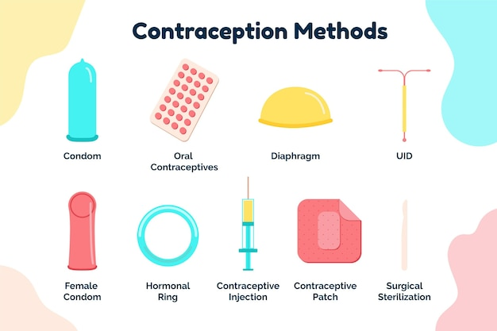
Separate Solutions

Slide 7
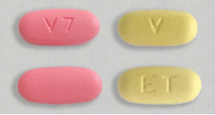
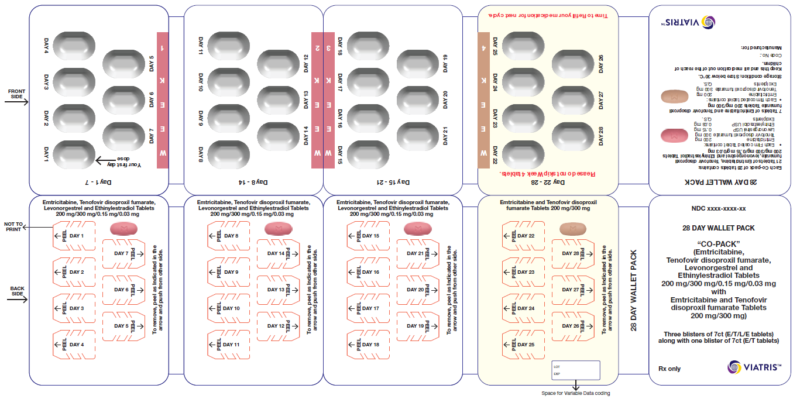
DPP: A Revolutionary Solution

Slide 8
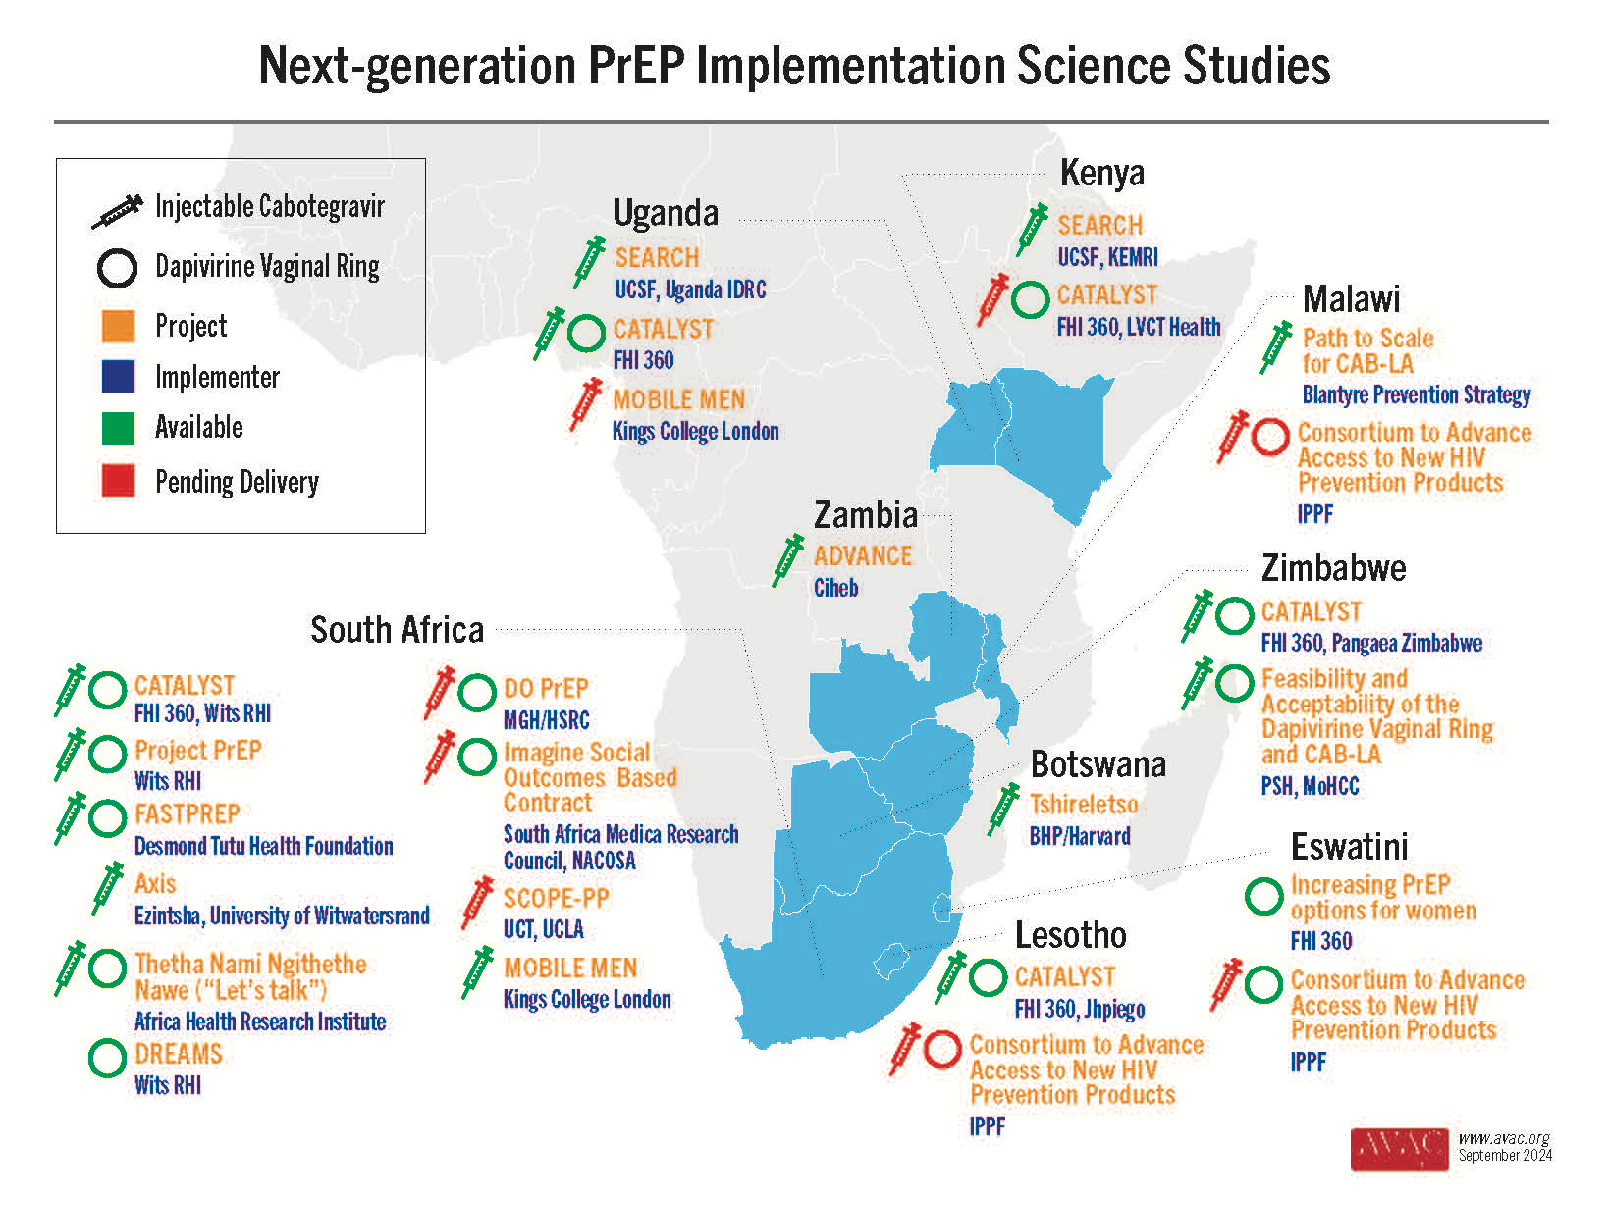
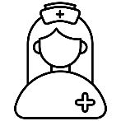
What’s Next? Evidence Generation
Notes:
Implementation science must play a key role in ensuring that the DPP’s impact can be effectively measured and scaled, so we can continue to learn and improve as we move forward.

Slide 9
What’s Next?
Notes:
As we look ahead, the successful rollout of the Dual Prevention Pill will require healthcare providers to adapt. They must be trained to deliver integrated services that address both HIV prevention and reproductive health. Additionally, outreach and education will be essential, particularly for young women who are often underserved by current systems.
Young women's leadership and advocacy

Slide 10
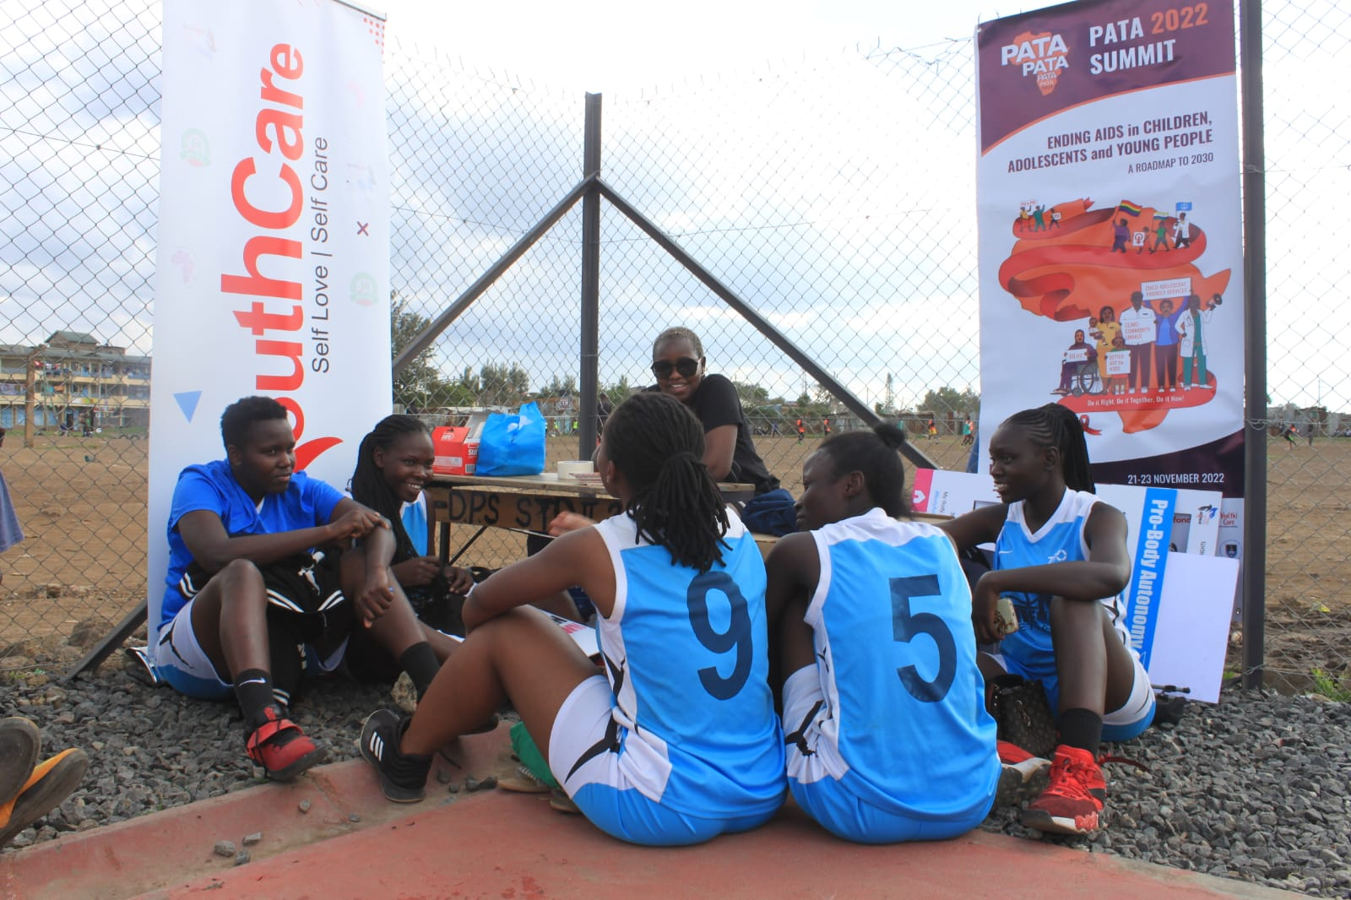
LED BY WOMEN FOR WOMEN

Slide 11
Asante Sana!
DPP Civil Society Advisory Group AVAC
UNICEF
IAS
Notes:
Certain vulnerabilities significantly increase the risk of both HIV and unintended pregnancies, particularly for young women.
Gender inequality, limited education, and lack of healthcare access play key roles.
Adolescent girls and young women, in particular, are often left without comprehensive services that address their dual needs. This disconnect in sexual and reproductive health services means they are often forced to choose between one aspect of their health over the other.

