Slide 1
Research and Development of the Dual Prevention Pill
Kate Segal, AVAC
Delivering on the promise: Defining optimal implementation strategies and service delivery packages for the Dual Prevention Pill

Slide 2
Please download and install the Slido app on all computers you use
slido
Have you heard of the Dual Prevention Pill before today ?
ⓘ Start presenting to display the poll results on this slide.

Slide 3
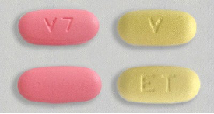
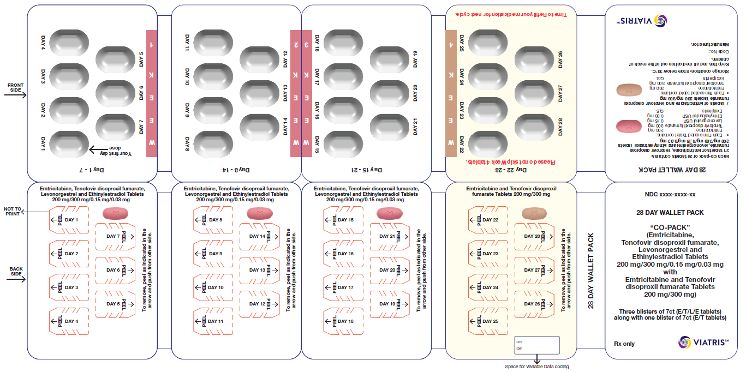
What is the Dual Prevention Pill (DPP)?
Daily pill that prevents both HIV and pregnancy
Co-formulated tablet that combines oral PrEP (TDF/FTC) + combined oral contraception (COC) (LNG/EE) in a single pill
28-day regimen of 21 PrEP/COC pills (pink) and 7 days PrEP-only pills (yellow)
Packaging will be a cold-form blister in a wallet pack to more closely resemble OC packs, with tear-off weekly sheets with instructions
Pill colors and packaging validated with end users in South Africa and Zimbabwe
Developed by Viatris
Notes:
So let’s talk more about the DPP product. The DPP is a daily oral pill that combines oral PrEP and oral contraception to prevent HIV and pregnancy at the same time.
It has a 28-day regimen with 21 days of combined PrEP/OC pills followed by 7 days of PrEP-only pills, which you can see in the top-right image. The different pink and peach colors were preferred by end users to differentiate the two pills in the pack as well as to appear different from blue-colored ARVs.
The packaging will be a cold form blister in a wallet pack. This is meant to more closely resemble OC pill packs, and to differentiate DPP packaging from the “rattling” pill bottles associated with oral PrEP and ARVs. Users will be able to tear off weekly sheets for ease of use.
We’ve learned that women want MPTs that are discreet, easy to understand, and resemble contraception to minimize stigma associated with PrEP and ARVs. DPP pill colors and packaging were validated with end users to reflect their input in the product design.
The DPP is being developed by the pharmaceutical company Viatris. It could receive regulatory approval in 2025, which means it could be ready for rollout in the next couple of years.

Slide 4
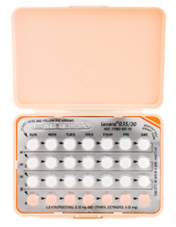
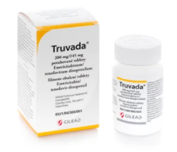

DPP Product Development
Because the DPP combines previously-approved oral PrEP + COC, a clinical trial is not required
Bioequivalence (BE) study compares a new drug product with existing, approved “reference” products. If the products are bioequivalent, they are expected to have the same safety and efficacy
DPP bioequivalence to oral PrEP and COC taken separately would be sufficient evidence to submit the DPP to regulators, which should accelerate time to market
DPP achieved successful pivotal BE results in June 2024
Viatris plans to submit the DPP for regulatory review by end of 2024
Reference products and DPP packaging
Notes:
We also learned that the DPP will follow a different development pathway than other new products. Because the DPP combines two products that are already approved, the usual clinical trial process is not required. Instead, the DPP must undergo bioequivalence testing, which measures whether the absorption rate of the DPP in the body is roughly equal to when oral PrEP and OC pills are taken separately at the same time. This should accelerate time to approval, as BE studies are much shorter than clinical trials. The DPP achieved successful pivotal BE study results in June 2024, which paves the way for dossier submission to a stringent regulatory authority by the end of this year.

Slide 5





























Generating Demand for the DPP
Women struggle with the unpredictability of life, with uptake of OC/PrEP often triggered by the negative actions of partners
DPP can help users navigate the “moments” they need to take control of their sexual health
Users are motivated when their individuality is celebrated around goals, enjoyment, or self-care
Notes:
Audience insights generated through HCD research in Kenya, South Africa, and Zimbabwe has identified potential approaches to introducing the DPP
What else has been done to help prepare for DPP introduction? Learnings from market research in Kenya, South Africa, and Zimbabwe found that women often began using OC and PrEP after negative triggers, and usually in response to the actions of their partners. End users resonated with messaging that celebrated their individuality, and they saw the DPP as a tool that could help them prepare for the unpredictability of life. You can see an example of the creative route we developed for the DPP based on these findings.

Slide 6
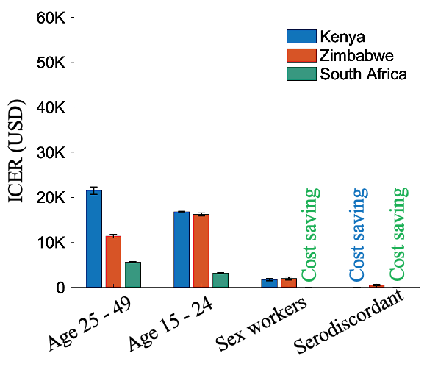

Delivery Considerations for the DPP
DPP more likely to be cost-effective in settings with high HIV incidence and when it increases adherence
Public HIV and FP clinics, private provider networks, and pharmacies (where authorized) are initial recommended delivery channels
Subsidy likely required to make DPP affordable for OC users
Cost-Effectiveness by Population
Notes:
Evidence generation in Kenya, South Africa, and Zimbabwe has identified potential approaches to introducing the DPP
The DPP will leverage channels that make access more convenient and align with user preferences. Because the DPP is an MPT with contraception, it could catalyze differentiating and de-medicalizing PrEP delivery, which could improve integration. Modeling found that the DPP could be cost-effective, particularly in settings with high HIV incidence, among certain populations, and when it increases adherence.

Slide 7
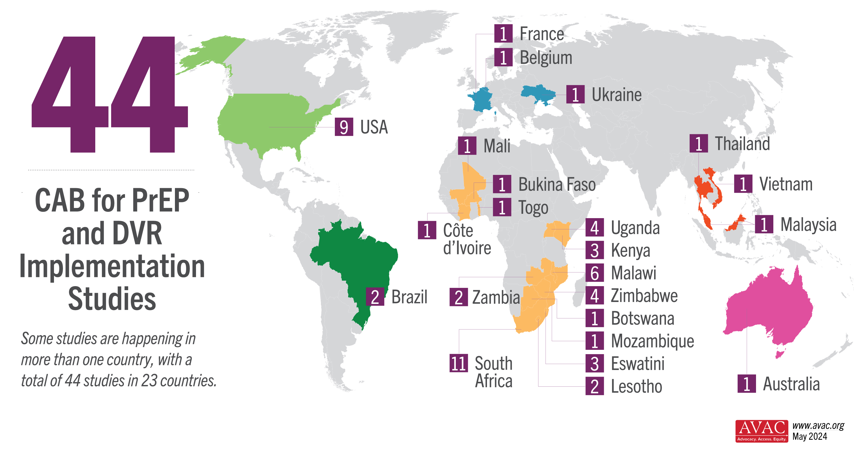
DPP in a PrEP Choice World
BioPIC Implementation Study Tracker
Notes:
There are currently 44 implementation science studies in 23 countries that are introducing CAB for PrEP and the DVR. The landscape is already more diverse and better coordinated than in the early days of oral PrEP demonstration projects. …
With CAB for PrEP and the DVR, the ultimate goal should be to understand how to move faster, more strategically, and more coordinated... with an acceleration towards impact.

Slide 8
What’s Next for the DPP
Q4 2024
2025
2026
Finalize DPP branding
DPP dossier submission
Country consultations
Design DPP studies/projects
1st regulatory approval
Stakeholder consultation
ongoing
Notes:
The DPP Consortium is a coalition of organizations working together to plan for introduction of the DPP. Now that we are moving toward regulatory submission, we have a busy few months ahead of us! We will convene a satellite session and closed strategy meeting on the DPP at the HIVR4P conference; finalize an initial implementation agenda and demand generation toolkit on the DPP; convene country entry meetings with Ministries of Health and implementers in at least two focus countries, which will inform the development of country introduction roadmaps. With the HPTN 104 study team, we are working to plan a community consultation with advocates and study site representatives prior to study start. In addition to HPTN 104, we are actively developing proposals for additional DPP studies. And lastly, we are supporting Viatris to prepare to file for regulatory approval.

Slide 9

Thank you!
Acknowledgements
To learn more about the DPP
Pop Council, UNICEF (co-organizers)
CIFF
DPP Consortium
DPP Advisory Board
DPP Civil Society Advisory Group
Scan:
Contact:
kate@avac.org

