Slide 1
LESSONS FROM IMPLEMENTATION AND SCALE-UP OF PrEP AND FP FOR CISGENDER WOMEN: HOW TO MAKE PrEP/FP INTEGRATION WORK
Delivering on the promise:
Defining optimal implementation strategies and service delivery packages for the Dual Prevention Pill
Lloyd Mulenga, BSc, MBChB, MSc, MMed, PhD
Director: Infectious Diseases, Ministry of Health, Zambia
Affiliations:
University of Zambia, Lusaka, Zambia
Vanderbilt University, Nashville, TN, USA
University Teaching Hospital, Lusaka, Zambia
Ministry of Health, Lusaka, Zambia

Slide 2
PrEP Introduction in Zambia
2017
Oral PrEP introduced in Zambia (Pilot study Lusaka, Livingstone)
2018
Inclusion of PrEP in National HIV Guidelines
2020
Rapid assessment found high acceptability and desire to access oral PrEP
2022
CAB PrEP Introduction in Zambia Value Chain Situation Analysis
Mar. 2023
PEPFAR announces that Zambia among the first five countries to get support for CAB-LA
Jan. 2024
First Batch of CAB-LA arrives in country
Feb. 2024
CAB-LA launched in Zambia and implementation begins
To help achieve the goal of reducing new HIV infections to 18,000 from 30,000 by 2025 three (3) PrEP Choices have been adopted:
Oral PrEP
Tenofovir Disoproxil Fumarate/Emtricitabine (TDF/FTC)
Tenofovir Disoproxil Fumarate/Emtricitabine (TDF/3TC)
Injectable PrEP
Long Acting Cabotegravir (CAB-LA)
Vaginal PrEP
Dapivirine Vaginal Ring (DVR)

Slide 3
Key high level considerations for PrEP introduction
Current Pricing
Future Pricing
Related Costs
Development pipeline
# of suppliers
Market-place concerns
Dosing schedule
Administration
Cost
Convenience
Supply &
Availability
New Product
e.g. LAIs
Efficacy
Toxicities
Side effects
Contraindications
Durability
Drug interactions
Special & General
Populations
HCW Trainings
Community Awareness
Country capacity
Client Benefit
PrEP
Demand
3

Slide 4
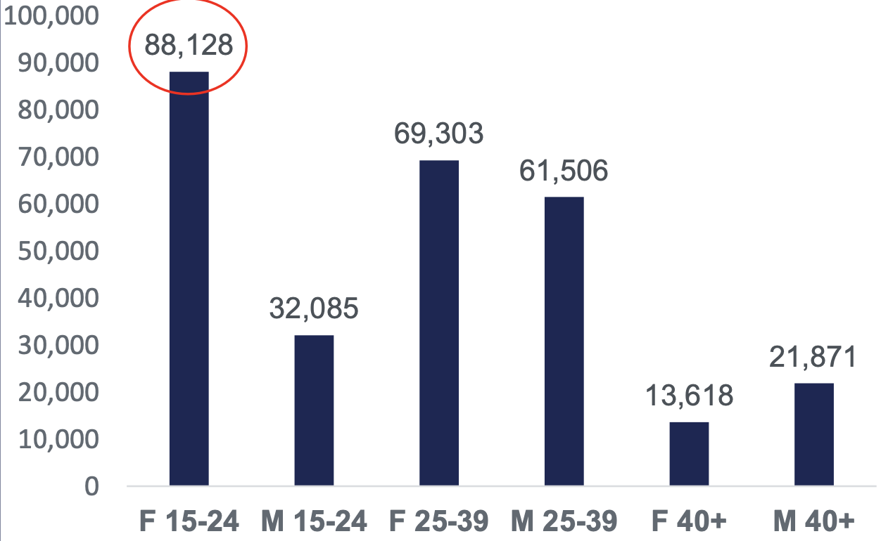
PrEP Uptake Oct 2023-Jun 2024
PrEP Uptake by Age and gender
286,522 clients initiated on PrEP
284,712 on Oral PrEP
1,810 on CAB-LA
PrEP Uptake by Age and gender

Slide 5
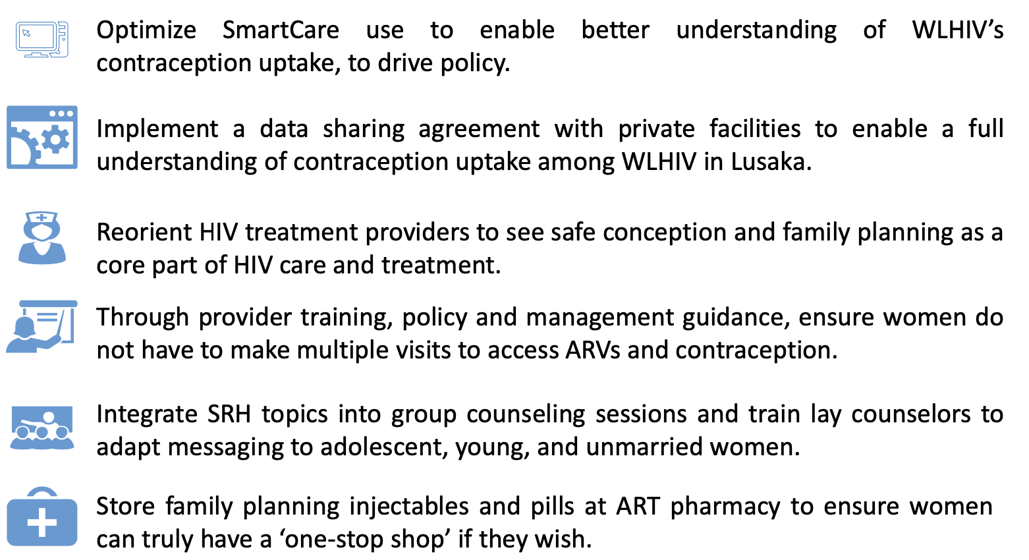
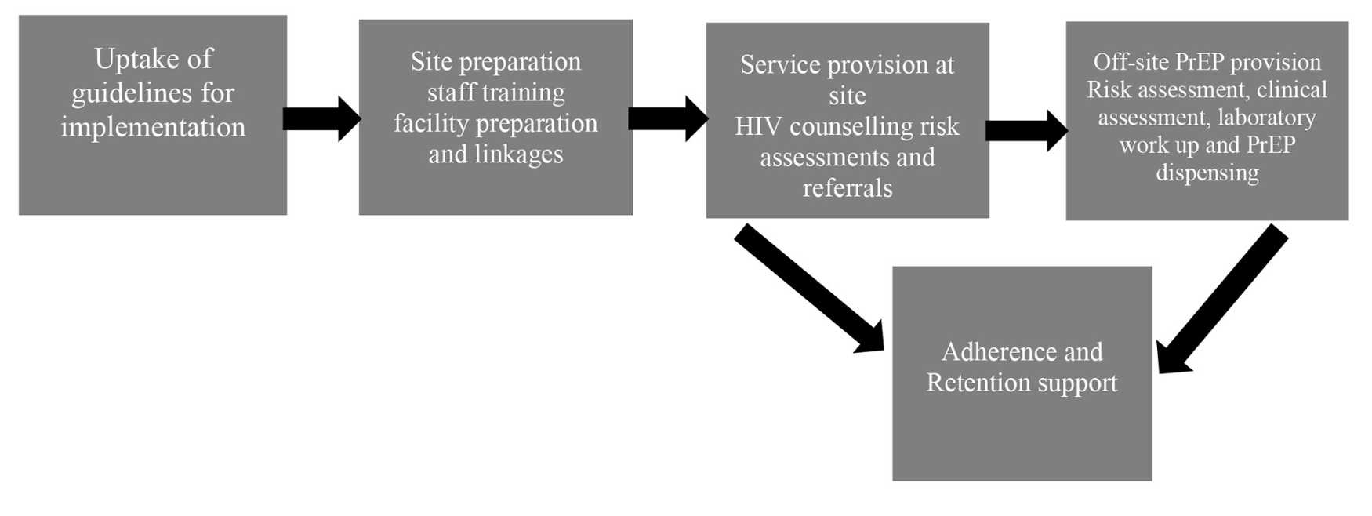
Integrated FP services for WLHIV in Zambia: 2018
Model 1: Integration of FP into HIV services
Model 2: Integration of PrEP into FP services

Slide 6
FP & HIV Service integration: What worked in Zambia
Better use of data and HMIS to reflect integrated models
Strong “facilitated” referrals
Community involvement including high-risk groups such as FSWs, discordant couples, and youth
Multi-month dispensing and decentralized service delivery platforms for WLHIV
Ensured linkages between family planning and HIV prevention, care, and treatment programming
Government leadership
policies, guidelines, frameworks, and technical working groups
coordinated planning, budgeting, implementation and monitoring
Locally contextualized “Levels” of integrated services
Pre- and in-service capacity building
Task shifting
Facility and community-based settings

Slide 7
FP & HIV Service integration: Observed challenges in Zambia
Initial weak coordination between government units responsible for reproductive health services and HIV services
Vertical funding mechanisms including quantification and forecasting
Opposition from some faith based groupings and perceived as donor driven
Lack of robust involvement of recipients of care
Human resource constraints with perceived heavy workloads
Limited space in HIV clinics for private contraceptive counseling or method provision
particularly for longer-acting or permanent methods
Insufficient screening of FP needs among sexually active clients
Insufficient training of providers on informed-choice counseling for FP and method provision
Weak referral systems between HIV and FP service delivery points when a full range of FP methods is not feasible to provide at the HIV clinic

Slide 8
How To Make DPP Roll Out Work?

Slide 9
Key country-level DPP Support Needs: Adoption, Registration & Engagement
Develop investment case for DPP
Support revision of national guidelines & policies
DPP Adoption
Decision Making
Support registration of DPP and/or secure necessary waivers for initial procurement
Registration
Stakeholder Engagement
Ongoing engagement with diverse stakeholders
including communities & Media platforms
ensure delivery and demand models align with end-user preferences and priorities
2 YRs Before Intro
1 YR Before Intro
Introduction
Exact timelines approximate
9

Slide 10
Key country-level DPP Support Needs: Planning, Forecasting & Procurement
Develop rollout strategy
site selection, populations
Initial budget for training and introduction
Planning & Budgeting
Government & other partners to plan for secure supply
aligned with demand & avoid stockouts
Forecasting & Quantification
Support strong phased procurement
generate sufficient early evidence to drive rapid scale-up
across priority populations
Procurement Planning
2 YRs Before Intro
1 YR Before Intro
Introduction
Exact timelines approximate
10

Slide 11
Key country-level DPP Support Needs: Implementation & Monitoring
Assessments to determine
readiness
operational gaps
Capacitate facilities and providers
training
mechanisms for ongoing supportive supervision
Facility-Level Implementation Planning
Adapt M&E systems
ensure ongoing data visibility
integrate needed indicators into national health information systems
developing and implementing enhanced monitoring for early introduction
Monitoring
2 YRs Before Intro
1 YR Before Intro
Introduction
Exact timelines approximate
11

