Slide 1

Delivering a dual prevention product in the context of choice: Considering preferences, counseling, and support for end users and healthcare providers
Sanyukta Mathur, DrPH MHS
Delivering on the Promise: Defining optimal implementation strategies and service delivery packages for the Dual Prevention Pill
Sunday, October 6

Slide 2
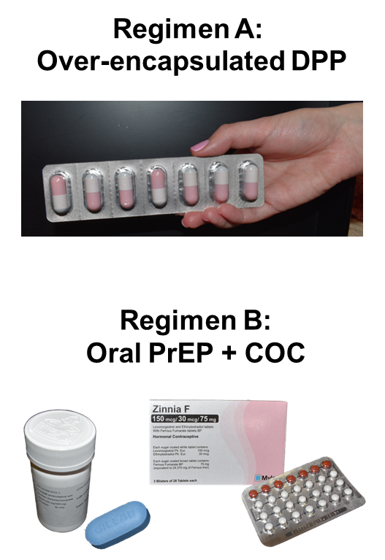
Acceptability studies in Zimbabwe and South Africa offer the first evidence on user experiences with an over-encapsulated dual prevention pill (DPP)
What was
our hypothesis?
Who participated
in the study?
What were the study products?
96 women
16–40 years old Hillbrow,
Johannesburg
A single DPP would be preferred, acceptable, and increase PrEP
adherence compared to
PrEP alone.
30 adolescent girls and young women
16–24 years old Chitungwiza, Zimbabwe
Notes:
24 week choice period
12 weeks with a regimen
Cross over
12 weeks with the other regimen
+ up to 24 week choice period in SAf

Slide 3
Pregnancy prevention and concern about HIV acquisition was noted by most of the participants
 | Zimbabwe | South Africa
Importance of avoiding pregnancy | 93% said it was somewhat or very important | 93% said it was somewhat or very important
Worry about getting HIV in the next 3 months | 26% were somewhat worried and 56% very worried | 13% were somewhat and 44% were very worried
At both sites, participants were motivated to join the study because of concerns about HIV, partners’ behavior, and possibility of dual protection
Notes:
To prevent both pregnancy and HIV and ease anxieties around sexual activity.
Fear of gender-based violence and rape were an additional motivator.
Increased knowledge about HIV prevention and PrEP.
Optimism surrounding more young women
having access to dual prevention medication,
given risk of contracting HIV.
Appreciation of access to health services,
and study staff who provided knowledge/
support on sexual and general health.

Slide 4
Preference for DPP varied by site: Zimbabwean participants preferred the DPP whereas South African participants preferred the 2-pill regimen
Zimbabwe
South Africa
Notes:
At the end of the study, among the 26 people who answered the question in Zimbabwe, 62% preferred the DPP and 38% preferred 2 pills.
In South Africa, the opposite was true – of the 83 participants answered the question, 61% preferred 2 pills and 39% preferred the DPP.
No diff in acceptability – very high/near universal in both
No diff in adherence – very low in both

Slide 5
Experience swallowing the DPP varied by site: in Zimbabwe, most felt the DPP was big, but all could swallow vs. some in South Africa could not swallow it at all
“It is big [DPP] but I could swallow it.”
—30 years old, South African participant
“…It might be difficult to swallow. You might hesitate way before you even drink it…it might sit on your throat, and you will need a full cup of water for it to go down.”
—17 years old, Zimbabwean participant
“I found myself in the comfort zone when taking DPP pills. It wasn’t even hard for me to swallow.”
—31 years old, South African participant

Slide 6
Side effects also varied by site: Most participants in Zimbabwe did not have side effects vs. most in South Africa experienced side effects that bothered them
“I experienced nausea, burning in my stomach and I wondered whether it [DPP] was working or not… As well as a headache, but I did notify the doctor and she suggested that I drink the tablets at night before I sleep as I was taking it in the morning, so I then used that strategy and got used to the medication.”
—19 years old,
South African participant

Slide 7




Most willing to use DPP
In Zimbabwe, 54% liked & 46% did not mind taking the DPP every day.
In S. Africa, 38% liked & 59% did not mind taking the DPP every day.
100% of Zimbabwean and 96% of S. African participants would be likely to recommend to a friend
Zimbabwe: 72% willing to pay small fee, 12% willing to use if free;
16% would not use even if free.
South Africa: 46% willing to pay small fee, 39% willing to use if free; 14% would not use even if free.
Varied preferences for
where and who to get it from
HIV and FP clinics, pharmacies, private doctors
Nurses, counselors, doctors at public or private facilities
Notes:
This slide is focused on willingness to use the DPP and considerations for service delivery. These data come from the quantitative behavioral interview at the end of the study.
All participants either liked or did not mind taking the DPP every day.
93% said they would be willing to use it if it were available and 100% said they would be more likely to use it if it also prevented STIs other than HIV. A majority said they would be willing to pay a small fee for the DPP and 12% said they would only use it if it were free.
Everyone said they would recommend it to friends
There was no single preference for WHERE to get the DPP or WHOM to get it from. Participants had varying opinions ranging from public clinics to private clinics and pharmacies and wanting to get it from nurses, doctors, counselors or pharmacists.

Slide 8
Consider client preferences
    Consider clients’ dual prevention needs
    Support clients to better self-assess their need for HIV prevention (prior to client-provider interaction)
    Support clients to assess which PrEP method is right for them & fit with their lifestyle
    Consider duration/timing of protection desired by clients
    Consider clients' decision-making autonomy
“He [my husband] is a driver so he is rarely around so I wouldn’t know what he will be doing. That is the main reason I joined the study.”
—16 years old, Zimbabwean participant
“It’s a single tablet. There are no missed days or a confusion…sometimes I would forget if I had taken contraceptives since I was used to taking one pill…. So I prefer one, you can keep track if you took the pill and it is a combined prevention method.”
—40 years old, South African participant

Slide 9
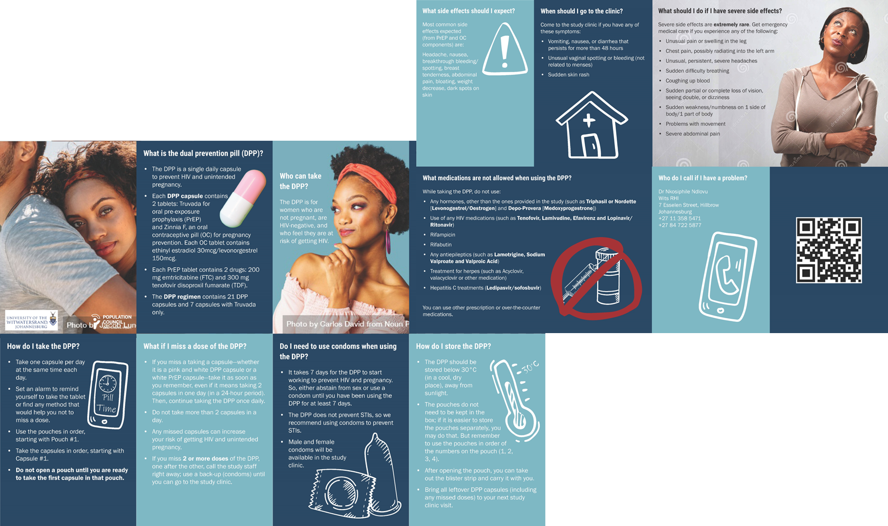
Counseling needs for the DPP
Trouble with pill swallowing
Experiencing side effects
Missed DPPs
Timing of initiation for oral contraceptives (menstrual cycle)
Concomitant medications
Addressing myths and misconceptions about oral contraceptives and PREP
Disclosure, partner/family support, and potential conflicts
Missed DPP Guidance
(developed by the DPP counseling sub-group of the DPP consortium)
If you miss 1 or 2 pills in a month:
Take DPP as soon as you remember, even if it means taking 2 pills in one day.
Do not take more than 2 pills in a day.
Keep going with the pack.
Any missed pills can increase your risk of pregnancy and HIV acquisition.
Notes:
7 consecutive days of DPP pills containing OC are required to recoup pregnancy protection.

Slide 10
Support for effective use of the DPP
    Adherence higher among participants who felt it was unlikely that they would be shunned by the community.
    Community-level awareness campaigns about multi-purpose technologies
    Address underlying stigma associated with HIV and PrEP
Individual Support
Partner/ Family Awareness & Support
Community Awareness & Support
    Most participants disclosed product use to their partners or family members. Partner support was associated with higher adherence.
    Engage men as partners, health promotion materials designed for partners and families
    Individualized strategies required for successful use.
    How to manage side effects
    Counseling on the importance of adherence and consequence of missed doses
    Adherence support: buddy systems; adherence clubs; text reminders

Slide 11


Key takeaways
First study examining acceptability of an over-encapsulated daily oral MPT product (as proxy for the co-formulated DPP in development)
Choice is important
Potential considerations for uptake/use
“- Zimbabwe study participant
  Women are interested in dual/
  multipurpose prevention
  DPP was preferred in Zimbabwe, but 2 pills were preferred in South Africa
  Expanding prevention options may increase demand for prevention products overall
  DPP size & packaging
  Counseling & support on dual prevention for effective use
  Subsequent research is planned to assess the adherence, acceptability, preference, and tolerability of the co-formulated DPP (HPTN104).

Slide 12
Find out more about our DPP research at HIVR4P!
Tuesday, 10/08 Poster Exhibition | 17:00–19:00 PET (GMT-5 hours) | Levels 3&4
  “Comparison of self-reported, pill count and biomarker measures of adherence to oral PrEP or a dual prevention pill in crossover clinical trial in Harare, Zimbabwe” M. Plagianos et. al. LATE BREAKER
  “Correlates of adherence to oral PrEP or a dual prevention pill in a crossover clinical trial in Harare, Zimbabwe and Johannesburg, South Africa” M. Plagianos et. al.
Wednesday, 10/09 Poster Exhibition | 18:30–20:30 PET (GMT-5 hours) | Levels 3&4
  “Experiences with and recommendations for a dual prevention pill (DPP) for HIV and pregnancy prevention: in-depth interviews with women participating in a crossover acceptability study in Johannesburg, South Africa” S. Tenza et. al.
  “Preference for and adherence to a dual prevention pill (DPP) versus two separate pills for PrEP and contraception among women in Johannesburg, South Africa” B. Zieman et. al.
E-posters | Online
  “’DPP is good because you will be taking it as one pill’ Attitudes and experiences with the dual prevention pill (DPP) among adolescent girls and young women in Harare, Zimbabwe” A. Dandadzi et. al.
  “High levels of vulnerability among adolescent girls and young women (AGYW) enrolled in a crossover pilot study of a dual prevention pill for HIV and pregnancy prevention in Harare, Zimbabwe” M. Nkangu et. al.

Slide 13
DPP Study Team
Population Council
Barbara Friedland
Principal Investigator
Dr. Sanyukta Mathur
Principal Investigator
Dr. Lisa Haddad
Medical Monitor &
Co-investigator
Dr. John Steytler
Pharmacovigilance
Marlena Plagianos
Senior Statistician
Brady Zieman
Statistical Data Manager
Irene Bruce
Study Coordinator
Lorna Begg
Research Assistant
Susanna Grecky
Scientific Liaison
Jenna Lopus
Operations & Finance
Mohammad Farid
Administrative &
Financial Management
Samir Souidi
ACASI Programmer
Daniel Loeven
Regulatory Affairs &
Quality Assurance
Dr. Bruce Variano
Stability Testing
Heather Sussman
Clinical Research
Associate
Michele Frix
Intern
UZ- CTRC (Zimbabwe)
Dr. Nyaradzo Mavis Mgodi​
Principal Investigator
Sheu Matimbira
Medical Officer
Adlight Dandadzi
Study Coordinator
Gamuchirai Michelle Mavemwa
Lab Technician
Allen Matubu
Laboratory Manager
Petina Magwidi-Musara
Clinical Research Site Coordinator
Caroline Murombedzi
Pharmacist of Record
Grecenia Ndhlovu
Clinic Manager
Charles Chasakara
Community Coordinator
Wits RHI (South Africa)
Prof. Thesla Palanee-Phillips
Principal Investigator
Dr. Nkosiphile Ndlovu
Co-Principal Investigator/ Research Clinician
Krishnaveni Reddy
Co-investigator/Technical Head
Siyanda Tenza
Qualitative Researcher
Hlalifi Rampyapedi
Community Liaison Manager
Mpho Moji
Research Study Assistant
Mpumie Sigcu
Laboratory Manager
Dr. Ché Kgahliso Moshesh
Research Clinician
Logashnee Govender
Research Clinician/
Co-Investigator
Nazneen Cassim
Pharmacist
Sihle Zulu
Study Coordinator
Lerato Shale
Regulatory Compliance Officer
Dr. Reolebogile Kgoa
Research Medical Officer
Notes:
Before I end, I want to acknowledge that I am presenting on behalf of a large team.
The studies are a collaboration between Population Council, University of Zimbabwe and Wits RHI in South Africa. With funding support from USAID/PEPFAR through the EECO project, CIFF, NIMH at NIH and with product donations from Gilead.

Slide 14




Funding support was provided by:
Mathur, Sanyukta. 2024. “Delivering a dual prevention product in the context of choice: Considering preferences, counseling, and support for end users and healthcare providers,” HIVR4P, Satellite Presentation, 06 October.
This presentation is made possible by the generous support of the American people through the U.S. President’s Emergency Plan for AIDS Relief (PEPFAR) and U.S. Agency for International Development (USAID). The contents are the responsibility of the authors and do not necessarily reflect the views of PEPFAR, USAID, or the U.S. Government.
Research reported in this publication was also supported by the National Institute of Mental Health of the National Institutes of Health under Award Number R34MH119982. The content is solely the responsibility of the authors and does not necessarily represent the official views of the National Institutes of Health.
Truvada was donated by Gilead.

