Slide 1
The Brightest Under 30:
Celebrating Youth Voices and Promoting Meaningful Youth Engagement in HIV Prevention Research
MOSAIC Project
Notes:
Hello everyone 🙂
My name is Adaobi Olisa and I work with FHI 360 as a technical officer on the MOSAIC project and I represent Nigeria on MOSAIC’s NextGen Squad (which you’ll hear more about soon from my fellow NGS member Nolwazi). I am also a fellow for the IAS Advocacy-for-HIV-Cure Academy, a CROI Community Educator Scholar, and a member of CASPR’s Clinical Trial Design Academy. Most importantly, I'm very excited to be your moderator for today. Welcome! Energy; This session is all about young people.
You maybe wondering why there's a whole session about MYE and Young People; here are a few reasons;
Young people especially AGYW are disproportionately affected by HIV; according to UNAIDS, in 2023, everyday 1,100 young people (aged 15 to 24 years)—acquired HIV. This means that about (31%) 1 out of every 3 new HIV acquisition globally were among young people aged 15-24. Every week 4000 young women and girls around the world acquired HIV— 3,100 (77.5%) are in sub-Saharan Africa. These numbers are fueled by several barriers which limit access to and uptake of HIV services among AYP.
However, these statistics and challenges do not define young people because we are resilient, bold, innovative, passionate and most importantly we have been identified as a major resource needed to accelerate and sustain the advances towards achieving HIV epidemic control.
Over the next 90 minutes, we will be Celebrating Youth Voices and Promoting Meaningful Youth Engagement in HIV Prevention Research and in the spirit of celebration, let's take a minute to appreciate the young people in the room today, the young researchers and advocates, the young people who are back home at the frontlines contributing to the HIV response and also the resilient young people who are living with and affected by HIV.
This satellite session will highlight the vital role young people play in HIV prevention research and the impact of integrating their voices throughout the research process.

Slide 2
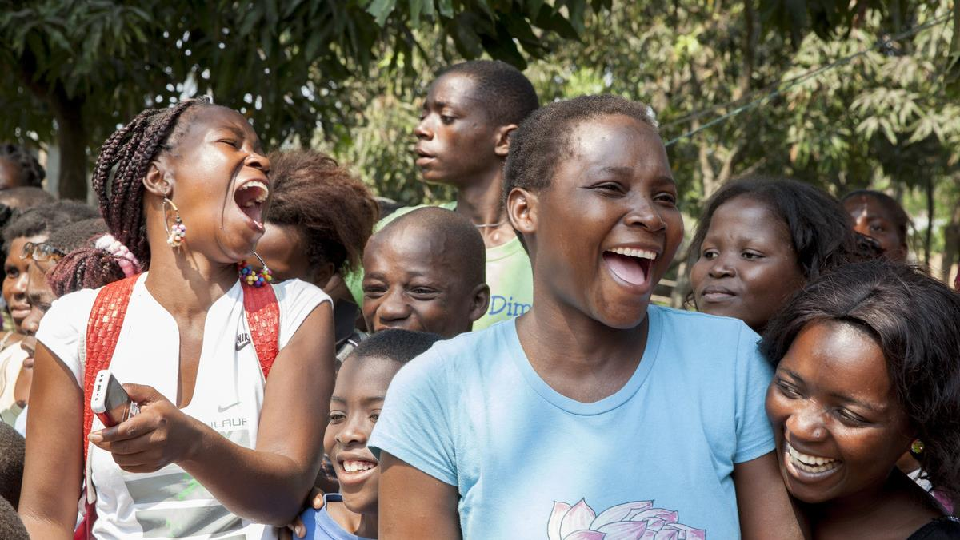
MOSAIC Project Overview
7-year global project funded by PEPFAR through USAID (2021-2028)
Focuses on introduction and access for new biomedical prevention products to prevent HIV for women in sub-Saharan Africa
Works across multiple countries – Botswana, Eswatini, Lesotho, Kenya, Namibia, Nigeria, South Africa, Uganda, Zambia, and Zimbabwe
Supports a multi-product market with informed choice for HIV prevention as new products enter the market
VALUES
Country-led
Women-focused with emphasis on AGYW
Informed choice
Equitable co-leadership
Intentionality
Notes:
Adaobi
MOSAIC is really proud to be hosting this session today.
MOSAIC which is an acronym for Maximizing Options to Advance Informed Choice for HIV Prevention is a 7 year project funded by PEPFAR/USAID which focused on HIV prevention access for women with emphasis on AGYW. MOSAIC works across 10 African Countries

Slide 3

Meaningful youth engagement (MYE) is an inclusive, intentional, mutually respectful partnership between youth and adults whereby power is shared, respective contributions are valued, and young people’s ideas, perspectives, skills, and strengths are integrated into the design and delivery of programs, strategies, policies, funding mechanisms, and organizations that affect their lives and their communities, countries, and the world.​
​
USAID Youth In Development Policy​
Notes:
Throughout this session you'll be hearing about MYE , so what does it actually mean?
Here's a definition from USAID Youth in Development Policy which we use in MOSAIC
In a nut shell, MYE simply means empowering young people with the knowledge, skills, resources and platforms they need to effectively contribute to interventions, policies and decisions that affect them.

Slide 4
Agenda
Presentations
  Intentional Youth Engagement through PEPFAR and USAID
  The Role of Youth Advocates as Advisors in Clinical Research
  Youth Engagement and Leadership in HIV Prevention Implementation Research
  Innovating HIV Prevention Research through the Engagement of Adolescents and Youth from Key Populations
Audience Q&A
Panel Discussion and Q&A with Youth Advocates and Seasoned Leaders
Call to Action and Closing Remarks
Notes:
Adaobi
Here's how the session will go:
We'll start with an interesting line up of presentations from a diverse group of voices; both young innovators and established leaders to highlight the vital role young people play in HIV prevention research and the impact of integrating their voices throughout the research process.
We'll then take a few questions from the audience, after which, we'll delve into an intergenerational panel discussion with Youth Advocates and Seasoned Leaders.
After the panel discussion, we'll take questions from the audience and we'll wrap up the satellite session with a call to action and closing remarks.

Slide 5
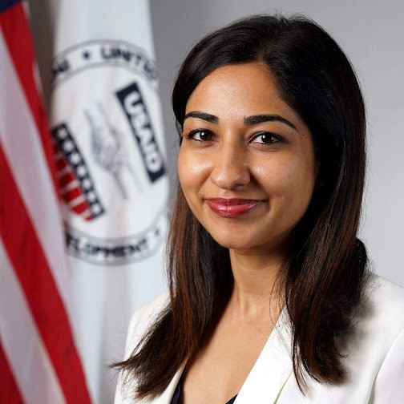
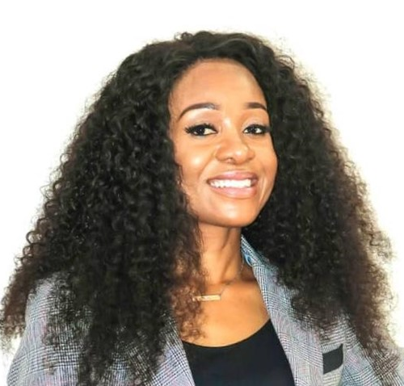
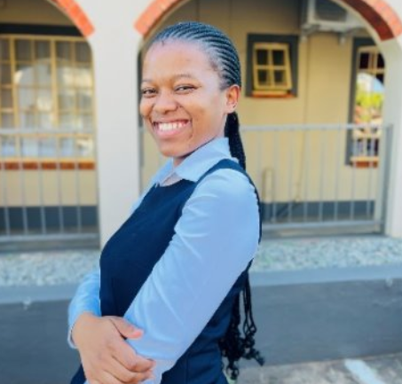
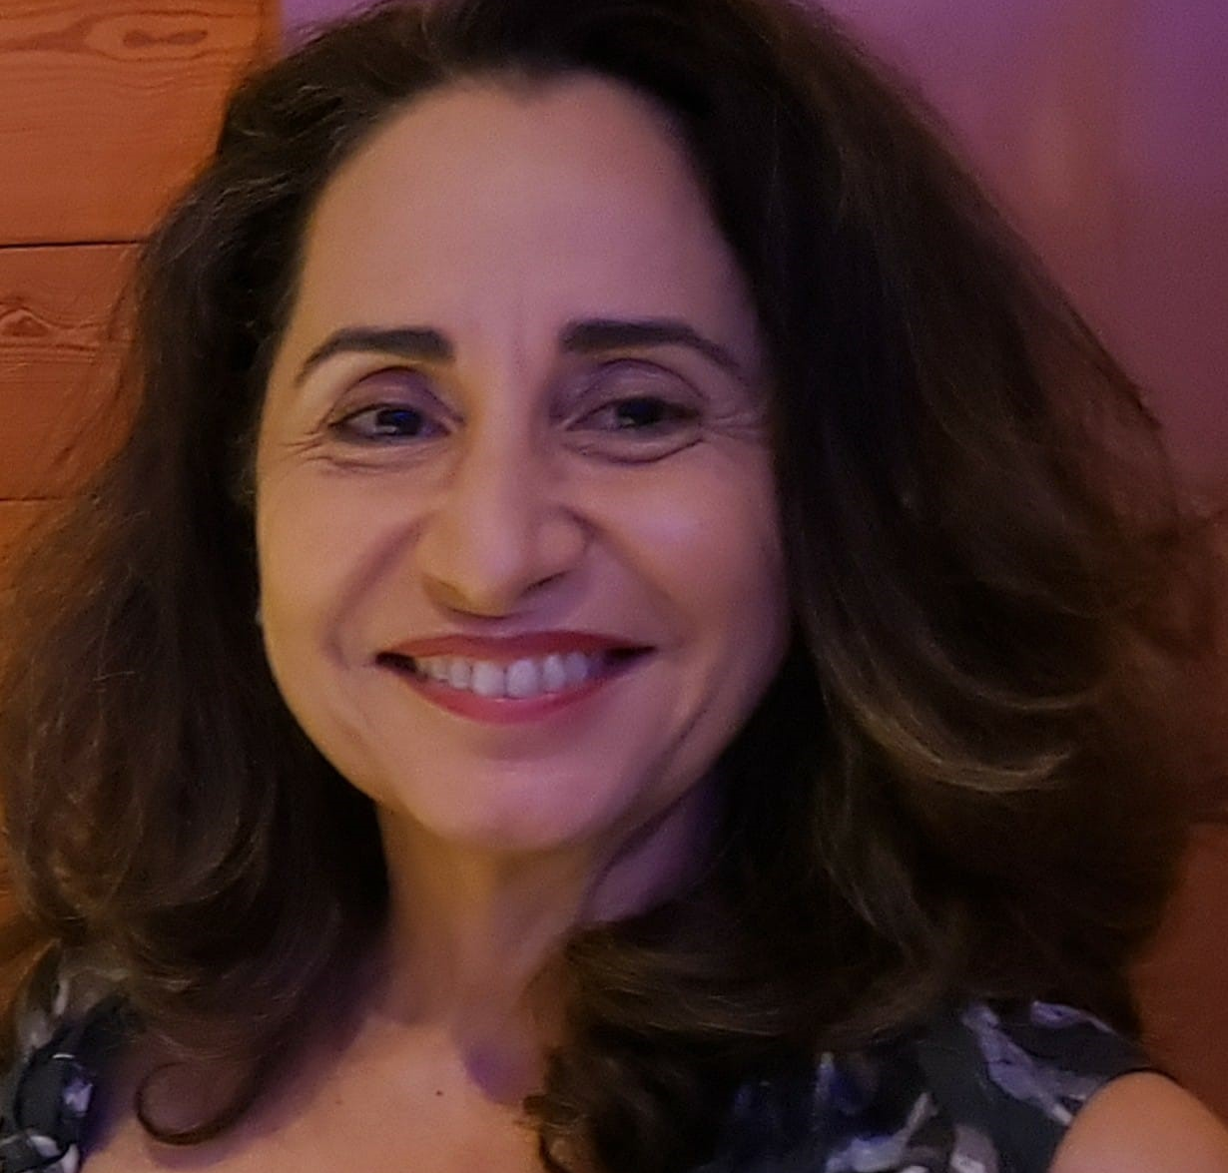
Presenters
Ashley Vij
USAID, USA
Chilufya Kasanda
Treatment Advocacy and Literacy Campaign, Zambia
Nolwazi Khanyile
FHI 360, Eswatini
Ines Dourado
PrEP 1519, Brazil
Ashley is with USAID's Office of HIV/AIDS where she currently serves as the PrEP Introduction and Access Lead. Prior to this role, she was the Agreement Officer Representative for the MOSAIC project.
Chilufya is a Program Officer for HIV Prevention & Research for the Treatment Advocacy and Literacy Campaign and a project lead for CASPR. She holds a Bachelor's degree in Development Studies from the University of Zambia and has experience in gender transformative programs, advocacy, and community mobilization.
Nolwazi is a qualified nurse-midwife, a Research Assistant for FHI 360 Eswatini, and a proud member of the NextGen Squad. She is deeply passionate about meaningful youth engagement, leadership, and mentorship.
Dr. Ines Dourado, MD, PhD, is a full professor, researcher at the Federal University of Bahia, Brazil, and is experienced leading public health research using epidemiological and mixed-methods research. Her main research area is HIV/AIDS. She is the PI of a PrEP choice implementation study among sexual minority adolescents in Brazil.
Notes:
Adaobi
Let's welcome our presenters for today**** Adaobi to read presenter bios from the slide- read the first sentence for each person
After reading all the bios; I'll hand over to Ashley Vij to kick us off

