Slide 1
Intentional Youth Engagement Through PEPFAR and USAID
Ashley Vij
Health Science Specialist
avij@usaid.gov
This presentation was made possible by the support of the American people through the United States Agency for International Development (USAID) under the U.S. President's Emergency Plan for AIDS Relief (PEPFAR). The contents in this article are the sole responsibility of the authors, and do not necessarily reflect the views of USAID, PEPFAR or the United States Government.
Notes:
USAID Ring Framework document

Slide 2
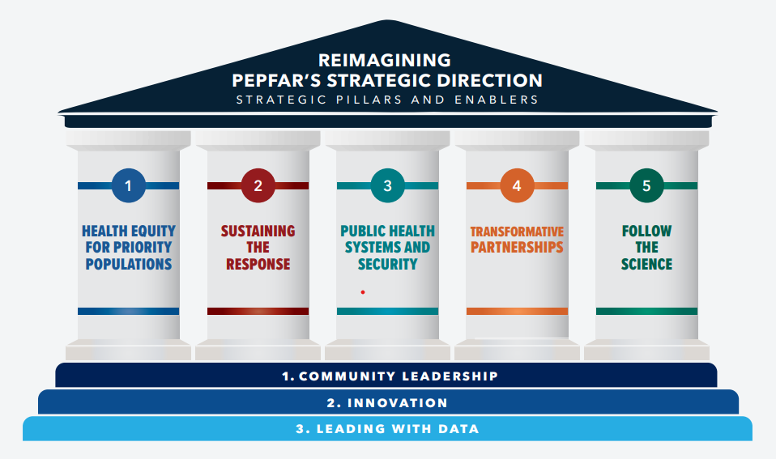
Research is a key pillar of PEPFAR’S reimagined strategic direction
Key Takeaways
  Proactively identify and provide early financing to deploy and pilot scientific innovations on the horizon
  Optimize the scale-up of effective innovations
  Embrace and elevate the best new scientific innovations
  Address key forward-looking implementation questions and rapidly translate findings into HIV programs
  Center local leadership and ensure AGYW receive evidence-based services
Research: Investing in the scale-up of cutting edge behavioral & implementation science to bend the curve on new infections

Slide 3
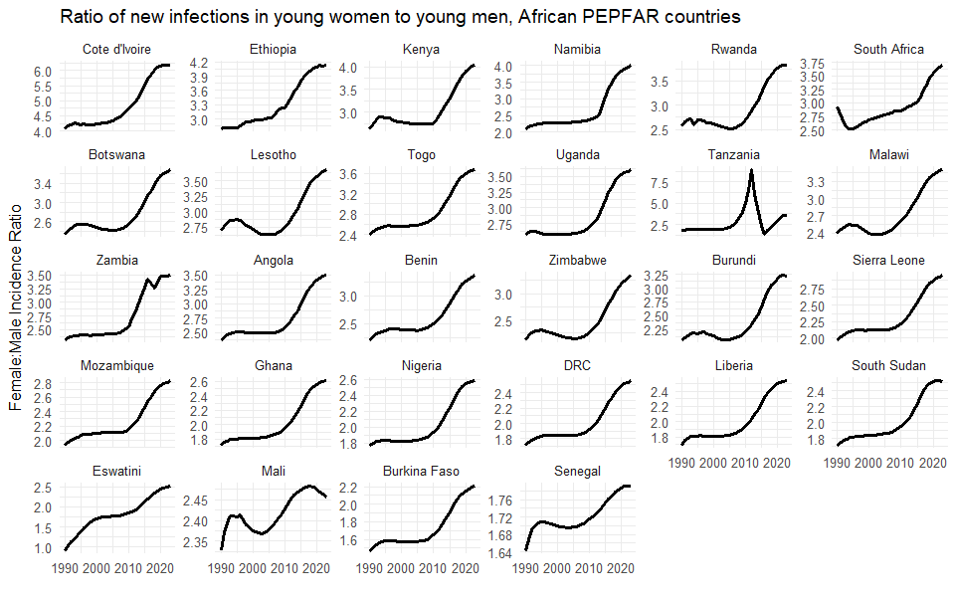
While infection rates have decreased, the gender disparity has
increased.
Ratio of new HIV infections in AGYW to ABYM (ages 15-24) in all African PEPFAR countries
In Côte d’Ivoire, for every 1 infection in a young man, there were 4 young women infected in 2000. Now this rate has increased to over 6 infections in young women compared to young men.
Data Source: 2023 UNAIDS estimates from AIDSinfo
Notes:
This slide shows data from the most recent UNAIDS report,This dat shows that will rates of new infections among youth generally are decreasing, the ratio of new infections among AGYW as compared to ABYM is in fact growing

Slide 4
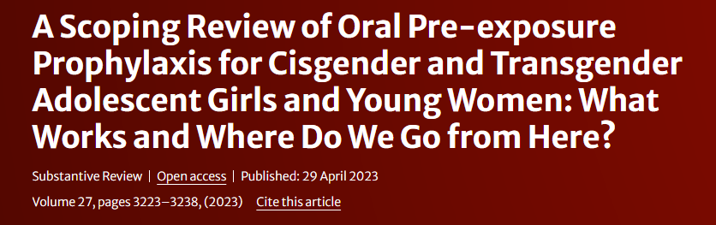
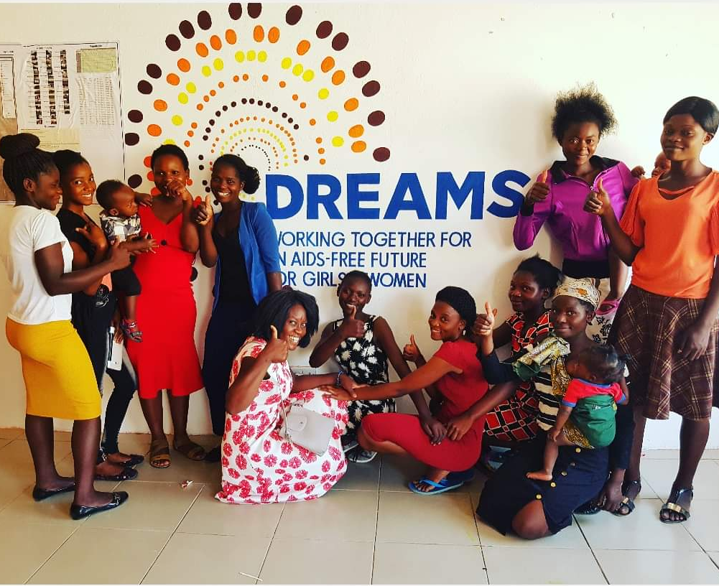
Combination Approach to PrEP - with Meaningful Youth Engagement
Prioritize PrEP uptake and continuation with increased efforts to integrate youth friendly services and spaces.
Programs where AGYW feel accommodated (safe spaces) have the highest rates of PrEP uptake and continuation among AGYW.
Support interventions to address IPV are associated with initiation and completion.
Layering services in youth spaces has the highest continuation rates for cisgender AGYW.
  Zimbabwe: In DREAMS vs. non-DREAMS sites, 28% of young women who sold sex in DREAMS sites reported ever use of PrEP vs less than 1% in non-DREAMS site.
Photo credit: USAID Zambia/DREAMS
Notes:
https://link.springer.com/article/10.1007/s10461-023-04043-x#Sec5
In terms of bio medical approahes, which are a critical component of a multiprongged approach to AGYW, global evidence points to the need for a combination approach to PrEP particularly for AGYW.
This is because the same multifaceted complex structural and gender barriers that place AGYW at an increased risk of HIV also act as barriers to PrEP initiation and continuation for this population
USAID colleagues along side the OPTIONS project, conducted a scoping review consisting of 20 AGYW-specific studies
The studies analyzed examined the characteristics of various interventions and their impact on on PrEP interest, uptake, and continuation.
Results show that interventions to improve the adolescent/ youth friendliness of PrEP delivery, including the provision of PrEP within safe spaces contributed to uptake and continuation
Interventions addressing IPV, were associated with initiation and continuation
Programmatic layering in youth-focused spaces which is defined as deploying multiple interventions at the individual- and community-levels; DREAMS as one example of this, is associated with high rates of continuation
For example in Zimbabwe, 28% of AGYW enrolled in DREAMS who sold sex had ever used PrEP vs 1% of AGYW who sold sex in non-DREAMS sites
Conversely programs that targeted a broader audience, including but not tailored to the needs of youth, were less successful
This data points to the need for a combination approach to support the use of biomedical interventions for this population

Slide 5

Research Gaps Remain
Young people’s lives are complex and reducing their exposure to HIV requires a multi-faceted approach.
Implementation research is needed on how to support young people stopping and starting PrEP products or moving between products.
Research questions should consider how to integrate PrEP products as part of a comprehensive HIV prevention package and the broader system within which that package is offered.
NextGen Squad; Photo Credit: MOSAIC
Notes:
Maximizing Options to Advance
Informed Choice for HIV Prevention
(MOSAIC) Gender and Youth Strategy
DECEMBER 2022

Slide 6
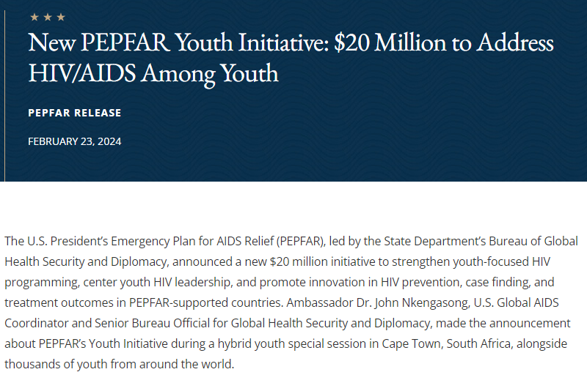
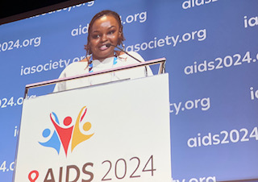
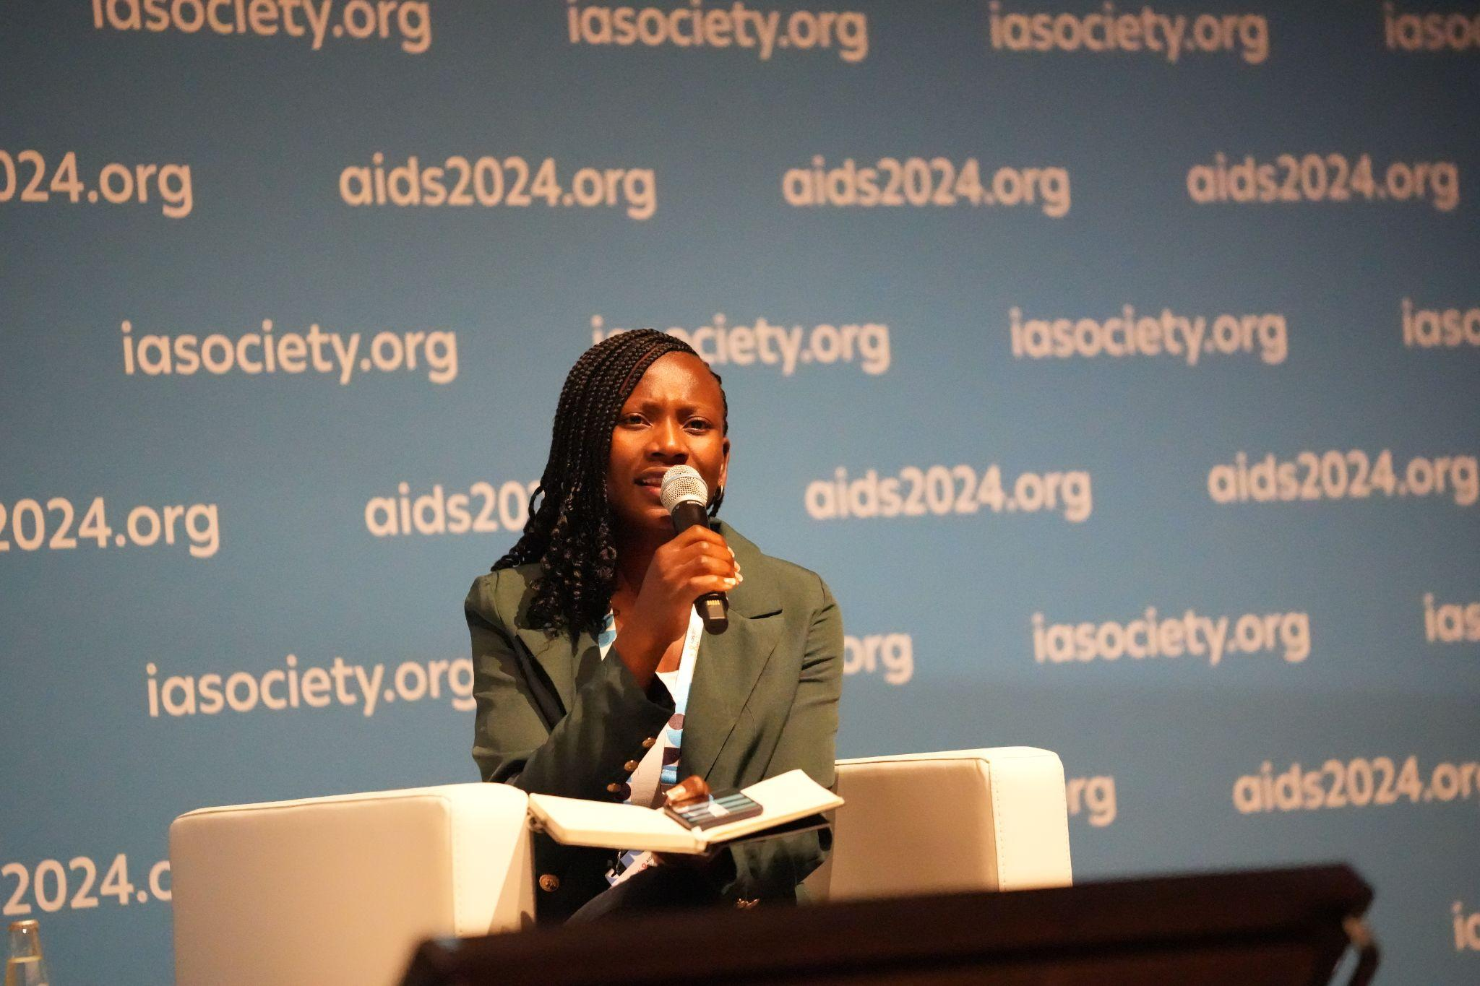
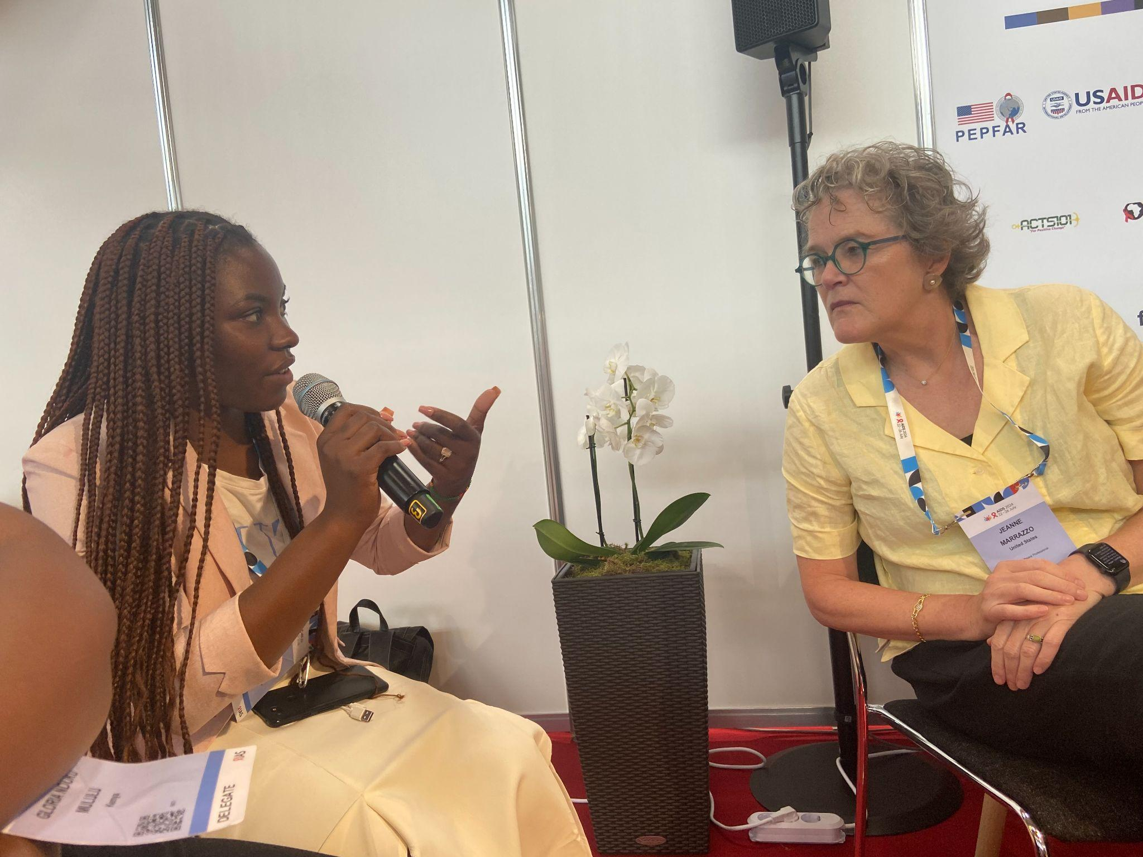
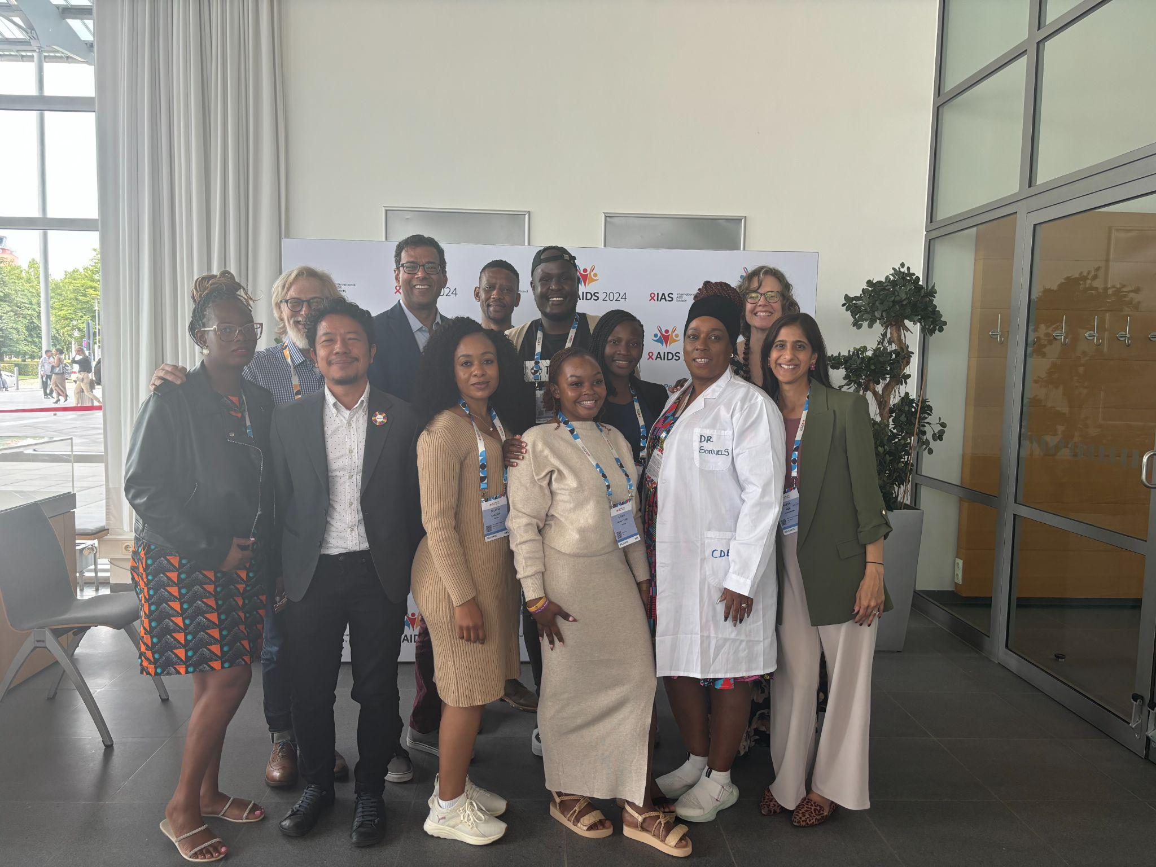
Youth Leadership and Engagement Is the Key To Success
Notes:
The conversations need to happen across the board, YOUTH have been pivotal in important conversations
Atul with Advocates
Jeanne with Youth People
They are at the table with them and we see success. There are all there all these opportunities. Young people know what leadership is and are best to guide youth engagement
End with youth initiative

