Slide 1



The Role of Youth Advocates as Advisors in Clinical Research
Chilufya Kasanda Hampongo
The Brightest Under 30: Celebrating Youth Voices and Promoting Meaningful Youth Engagement in HIV Prevention Research

Slide 2

Overview
Why Youth Participation Matters in HIV Prevention
Benefits of Engaging Youth Advocates as Advisors in Clinical Research
Role of the Young Women's HIV Prevention Council
Recommendations

Slide 3
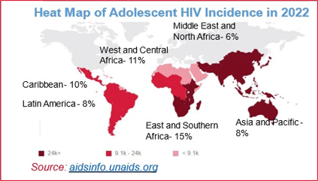
Why Youth Participation Matters in HIV Prevention
Youth at the Center of the Epidemic: Adolescents and young adults, particularly AGYW, are disproportionately affected by HIV.
Advisory Role & Unique Perspectives: Youth bring lived experiences that provide valuable insights into their needs, preferences and barriers.
Innovation, Trust and Sustainable Solutions: Engaging youth leads to provide innovative, culturally relevant, and sustainable approaches and solutions builds trust and meaningful relationships between researchers and the youth.
Notes:
*Key Stat: According to the 2023 UNAIDs report: Adolescent Girls and Young Women account for about 66% of new infections among people aged 15 years and above of whom over 77% of new infections were among people aged 15-24 years.
In sub-Saharan Africa in 2022, approximately 160 000 [93 000–230 000] adolescent girls and young women aged 15–24 years acquired HIV, half as many (53%) as in 2010, compared with 47 000 [9300–75 000] of their male counterparts, a 66% reduction since 2010.
Also highlight the importance of peer leadership!

Slide 4
Benefits of Engaging Youth Advocates as Advisors in Clinical Research
Advisors on Protocol Design: Youth advocates provide valuable insights into designing trials that are culturally sensitive and accessible. Youth can provide important perspective on the broader HIV prevention context, often that researchers in their siloes do not see, understand, or incorporate into their protocols and research agendas.
Ethical Considerations: Youth advocates help address ethical concerns, such as consent, inclusion/exclusion criteria, confidentiality, and stigma.
Feedback Loops: Ongoing input from youth advocates ensures that interventions remain relevant and responsive to the evolving needs of the youth.
Enhanced Relevance: Youth involvement ensures that research questions align with the actual needs and realities of young populations.
Increased Enrollment and Retention: Studies with input from the youth and youth advocates see higher participation and retention rates.
Community Trust: Youth advocates serve as bridges between research teams and their communities, building trust and credibility.
Notes:
Example: Youth advisors from diverse backgrounds improving the inclusivity of trial recruitment strategies.

Slide 5
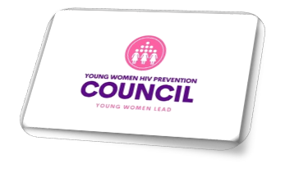
Introduction of the Young Women’s HIV Prevention Council (YWHPC)
Launched in June 2023 at the 11th SA AIDS Conference
Umbrella structure for enthused AGYW and young women advocates invested and involved in the HIV prevention and SRH spaces.
Organizes AGYW engaging with HIV prevention research activities into a structure that aligns and drives AGYW advocacy efforts and their research agenda forward.
Has 15 members; membership is drawn from USAID-funded projects and CASPR partners (i.e. APHA Ground Forces, AfNHi Youth Cohort, Copper-Rose Zambia, African Women’s Accountability Board, MOSAIC’s next gen squad, DPP Civil Society Adv Group, CONRAD’s Project Engage Advisory Group).
Expanding membership in December 2024.

Slide 6
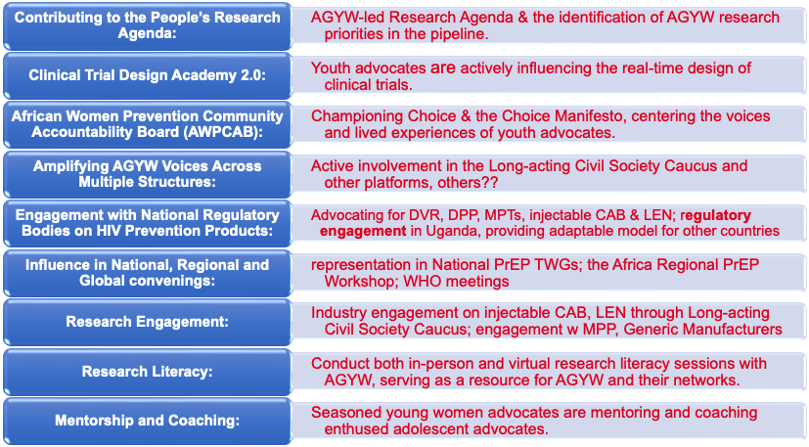


YWHPC's Contribution and Impact in Clinical Research
From left to right: Chilufya Hampongo, Shakira Namwanje, Ivy Zwane, Siviwe Gaika, and Oyama Eland represent the YWHPC at ICASA.
Notes:
Chillufya to add the work that Jerop will be done in UNGA in NYC!
Ruth’s work on the DPP in Uganda.

Slide 7
YWHPC's Role in Recent HIV Prevention Trials
The Council has contributed towards protocol review and strategic input to trials and research involving AGYW, including:
Gilead’s PURPOSE 1 Trial:
  Advocated for the inclusion of adolescents in the study and their decision to join PURPOSE 1
  Advocated for participants to access free birth control
  Advocated for PLP to continue study medication
  Advocated for the inclusion of intimate partner violence screening
Bioequivalence Study of the Dual Prevention Pill (DPP)
  Provided input on recruitment materials for acceptability studies in South Africa, Zimbabwe
  Provided feedback on design of human-centered design research and DPP creative concepts
  Developed DPP FAQs and messaging on bioequivalence (BE) studies to build literacy
  Conducted regulatory engagement in Uganda, a model that could be adapted to other countries
  Initiated engaging with HPTN 104 community engagement team to explore partnership.

Slide 8
YWHPC's Role in Recent HIV Prevention Trials
Upcoming Trials:
Merck’s 8527 trial, looking at a monthly oral pill for HIV prevention
  Participated in an AVAC-led advocates’ consultation on the design and implementation of Merck’s 8527 efficacy trial – anticipated to start in 2025.
HPTN 104 - evaluating adherence to a single, dual prevention pill vs. two separate tablets
  Currently contributing to the planning of HPTN 104’s community consultation, scheduled for December 2024.
  Currently reviewing the HPTN 104 protocol.
Notes:
Put into a graphic

Slide 9
Recommendations: Engaging Youth Advocates as Advisors in Clinical Research
Meaningful Participation and Involvement
Capacity Building and Empowerment
Sustained Engagement Beyond Rollout
Comprehensive Support Systems
Active Involvement: Youth advocates engaged at all stages from design to implementation.
Co-Designing Interventions: Collaborate with youth in forming research questions, methodologies, and data work.
Youth Leadership: Empower youth to take leadership roles for sustained involvement.
Advisory Committees: Create youth advisory bodies to ensure their voices are consistently heard.
Leadership and Agency: Encourage youth to take ownership of impactful decisions.
Flexible Approaches: Adapt interventions as AGYW needs evolve.
Addressing Barriers: Overcome barriers like stigma and transportation for accessible services.
Ongoing Engagement: Maintain youth participation through rollout and evaluation.
Youth-Informed Rollouts: Tailor rollouts based on youth advocate insights
Collaboration with Stakeholders: Partner to provide integrated health, education, and mentorship.
Comprehensive Education: Offer thorough sexual and reproductive health education for informed choices.
Notes:
Meaningful Participation and Involvement:
Active Involvement: Youth advocates should be involved at every stage, from research design to implementation, ensuring their voices are central to the process.
Co-Designing Interventions: Engage youth advocates in co-designing research questions, developing methodologies, and participating in data collection and analysis.
Youth Leadership: Empower youth advocates to take on leadership roles within programs and research efforts, building their capacity for long-term involvement.
Advisory Committees: Establish youth advisory committees to ensure their perspectives are consistently integrated.
Capacity Building and Empowerment:
Leadership and Agency: Amplify the voices of the youth by encouraging them to take ownership of decisions that directly impact them.
Flexible and Adaptive Approaches
Adapting Interventions: Be flexible and ready to adapt interventions as AGYW’s needs evolve, ensuring interventions remain relevant and effective.
Addressing Barriers: Identify and address logistical, cultural, and social barriers faced by the youth in accessing services, including issues like stigma, discrimination, and transportation.
Sustained Engagement Beyond Rollout:
Ongoing Engagement: Maintain continuous engagement with youth advocates beyond the research phase, ensuring they are part of the rollout and subsequent evaluation phases.
Youth-Informed Rollouts: Use insights and feedback from youth advocates to inform and guide the rollout of interventions, ensuring they meet the target audience’s needs.
Comprehensive Support Systems:
Collaboration with Stakeholders: Partner with other organizations and stakeholders to provide holistic support to the youth, integrating health services, education, and mentorship.
Comprehensive Education: Programs should provide the youth with comprehensive sexual and reproductive health education to enable informed decision-making.

Slide 10
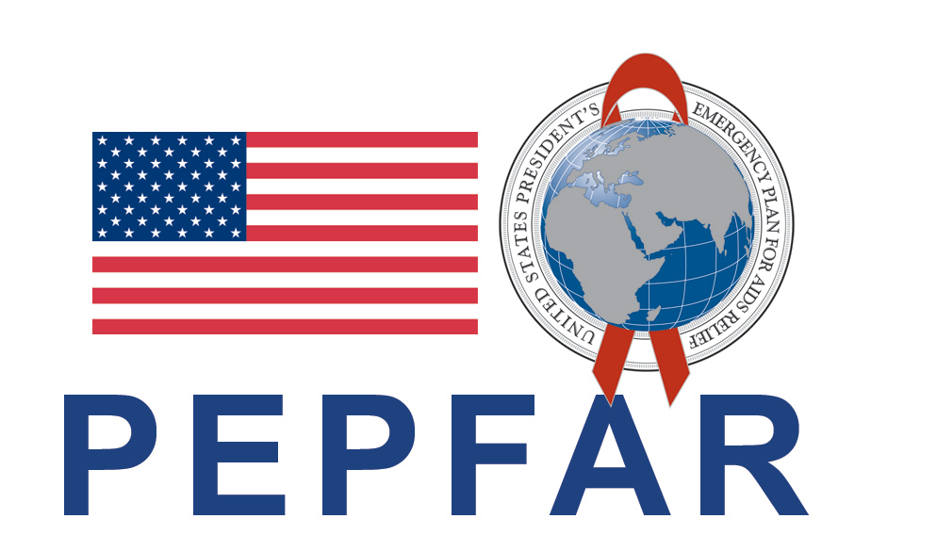


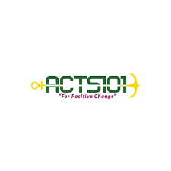
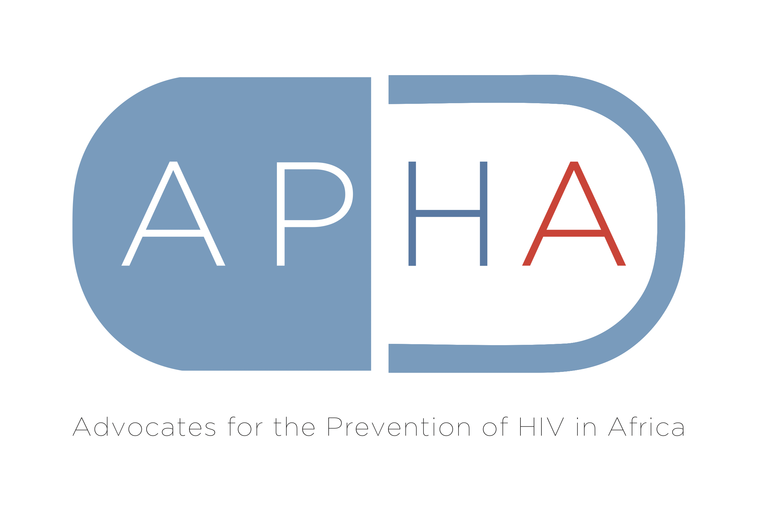


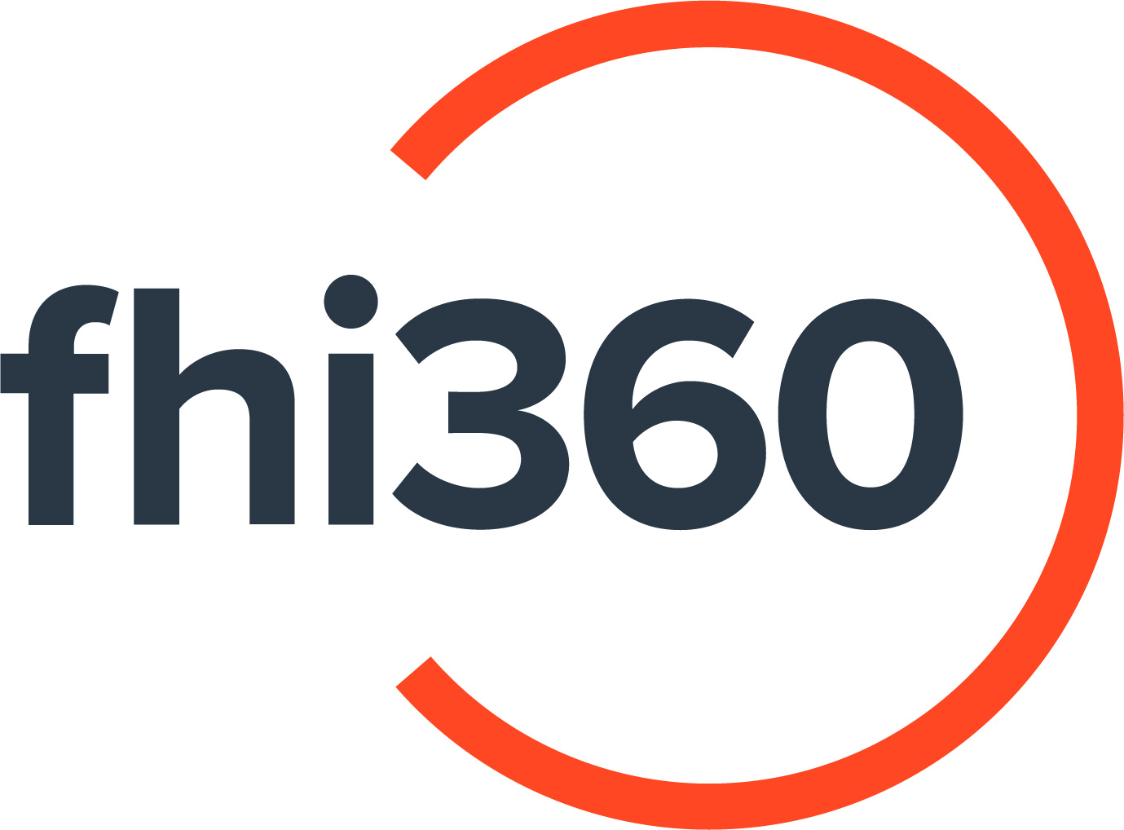
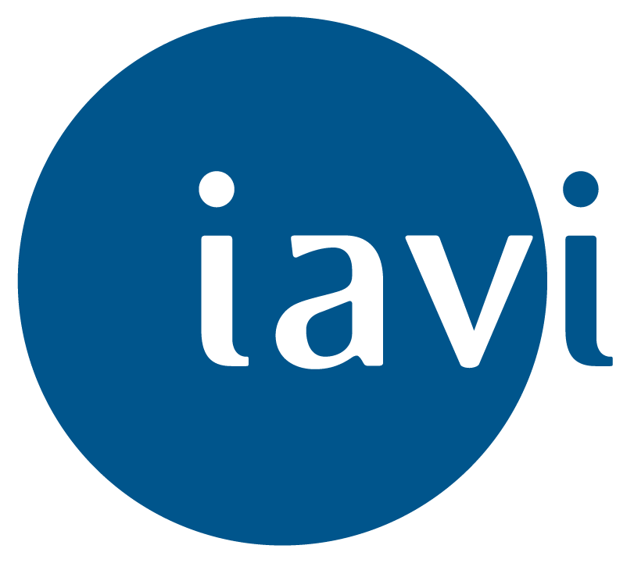



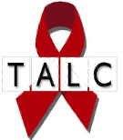



Thank You!
Coalition to Accelerate and Support Prevention Research (CASPR)
Cooperative Agreement No. AID-OAA-A-16-00031
HIV Vaccine and Biomedical Prevention Research Project—Objective 3
Notes:
Thank you! The Young Women’s HIV Prevention Council is excited to share a report highlighting key work on AGYW research priorities within the HIV prevention pipeline. This includes best practices for engaging AGYW from research to rollout, and insights on shaping an AGYW-led research agenda.
Please join us today at 5 PM to hear directly from young women about their needs and priorities in HIV prevention. Don’t miss this opportunity to learn what the future of HIV prevention should look like—driven by those it impacts the most.

