Slide 1
Youth Engagement and Leadership in HIV Prevention Implementation Research
Nolwazi Khanyile – FHI 360
The Brightest Under 30: Satellite session

Slide 2

Helping women prevent HIV by accelerating the introduction and scale-up of new and emerging biomedical prevention products.
Notes:
Maximizing Options to Advance Informed Choice for HIV Prevention (also known as “MOSAIC”) is a seven-year global project funded by PEPFAR through USAID to help adolescent girls and young women, and other women, prevent HIV by accelerating introduction and scale-up of new and emerging biomedical prevention products. MOSAIC collaborates with ministries of health, missions, implementing partners, civil society, end users, providers, and other local and global stakeholders, in Botswana, Eswatini, Lesotho, Kenya, Namibia, Nigeria, South Africa, Uganda, Zambia, and Zimbabwe.

Slide 3


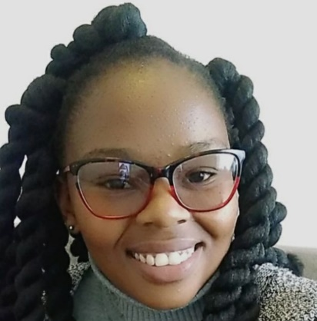
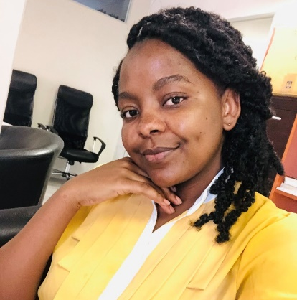
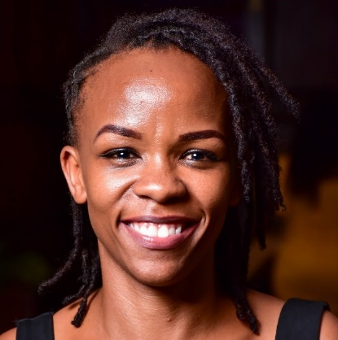


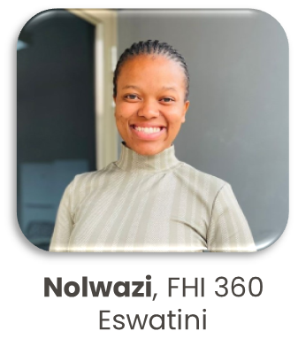



Meet the NextGen Squad
Adaobi, FHI 360 Nigeria
Celi, Wits RHI
South Africa
Nts’ebo, Jhpiego Lesotho
Febbe, Jhpiego Namibia
Merci, LVCT Health Kenya
Luwi, FHI 360 Zambia
Maggie, LVCT Health Kenya
Rubuna, FHI 360 Uganda
Sanele, PZAT Zimbabwe
Chantel, Wits RHI
South Africa
Notes:
One way that MOSAIC is meaningfully and strategically engaging young people is through the NextGen Squad a team of 11 paid youth advocates under the age of 30 from Eswatini, Kenya, Lesotho, Namibia, Nigeria, South Africa, Uganda, Zambia, and Zimbabwe.
This dynamic group of young people shape and participate in MOSAIC project activities through local partners.
The NGS shape, participate in, and hold MOSAIC accountable to its plans, actions, and monitoring, evaluation and learning efforts to:
Be responsive to young people’s needs, preferences, and lived experiences
Be inclusive of the diversity of AGYW
Meaningfully engage young people in research and research utilization

Slide 4





CATALYST
Study goal: Characterize and assess the implementation of an enhanced service delivery package providing informed choice of PrEP products among women at 28 PEPFAR delivery sites in Kenya, Lesotho, South Africa, Uganda, and Zimbabwe.
  7 sites in Uganda
  FHI 360, TASO
  6 sites in Kenya
  LVCT Health, University of Nairobi, Path Kenya
  6 sites in Zimbabwe
  PZAT, OPHID
Daily oral PrEP
Monthly PrEP Ring
Bi-Monthly CAB PrEP
  6 sites in South Africa
  Wits RHI
  3 sites in Lesotho
  Jhpiego, EGPAF
Notes:
The Eswatini Ring Study and CATALYST are both PrEP choice implementation studies under MOSAIC. [Go through description of each study]. Young people work on both studies, and you’ll hear more about that soon, but I work most closely with the Eswatini Ring Study.

Slide 5
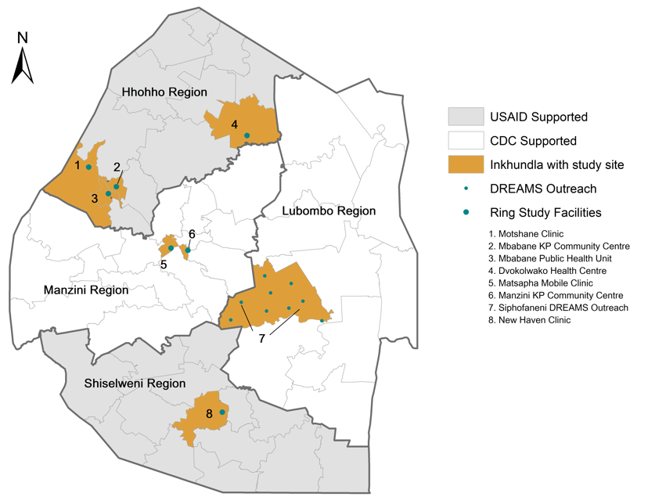
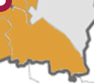

Eswatini Ring Study
4
1
2
3
Study goal: Characterize and assess the feasibility, acceptability, uptake, and patterns of use of an enhanced service delivery package providing fully informed choice of oral PrEP and the PrEP ring among women, especially AGYW, in Eswatini.
9
5
6
o
8
USAID Supported
CDC Supported
Inkhundla with study site
Fixed study site
Outreach/mobile site
7
Monthly PrEP Ring
Daily oral PrEP
Ring Study sites – 2024
Notes:
The Eswatini Ring Study and CATALYST are both PrEP choice implementation studies under MOSAIC. [Go through description of each study]. Young people work on both studies, and you’ll hear more about that soon, but I work most closely with the Eswatini Ring Study.

Slide 6
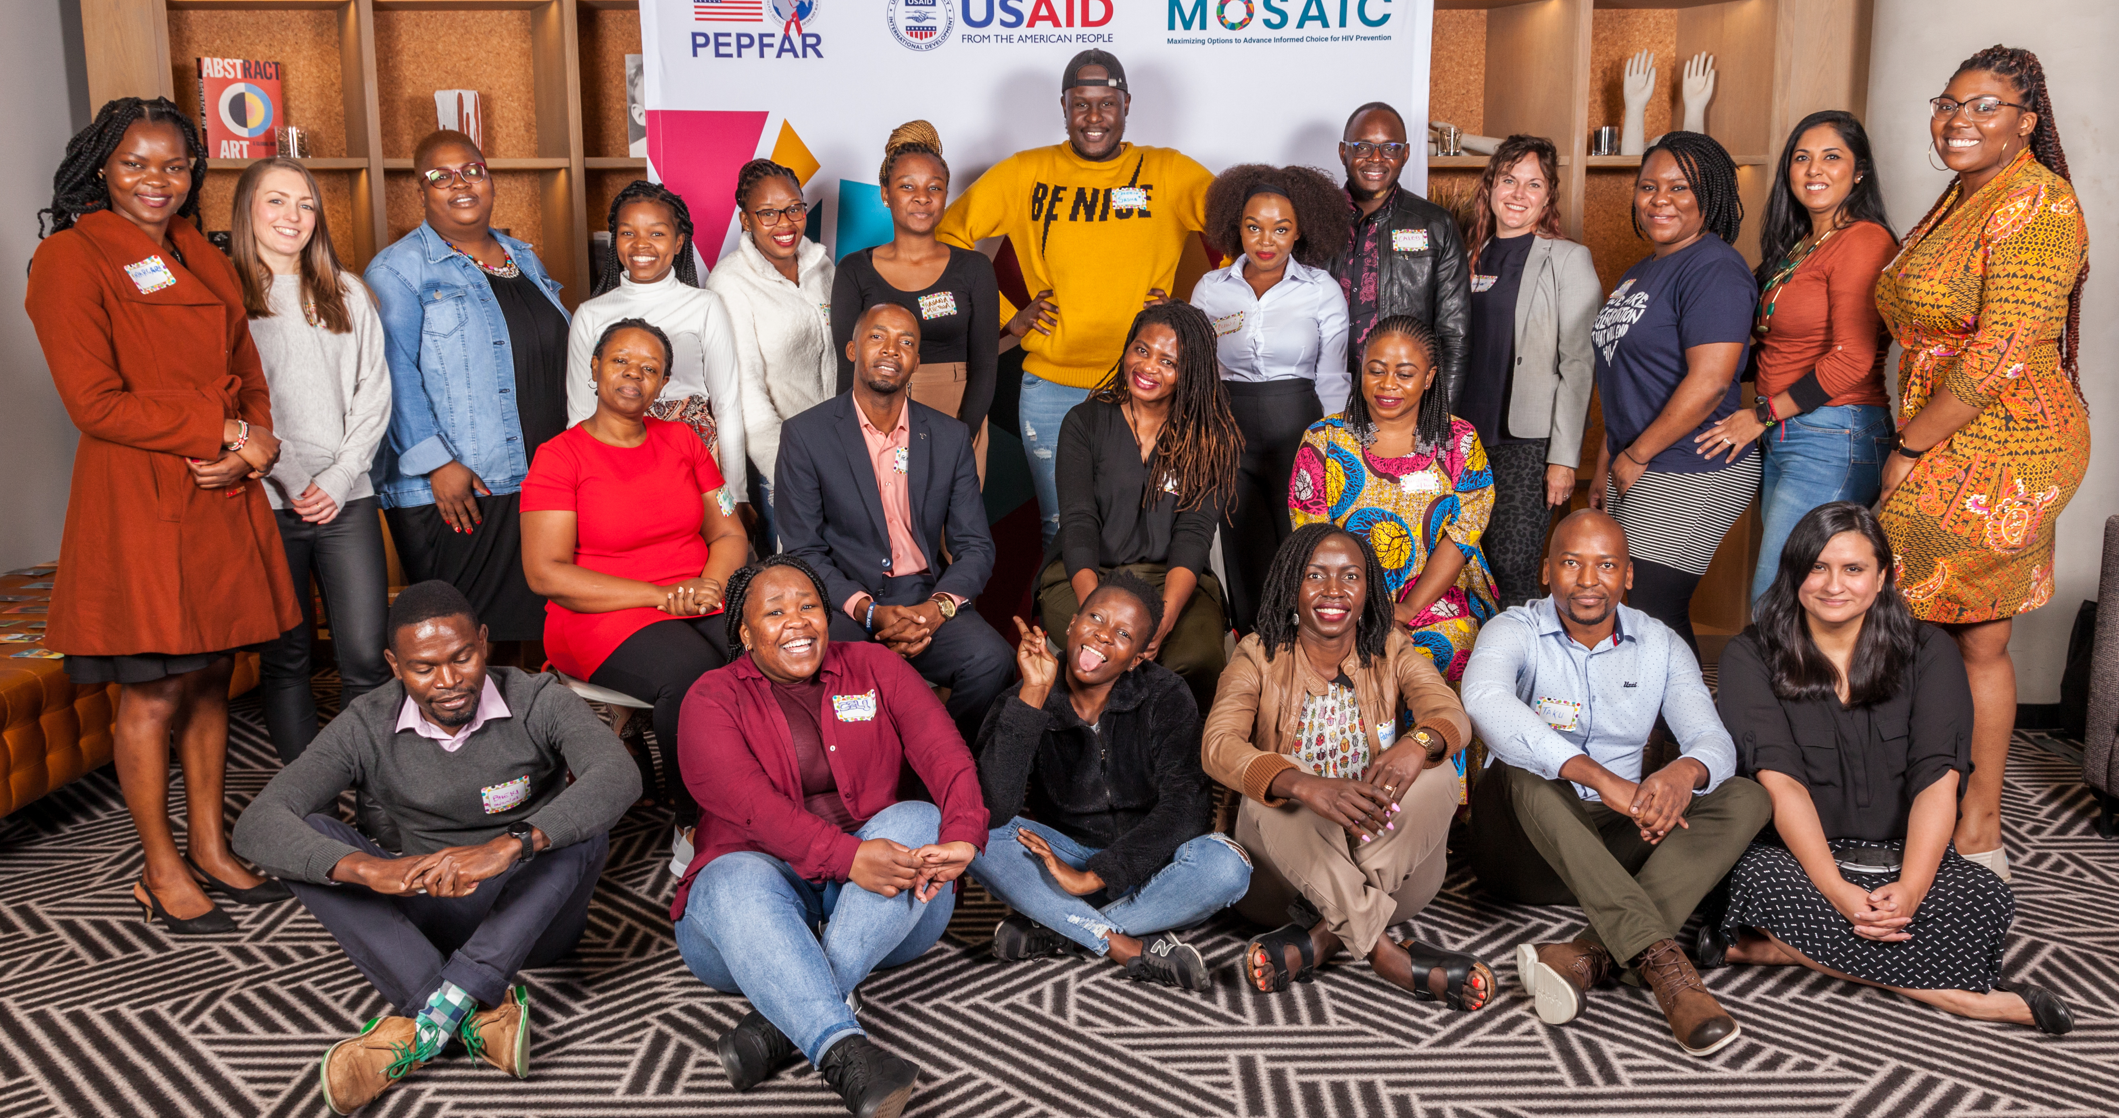
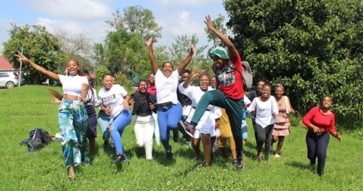
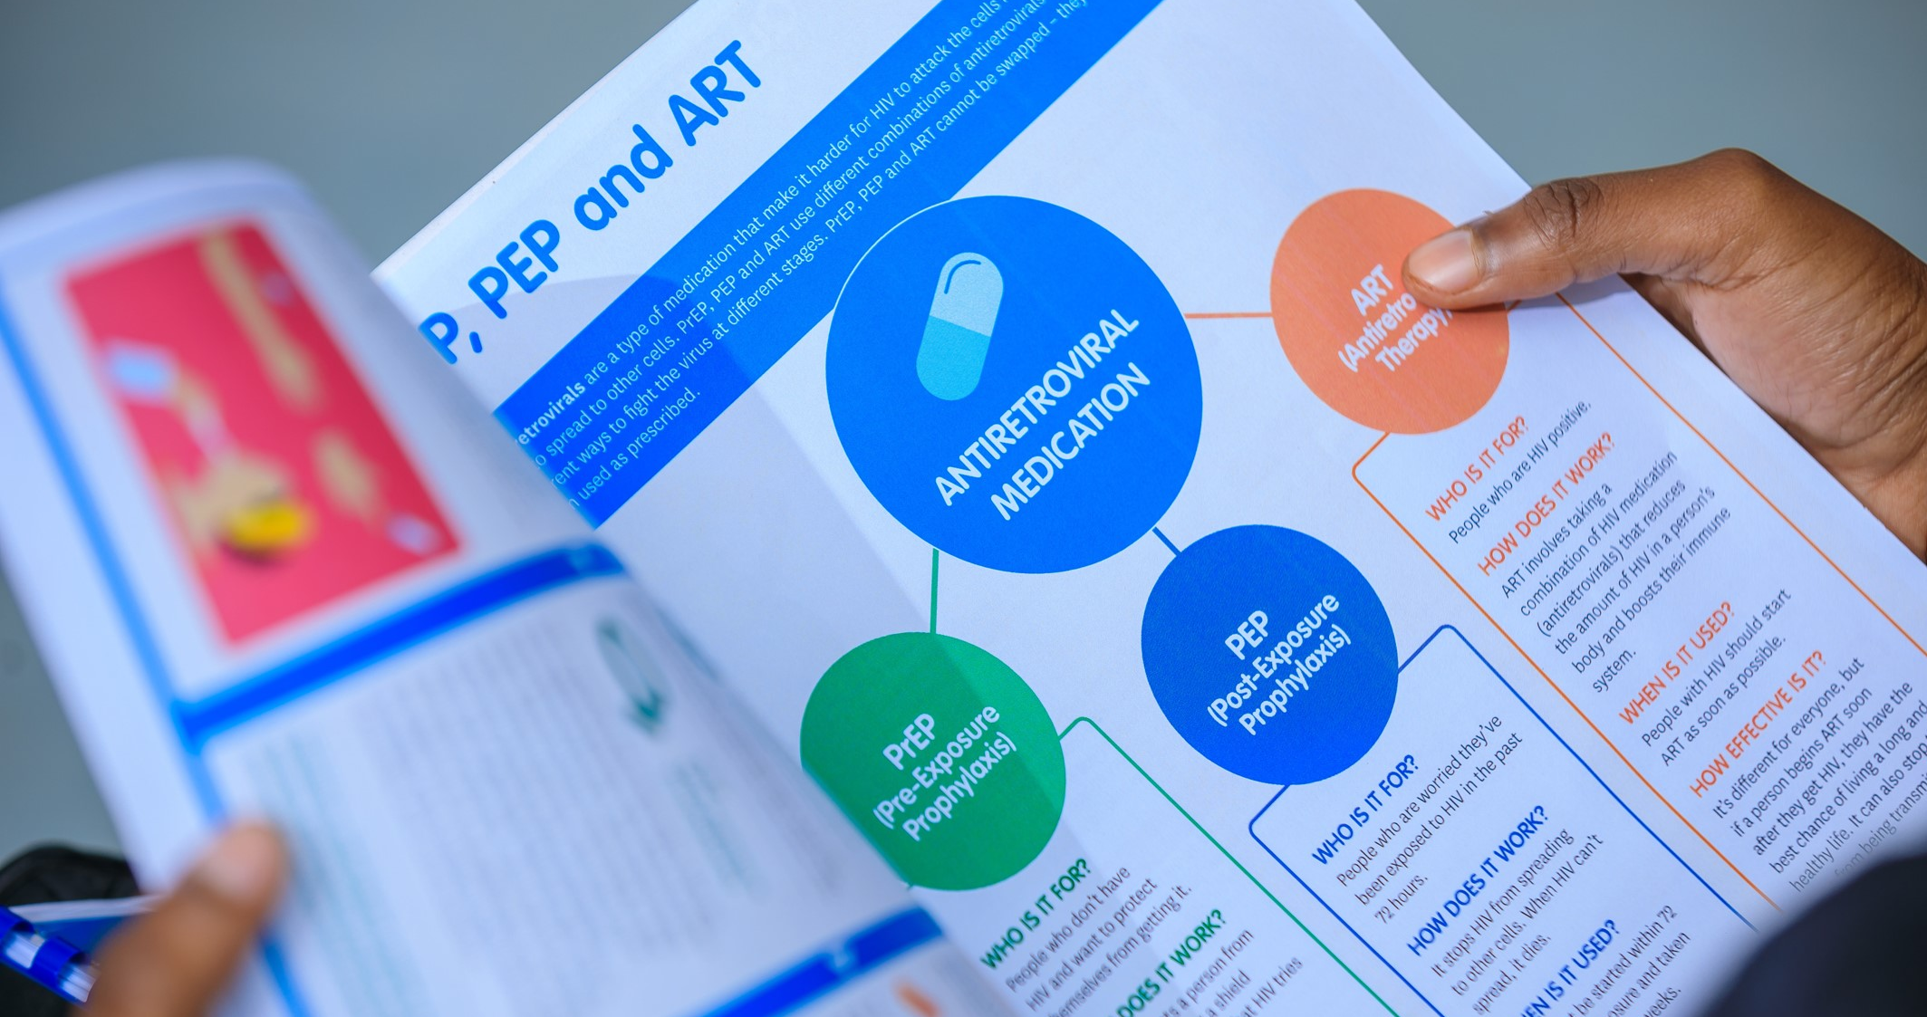
Opportunities for Meaningful Youth Engagement in Implementation Research
Consult Young People to Inform Study Design and Protocol
Hold consultations with young people so they can co-create the study design and make recommendations on the study protocol to ensure study questions and procedures will meet the needs of and be acceptable to young people.
Establish and Engage Youth Advisory Committees (YAC)
Form diverse, local YACs with young people and key populations to meet regularly, lead capacity-building initiatives, and contribute to study design and outreach strategies to make the study relevant to youth.
Create Youth-Centered Study Materials
Based on national PrEP guidelines and implementation guides, support the development of Information, Education, and Communication (IEC) study materials to ensure they are youth-friendly.
Notes:
1. Forming Youth Advisory Committee (YAC)
Played a pivotal role in establishing YAC and ensured diverse youth representation.
YACs in Eswatini Ring Study & Youth Advisory Boards (YABs) in CATALYST
Leading capacity-building initiatives, equipping members with research skills, health literacy, and leadership tools. ​
Empowering YAC to contribute to study design and outreach strategies.
2. Leading the Creation of Youth-Centered Materials
I spearheaded the development of Information, Education, and Communication (IEC) materials. ​
Supporting the development and review of national PrEP guidelines and implementation guides which affect study procedures.
3. Guide stakeholders in understanding youth perspectives
Supporting the development of training materials and conducting trainings for data collectors and healthcare workers ensuring they understand the study’s objectives and procedures, and how to address young people’s concerns. ​
​Orienting facility managers on study amendments, keeping them updated and engaged throughout the study.​
My role helps to bridge the gap between healthcare workers and young people, fostering a more supportive and inclusive research environment.​

Slide 7

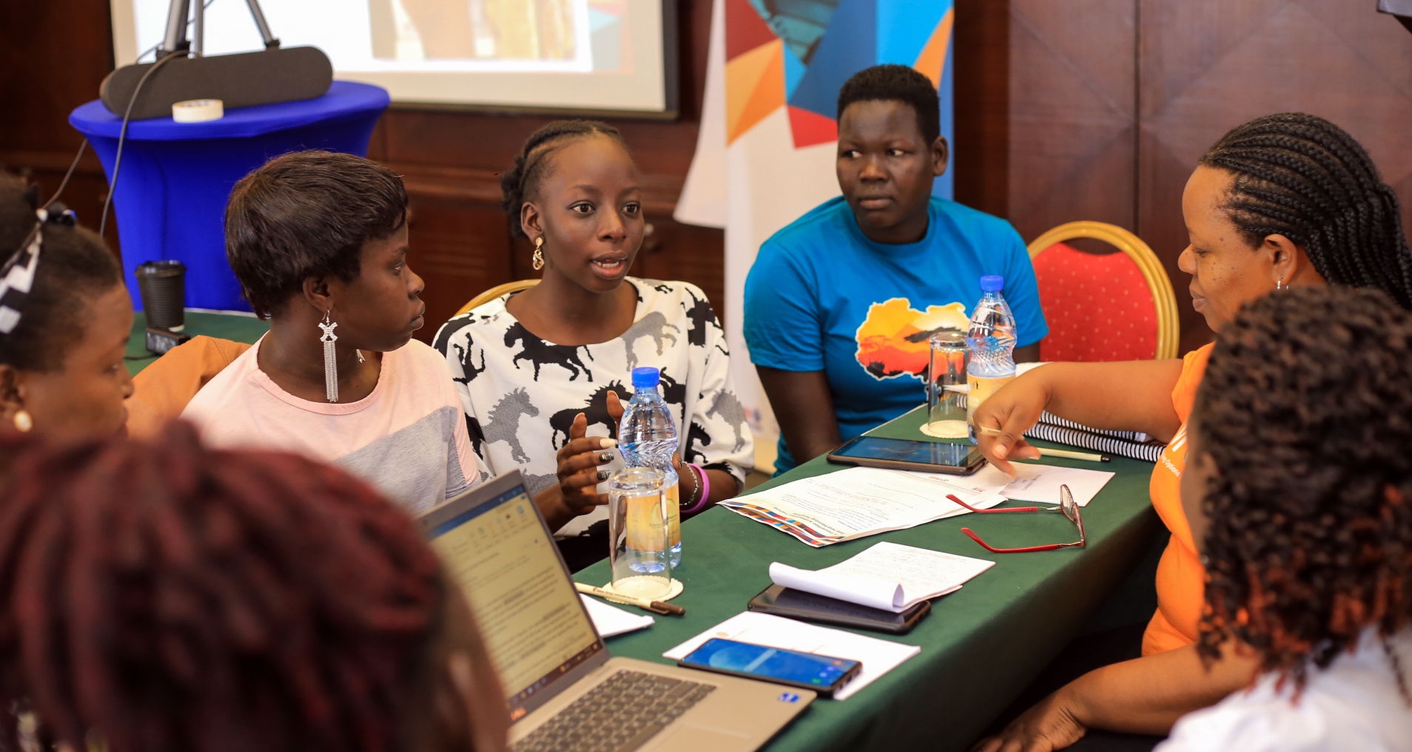

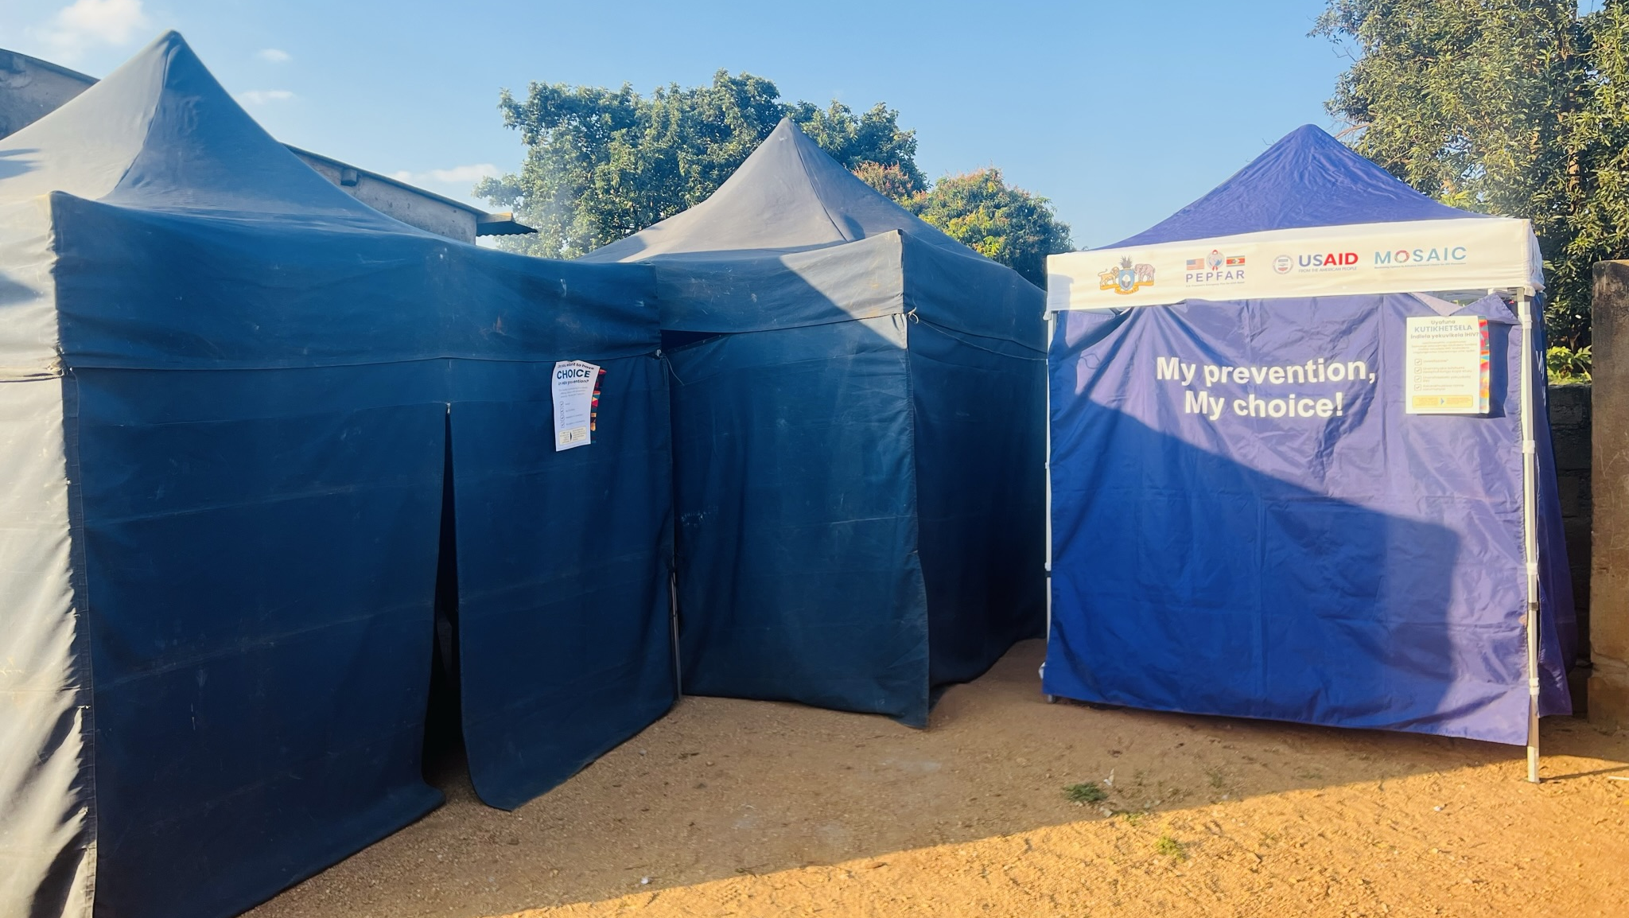
Guide Stakeholders in Understanding Youth Perspectives
Foster an inclusive study environment by conducting trainings to make sure healthcare workers and data collectors are youth-friendly and can address young people’s concerns.
Participate in Data Collection
Administer baseline and midline structured questionnaires and conduct in-depth interviews with study participants to understand implementation successes and challenges in offering PrEP choice to young people.
Assess Youth-Friendly Environments at Study Sites
Lead open discussions with young people regarding their access to services in the study sites, their perception of care from healthcare providers, and their standards for a youth-friendly study setting and feedback to study team.
Support Community Outreach
Assist with study recruitment outreach (in mobile clinics and other outreach settings), recognizing that the presence of a youth researcher can bolster the participation of younger potential PrEP users.
Notes:
4. Engage Young People to Inform Study Design and Protocol
Peer to peer consultations before the study commences ensures that the study is user centered with young people at the center of needs assessments and participating in the design of service delivery for them. Young people are experts in their own needs hence involving them was essential.​
Young people made recommendations during Eswatini Ring consultations and these were taken into consideration when the study implementation started. This shows active participation of young people from inception of study as recommendations were integrated in the protocol.​
Young people described what they would be comfortable with during the study implementation and the study recruited data collectors with those characteristics to make the services accessible with a friendly environment and welcoming attitude of data collectors without a very large age gap.​
MOSAIC also held a Gender & Youth Leadership Workshop (called “GLOW”) during which the NGS were oriented on CATALYST study design and protocol, and able to provide feedback on the CATALYST Protocol
**This photo is from the GLOW workshop
5. Assess Youth-Friendly Environments at Study Sites
The Eswatini Ring study team visited the study sites after six months of enrolments to conduct feedback sessions. In these feedback sessions, I led the discussions of young people accessing services in the study sites, providers interacting with young people, and systemic facilitators and barriers in reaching young people.​
I also led discussions on the perception of healthcare providers on youth friendly standards and their performance in offering youth friendly services.​
Facilitated discussions on areas of improvement as suggested by providers​
6. Lead In-Depth Interviews and Data Collection
Administering baseline and midline structured questionnaires with healthcare providers to ascertain knowledge, acceptability, appropriateness and feasibility of PrEP choice service delivery.​
Conducting indepth interviews with providers using semi-structured interview guides to better understand drivers of implementation success or challenges when offering PrEP choice.​
Added to the rich pool of data for the study
**Photo from a training session in Uganda
7. Support Community Outreach
Supporting the provision of services in mobile clinics under the study breaching gap between researchers and young participants.​
This ensures that the mobile clinics are youth friendly especially where there are young people. They relate better to a young researcher. ​
Presence of a young researcher ensures that the services are tailored to the needs of young people and the environment is friendly. ​

Slide 8
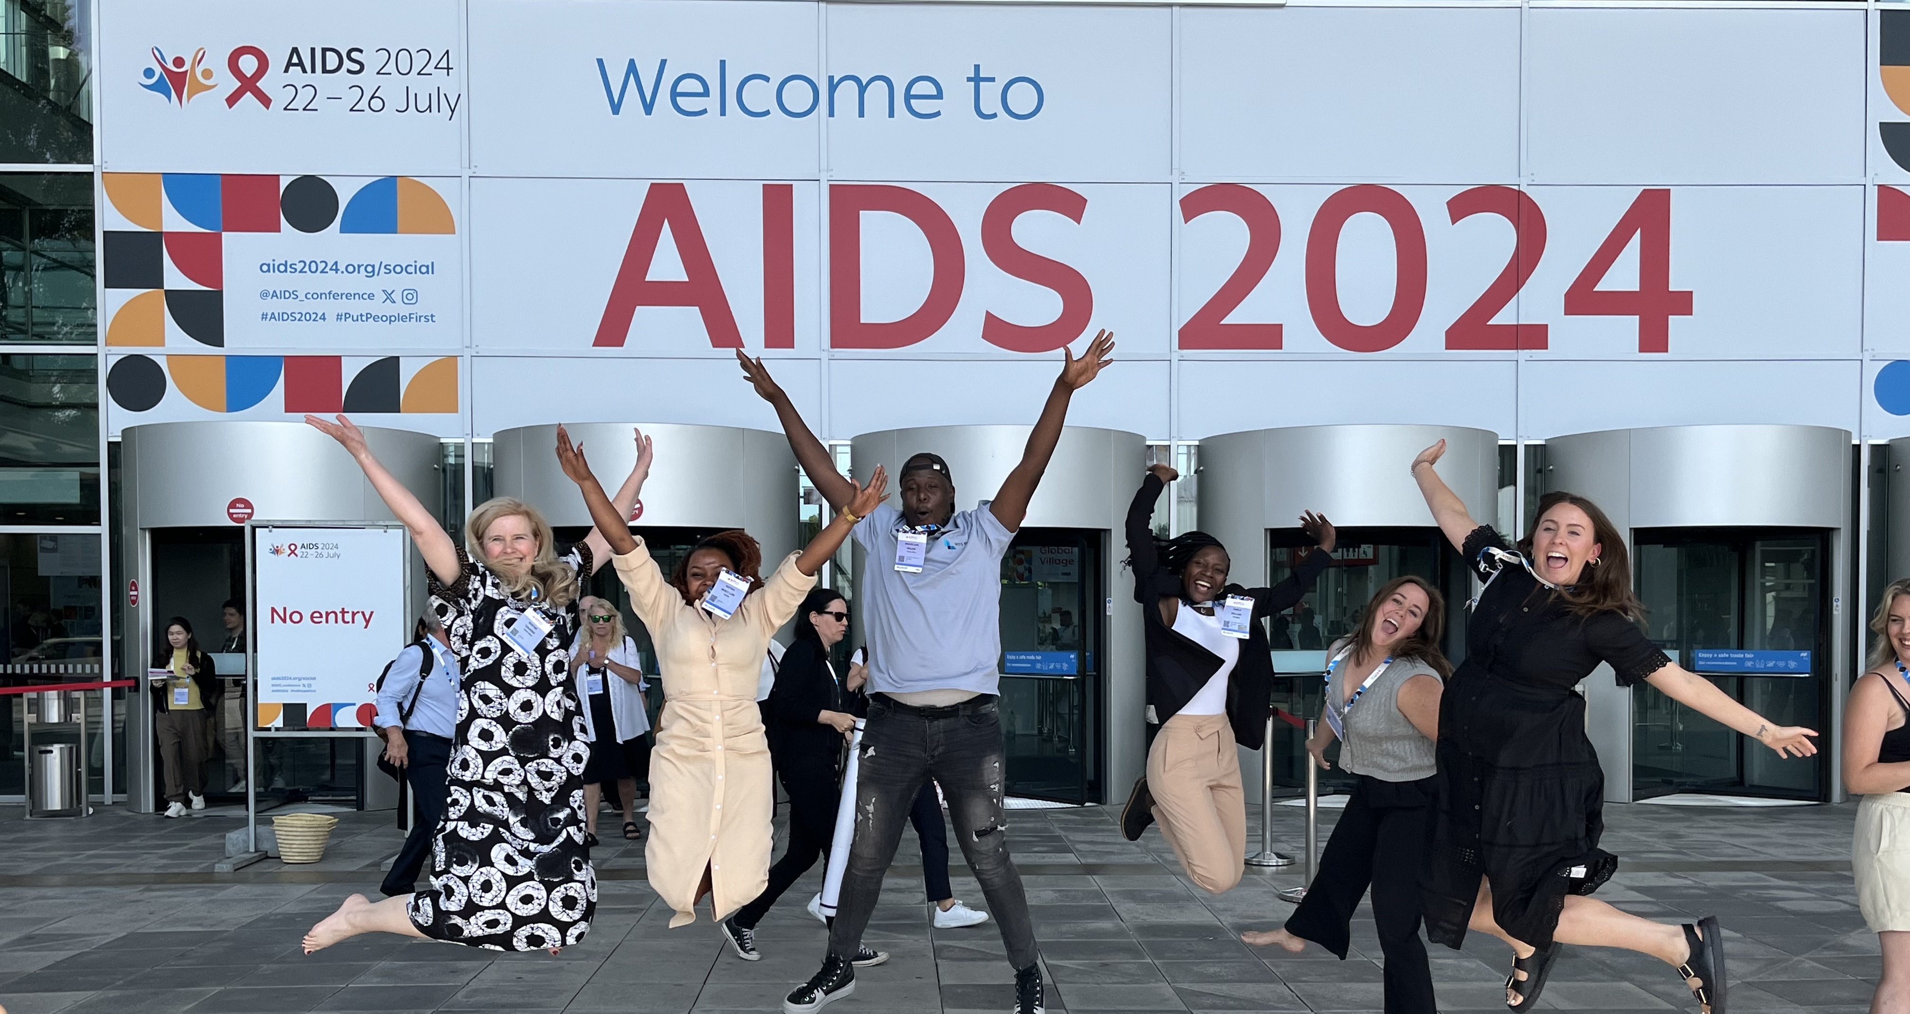
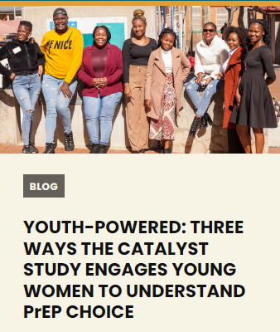
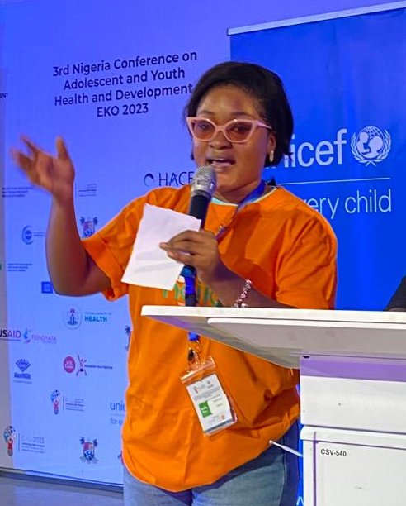
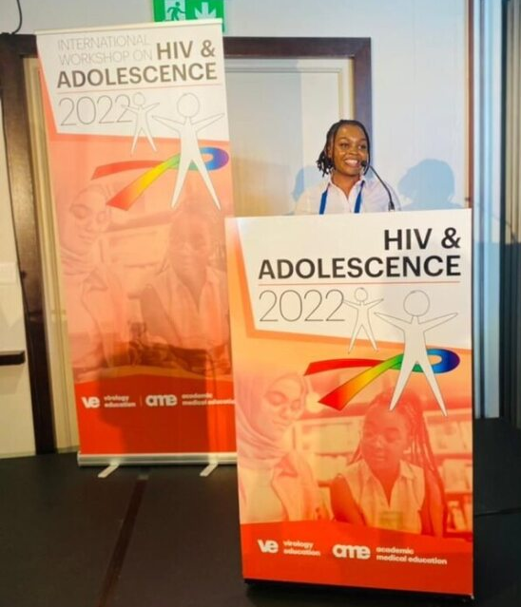
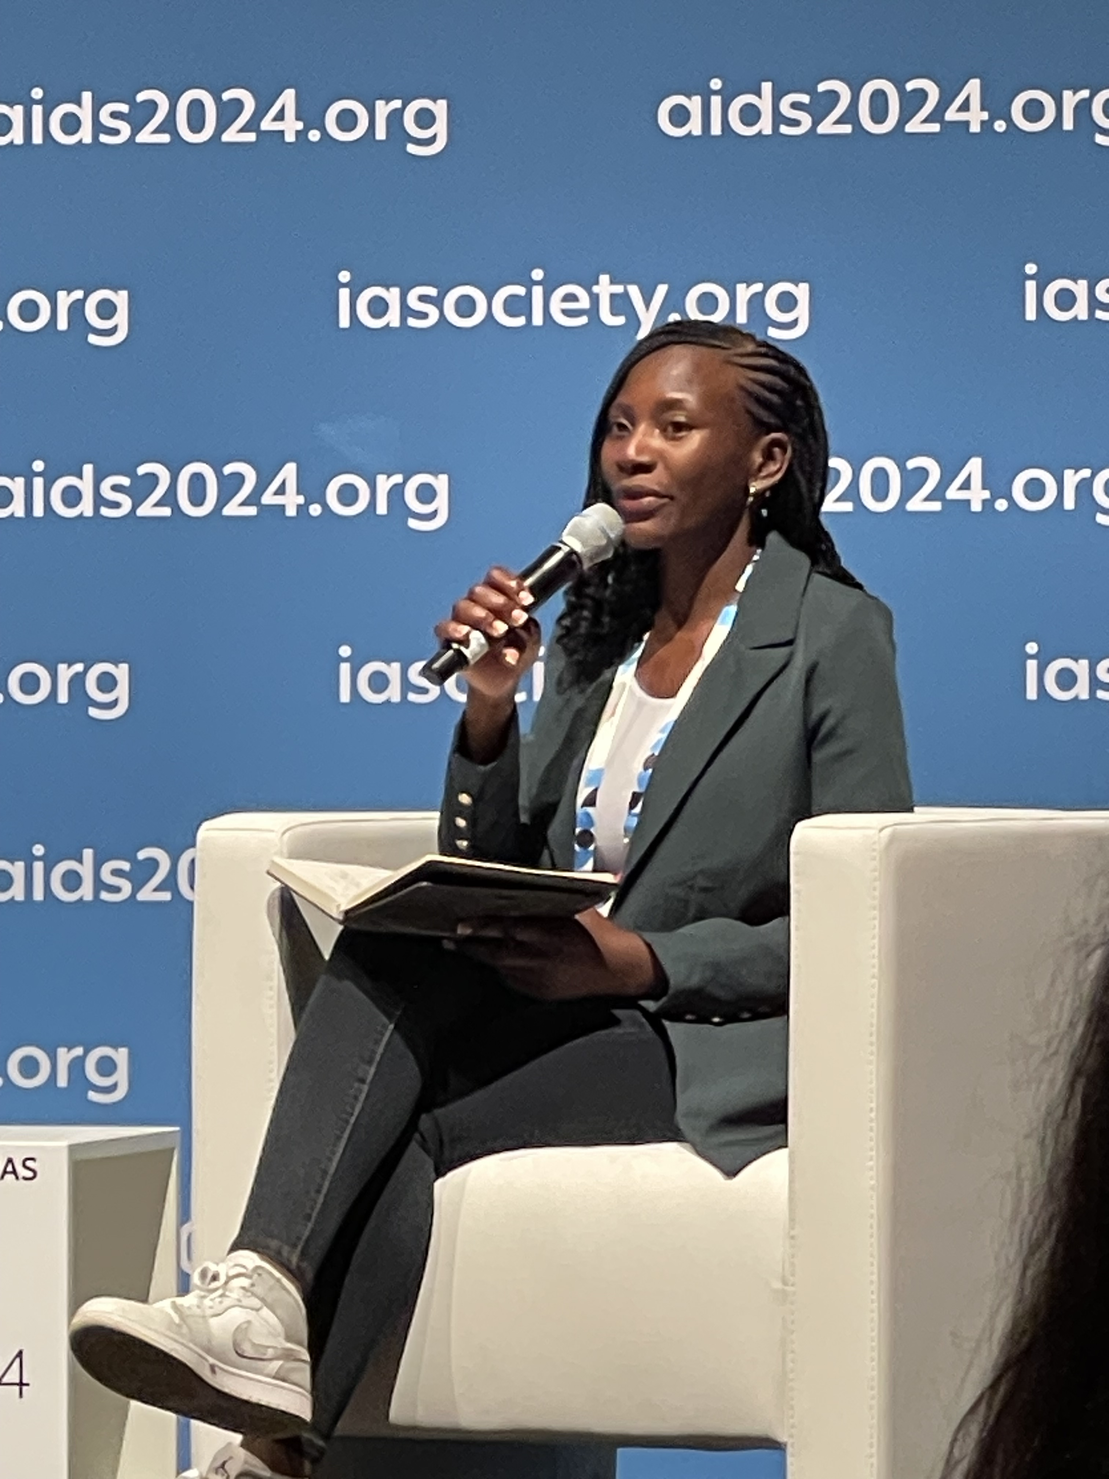
Elevate Youth Voices in Research Dissemination
Amplify the perspectives and lived experiences of young people in knowledge management, research utilization, and dissemination; their opinions will keep research findings accessible and relevant to youth PrEP end users.
Notes:
NGS members have engaged and led several aspects of MOSAIC and CATALYST, including conferences, partner calls, blog posts, and writing abstracts and journal articles.

Slide 9

NGS Members share their thoughts
Nts’ebo, Lesotho
With support from MOSAIC demand generation team [and] CATALYST, I contribute to technical direction and implementation of engagement with the Youth Advisory Board and other community stakeholder groups to ensure youth perspectives and preferences are sought and incorporated in project activities and materials.​
Merci, Kenya
I have significantly contributed to the CATALYST study materials and worked on manuscripts, articles, and blogs focused on PrEP choice for young women.
I also conduct trainings with young women and healthcare providers to build their capacity and knowledge in HIV prevention tools.
NGS members and other MOSAIC staff at a workshop for meaningful youth engagement in 2022.

Slide 10

Call to action
The leadership of young people in implementation research has contributed to a research environment that is more inclusive, responsive, and effective in engaging young people.
Remember that youth engagement is not passive. Make a deliberate effort to include young people.
Budget for young people’s inclusion in implementation studies. Do not fill in a room with beneficiaries and call it youth engagement. Engagement must be intentional!
Listen to young people’s lived experiences through peer-to-peer consultations in order to develop research questions that meet young people’s needs.
Ensure the roles and responsibilities of young people are clear and substantive.
Notes:
The roles and responsibilities of young people should be clear. The engagement should not be a response from external pressures. Superficial engagement leads to lost opportunities and ineffective collaboration between young people and organizations.

Slide 11
Thank you

Slide 12
Acknowledgements
MOSAIC Eswatini Project Lead: Anita Hettema
Presentation Contributors:
Lauren R. Rutherford, MPH; Allison Cole, MPH; Shyla Napier

