Slide 1
Innovating HIV Prevention Research through the Engagement of Adolescents and Youth from Key Populations
Inês Dourado, MD, PhD
Universidade Federal da Bahia, Brazil
Satellite: The Brightest Under 30: Celebrating Youth Voices and Promoting Meaningful Youth Engagement in HIV Prevention Research

Slide 2
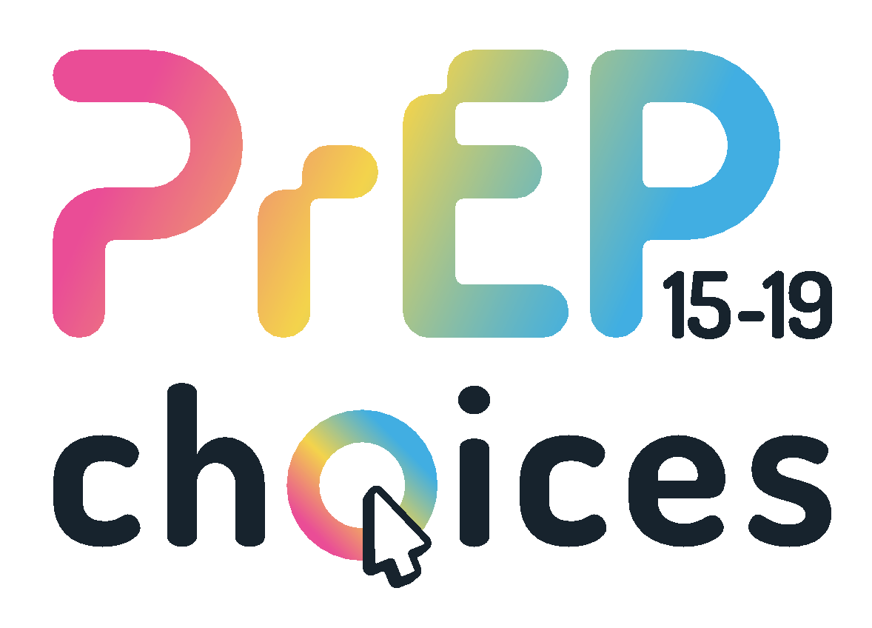
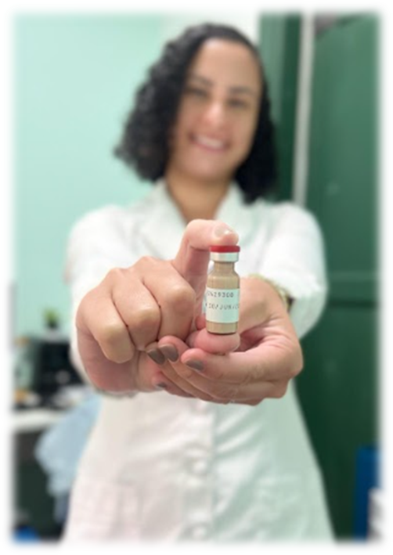

Why we need prevention options for adolescents and youth from key populations (AYKP)
While the rates of HIV infection among adolescents and youth have been increasing;
There are many access gaps in HIV prevention interventions specifically aimed at this population;
Long acting PrEP showed higher protection when compared to daily oral PrEP among men who have sex with men and transgender women;
Possibly a better alternative for those with difficulty adhering to daily oral pills, such as adolescents.

Slide 3
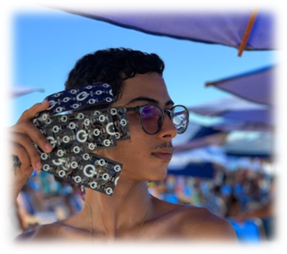
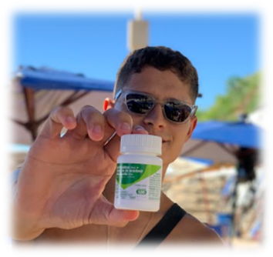
Offering HIV PrEP to AYKP
Offering HIV PrEP to adolescents and youth requires a multifaceted approach addressing their specific needs;
Actively involving AYKP in the design and delivery of services is essential for the success of HIV prevention programs and to strengthen their sense of agency;
The importance of formative research in mapping and listening to communities to be researched;
Building bridges among researchers, healthcare providers, policymakers, and community organizations is crucial for creating effective and sustainable prevention programs.

Slide 4

PrEP15-19 Choices: An Implementation study of PrEP Choices among men who have sex with men, non-binary and trans people 15-19 years old in Brazil
Self-identified trans women or trans men
Living in Belo Horizonte, Salvador and São Paulo
Primary objective
To evaluate the implementation of a PrEP protocol with three modalities (CAB-LA, event-driven, and daily oral) for adolescent men who have sex with men, non-binary assigned as male at birth, and trans people aged 15-19 years in Brazil.
Self-identified non-binary assigned as male at birth
Self-identified non-binary assigned as male at birth
Age 15-19 years
Study population
Self-identified as men who have sex with men
In contexts of increased vulnerability or risk of HIV infection
Notes:
Self-identified AMSM, non-binary assigned as male at birth, and ATGW and ATGM;
Age 15-19 years old;
HIV-negative status at study entry;
In contexts of increased vulnerability or risk of acquiring HIV infection with at least one of the following criteria:
- condomless receptive or insertive anal intercourse in the last 6 months;
- condomless vaginal intercourse in the last 6 months;
- any STI in the last 6 months;
- PEP use at least once in the last 6 months;
- frequent use of alcohol or drugs before or during sexual intercourse;
- transactional sex;
- PrEP request by the participant.
No report of hepatic dysfunction.

Slide 5
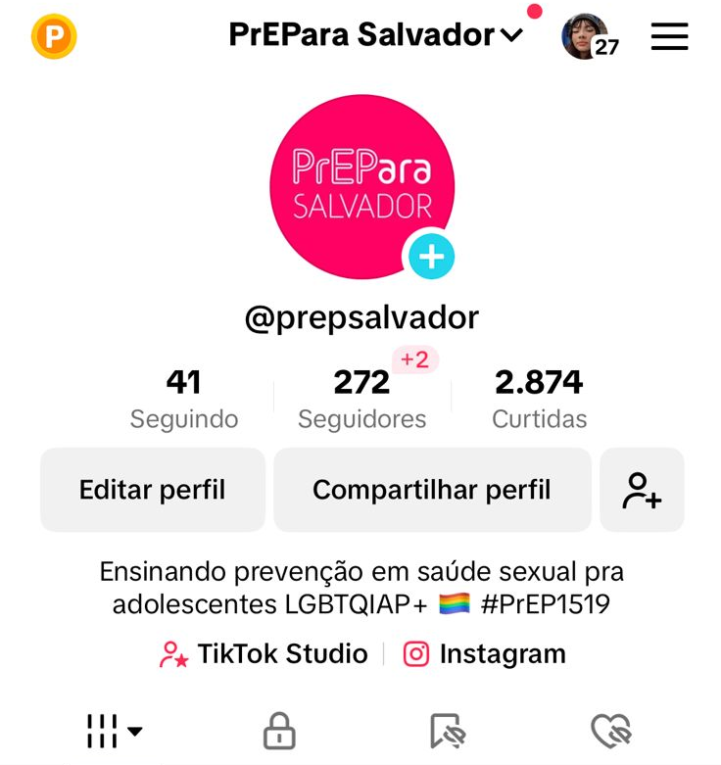
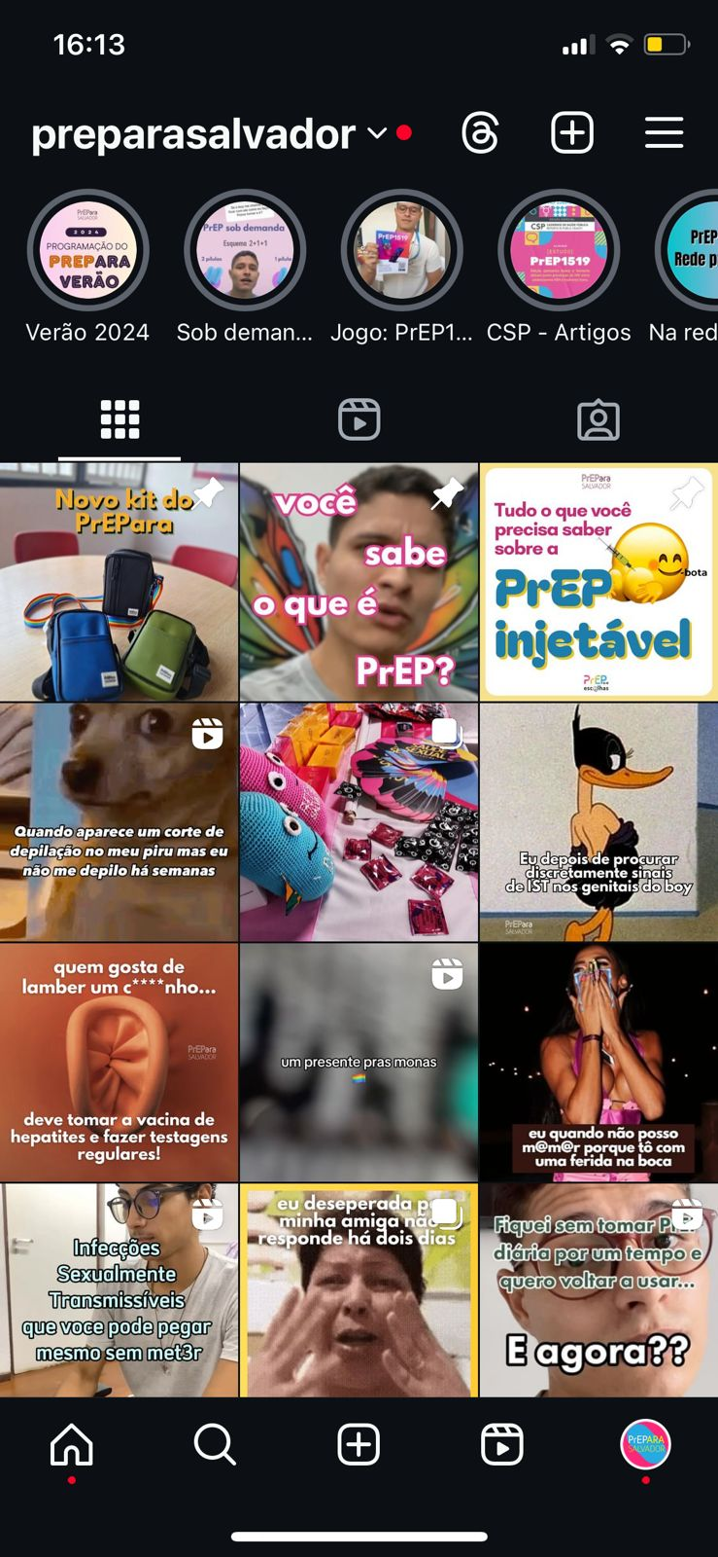
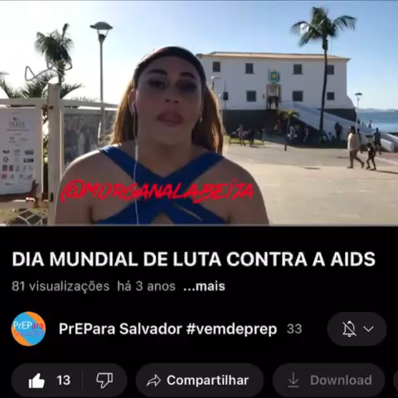
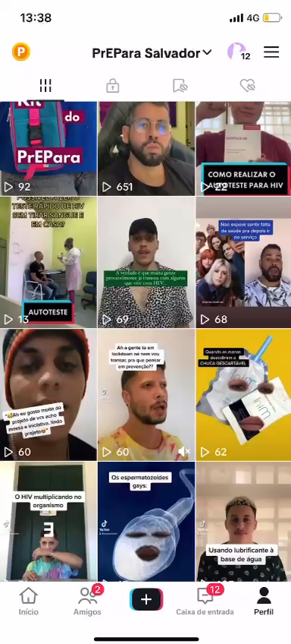

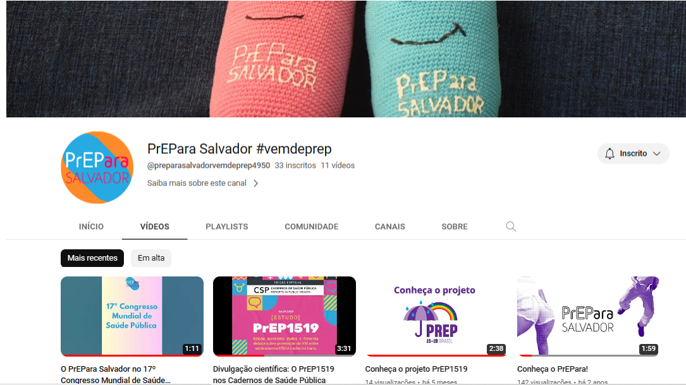
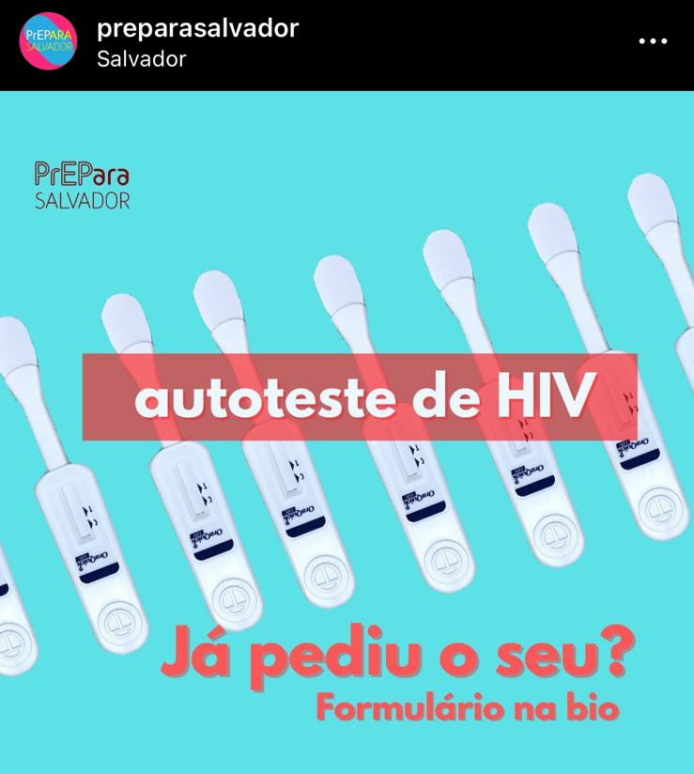
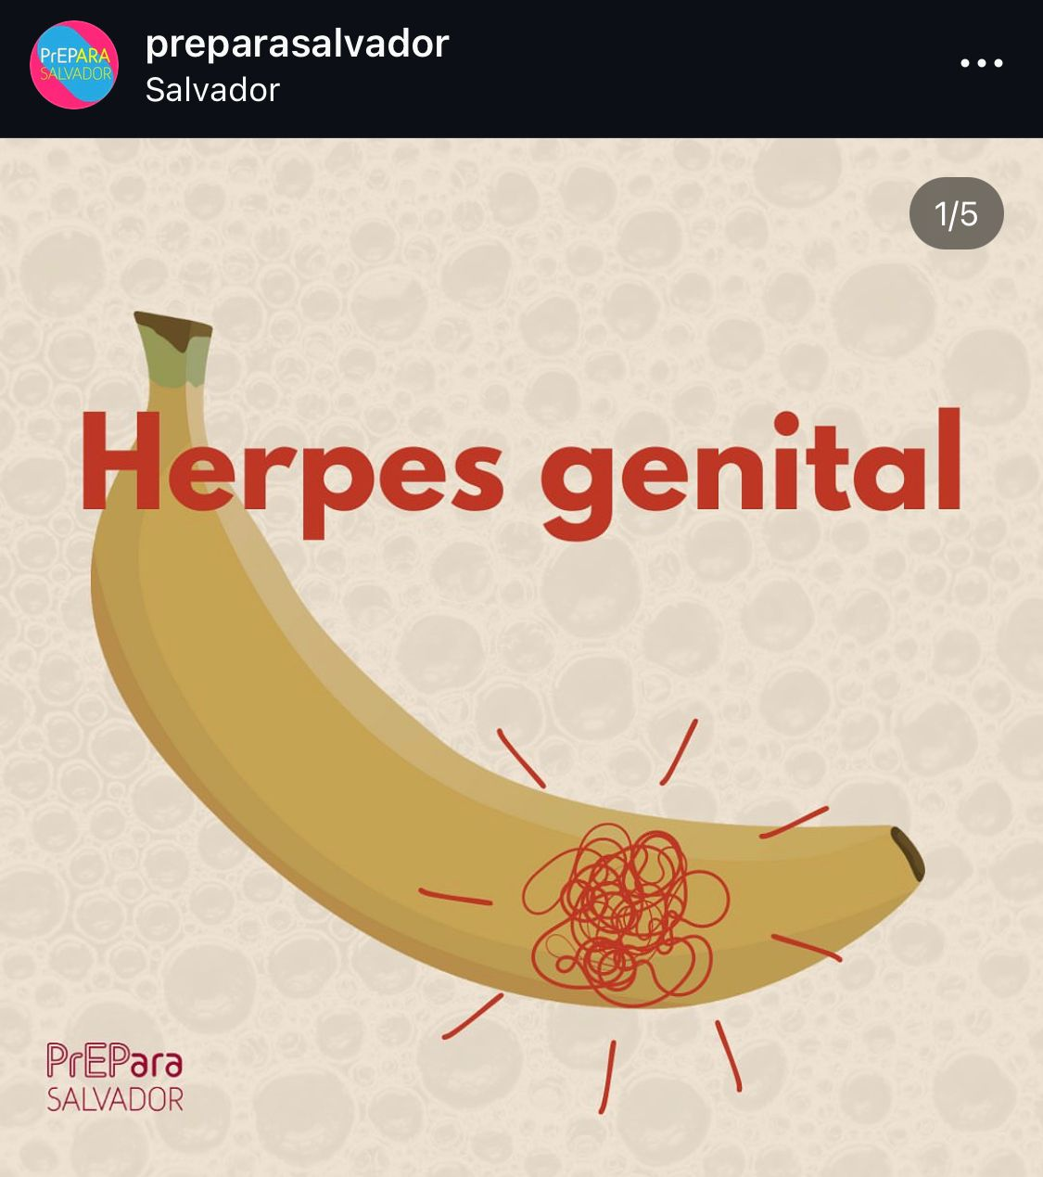

Being where young people are - using accessible language, using memes and personas from the LGBTQIA+ community
TikTok
YouTube
Instagram
Active role of peer educators

Slide 6
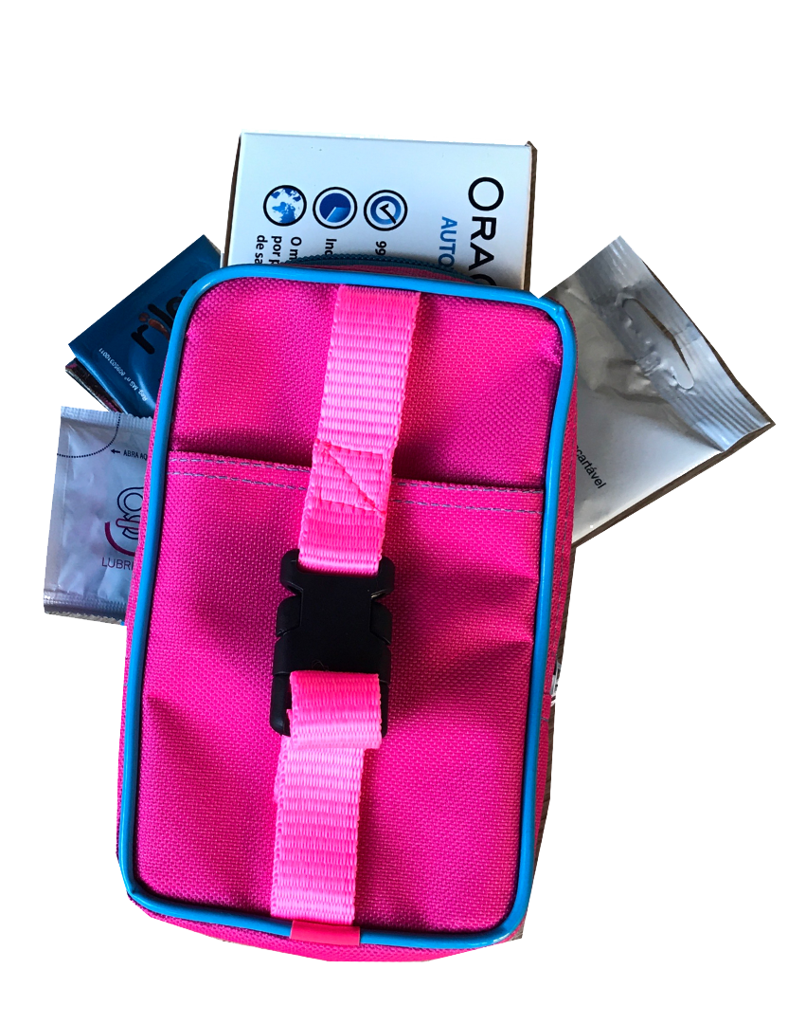
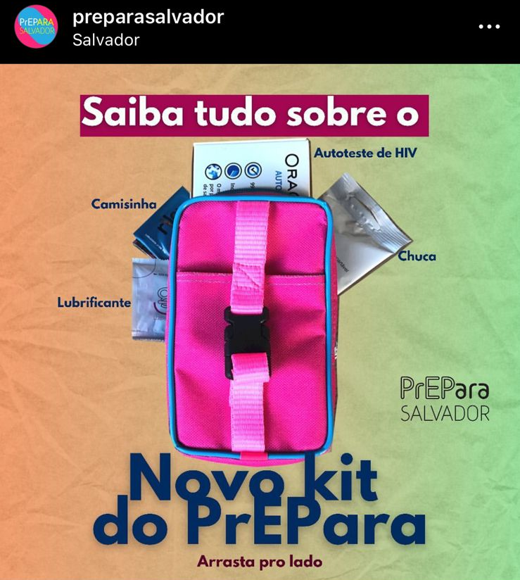
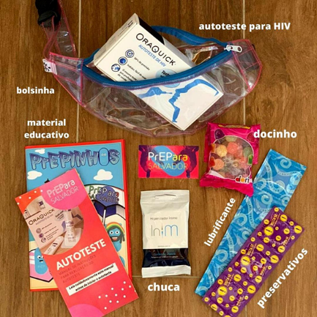
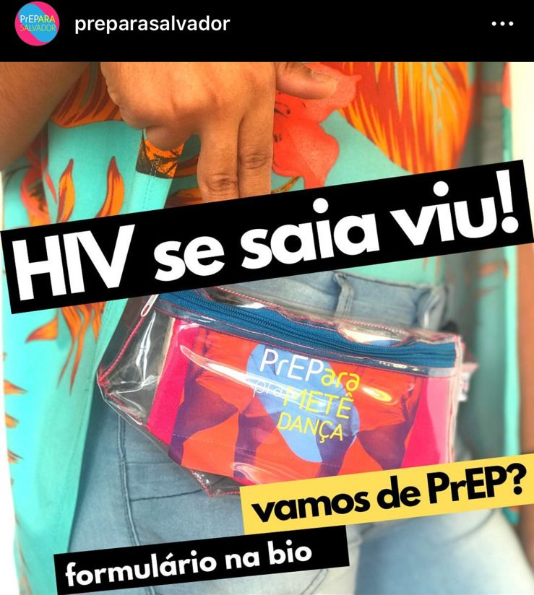
Fun pouch and prevention kit
Strategy organized by peer educators for recruitment
Recruitment form for those interested in the prevention kit -invitation to participate.
Kit Contents:
HIV self test
Condoms
Lubes
Sensual Perfume
Informational Flyer

Slide 7
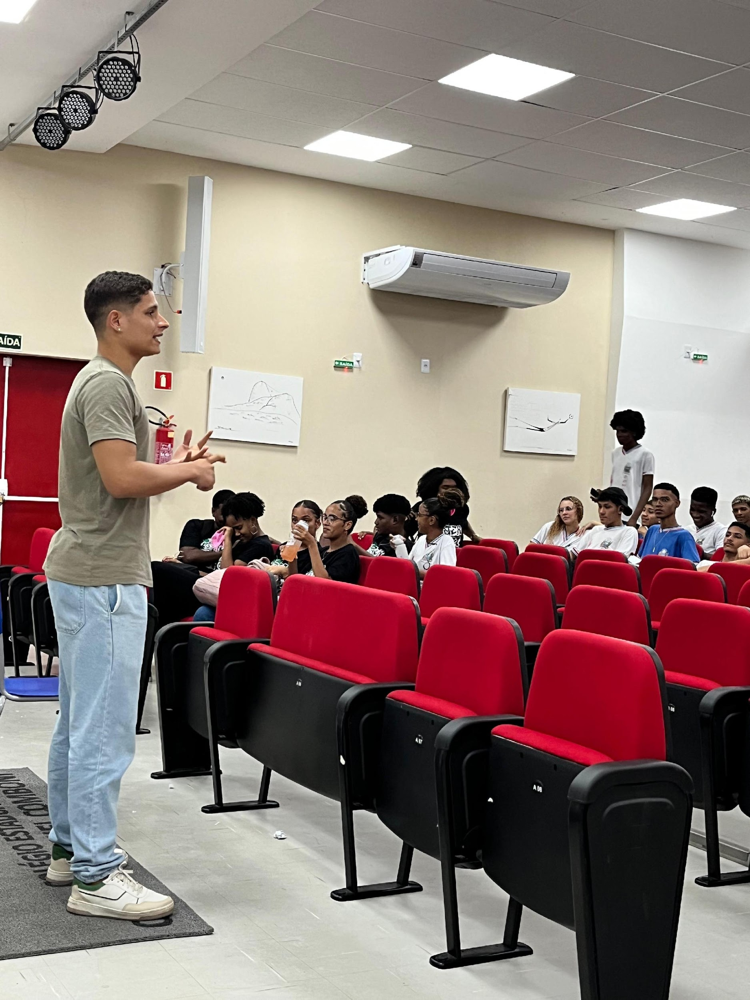
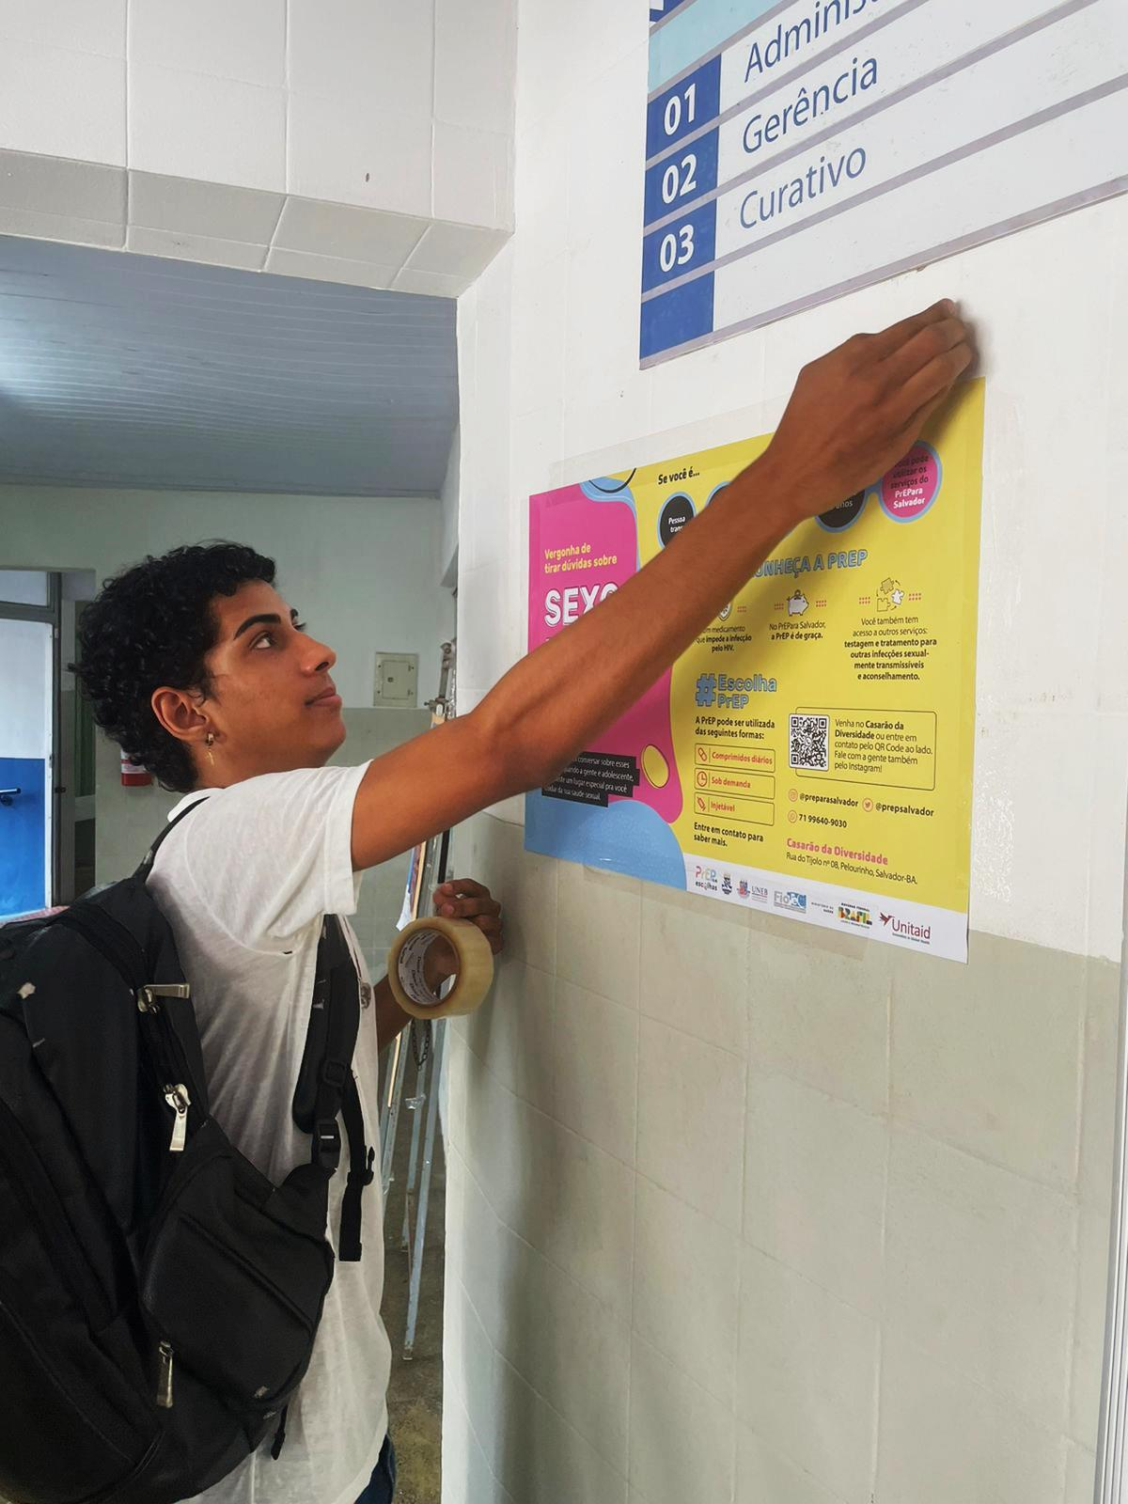
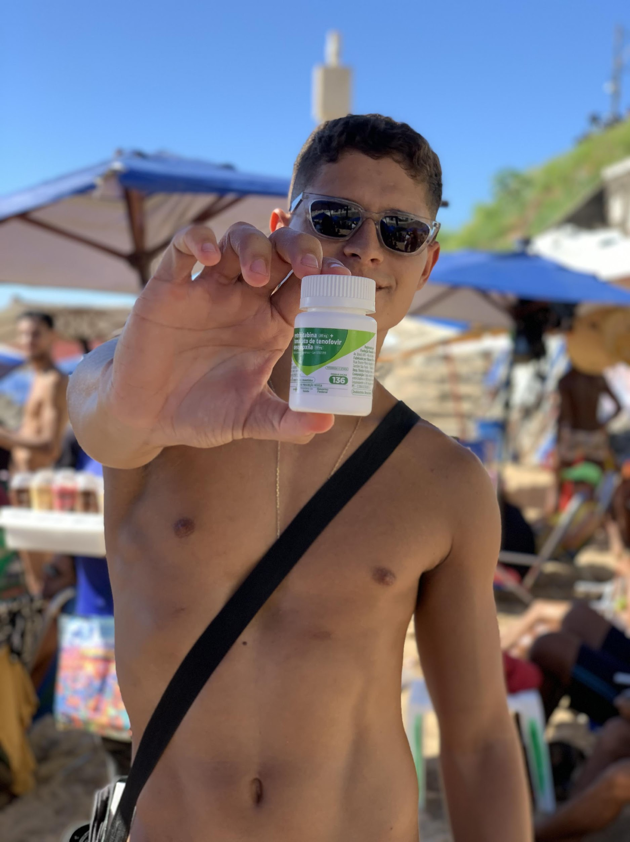
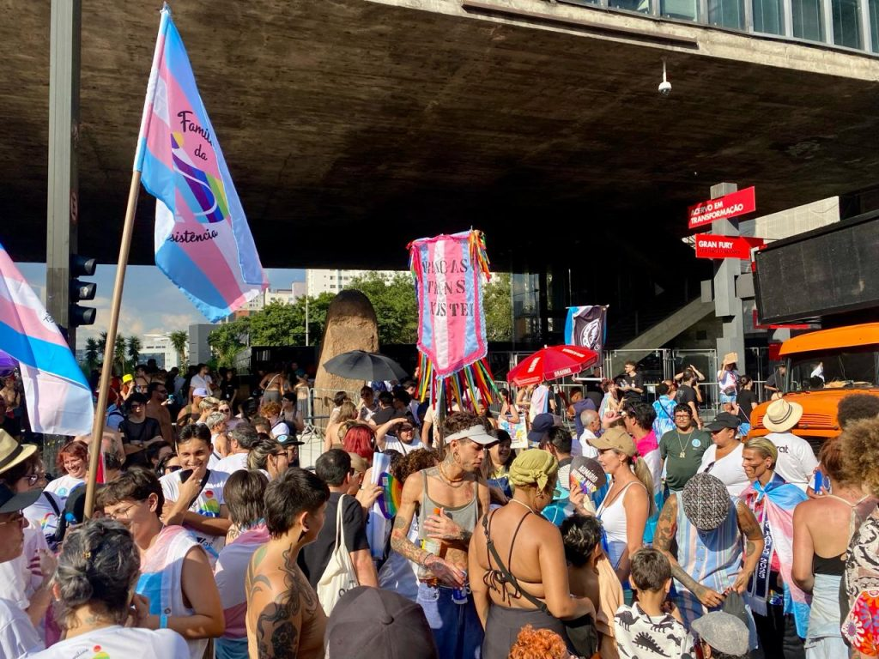
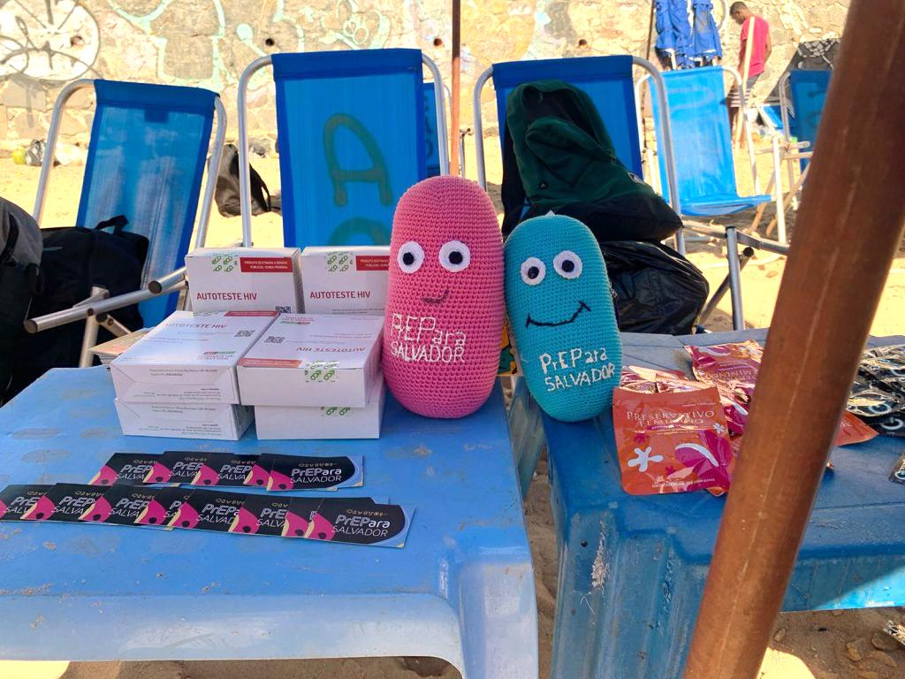

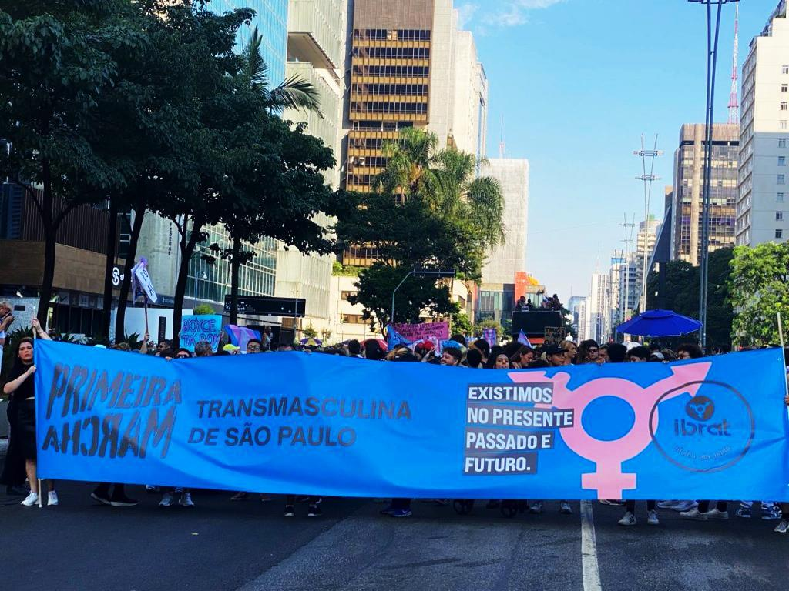
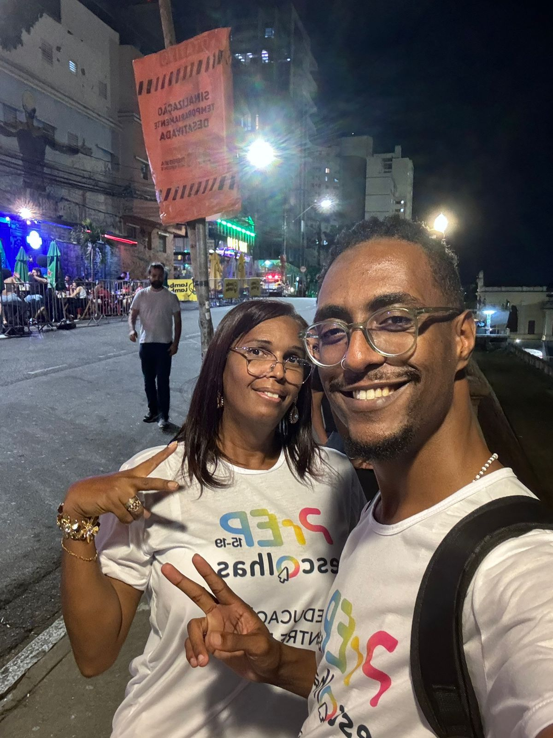
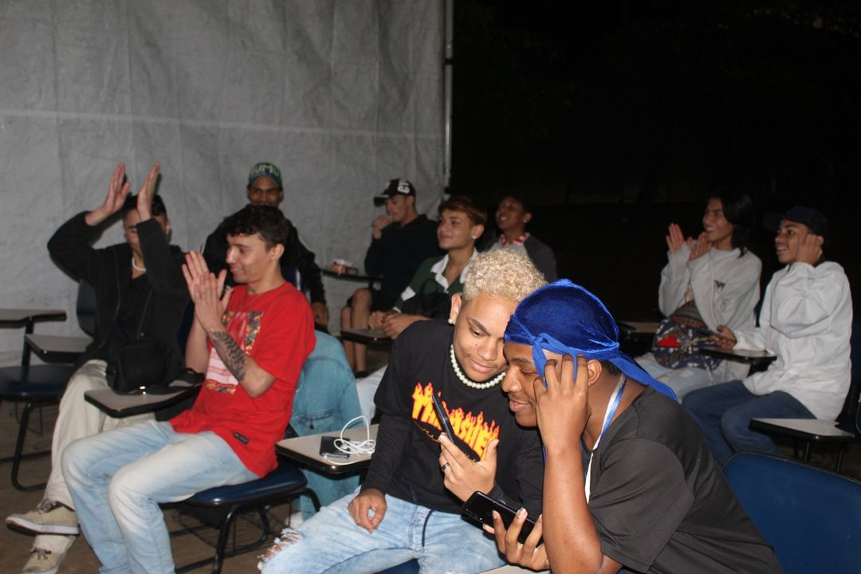
Face to face demand creation- outreach
At the beach in Salvador
Trans March in São Paulo
Schools
in Salvador
Sarau (dance and poetry)
in São Paulo
At venues in Belo Horizonte

Slide 8

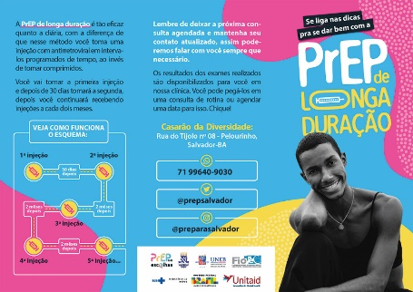



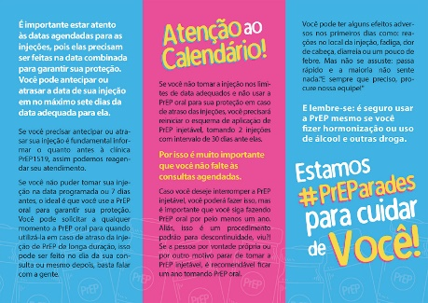
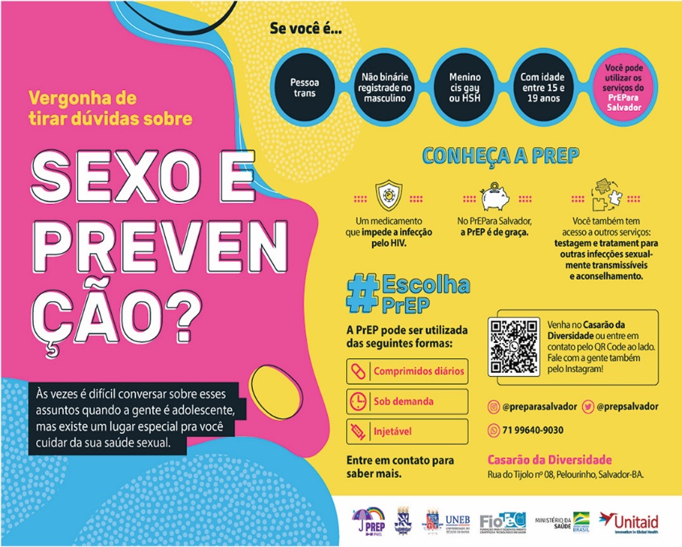

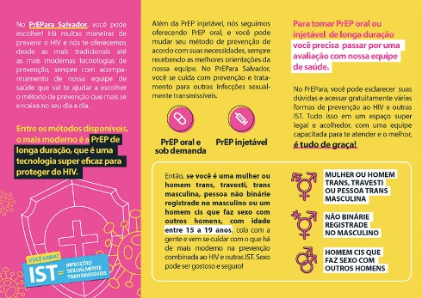
Speak the language of the community you are working with
Colors inspired by the transgender and non-binary flags
Simplified LAI-PrEP Info
QR code for youth to easily access our social networks and contact channels.
Posters:
Sex and HIV prevention
Fans
Brochures

Slide 9






Pride to be happy
Lessons learned
Pride to be fight
Expanding PrEP access to AYKP aged 15-19 requires community mobilization, along with innovative and active peer participation to create demand, attract, and recruit;
LGBTQIA+ youth staff and inclusive, welcoming spaces play a crucial role in connecting adolescents with HIV prevention services;
Fostering stigma-free spaces is key to making PrEP services more accessible, appealing, and safe for young people;
A combination of online and peer-driven face-to-face strategies can provide a critical balance, offering wide coverage and equitable sexual health services to AYKP from diverse socioeconomic backgrounds.
Gay adolescent – peer educator
TGM -peer navigator
Pride to be LOVE
Pride to be hope
Transgender man – navigator care
TGW-young peer educator
Pride to be happy
Pride to be affection
Bissexual nurse
Gay psychologist

Slide 10
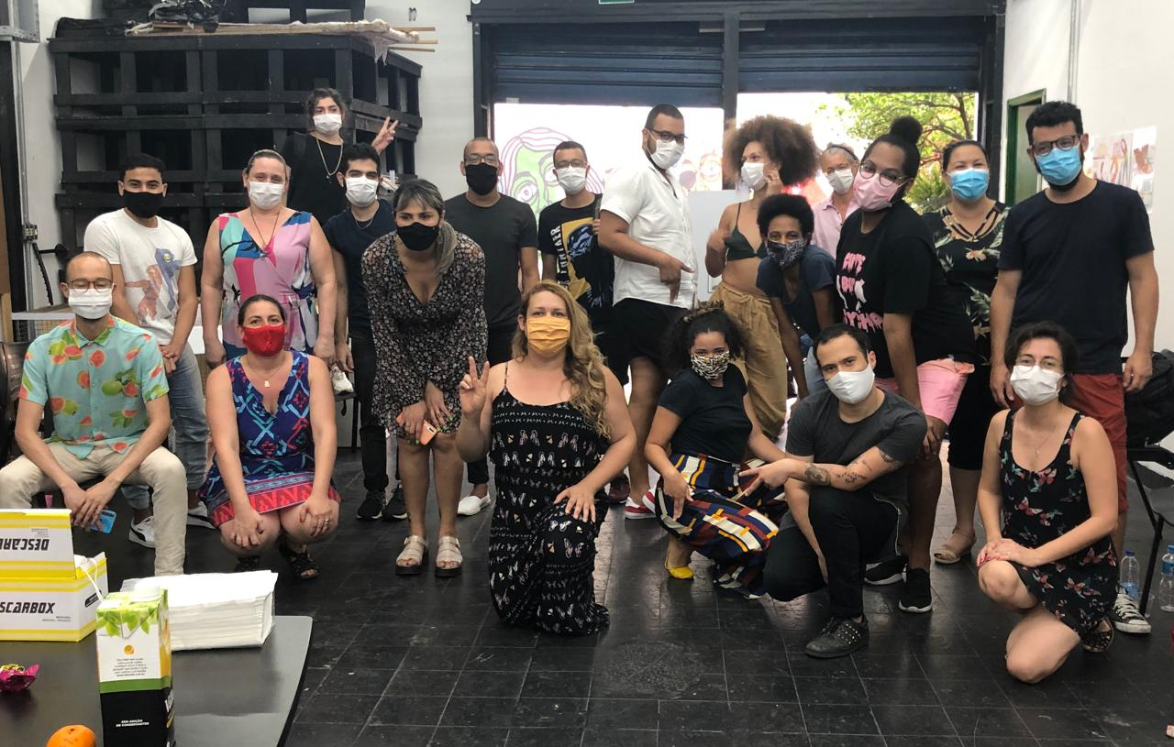
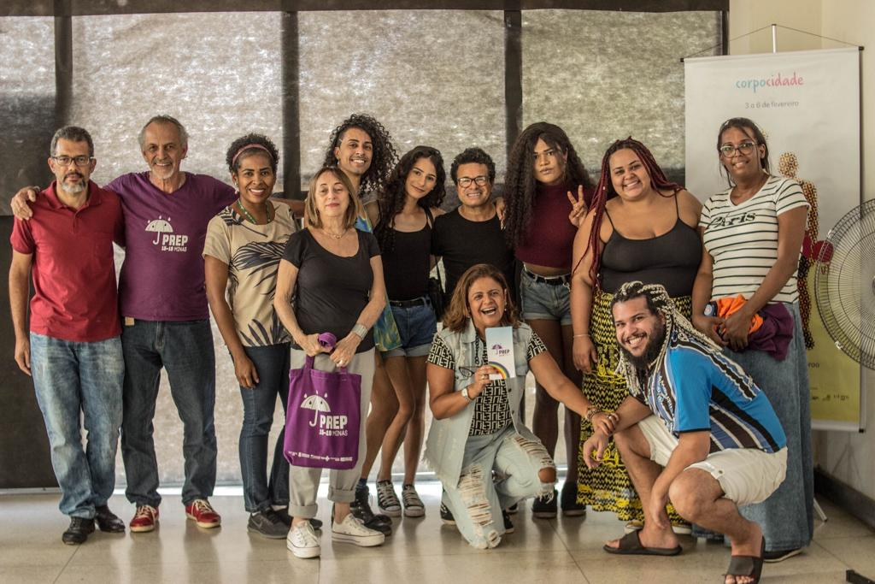
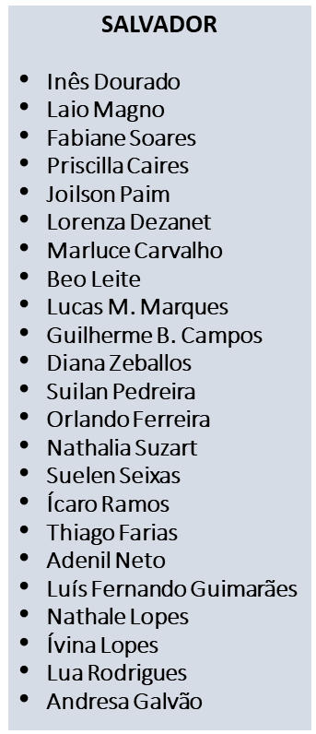
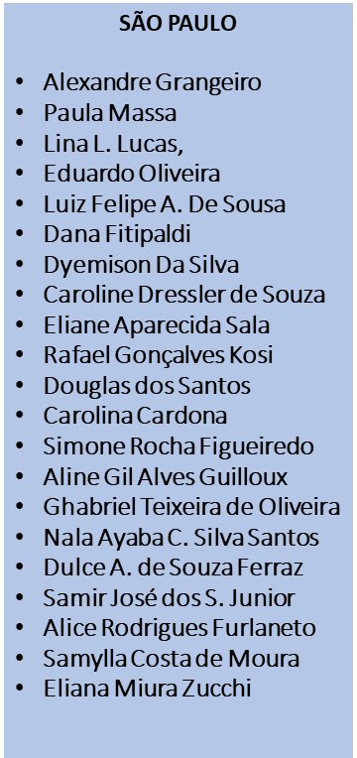
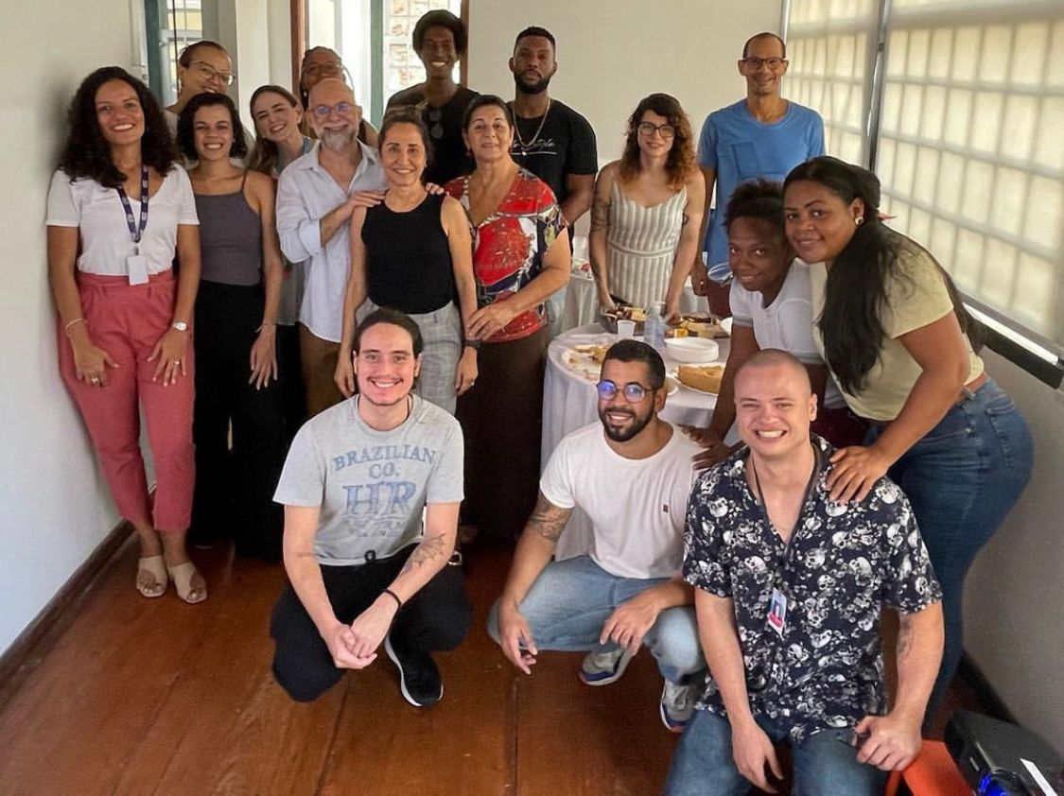

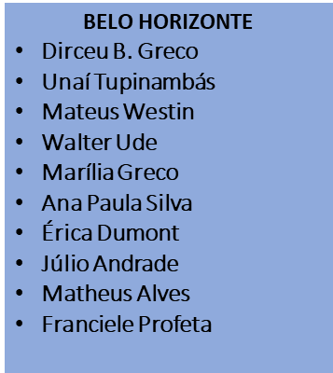

Acknowledgments - Teams
Gracias!
Thank you!
Thanks to sponsors and many others on the PrEP15-19 Choices team
Funding: Thanks to the generous support of Unitaid

