Slide 1
Question
& Answer
Notes:
Adaobi --
Thanks to our amazing presenters for such insightful presentations.
Now we will take about 3 questions from the audience, if you have questions kindly walk up to the microphone.
Thanks for the lovely questions and engagement, I love the energy in the room.
Let's give a round of applause to the lovely presenters as we wrap up this portion

Slide 2
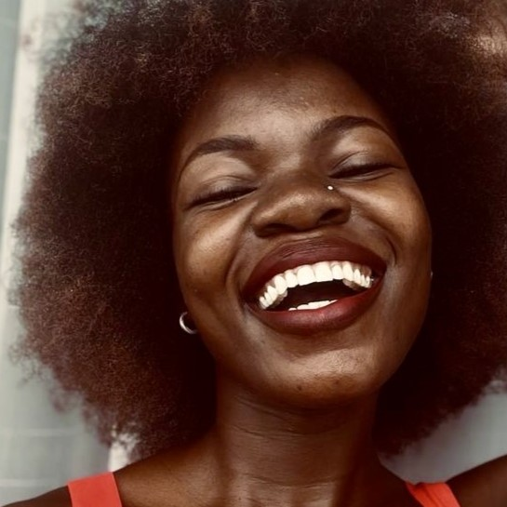
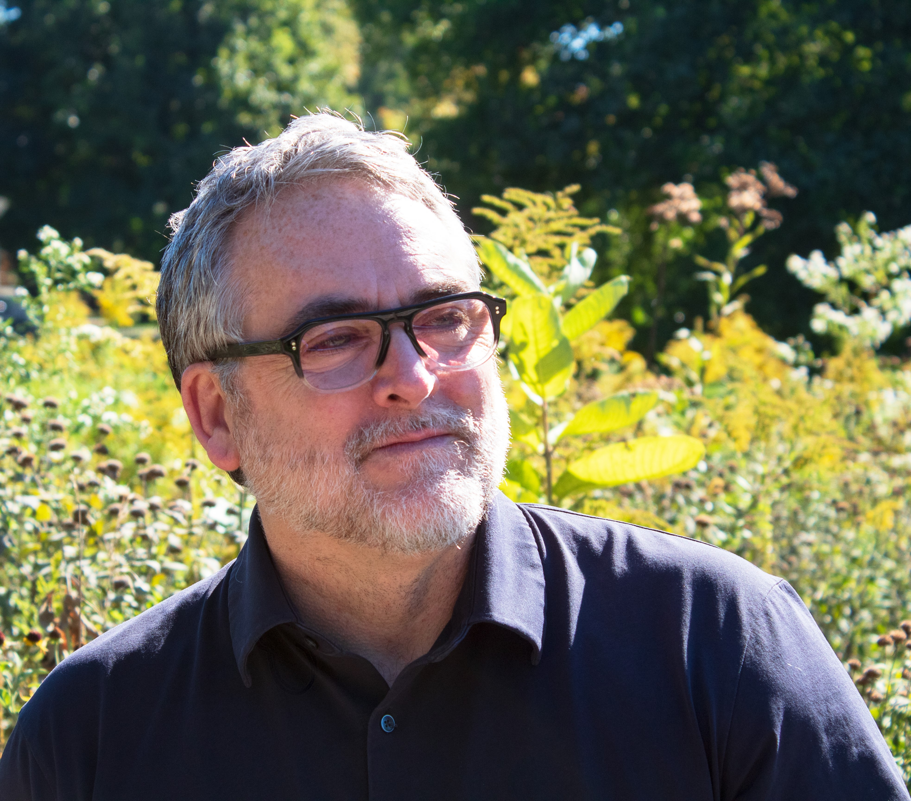
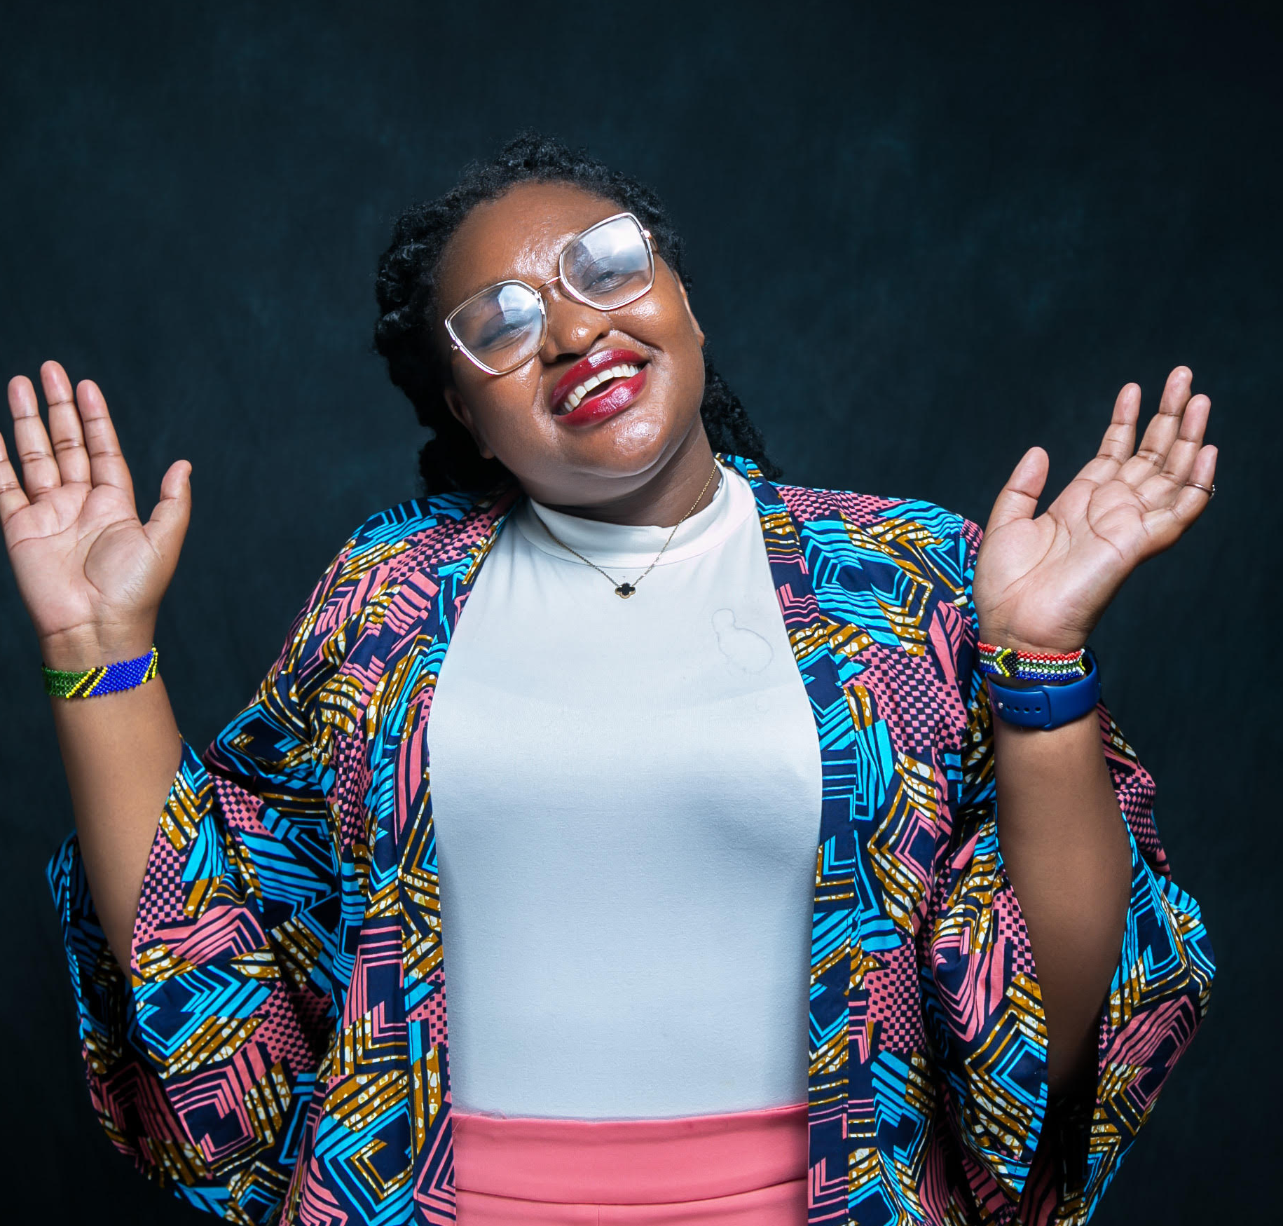
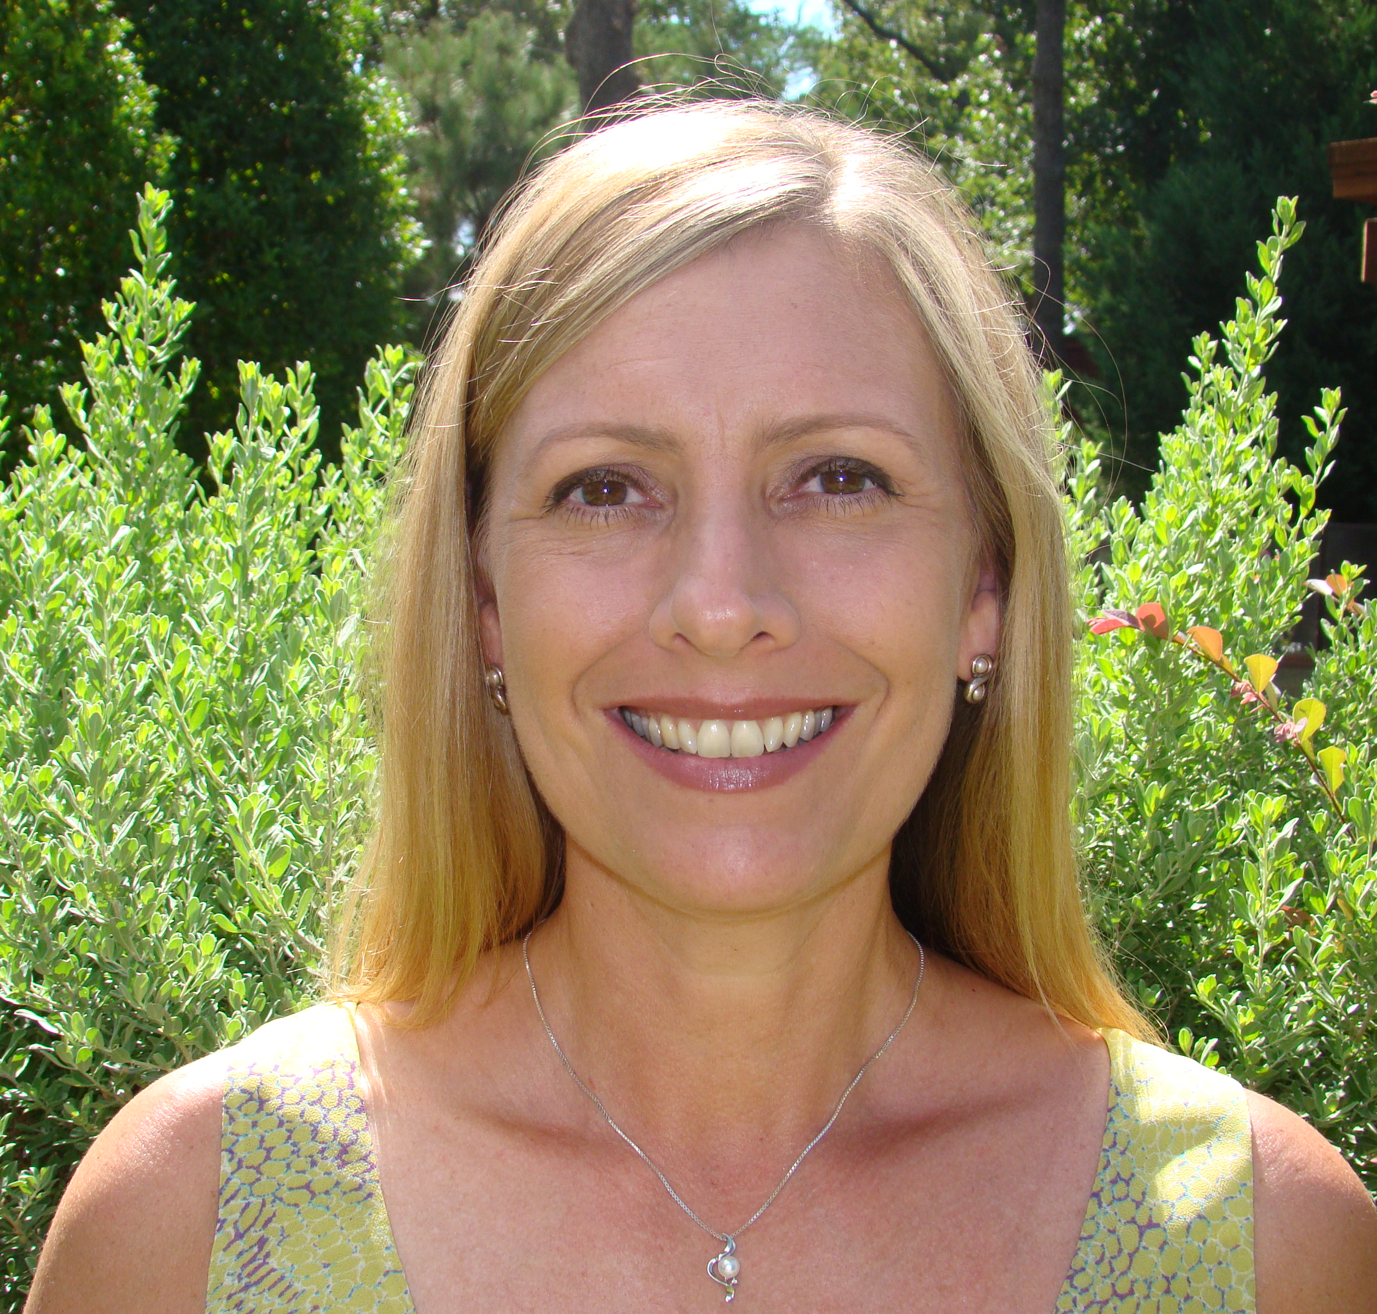
Panelists
Elizabeth Onyango
COSWA, Kenya
Jim Pickett
The Choice Agenda, USA
Doreen Moraa Moracha
Advocate, Kenya
Annaliese Limb
USAID, USA
Elizabeth is a queer sex worker from Mombasa, an afro-feminist, a gender and SRHR activist passionate about the meaningful engagement of sex workers in all spaces where decisions about their health and human rights are being made.
Jim helps lead PrEP4Teens - an arts, social marketing, and community mobilization campaign focused on PrEP awareness and uptake among Black and Brown young people in Chicago. He is also a Senior Advisor for AVAC and has been living with HIV since 1995.
Doreen is implementing an HIV cure literacy project with support from IAS and AVAC and founded "I AM A BEAUTIFUL STORY," a digital platform that inspires people living with HIV. Doreen was also recognized as one of Africa's 100 most impactful changemakers.
Annaliese is the Deputy Division Chief for the Priority Populations, Integration, and Rights Division in the Office of HIV/AIDS at USAID. Annaliese began her work in HIV/AIDS in 1995 with U.S. community organizations and transitioned to global health with the U.S. Peace Corps. She joined USAID in 2015.
Notes:
Adaobi
Now we'll dive into this panel session which will really be an intergenerational dialogue to appreciate a variety of perspectives on the importance of MYE and how it has evolved over the years.
Let's welcome our panelists …................Read panelists bios (only first sentence)
Delve into panel questions

