Slide 1
Differentiated service delivery for PEP and PrEP
Beatriz Grinsztejn, Fundação Oswaldo Cruz (Fiocruz), Brazil
Differentiated PEP and PrEP – reaching more people with HIV prevention services using DSD
Notes:
Thank you for joining us for this exciting satellite session.
Over the next 20 mins or so, I’ll be provided an overview of how differentiated service delivery, or DSD, has a role in support the effective scale-up and provision of PrEP and PEP services.
1

Slide 2
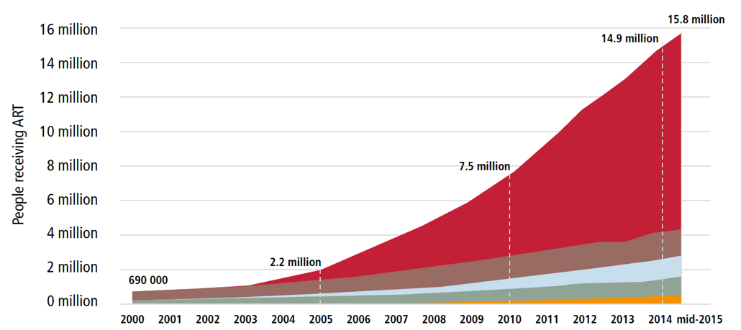
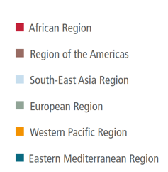
Background to differentiated service delivery (DSD) for HIV treatment
Think back to 2015
For the first time in global health history, the world reached a global treatment target prior to the agreed deadline – providing ART to 15 million people by mid-2015
Notes:
If we think back to 2015, this was an exciting time for the HIV response.
After an initially slow start in the scale-up of antiretroviral treatment, we had just seen the first global public health target met ahead of schedule with 15 million people receiving ART by the middle of the year, six months before the deadline.
This was applauded – and in many ways attributed to the meaningful engagement of communities affected by HIV, the simplification of HIV treatment approaches, and really a one size fits all approach to how treatment was delivered.

Slide 3
HIV treatment in 2015
One-size-fits all approach to delivery
  Monthly visits, at health facilities, to be seen by a clinician
WHO recommended “treat all”
Need to double the treatment cohort
While also supporting sustained retention and adherence for those access ART
Notes:
Also in 2015, the World Health Organization recommended “treat all” with the evidence from TEMPRANO and START trials, and 17 observational studies.
Further, WHO also recognized that ”what got us here”, won’t get us there. To double the treatment cohort, change was needed.
WHO also made recommendations around service delivery – and began highlighting that there were a diversity of needs among people accessing ART and that the one-size fits all approach would need to be revisited if we were to accelerate and double the treatment cohort.
We also were beginning to see data from our treatment cohorts of sub-optimal retention rates, and this was presenting challenges to ensuring life long adherence and viral suppression.

Slide 4


Shift from one-size fits all
Monthly visits to collect ART
Three-hour trip to clinic: Cost of transport
Long queues at the clinic
Leaving family and activities at home
Client needs
Health system needs
Notes:
Recipients of care had specific challenges – as this client in Lesotho highlights

Slide 5
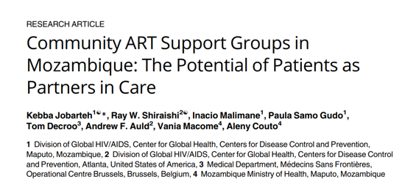
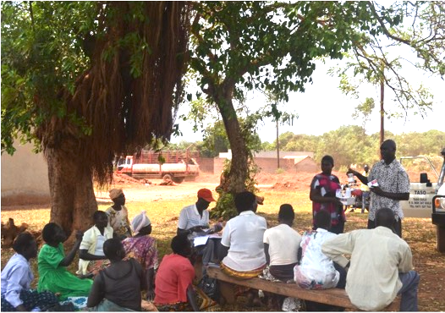
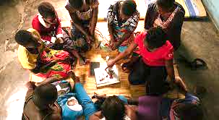
Result was DSD
South Africa – Adherence Clubs
Mozambique– Community Adherence Groups
Uganda– Community drug distribution points and and client-led ART delivery
Notes:
From this, DSD was born.
In South Africa with a large epidemic, this meant adherence clubs in urban areas to solve for overcrowding.
In Mozambique, this was community ART refill groups or CARGs – self-forming groups of recipients of care overcoming transport challenges and short supplies.
And in Uganda, this is was community drug distribution points and community-led ART delivery decentralizing care closer to home.
People living with HIV, along with healthcare workers in the HIV response including peers and lay providers, nurses and clinicians, began adapting the way HIV services were provided. Those who were established on treatment and empowered with treatment literacy, were seen less often by clinicians and able to access ART refills through different mechanisms.

Slide 6
“Differentiated service delivery (DSD), or differentiated care, is a person-centred approach. It simplifies and adapts HIV services across the cascade of HIV care to reflect the preferences and expectations of various groups of people living with or at risk of acquiring HIV while reducing unnecessary burdens on the health system.”
Adapted from Grimsrud A et al. Journal of the International AIDS Society 2016, 19:21484
Notes:
DSD is defined as a person-centered approach. With the person at the centre, HIV services are simplified and adapted to meet the preferences and expectations of groups of people, whiel also reducing unnecessary burdens on the heath system.
The approach acknowledges that people need different care at different points in time.

Slide 7
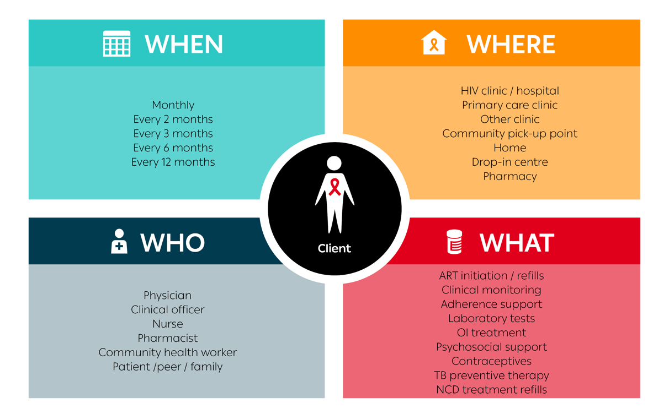
Building blocks of service delivery for HIV treatment
Notes:
DSD advocates for adapting the building blocks of service delivery.
The when – or how frequent services are provided,
The where – or the location of services
The who – or the cadre of worker providing the services, and
The what – or the package of services provided.

Slide 8
DSD for HIV treatment evolution*
 | ART refill-only | Clinical consultation
WHEN Service frequency | 3 to 6 monthly (increasingly 6 monthly) | 6 to 12 monthly
WHERE Service location | Home delivery Community pick-up Health facility fast lane | Community outreach Health facility
WHO Service provider | Client Peers Lay health providers | Nurse
WHAT Service package | Minimum package commonly only distributing ART | ART clinical guidelines
 | Clinical consultation + ART refill
WHEN Service frequency | Monthly
WHERE Service location | Health facility
WHO Service provider | Doctor/Nurse
WHAT Service package | ART clinical guidelines
*Once established on ART
Notes:
These building blocks for HIV treatment have now been separated for those who are established on ART.
In other words, there is one set of building blocks for the clinical consultation and one set of building blocks for treatment only refills. And this makes sense. When just a refill is needed, it may be unnecessary an not efficient to have someone see a clinician or visit a busy clinic. Refills can be provided through alternative mechanisms and by peers or lay providers. Given that the recipient of care is established on ART and has strong treatment literacy, they do not need to see a clinician frequently but maybe just for routine visits once or twice a year.
This slide highlights the shift seen from 2015 to today – where once everyone on ART came monthly to a heath facility and saw a clinician, clients now get refills from decentralized locations and from lay providers with less frequent clinical visits at the health facility.

Slide 9
DSD for HIV treatment is enabled by:
Less frequent clinical visits (the “when”)
Decentralization (the “where”)
Task sharing (the “who”)
Longer refills (the “what”
Notes:
This approach requires enabling policies for each of the building blocks.
For HIV treatment, global and national guidelines have been revised to support:
When = less frequent clinical visits
Where = decentralized access to ART refills
Who = task sharing among lay cadres and peers
What = extended refills for 3 or 6 months

Slide 10
But how does this relate to PreP?

Slide 11
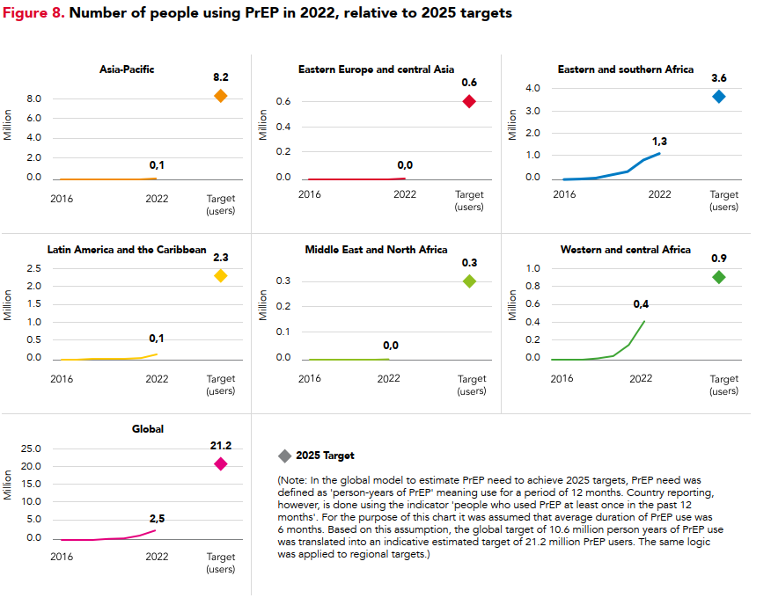
PrEP coverage below global targets
Considerable recent progress with PrEP scale up, but still far behind global targets
PrEP access varies between regions
UNAIDS report. HIV Prevention: From Crisis to Opportunity.2024
Notes:
The first important thing to note with PrEP is that despite the considerable progress in increasing access, we are still very, very far being our global PrEP targets.
While there are many reasons for not reaching these targets, it is clear that making PrEP easier to access and less medicalized could support increasing the number of people using PrEP.

Slide 12
COVID silver lining was shifts to prioritize PrEP access
PrEP emergency response to COVID pandemic:
Quickly leveraged differentiated service delivery (DSD) approaches used for treatment
Simplified, decentralized and de-medicalized PrEP service delivery
Increased flexibility and increased scale
Notes:
The second thing – is that PrEP scale up was accelerate during COVID-19. Pre COVID, it was harder for someone to get antiretrovirals for prevention that it was for treatment. What happened during COVID was that policies became more relaxed and together with clinicians, there was consensus that access needed to be prioritized. The result was that PrEP became simplified, decentralized and demedicalised and the increased flexibility led to increased uptake.
Subsequently, work has been done to maintain the innovations that occurred under the emergency response and to shift policies to enable these innovations to proliferate.

Slide 13
A DSD approach supports expanding access, uptake and PrEP continuation
Notes:
So what were the policy changes that have enabled a DSD approach for PrEP?

Slide 14
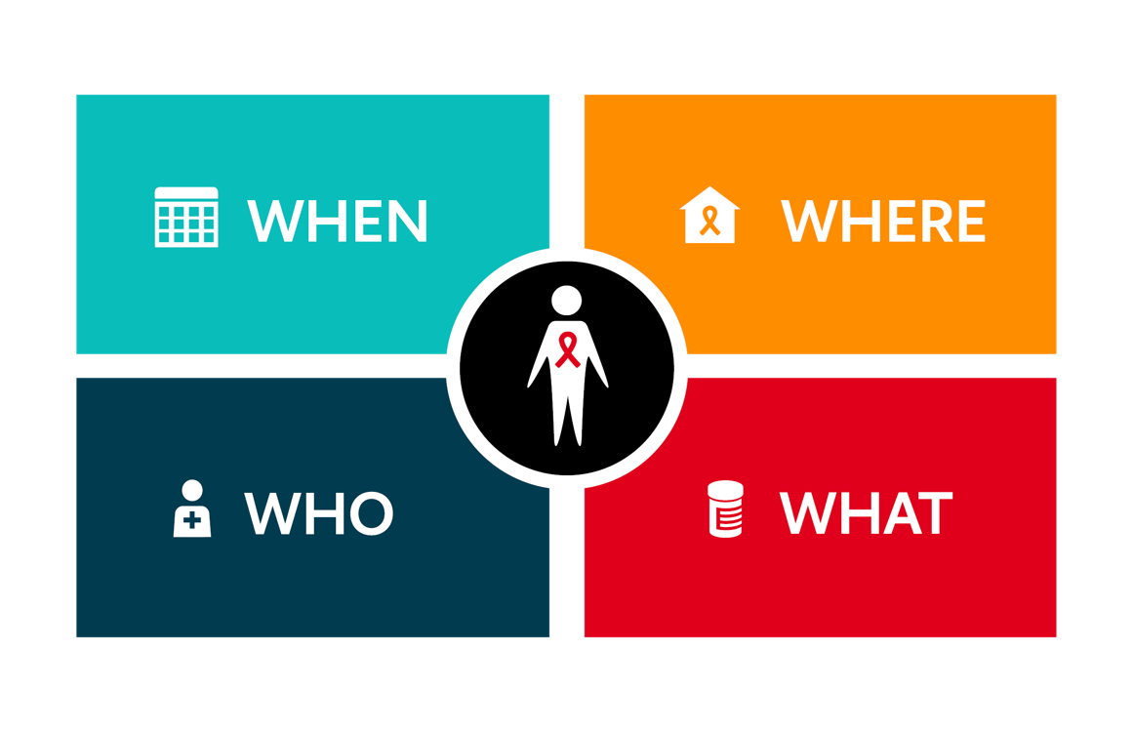
DSD for PrEP has enabled supportive policies
Decentralized and closer to home (e.g., drop-in centers, community-led)
Longer PrEP refills with less frequent clinical monitoring
Support by peers,
expert clients, nurses
PrEP refills and comprehensive health services, self-screening
Notes:
This first, on the WHEN, is that many countries are now providing longer PrEP refills during the maintenance phase and requiring less frequent monitoring.
On WHERE – there has been greater decentralization out of health facilities and towards drop in centers, pharmacies, mobile services and other locations outside of the traditional brick and mortrar primary health care facilities.
On WHO – increasing the role of peers and expert clients is being realized and finally, on the
WHAT – there is more acknowledgement of self-care technologies to support comprehensive prevention needs.

Slide 15
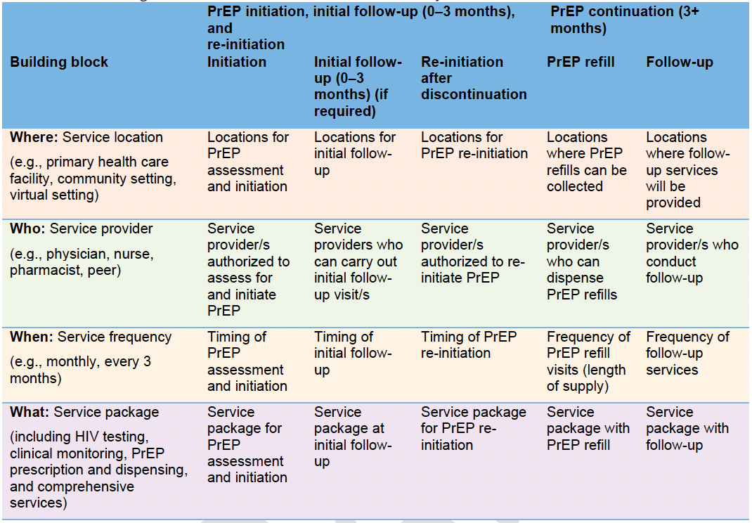

WHO implementation guidance to support DSD for PrEP
WHO. Differentiated and simplified pre-exposure prophylaxis for HIV prevention: Update to WHO implementation guidance.2022
Notes:
WHO has led on providing timely updates to global guidance, including on PrEP service delivery. In 2022, they launched this implementation guidance using the building blocks and sharing how the building blocks could be adapted during PrEP initiation and initial follow-up vs during PrEP continuation. Importantly, you can see that just like with HIV treatment, there can be different building blocks for PrEP refills and PrEP clinical follow-up during the continuation phase.

Slide 16
Why country PrEP DSD guidance?
To enable health authority managers, implementing partners and healthcare providers
Who can prescribe PrEP or provide repeat scripts?
Who can distribute PrEP refills? Or administer PrEP injectables?
Where can a person collect their PrEP refills or have PrEP injections administered?
How frequently must a person on PrEP be seen for a clinical consultation?
What is the minimum package of care at clinical follow-up visits by PrEP method?
PrEP DSD policy guidance can be incorporated in:
Service delivery operational guidance across the cascade; OR
PrEP clinical guidelines as a separate section
Notes:
For countries, it’s also critical that their PrEP guidance be updated to enable service delivery adaptions. These key questions can help countries to ensure their policies align with their PrEP scale up goals. PrEP DSD policy can be revised either in their HIV service delivery guidance or as part of the PrEP clinical guidelines.

Slide 17

IAS developed a brief to support countries to include DSD for PrEP in their guidance
An introduction to PrEP DSD
Eight key policy areas for DSD PrEP guidance
A draft of each key policy areas for consideration and country adaptation.
Notes:
To support countries to include DSD for PrEP guidance following the WHO implementation guidance, IAS released a country policy brief also in 2022. This document provides sample policies eight key areas to facilitate countries to discuss service delivery policies they would like to implement to support PrEP service delivery.

Slide 18
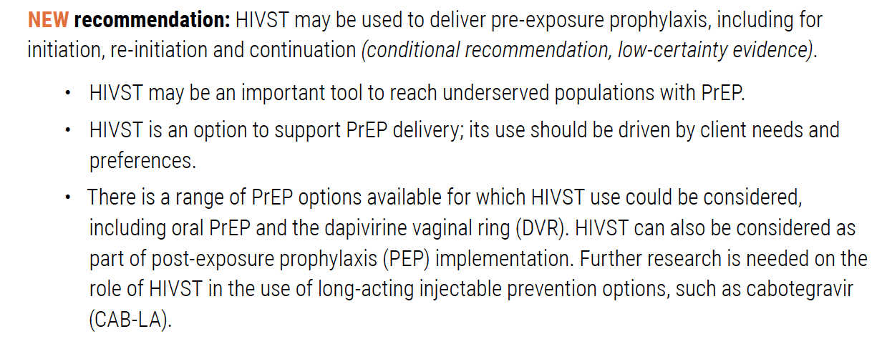
Updated WHO recommendation on HIVST and PrEP
Source: WHO. Consolidated guidelines on differentiated HIV testing services. 2024
Notes:
Another key guidance update is WHO’s 2024 recommendation around HIV self testing and PrEP. As was highlighted in the “what” building blocks, HIVST is a self-care option that can be complimentary in supporting PrEP initiation, re-initiation and continuation and enable PrEP access outside of healthcare facilities.

Slide 19
Looking ahead with long-acting PrEP (1)
 | Current DSD model with daily oral tablets
 | Clinical visits | PrEP-refill only visits
WHEN | 3- to 6-monthly clinical visits | 3-monthly PrEP refills (moving towards 6-monthly)
WHERE | Clinical visits at primary healthcare or via telemedicine | PrEP refills decentralized to community settings
WHO | Clinical visits by trained HCWs or lay providers supports by clinicians (prescriptions by clinicians) | PrEP refills distributed by lay providers, peers, pharmacists, CHWs and courier
WHAT | PrEP refills, other prevention commodities, HIV self-test kids, HIV risk and PrEP effective use counselling, PrEP clinical management and monitoring | PrEP refills, other prevention commodities, HIV self-test kids, HIV risk and PrEP effective use counselling
Differentiation will still be important
Adapted from Grimsrud A et al. JIAS, 2023, https://doi.org/10.1002/jia2.26095b
Notes:
So now, we can look at the building blocks and see how for PrEP continuation they can be adapted with different PrEP products.
Here is the current model with daily oral pills. Differentiation to date has focused on longer refills, decentralized collections, and task sharing – as well as the separation between clinical visits and PrEP refills.

Slide 20
Looking ahead with long-acting PrEP (2)
 | DSD with current long-acting (CAB-LA)
 | Clinical visits with 2-monthly IM injections
WHEN | 2-monthly IM injections and clinical visits
WHERE | PHC/hospital (with infrastructure for IM injection, management of syringes and needles)
WHO | Trained HCW for IM injections and PrEP prescribing and monitoring
WHAT | Same as current DSD - PrEP injection + other prevention commodities, HIV self-test kids, HIV risk and PrEP effective use counselling, PrEP clinical management and monitoring
CAB-LA – requires more frequent visits, less decentralization, less task shifting
Adapted from Grimsrud A et al. JIAS, 2023, https://doi.org/10.1002/jia2.26095b
Notes:
Looking ahead, the building blocks would change with CAB-LA.
Importantly with CAB, there are less differentiation options given that it’s a 2-monthly intramuscular injection. This limits the decentralization and task-shifting options and makes two-monthly clinic visits essential.

Slide 21
Looking ahead with long-acting PrEP (3)
Differentiation will still be important
 | DSD with LEN (for prevention)
 | Clinical visits with 6-monthly injections
WHEN | 6-monthly SC injections + clinical visits
WHERE | At PHC
WHO | Trained HCW for SC injections and PrEP prescribing and monitoring
WHAT | Same as current DSD - PrEP injection + other prevention commodities, HIV self-test kids, HIV risk and PrEP effective use counselling, PrEP clinical management and monitoring
Notes:
Shifting and thinking about LEN – this is more exciting given that only two visits per year would be necessary once established on PrEP.

Slide 22

Looking ahead with long-acting PrEP (4)
Differentiation will still be important
 | Ideal with future long-acting extended delivery (including oral tablets, injections, implants and patches)
 | Clinical visits | PrEP-refill only visits
WHEN | 6- to 12-monthly clinical visits Aligned with visits for other medical needs | 6-12 monthly delivery systems (LA oral tables, longer IM injections, SC self-injections, implants and patches)
WHERE | Decentralized – fast track delivery at facilities or outside of PHC and into communities (e.g., pharmacies, community-based organizations, mobile vans, etc.) supported by telemedicine | PrEP refills decentralized to community settings
WHO | Clinical visits by trained HCWs or lay providers supports by clinicians (prescriptions by clinicians) | Prevention options support self-management: choice of, for example, 6- to 12-month implant; 6 x monthly oral tablets; 6-12 months of self-managed SC or patch
WHAT | Stipulated minimum package of services (supporting demedicalization) + product service integration with other health needs including STIs, contraception, NCDs and gender-affirming hormonal therapy | PrEP refills, other prevention commodities, HIV self-test kids, HIV risk and PrEP effective use counselling
Adapted from Grimsrud A et al. JIAS, 2023, https://doi.org/10.1002/jia2.26095b
Notes:
But there’s more in the future of PrEP and DSD. What about self-injectable systems? What about more integration of self-management? What about co-formulations?
There is a bright future with more innovations in the PrEP products that could be available – oral tablets, injections, implants and patches.

Slide 23
And how does DSD relate to PEP?
Notes:
Now, and finally, let’s shift gears and talk a little bit about PEP.

Slide 24
Current PEP situation
Historically, PEP has been underutilized outside of occupational HIV exposure and in sexual assault cases. While PrEP initiations have increased, PEP usage has flatlined
Recent differentiated approaches to PrEP delivery have highlighted the unmet need for PEP. Examples include:
  Uptake of PEP from private pharmacies in Kenya
  Uptake of PEP from mobile clinics
Crucial to PEP efficacy is timely access. Recent innovations to improve access include:
  Vending machine distribution
  Online linkage to commodities
Notes:
Not a lot of us talk about PEP – but it surely has a role to play given that it has historically been used almost exclusively for occupation HIV exposure and in sexual assault cases. Given that the majority of transmissions occur outside of these exposures, how can we improve PEP literacy and uptake?
Recent work, including by the KEMRI group that will present later, has highlighted that many people accessing PrEP and emergency contraceptives, actually want PEP
And given that PEP efficacy relates to timely access, it’s important to discuss how to get people access quickly.

Slide 25
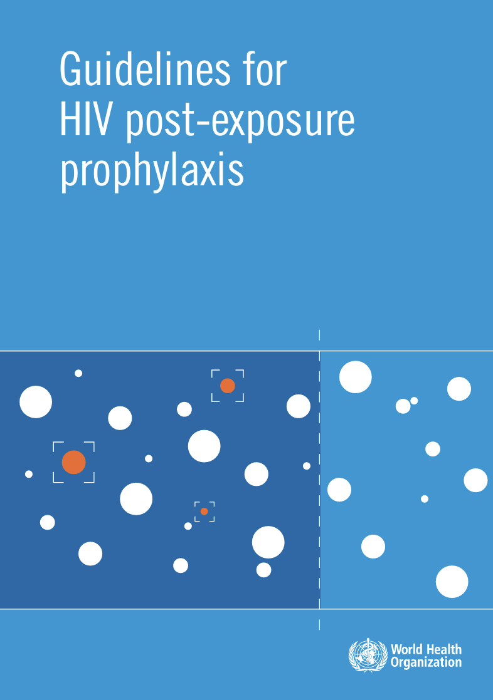
Newly launched PEP guidelines from WHO
Two new recommendations relate to building blocks
WHO. Guidelines for HIV post-exposure prophylaxis.2024
Notes:
Earlier this year, who launched updated PEP guidance and it included NEW recommendations related to two of the building blocks.

Slide 26
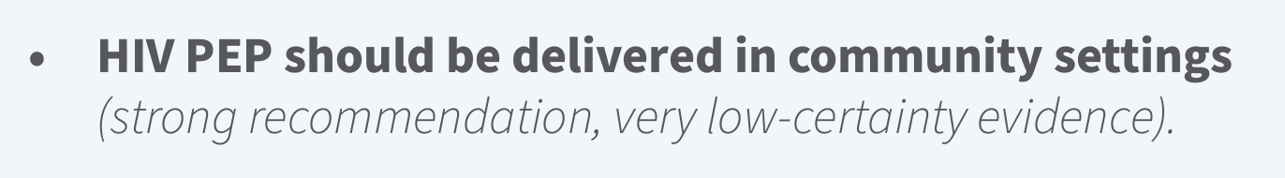
WHERE – WHO recommendation for PEP decentralization
NEW 2024 recommendation
Notes:
First, and critically, WHO recommends that PEP should be delivered in community. This decentralization recommendation is critical to having PEP closer to people that need it, and in taking it out of just being at health facilities.

Slide 27
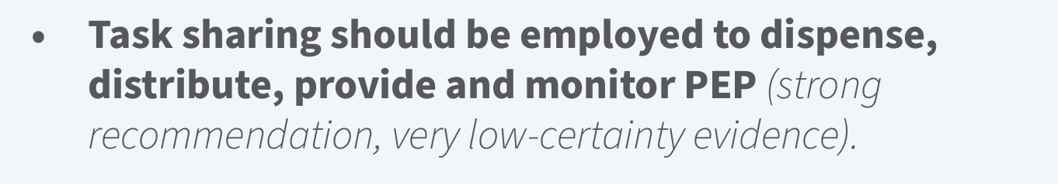
WHO – WHO recommendation for PEP task sharing
NEW 2024 recommendation
Notes:
Secondly, the task sharing or “WHO” recommendation is that “task sharing should be employed to dispense, distribute and monitor PEP”. Again, by expanding who can provide PEP, we can make it accessible quicker to those who need it.
Stay tuned for PEP data in this session where innovation models that utilized both adaptations to the WHERE and WHO have increased PEP access.

Slide 28
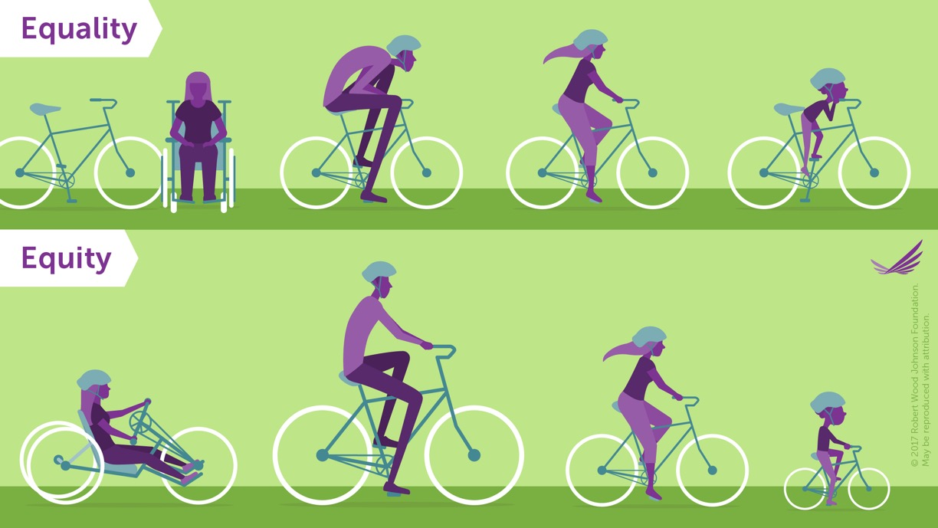
“It’s not about everybody getting the same thing. It’s about everybody getting what they need in order to improve the quality of their situation.” C. Parker
DSD can support equity in access to PrEP and PEP – and positively impact uptake, persistence and effective use
Notes:
In summary - DSD for PrEP & PEP can support us in reaching our global HIV goals positively impacting access, uptake and persistence and effective use.
It’s not about everyone getting the same thing – it’s about everyone getting what they need to improve their situation.

Slide 29
Today’s session will highlight innovative DSD models for PrEP & PEP
Focus on innovations in where PrEP and PEP are provided to improve access and uptake
Adapting the where for PEP & PrEP – expanding service reach through private pharmacies in Kenya
The era of choice – the FastPREP model in South Africa
Expanding options and reach - online PEP and PrEP in Brazil
Notes:
Thank you

