Slide 1
Adapting the where for PEP & PrEP – expanding service reach through private pharmacies in Kenya
Damary Rehema Chora, Kenya Medical Research Institute; on behalf of Pharm PrEP study team
Differentiated PEP and PrEP – reaching more people with HIV prevention services using DSD
Notes:
1

Slide 2
In Kenya, barriers to PrEP/PEP remain that could be addressed with pharmacies
Dominant PrEP/PEP delivery model:
New PrEP/PEP delivery model:
Private community pharmacies
Public
HIV clinics
Barriers to client access:
Health services commonly sought here (~50% of individuals in low- and middle-income countries)
Long operating hours & operate on weekends
Quick, discreet services (No HIV stigma)
Large purveyor of SRH products (e.g., condoms, emergency contraception)
Stigma
Associated with visiting HIV clinics when HIV uninfected
Limited hours of operation
Closed on weekends when prevention (especially PEP) needed
Long wait times & travel distance
Associated w/ overcrowding, many stops, limited PrEP/PEP clinics
In Kenya, >5000 licensed pharmacies overseen by a regulatory board, with annual renewal & continuing professional development requirements.

Slide 3
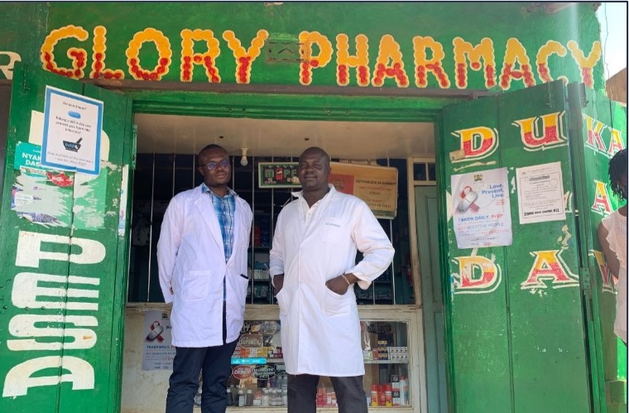
We have demonstrated the feasibility of pharmacy-delivered PrEP/PEP in pilots
Care pathway for pharmacy PrEP/PEP:
Utilizes prescribing checklist w/ remote clinician oversight
Key findings
Pharmacies reached PrEP/PEP naïve clients with HIV risk not often engaged in clinic-delivered PrEP/PEP services
Delivering public drugs in a new private settings was feasible; services delivered with high fidelity
PrEP continuation was comparable with that observed at public clinics
HIV risk assessment
Not at HIV risk
Medical safety assessment
Medical conditions that might contraindicate drug safety
HIV testing
HIV-positive
Research on implementation strategies to support scale-up needed
Referred to clinic services
Drug dispensing
Tested in 12 pharmacies in Western and Central Kenya over ~18 months
(Ortblad KF et al., CROI 2022; Roche et al., CROI 2023)
Photo used with permission.

Slide 4
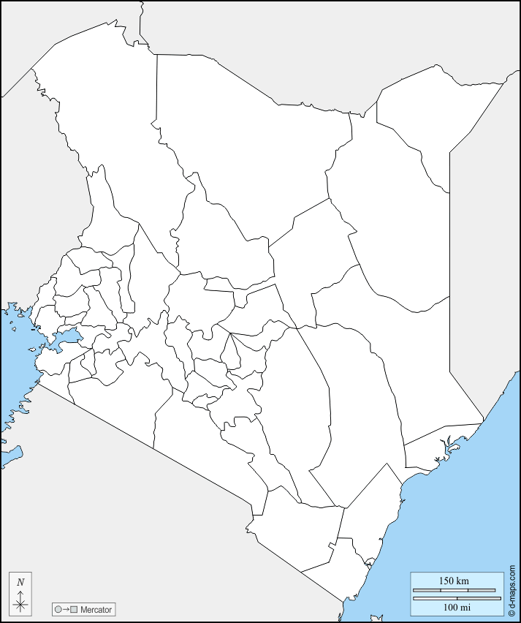
An ongoing cluster-randomized controlled trial is testing implementation strategies to inform scale-up
Retail pharmacies
(k=60 pharmacies)
Start: June 2023
Anticipated end: June 2025
Arm 1
Arm 2
Arm 3
Arm 4
PrEP/PEP: Fee
PrEP/PEP: Free
PrEP/PEP: Free
w/ HTS counselor
SOC: PrEP/PEP referral
Provider leading screening & HIV testing | Pharmacy provider | Pharmacy provider | HTS counselor | Pharmacy provider
Client pays pharmacy* | 250 KES | 0 KES | 0 KES | 0 KES
Study pays pharmacy* | 0 KES | 250 KES | 100 KES | 100 KES
(k=15 pharmacies)
(k=15 pharmacies)
(k=15 pharmacies)
(k=15 pharmacies)
Outcomes: PrEP initiation & continuation (primary); PEP initiation & repeat use
Setting: 6 counties in Western and Central Kenya
*Per HIV test completed or (if Arm 4) per referral

Slide 5
Overview of pharmacy PrEP delivery in the intervention pharmacies, k=45
 | DSD for PrEP: initiation (0 months) |  | DSD for PrEP: continuation (>1 month)
 | Assessment and initiation | Early follow up | PrEP refill & clinical consultation
WHEN | Month 0: Immediately after confirming ongoing HIV risk and testing HIV-negative | Month 1; following screening for drug side effects + HIV testing | 3-monthly; following screening for drug side effects + HIV testing
 | During pharmacy hours (incl. evenings & weekends)
WHERE | Intervention pharmacies, k=45 | At pharmacy where PrEP initiated | At pharmacy where PrEP initiated
WHO | Pharmacy providers (i.e., pharmacist or pharmaceutical technologists), w/ HTS counsellor support (Arm 3) | Pharmacy providers (+ HTS counsellor, Arm 3) | Pharmacy providers (+ HTS counsellor, Arm 3)
WHAT | HIV risk assessment (+ counselling); medical safety assessment; HIV testing; PrEP dispensing | HIV risk assessment; side effect screening; HIV testing; PrEP dispensing | HIV testing; 3 months of PrEP

Slide 6
Overview pharmacy PEP delivery in the intervention pharmacies, k=45
 | DSD for PEP
 | Assessment and initiation | Follow-up
WHEN | Month 0: Immediately after confirming a potential HIV exposure in the past 72 hours and testing HIV-negative → During pharmacy hours (including evenings and weekends) | Month 1 & 3: After 28 days, and 12 weeks
WHERE | Intervention private pharmacies, k=45 | At pharmacy where PEP initiated
WHO | Pharmacy providers (i.e., pharmacist or pharmaceutical technologists), w/ HTS counsellor support (Arm 3) | Pharmacy providers (+ HTS counsellor, Arm 3)
WHAT | HIV risk assessment (+ counselling); medical safety assessment; HIV testing; PEP dispensing | HIV risk assessment; side effect screening; HIV testing; potential PrEP transition

Slide 7
Pharmacy PrEP/PEP uptake among pooled intervention pharmacies, k=45
Completed screening*
n=2,134
*Pooled across 3 intervention arms
Data from: July 2023 to June 2024
Prescribing checklist components:
HIV risk assessment
Pharmacy PEP candidate:
HIV exposure < 72 hrs
n=1,279
Pharmacy PrEP candidate:
Ongoing HIV risk
n=855
60% interested/ eligible for PEP (vs. PrEP)
Medical safety assessment
No contraindicators
n=1,279
No contraindications
n=853
Preliminarily eligible for service delivery
Declined testing, n=48
Tested HIV-positive, n=13
Declined testing, n=92
Tested HIV-positive, n=18
HIV testing
Tested HIV-negative
n=1,218
Tested HIV-negative
n=743
Dispensing
Dispensed PEP
n=1,203
Dispensed PrEP
n=715
95% among eligible**
86% among eligible**
**Excludes those who test HIV-positive

Slide 8
Reach of pharmacy PrEP/PEP: demographics of clients initiating services
 | Private pharmacies
Characteristic | PEP clients (n=1,203) | PrEP clients (n=715)
Male | 717 (59%) | 326 (46%)
<25 years | 396 (33%) | 271 (38%)
Unmarried | 704 (59%) | 353 (49%)
Relationship status
One primary & casual partners | 390 (32%) | 214 (30%)
Casual only | 335 (28%) | 203 (28%)
One primary partner | 316 (26%) | 190 (27%)
No partners | 119 (10%) | 20 (3%)
Population type
Key population | 13 (1%) | 31 (4%)
Serodiscordant couple | 9 (1%) | 24 (3%)
Prior PEP/PrEP use*
Prior PEP use | 125(13%) | 32 (6%)
Prior PrEP use | 140(15%) | 59 (12%)
Majority of PrEP/PEP clients were male (54%) and unmarried (55%)
Most reported at least 1 casual partner (60%); few identified as a member of a key population (2%)
Little prior PrEP/PEP use (<15%) reported among pharmacy PrEP/PEP clients

Slide 9
Reach of pharmacy PrEP/PEP: demographics of clients initiating services
Data from large-scale implementation project: Partner’s Scale-Up
 | Private pharmacies |  | Public clinics
Characteristic | PEP clients (n=1,203) | PrEP clients (n=715) | PrEP clients (n=4,898)
Male | 717 (59%) | 326 (46%) | 2,257 (46%)
<25 years | 396 (33%) | 271 (38%) | 969 (20%)
Unmarried | 704 (59%) | 353 (49%) | 432 (9%)
Relationship status
One primary & casual partners | 390 (32%) | 214 (30%)
Casual only | 335 (28%) | 203 (28%)
One primary partner | 316 (26%) | 190 (27%)
No partners | 119 (10%) | 20 (3%)
Population type
Key population | 13 (1%) | 31 (4%)
Serodiscordant couple | 9 (1%) | 24 (3%) | 4092 (84%)
Prior PEP/PrEP use*
Prior PEP use | 125(13%) | 32 (6%)
Prior PrEP use | 140(15%) | 59 (12%)
Compared to PrEP clients at public clinics, more pharmacy PrEP/PEP clients are: younger, unmarried, and not in a serodifferent couple.

Slide 10
Behaviors associated with HIV risk among pharmacy PrEP/PEP clients
Behaviors associated with HIV risk, past 6 months
Acute HIV exposures, past 72 hours
Most HIV exposures from unprotected sex
Condom
break/
condomless
sex
Needle prick:
drug use/ occupational
Sexual
assault
Other
PEP clients
PrEP clients

Slide 11
High acceptability of pharmacy PrEP/PEP among clients
Assessed different component constructs of the Theoretical Framework of Acceptability following clients’ first visit
PEP Acceptability
Affective attitude: Likes getting PEP at pharmacy
100%
Perceived effectiveness: Pharmacy PEP reaches people at risk.
98%
Burden*: It is hard to get PEP at a pharmacy.
89%
8%
Opportunity cost*: Getting PEP at the pharmacy interfered with other priorities.*
96%
4%
PrEP Acceptability
Affective attitude: Likes getting PrEP at pharmacy.
100 %
Perceived effectiveness: Pharmacy PrEP reaches people at risk.
100 %
Burden*: It is hard to get PrEP at a pharmacy.
88%
9%
Opportunity cost*: Getting PrEP at the pharmacy interfered with other priorities.*
88%
11%
Percentage of pharmacy clients
*Question reverse coded: A validation technique to bring out a positive item in a negative way
Strongly disagree | Disagree | Neither agree nor disagree | Agree | Strongly agree

Slide 12
Key takeaways to date
Reached clients who could benefit and are not engaged in existing clinic-based PrEP/PEP services, by adapting the “where” of PrEP/PEP service delivery
Private pharmacies might expand the reach of PrEP/PEP services rather than decongest existing delivery platforms
Great demand for pharmacy PEP services; with extended hours, including weekends, pharmacies may be well-suited to deliver this time-sensitive service
Highlights need for periodic versus persistent HIV prevention interventions
Underscores role PEP could play in delivery of comprehensive HIV services that enable choice
Pharmacy-delivered PrEP/PEP services are highly acceptable among clients who received services
Emphasizes the need for diverse delivery platforms that suit various client preferences

Slide 13
Next steps
Add private pharmacies as recommended delivery platform to PrEP/PEP implementation guidelines
Identify a model of pharmacy PrEP/PEP for scale-up, informed by the ongoing cRCT findings
Develop implementation strategies that support the scale-up and sustainability of the approach
e.g., electronic dispensing records, curriculum for providers, quality assurance tools, MOH reporting tools
Adapt the model ongoing in Kenya for other countries and interventions, including injectable PrEP forms, ART, and combination prevention interventions
Photo used with permission

Slide 14
Acknowledgements
We would like to acknowledge all the clients, pharmacy providers, research assistants, and technical officers in the study; the Kenya National AIDS & STI Control Program (NASCOP); and the Kenya Pharmacy and Poisons Board (PPB).
Funding: The Bill & Melinda Gates Foundation (INV-033052)
Principal Investigators: Dr. Katrina Ortblad (Fred Hutchinson Cancer Center), Professor Elizabeth Bukusi (KEMRI), Assoc. Professor Kenneth Ngure (JKUAT), Dr. Daniel Were (Jhpiego)
Damary Rehema
rdamary@kemri-rctp.org

