Slide 1
The era of choice – the FASTPREP model in South Africa
Keitumetse Lebelo, Desmond Tutu Health Foundation, South Africa
Differentiated PEP and PrEP – reaching more people with HIV prevention services using DSD
Notes:
1

Slide 2
Background
South Africa has the highest HIV prevalence globally, with approximately 7.8 million people living with in 2022.
BIOMEDICAL
Pre-Exposure Prophylaxis (PrEP)
Voluntary Medical Male Circumcision (VMMC)
HIV Testing and Treatment (Test and Treat)
BEHAVIOURAL
Programmes promoting safer sexual practices
Targeted campaigns like “She Conquers” and “#foreverWena”
STRUCTURAL
Social determinants of health, such as gender inequality, poverty, and education
Improve education and economic opportunities, especially for young women
Access to HIV prevention services

Slide 3
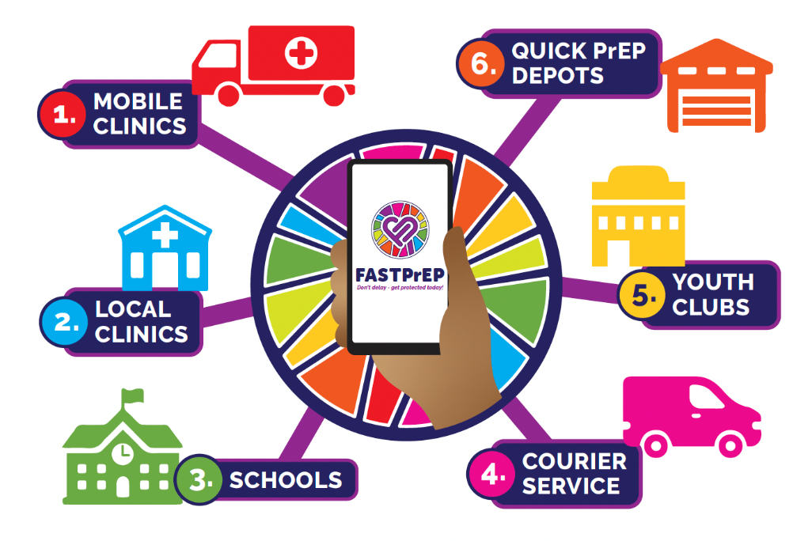
FASTPrEP
FASTPrEP aim: implement and evaluate a District wide PrEP intervention that will lead to
increased coverage of at risk, sexually active population (AGYW, incl. pregnant women), male partners and MSM through provision of sexual reproductive health service and PrEP engagement (uptake and effective use) in a peri-urban setting in Cape Town, South Africa
HUB-and-SPOKES MODEL
The primary objectives are to distinguish PrEP persistence patterns across different PrEP modalities (vaginal, oral, and injectable) and from multiple PrEP delivery platforms that will aid the provision of PrEP choice to adolescents and young people in South Africa
Geographic coverage: South Africa, Western Cape – Klipfontein/Mitchells Plain health sub-district

Slide 4
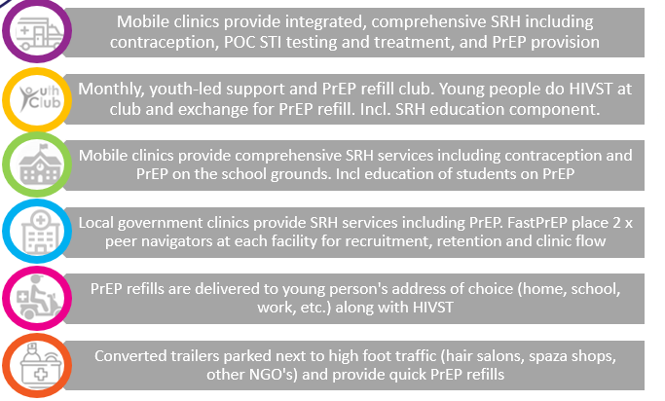
HUB-and-SPOKES MODEL
Mobile clinics and government facilities - HUB – provide PrEP initiation, while PrEP refills can also be accessed from schools, courier delivery, or youth club. Participants’ movement tracked biometrically.
AGYW 15,000
PBFW 4,000
MSP 3,500
MSM 2,000

Slide 5
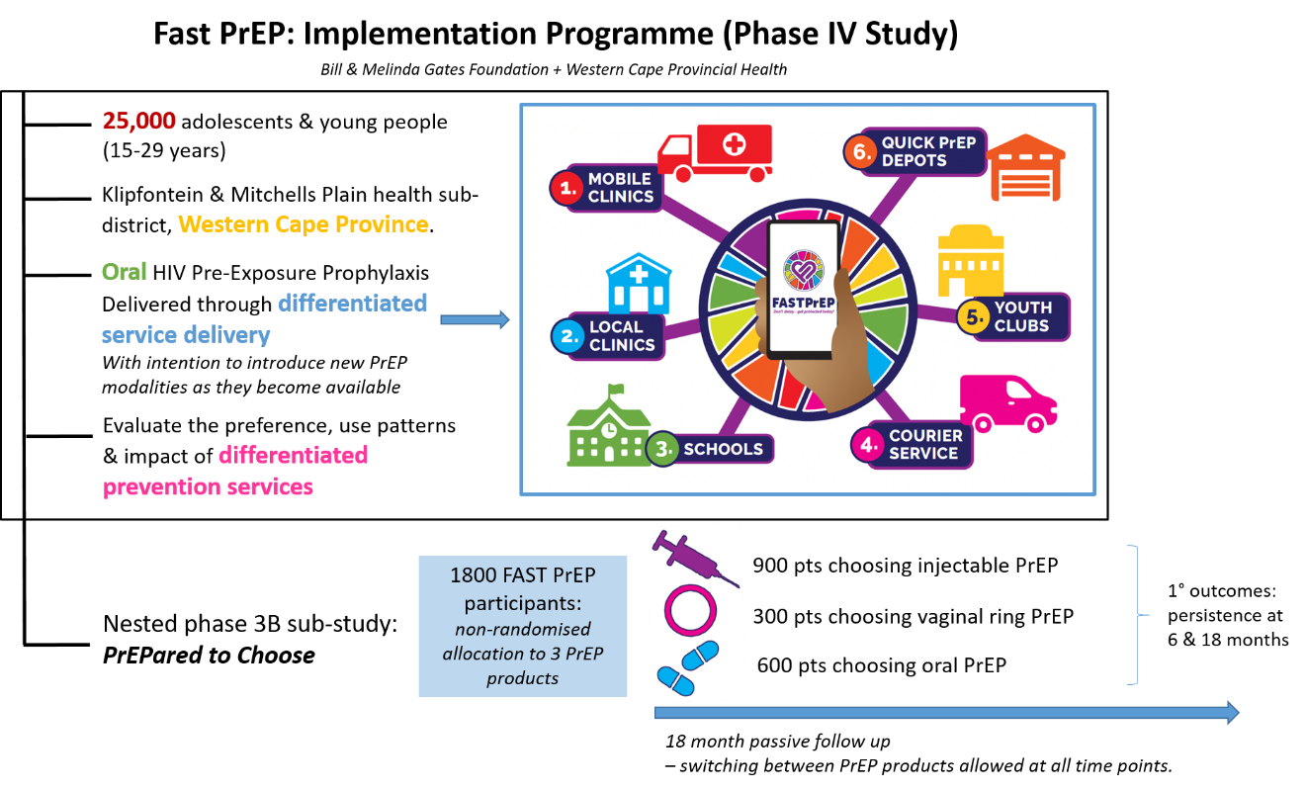

Slide 6
Overview of the intervention (FastPREP)
 | Oral PrEP | Vaginal PrEP | Injectable PrEP
WHEN | At initiation – one month supply given After 1 month: – 3-month supply given | At initiation – one month supply given After 1 month: – 3-month supply given | Every 8 weeks: 1 injection given
WHERE | At initiation Mobile clinics and local clinics only All sites (mobile clinics, local clinics, schools, courier services, youth clubs, quick PrEP depots) | At initiation Mobile clinics and local clinics only All sites (mobile clinics, local clinics, schools, courier services, youth clubs, quick PrEP depots) | Mobile clinics Local clinics
WHO | Healthcare providers Lay counsellors | Healthcare providers Lay counsellors | Only healthcare providers (NIMART-qualified professional nurses or medical doctors)
WHAT | PrEP choice counselling HIV testing: self-testing option Comprehensive SRH service: STI testing and treatment Pregnancy testing and contraceptive counselling |  | The same, but excluding HIV self-testing option

Slide 7
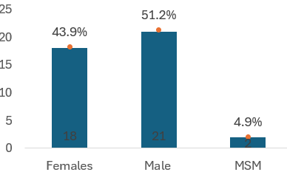
FASTPrEP
Table 1: Baseline characteristics and PrEP uptake
 | Clinic (12) | Mobile truck(4) | Total
N (%) | 3,085 (23.3%) | 10,131 (76.7%) | 13,216 (100.0%)
Age m(IQR) | 23(19-27) | 23(19-28) | 23(19-28)
Population*
AGYW | 1,903 (61.7%) | 6,022 (59.4%) | 7,925 (60.0%)
PBFW | 226 (7.3%) | 92 (0.9%) | 318 (2.4%)
MSM | 82 (2.7%) | 212 (2.1%) | 294 (2.2%)
MSP | 874 (28.3%) | 3,804 (37.6%) | 4,678 (35.4%)
PrEP product at baseline
DVR** | 6 (0.2%) | 169 (1.7%) | 175 (1.3%)
Oral PrEP | 3,079 (99.8%) | 9,962 (98.3%) | 13,041 (98.7%)
AGYW 15,000
PBFW 4,000
MSP 3,500
MSM 2,000
* 1 participant missing for mobile truck
**Dapivirine Vaginal Ring (started September 2023)
Figure1: FASTPrEP PEP uptake
17,254 people who tested for HIV at baseline, 2.09% were positive. Additionally, of the 16,422 STI tests conducted, 16.8% were positive.
Note: PEP (started June 2024)

Slide 8
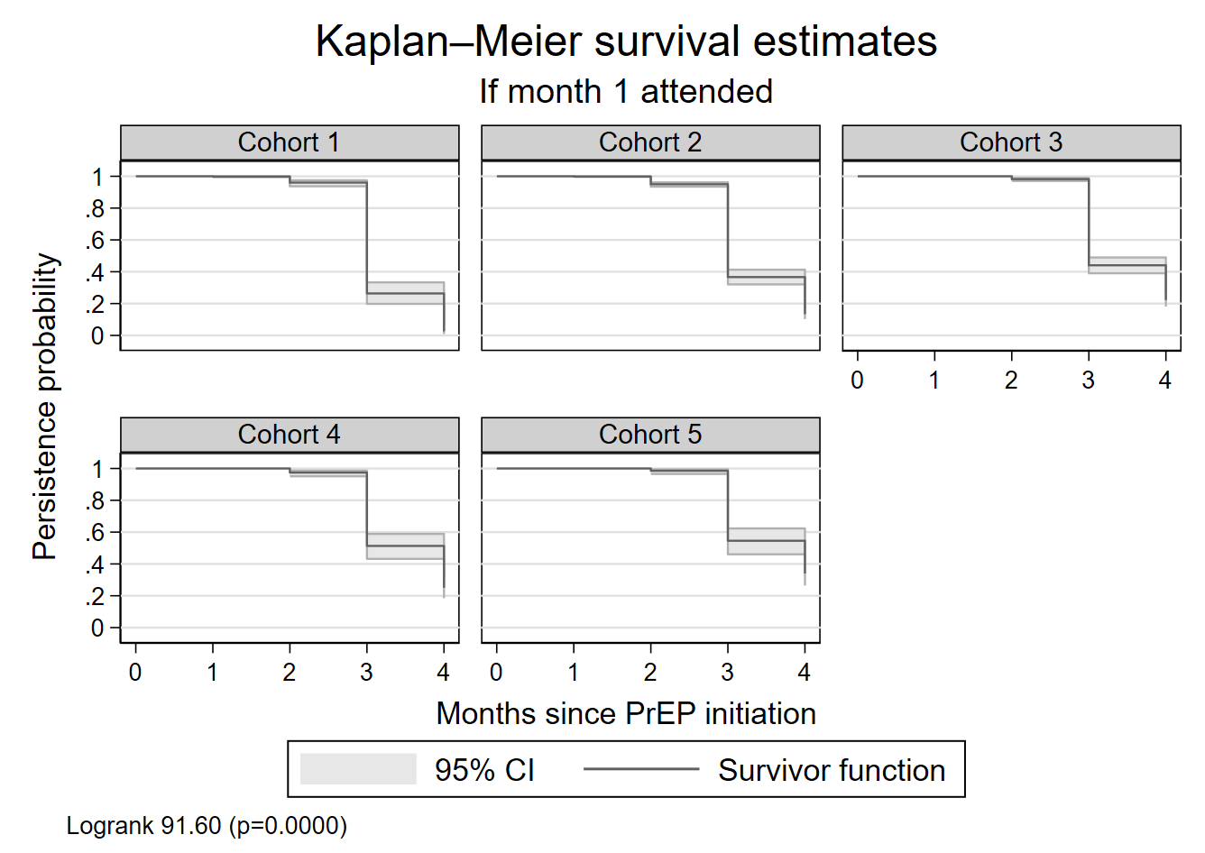
Study results (outcomes)
FastPrEP introduced multiple PrEP service delivery access points in a phased approach between August 2022 and November 2023, with the rollout spanning cohorts 1 to 4. By the time cohort 5 entered, all access points had been fully established. In this analysis we included:
3,456 people (2,769 mobile clinic and 687 government health facilities)
Median age 24 (IQR 20-28) years
2,109 (61.0%) were young women
Cohorts* |  | PrEP uptake n(%)
1. | Aug-Nov 2022 | 370 (10.7%)
2. | Dec 2022-Mar 2023 | 424 (12.3%)
3. | Apr 2023-Jul 2023 | 947 (27.4%)
4. | Aug-Nov 2023 | 907 (26.2%)
5. | Dec 2023-Mar 2024 | 808(23.4%)
*Defined based on their PrEP initiation date and grouped according to
the four-month intervals: i.e. those who initiated PrEP and attended their
month 1 PrEP refill visit
TAKE HOME: PrEP persistence increasing with better accessibility

Slide 9
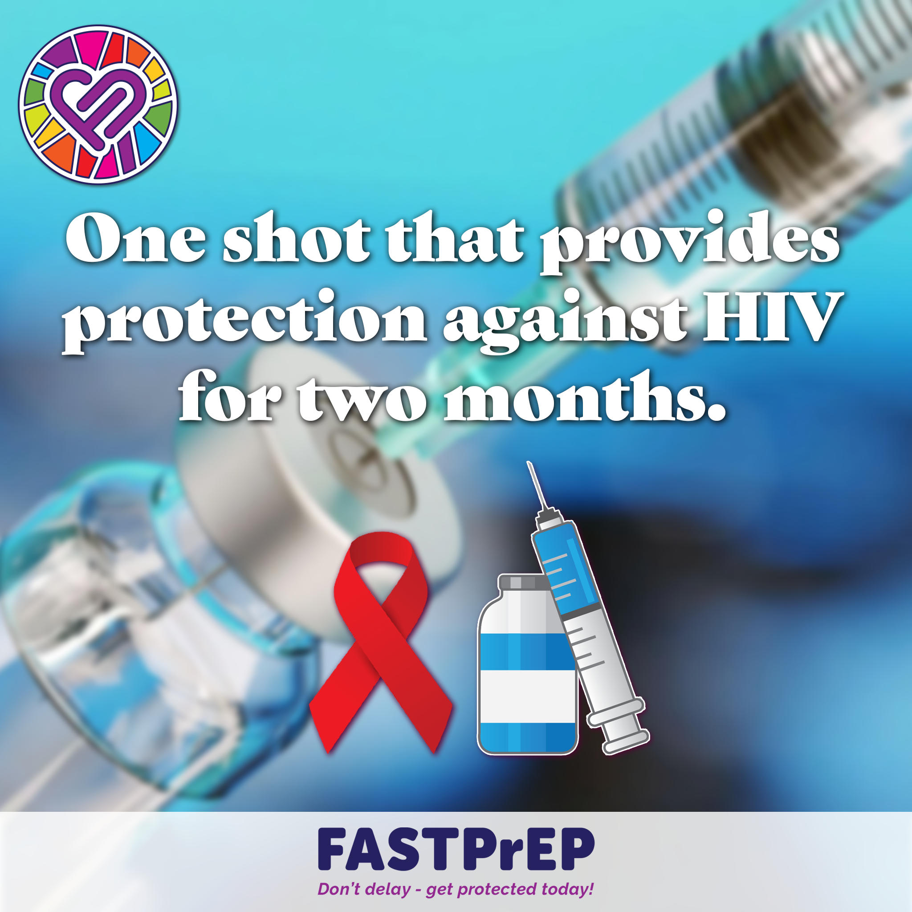
PrEPared to Choose
Table 1: PrEPared to choose, baseline characteristics and PrEP uptake
 | Oral PrEP | DVR | CAB-LA | Total
N (%) | 289 (24.8%) | 12 (1.0%) | 862 (74.1%) | 1,163 (100.0%)
Age Category
15-19 | 75 (26.0%) | 0 (0.0%) | 154 (17.9%) | 229 (19.7%)
20-24 | 91 (31.5%) | 7 (58.3%) | 301 (34.9%) | 399 (34.3%)
25-29 | 67 (23.2%) | 5 (41.7%) | 264 (30.6%) | 336 (28.9%)
>29 | 56 (19.4%) | 0 (0.0%) | 143 (16.6%) | 199 (17.1%)
Population
Male partner | 118 (40.8%) | 0 (0.0%) | 250 (29.0%) | 368 (31.6%)
AGYW | 159 (55.0%) | 12 (100.0%) | 557 (64.6%) | 728 (62.6%)
MSM | 5 (1.7%) | 0 (0.0%) | 11 (1.3%) | 16 (1.4%)
PBFW | 7 (2.4%) | 0 (0.0%) | 44 (5.1%) | 51 (4.4%)
PrEP experienced
No | 242 (83.7%) | 6 (50.0%) | 562 (65.3%) | 810 (69.8%)
Yes | 47 (16.3%) | 6 (50.0%) | 298 (34.7%) | 351 (30.2%)
PrEPared to Choose: 74.1% choose CAB-LA (of which 65.3% were PrEP naïve at initiation)
Among AGYW, 76.5% (n=557/728) opted for CAB-LA
Among male partners, 67.9% of the 368 males who started on PrEP chose CAB-LA
Of the 862 people who initiated CAB-LA, 33.5% did so at a government facility.

Slide 10
Discussion
To date, mobile clinics were the most used PrEP delivery platform (76.2% of PrEP clients) highlighting the importance of mobile services (the “where”) in expanding reach
Accessed by 54.9% of AGYW who used PrEP
Uptake differs by populations and location – need choice
Pregnant women were less likely initiate PrEP at mobile clinics compared to primary health facilities
Phased rollout, spanning five cohorts, meant cohort 5 saw the greatest benefit in terms of convenience and flexibility, which translated to higher retention and persistence rates compared to earlier cohorts.
More access points = greater persistence
Preliminary evaluation of FASTPrEP indicates that early oral PrEP persistence (beyond month 1) increased among young people accessing community and facility-based PrEP when PrEP access and distribution outlets increased

Slide 11
Next steps
Increase the # of PrEP access points: Further expand PrEP service points, including mobile clinics and community-based services, to provide reachable services for previously unreached populations
Integrate PrEP into existing health services like family planning, STI treatment, and maternal and child health clinics
Implement telehealth and home delivery models to improve convenience and reduce stigma
Incorporate 3D PrEP-User journey integration: Ensure a more holistic and personalized approach to PrEP delivery, tailoring services to the preferences, behaviors, and life circumstances of individual users to optimize adherence and health outcomes
Collaborate for broader Access: strengthen partnerships with government health facilities and non-governmental organizations to scale up PrEP services and integrate them into routine health care offerings

Slide 12
Acknowledgement
FastPrEP strategic and operational management team: Linda-Gail Bekker, Elzette Rousseau, Dvora Joseph Davey, Ntombovuyo Mathola, Mbali Jonas, Philip Smith, Thando Wonxie, Ntando Yola, Onesimo Vanto, Melissa Wallace, Pamela Fuzile, Chelsea Coakley, Pippa Macdonald, Nandipha Mema, Bryan Leonard, Carey Pike, Andile Khuzwayo
Social Scientists: Lauren Fynn, Siyaxolisa Sindelo, Prisca Vundhla
FastPrEP mobile teams: Pakama Mapuka, Ande Kholisa, Ncumisa Nothobela,Ayanda Qinga, Andiswa Gatyeni, Xolisa Mondliwa, Vuyisa Dumile, Nkosiyabo Futshane, Mfundo Hababisa, Lwazi Thami, Yoliswa Faku, Yolanda Mpande, Cheslyn Louw, Busisiwe Lento, Buntu Norman, Lusindiso Baliso, Lunga Notenga, Siphelele Jako Noma Hokolo, Thamsanqa Mrwebi, Kwanda Xaso, Thozama Langa
FastPrEP peer navigators: Noluthando Magudu, Ntombizanele Gqesha, Siphesihle Siyeka, Siphosethu Bota, Yamkela Mangwane, Zintle Ngesi, Kholelwa Mjayezi, Buyiswa Ntwanambi, Levania Titus, Masonwabe Mbhejwa, , Sip[hosetu Gqomfa, Abongile Mdingazwe, Asive Mzola, Simfumene Magidigidi, Zine Kose, Bongiwe Siqholo, Esona Maxhama, Mandisi Phika, Onele Nomji, Zimasa Msongelwa, Anazo Somgqeza, Anele Maseti, Erin Herbert, Lukhanyo Mzimane, Sive Mphambaniso, Zikhona Buhe, Vuyiseka Yiba, Thina Somdaka, Pakama Mbizweni, Phaphama Sifingo, Esethu Javu, Ayanda Xamane
FastPrEP Youth Reference Group, youth CAB, CAB, WCDoH stakeholders, facility managers

