Slide 1
IP Management of HIV Vaccines: mRNA Opportunities and Challenges
Prof Petro Terblanche, CEO Afrigen Biologics, South Africa
Understanding and managing intellectual property for HIV vaccine research and development - 7 October 2024 10:30

Slide 2
Some opening remarks…….
Patenting/IP protection is not a pre-requisite for innovation;
IP protection can restrict/prioritize access, yet IP protection provides choices for equitable access and sharing;
HIV vaccines are as strong case for a “public good product” and royalty sacrificing to ensure affordable rapid access
IP trends in bNAbs is a scientific revolution in the field of antibody modifications and discover opening the road to novel preventive and therapeutic HIV strategies (> 200 filings. USA 90% of national priority filings).
mRNA new promising approach for rapid screening of vaccine candidates as well as vaccine process scale up and development (an alternative to viral vector, sub-unit and other technologies which are widely researched).
HIV vaccine IP space is evolving and fast, partnerships across the discovery value chain essential for local innovation and a great opportunity for local production.

Slide 3

CONTENT INTENSIVE

Slide 4

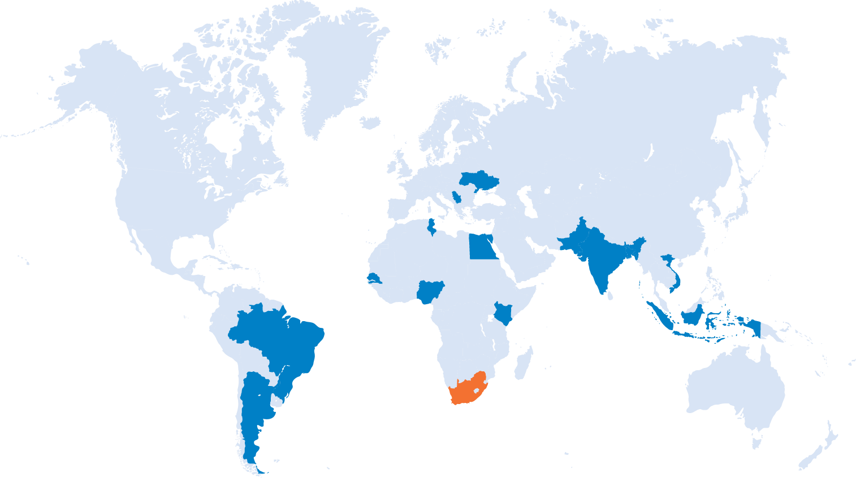




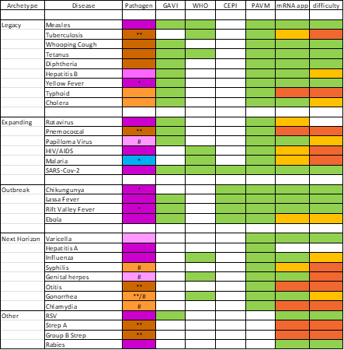






mRNA TT Programme Disease Targets
04
Expanding preventative measures for unmet medical needs and improving patient outcomes.
Afrigen
Biovac
BioVax Kenya
Bio-Manguinhos Biofarma BiologicalE BioGeneric Pharma Biovaccines Nigeria Darnitsa
Incepta Vaccine Institut Pasteur de Dakar Institut Pasteur de Tunis
Institut Torlak
National Institute of Health,
Polyvac Sinergium Biotech
Dengue Nipah Rota
Flu
Malaria
Rabies TB
HPV
RSV COVID-19
SAMRC, Afrigen and partners products in early development
HIV
HSV
Lassa Measles RVF
Varicella
Leishmaniasis YF
CCHF
Chikungunya Disease X Ebola Gonorrhea HepB
Flaviviruses
Courtesy Pierre Gsell. WHO/MPP mRNA Technology Transfer Programme Meeting. Cape Town. April 2023

Slide 5
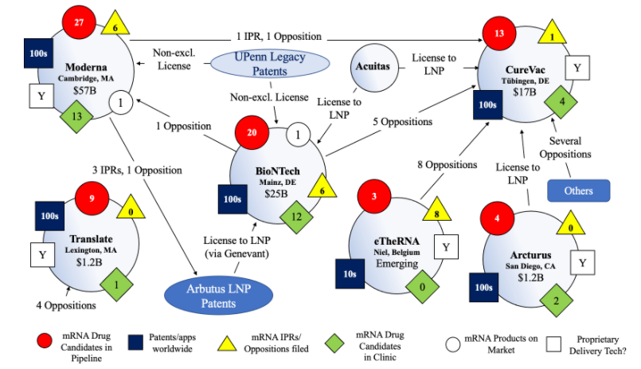
mRNA TT Programme:
IP Management Key to Innovation Process
Latest file available for download from Patent database is dated 31 May 2024: >1700 records
Expand sections to access additional information
22
https://medicinespatentpool.org/what-we-do/mrna-technology-transfer-program/resources#pills-Intellectual-Property-IP

Slide 7
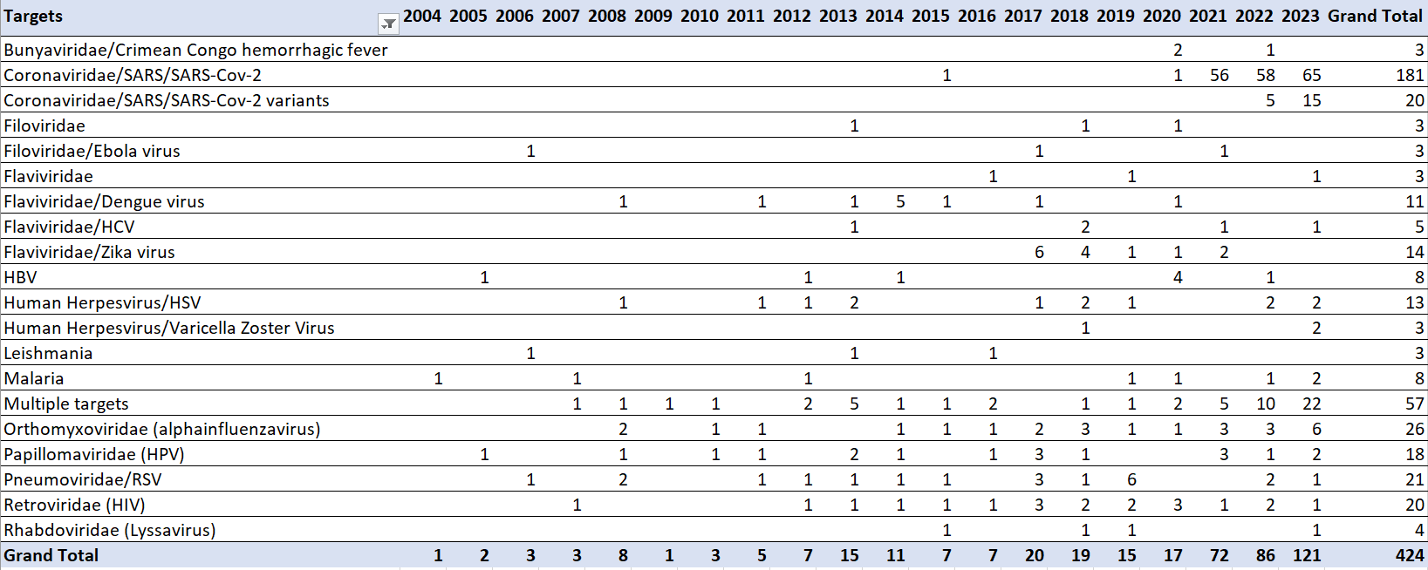
MPP mRNA TT Programme Database: mRNA HIV Patents by Target

Slide 8
CO-CREATION AND CO-OPERATION FOR FTO

Slide 9
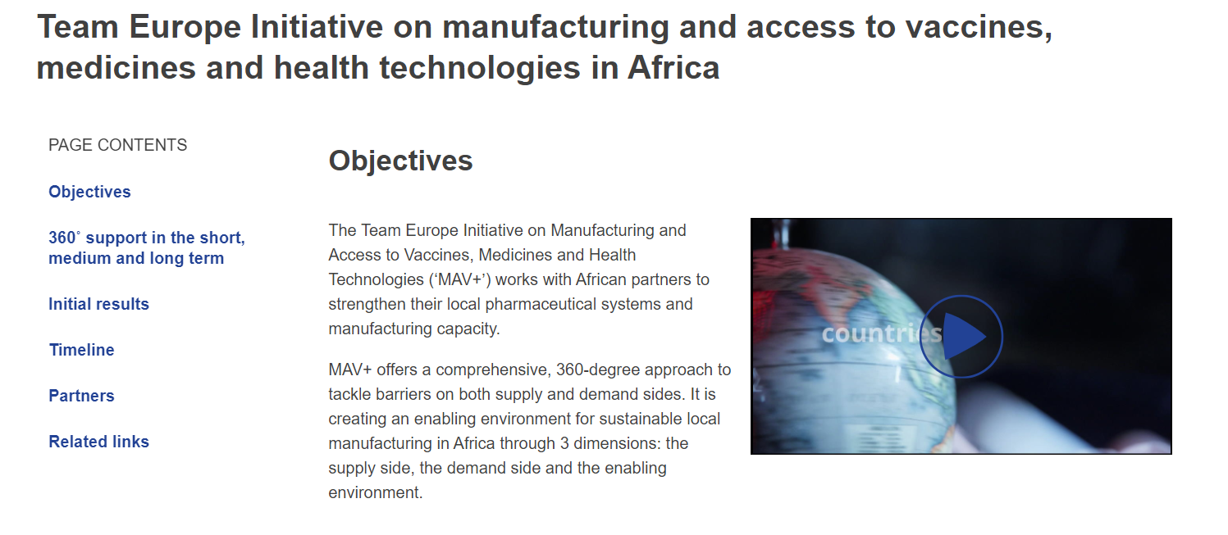
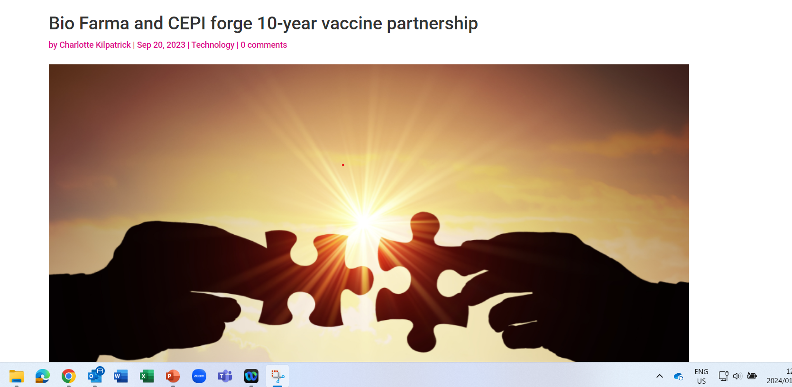
IP ACCESS: A CRITICAL ROLES OF VISIONARY FUNDERS

Slide 10

HIV vaccine local manufacturing core to the Africa Vision 2040

Slide 11
THANK YOU

