Slide 1
Beyond prevention:
Harnessing HIV vaccines for an HIV cure.
Satellite - HIVR4P 2024; Lima, Perú
October 6th, 2024
Beatriz Mothe, MD, PhD
Department of Infectious Diseases & IrsiCaixa
Hospital Germans Trias I Pujol,
Badalona (Barcelona), Spain
bmothe@irsicaixa.es
@BeaMothe
1

Slide 2
Conflicts of interest
BM is co-inventor of the HTI T-cell immunogen (PCT/EP2013/051596) on clinical development
BM has received consulting fees from AELIX Therapeutics SL & AbbVie, and for scientific communications from Gilead, Janssen & ViiV Healthcare
Mothe B. HIV R4P

Slide 3
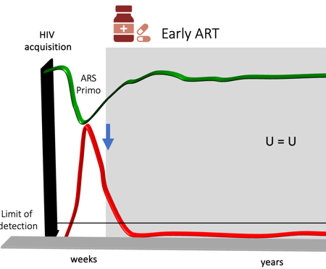
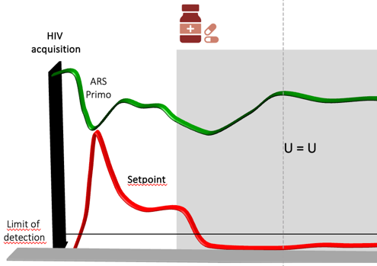
Upon HIV exposure
NO infection
Abortive
Established Infection
PrEP : oral, rings, injectables…
Passive administration of bNAbs
AAV vectored immune profilaxis
Vaccines to induce bNAbs
+/- T cells
CMV-vaccines
(SIV)
Interventions during Early HIV
Interventions during Chronic HIV
Unconventional
MHC-E restricted
T cells
↓ Reservoir
↑ Immune Response
3
Mothe B. HIV R4P

Slide 4
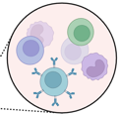
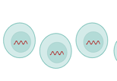
Functional Cure (ART-free remission)
Tackling the viral reservoir will need to go along with a boosted immune response able to eliminate virus harboring cells and contain virus rebound
Immune Response
APPROACHES
Early ART (limit size & diversity)
Reverse Latency (Ag expression)
Block & Lock (induce stemness)
APPROACHES
Increase breadth / Depth
Escape coverage
Specificity / Dominance patterns
Increase cytotoxicity / functionality
Reverse exhaustion
Migration (B cell follicle)
Enhance NK function / CD4 T help
Viral Reservoir
→ T cell vaccine backbone
Mothe B. HIV R4P

Slide 5
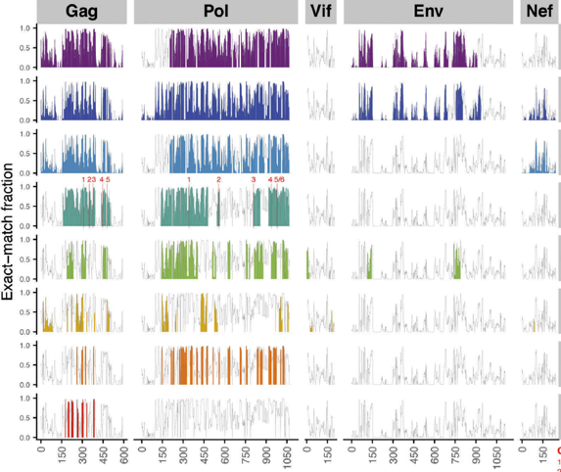
Vaccine Components
Vaccine Inserts
Vectors / Delivery
Mosaic¹
HVTN505²
DNA.
(D)
ChAdOx1 / Ad26
(C)
Step³
tHIVconsvX⁴
HIVconsv⁵
MVA
(M)
mRNA
HTI⁶
Ultraconserved⁷
Prime / Boost regimens
p24gagCE⁸
1 Barouch DH, et al. Lancet 2018; 2 Hammer S, et al. N Engl J Med . 2013; 3 Priddy FH, et al Clin Infect Dis. 2008; 4 Ondondo B, et al. Mol Ther. 2016; 5 Letourneau S, et al. PLoS One. 2007; 6 Mothe B, et al, J Transl Med. 2011; 7 Wilson CC, et al. J Immunol. 2003; 8 Kulkarni V, et al. PLoS One. 2013.
Mothe B. HIV R4P
Notes:
A focused T-cell immu
Guided by human immunogenicity data associated with improved HIV control generated in extended populations and broader HLA coveragenogen could help avoid inducing responses to potential decoy targets that may divert effective T cell responses towards less protective viral targets.
529 aa immunogen (∼16% proteome)
Includes 16 regions of Gag, Pol, Vif and Nef
Linked by triple alanine sequences (AAA)
Cover 26 beneficial overlapping peptides (OLP) identified with a protective ratio >1 ^{1,2}
3 different plattforms as delivery have been tested so far, an optimized plasmid DNA and 2 viral vectos, a modified vaccinia Ankara virus and the same chimpadenovirus that has been used for the AZ COVID19 vaccine, that was developed by collarobators at Oxford

Slide 6
Functional Cure (ART-free remission)
Tackling the viral reservoir will need to go along with a boosted immune response able to eliminate virus harboring cells and contain virus rebound
Immune Response
APPROACHES
Early ART (limit size & diversity)
Reverse Latency (Ag expression)
Block & Lock (induce stemness)
APPROACHES
Increase breadth / Depth
Escape coverage
Specificity / Dominance patterns
Increase cytotoxicity / functionality
Reverse exhaustion
Migration (B cell follicle)
Enhance NK function / CD4 T help
Viral Reservoir
What about B-cells??
→ T cell vaccine backbone
Mothe B. HIV R4P

Slide 7
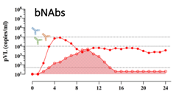
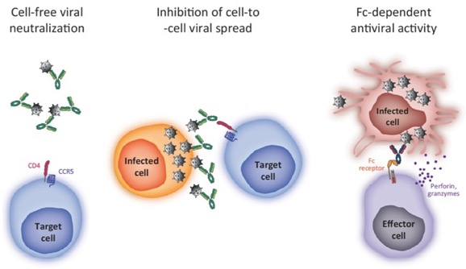
Functional Cure (ART-free remission)
Tackling the viral reservoir will need to go along with a boosted immune response able to eliminate virus harboring cells and contain virus rebound
bNAbs / aNAb
Capture released viruses and slow down viral recrudescence → ‘facilitate’ CTL to work
'Vaccinal Effect’
Passive administration of bNAbs in PWH enhance cellular immune responses and results in a delay in viral rebound after treatment interruption.
Sneller M, et al, Nat Med 2022, Gaebler C, Nat Med 2022; Gunst J, Nat Med 2023; Rosas-Umbert, Nat Med 2023
Mothe B. HIV R4P

Slide 8
Speakers
Tomáš Hanke
Vaccine Strategies for HIV-1 Cure Utilizing Protective Killer T Cells
Boris Julg
Overview on the therapeutic use of Ad26 based HIV-1 vaccines.
Sharana Mahomed
bNAbs- Passive Immunization for HiV prevention
Mitch Matoga
A community perspective on HIV vaccines :
From prevention to cure.
Q & A
Mothe B. HIV R4P

