Slide 1
Vaccine Strategies For HIV Cure Utilizing
Protective s
Killer T Cells
Tomáš Hanke, University of Oxford
Beyond Prevention:
Harnessing HIV Vaccines For An HIV Cure

Slide 2
Summary
What is your main question?
The Holy Grail of HIV vaccinology is the induction of broadly neutralizing antibodies. Our contribution to an effective vaccine is developing a strategy for inducing protective T cells.
What did you find?
Through iterative improvements of both the immunogens and vectors informed by human data, our 3rd-generation HIVconsvX vaccines targeting conserved regions of HIV have been safe and induced high frequencies of T cells, which inhibited 7 out of 8 HIV isolates representative of four major global HIV clades A, B, C and D. Studies in PLWH on cART with analytical treatment interruption (ATI) are underway.
Why is it important?
The field can do better for the induction of protective T cells (and protective antibodies) than the vaccines tested in efficacy trials so far.

Slide 3

Killer T Cells (CTL)
Are An Important Arm Of Adaptive Antiviral Immunity
Kill HIV-1 factories in the body
Produced cytokine and chemokines
Clearly impose selective pressure on HIV-1
Vaccines should harness their protective potential
Sadly, killer T cells have been neglected for a long time

Slide 4

Not All Killer T Cells Are Equally Protective
Variable epitopes are easily escaped

Slide 5

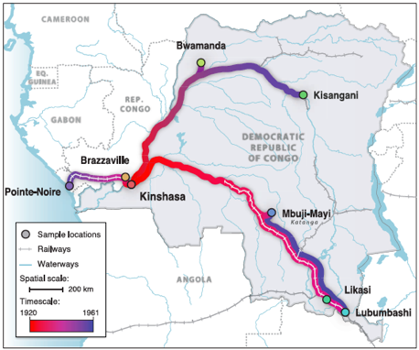
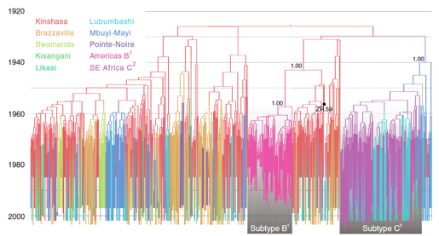
The Biggest Challenge For Vaccines Is
The Extreme HIV-1 Diversity
Multiple transmissions from chimpanzees around Kinshasa and Brazzaville in West Africa in 1920’s
Origins Of HIV
AIDS
Each vertical line is a unique HIV variant
grouped into subtypes (strains/clades)

Slide 6
Our Strategy Against HIV-1 Diversity Is Targeting HIV-1’s Functionally Conserved Regions
HIV-1 needs to keep at least some parts of its proteins the same (conserved) to survive
Common to most global HIV-1 variants
Changes (escape) in these regions are often associated with loss of replicative fitness / loss of virulence
We target HIV-1 at its Achilles’ heel
Also, the immunogen delivery & presentation matter

Slide 7
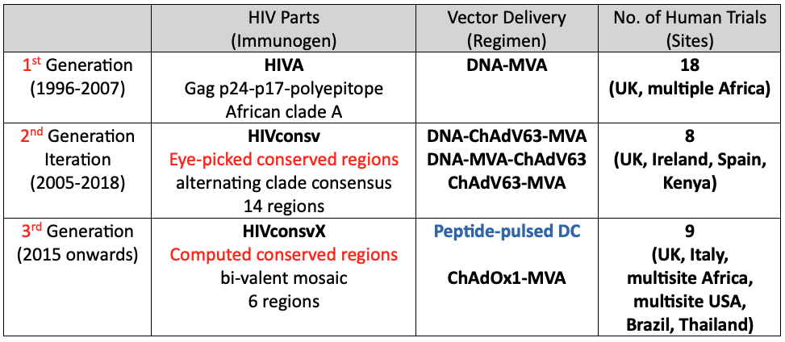
Iterative Improvements Of T-Cell Vaccines Based On Human Data
Mice lie and even monkeys don’t always tell the truth
Current
Hanke et al. J Gen Virol 2007; Hanke Expert Opin Biol Ther 2014; Hanke Expert Rev Vaccines 2019

Slide 8
What Can Protective T Cells Do Without Antibodies?

Slide 9
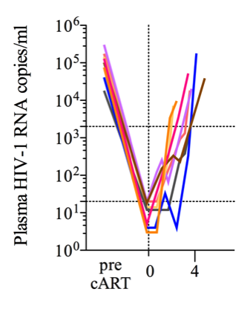
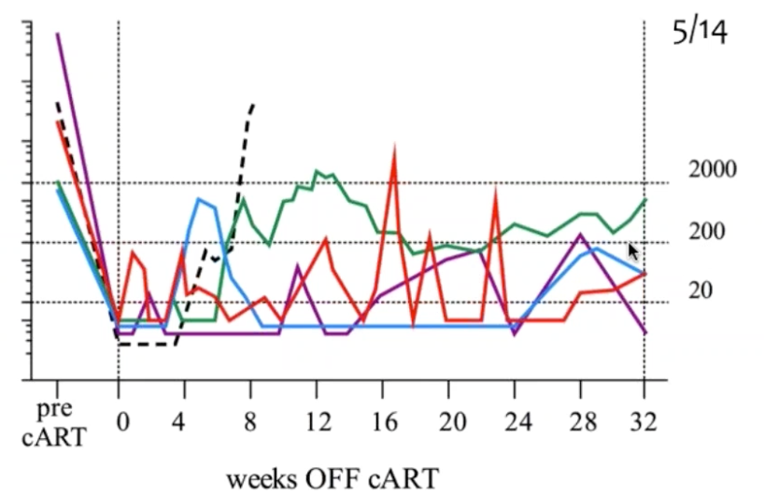
T-Cell Vaccines Without Antibodies
Signal in BCN 01/BCN 02
PLWH
The HIVconsv / ChAdV63-MVA + MVA-MVA vaccination together with LRA Romidepsin provided a signal of durable HIV-1 remission following cART cessation in 23% of individuals, contrasting the 10—13% spontaneous post-treatment control (PTC)
Open-label, small numbers, no placebo
cART
stop
9/13
cART
stop
3/13 (23%)
Censored out
weeks
Mothe et al. Front Immunol 2020

Slide 10
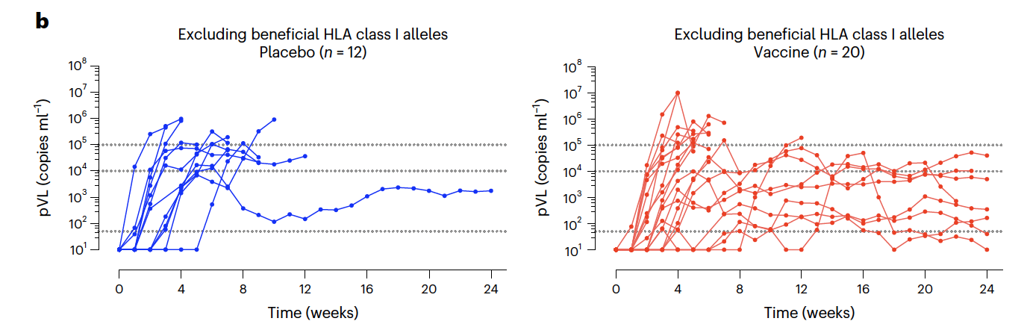
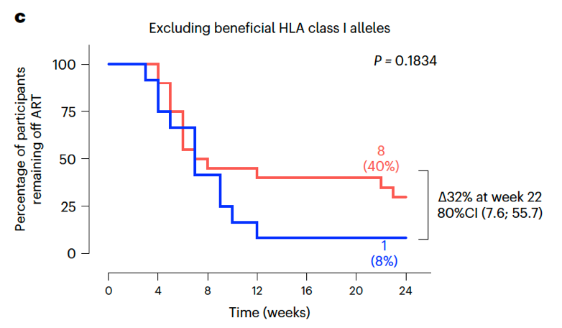
T-Cell Vaccines Without Antibodies
Post-Hoc AELIX 002
PLWH
The HIVACAT T-Cell Immunogen (HTI) developed by IrsiCaixa targets vulnerable, mostly conserved epitopes associated with low virus load in PLWH. The HTI/DNA-ChAdOx1-MVA vaccination resulted in a drug-free PTC in 40% of vaccine vs 8% placebo recipients without beneficial HLA class I
Post-hoc analysis
Placebo
Vaccine Regimen
Bailon et al. Nat Med 2022

Slide 11
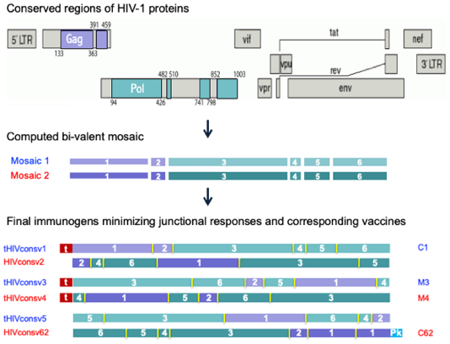
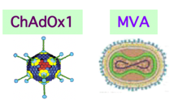
The 3rd-Generation HIVconsvX
Conserved Bi-Valent Mosaic Immunogens
Current
8% aa difference
always used together
C1C62 M3M4
PRIME BOOST
Ondondo et al. Mol Ther 2016; Wee et al. Mol Ther Methods Clin Dev 2021; Hannoun et al. Vaccines 2022

Slide 12


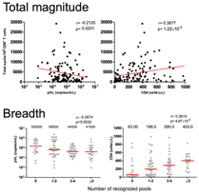
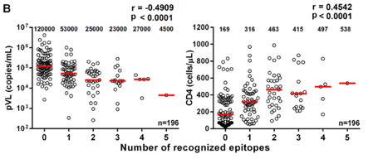
HIVconsvX-Specific T Cells
Are Protective
In Treatment-Naïve PLWH
PLWH
HIVconsvX peptide pools
Protective epitopes
Support of our working hypothesis
HIVconsvX T-cell magnitude
HIVconsvX T-cell breadth (Pools or Epitopes)
~
pVL
CD4 count
Statistically
highly significant
Ondondo et al. Mol Ther 2016; Murakoshi et al. Retrovirology 2018; Zou et al. J Virol 2019

Slide 13

The HIVconsvX Vaccine
Regimen C1C62-M3M4
Simian Adenovirus PRIME
Poxvirus BOOST
ChAdOx1.tHIVconsv1 (C1)
MVA.tHIVconsv3 (M3)
+
mosaic 1
+
mosaic 1
ChAdOx1.HIVconsv62 (C62)
MVA.tHIVconsv4 (M4)
mosaic 2
mosaic 2
Same ChAdOx1 as in
the Oxford-AstraZeneca COVID-19 vaccine
Same as smallpox/monkeypox vaccine

Slide 14




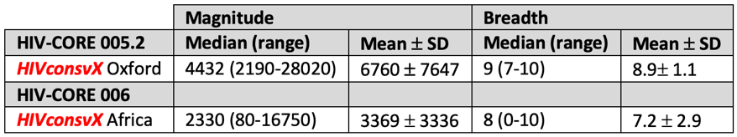
Immunogenicity Of The HIVconsvX Vaccines In PLWoH
Induction of Strong and Broad T-cell responses in all or almost all (~100%) volunteers
Borthwick et al. The Lancet Microbe In press; Chanda et al. The Lancet Microbe Under review
STEP Study 77% responders ex vivo peaked at 136-686 IFN-g SFU/10⁶ PBMC

Slide 15
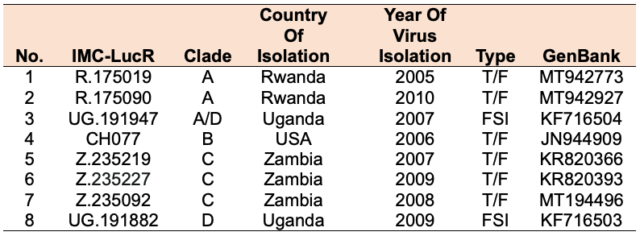
Broad Cross-Clade HIV-1 Inhibition In VIA
Infectious Molecular Clones of HIV-1 expressing LucR
T/F – transmitted/founder virus, FSI – Fiebig stage I; LA- Lab adapted
Vaccine-induced T cells inhibited in the laboratory at peak
on average 6.4 ± 0·4 out of 8 IMCs derived from
4 major global HIV-1 clades A, B, C and D

Slide 16
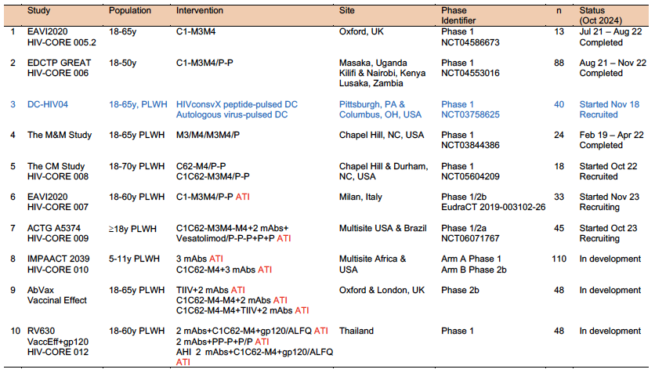






The HIVconsvX Vaccines In Clinical Trials
PLWoH
PLWH
Vaccines were safe, immunogenic and induced cross-clade inhibiting CD8 T cells

Slide 17
Will The Vaccine-Elicited T Cells [Help] Slow/Stop HIV-1 In Vivo?
Analytical Treatment Interruption ATI

Slide 18
HIVconsvX Vaccine Efficacy Alone And In Combination With Other Tools
PLWoH
PLWH
Do vaccine-elicited immune responses benefit the vaccine recipients?

Slide 19
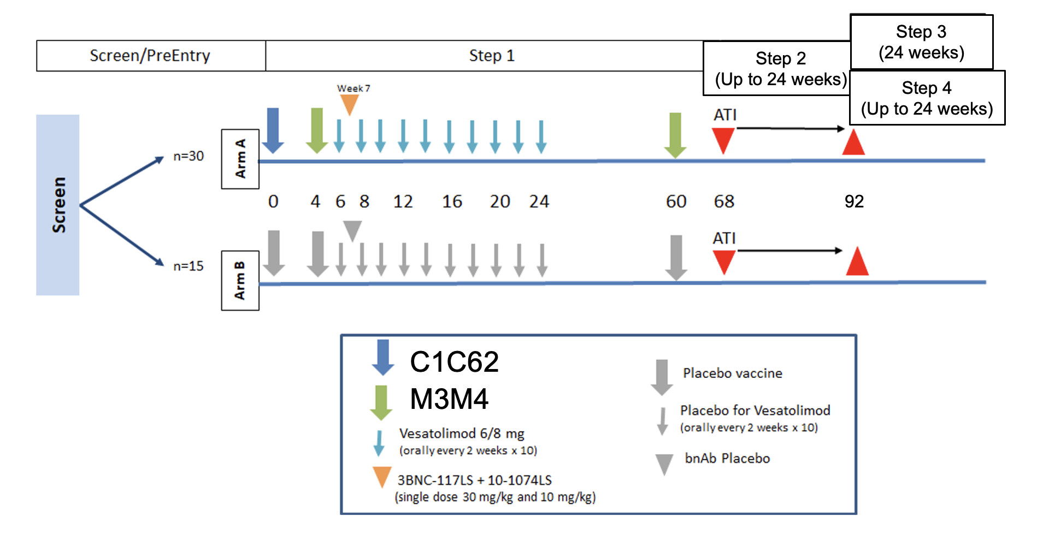
ACTG 5374
A Phase I/IIa Randomized, Placebo-Controlled Trial of Conserved-Mosaic T-cell Vaccine in a Regimen with Vesatolimod and Broadly Neutralizing Antibodies in Adults Initiated on Suppressive Antiretroviral Therapy during Acute HIV-1
PLWH

Slide 20
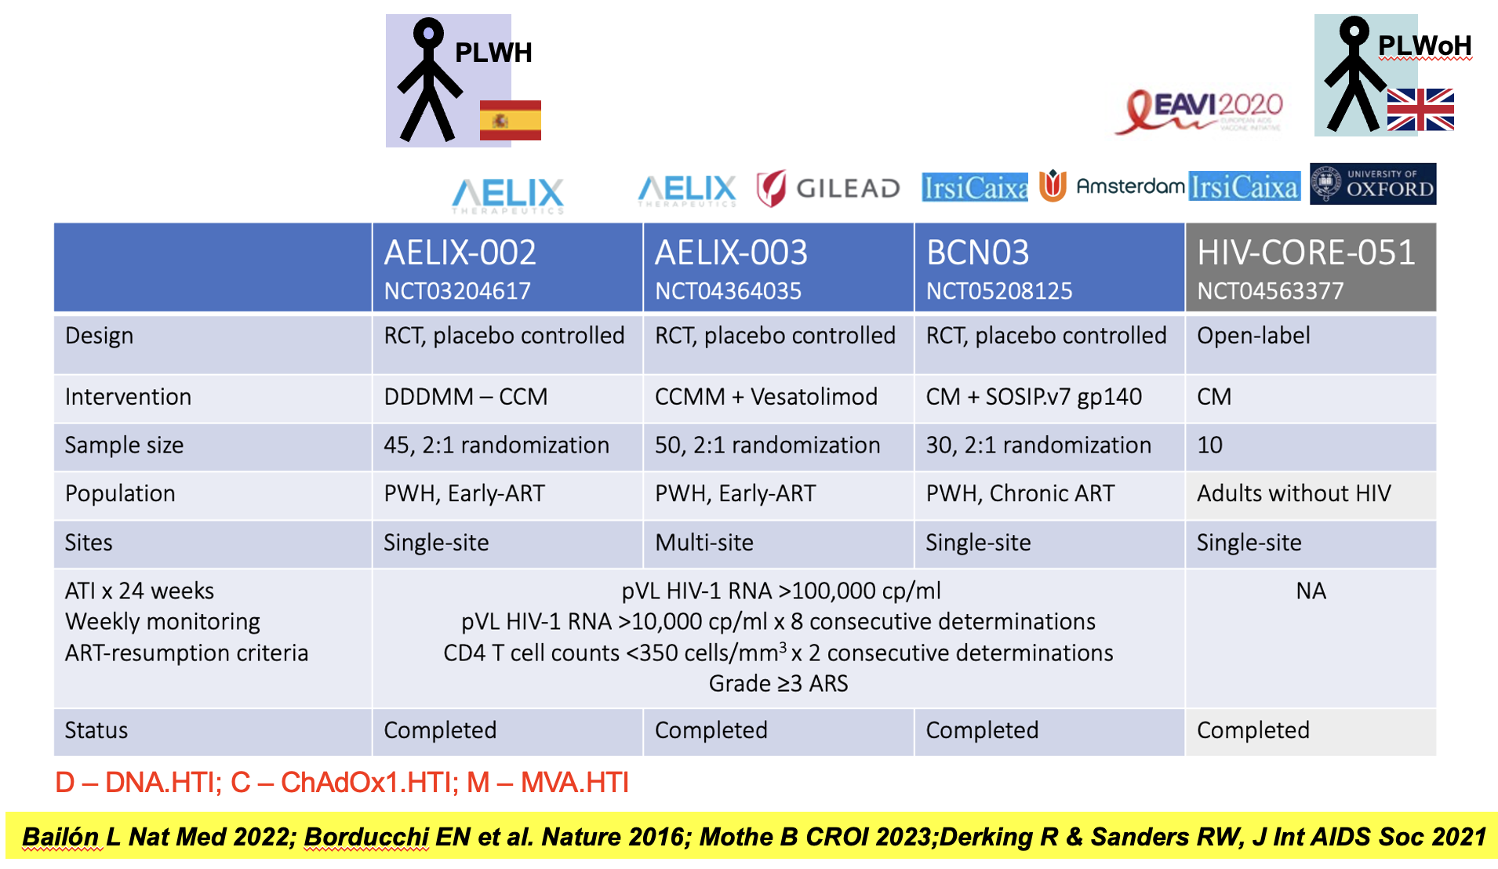
The HTI Vaccines In Clinical Trials Mothe & Brander
Courtesy of Beatriz Mothe

Slide 21
Conclusions
The field can do better for inducing protective T cells (and protective antibodies) than the vaccines tested in efficacy trials so far

Slide 22
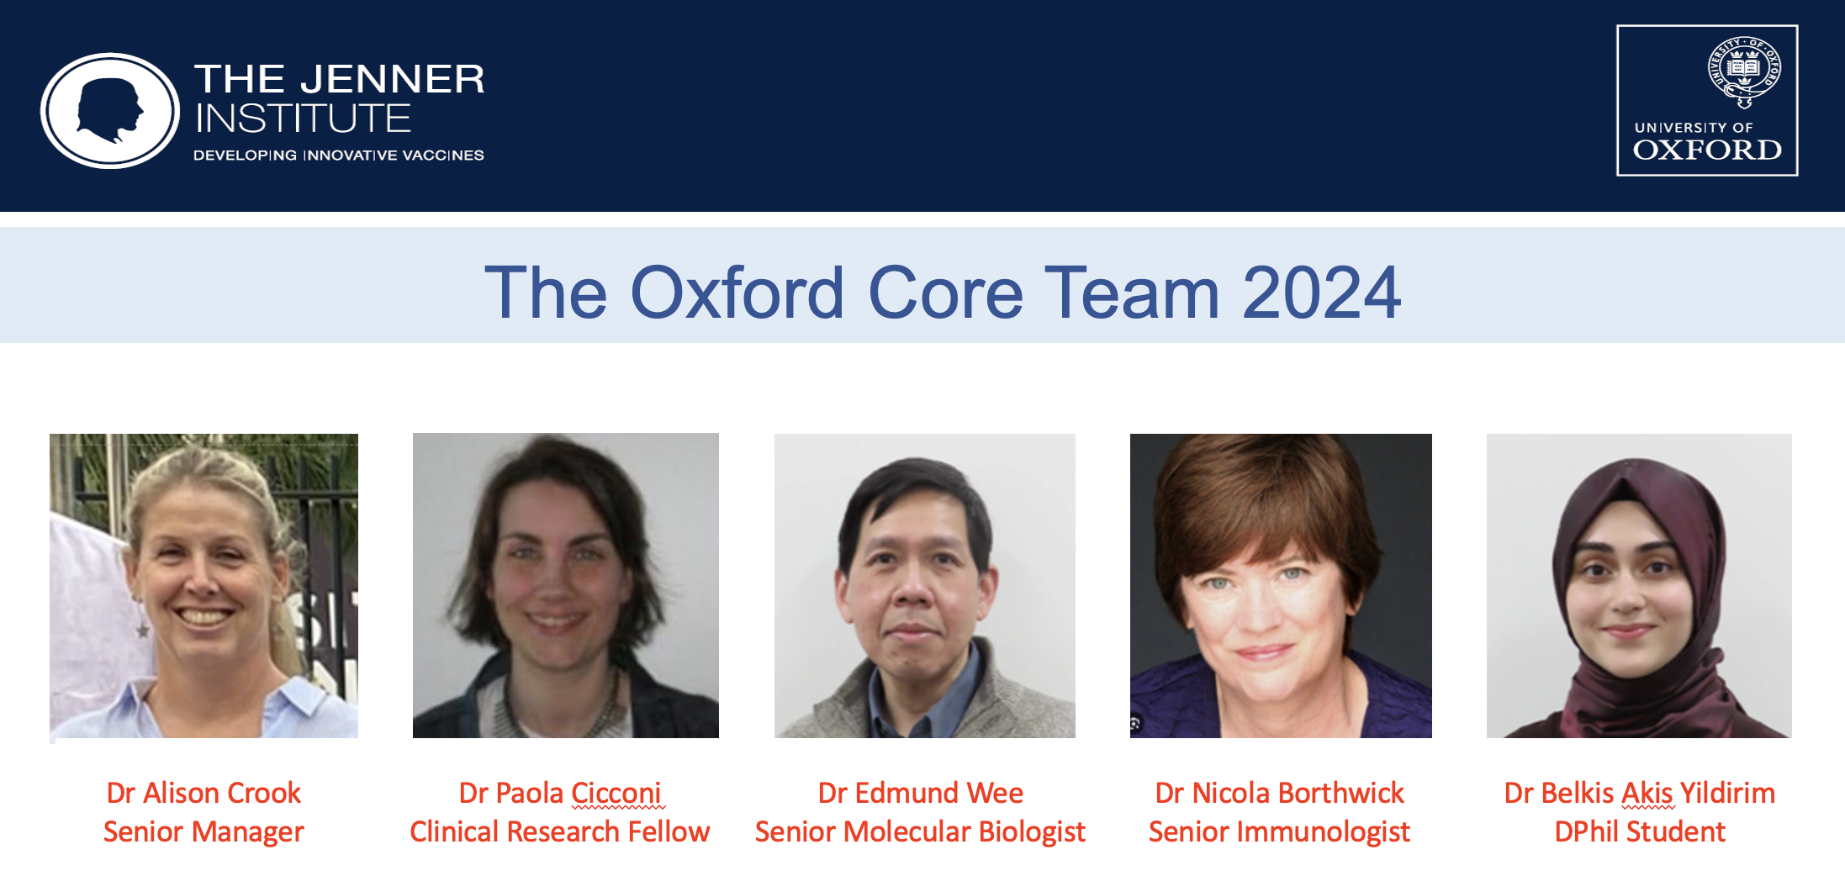
Acknowledgements

Slide 23
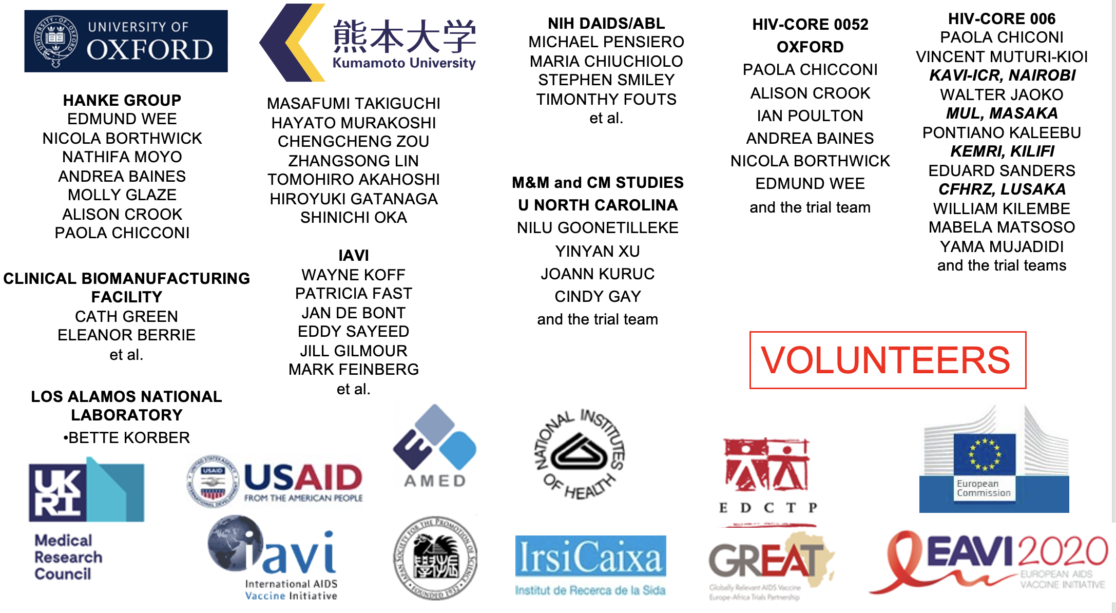
Acknowledgements

Slide 24
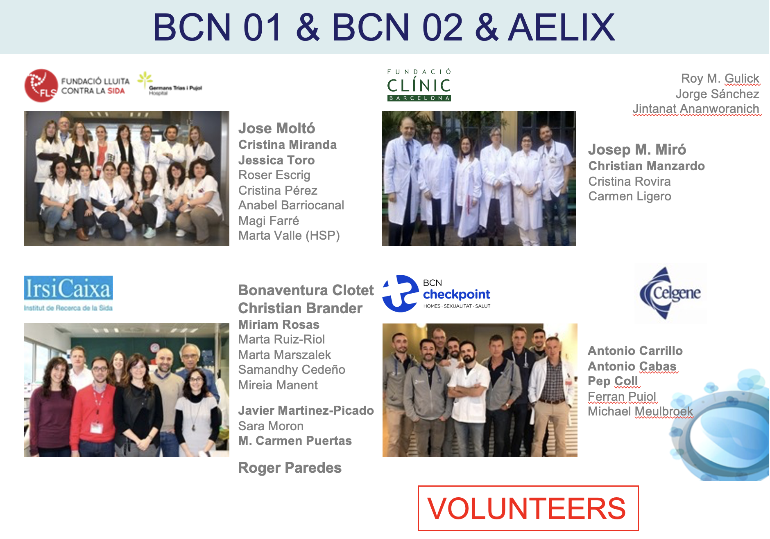
Acknowledgements

Slide 25

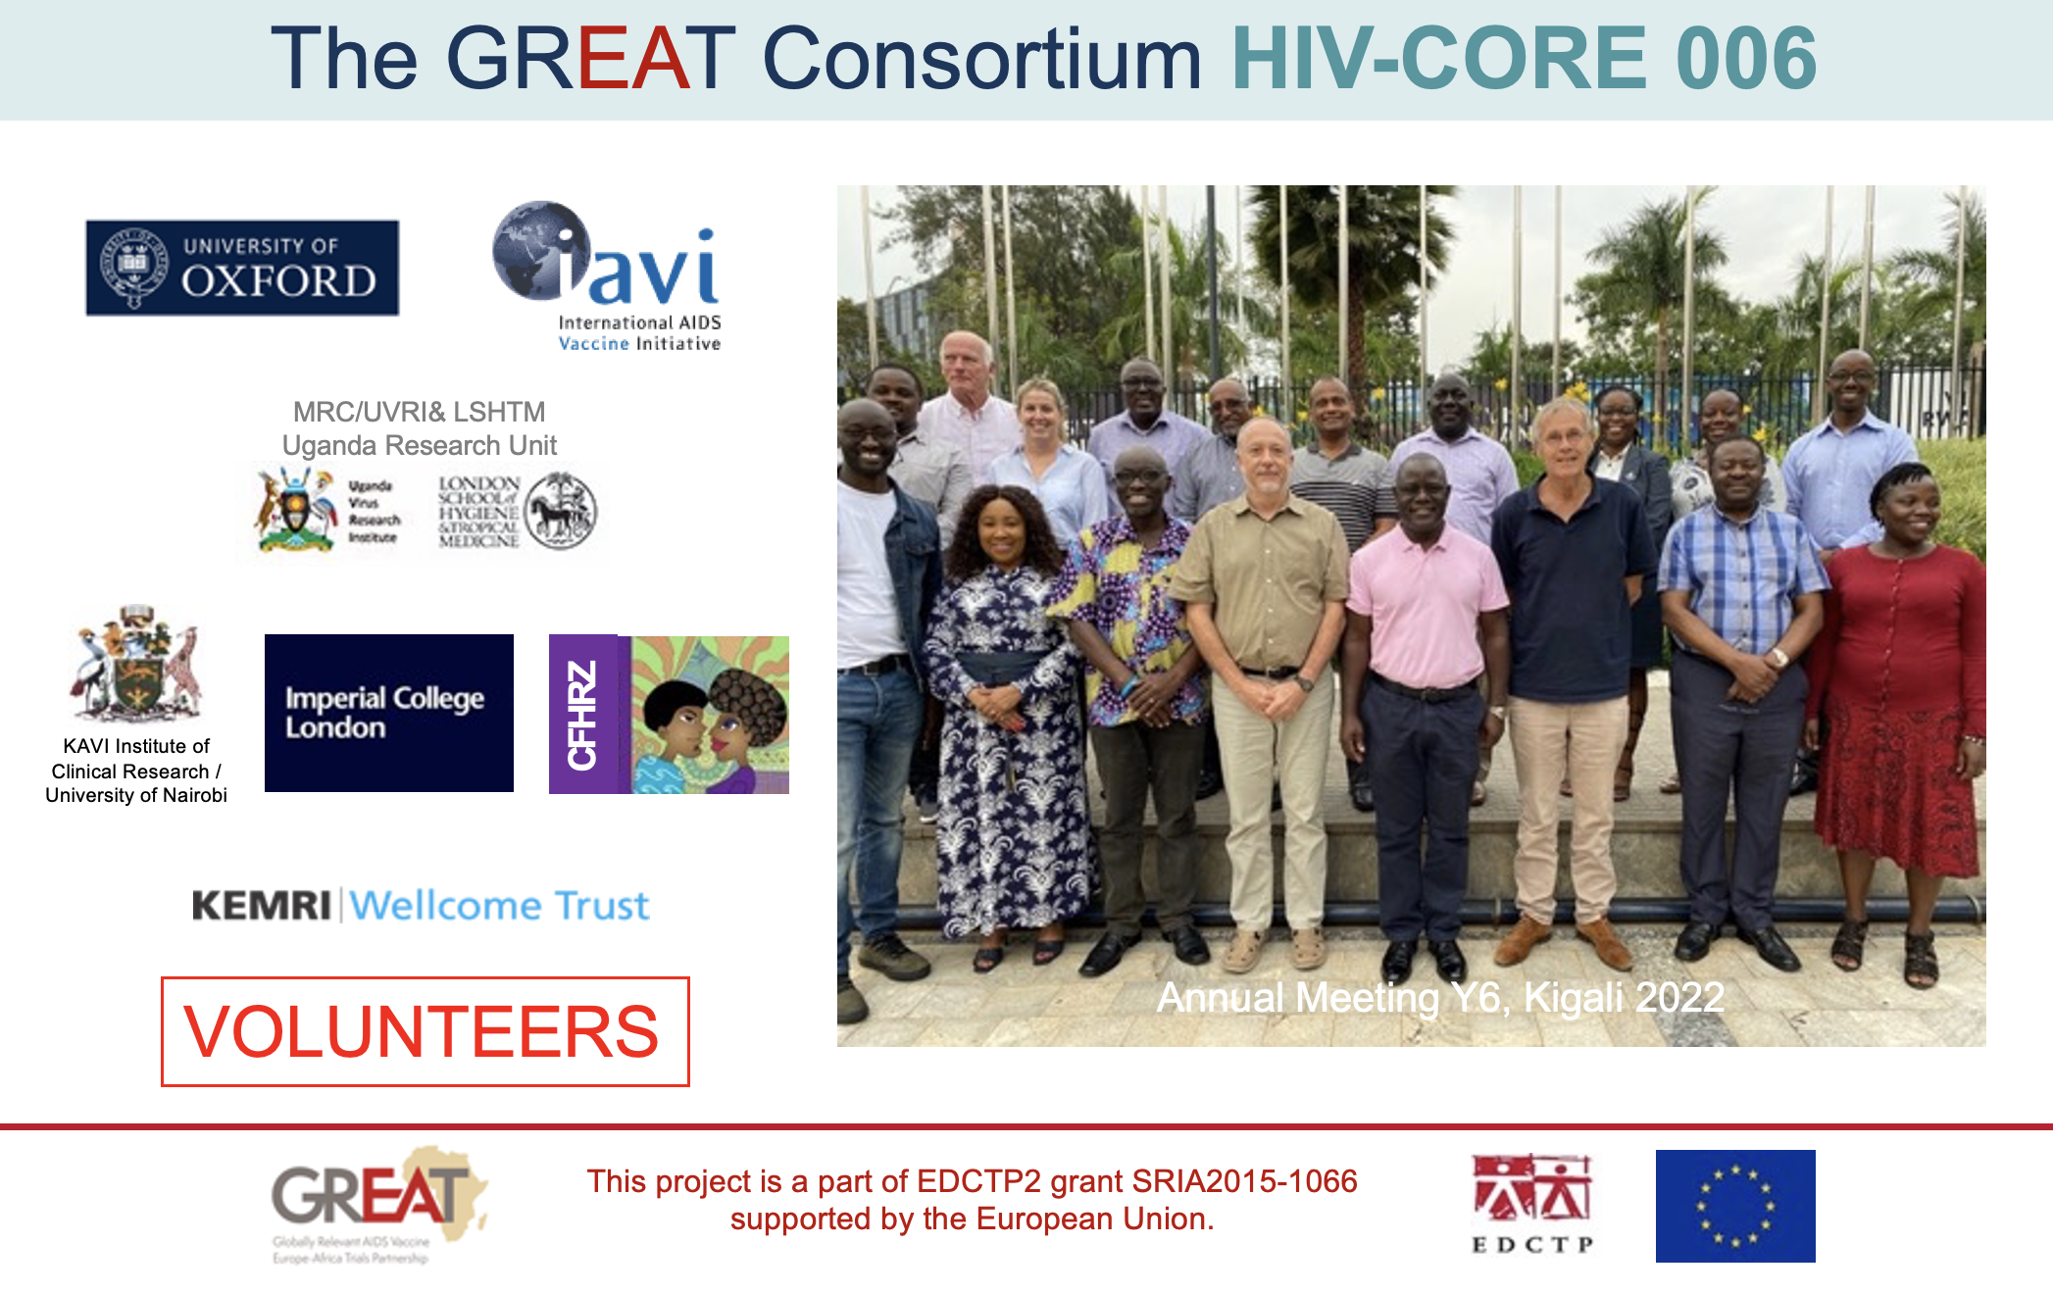
Acknowledgements

Slide 26
Acknowledgements
THANK YOU

