Slide 1
A Community Perspective on HIV Vaccines: From Prevention to Cure
Mitch Matoga, MD, MSc, University of North Carolina Project Malawi
Beyond prevention: harnessing HIV vaccines for an HIV cure

Slide 2
No conflict of interest

Slide 3
Outline
Why HIV vaccine(s)
Overview of HIV vaccine research
Community perspectives
  Meaningful community engagement
  People’s research agenda

Slide 4
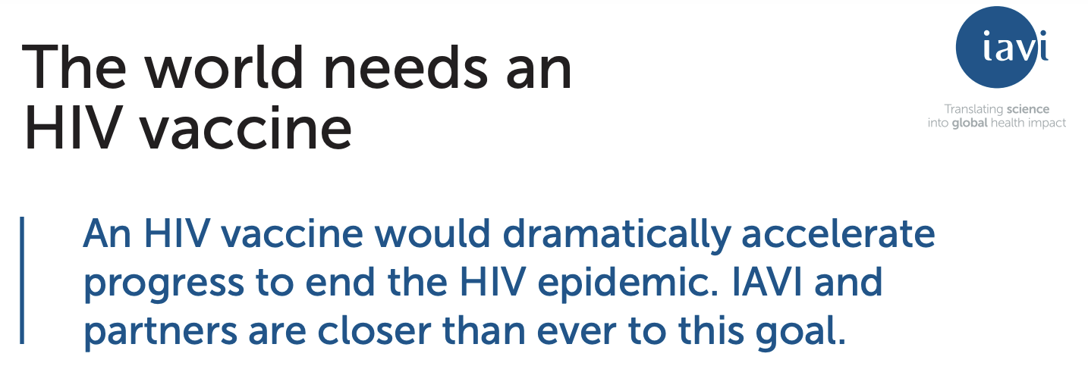
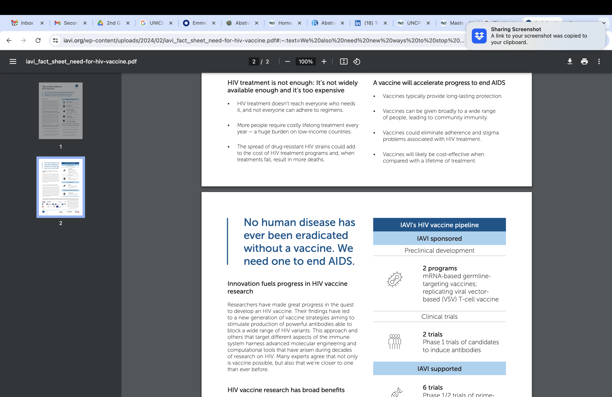
Why an HIV Vaccine?

Slide 5
Why an HIV Vaccine?

Slide 6
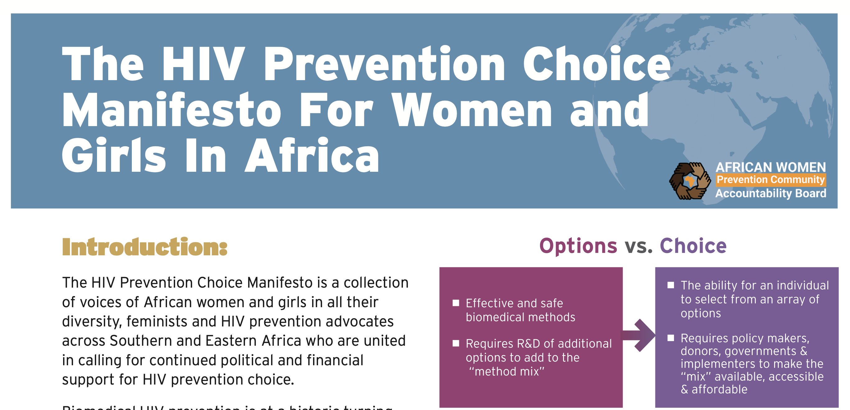
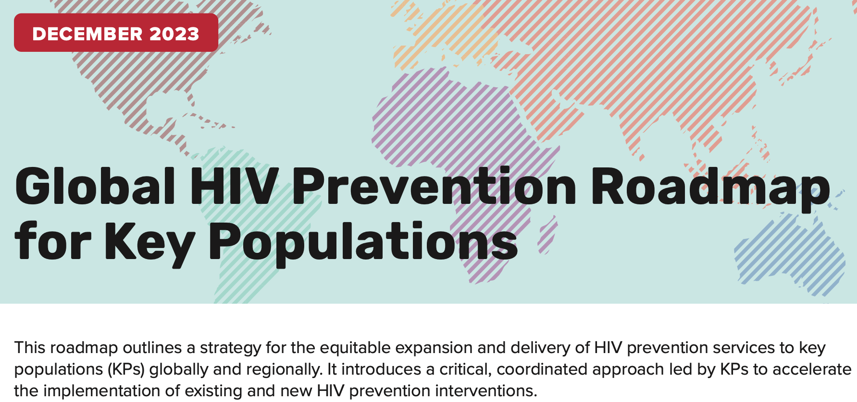
Why is an HIV Vaccine Needed: Choice
Global Key Population HIV Prevention Advisory Group
African Women Prevention Community Accountability Board
HIV Prevention Choice Manifesto
Global HIV Prevention Roadmap for Key Populations

Slide 7
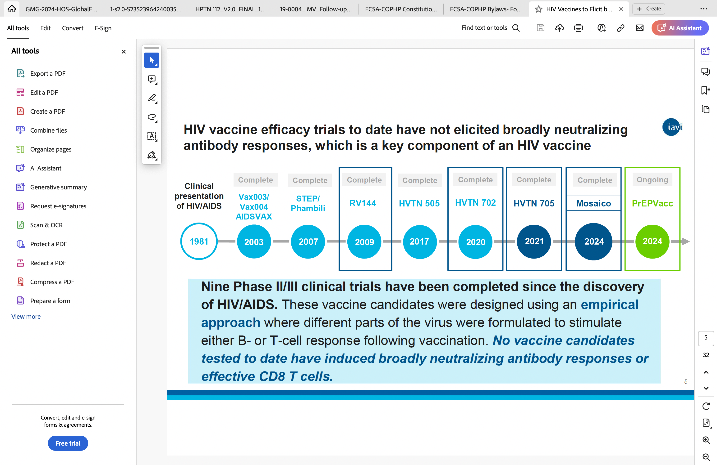
Overview of HIV Vaccine Research: Efficacy Trials

Slide 8
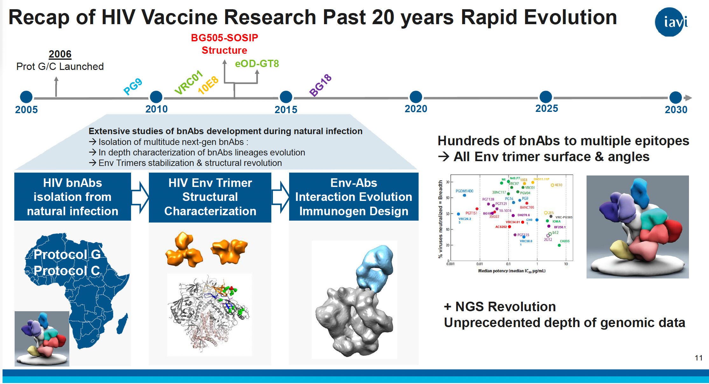
Overview ofHIV Vaccine Research: bnAbs

Slide 9
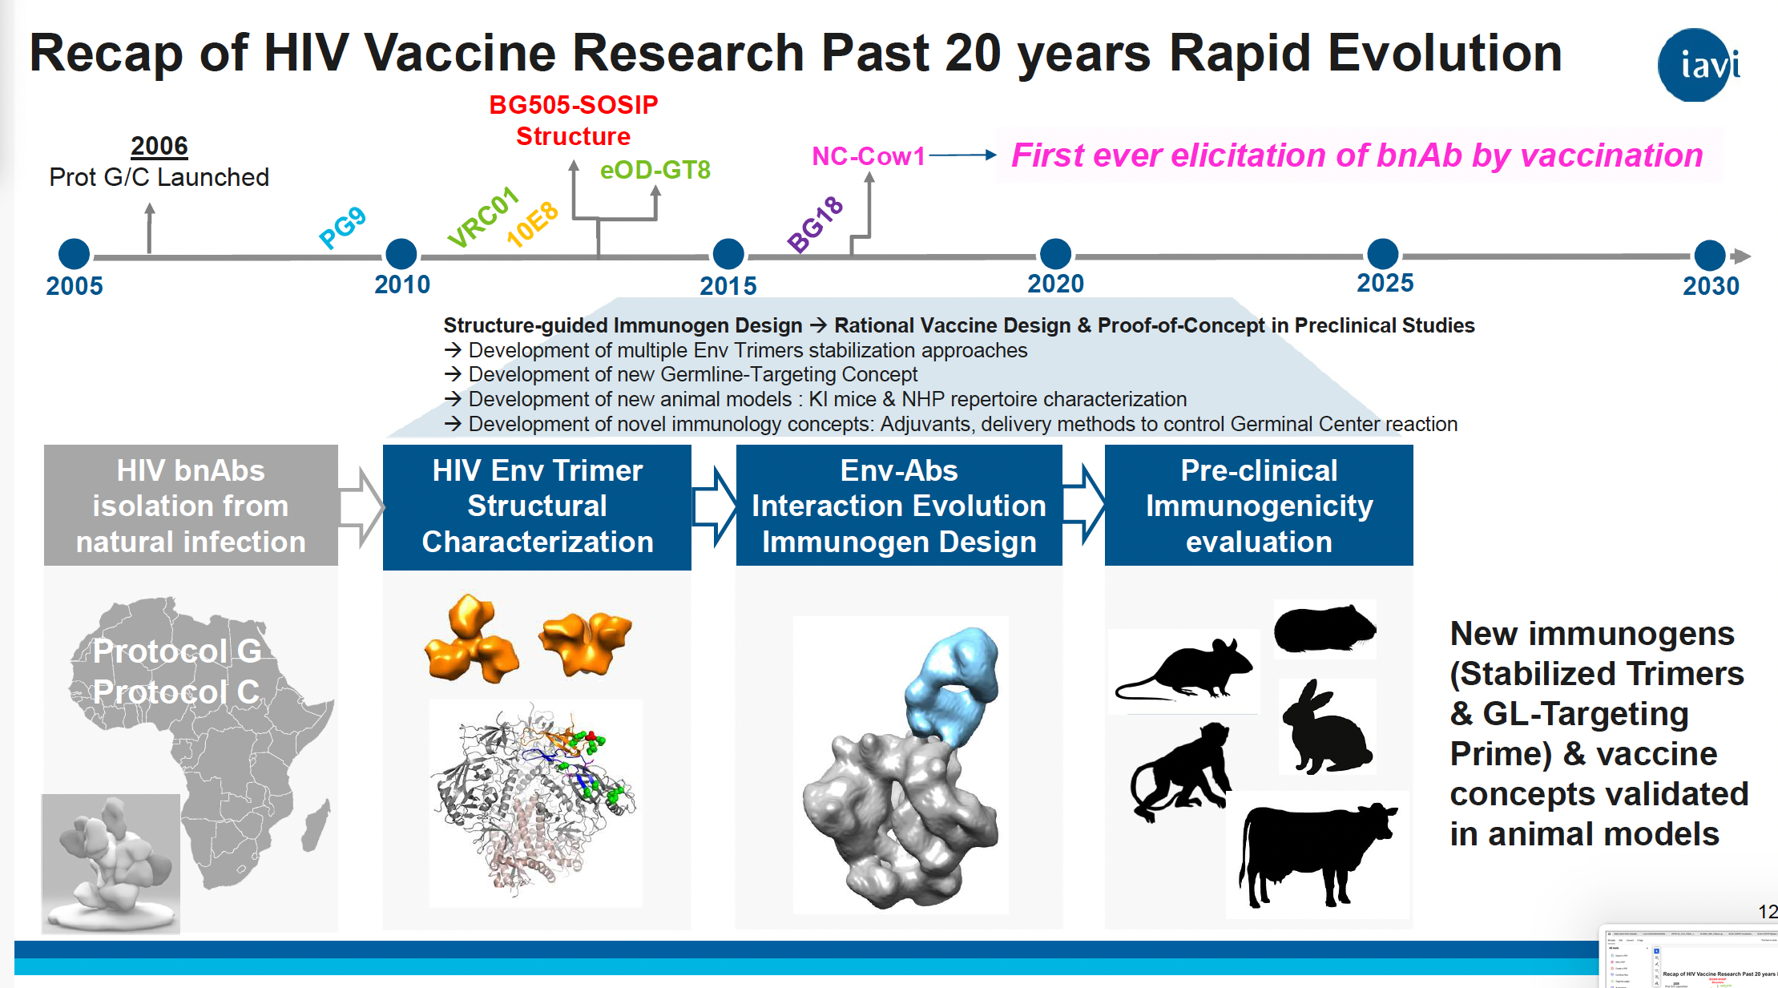
Overview of HIV Vaccine Research: bnAbs

Slide 10
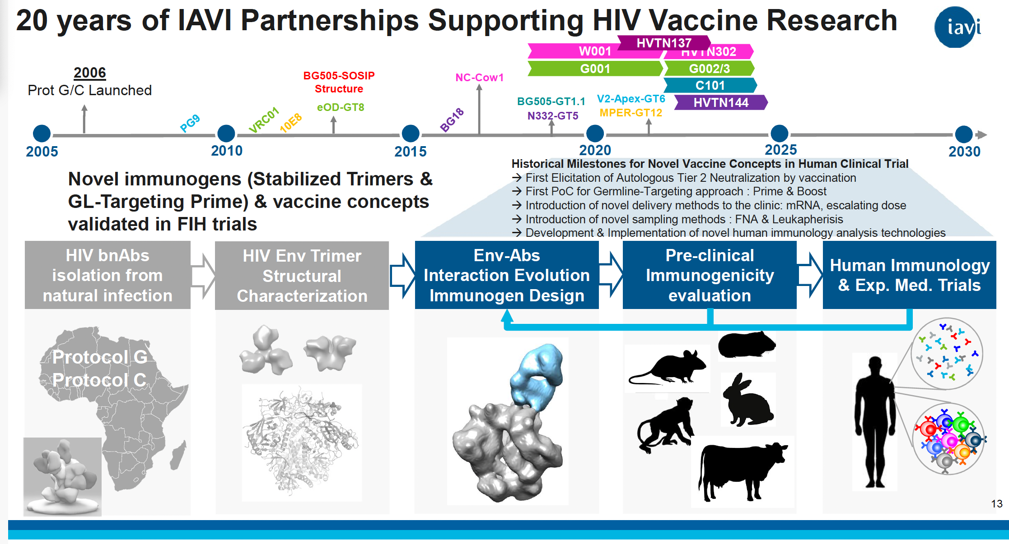
Overview of HIV Vaccine Research: bnAbs

Slide 11
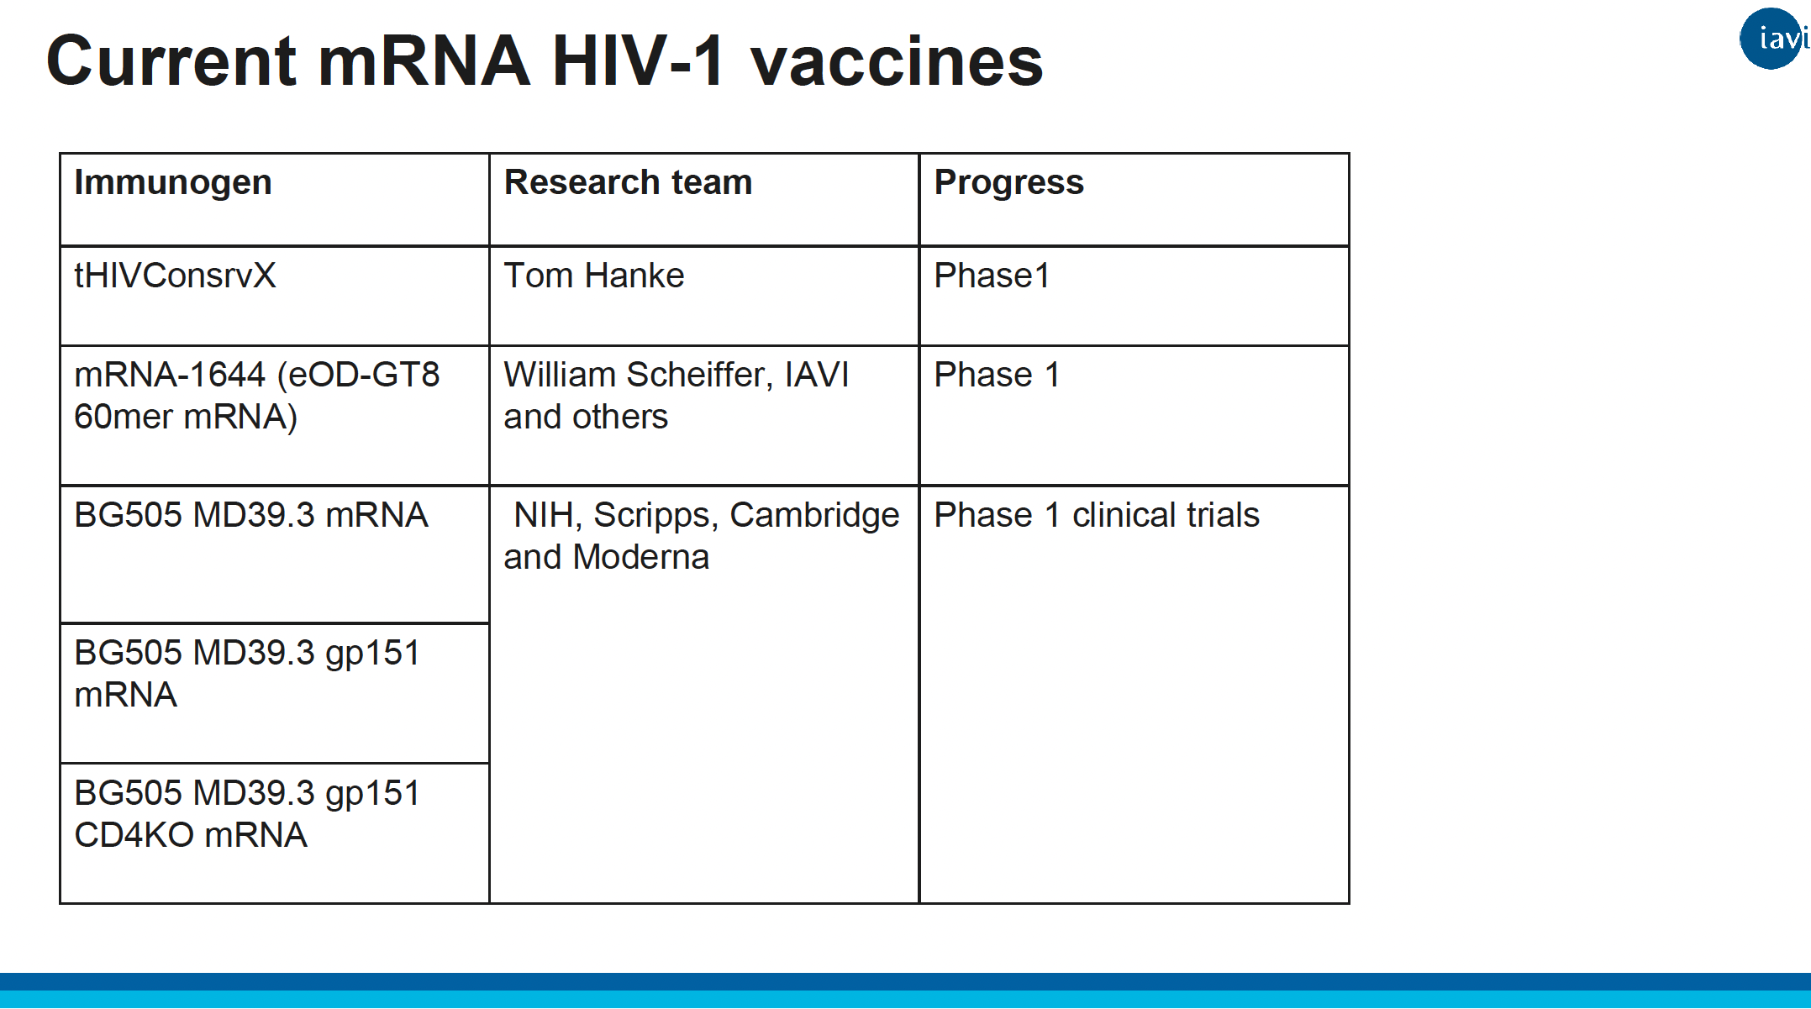
Overview of HIV Vaccine Research: mRNA

Slide 12
Community Perspectives: Community Engagement
What is meaningful community engagement?
“Meaningful community engagement includes a spectrum of activities, from education to relationship-building to routine partner or planning group meetings and collaboration. Increasing levels of engagement can build trust.”- CDC
“The myriad of ways in which the activity and benefits of higher education and research can be shared with the public. Engagement is by definition a two-way process, involving interaction and listening, with the goal of generating mutual benefit”- National Co-ordinating Centre for Public Engagement
“The meaningful involvement of patients, caregivers, clinicians, and other healthcare stakeholders throughout the entire research process—from planning the study, to conducting the study, and disseminating study results”- patient-centered outcomes research institute

Slide 13
Community Perspectives: Community Engagement
Why it is needed now than ever before:
COVID-19 exposed alarming rates of vaccine hesitancy, linked to a global “infodemic” – this may become a major obstacle for HIV vaccines
  Mis-information, Mis-trust
Vaccine research is in early phase- communities need more engagement to understand where the field is at
Strong, consistent community engagement is key to building confidence in HIV vaccine research

Slide 14
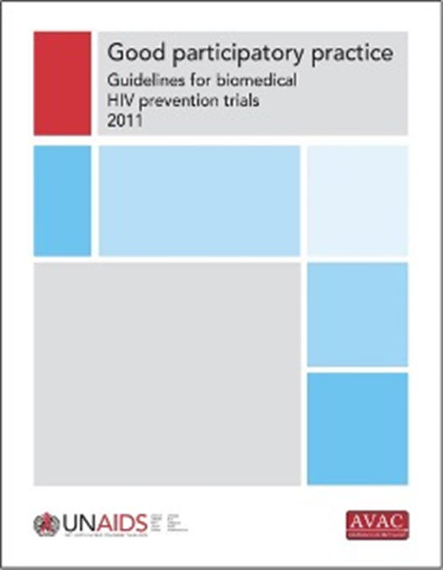
Community Perspectives: Community Engagement
Why it is needed now than ever before:
Questions around how to engage communities in discovery medicine vaccine trials need to be collaboratively answered
The Good Participatory Practice (GPP) guidelines, developed for HIV and recently updated for COVID, provide a critical roadmap for ethical, inclusive research practice.

Slide 15
Community Perspectives: Community Engagement
Platforms of Engagement in HIV Vaccine Research
Global Community Advocacy Groups
Site level community advisory boards
Network-led community working groups
Civil Society engagement & Advocacy on clinical trials
IAS Vaccine Academy for advocates
Clinical Trial Design Academy

Slide 16
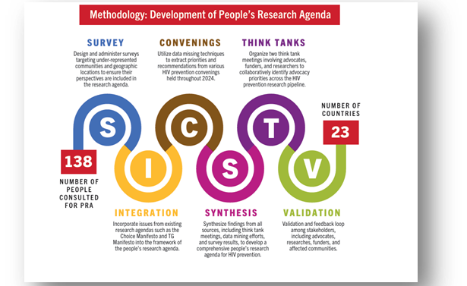

Community perspectives: People’s Research Agenda
An initiative of the Coalition to Accelerate and Support Prevention Research (CASPR)
Multiple approaches to gather community insights about the HIV prevention research pipeline, including vaccines and bnAb product categories.
The People’s Research Agenda reflects the voices of over 130 advocates from 23 countries.
It outlines community-defined priorities and recommendations for HIV prevention research, implementation and investments for the future, including for the vaccine field
Perspectives from the Clinical Trial Design Academy workshop were included in the PRA; this group of advocates aims to reflect on and influence thinking around trial designs of the future.
Above: Members of the Clinical Trial Design Academy

Slide 17
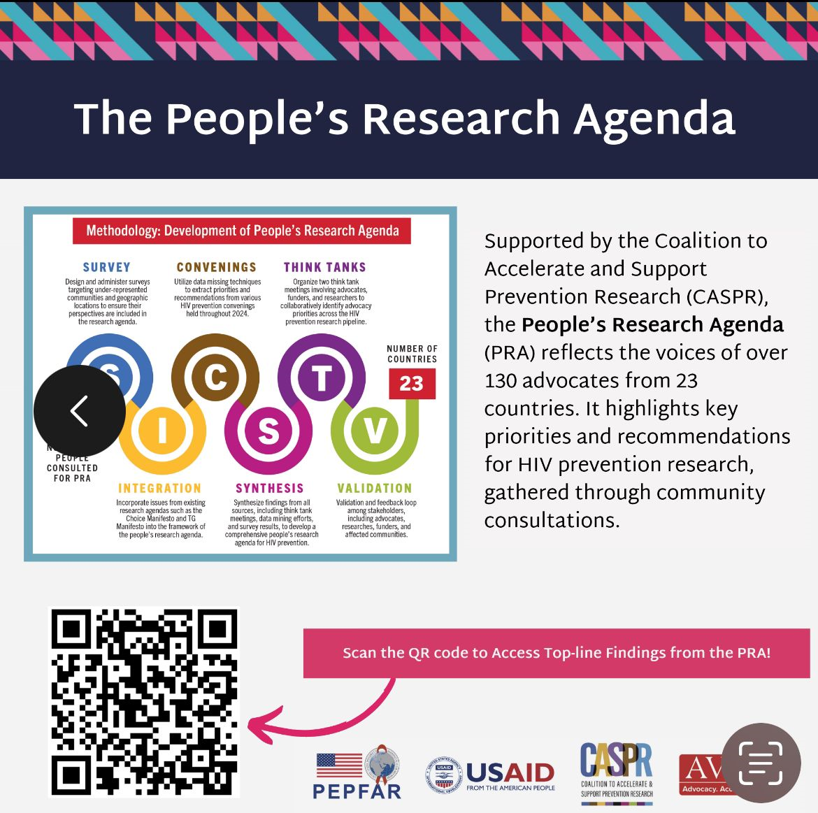
Community Perspectives: People’s Research Agenda
Find out more – launch Sunday, October 6th, 6-8 pm

Slide 18
Key Messages
Strive to collectively achieve meaningful community engagement in vaccine research including HIV vaccine using the available resources and platforms
Utilize the People’s Research Agenda – join the launch

Slide 19
Acknowledgements
University of North Carolina Project Malawi
Dr. Vincent Muturi-Kioi (IAVI)
Grace Kumwenda (AVAC)

Slide 20
Thank you!

