Slide 1
HIV pre-exposure prophylaxis engagement and adherence in Peru: How do people engage with PrEP, who uses it in Peru?
Kelika A. Konda, USC; CIISSS, UPCH; CITBM, San Marcos
Enhancing service providers' engagement in PrEP delivery, uptake, and retention in Latin America & the Caribbean
Notes:
Hello and thank you very much for the opportunity to present on HIV PrEP engagement and adherence in Peru.

Slide 2
Summary
What is your main question?
How do people engage with PrEP and who uses PrEP in Peru?
What did you find?
While PrEP became available within the public health system in Peru in June 2023, most of what we know about PrEP users comes from the ImPrEP demonstration study
Why is it important?
PrEP roll out will be key to Peru, where HIV incidence remains high. While we have learned from projects such as ImPrEP more is needed to refine local PrEP programs.

Slide 3
Background
PrEP became available within the Peruvian public health system in June 2023
Peru participated in multiple PrEP studies including iPrEx, HPTN 083, and ImPrEP
PrEP availability was delayed due to COVID-19
  TDF/FTC for prevention had been included in Peru’s list of medications to purchase at the PAHO price in 2019
  And PrEP provided for pregnant partners of PLHIV since 2019

Slide 4

ImPrEP cohort: Peru Participant characteristics
Peru n=2299 | %
Race
White | 10.0%
Non-white (almost all Metizo) | 90.0%
Reason to attend the site
Looking for PrEP | 50.0%
Any other reason (primarily HIV testing) | 50.0%

Slide 5
ImPrEP participants qualitative interviews
Sexual freedom and confidence
HIV vulnerability and control
“Well, it gives you more freedom to explore your sexuality, avoiding risks and helps you to feel calmer. It also helped me to feel more pleasure with my sex partners and to share the confidence and the certainty that we will be safe”.
(Regional Teaching Hospital of Trujillo – MSM – 28 years old)
“I decided to use it because I'm a sex worker, and sometimes the condom can break with the client, and in general, many trans girls need to take PrEP, because we are exposed to rape, sexual abuse and other situations. Now for me, using PrEP means that I have more control of my health, and I feel really great about it”.
(Tahuantinsuyo Bajo – TW – 31 years old)

Slide 6
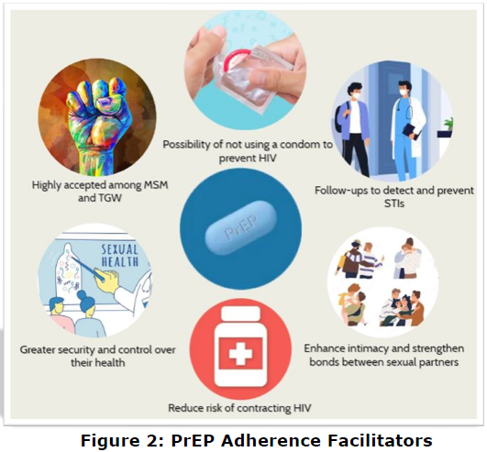
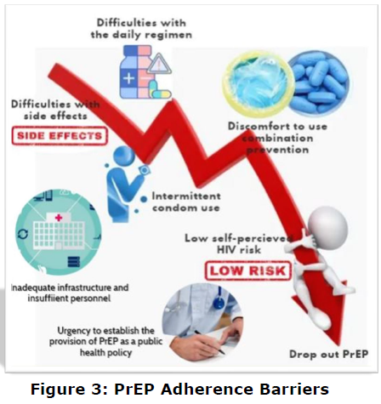
ImPrEP participants: PrEP barriers & facilitators
Facilitators
Barriers
Sexual freedom and confidence
Jiron et al. Understanding barriers and challenges to PrEP adherence: experiences of PrEP discontinuation among MSM and Transwomen in Peru - The ImPrEP Demonstration Study. IAS. 2021. PED652.

Slide 7
Who was not adherent to PrEP?
Self-reported PrEP adherence at week 4 (no missing pill in the previous 30 days)
- Peru: 31.9% fully adherent
Medical possession ratio (MPR) ≥0·6,
Days between their visits = sufficient pills for 4+ pills/week
- Peru: 48.4%
Veloso VG, et al. Lancet HIV 2022. https://doi.org/10.1016/S2352-3018(22)00331-9.

Slide 8
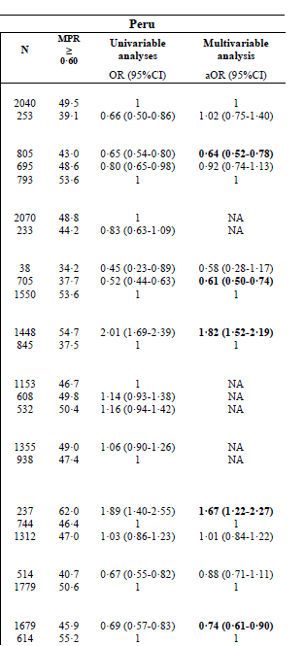
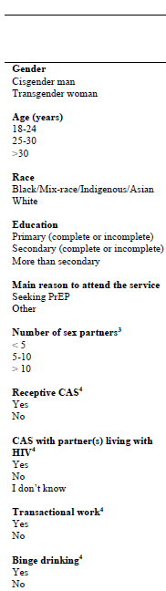
Who was not adherent to PrEP?
Overall, being from Peru was a primary characteristic for non-adherence
In Peru – younger age, less than secondary schooling, & binge drinking were asso. w/decreased adherence
CAS with a partner LHIV was associated with increased adherence
Veloso VG, et al. Lancet HIV 2022. https://doi.org/10.1016/S2352-3018(22)00331-9.

Slide 9
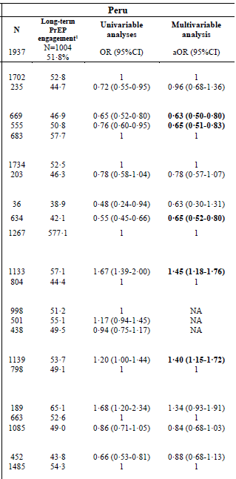
Who did not stick with PrEP?
Overall, being from Peru was a primary characteristic for non-adherence
In Peru – younger age and less than secondary schooling were asso. w/less long term engagement
CAS was associated with increased long term engagement
Veloso VG, et al. Lancet HIV 2022. https://doi.org/10.1016/S2352-3018(22)00331-9.

Slide 10
Who was not adherent to PrEP?
Hazard ratios from weighted multivariable Cox proportional hazards regression models for the effect of factors of interest on HIV seroconversion among MSM and TGW in ImPrEP
 | Peru
 | aHR (95%CI) | p-value
Age groupª
18-24 | 6.04 (2.30-15.80) | <0.001
25-34 | 3.87 (1.36-11.00) | 0.01
≥35 | 1.00 | -
Gender^{b}
Cisgender man | 1.00 | -
Transgender woman | 2.45 (1.10-5.45) | 0.03
Education^{c}
Secondary or less | 1.47 (0.87-2.49) | 0.15
> secondary | 1.00 | -
Transactional sex^{d}
Yes | 1.80 (1.02-3.18) | 0.04
No | 1.00 | -
Binge drinking^{e}
Yes | 1.60 (0.86-2.97) | 0.13
No | 1.00 | -
Number of sex partners^{f}
< 5 | 1.00 | -
5-10 | 1.63 (0.83-3.19) | 0.15
> 10 | 0.96 (0.44-2.09) | 0.91
 | Peru
 | aHR (95%CI) | p-value
Receptive condomless anal sex^{g}
Yes | 2.29 (1.17-4.49) | 0.02
No | 1.00 | -
Condomless anal sex with people living with HIV^{g}
Yes | 1.04 (0.40-2.67) | 0.94
No | 1.00 | -
I don’t know | 1.22 (0.65-2.30) | 0.53
STI symptoms^{h}
Yes | 0.99 (0.43-2.30) | 0.98
No | 1.00 | -
Main reason to attend the service^{i}
Seeking PrEP | 1.18 (0.60-2.32) | 0.62
Other | 1.00 | -
STI diagnosis^{j}
Yes | 2.80 (1.59-4.94) | <0.001
No | 1.00 | -
MPR at week 4^{k}
< 0.60 | 2.38 (1.29-4.39) | <0.01
≥ 0.60 | 1.00 | -
Variables were added based on our DAG, with each subsequent model adjusted for the variables included in the prior model using inverse-probability weighting
Caceres, C.F. et. Al. IAS. 2023

Slide 11
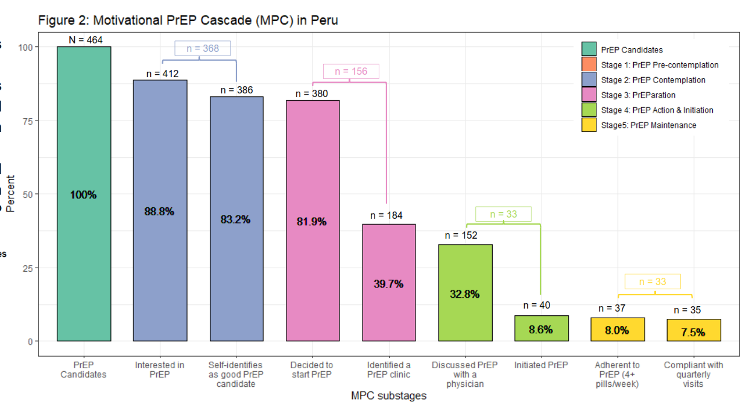
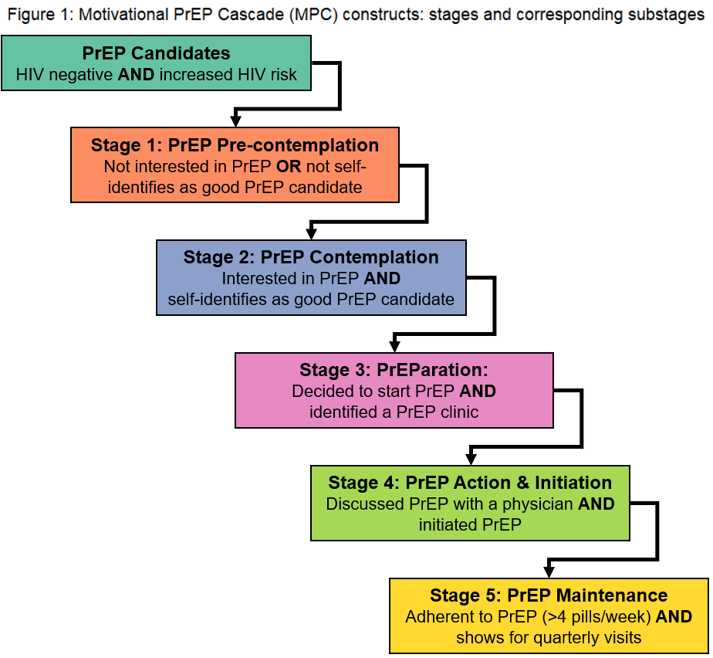
Motivational PrEP cascade
Online survey conducted in June-August 2023
Gaps: Access barriers
Slide from Jorge Gallardo

Slide 12
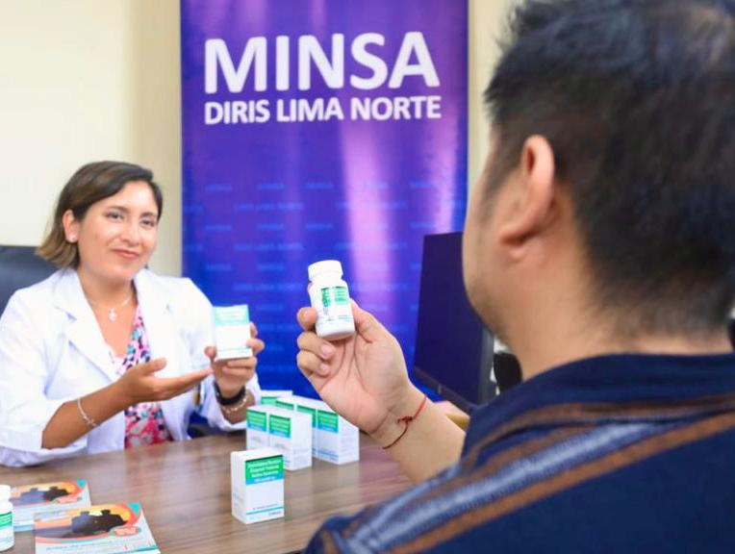
PrEP roll-out within the Peruvian MoH
As of August, 2024
123 MoH centers (country-wide) enrolled at least 1 client in PrEP
4096 PrEP initiations (most in Lima/Callao)
Slide from Jorge Gallardo

Slide 13
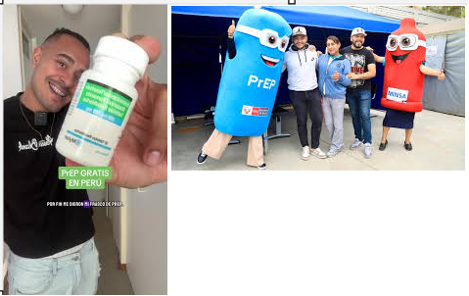
PrEP inclusion in Peru
It is offered to 18-year-old people from more high-risk populations for HIV: MSM, TW, SW and serodiscordant couples who meet the criteria to receive it and who voluntarily choose to enroll in PrEP. To receive PrEP you must consider the following criteria:
Be 18 years or older.
Belonging to high-risk communities to acquire HIV.
- Do not have HIV.
Absence of suspicion of acute HIV infection.
Absence of risk exposure to HIV in the last 72 hours.
Absence of contraindications for receiving PrEP medications.
Voluntary decision to practice PrEP.
Tictok & Minsa PrEP and condom mascots
Translated from the Peruvian Technical Guideline for PrEP, June 2023.

Slide 14
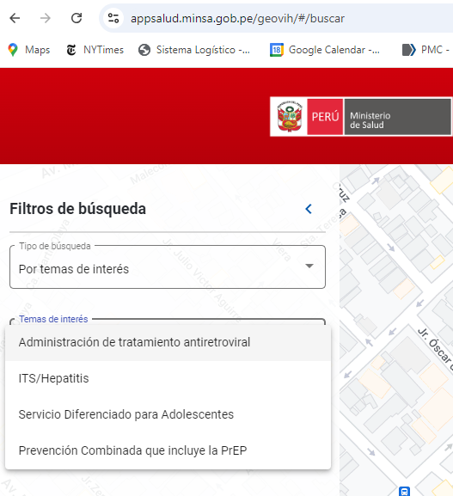
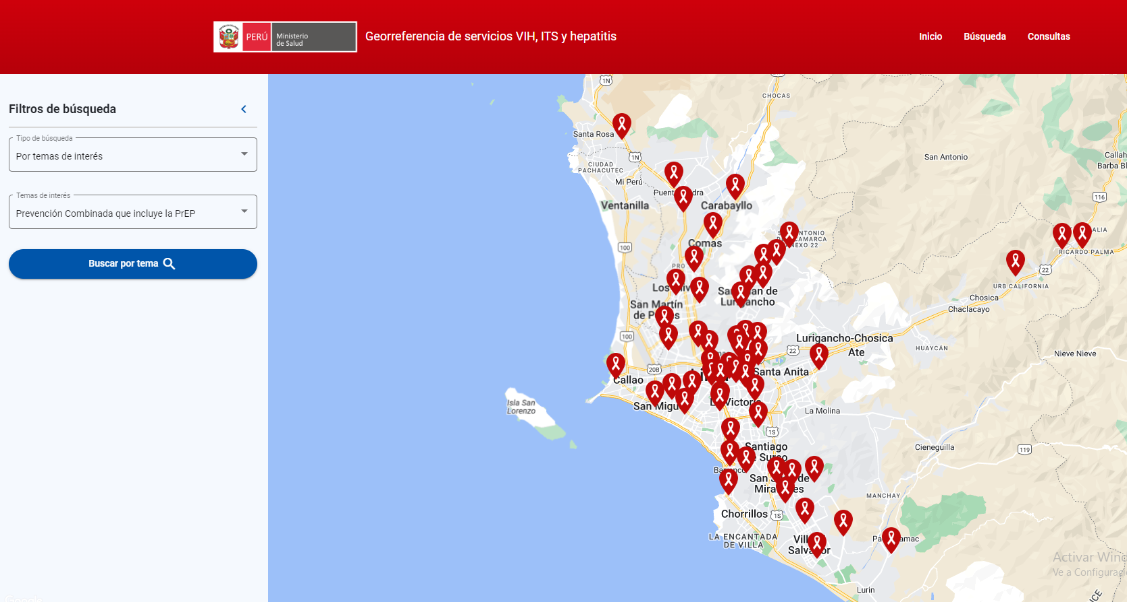
GeoVIH

Slide 15
Providers and structural barriers
PrEP services are being included in already overloaded HIV care services
These services are being asked to take on new, longitudinal clients often without increasing their workforce
Doctors still need to provide a PrEP prescription
  The WHO recommends against this and for task shifting
  Laws would have to be changed to accomodate this recommendation

Slide 16
Providers and structural barriers, cont.
The entity that creates new tasks for these services (the HIV program) is not the same as the entity deciding on their staffing or providing money for staffing (District health services)
Providers also need more training & understanding of the need for PrEP

Slide 17
Final thoughts
Thank you very much!
Knowledge gaps remain to get people to start PrEP
  Also, need to think about <18s
More demand creation is needed
Among those receiving PrEP, remaining on PrEP was a challenge
  Easier access is needed
  The MoH should/is consider/ing community-based provision
Changes toward the adoption of WHO recommendations would be helpful

Slide 18
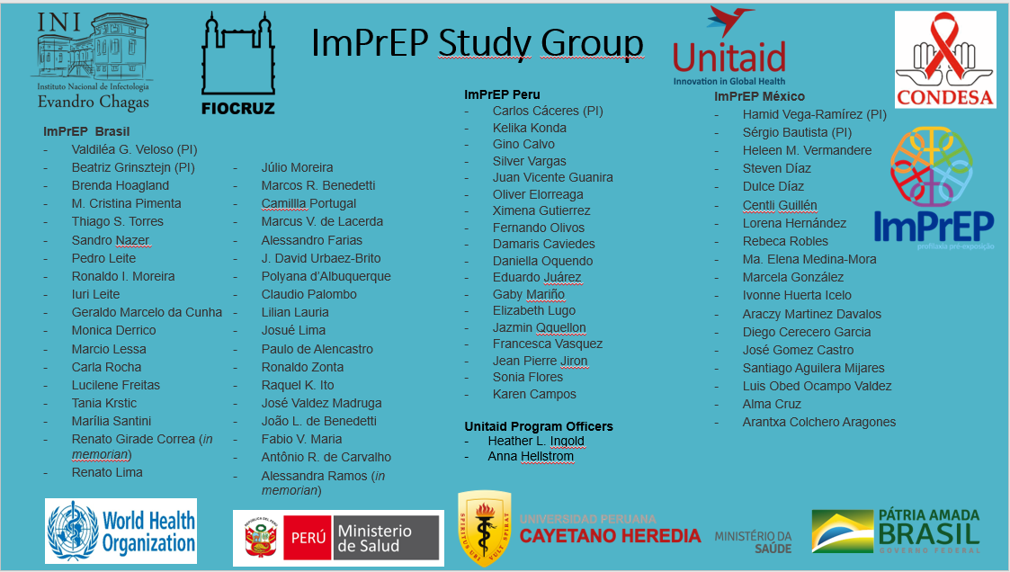

Acknowledgments
PrEP Peru
Impluso
Jorge Gallardo
Jorge Sanchez
Peru CTU study centers
All participants and staff across the studies

Slide 19
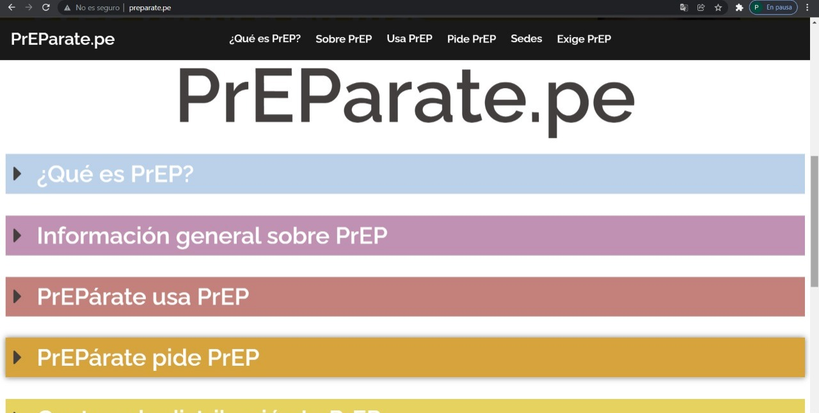
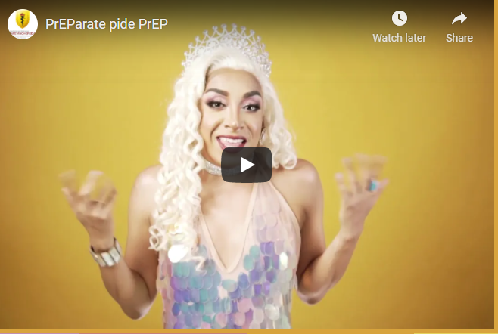


PrEP Campaigns
Preparate.pe is a website that offers PrEP information, developed during ImPrEP
To promote knowledge and uptake
  ImPrEP conducted community outreach events
  PrEP messages from influencers

