Slide 1
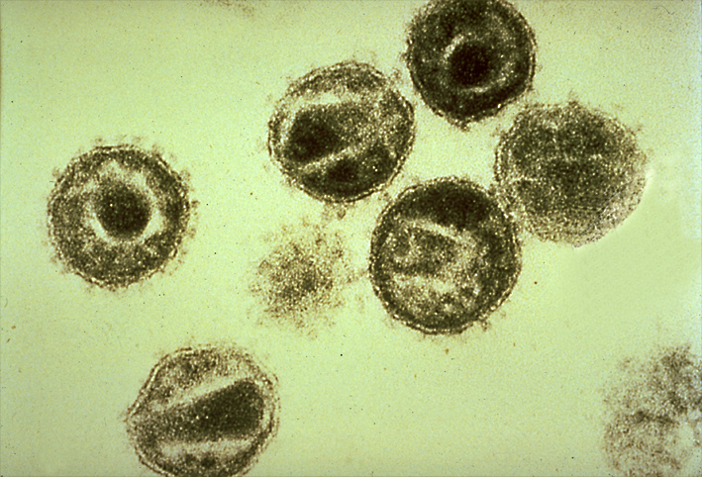


Short-term combination immunotherapy with broadly neutralizing antibodies and CCR5 blockade mediates ART-free viral control in infant rhesus macaques
Jonah B. Sacha, Ph.D.
Oregon Health & Science University

Slide 2
Conflict of interest statement:
JBS has received compensation for consulting for and serving on the scientific advisory board of CytoDyn. This potential conflict of interest is reviewed and managed by OHSU.

Slide 3
Summary
What is your main question?
Can we prevent/clear reservoir seeding in infants soon after HIV is acquired?
What did you find?
Combination of broadly HIV neutralizing antibodies, CCR5 blockade, and antiretroviral therapy prevented reservoir establishment in SHIV-infected macaque infants.
Why is it important?
Synergy between HIV neutralizing antibodies and CCR5 blockade reveals new clinical option.

Slide 4
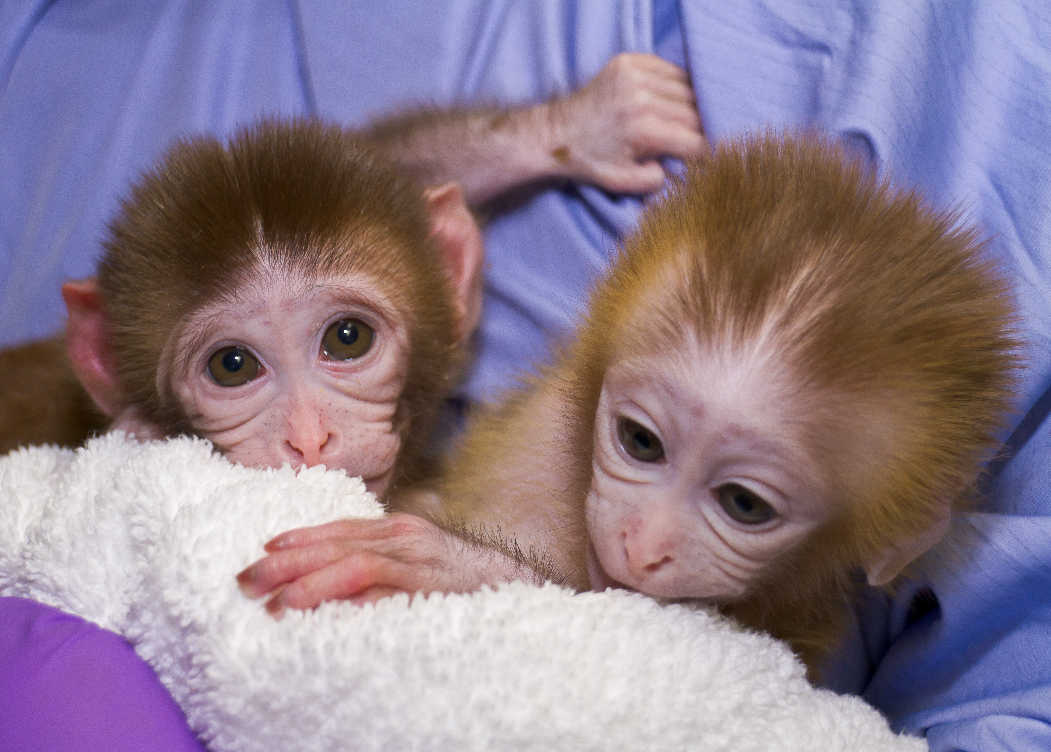
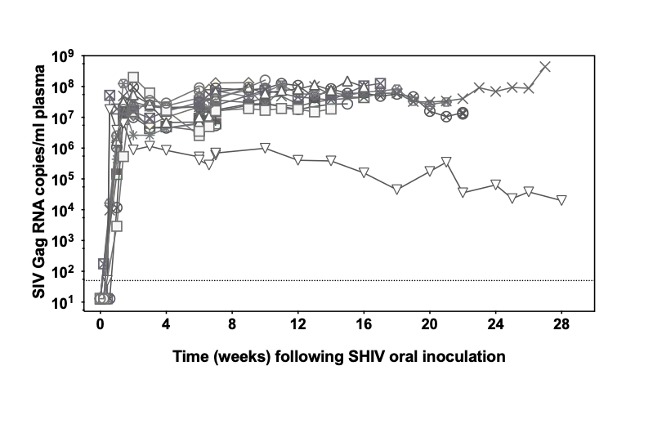
Infant macaques a model for human pediatric HIV infection
Born in a natural setting and allowed to suckle up to 7 days
Oral high dose SHIV_{SF162P3}
  100% infection rate (4 x 10⁴ TCID₅₀)
  Rapid pathogenesis
75% mortality by 6 months w/o treatment
Notes:
Suckle up to 7 days to help establish microbiome
Model validation….well established model, dose, sf162p3 → check. Mariyas paper

Slide 5


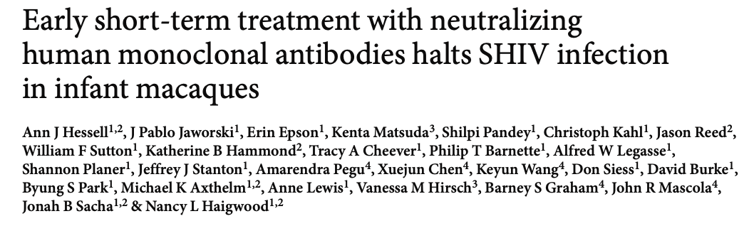
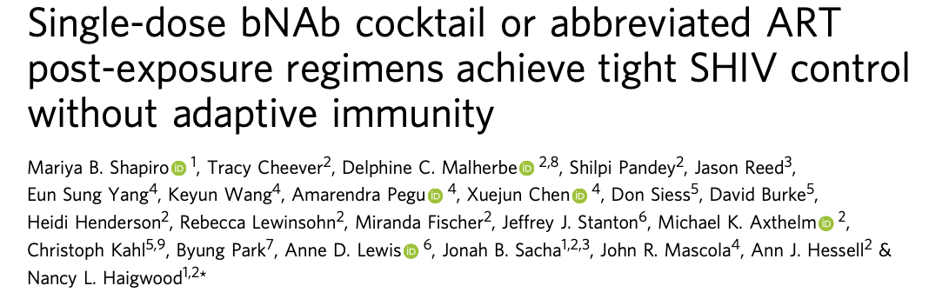
Defining the window of opportunity for treatment
SHIV only
Day 7, no Tx
SHIV + bNAbs
Day 7; 10 mg/kg

Slide 6
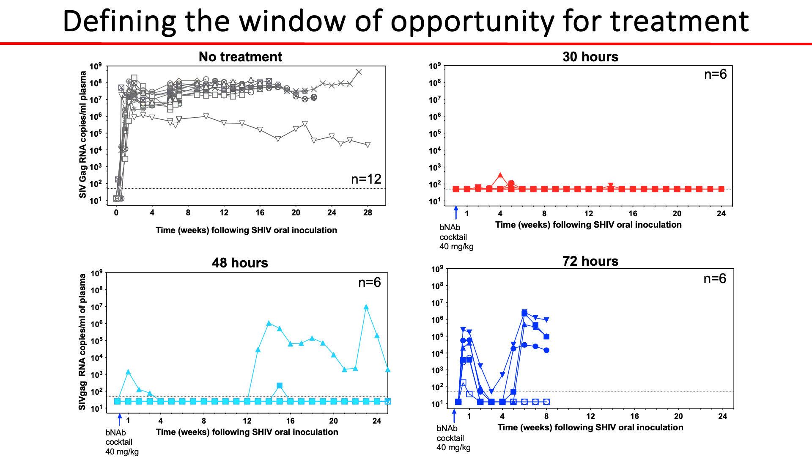
Defining the window of opportunity for treatment
No treatment
30 hours
n=6
n=12
48 hours
72 hours
n=6
n=6

Slide 7
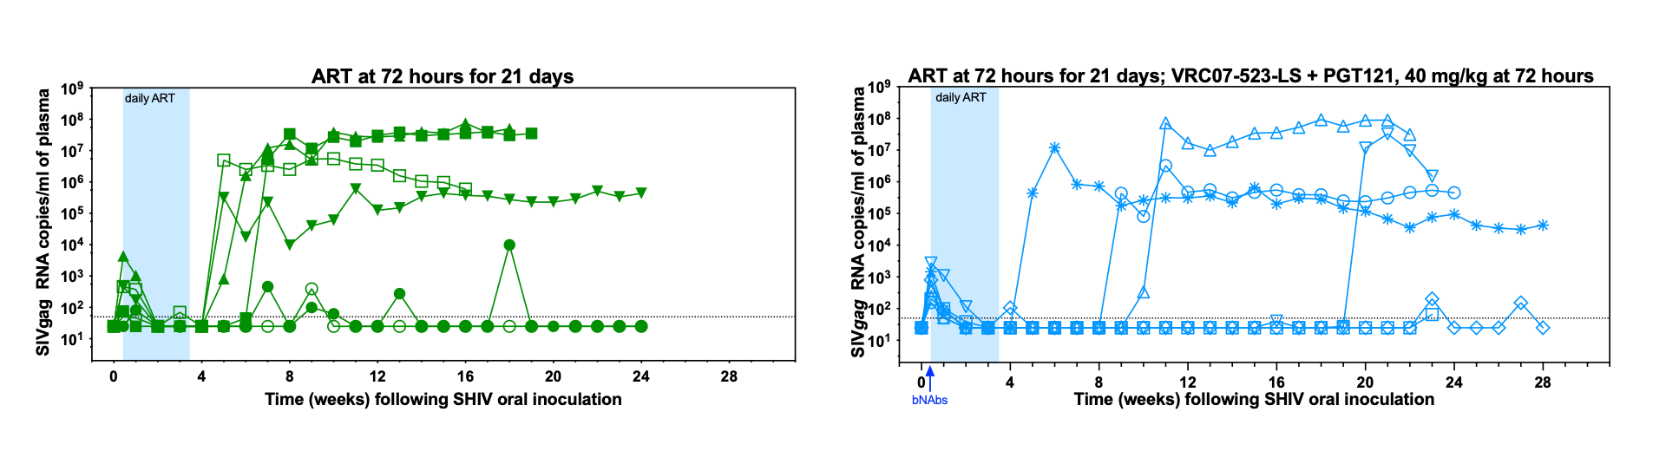
ART +/- bNAbs at 72 hours is insufficient
Would CCR5 blockade alone, or in combination, be effective at 72 hours post infection in infants?

Slide 8
Leronlimab (formerly PRO140)
Humanized monoclonal IgG4 antibody

Slide 9
Leronlimab (formerly PRO140)
Humanized monoclonal IgG4 antibody
Binds to N-terminus and ECL2 of CCR5

Slide 10
Leronlimab (formerly PRO140)
Humanized monoclonal IgG4 antibody
Binds to N-terminus and ECL2 of CCR5
In clinical trials
  Tested in over 1,000 PLWH

Slide 11
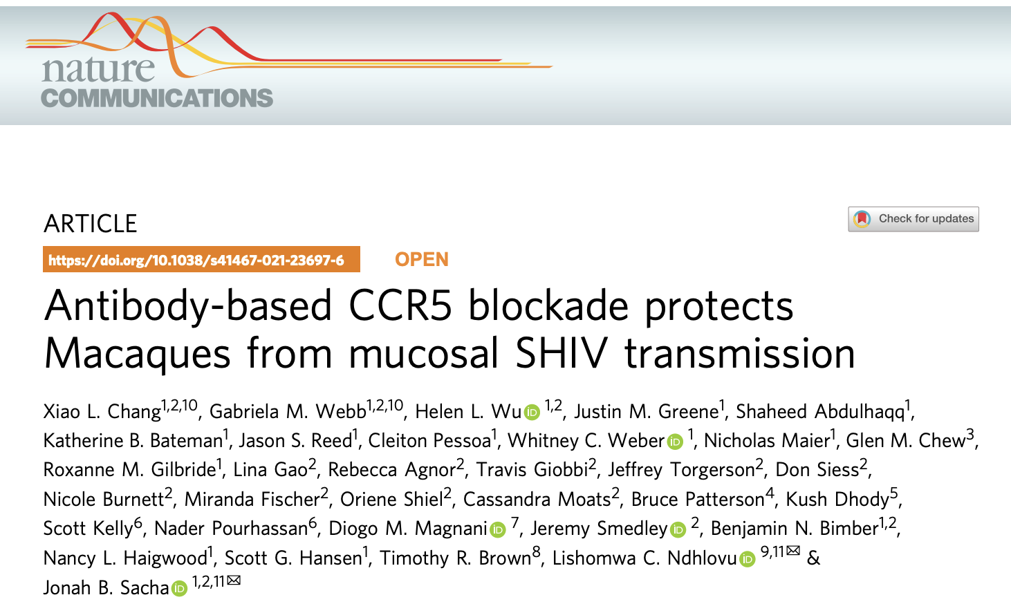
Leronlimab (formerly PRO140)
Humanized monoclonal IgG4 antibody
Binds to N-terminus and ECL2 of CCR5
In clinical trials
  Tested in over 1,000 PLWH
  Successfully used as PrEP to protect from mucosal SHIV acquisition

Slide 12
Combining ART, bNAbs, and LRM for cure

Slide 13
Combining ART, bNAbs, and LRM for cure
Notes:
Two concurrent controls

Slide 14
Combining ART, bNAbs, and LRM for cure
Notes:
Put blue first before pink.

Slide 15
Combining ART, bNAbs, and LRM for cure

Slide 16
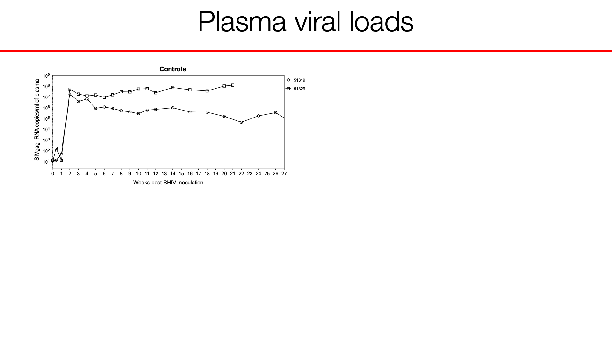
Plasma viral loads

Slide 17
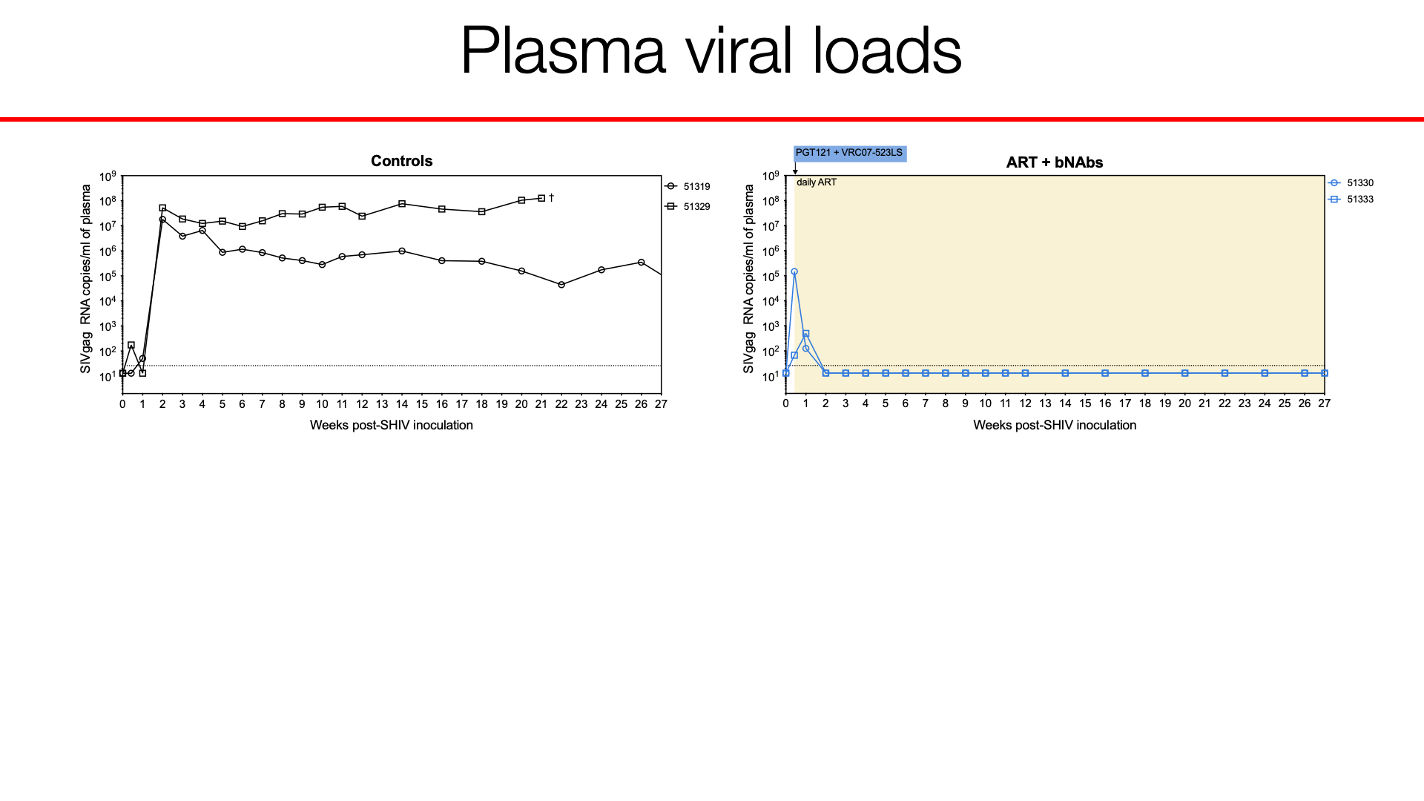
Plasma viral loads

Slide 18
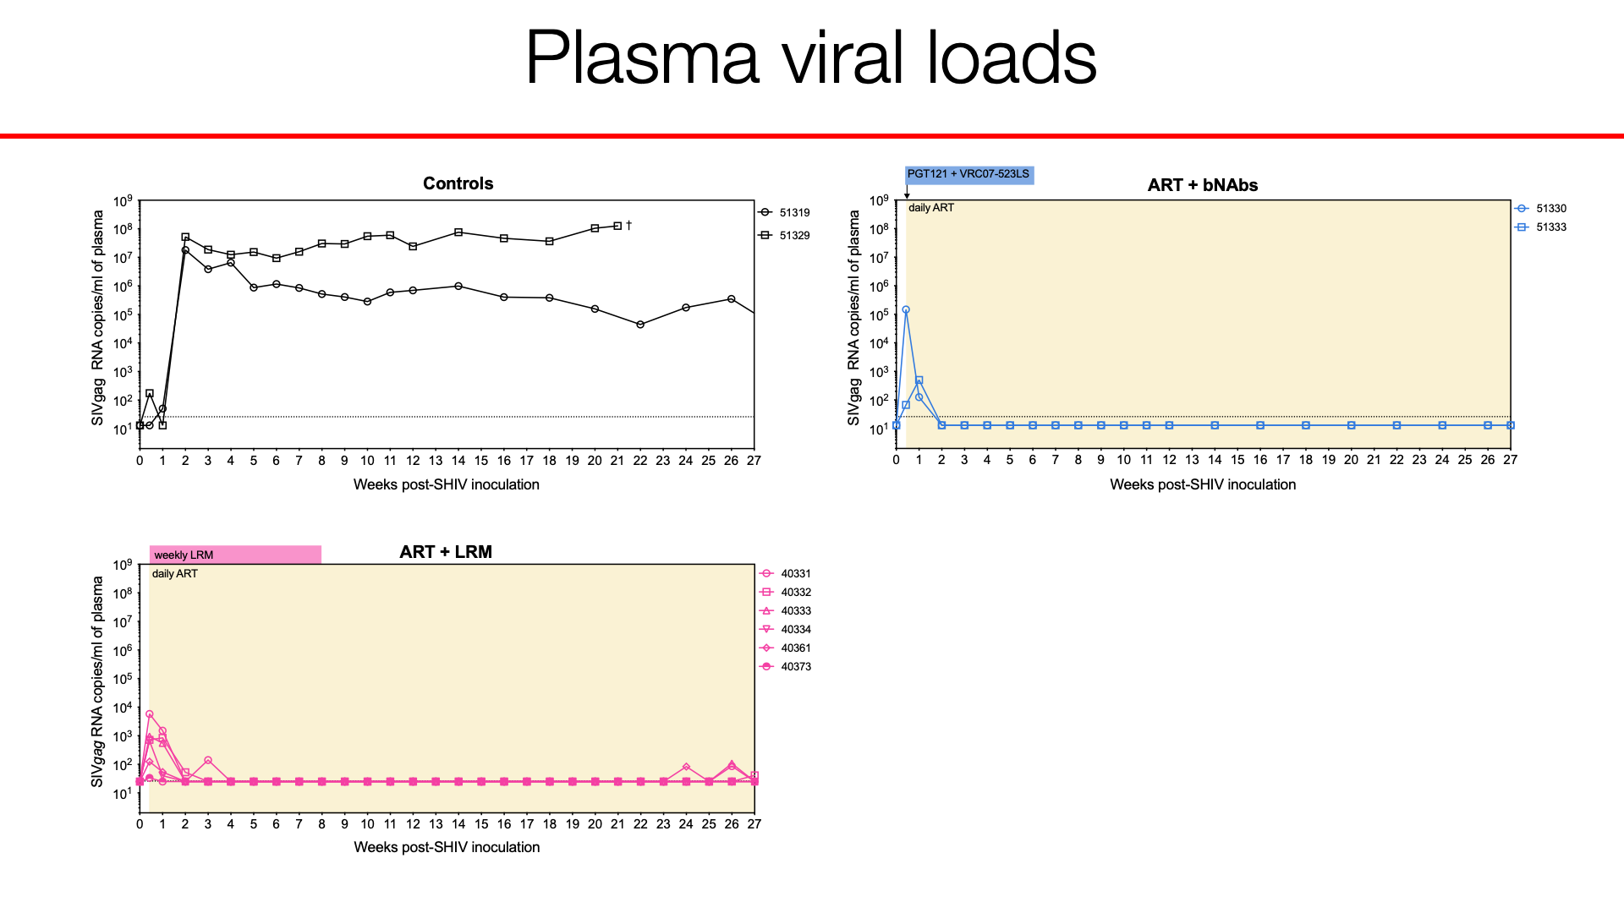
Plasma viral loads

Slide 19
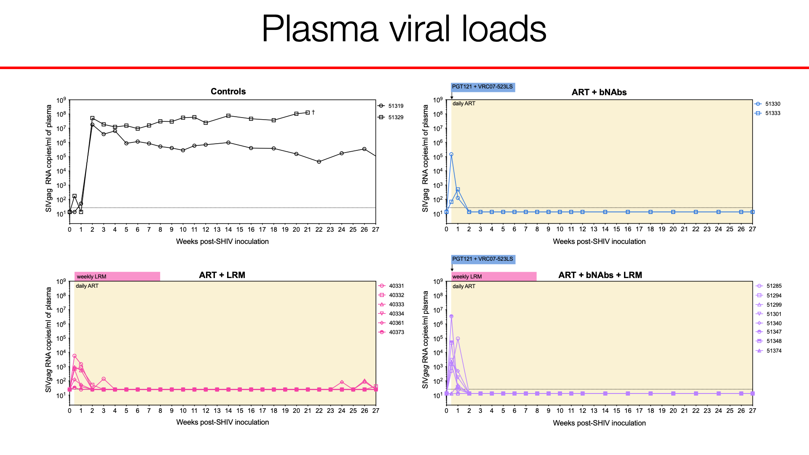
Plasma viral loads

Slide 20
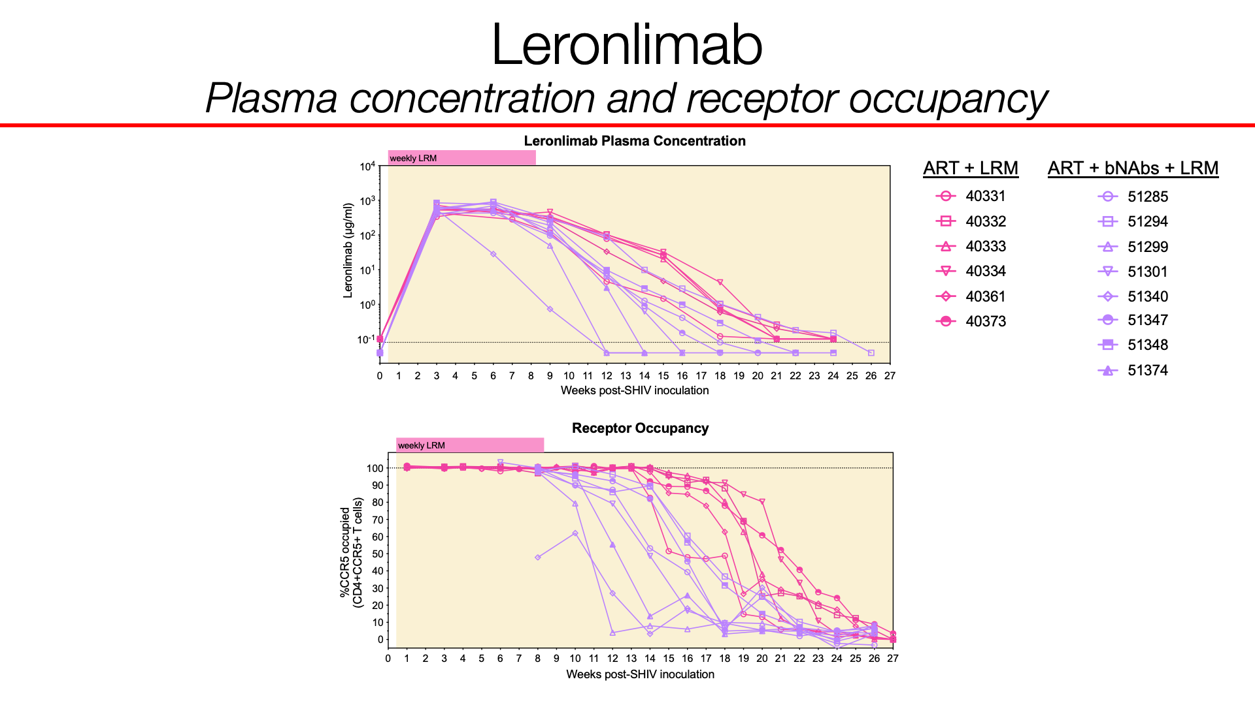
Leronlimab
Plasma concentration and receptor occupancy
ART + LRM
ART + bNAbs + LRM
Notes:
Add LRM + ART group

Slide 21
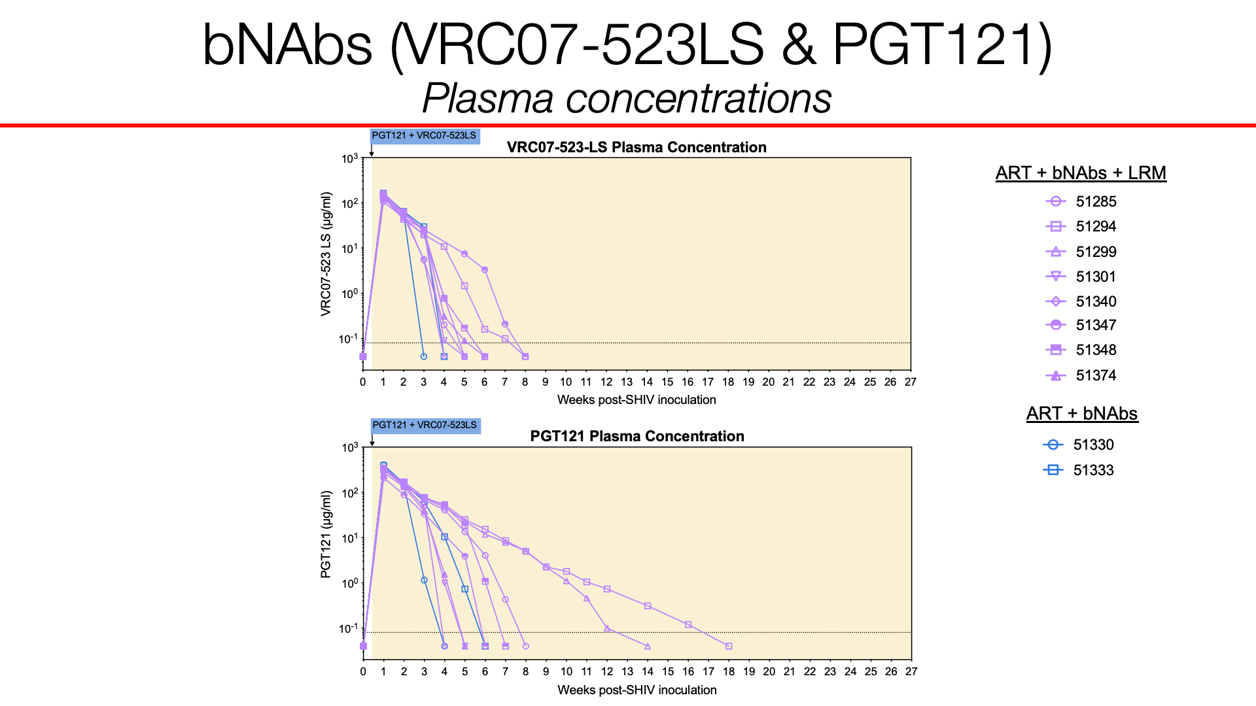
bNAbs (VRC07-523LS & PGT121)
Plasma concentrations
ART + bNAbs + LRM
ART + bNAbs

Slide 22
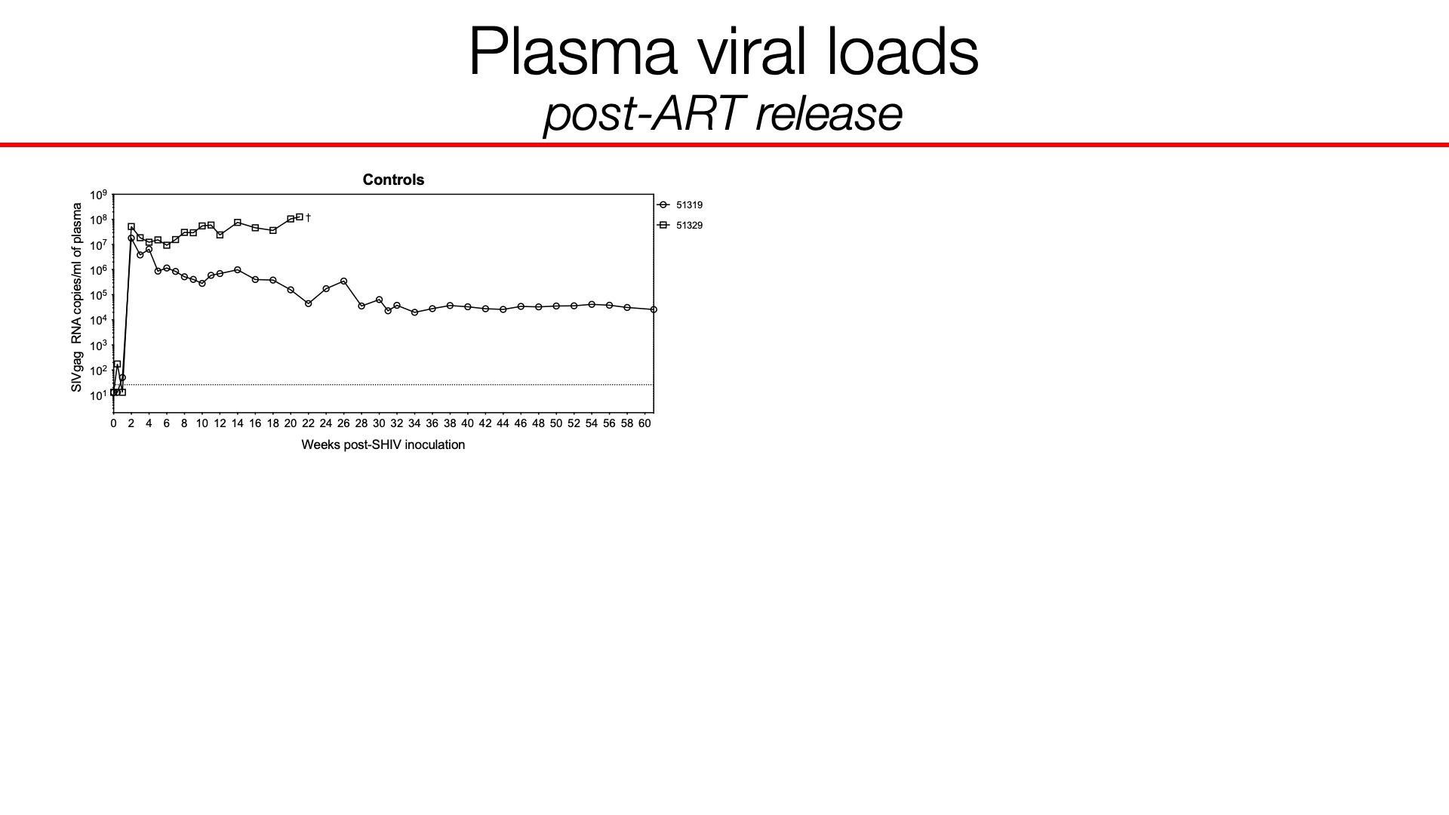
Plasma viral loads post-ART release

Slide 23
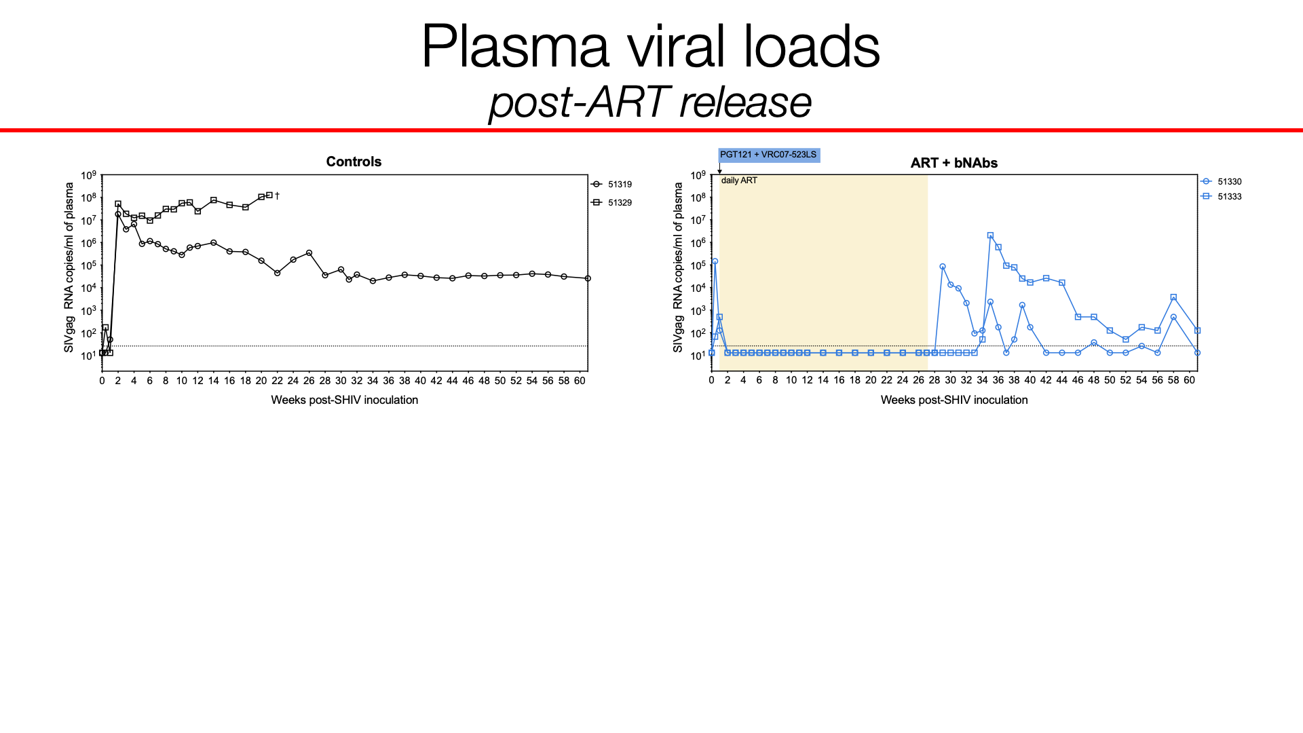
Plasma viral loads
post-ART release

Slide 24
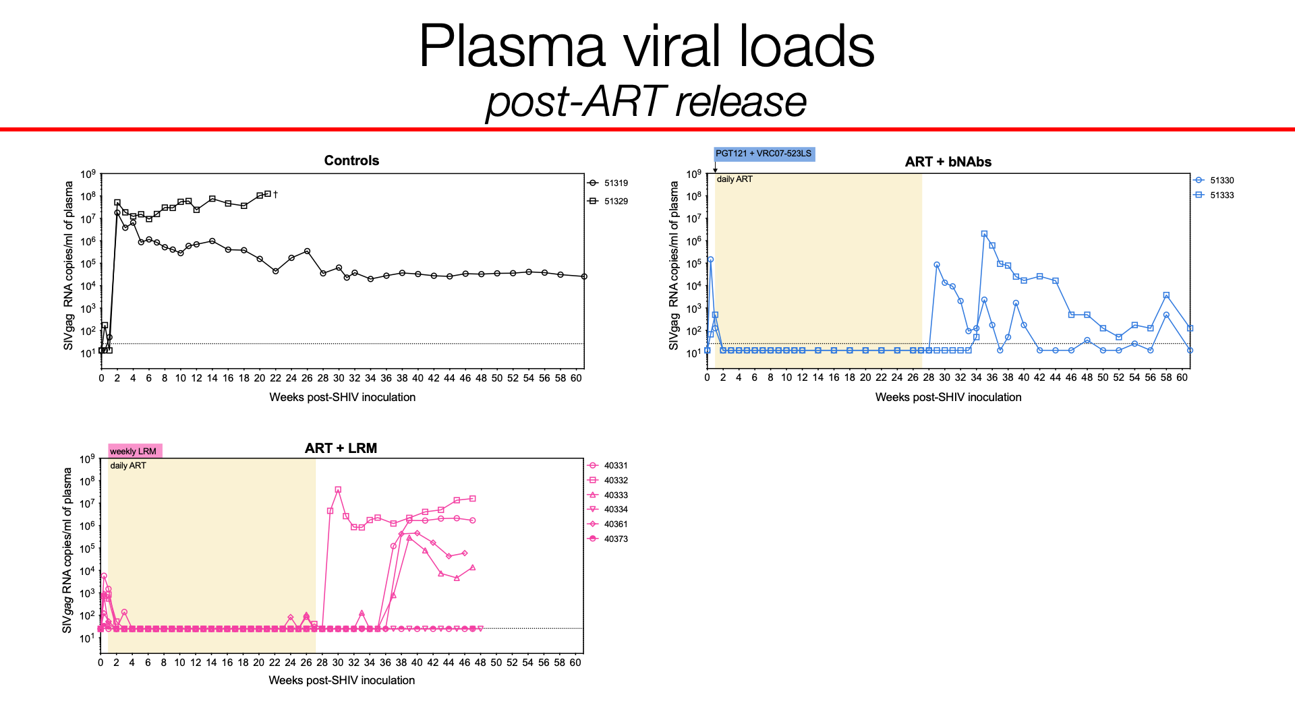
Plasma viral loads
post-ART release

Slide 25
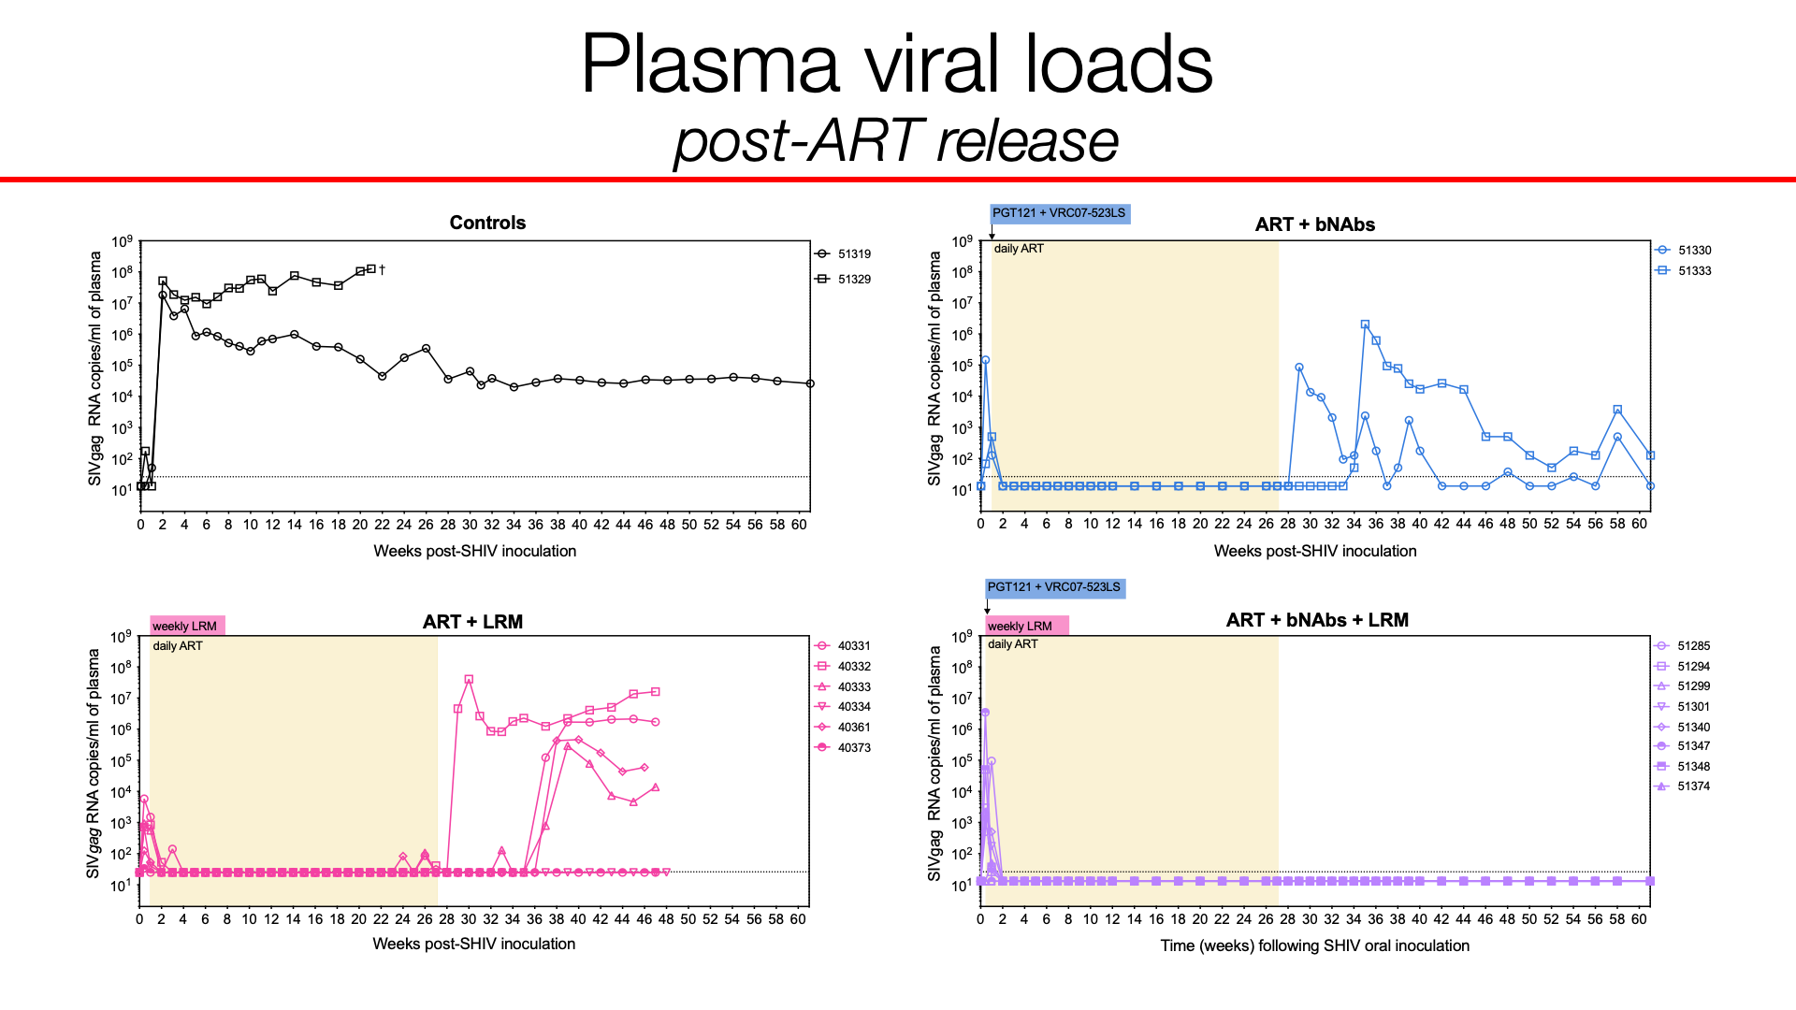
Plasma viral loads post-ART release

Slide 26
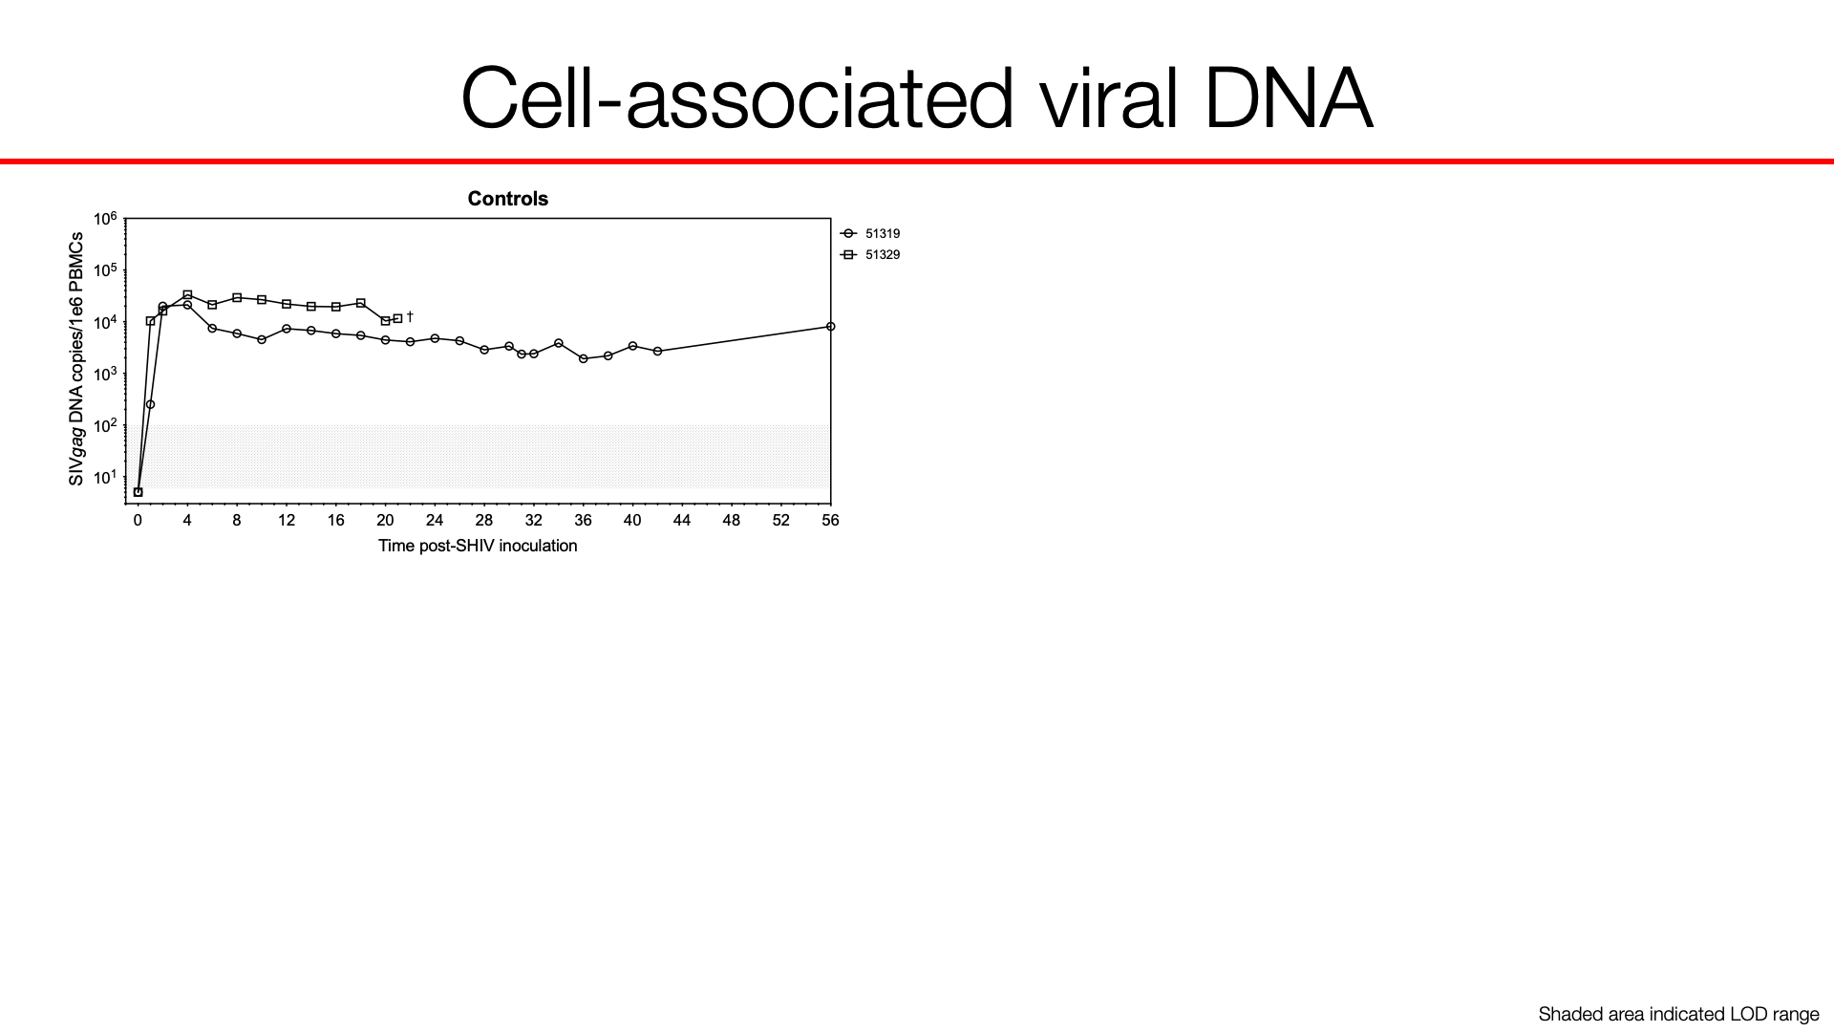
Cell-associated viral DNA
Shaded area indicated LOD range
Notes:
Check for prism file with open/closed version tracy sent

Slide 27
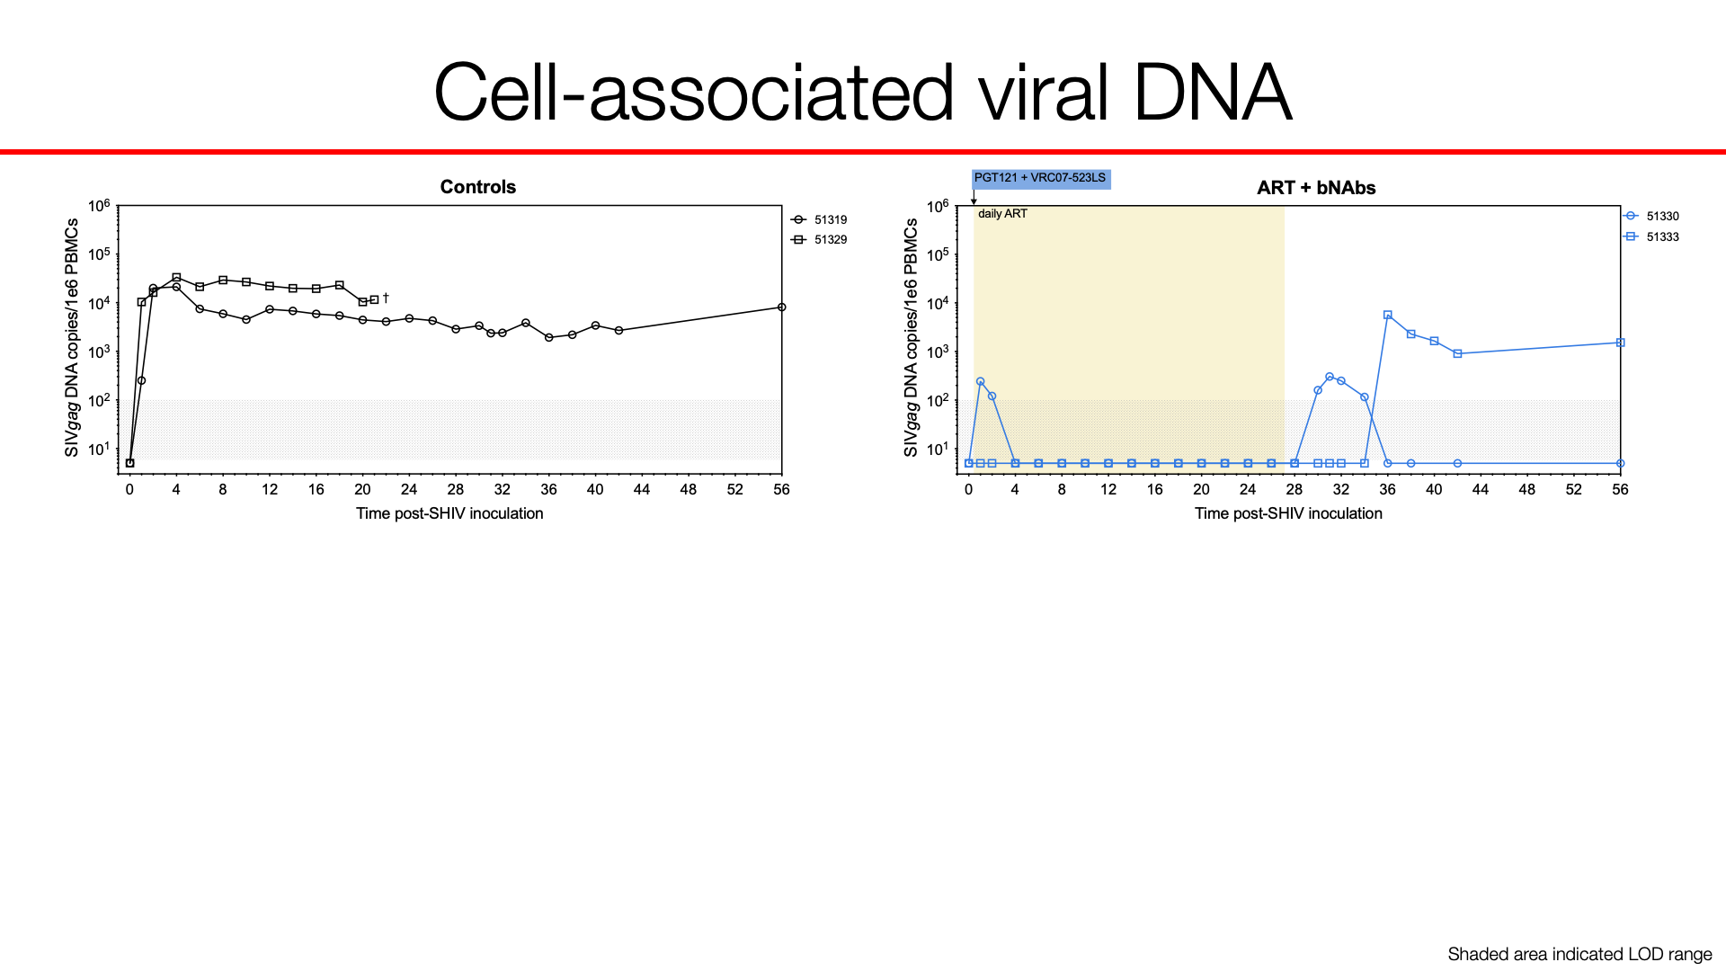
Cell-associated viral DNA
Shaded area indicated LOD range
Notes:
Check for prism file with open/closed version tracy sent

Slide 28
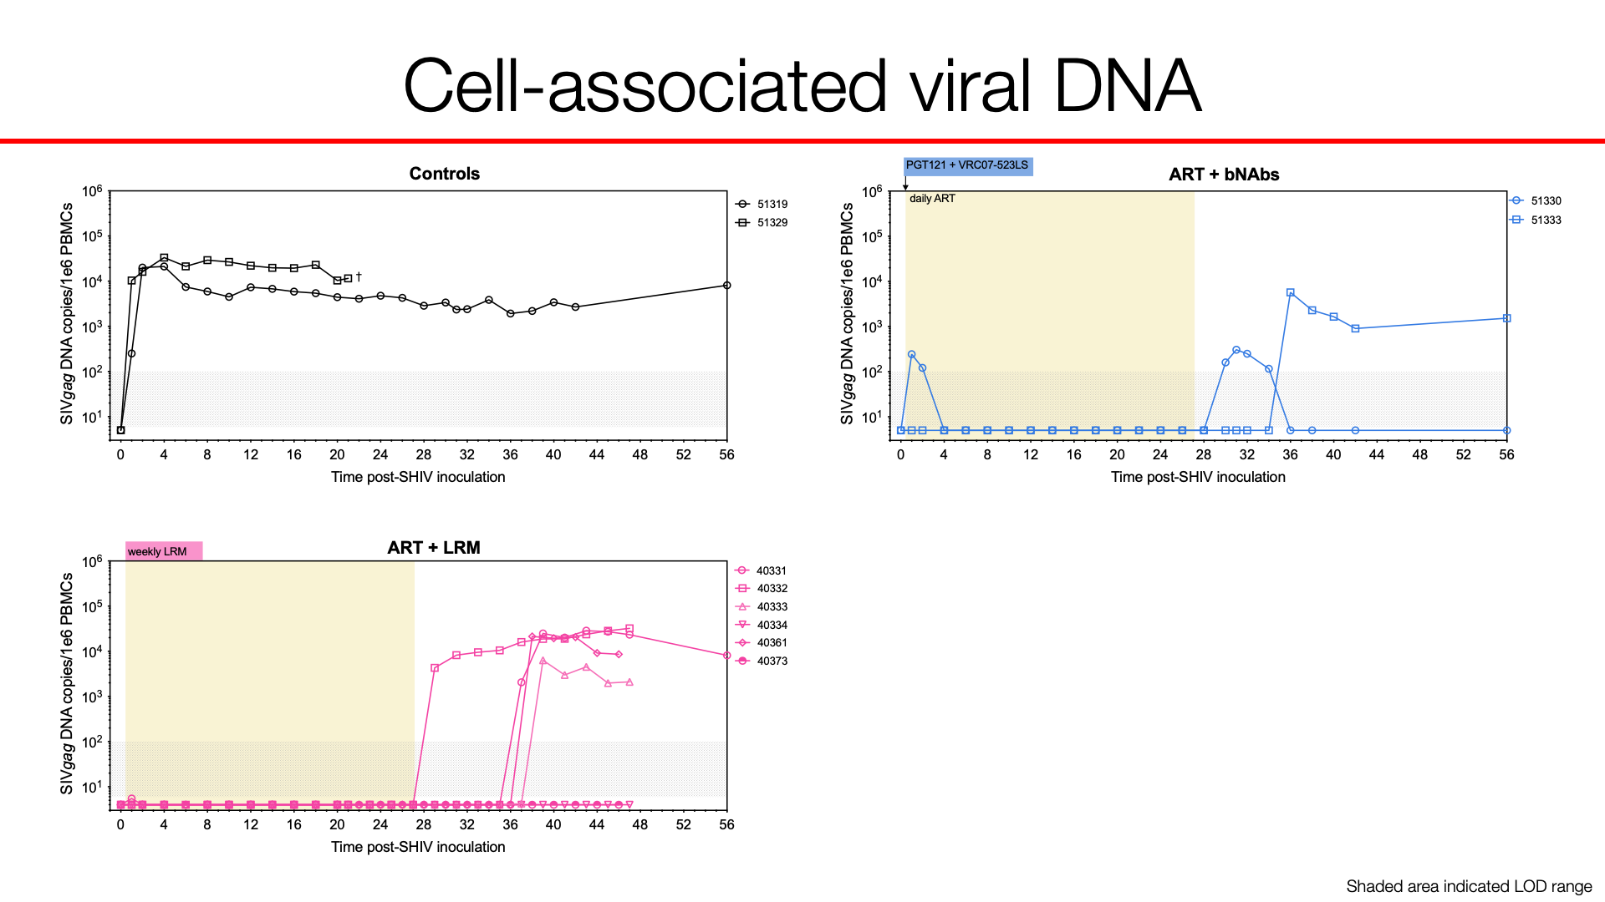
Cell-associated viral DNA
Shaded area indicated LOD range
Notes:
Check for prism file with open/closed version tracy sent

Slide 29
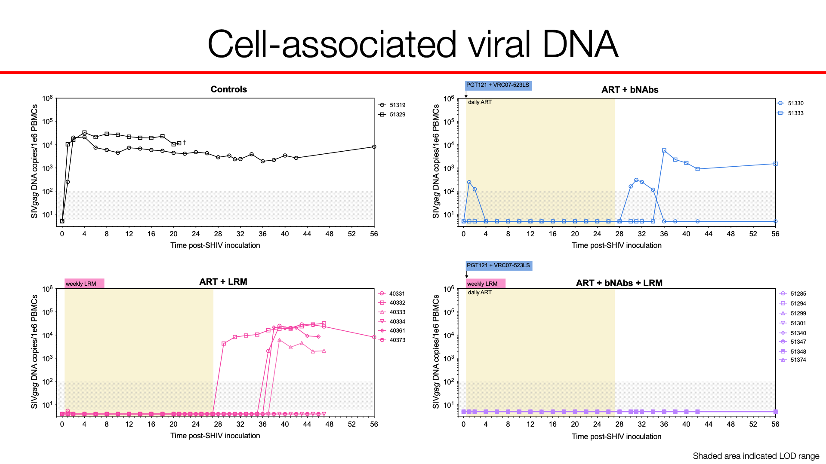
Cell-associated viral DNA
Shaded area indicated LOD range

Slide 30
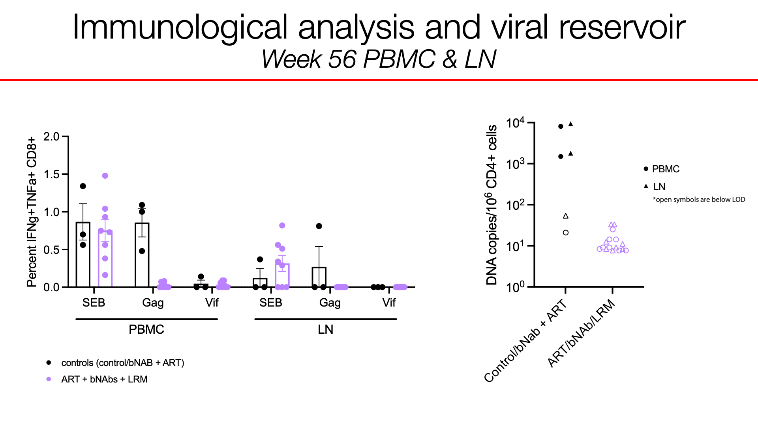
Immunological analysis and viral reservoir
Week 56 PBMC & LN

Slide 31
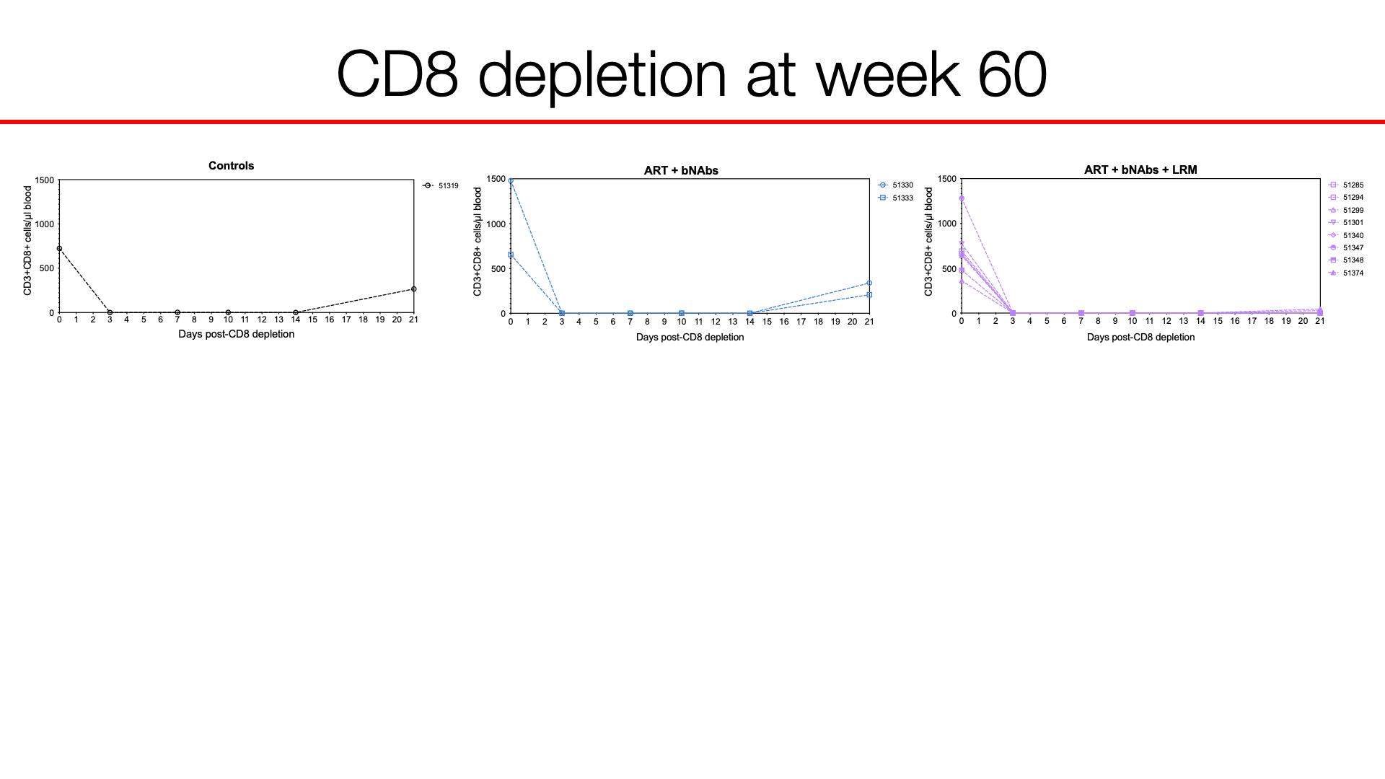
CD8 depletion at week 60

Slide 32
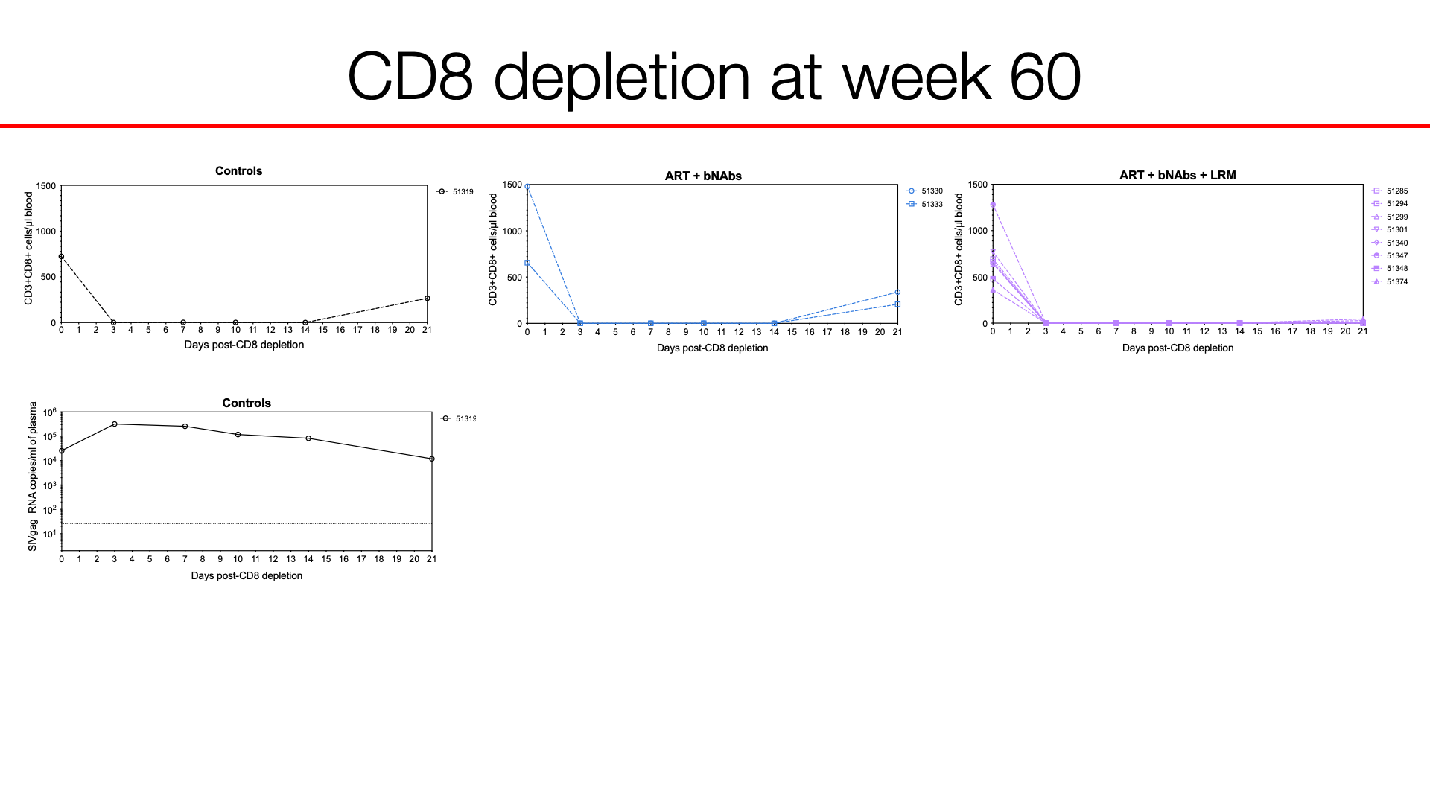
CD8 depletion at week 60

Slide 33
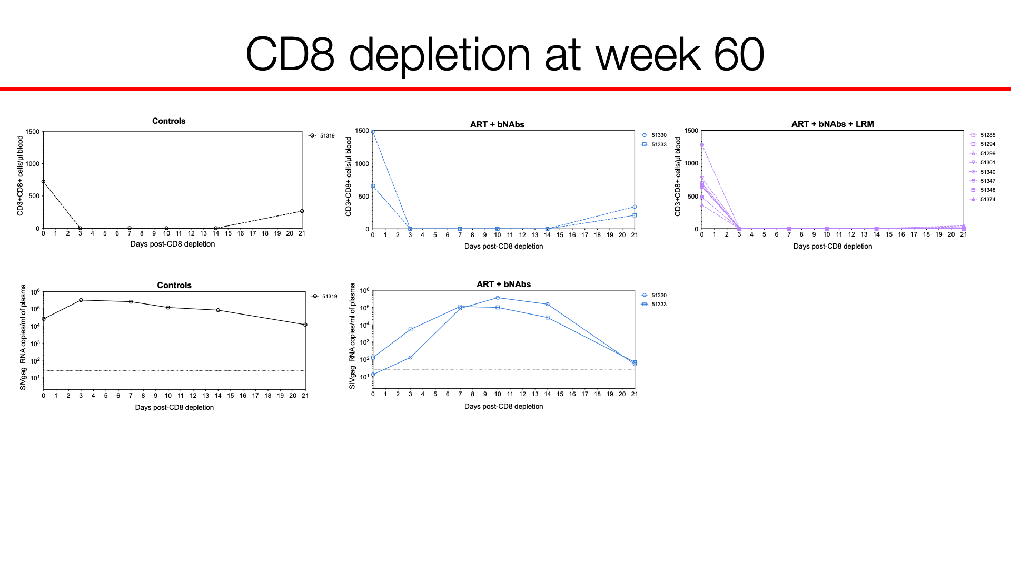
CD8 depletion at week 60

Slide 34
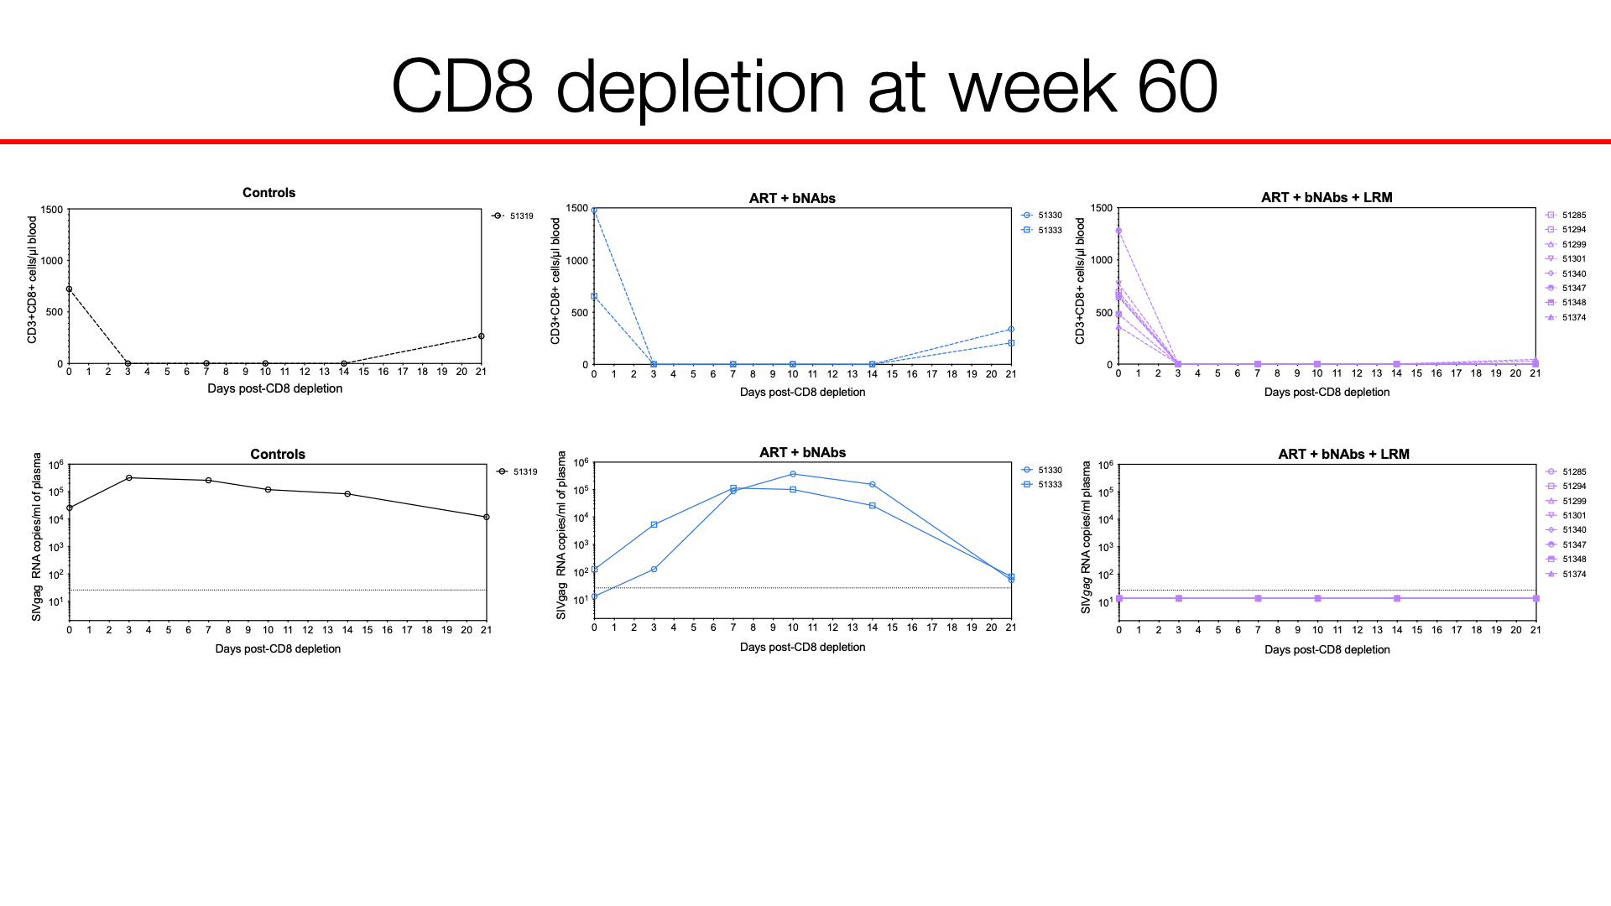
CD8 depletion at week 60

Slide 35
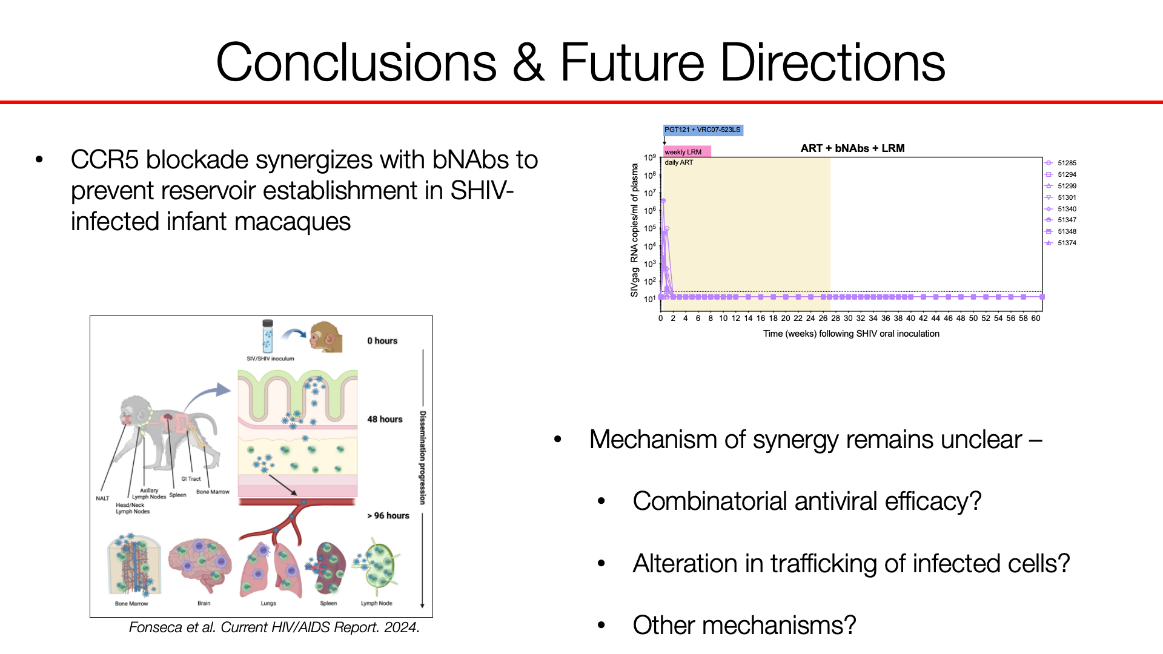
Conclusions & Future Directions

Slide 36



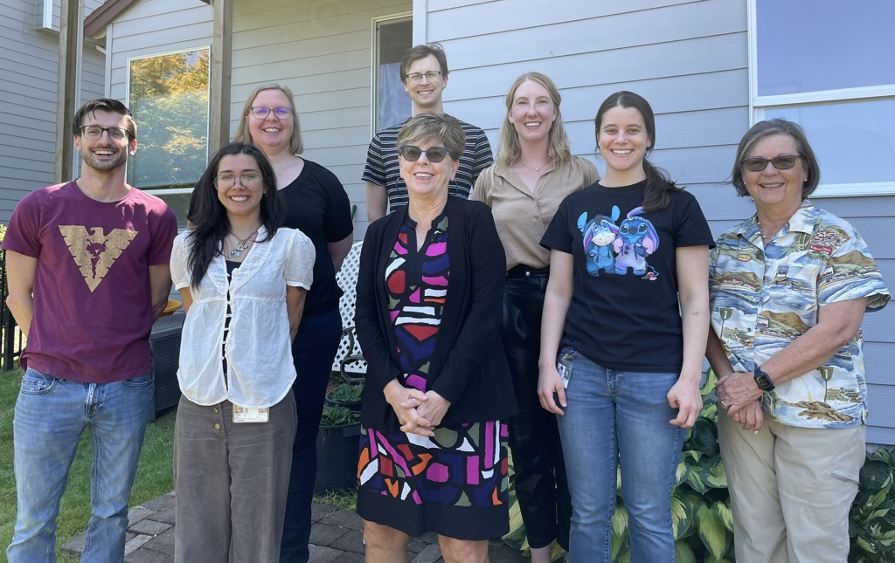
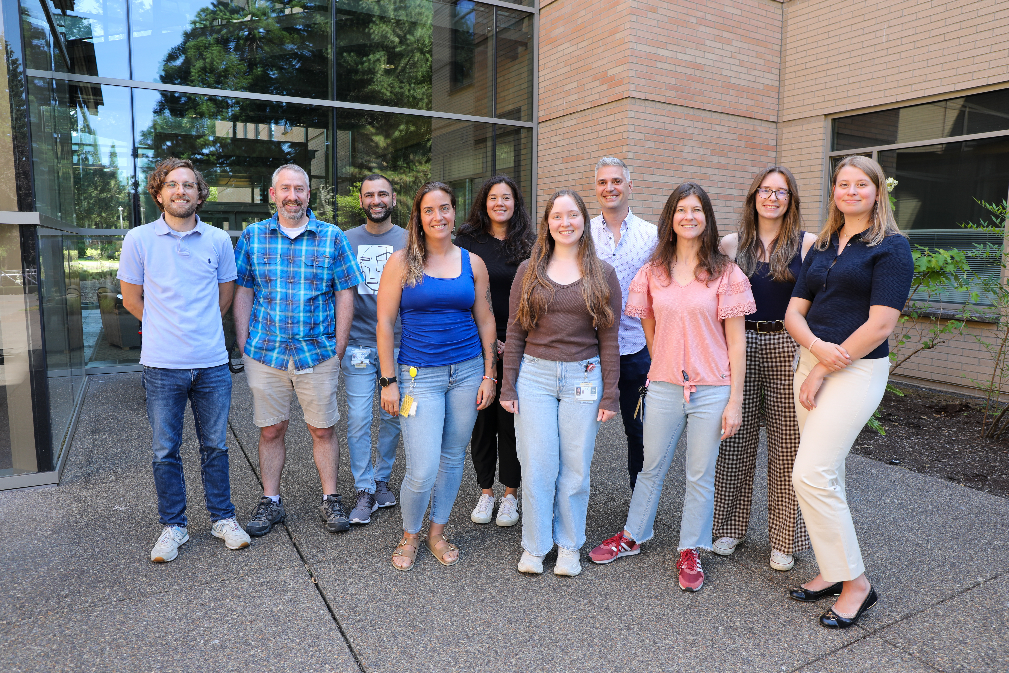

Acknowledgements
Haigwood Laboratory
Nancy Haigwood
Tracy Ordonez
Shilpi Pandey
Ann Hessell
Sacha Laboratory
Gabriela Webb
Jason Reed
Cleiton Pessoa
Hannah Fisher
Matthew Humkey
ONPRC
Scott Hansen
Kim Armantrout
Rachele Bochart
Jeremy Smedley
Tonya Swanson
Bree Fischer
Ann Lewis
UC Davis
Koen Van Rompay
Jennifer Watanabe
Jodie Usachenko
CNPRC husbandry staff
NIH/VRC
John Mascola
Xuejun Chen
Amar Pegu
NIH P51 OD001092 and U42 (ONPRC);
R01-HD 080459 and R01-AI133712

