Slide 1
Induction of precursor CD4bs-targeting bnAbs in infant macaques following immunization with germline-targeting SOSIP trimers.
Ashley Nelson, PhD – Weill Cornell Medicine
Planet of the Apes: Learning immunogenicity from animal models

Slide 2
Summary
What is your main question?
Our key question: Can HIV vaccination in early life generate protective antibodies prior to adolescence, when sexual HIV exposure risk substantially increases?
What did you find?
Our 2-step immunization strategy elicited antibody responses with features that signify early development of a class of bnAbs that target the CD4bs on the HIV envelope in 3 out of 5 infants.
Why is it important?
This study demonstrates the utility of an HIV vaccination strategy in early childhood to eliciting protective immunity in order to avert the >400,000 new infections yearly among adolescents worldwide.

Slide 3

Adolescents represent a growing population of people living with HIV worldwide
In 2021, ~1.3 million new HIV infections among individuals age 15+ years
    25% of new infections were in young people aged 15-24yrs
Early childhood is an opportune window to elicit protective HIV immunity prior to adolescence
  Children living with HIV generate bnAbs with 1-2 years of virus acquisition
  Low-risk
  Time – bnAb induction
  Incorporation into standardized immunization schedule

Slide 4
Sequential immunization with BG505 SOSIP Native-like Trimers
BG505 SOSIP.664 trimer
BG505 SOSIP v4.1-GT1.1 trimer
  Engages a broad range of VRC01-class precursor bnAbs
  Elicits autologous tier 2 nAbs in adult RMs
  Does not engage germ-line forms of bnAbs
Can we develop an immunization strategy using BG505 SOSIPs that will elicit VRC01-class precursor bnAbs in infants?
Caniels et al. Sci Immunology 2024
Max Medina-Ramírez et al. J Exp Med 2017

Slide 5
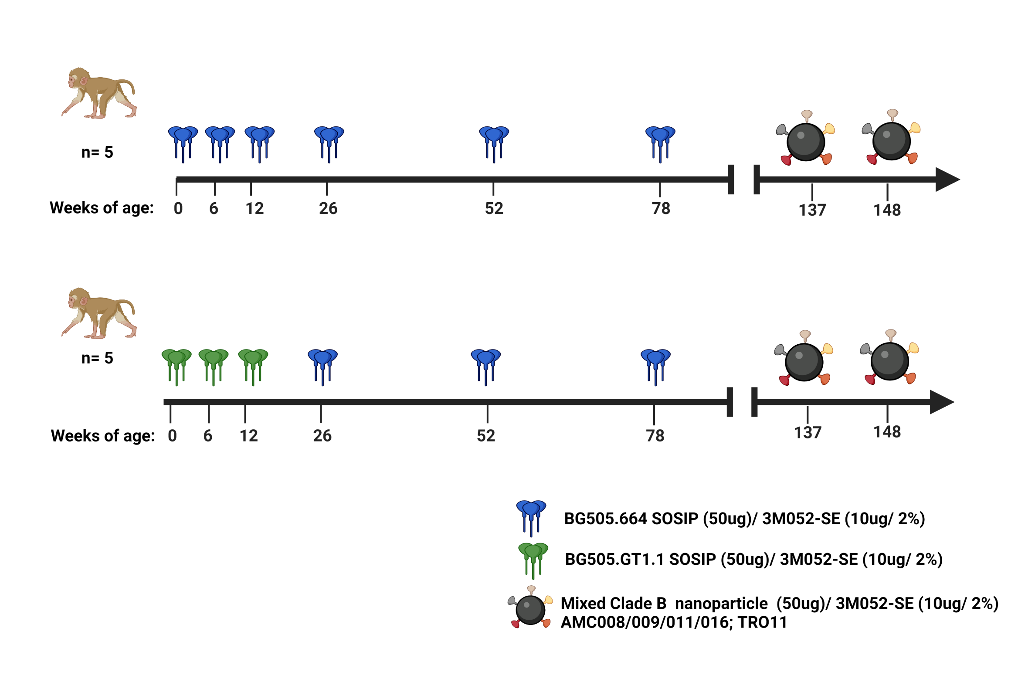
BG505 SOSIP Immunization Schedule
WT BG505.664 SOSIP
BG505 GT1.1 SOSIP
Ne
Nelson et al. Sci. Immunology.2024
Notes:
Two main goals. Assess the immunogenicity of BG505.664 and BG505 GT1.1 SOSIP immunization strategies in infant rhesus macaques
Compare the ability of both BG505 SOSIP immunization strategies to elicit tier 2 virus neutralizing antibodies and CD4bs bnAb precursors

Slide 6
BG505 SOSIP immunization induces durable antibody binding and neutralization responses
BG505/T332N
Tier 2
BG505.664
BG505 GT1.1
Nelson et al. Sci. Immunology.2024
Notes:
Similar binding responses, that ere durable throughout the study.
Tier 2 virus neutralization detected as early as 14 weeks, with improved durability following the 5th an 6th immunizations.

Slide 7
Development of VRC01-like precursor bnAbs in three infant RMs
Wk 28
4 doses
Wk 80
6 doses
Wk 112
6 doses
WT BG505.664
BG505 GT1.1
D. Montefiori
C. LeBranche
H. Gao
X. Shen
Notes:
Next we wanted to assess the ability of our two immunization strategies to induce CD4bs precursor bnAbs, using a virus neutralization based strategy.
Glycans bordering the CD4bs impede the binding of germline-reverted forms of VRC01-class bnAbs. So we screened sera against a clade C Psv containing targeted deletion of a subset of N-glycans bordering the CD4bs, and produced in 293S GnT1⁻ cells which generate Man₅-enriched PsV, with the rationale that relatively small Man₅ would replace larger complex-type glycans, thereby improving access to the CD4bs.
Misc:
The GT1.1 was designed from the BG505 WT SOSIP to target germline CD4bs and trimer apex bnAb precursors, and some glycans were removed in the modifications. Since there is not evidence of CD4bs bnAb precursors, I wonder if the neutralizing abs here are targeting the trimer apex?
Deleting a subset of these glycans permits Env antigen binding but not virus neutralization, suggesting that additional barriers impede germline-reverted VRC01-class antibody binding to functional Env trimers.

Slide 8
What are the epitope targets of polyclonal Abs in plasma following BG505 SOSIP immunization?
nsEMPEM
cryoEMPEM

Slide 9






Plasma antibodies target the CD4bs in the majority of BG505 GT1.1 primed infants
Week 80:
47729
47734
47739
47750
47754
CD4bs bnAb precursor
GT1.1 | BG505
888942 | 4086
GT1.1 | BG505
26861 | 67
GT1.1 | BG505
580641 | 5546
GT1.1 | BG505
2927 | 741
GT1.1 | BG505
9173 | 202
ID₅₀:
Base
N611 glycan
Fusion Peptide
N355/289 glycan
CD4bs
C3/V5
V1/V2/V3
A. Ward
G. Ozorowski
L. Sewell
Nelson et al. Sci. Immunology.2024
Notes:
MIV08 GT1.1 Pre-Clinical EMPEM: 500 ug polyclonal Fab complexed with BG505 GT1.1 + stabilizing mutation (CC2)

Slide 10
BG505 GT1.1 priming elicits plasma antibodies targeting a variety of epitopes
BG505 GT1.1
Infants (n=5)
BG505.664
Infants (n=5)
R. Sanders
S. Zhang
G. Ozorowski

Slide 11
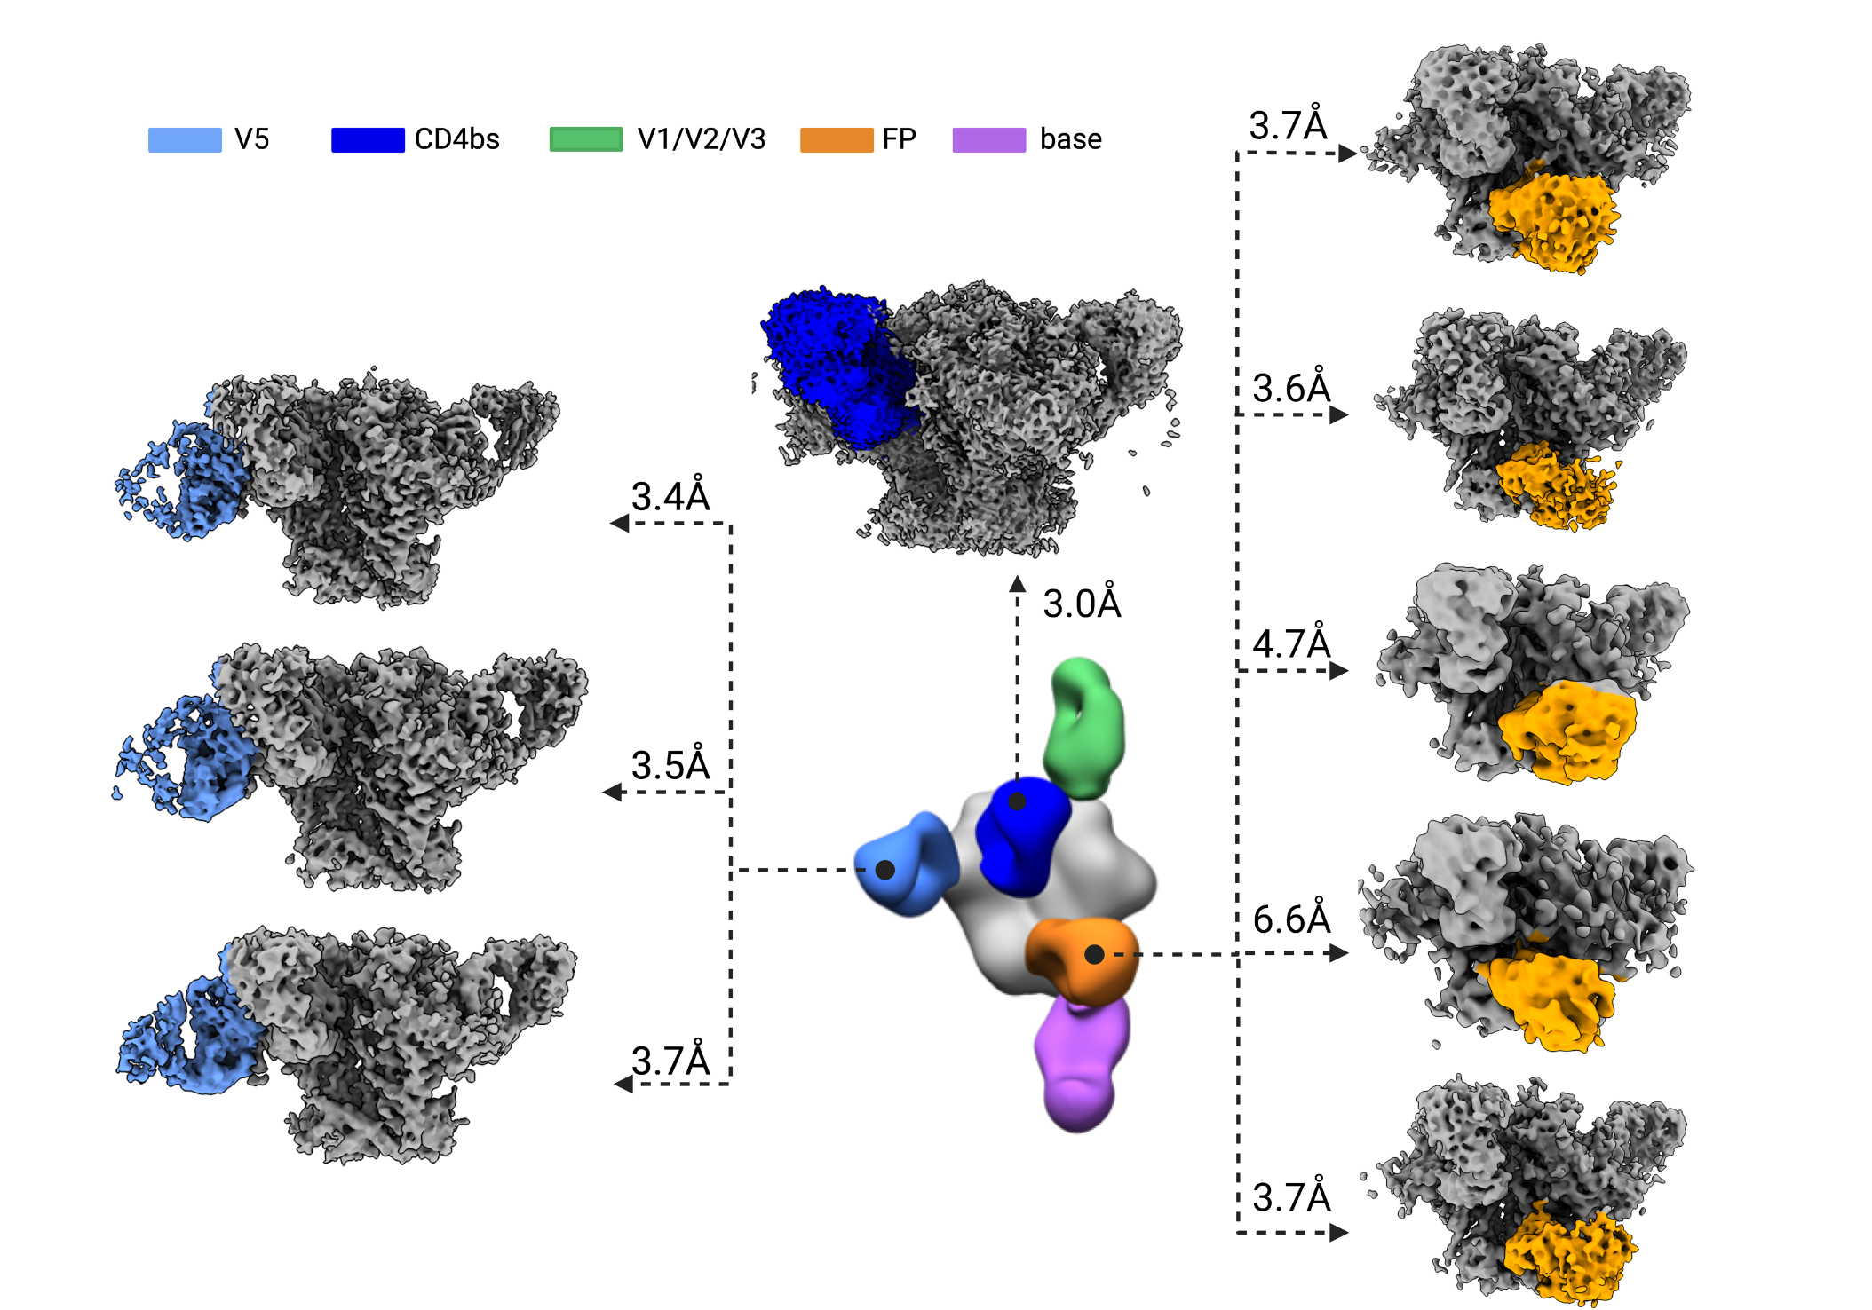
CryoEMPEM reveals dominant CD4bs response
32 weeks post-immunization
NHP-47729
wk 112
G. Ozorowski
S. Zhang
A. Ward
Notes:
No base or V1/V3 detected. Waning titers?
We used 501C-663C ”CC2” stabilized trimers that might block some base responses, but same CC2 trimer was used for nsEMPEM

Slide 12
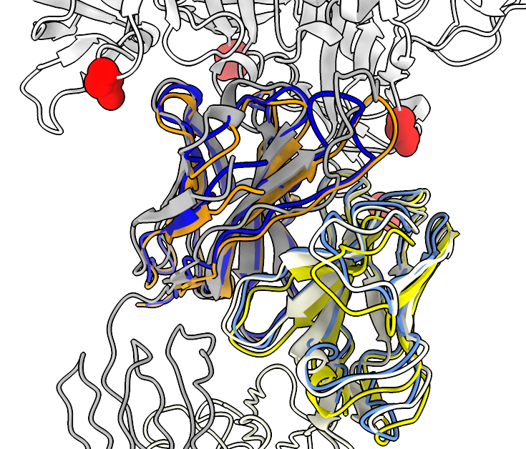
Dominant polyclonal (p) Ab response resembles that seen in “adult” NHP, and likely uses the same VH/VL
gp120 alignment
Infant/adult CD4bs-1 pAbs are predicted to to have CDRH3 of 16 aa; 21N13 has CDRH3 of 21 aa.
All 3 have CDRL3 of 9 aa.
All 3 can accommodate a glycan at N276.
Animals in three different study groups converge on CD4bs response that uses the same VH and VK genes.
386
Locations of
glycan knockouts
197
276
462
Infant pAb LC
Adult CD4bs-1 pAb LC
Adult 21N13 mAb HC
Infant pAb HC (3.0Å)
Adult CD4bs-1 pAb HC (3.4Å)
Adult 21N13 mAb HC(4.6Å)
G. Ozorowski
Notes:
an overlay of infant CD4bs pAb with one identified in adult NHP from L1 study shows similarity in HC/LC and binding angle, despite differences in HCDR3 length
CD4bs-1 pAb:
<4% SHM aa (IGHV)
<4% SHM aa (IGKV)
(based on matched sequences from structural prediction)
21N13 mAb:
~13% SHM aa (IGHV)
~8% SHM nt (IGKV)
21N13 binds to BG505 (EC₅₀: <0.01 μg/mL) and neutralizes BG505 pseudoviruses (IC₅₀: 0.34 μg/mL).
CD4bs-1 pAb is predicted to to have CDRH3 of 15 or 16 aa; 21N13 has CDRH3 of 21 aa.
High overlap suggests that CD4bs response is not specific to this animal only.

Slide 13
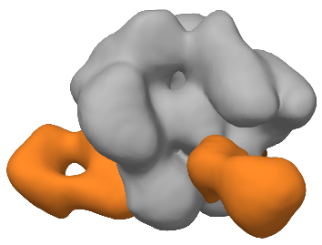
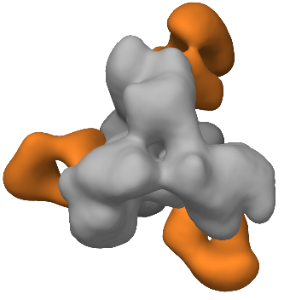

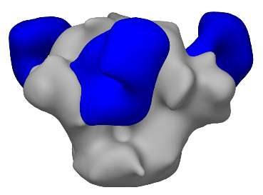
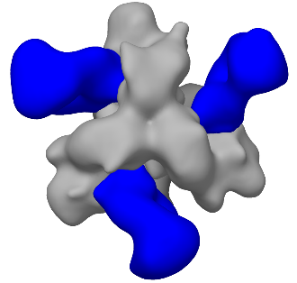

Isolation of a tier 2 autologous virus neutralizing mAb (220_Rh) targeting the CD4bs
FP
128_Rh
9% SHM
VH4-80/Vk1-32
CD4bs
220_Rh
14% SHM
VH4-122/Vk1-74
BG505 GT1.1
A. Nelson
S. Zhang
A. Ward
Isolated mAbs originated from NHP 47729
Notes:
Consistent with the pAb mapping results, BCR repertoire analysis led to the isolation of 2 mAbs with autologous virus neutralizations activity.

Slide 14
mAb 220_Rh demonstrates moderate heterologous neutralization activity
Isolated mAbs originated from NHP 47729

Slide 15
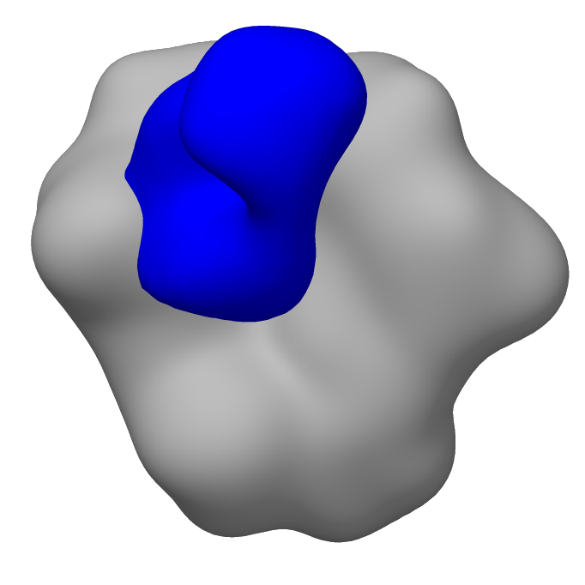
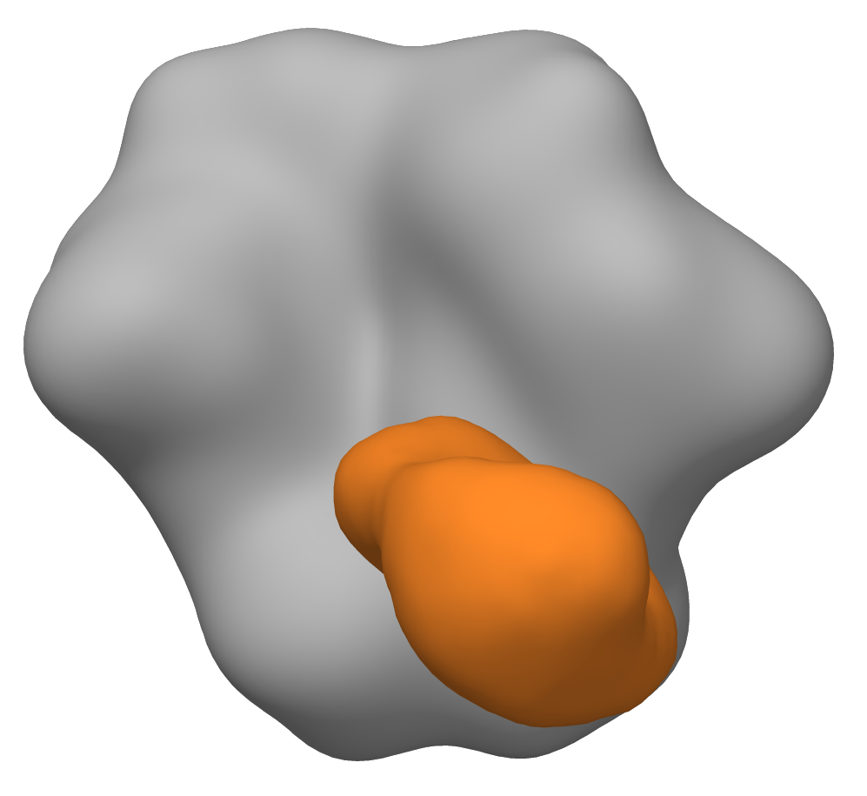
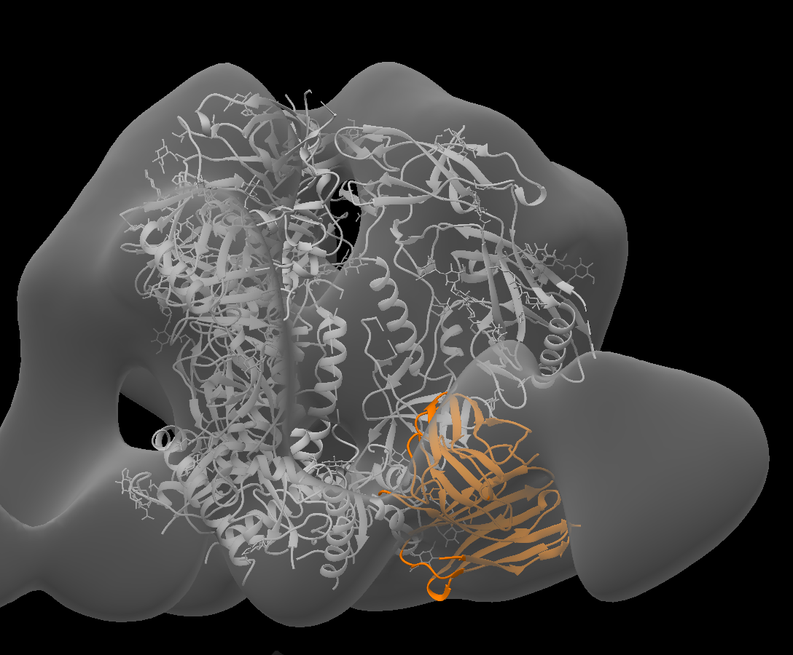
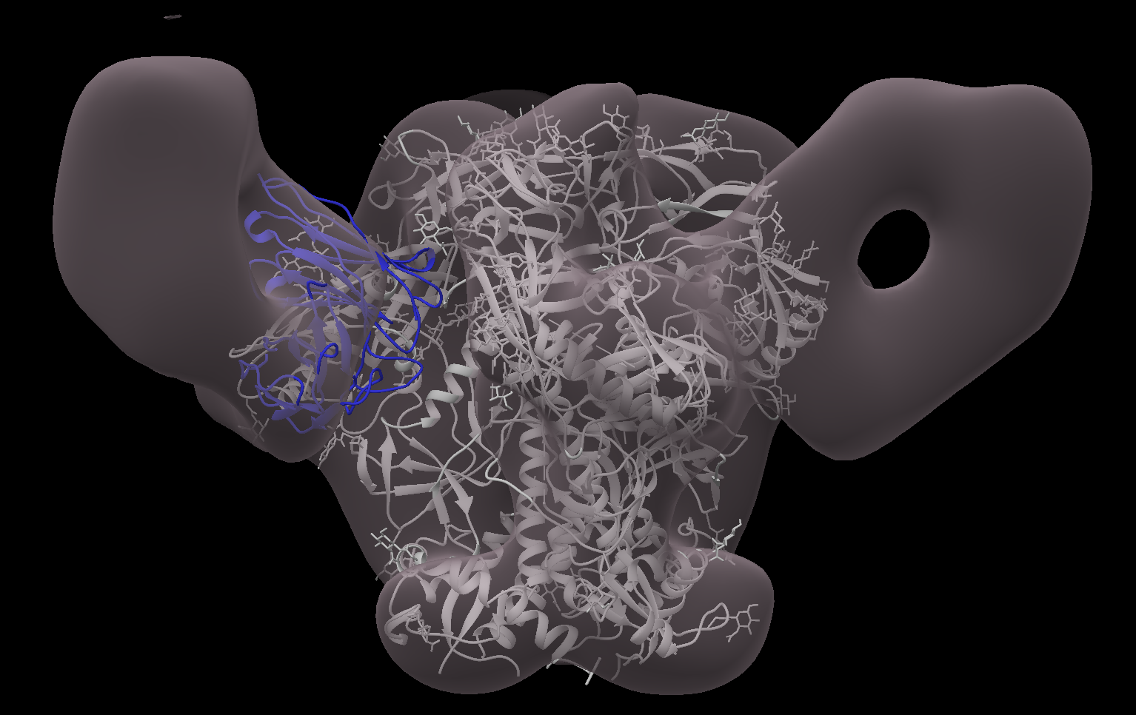
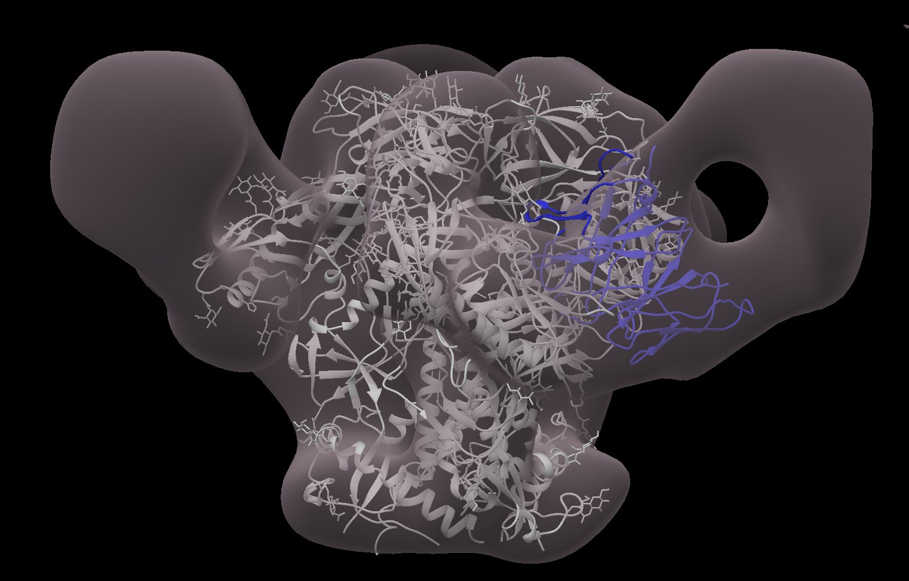
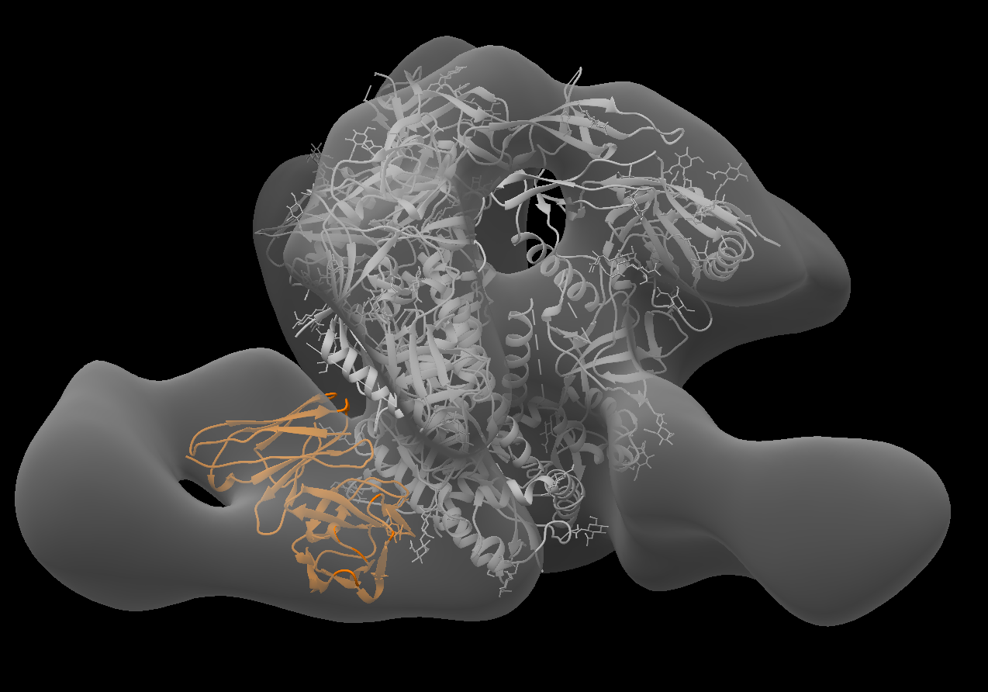
Isolated mAbs resemble an adult NHP isolated FP-specific mAb and CD4bs pAb responses
CD4bs
GT1.1
GT1.1
128_RH
220_RH
FP
CD4bs-1 pAb from cryoEMPEM (MIV08 animal 47729) fitted into the nsEM map
21N13 mab isolated from GT1.1 adult NHP study fitted into the nsEM map
A. Nelson
S. Zhang
G. Ozorowski
A. Ward

Slide 16
Summary
BG505 SOSIP immunization strategies induced high magnitude and durable IgG binding and autologous virus neutralization
3 out of 5 GT1.1 immunized infants developed VRC01-like bnAb precursors
EMPEM analysis of plasma antibodies confirmed the importance of GT1.1 priming in eliciting CD4bs targeting Abs in infant and adult RMs
  CryoEMPEM revealed the dominant response in polyclonal plasma as CD4bs
Two autologous virus neutralizing mAbs isolated, targeting the CD4bs and the Fusion peptide regions

Slide 17
Acknowledgements
Duke Human Vaccine Institute
Hongmei Gao
Xiaoying Shen
David Montefiori
Celia LeBranche
Justin Pollara
Guido Ferrari
Sravani Venkatayogi
Kevin Wiehe
Barton Haynes
UNC Chapel Hill
Kristina De Paris
Emma Milligan
Dominique Davis
Vidya Vijayan
Michael Hudgins
Katlyn Cross
UC Davis
Koen K.A. VanRompay
Jennifer Watanabe
Weill Cornell Medicine
John P. Moore
Albert Cupo
University of Amsterdam
Rogier W. Sanders
Ronald Derking
Dr. Sallie Permar (WCM)
Yasmine Issah
John Ramos
John Isaac
Xintao Hu
Mackensie Gross
Joshua Eudailey
Additional Lab members
Fouda/Nelson Lab (WCM)
Maria Dennis
Kenneth Vuong
Stella Berendam
Alliyah Byrd
The Scripps Research Institute
Andrew Ward
Gabriel Ozorowski
Shiyu Zhang
Leigh Sewell
NIH
Adrian McDermott
Funding:
HIVRAD project grant (NIH) #1P01A117915-03

