Slide 1
Induction of V3 glycan-directed responses by vaccination with
CH848 gp160 mRNA-LNP in infant rhesus macaques
Dominique Davis, University of North Carolina at Chapel Hill, USA
Planet of the Apes:
Learning immunogenicity from animal models

Slide 2
Summary
What is your main question?
Can early life HIV-1 Env mRNA-LNP vaccination induce V3 glycan-directed broadly neutralizing antibodies in infant rhesus macaques?
What did you find?
nAb responses against the GDIR motif were induced in 4 of 6 infant RMs.
Why is it important?
A multidose vaccine regimen to induce bnAbs that can protect against sexual acquisition in the high-risk group of young adults could be incorporated into the EPI schedule.
Notes:
The goal of this study was to induce v3 glycan-directed bnAbs in RMs by vaccinating with HIV Env mRNA-LNP immunogens beginning during infancy.
We found that our vaccine strategy induced nAb responses directed against the GDIR motif in 4 out of 6 RMs
Young adults are high-risk group for HIV acquisition. These findings contribute valuable information for the progress of using a multidose vaccine regimen to induce protective bnAbs by the age adolescence, and if started during infancy the vaccine could easily be incorporated into the EPI schedule.

Slide 3
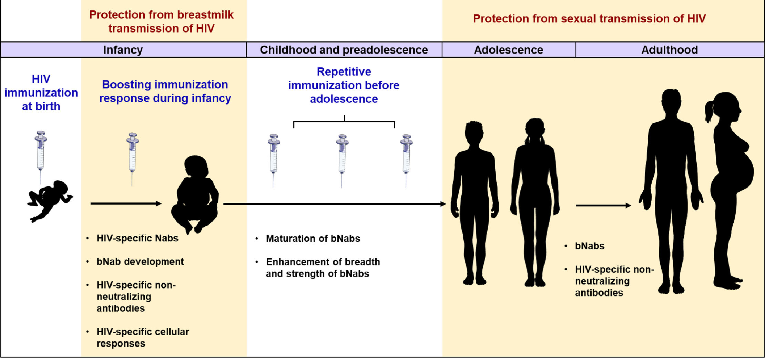
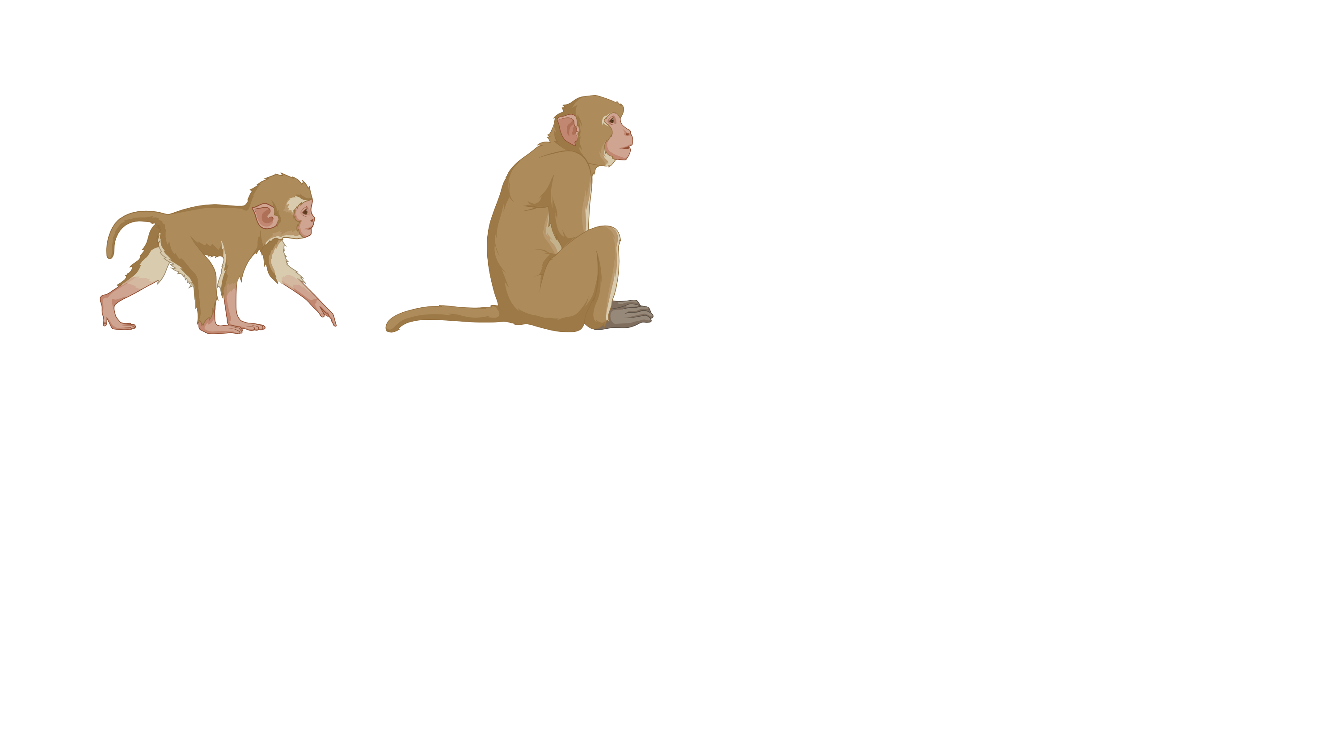
Rationale: Early Life HIV Vaccine
Fouda et al., Cell, 2020
prime
shepherd + polish
protective bnAbs
induction of bnAbs requires a multi-dose regimen
birth is the most reliable healthcare contact; easy implementation into EPI schedule
vaccination in early life provides the window of time necessary for bnAb induction
vaccine-induced protective immunity needs to be achieved prior to sexual maturity
Notes:
Beginning vaccination during early life would provide time for bnAbs to develop and protect before the age of sexual maturity, which is imperative.
Previous studies have shown that an effective HIV vaccine that induces bnAbs will require a multi-dose regimen, so we used an infant RM model and vaccinated using a priming immunogen followed by sheparding and polishing immunogens to try to induce protective bnabs.

Slide 4
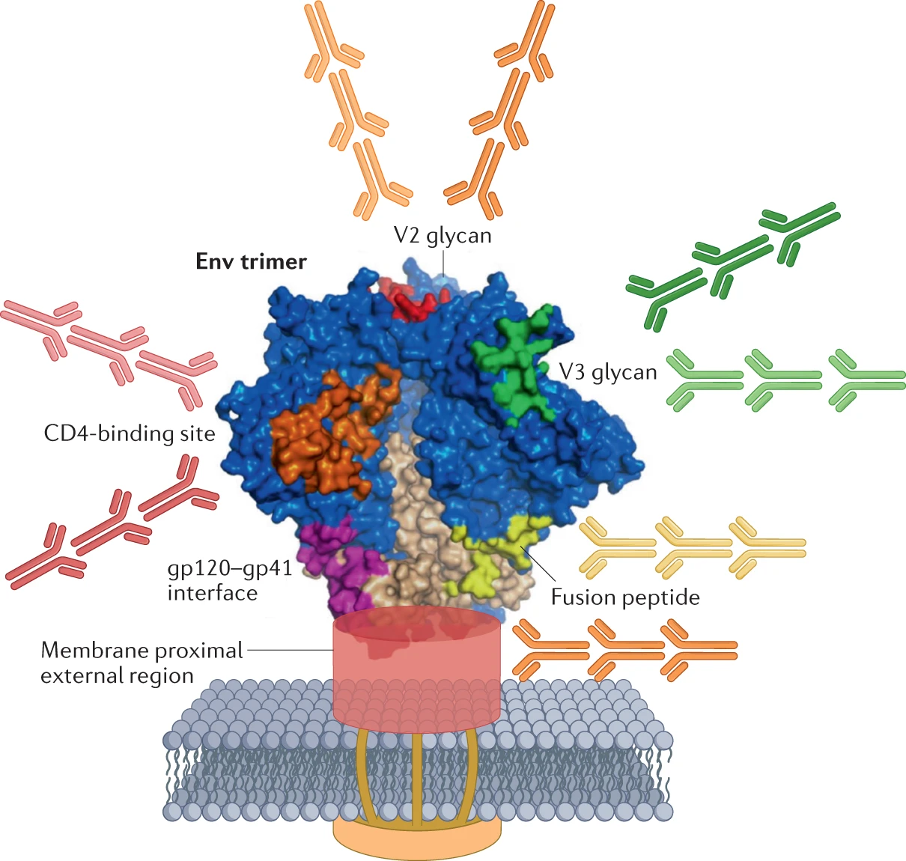
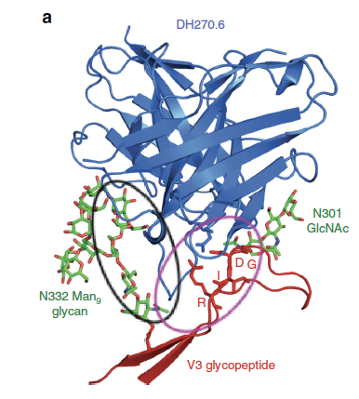
Rationale - Immunogen
induction of bnAbs is a rare event
V3 glycan-targeting bnAbs require fewer improbable mutations
  - 4 mutations in DH270 sufficient for >70% neutralization capacity
DH270
DH270
N332T
GDIR
Haynes et al., Nat Rev Immunol, 2023
Fera et al., Nat Comm, 2018
Notes:
Our vaccine regimen targeted the V3 glycan site. Isolated antibodies, such as DH270 have been found to require fewer improbable mutations before achieving neutralization breadth.
To determine if our animals had a response to the V3 glycan, we specifically looked at responses that were dependent on either the N332T glycan or the GDIR motif

Slide 5
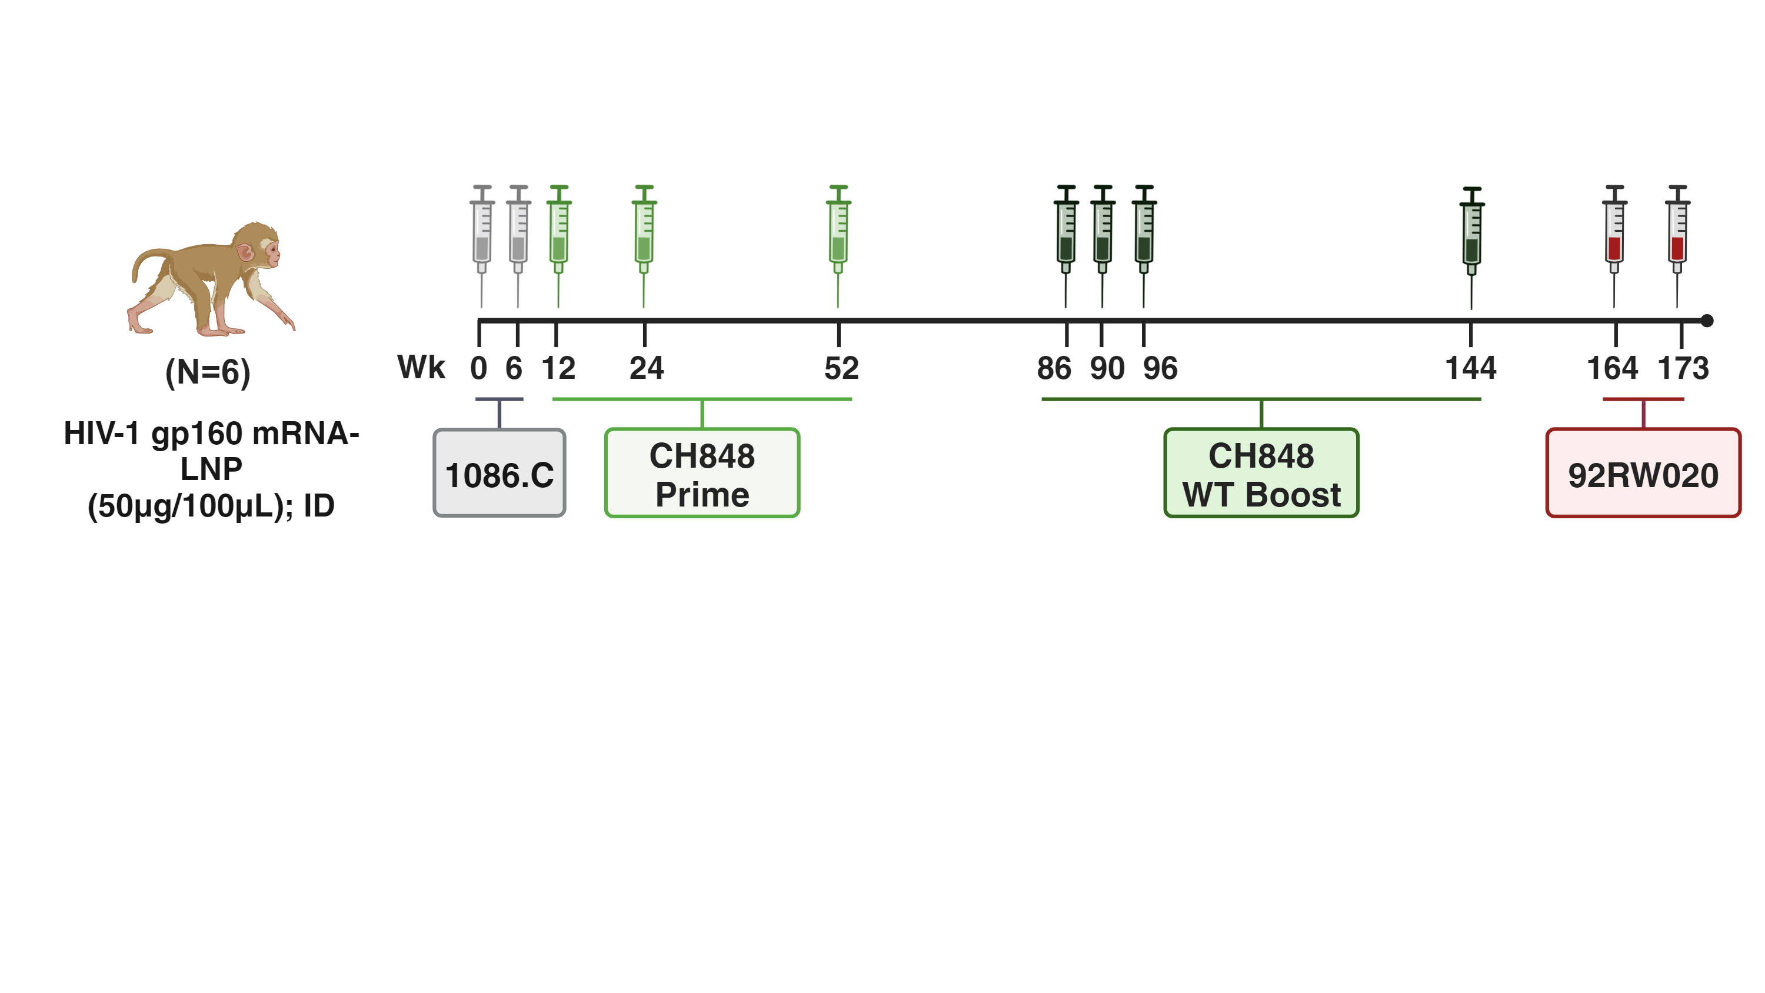
Study Design
Lacking N133 and N138 V1 glycans
V1 glycans restored
Notes:
We initially began by vaccinating with 1086.C but switched immunogens early on due to poor tier 1 neutralizing responses in a separate study.
We then began vaccinating with a CH848 priming immunogen that lacks the N133 and N138 V1 glycans which we then followed by boosting with CH848 WT, which had the V1 glycans added back.

Slide 6
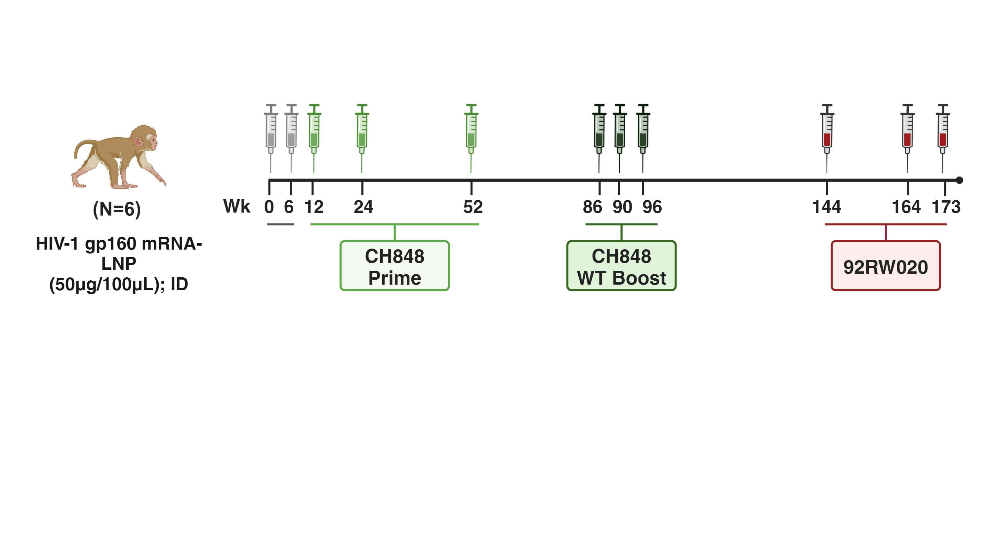
Antibody Responses
- wk 54/ post prime -
Autologous Tier 2 nAbs
CH848 gp120 Binding IgG
CH0848.3.d949.10.17.N133D.N138T
Plasma IgG recall response after each boost
4 of 6 infant RM ID50 titers >10⁵
Notes:
2 wks post the third priming immunogen, we found recall IgG response in the plasma
4 out of 6 infants also had high autologous tier 2 nAb titers in the sera.

Slide 7
Neutralizing Antibody Responses
- wk 54/ post prime -
ID₅₀ Fold Change
(CH848 Prime/ CH848 Mutant Pseudovirus)
Tier 2 Heterologous nAb
RM 2
RM 5
RM 6
N332T
GAIR
GDAR
N332T directed response in two infants
GDIR Motif directed response in two infants
Low heterologous nAb responses in three infants
Notes:
We wanted to see if the nAb responses were targeting the V3 glycan. By testing mutant pseudoviruses and looking for neutralization dependence, we found that two infants had a greater than 3 fold decrease against the N332T glycan, and two infants had a GDIR motif directed response. All indicative that the Abs induced were V3 glycan-directed.
When sera was tested against a tier 2 heterologous panel, we also found that 3 of the 4 infants that had a V3 glycan-directed response also had low tier2 heterologous neutralization.

Slide 8
Env-specific B Cell Responses
- week 54/ post prime -
CH848-specific B cells
V3 glycan-specific B cells
Hook+ (%CD27+ B Cells)
N332T- Hook+ (%CD27+ B Cells)
3 of 4 infants with V3-glycan targeting nAbs had detectable V3 glycan-specific B cells
Notes:
We used spectral flow cytometry to test for Env-specific B cells in PBMCs. We found that 5 out of 6 infants had detectable Env-specific B cells, and four of six had V3 glycan-specific B Cells. Three of which also had V3-glycan targeting nAbs.

Slide 9
Neutralizing Antibody Responses
- week 98; post boost/shepherding -
Autologous Tier 2 nAbs
ID₅₀ CH848 WT Vaccine Virus
CH0848.3.d949.10.17
Animal ID | Wk54 | Wk98
RM1 | <19.9 | <19.9
RM2 | <19.9 | 41.5
RM3 | <19.9 | 27.1
RM4 | <19.9 | 42.9
RM5 | <19.9 | 22.2
RM6 | 30.0 | 30.4
CH0848.3.d949.10.17.N133D.N138T
high nAb titers to the vaccine prime virus
low nAb titers to the vaccine boost virus
Notes:
After the infants received their third WT boost immunogen with the V1 glycans added back, we found that all infants still had autologous tier 2 neutralization against the CH848 priming immunogen
In contrast, the titers against the WT boost virus were low and only detected in 5 out of 6 animals.

Slide 10
Env-specific B Cell Responses
- week 98/ post boost/shepherding -
CH848-specific B cells
V3 glycan-specific B cells
Hook+ (%CD27+ B Cells)
N332T- Hook+ (%CD27+ B Cells)
persistence of CH848 Env-specific B cells
loss of V3-specific B cells
CH848 WT Boost did not promote V3-specific B cell
lineage maturation
Wk 54
Wk 98
Wk 54
Wk 98
Notes:
When looking in PBMCs, the env-specific B Cells persisted but there were no longer detectable V3 glycan-specific B cells present.
Based on these responses, we believe that the WT boost did not shepard the response to promote V3-specific B cell lineage maturation.

Slide 11
Plasma Antibody Breadth
- week 120/ 6 months post boost -
Binding
(log AUC)
SOSIP Trimer
6x doses; 6 mo post boost
JRFLv6
Wk 120
JRFLv6_MCD5
AC10.29
binding to both the CH848 priming and WT immunogens
4 of 6 infants can binding to
heterologous Envs
92RW020
NTD_ADEm3
Man9V3
CH848.1017
CH848.1017.DT
RM1
RM2
RM3
RM4
RM5
RM6
E. Lee, K. Saunders, B. Haynes
Notes:
Nonetheless, Kevin Saunders group tested plasma from these infants 6 months post WT boost for antibody breadth. They found that 4 of 6 infants had binding responses to heterologous Envs, specifically to 92RW020.

Slide 12
Study Design
- heterologous boost/polishing?! -
Clade A
Notes:
Based on those findings, we decided to boost with a heterologous immunogen, 92RW020, which is clade A. I also want to note that by the point of heterologous vaccination the animals were juveniles.

Slide 13
Plasma Binding IgG
- week 175/ post heterologous boost -
gp120 Binding IgG
Wk175
CH848
CH848
92RW020
92RW020
Notes:
Looking at plasma IgG binding, we see that the Ch848 recall responses were present throughout the study. by the second immunization the animals had higher binding to 92RW020.

Slide 14
Neutralizing Ab Responses
- week 175/ post heterologous boost -
Autologous Tier 2 nAbs
Fold Change
ID₅₀
ID₈₀
CH848 Prime
92RW020
92RW020
psuedovirus
N332T
GAIR
GDAR
N332T
GAIR
GDAR
nAbs of 4 of 6 RMs target GDIR motif
Notes:
Serum neutralization was higher against the CH848 Priming pseudovirus.
We then wanted to see if these responses were targeting the V3 glycan, and found four of six infants were dependent on the GDIR motif.

Slide 15
Longitudinal CH848-specific B Cell Frequencies
CH848-specific B cells
V3 glycan-specific B cells
Hook+ (%CD27+ B Cells)
N332T- Hook+ (%CD27+ B Cells)
Wk 54
Wk 98
Wk 175
Wk 54
Wk 98
Wk 175
CH848-specific B cells in 6/6 RMs
heterologous Env boost increased V3 glycan-specific B cells
Notes:
We found that CH848 Env-specific B cells were still present in the PBMCs, and there were significantly higher V3 glycan-diected Env-specific B Cells after the heterologous boost.

Slide 16
CH848 vs. 92RW020 Responses in Tissues
- week 175 -
92RW020-spec. B cells > CH848-spec. B cells
Memory response
Notes:
Lastly, we compared frequency of env-specific B cells in tissues as well as PBMCs post the second 92RW020 immunization. We found that there were more 92RW020-specific B cells than Ch848, but there were still some Ch848-specific B cells presentin the PBMCs which indicates that there is still a memory response.

Slide 17
Conclusion
N332T and GDIR V3 glycan-directed nAb responses can be elicited by early life vaccination
infants vaccinated from infancy throughout childhood and into adolescence were able to induce comparable responses against the vaccine and the heterologous Env immunogen
persistence of B cell responses = memory
development of bnAbs relies on optimal choice of shepherding and polishing immunogens
Notes:
In conclusion, vaccination beginning in infancy and throughout adolescence induced V3 glycan-directed responses. Animals developed comparable responses against the CH848 priming immunogen and the heterologous immunogen. There were persisting Env-specific B cells in the PBMCs, indicative of a memory response.
Lastly, the choice of the sheparding and polishing immunogens requires optimization in order for bnAbs to develop.

Slide 18





Team Members
Sallie Permar
Kimberly Courtney
Joshua Eudailey
Giny Fouda
Ria Goswami
Yasmine Issah
Ashley Nelson
John Ramos
Kenneth Vuong
Carolyn Weinbaum
Koen Van Rompay
Jennifer Watanabe
Jodie Usachenko
Ramya Immareddy
Wilhelm von Morgenland
Miles Christensen
Adam Hubert
Jennifer Stevenson
Alfonso Davalos
Katherine Olstad
Rachel Reader
Kristina De Paris
Katie Bosch
Dominique Davis
Dirk Dittmer
Jasmine Edwards
Alex Everhart
Michael Hudgens
Vidya Vijayan, K.K
Kasie Welch
Guido Ferrari
Danting Jiang
David Montefiori
Justin Pollara
Nicole Rodgers
Xiaoying Shen
Neil Surana
Kevin Wiehe
Sravani Venkatayogi
Bart Haynes
Kevin Saunders
Esther Lee
Drew Weissman
Mohamad-Gabriel Alameh
1P01 AI117915 Anjali Singh
1P01 AI178377 Amy Palin
Notes:
I would like to thank all of my team members that have put their time and effort into this project.

Slide 20



Acknowledgements
Special Thanks:
National Institute of Allergy and Infectious Diseases (NIAID)
National Institutes of Health (NIH)
Division of AIDS (DAIDS)
U.S. Department of Health and Human Services (HHS)
Duke Office of Clinical Research (DOCR)
Duke Human Vaccine Institute and School of Medicine
UNC School of Medicine
UC Davis California National Primate Research Center
Infectious Disease Research institute (IDRI)
3M and IDRI
Weill Cornell Medicine
Funded By:
Early Life Vaccination to Prevent HIV Acquisition during Adolescence (1P0 1A117915)
NIH/ NIAD
Anjali Singh
Amy Palin

Slide 21
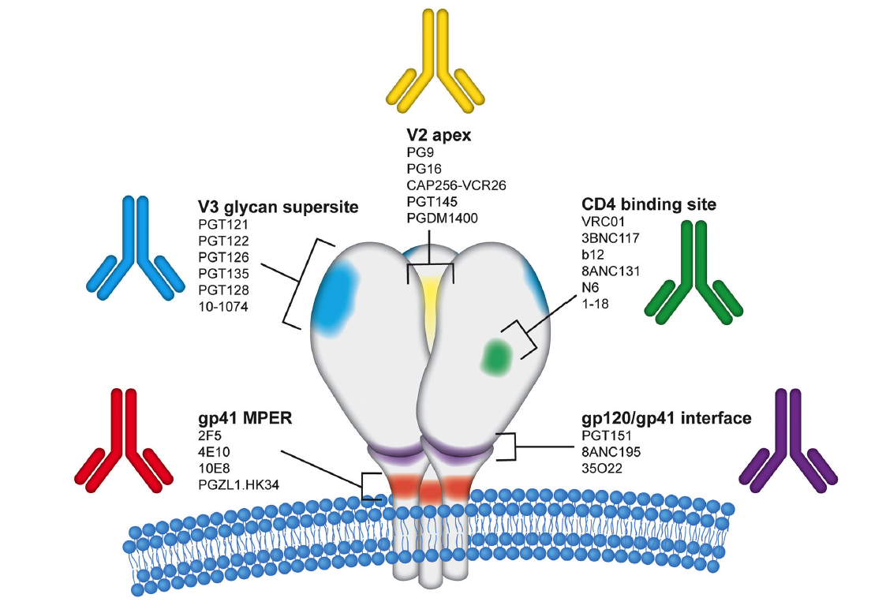
Rationale
DH270.6
Haigwood and Hessell et al., Front. Public Health., 2021
N332T
GDIR
different types of bnAbs target distinct regions of Env
induction of bNAbs and/or their precursors is a rare event
V3 glycan site bnAbs require fewer improbable mutations
  only 4 mutations are sufficient for DH270 clone to achieve >70% neutralization capacity
Fera et al., Nat Comm, 2018
Notes:
Induction of bnAbs requires a series of rare events: Env needs to engage with germline targeting BCR, BCR must undergo affinity maturation that includes numerous improbable mutations to proceed towards bnAb precursors and their maturation
V3 glycan –directed bnAbs, such as DH270.6, PGT121 isolated from adults and the BF520.1 bNAb isolated form an infant all have in common fewer improbable mutations
We decided to focus on the induction of V3 glycan targeting bnAb precursors. We know that the induction of broadly neutralizing Abs is a rare event and that it requires improbable mutations. To achieve the development of V3-like and lineage bnAbs there are fewer improbable mutations that must occur.
Looking at the second graph, the x-axis the # of improbable mutations in the heavy chain and on the Y-axis you see the frequency of mutations. Highlighted in green are the CD4bs, which requires a minimum of 12 whereas if you look at DH270.6, which is V3 targeting isolated from an infected adult, it requires fewer improb. Mutations, even less than is on this figure. Recent findings that Kristina presented earlier from Kevin Wiehe show that only 4 mutations are necessary to achieve over 70% neutralization capacity. Lastly, highlighted in white is a bnAb isolated from an infected infant, which interestingly required fewer mutations.

Slide 22
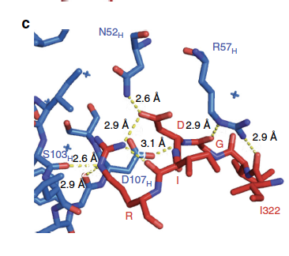
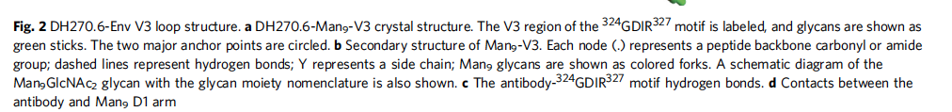
Fera et al., Nat Comm, 2018

