Slide 1
Early Life HIV Immunization:
Immunogenicity of germline-target BG505 SOSIP trimer immunization in infant and juvenile Rhesus Macaques
Yasmine Issah, ScM
Weill Cornell Medicine, Department of Pediatrics
Mentors: Dr. Sallie Permar and Dr. Ashley Nelson
HIVR4P 2024
October 9th, 2024
Notes:
[Fn, atl, F5]

Slide 2

Summary
What is your main question?
Using a germline targeting immunization strategy can we elicit precursors of broadly neutralizing antibodies (bnAbs) in infant and juvenile rhesus macaques?
What did you find?
Infants displayed a stronger immunogenicity profile compared to juveniles when it come to antibody binding, bnAb precursor development, and heterologous neutralization.
Why is it important?
Understanding how HIV-immunization strategies can be introduced in early life can help provide protection to children and adolescents, which are an important age group to focus our efforts on. The early life immune systems seems uniquely situatied to promote to production of bnAbs

Slide 3
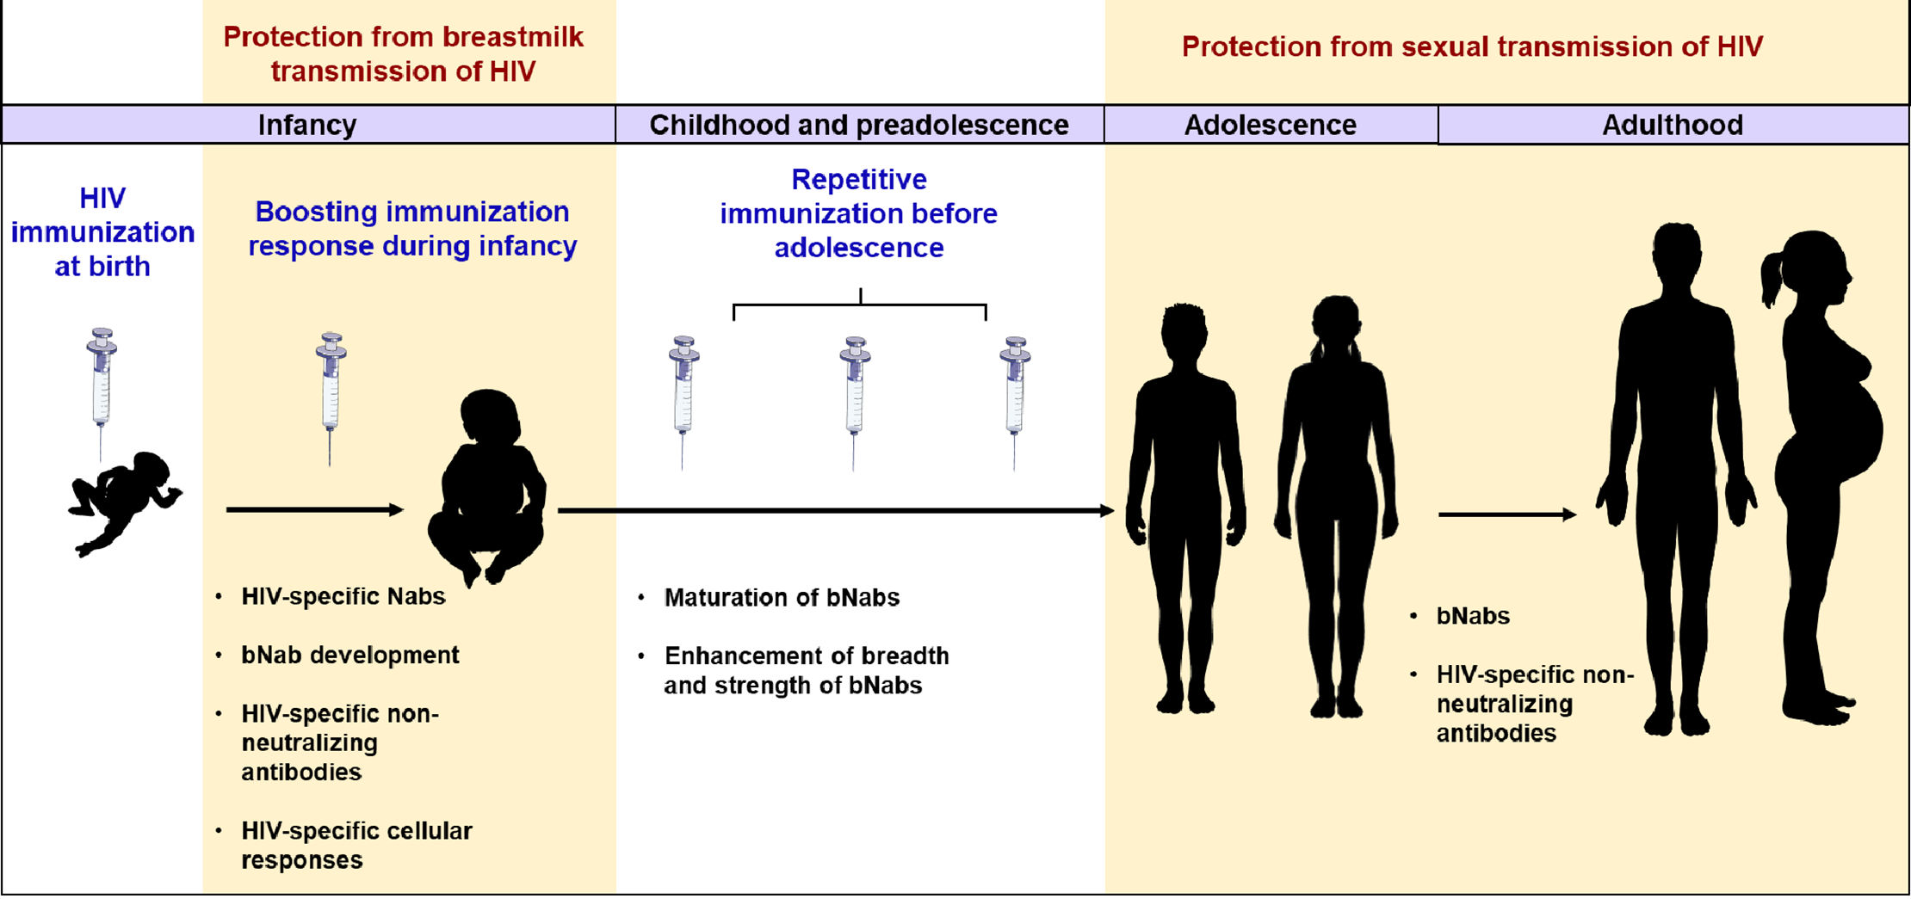
Imperative to develop a HIV-1 vaccine to protect children before adolescence
Risk of vertical transmission still results in ~120,000 infants born with HIV
Worldwide, there are ~410,000 new HIV infections annually among young people ages 10-24
Goswami et al. PLoS Pathog. (2020)
Notes:
Though antiretroviral therapy (ART) has reduced the risk of vertical transmission from mother to child, annually there are still about 160,000 infants born with HIV.
Mover worldwide…[read]
Therefore, as shown in this diagram below, it is imperative to develop a vaccine that can be given to children at birth and using subsequent boosters, protect children before they reach the age where HIV is more likely to be sexually transmitted and well into adulthood in the form of broadly neutralizing antibodies (bNabs) or HIV-specific non-neutralizing antibodies
https://journals.plos.org/plospathogens/article?id=10.1371/journal.ppat.1008983

Slide 4
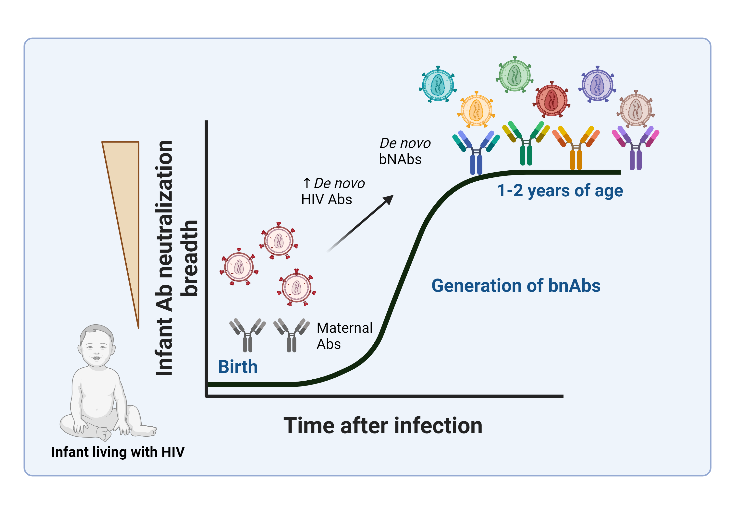
Effects of Age on Immune Response to HIV
Infants living with HIV can develop bNAb responses in plasma at a faster rate than adults living with HIV
Multi-epitope targeting bNAb lineages have been found in children with chronic infections, though the factors that cause this are unknown
Figure Adapted from Tomaras & Haynes. Nature Medicine. (2014). Made in BioRender
Notes:
Spend 30 sec
Though infants have a less experienced immune system, it actually more flexible is more flexible. Their naïve B cell clonal repertoire does evolve with the sequential exposure to pathogens and vaccines; thereby allowing them to generate immunity.
While maternal Abs can help control easy neutralize virus as time progress, the infants are able to generate their own breadth of bNAbs (often within 1-2 years), much faster than adult living with HIV. These infants have exceptional breadth in neutralization through the activation of multiple B cells lineages that can generate polycolonal responses (that can target multiple bNAb epitopes).
Despite knowing this, our understanding of why the infant immune landscape is so conducive for eliciting bNAbs is lacking.

Slide 5
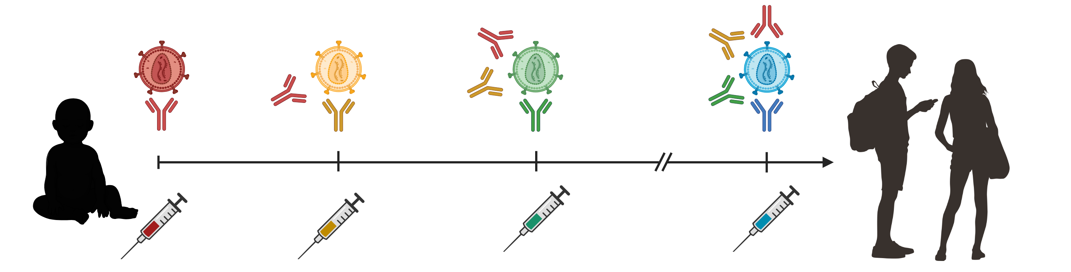
Study Goal
Does a protein-based BG505 GT1.1 SOSIP immunization followed by subsequent boosters elicit precursor bnAbs at a similar frequency in infants and juveniles?
Notes:
In the Permar lab, we have been conducting research on how to generate bNAbs that can provide protection to autologous and heterologous viruses using different immunization strategies.
So, the key question posed for our study was [READ]
[natural infection with HIV allows ]

Slide 6
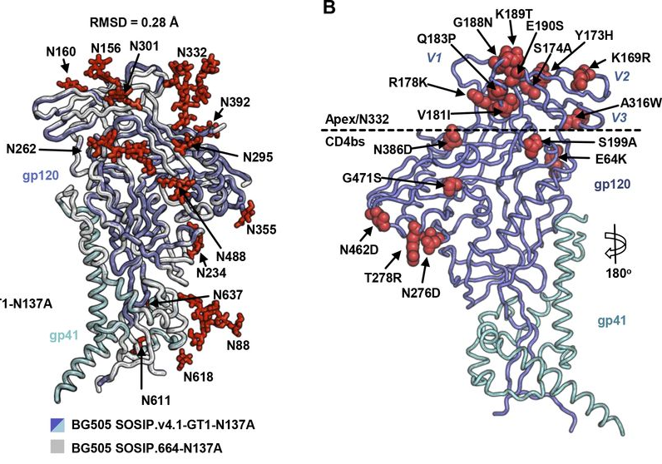
BG505 SOSIP Native-like Trimers
BG505 SOSIP.664
  Based on the subtype A T/F, BG505
  Elicits autologous tier 2 nAbs in adult RMs
  Engages VRC01-class UCAs that it can bind.
BG505 SOSIP v4.1-GT1.1
Pauthner et al. Immunity 2017
Max Medina-Ramírez et al. J Exp Med 2017
Notes:
The HIV env is a highly immunogenic epitope that normally found as a meta-stable trimer consisting of three gp120 and three gp41 subunits. The protein used in the vaccine called SOSIP, has been engineered to mimic the native HIV trimer while specifically targeting the germline bnAbs.
SOSIP trimers can present various epitopes that can generate bnAbs and subsequent boosters with this protein are meant to further mature these bnABs, increasing breadth and potency. BG505 SOSIP immunization strategies have been shown to induced durable, high magnitude antibody binding responses through 2 years.
The SOSIP I wall be focusing on today (for the most part) is the GT1.1 shown here on the right, which was modify from the original 664 to allow enhanced binding of germline bNAbs to epitopes such as those targeting the CD4 binding site (bs)
Extra
[SOSIP comes from the disulfilde bond that stabilizes the gp120-gp41 subunits and an isoleucine to proline mutation on gp41.]
Ribbon representation of one protomer illustrating the mutations introduced to SOSIP.v4.1-GT1 to improve stability and enhance gl-bNAb-binding.

Slide 7
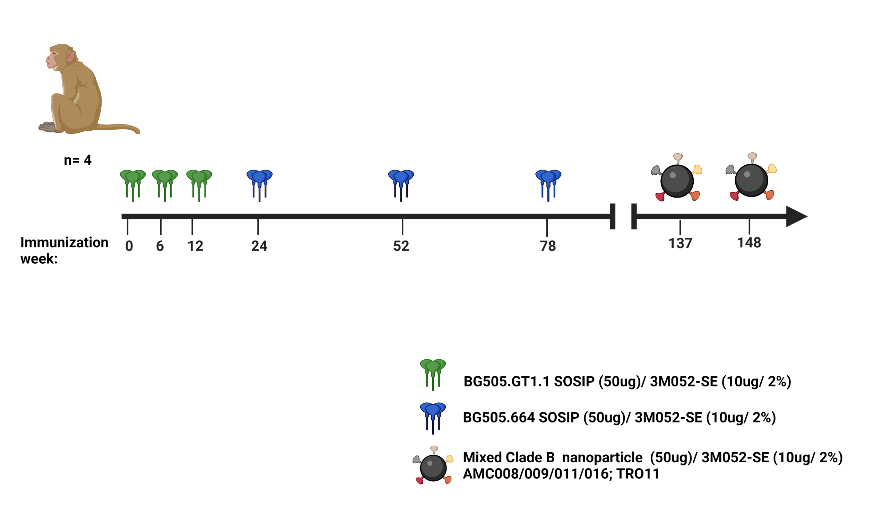
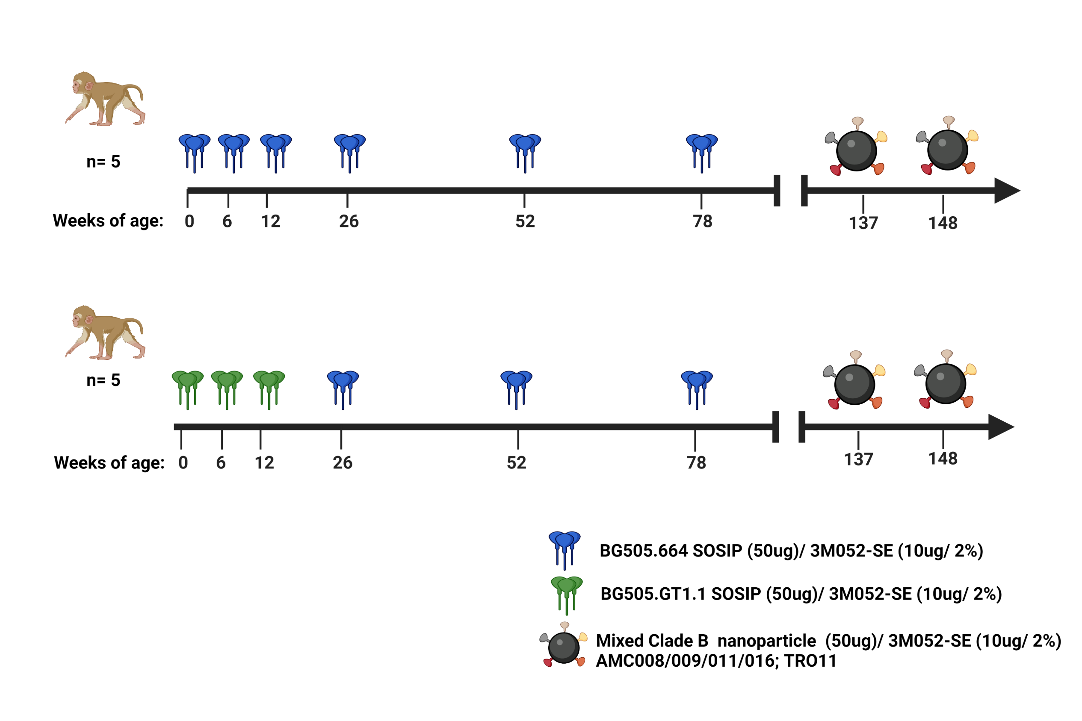
Immunization Schedule
Infant human age
(weeks):
<4
78
156
(3yr)
208-260
(4-5yr)
Juvenile human age
(weeks):
468-520
(9-10yr)
624-676
(12-13yr)
728-780
(14-15yr)
780-832
(15-16yr)
Notes:
For the Immunization Schedule, there were 5 animals in infant group (green) and 4 animals in juvenile (orange). The same vaccine regimen to both infant and juveniles which included 3 doses of BG505 GT1.1 SOSIP trimer prime followed by 3 doses of WT SOSIP boost all adjuanted with 3M-052
As you might have heard from previous talks adjuvant choice can augment humoral responses to provide better protection. For infants, this adjuvant has been shown to be effective in activating neonatal-presenting cells as well as generating a high breadth and functionality of antibody responses for the HIV env

Slide 8
Study Goal
  Evaluate the immunogenicity: binding and autologous neutralization

Slide 9
Infants
High GT1.1 Titers and the development of CD4bs precursor bnAbs in infant and juvenile RMs
Juveniles
GT1.1 Prime
WT Boost
X. Hu
J. Issac
Y. Issah

Slide 10
Infants
Comparable Autologous Tier 1 & 2 Neutralization Titers in infant and juvenile RMs
Juveniles
D. Montefiori

Slide 11
Study Goal
  Evaluate the immunogenicity: Binding and autologous neutralization
  Determine the epitopes on the HIV env that vaccine antibodies are binding to
Notes:
Next we wanted to assess the ability of our immunization strategy to induce CD4bs precursor bnAbs, using a virus neutralization-based assay.
We screened sera against the Puesdovirus 426c.TM1 containing targeted deletion of a subset of N-glycans bordering the CD4bs region that allow germline-reverted forms of VRC01-class bnAbs to neutralized the virus; the mutant puesdovirus which contains D279K mutations at the CD4bs should greatly reduce the antibody’s neutralization ability.
Glycans bordering the CD4bs can impede the binding of germline-reverted forms of VRC01-class bnAbs. So we screened sera against a Puesdovirus containing targeted deletion of a subset of N-glycans bordering the CD4bs region that allow germline-reverted forms of VRC01-class bnAbs to neutralized the virus; the mutant puesdovirus should greatly reduce the antibody’s neutralization ability

Slide 12
Infants
Development of CD4bs precursor bnAbs in infant and juvenile RMs
Juveniles
426c D279K Mutant
Fold Change
426c.TM1
ID₅₀
Infants
Juveniles
D. Montefiori
Notes:
Here we assign an animal as having the precursor response if we see an at least 3-fold difference between the WT and mutant strains.
When the sera was tested against these virus at weeks 54 and 80 we saw that 3 out 5 infants immunized with the GT1.1 SOSIP developed precursor bnAbs while only 1 out of the 4 juveniles developed that sample response.

Slide 13
Infants
High GT1.1 Titers and the development of CD4bs precursor bnAbs in infant and juvenile RMs
Juveniles
426c D279K Mutant
Fold Change
426c.TM1
ID₅₀
Infants
Juveniles
D. Montefiori
Notes:
Interesting we also found was that these animals that developed the precursor response also had the highest tier 1 GT1.1 virus neutralization titers. This could suggest that we might be able use the GT1.1 titers as a predictor for the development of the precursor response

Slide 14
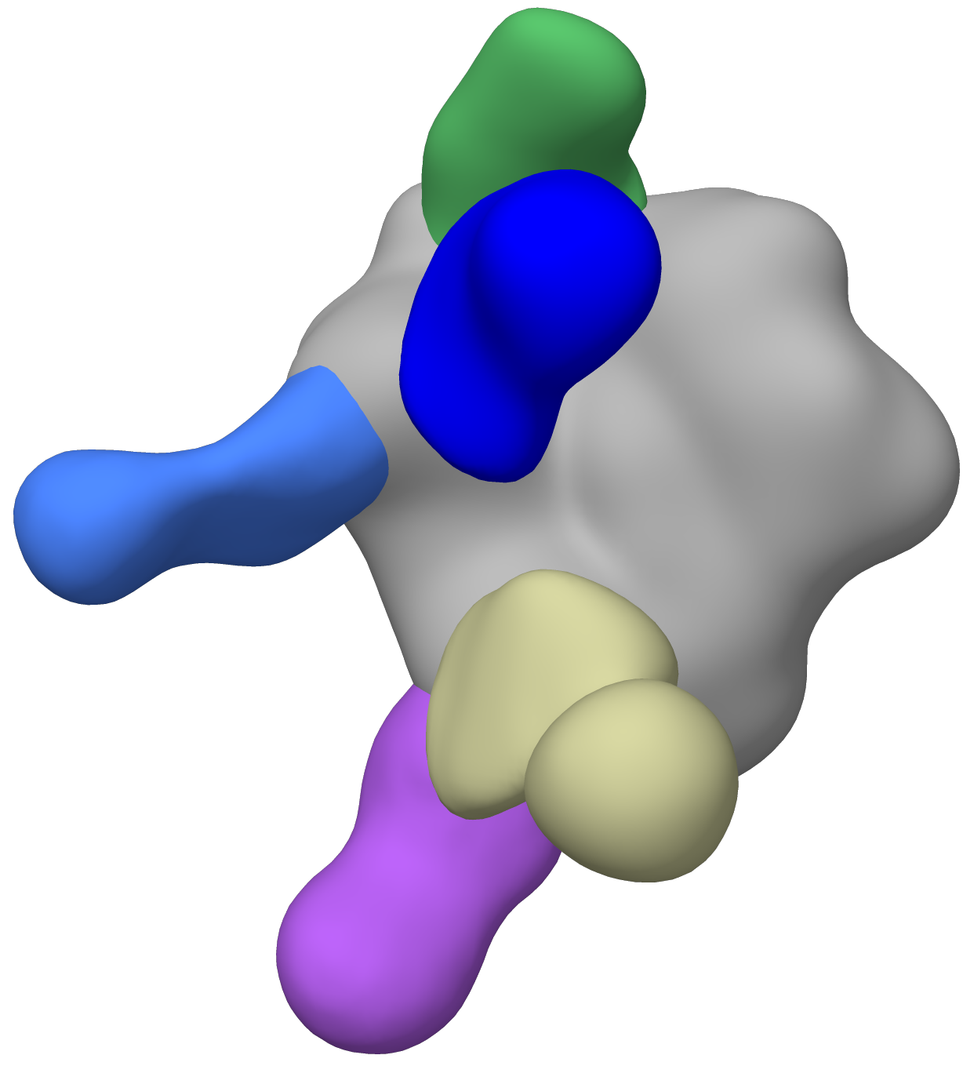
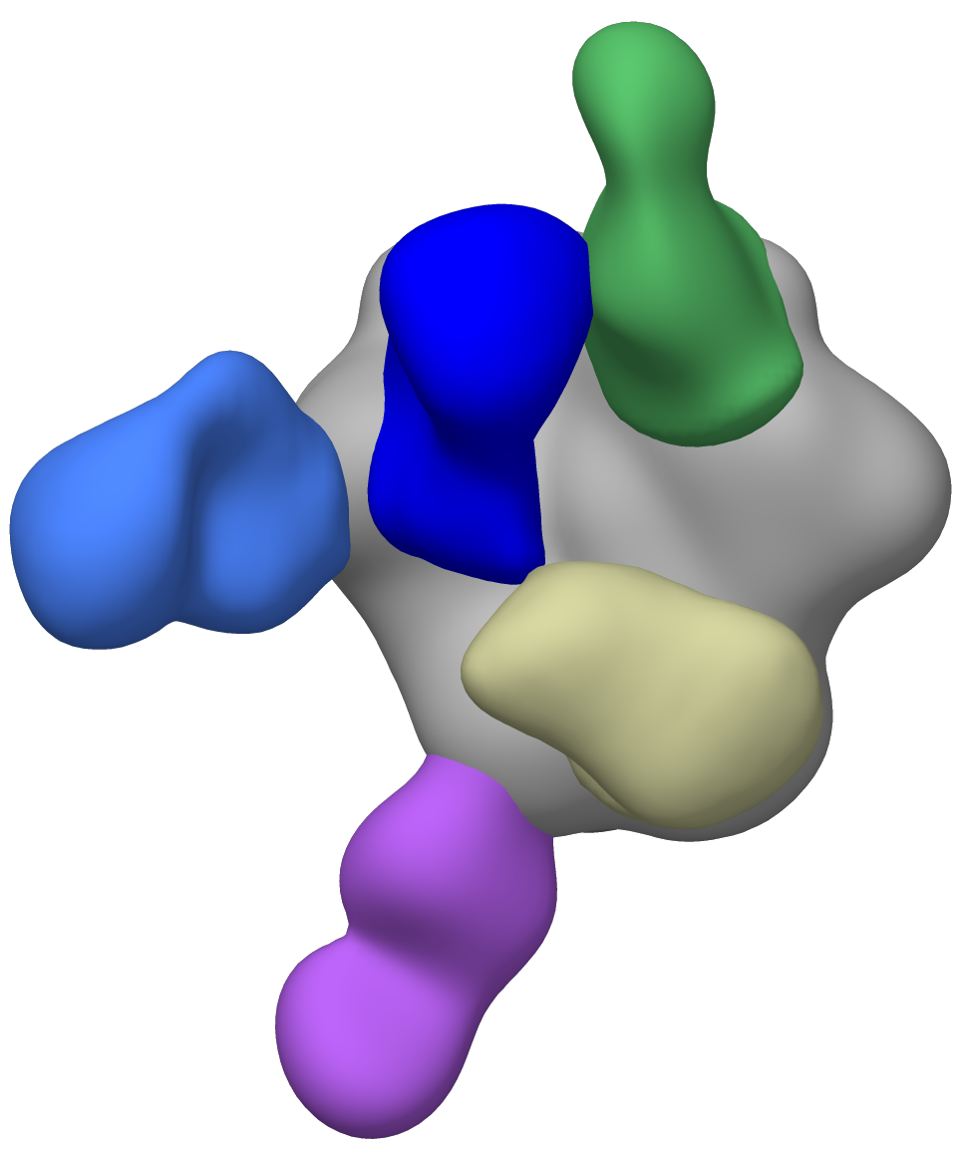
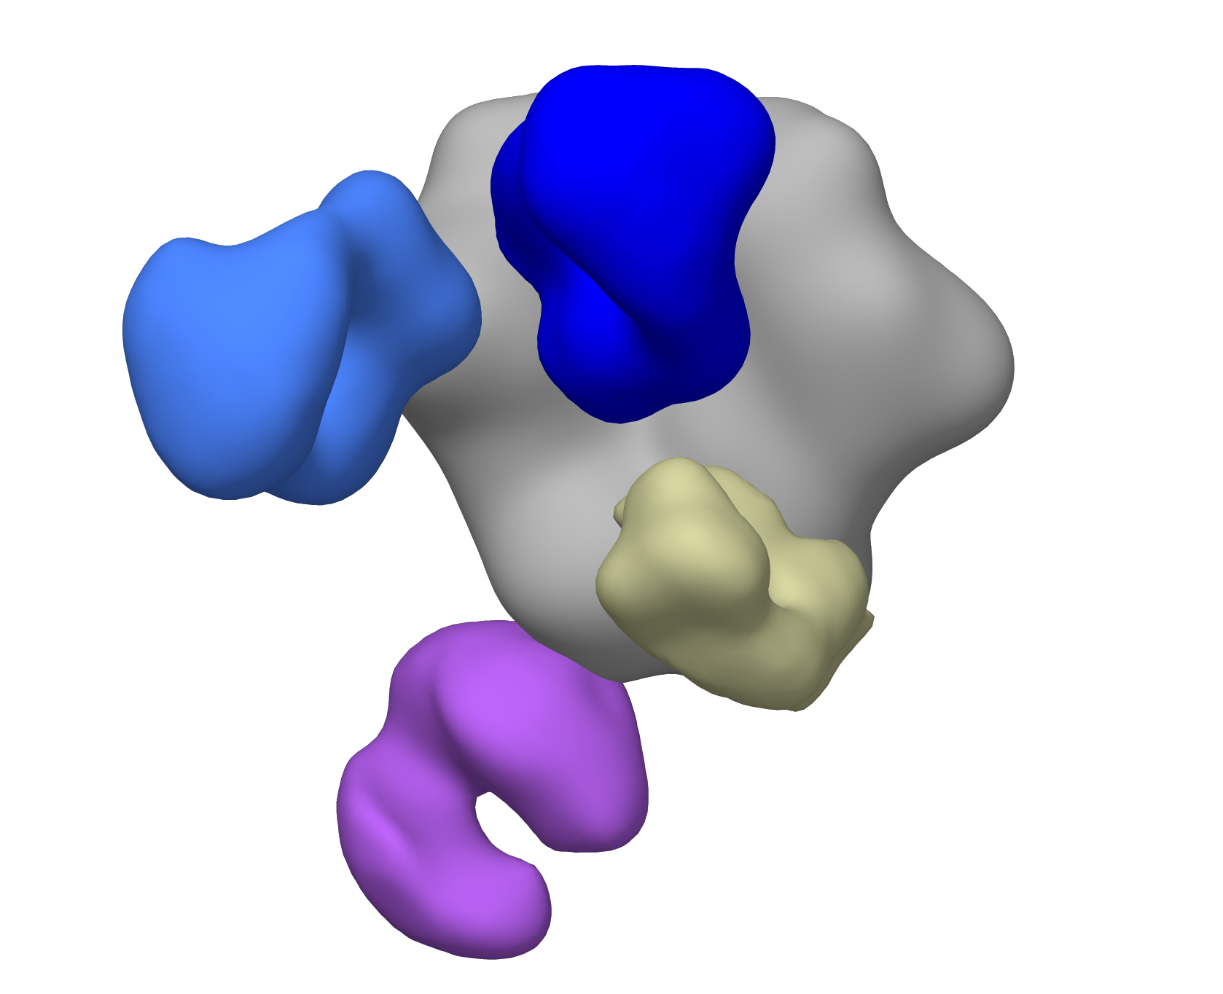
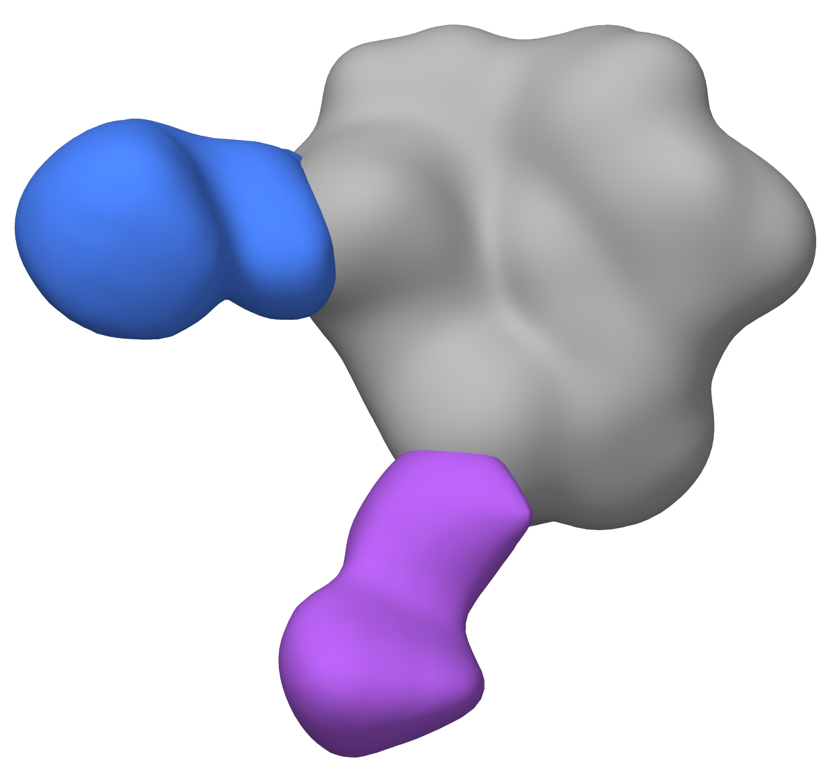






Plasma antibodies target the CD4bs and C3/V5 in most of the infants and juveniles
Week 80
47729
47734
47739
47750
47754
Infants
CD4bs bnAb precursor
46829
47465
Juveniles
47003
47362
A. Ward
G. Ozorowski
L. Sewell
S. Zhang
Base
gp41 GH/FP
gp41 GH/FP
N355/289 glycan
CD4bs
C3/V5
V1/V2/V3
Notes:
In order to get a prediction of which epitopes the plasma antibodies were binding to, you can use virus neutralization assays. While this method is useful it does give us a whole picture
In order to get a better understanding of how the polyclonal nature of our vaccine elicited antibodies, we utilize a method of negative staining Electron Microscopy Polyclonal Epitope Mapping (or EMPEM) to identify how the Fab portion of the antibodies are binding to epitopes. Here I am showing the structure that has been constructed from the Fab portions of isolated antibodies complexing to the trimer protein.
Boxed in red were the animals that had our CD4bs precursor signature. They do show more epitope binding that the other animals
nsEMPEM: MIV09 wk80 + GT1.1

Slide 15
BG505 GT1.1 immunization induces antibodies that can target diverse epitopes
Infants (n=5)
Juveniles (n=4)
Number of Animals
Number of Animals
R. Sanders
Jelle van Schooten
S. Zhang
G. Ozorowski
Notes:
Though they have similar binding to some epitopes the infants still seem to have a greater range in binding. This data also confirms what the GT1.1 SOSIP was designed to do; to drive antibody responses to target the apex (or V1/2/3) and the CD4bs.

Slide 16
Study Goal
  Evaluate the immunogenicity: Binding and autologous neutralization
  Determine the epitopes on the HIV env that vaccine antibodies are binding to
  Evaluate heterologous neutralizing antibodies

Slide 17
Immunization Schedule
Infant
Juvenile
Infant human age
(weeks):
<4
78
156
(3yr)
208-260
(4-5yr)
416-468
(8-9yr)
Juvenile human age
(weeks):
468-520
(9-10yr)
624-676
(12-13yr)
728-780
(14-15yr)
780-832
(15-16yr)
1040-1092
(20-21yr)
Notes:
For the Immunization Schedule, there were 5 animals in infant group (green) and 4 animals in juvenile (orange). The same vaccine regimen to both infant and juveniles which included 3 doses of BG505 GT1.1 SOSIP trimer prime followed by 3 doses of WT SOSIP boost and a clade B nanoparticle boost after over 1-year follow-up.

Slide 18
Infants
4 infants develop CD4bs precursor bnAb responses post-nanoparticle boost
Juveniles
426c-BG505 GT1.1
426c D279K Mutant
Fold Change
ID₅₀
Infants
Juveniles
D. Montefiori
Notes:
We again screened sera for precursors of CD4bs bnAbs
Now following the two doses of the nanoparticle boost using that same assay we saw that animal 47754 in the infant group was able to develop the CD4bs precursor bnAb response at week 150 and the other 3 animals maintained their precursor responses as well. The only animal in the infant group to now develop the precursor response consistently had the lowest GT1.1 titers
However for the juveniles the one animal that developed the response a weeks 54 and 80 was not able to maintain it, even post nanoparticle boost

Slide 19
Infants
Infants and juveniles show improved breadth in heterologous virus neutralization following clade B nanoparticle vaccination
Juveniles
Infant
Juvenile
4 of 5 infants with low level heterologous virus breadth
2 of 4 juveniles with low level heterologous virus breadth
Notes:
Lastly, we also wanted to evaluate the breadth of heterologous virus neutralization.
We again take sera from the animals and test them for neutralization against our global panel of viruses. When we look at the ability of vaccine elicited plasma antibodies to neutralize these different strains, we saw that in the infants, at 54, there is some heterologous neutralization but by 150, after the nanoparticle boost, 4 out of 5 infants show moderate/low levels of heterologous virus neutralization. In the juveniles, however, we see that 2 out of the 4 animals developed moderate/low levels of heterologous virus breadth.
So, both groups showed improved breadth but more infants showed a response following the NP boost

Slide 20
Summary
Study Goal | Results
 | Infants | Juveniles
BG505 SOSIP GT1.1 Binding | ↑ | ↓
Autologous Tier 1&2 Neutralization | ≡ | ≡
CD4bs precursor bNAbs | ↑ | ↓
Polyclone Epitope Mapping | ↑ | ↓
Heterologous Neutralization | ↑ | ↓
Take away: Immunization of infants at an early age seems to better environment to elicit precursor bNAbs that can neutralize key sites of the HIV env
Notes:
Make Takeaway and Future Directions a new slide.
Further examine the B cell and BCR repertoire of the infants and juveniles
Isolating and identifying sequences that correspond the broadly neutralizing phenotype seen in vaccine elicited plasma in infants and juveniles

Slide 21
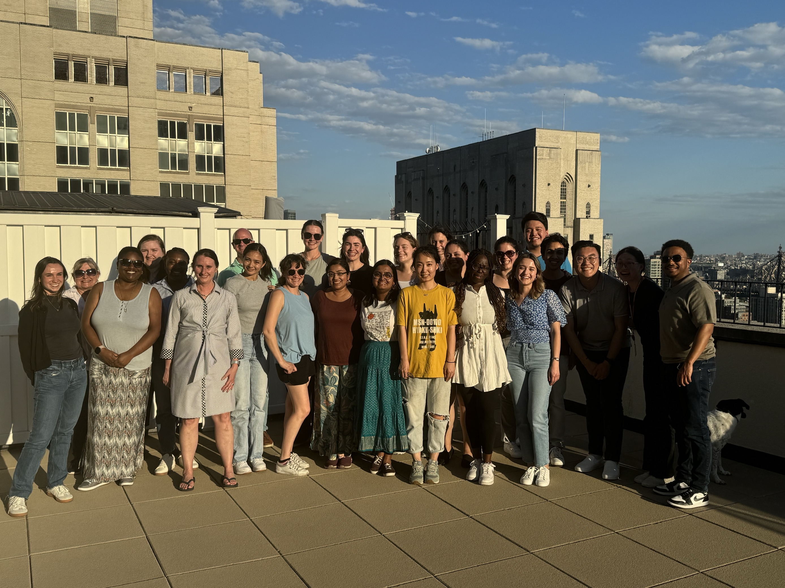
Acknowledgements
University of Amsterdam
Rogier W. Sanders
Ronald Derking
The Scripps Research Institute
Andrew Ward
Gabriel Ozorowski
Shiyu Zhang
Leigh Sewell
Permar Lab
Sallie Permar
Carolyn Weinbaum
Joshua Eudailey
Ria Goswami
Krithika Karthiegeyan
Caitlin Williams
Chelsea Crooks
Hsuan-Yuan (Sherry) Wang
Claire Otero
Megan Conners
Christian Binuya
John Ramos
Adelaide Fuller
Libby Mitchell
Nicole Soo
Dakota Koop
Aiquan Chang
Olusola (Sola) Omonije
Sergey Anayev
Fouda/Nelson Lab
Ashley Nelson
Genevieve Fouda
Maria Denis
Kenneth Vuong
UNC Chapel Hill
Kristina De Paris
Emma Milligan
Dominique Davis
Michael Hudgins
Katlyn Cross
UC Davis
Koen K.A. Van Rompay
Jennifer Watanabe
Weill Cornell Medicine
John P. Moore
Albert Cupo
Funding: HIVRAD project grant (NIH) #1P01A117915-03
Duke Human Vaccine Institute
Hongmei Gao
Xiaoying Shen
David Montefiori
Celia LeBranche
Justin Pollara
Guido Ferrari
Srivani Venkatayogi
Kevin Wiehe
Barton Haynes
T32 NIH Initiative for Maximizing Student Development (IMSD)
5R25GM130494-05
NIH
Adrian McDermott

Slide 22
Extra

Slide 23
Infants
Comparable plasma antibody binding to Clade B HIV env antigens across age groups
Juveniles
Y. Issah
Notes:
Here we use the bead-based method of Binding Antibody Multiplex Assay (BAMA) which unlike ELISA allows us to measure the ability of plasma antibodies to bind to multiple antigens within the same assay. Values are reported as MFI subtracted from the background of an untagged bead.
We tested plasma taken from weeks 13(which was the first dose of the NP) and 139 and 150 (two weeks following both doses of the NP. As exexpected we see an increase in binding following both immunizations

Slide 24
Infants
Comparable Binding to Clade B HIV env antigens across age groups
Juveniles
Y. Issah
Notes:
Here is a break down of the of the binding by each antigen and as you can see here there were no significant differences in binding across each of the different antigens

Slide 25
Neutralization screening for development of CD4bs precursor
426c.TM1: 426c.N276D.N460D.N463D GnT1- | Engages germline-reverted forms of VRC01-class bnAbs
Mutant: 426c.N276D.N460D.N463D.D279K GnT1- | Neutralization by the germline-reverted antibodies is abrogated by the VRC01 resistance mutation, D279K
LaBranche CC et al. Plos Path 2018
Notes:
Can remove [Can explain]- or can make it just in case slide
Next we wanted to assess the ability of our immunization strategy to induce CD4bs precursor bnAbs, using a virus neutralization-based assay.
Glycans bordering the CD4bs can impede the binding of germline-reverted forms of VRC01-class bnAbs. So we screened sera against a Puesdovirus containing targeted deletion of a subset of N-glycans bordering the CD4bs region that allow germline-reverted forms of VRC01-class bnAbs to neutralized the virus; the mutant puesdovirus should greatly reduce the antibody’s neutralization ability.
Misc:
These viruses were produced in 293S GnT1⁻ cells which generate Man₅-enriched PsV, with the rationale that relatively small Man₅ would replace larger complex-type glycans, thereby improving access to the CD4bs.
Virus is Clade C
The GT1.1 was designed from the BG505 WT SOSIP to target germline CD4bs and trimer apex bnAb precursors, and some glycans were removed in the modifications. Since there is not evidence of CD4bs bnAb precursors, I wonder if the neutralizing abs here are targeting the trimer apex?
Deleting a subset of these glycans permits Env antigen binding but not virus neutralization, suggesting that additional barriers impede germline-reverted VRC01-class antibody binding to functional Env trimers.

Slide 26
Summary
Study Goal | Results
BG505 SOSIP GT1.1 Binding | Infants consistently had higher binding
Autologous Tier 2 Neutralization | Comparable titers
CD4bs precursor bNAbs | 4 out of 5 infants developed precursor bnAbs post NP-boost while none of the juveniles did
Env Epitope Specificity | Infants showed diversity in epitopes
Clade B Env Binding | Comparable plasma antibody binding
Heterologous Neutralization | 4 of 5 infants with low level heterologous virus neutralization vs 2 of 4 juveniles
Take away: Immunization of infants at an early age seems to better environment to elicit precursor bNAbs that can neutralize key sites of the HIV env
Notes:
Make Takeaway and Future Directions a new slide.
Further examine the B cell and BCR repertoire of the infants and juveniles
Isolating and identifying sequences that correspond the broadly neutralizing phenotype seen in vaccine elicited plasma in infants and juveniles

