Slide 1

Anti-SIV Env RhmAbs +/- CD8a depletion and N-803 in ART-suppressed rhesus macaques leads to post-treatment control of viremia associated with transcriptomic changes in CD8+ and CD4+ T cells
Authors: Vidisha Singh, Divine Burgess, Amir Dashti, Hannah King, Emily Fray, Maud Mavigner, Rosemarie D. Mason, Jeffrey T. Safrit, Jeffrey D. Lifson, Bob Siliciano, Janet Siliciano, Mario Roederer, Ashish Sharma, Guido Silvestri, Ann Chahroudi
October 9th, 2024

Slide 2
Summary
What was the main question?
  Will a combination of antiviral antibodies and CD8 depletion + the IL-15 superagonist N-803 reduce viral reservoirs and change the dynamics of rebound viremia?
What did we find?
  The most striking result was a reduction in setpoint viral loads after ART interruption (vs pre-ART) in macaques that received antibodies, with 8/21 showing post-treatment control.
Why is it important?
  Investigation of post-treatment control suggests that antibody therapy can result in CD4+ T cell modulation that leads to reduced virus production/replication.
  Optimization of this approach could contribute to remission strategies.

Slide 3
“Shock and kill” strategy
N-803 + CD8 cell depletion
SIV Env-specific rhesus IgG1 mAbs
Adapted from Kim Cell Host Microbe 2018

Slide 4
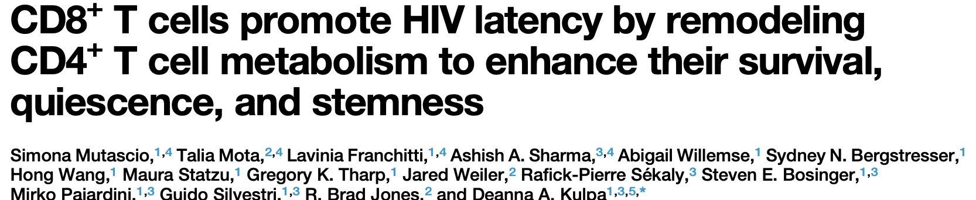


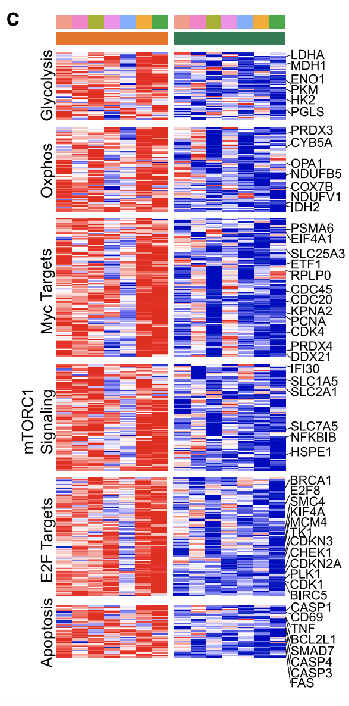
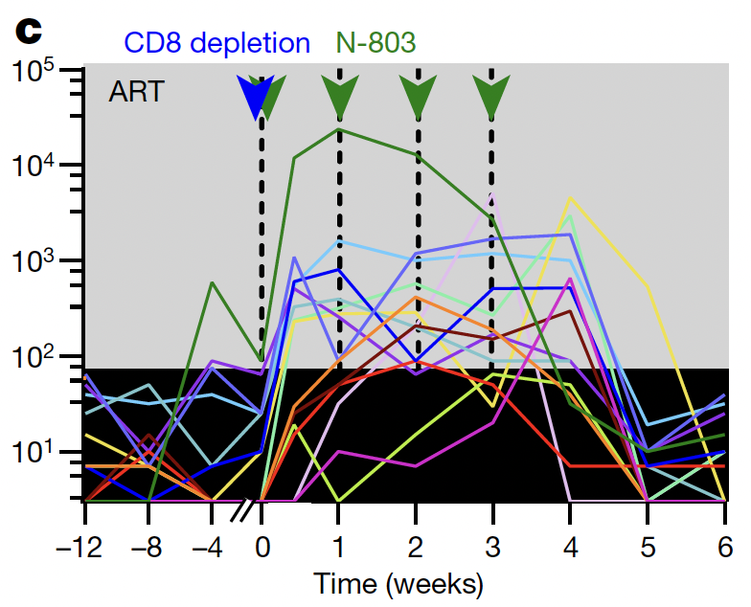
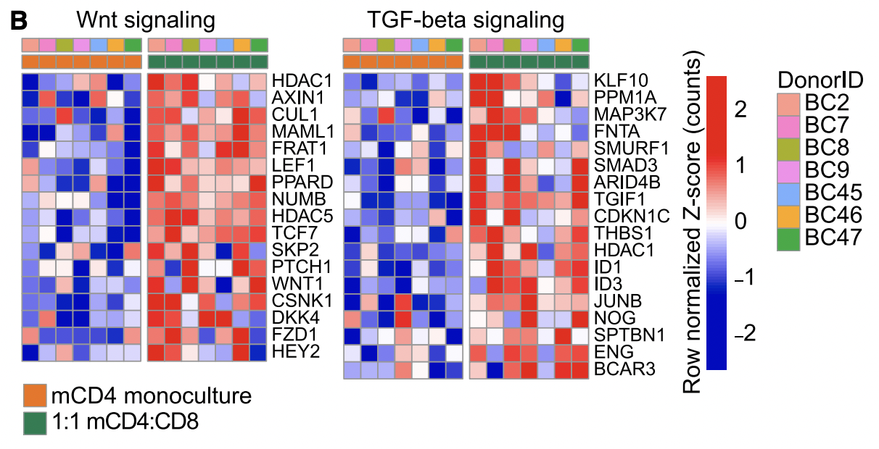
CD8 depletion: removes pro-latency effect

Slide 5
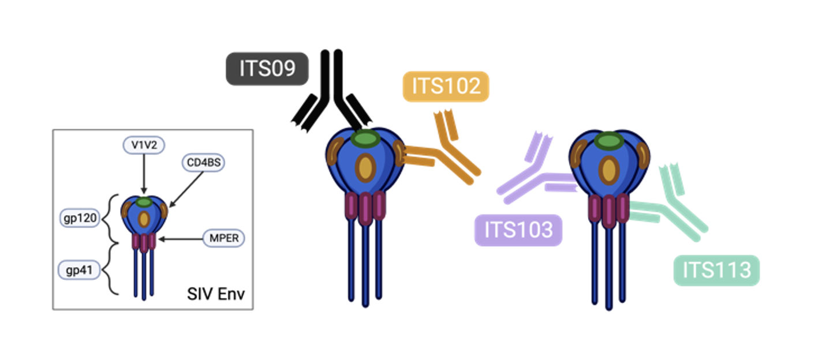
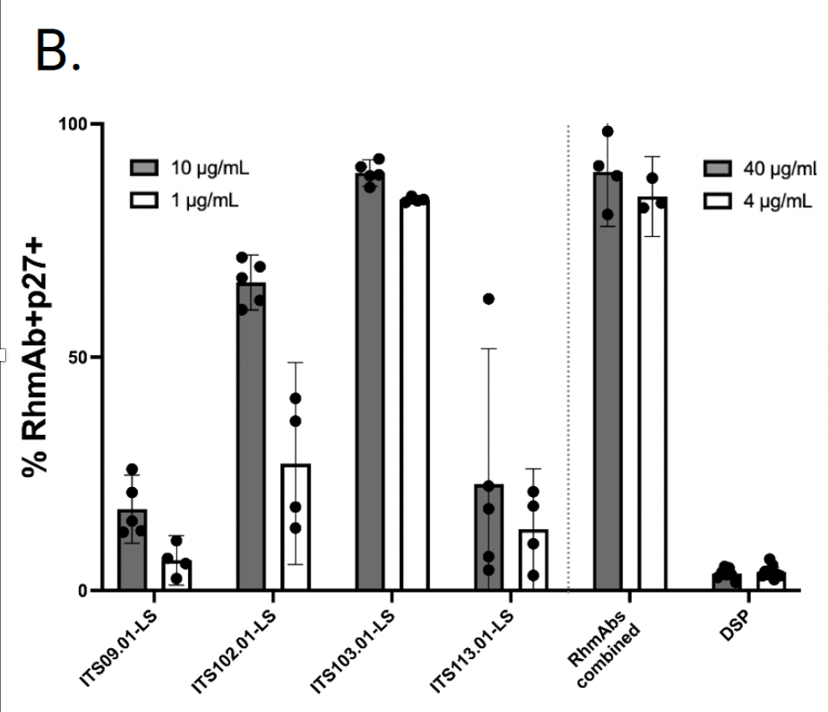
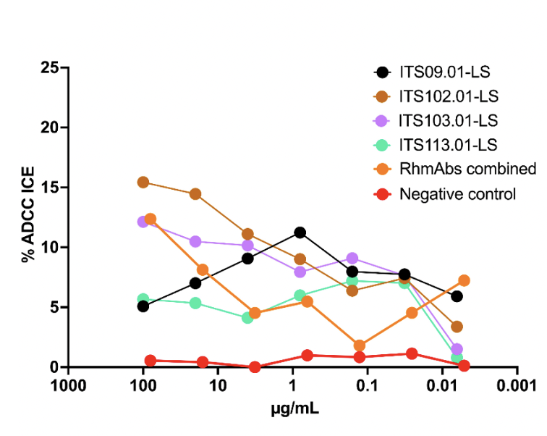
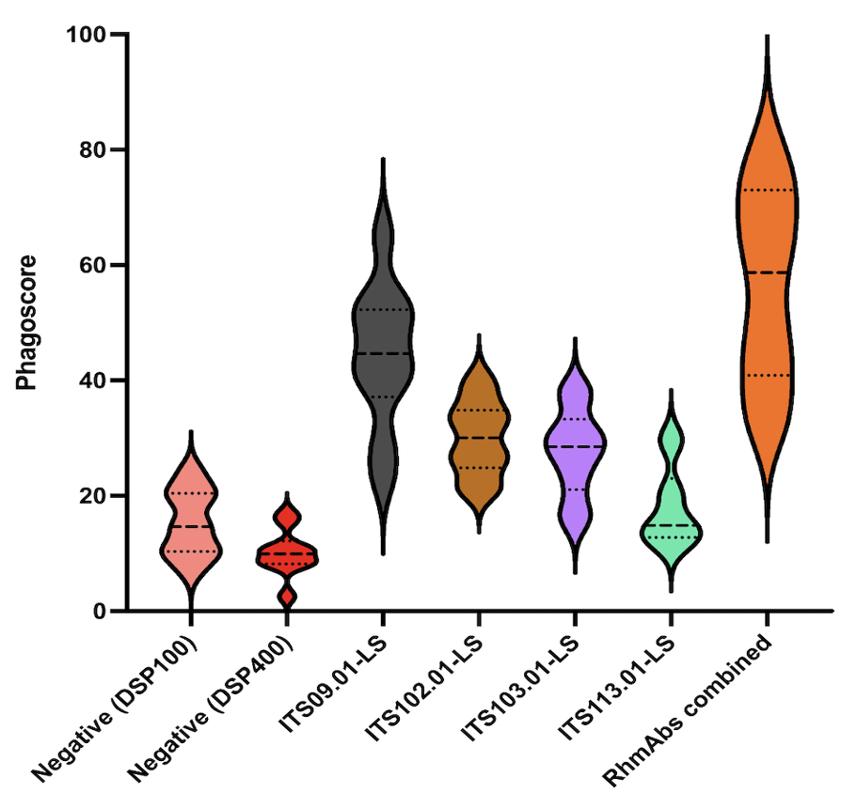
SIV RhmAbs selection
Binding to infected cells
ADCC
ADCP
Mason PLoS Pathog 2016, Welles PLoS Pathog 2022; Grunst PLoS Pathog 2023; Dashti Nature Medicine 2023
Notes:
Isolated from SIV-infected macaques, expressed as full-length rhesus lgG1

Slide 6
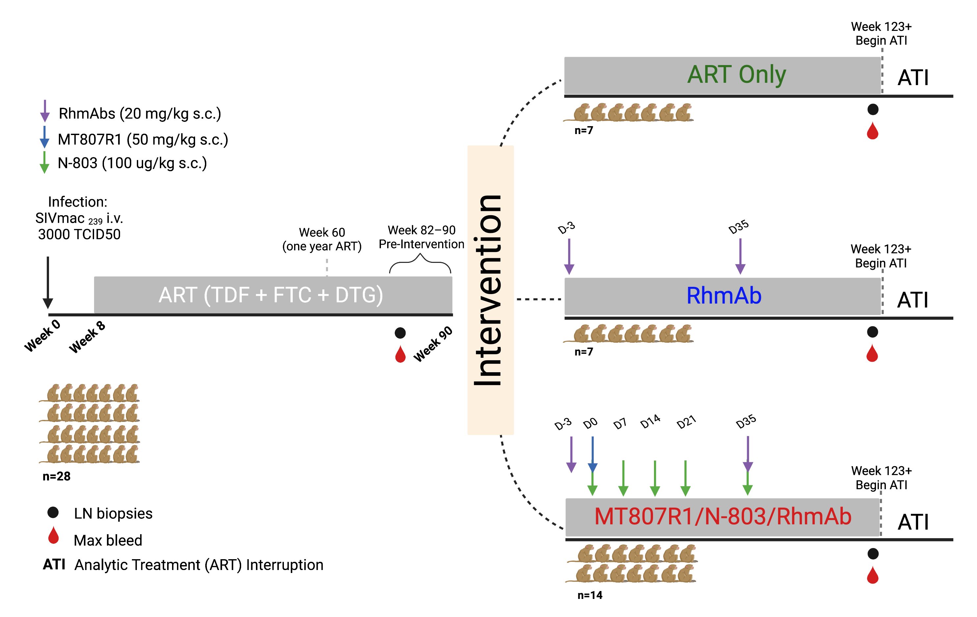
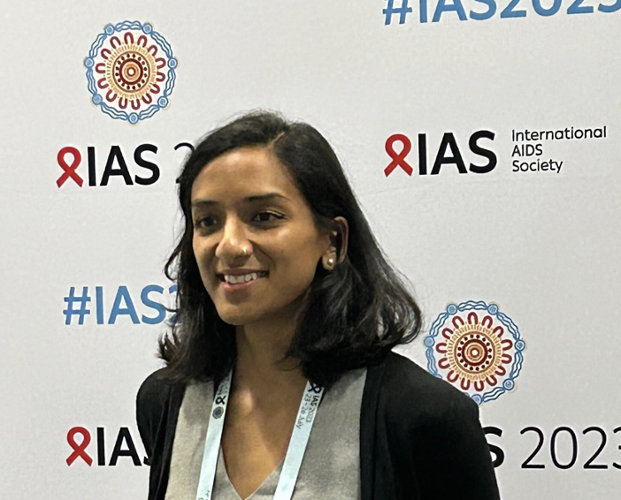
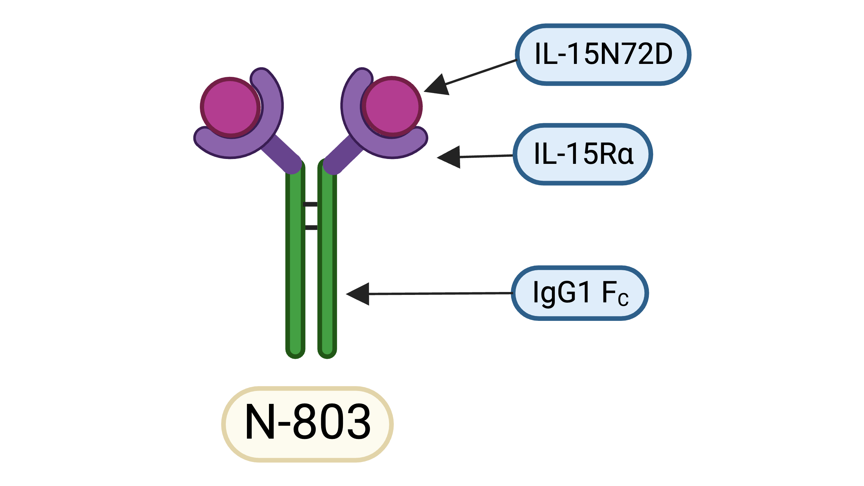

Experimental design
Vidisha Singh

Slide 7
Intervention phase during ART

Slide 8
On-ART viremia
MT807R1/N-803/RhmAb
CONTROLS
ART Only
RhmAb
11/14 RMs in experimental group showed on-ART viremia over 60 copies/ml following CD8 depletion and N-803 treatment

Slide 9
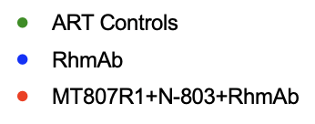
Intact SIV provirus levels reduced post-intervention
2-way repeated measures ANOVA; Dunnett’s post-test

Slide 10
ART interruption phase

Slide 11
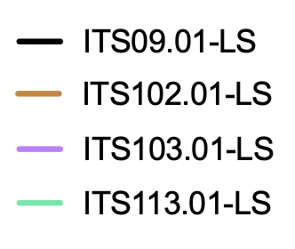
SIV RhmAb concentrations – pre ATI

Slide 12
Rebound viremia post ATI
FC rebound / pre-ART set point
ATI set point viremia
ART only
RhmAbs
MT807R1 + N-803 + RhmAbs
PTC = Post-Treatment Control

Slide 13
What is causing PTC / lower viral set points?
Vaccinal effect of SIV RhmAbs?
  Has the intervention resulted in an increase in neutralizing Ab levels?
  Has the intervention resulted in stronger SIV-specific CD8+ CTLs?
Effect of SIV RhmAb therapy on ability of CD4+ T cells to support virus production and/or replication?

Slide 14
What is causing PTC / lower viral set points?
Vaccinal effect of SIV RhmAbs?
  We did not observe increased neutralizing Ab levels
  We did not find evidence for stronger SIV-specific CD8+ CTLs
Effect of SIV RhmAb therapy on ability of CD4+ T cells to support virus production and/or replication?

Slide 15
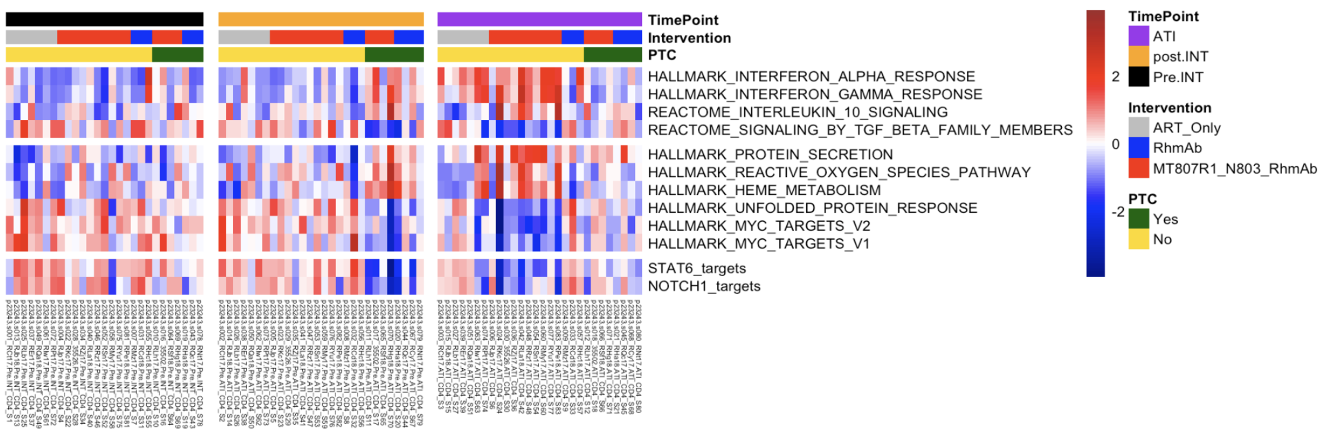
CD4+ T cell transcriptome
Pre-intervention
Post-intervention
ATI
Interferon and IL-10 pathways are increased while TGF-b signaling and MYC targets are decreased in CD4+ T cells of PTCers post-intervention
(seen in both RhmAb-receiving groups)

Slide 16
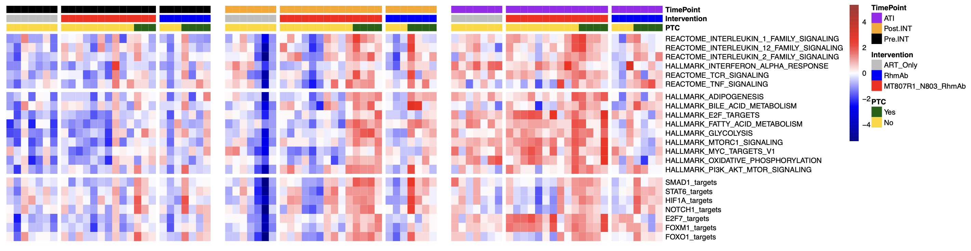
CD8+ T cell transcriptome
Pre-intervention
Post-intervention
ATI
mTOR, E2F, TCR signaling and metabolism pathways are increased in CD8+ T cells of PTCers post-intervention and during ART interruption
(most pronounced in MT807R1+N-803+RhmAb group)

Slide 17
Summary
Robust on-ART viremia observed in 11/14 RMs from MT807R1/N-803/RhmAb group (confirms McBrien et al., Nature 2020)
Decline in level of intact SIV provirus in CD4+ T cells post-intervention in MT807R1/N-803/RhmAb group (more so than in control groups)
Greater fold reduction in setpoint viral loads post-ATI in RhmAb-receiving animals, with 8 RMs showing post-treatment control
Investigation of PTC supports the concept of RhmAb therapy inducing CD4+ T cell modulation that results in reduced virus production/replication
CD8 depletion plus N-803 may also bias towards reconstitution of CD8+ T cells with a more suppressive capacity
Reasons for PTC in only a subset of RMs is still under investigation

Slide 18









Acknowledgements
Vidisha Singh
Bennie Ukhueduan
Tehillah Chinunga
Omotayo Farinre
Venkata Edara
Alexis King
Kedan Endrias
Kaleaha Davis
Patrick Whang
(Amir Dashti, Divine Burgess, Jordan Nelson, Zain Siddiqi)
Emory/ENPRC:
Guido Silvestri
Maud Mavigner
Ashish Sharma
Deanna Kulpa
Steve Bosinger
Greg Tharp
Stephanie Ehnert
Sherrie Jean
Shan Liang
Duke:
Guido Ferrari
Marina Tuyishime
Johns Hopkins:
Emily Fray
Bob Siliciano
Janet Siliciano
FNLCR:
Jeff Lifson
NIH Vaccine Research Center:
Mario Roederer
Rosemarie Mason
Hannah King
AccelevirDx
Greg Laird
Quality Biological, Inc:
Valerie Freemont
ImmunityBio:
Jeff Safrit
Funding:
R37 AI157862
R01 AI125064
UM1 AI126619
UM1 AI124436; AI169662
P30 AI050409
RR000165/OD011132

