Slide 1
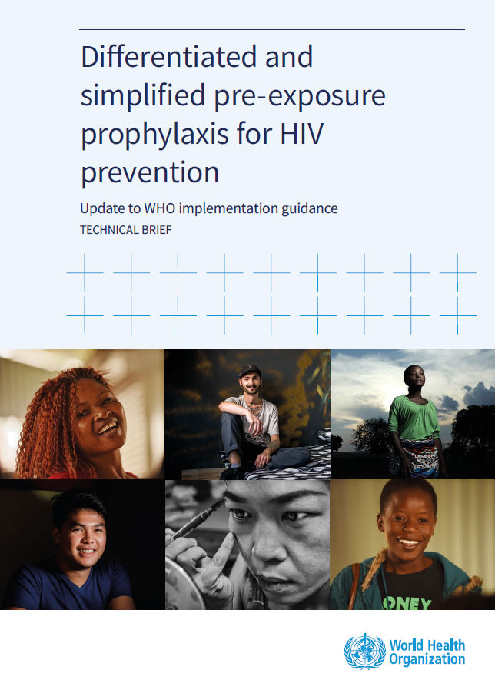
WHO PrEP Guideline Update
Global Status of Implementation
Lima, 6 October 2024
Dr Mateo Prochazka
WHO Headquarters, Geneva, Switzerland
prochazkam@who.int

Slide 2
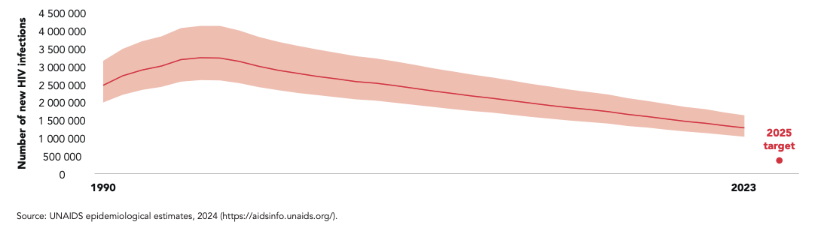
Number of new HIV infections: progress to 2025 UNAIDS target
Globally, 1.3 million people acquired HIV in 2023, compared to 3.2 million in 1995.
Our 2025 target is to reduce the number of new HIV transmissions to fewer than 370 000

Slide 3
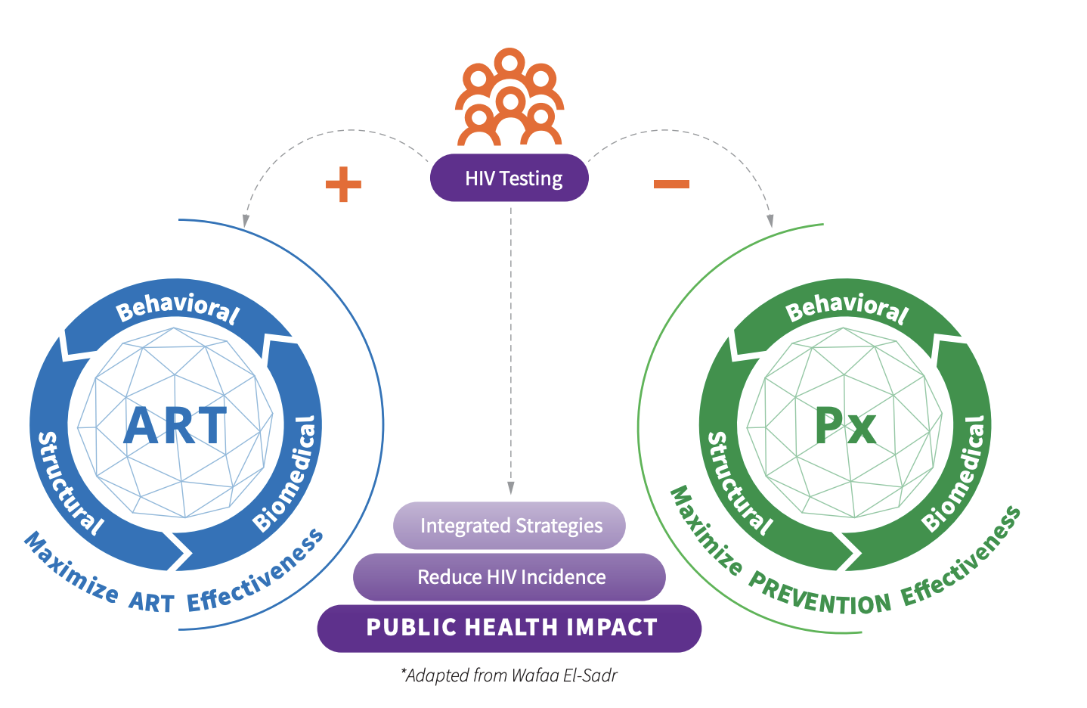
A package of evidence-based interventions
WHO promotes HIV prevention through “combination prevention”: a package of services and interventions that have been scientifically proven to prevent HIV
Combination Prevention: Integrating strategies to end the epidemic: https://avac.org/resource/combination-prevention-integrating-strategies-to-end-the-epidemic/
Notes:
New HIV infections have been reduced by 59% since the peak in 1995.In 2022, 1.3 million [1 million–1.7 million] people were newly infected with HIV, compared to 3.2 million [2.5 million–4.3 million] people in 1995.

Slide 4
What is “combination prevention” for HIV?
Human rights
Scientific evidence
Communities
What works?
Behavioural
Biomedical
Structural
What are the legal and social barriers preventing equal access?
INTERVENTIONS
What do communities and individuals need?
Differentiated and simplified service delivery at scale
SUSTAINED IMPACT
Reduction in the number of new HIV infections

Slide 5

Antiretroviral (ARV) based prevention is the use of ARVs to prevent infection in people who are HIV negative
Pre-exposure prophylaxis (PrEP)
Post-exposure prophylaxis (PEP)
HIV PrEP is the use of antiretroviral medications in people who are HIV negative to prevent acquisition before a possible exposure
Multiple products available:
  Pills/tablets for oral use (TDF/XTC)
  Suspension for injectable use* (CAB-LA)
  Silicone ring for vaginal use* (DVR)
HIV PEP is the use of antiretroviral medications in people who are HIV negative to prevent acquisition after a possible exposure (ideally within 24 hours and no later than 72 hours)
Pills/tablets for oral use (TDF/XTC/DTG)
While many PrEP products are available, pricing and supply are still barriers, especially for new products
Historically, PEP has been offered for occupational exposures, but there is large potential for its non-occupational use

Slide 6
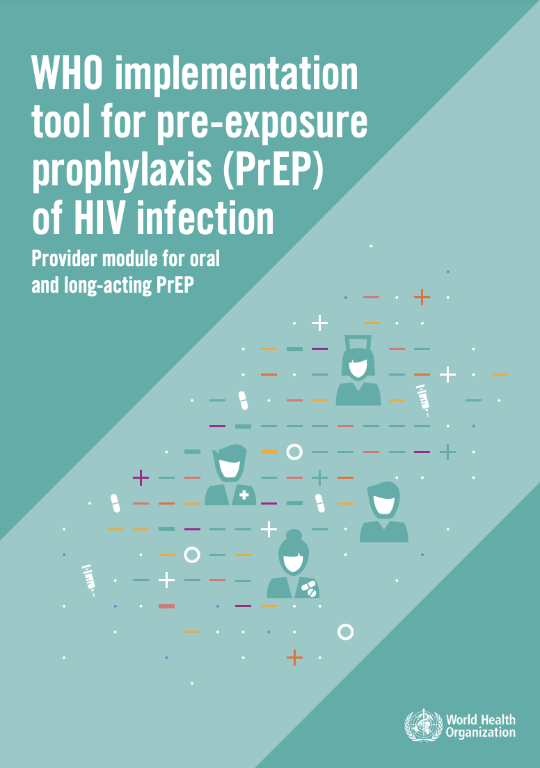
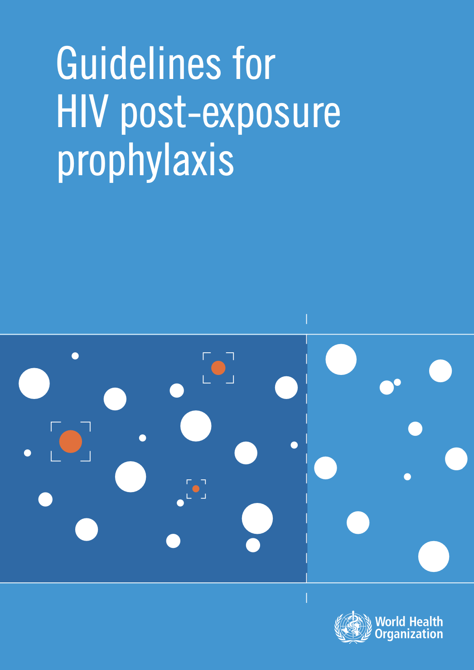


Guidelines and guidance for HIV prevention through the use of antiretrovirals: PrEP and PEP
Pre-exposure prophylaxis (PrEP)
Post-exposure prophylaxis (PEP)
2015
Daily oral PrEP for individuals at substantial risk of acquiring HIV (TDF/FTC or TDF/3TC).
2019
Event-driven, on-demand, or "2+1+1" PrEP, targeting gay men, bisexual men, and other men who have sex with men.
2021
PrEP through dapivirine vaginal ring (DVR) for cisgender women at substantial risk of acquiring HIV.
2022
Injectable PrEP (long-acting cabotegravir) can be used as an additional option for preventing HIV in individuals at substantial risk of acquiring HIV.
2016: Use of 3-antiretroviral regimens (TDF/XTC/DTG) to prevent HIV acquisition following potential exposure.
2024: Updated guidelines for the implementation of PEP in community settings - NEW
Scan the QR codes to access the documents!

Slide 7
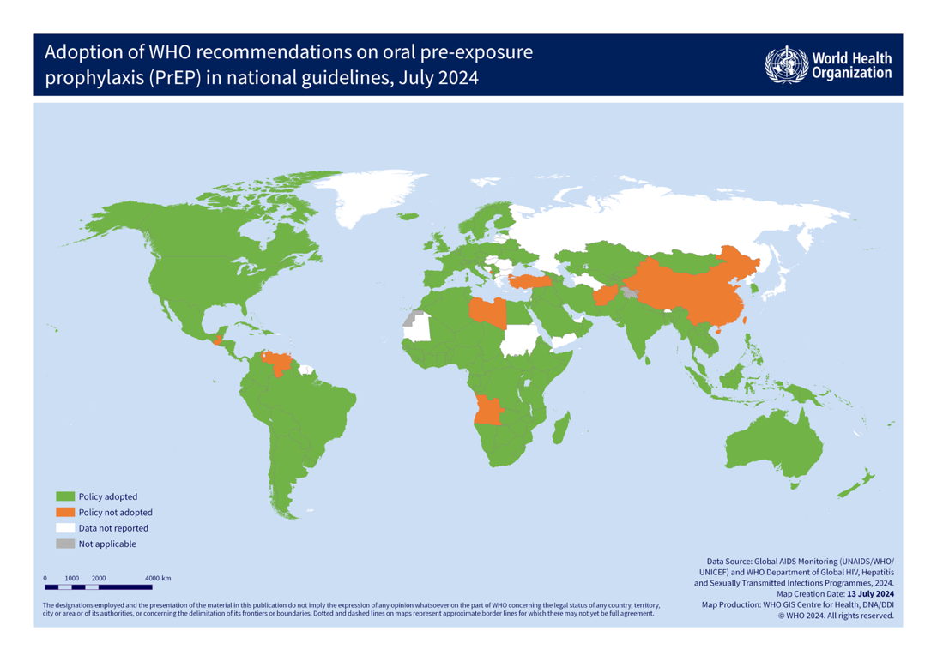
Globally, 152 of 162 reporting countries (94%) have already adopted WHO recommendations on pre-exposure prophylaxis (PrEP) in their national guidelines.
In addition, 12 countries have adopted policies for injectable long-acting cabotegravir (CAB-LA) for prevention, and 10 countries have adopted policies for the dapivirine vaginal ring (DVR).
Further, 10 countries reported that their national guidelines do not recommend any PrEP products.

Slide 8
In 2023, more than 3.5 million people received PrEP at least once.
Over 75% (2.6 million) of these were in the African region.
While the number of people who received PrEP increased by 35% between 2022 and 2023, these numbers are still below the target of 10 million people using PrEP by 2025.

Slide 9
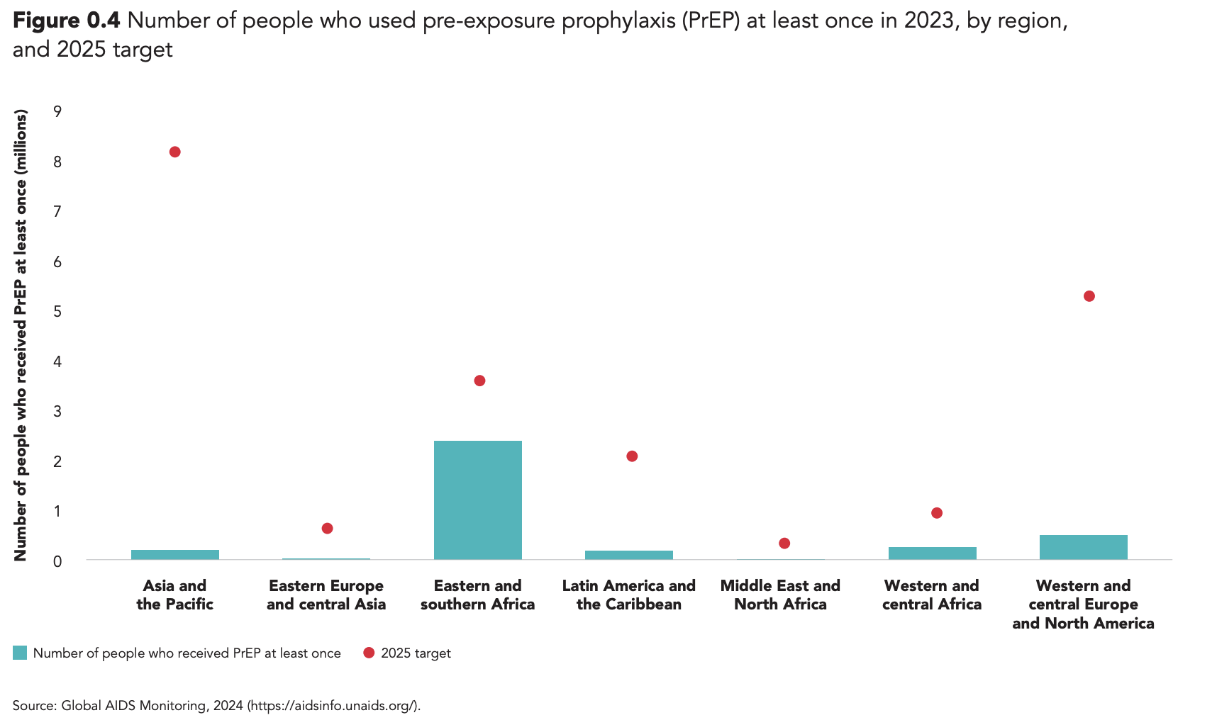
“Rapid, wider access to PrEP could massively reduce the numbers of new HIV infections, especially among people from key populations and among women in areas where HIV incidence is currently high.”
Slow and low uptake of oral PrEP
Availability?
Accessibility?
Acceptability including right mix of products / options?
Costs?
Implementation issues?
Enabling environment including stigma, discrimination and laws?

Slide 10
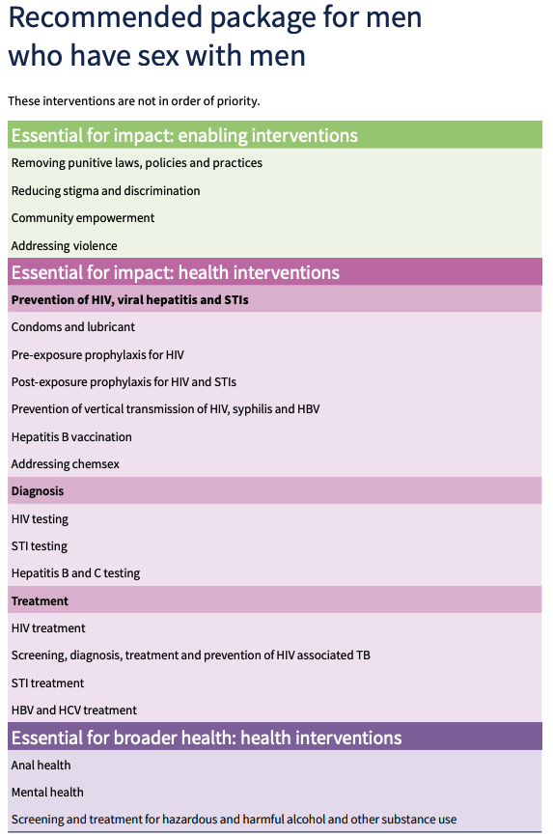
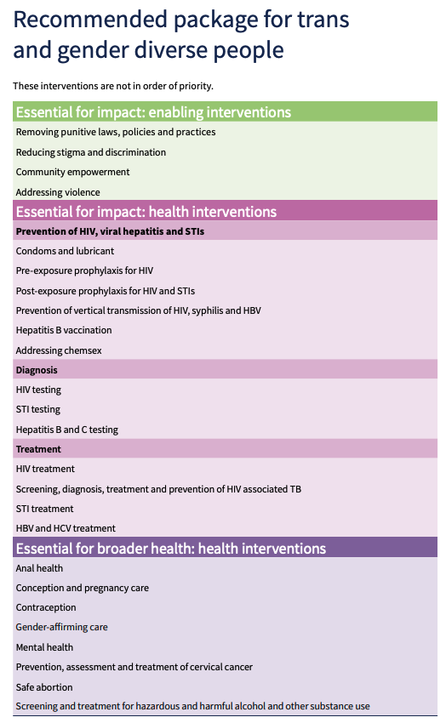
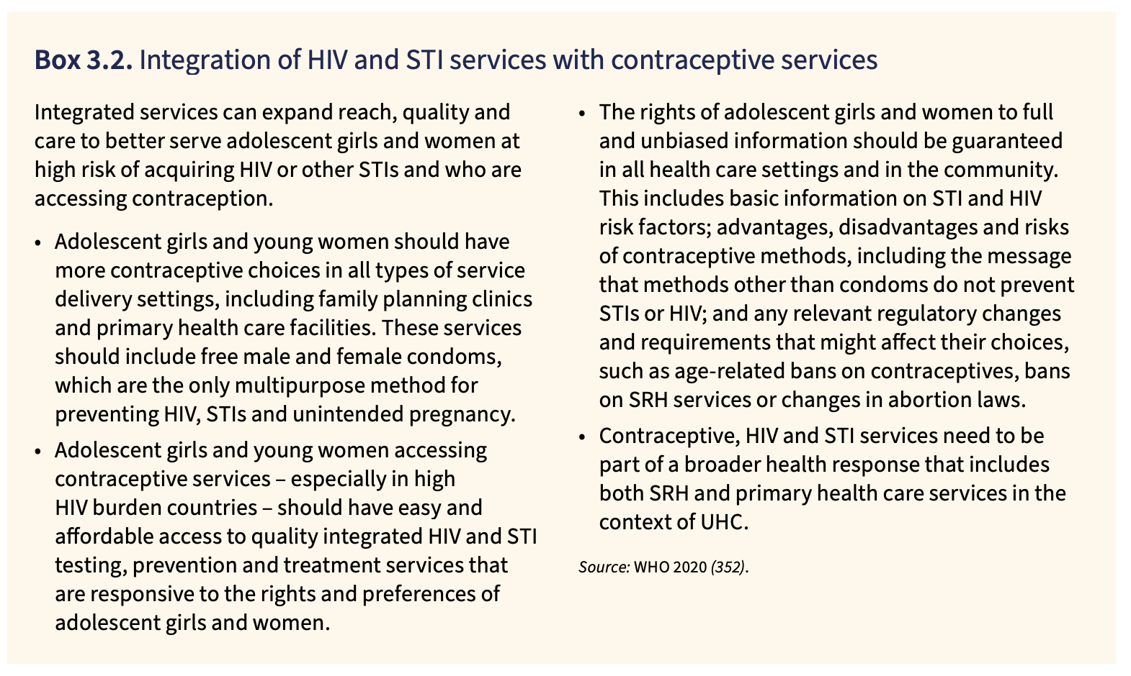
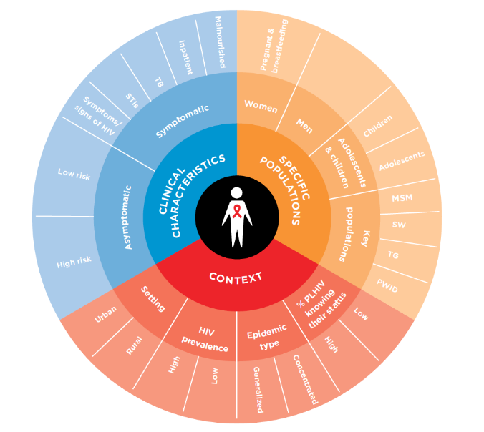
Know your epidemic to manage your epidemic:
the importance of person-centred approaches

Slide 11
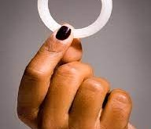
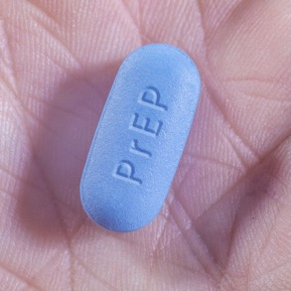
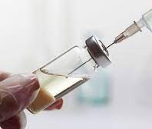
WHO recommendations on HIV PrEP
WHO has recommended three products for use as PrEP :
  Oral PrEP containing tenofovir disoproxil fumarate (TDF) (conditional recommendation 2012; strong recommendation for all people at substantial HIV risk 2015)
  Dapivirine vaginal ring (DVR) (conditional recommendation for women 2021)
  Long-acting injectable cabotegravir (CAB-LA) (conditional recommendation for all people at substantial HIV risk 2022)
  As part of comprehensive HIV prevention approaches, based on evidence for effectiveness, safety, community values and preferences, likely cost effectiveness etc.
Notes:
To date, 3 products;

Slide 12
Oral PrEP containing TDF
TDF/FTC or TDF/3TC (these are interchangeable for oral PrEP)
(TDF alone can also be used)
Effectiveness: at least 90%
Individuals can start and stop oral PrEP dynamically in accordance with risk / exposure to HIV, preference
Two simplified dosing regimens - depends on the individual’s characteristics, circumstances and route of exposure:
Dosing regimen for most groups of people with sexual or injecting exposure
  Start with 1 dose per day for 7 days (use alternative HIV prevention options during that time)
  Continue with 1 dose per day for as long as oral PrEP use is desired
  Stop by taking 1 dose per day for at least 7 days after the last potential exposure
  Population: cisgender women, trans and other gender diverse people assigned female at birth, transgender women and other gender diverse people assigned male at birth taking exogenous gender affirming hormones, people who inject drugs
Notes:
So let’s look at each of the PrEP options individually
Guidance is the same as 2022
Fixed dose combination;

Slide 13

Oral PrEP containing TDF
  Dosing regimen for people assigned male at birth with sexual exposure and who are not taking gender affirming hormones
  Whether for a single event, a short timeframe or a long time.
  Start with 2 doses 2-24 hours prior to the first exposure
  Continue with 1 dose per day for as long as oral PrEP use is desired
  Stop by taking 1 dose per day for at least 2 days after the last potential exposure
No longer using the term ED-PrEP to describe the dosing regimen
  For example, cisgender men and transgender women and other gender diverse people assigned male at birth not taking exogenous gender affirming hormones
Notes:
For people … this includes….
How to start and stop is the same way whether for a single event for a single event (for example, sex on only one day), or for infrequent “single” events that are weeks or months apart. This has been called event-driven PrEP (ED-PrEP) or 2+1+1.
Or for a short timeframe (days or weeks) or for a long time (weeks, months or years).
So what this means is that a
Sexual exposure only
But if exposure to HIV continues for more than one day - or if an individual prefers to continue to take oral PrEP every day - they should take one dose of oral PrEP every day (sometimes called daily oral PrEP ) for as long as desired AND until at least two days after the last potential exposure. This means that ED-PrEP can become daily oral PrEP simply by extending the time a client takes PrEP; there is no difference in how to start or stop oral PrEP. There are several reasons why some individuals may prefer to take oral PrEP every day over a period of time rather than starting and stopping repeatedly. These include unpredictable exposures, finding a daily routine easier, or because taking oral PrEP every day will provide continuing protection, even if a dose is missed.
Daily oral PrEP, also called daily dosing, refers to taking one dose of oral PrEP every day over a period. For details on how to start or stop oral PrEP safely and effectively, refer to the population specific guidance outlined in this module.
Overall

Slide 14

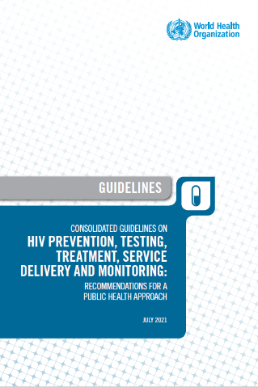
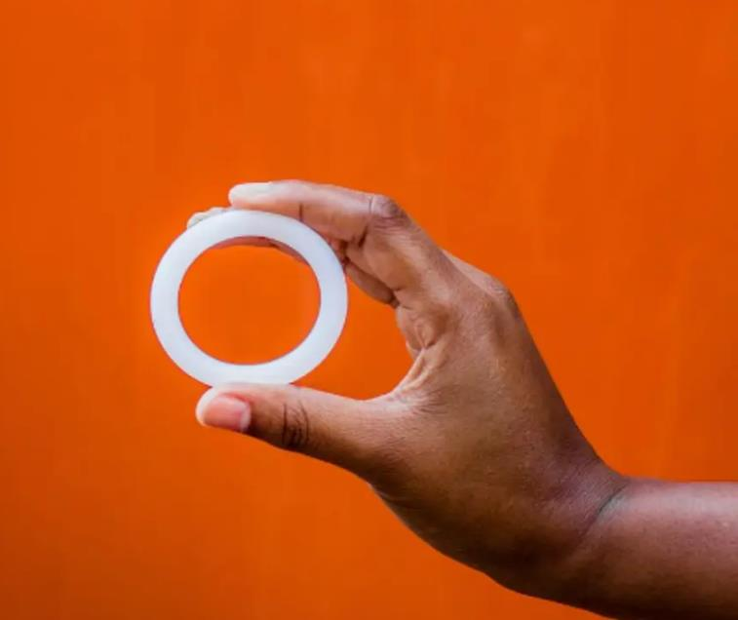
Dapivirine Vaginal Ring (DVR)
Flexible, silicon ring containing 25mg dapivirine – local action
  Inserted 24 hours prior to potential exposure
  Worn continuously in the vagina for 1 month (including during sex and menstruation) to protect against HIV acquisition through vaginal sex
    Does not protect against HIV acquisition for other exposure types: through anal sex, or injecting practices
  At 1 month, replace with a new ring immediately or use another prevention option as protection rapidly drops
  Effectiveness: 50-75%
  Follow-up visits typically every 3 months
Notes:
Flexible, silicon ring containing 25mg dapivirine
Inserted (by the individual or with provider assistance) 24 hours prior to potential exposure
Worn continuously in the vagina for 28 days (including during sex and menses) to protect against HIV acquisition through vaginal sex
At 28 days, replace with a new ring immediately or use another prevention option as protection rapidly drops
Acts locally in the vagina and so does not protect against HIV acquisition for other exposure types: through anal sex, or injecting practices
Effectiveness: at least 50%
Side effects: 10% of people and are usually mild
No known interactions with recreational drugs, alcohol, contraceptive hormones
Follow-up visits typically every 3 months

Slide 15
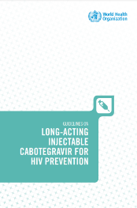
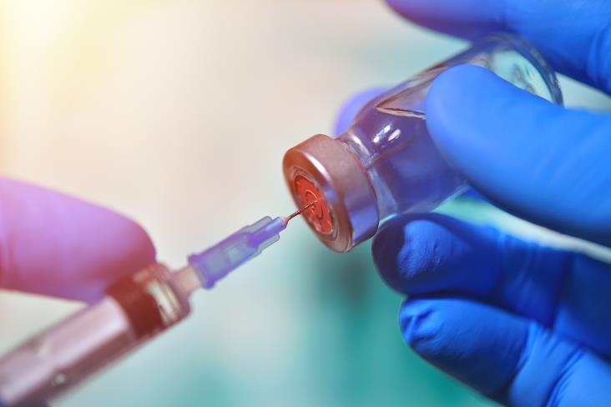
Long-acting injectable cabotegravir (CAB-LA)
Injectable formulation (600mg cabotegravir) administered as an intramuscular gluteal injection
  Dosing schedule for PrEP:
    First two (initiation injections) 1 month apart (+/- 7 days)
    Subsequent (follow-up) injections every 2 months (+/- 7 days)
Efficacy: Phase III trials (HPTN 083 and 084) showed high efficacy with a combined effect size of about 80% relative risk reduction (66% MSM and TG, 88% Women) compared with TDF/FTC*
  Better adherence /effective use among those using CAB-LA than those using oral PrEP
Notes:
CAB-LA is the second LA product and first injectable recommended.
First 2 injections administered 1 month apart then, every 2 months
Trials showed very high efficacy
Significant activity to reduce pricing and increase access – including through generic manufacture and this is certainly a hot topic
Beyond demonstration and implementation trials, Rollout started programmatically in Zam, Zim and Malawi soon, Ukraine not far behind.
Update:
APPROVAL: Australia Botswana Brazil European Medicines Agency(EMA) Malawi Malaysia Nigeria Peru Philippines South Africa Thailand Uganda United States Zambia Zimbabwe
SUBMISSION Canada Taiwan China Tanzania Colombia Ukraine Ivory Coast United Kingdom Kenya Vietnam Mozambique Myanmar Namibia Rwanda
Programmatic delivery: Zambia, Zimbabwe and Ukraine will be starting
Global fund can include CAB-LA – what can be done to influence GF?
CAB-LA pricing for SA about $30 per injection / $210 per year VS oral PrEP $<$5 (50-60 per year)

Slide 16

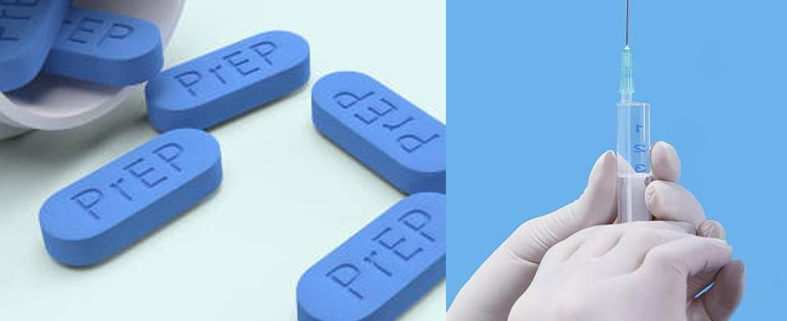
Offering choice in prevention and PrEP products can increase uptake, effective use, satisfaction and protection
The advantages, disadvantages and other features of each product should be clearly explained to allow a genuine choice
Prevention and PrEP choice is dynamic
WHO does not support one PrEP product over any other
The best PrEP product is the one someone wants to use and will use well
Notes:
The advantages, disadvantages and other features of each product should be clearly explained to allow a genuine choice
Prevention and PrEP choice is dynamic
Different PrEP products will be preferred by different people, at different points in their lives and/or with different partners
Evidence from SEARCH and other sources, shows what we’ve known for a long time, that offering choice can increase overall prevention coverage
WHO does not support one PrEP product over any other

Slide 17
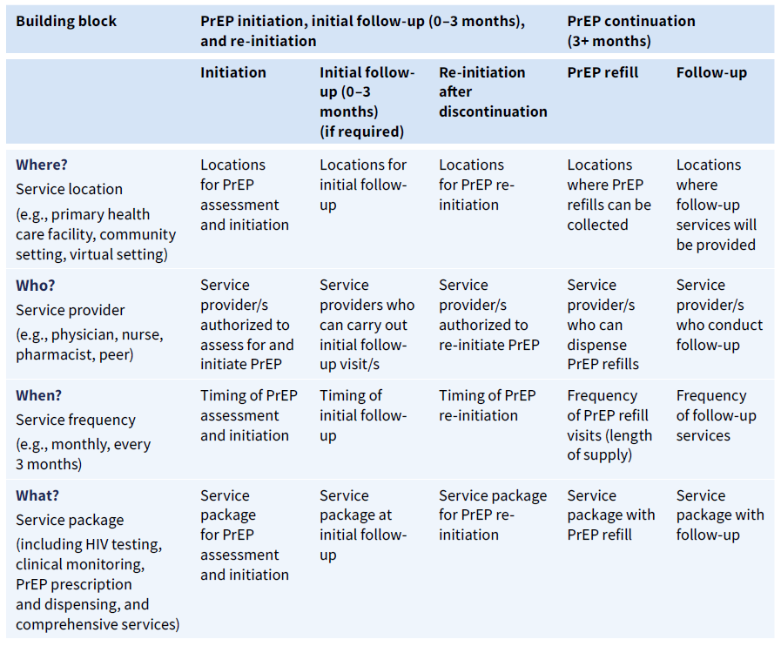
Differentiated and simplified service delivery
Common framework for differentiated PrEP service delivery: four building blocks
Building blocks can differ between PrEP initiation, continuation, and reinitiation, and between PrEP products.
From the beginning, plan to make services most acceptable and accessible!

Slide 18
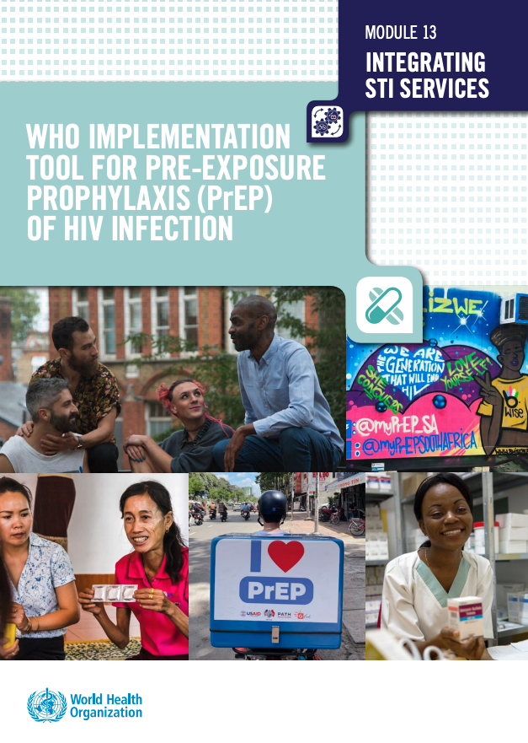
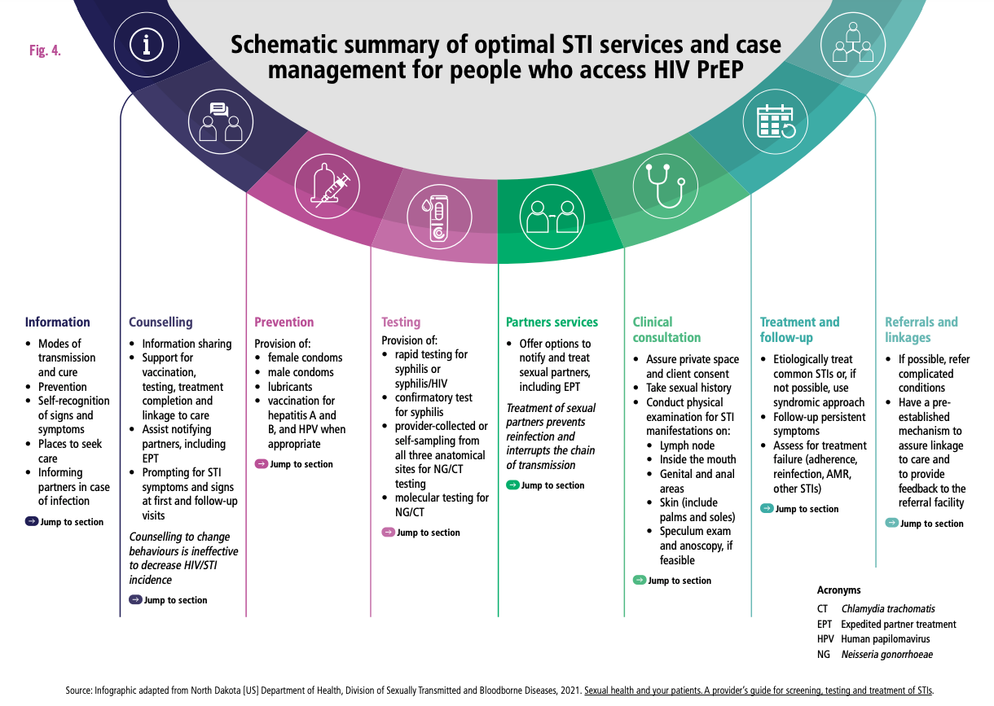
Integrating STI control into PrEP programs is a valuable opportunity

Slide 19


Acknowledgements
¡Gracias por su atención!
WHO: Heather-Marie Schmidt, Michelle Rodolph, Rachel Baggaley, Ioannis Mameletzis

Slide 20

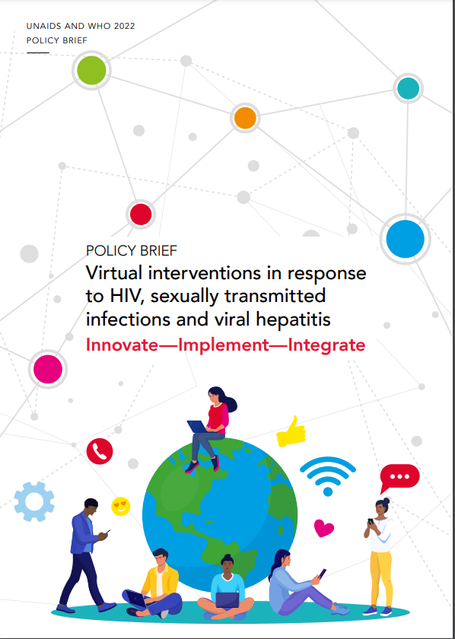
Key considerations for differentiated services
WHERE: service location
Service delivery sites are adapted to preferences of users and provide comprehensive and integrated services
Community involvement
Government support and policy
Supported by
  Logistics systems
  Adequate infrastructure
  Clinical oversight and referral pathways
  Data systems

Slide 21
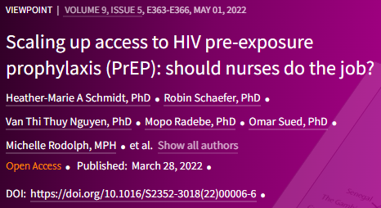
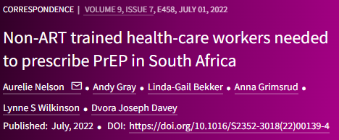
Key considerations for differentiated services
WHERE: service location
WHO: service provider
Service delivery sites are adapted to preferences of users and provide comprehensive and integrated services
Community involvement
Government support and policy
Supported by
  Logistics systems
  Adequate infrastructure
  Clinical oversight and referral pathways
  Data systems
Task sharing to make the best use of available human resources e.g. physicians, nurses, pharmacists, clinical officers, and trained and supervised peer and community health workers
Acceptability of provider types to the PrEP user
Registration and regulation of provider types to provide PrEP - may vary by PrEP product type (e.g. DVR and oral PrEP vs CAB-LA)
Training and accreditation, quality assurance, protocols, and linkage to facilities, remuneration

Slide 22



Simplified requirements for PrEP delivery
Viral hepatitis testing
  HBV: Test once within 3 months of initiation
  HCV: Test around within 3 months of initiation and every 12 months (where indicated)
  Testing for hepatitis is not a requirement for PrEP use or initiation
  Simplified guidance for kidney function
  Kidney impairment (eGFR <60ml/min) is a contraindication BUT uncommon among PrEP users
  Optional testing for those without comorbidities under 30 years and, depending on resources, for those under 50 years
    If eGFR <90ml/min, consider sceening every 6-12 months
  If done, can be within 3 months of starting and should not delay starting oral PrEP
https://www.thelancet.com/journals/lanhiv/article/PIIS2352-3018(22)00297-1/fulltext
https://www.thelancet.com/journals/lanhiv/article/PIIS2352-3018(22)00004-2/fulltext
Differentiated and simplified pre-exposure prophylaxis for HIV prevention: update to WHO implementation guidance
Notes:
Key points
HBV infection: not a contraindication fororal PrEP
An analysis of data on kidney function from global PrEP programs found a very low incidence of kidney impairment associated with PrEP
Any impariement in kidney function generally returns to normal soon after stopping PrEP

Slide 23
Key considerations for differentiated services
WHEN (service frequency) &
WHAT (service package)
WHERE: service location
WHO: service provider
Service delivery sites are adapted to preferences of users and provide comprehensive and integrated services
Community involvement
Government support and policy
Supported by
  Logistics systems
  Adequate infrastructure
  Clinical oversight and referral pathways
  Data systems
Task sharing to make the best use of available human resources e.g. physicians, nurses, pharmacists, clinical officers, and trained and supervised peer and community health workers
Acceptability of provider types to the PrEP user
Registration and regulation of provider types to provide PrEP - may vary by PrEP product type (e.g. DVR and oral PrEP vs CAB-LA)
Training and accreditation, quality assurance, protocols, and linkage to facilities, remuneration
Dynamic use of PrEP
Client centered: follow-up and dispensing tailored to needs of PrEP clients
Integrated service package that is responsive to the needs and wants of a client (N.B. some clients may only want PrEP)
Integration and co-delivery with STIs, family planning / contraceptive services etc.

Slide 24
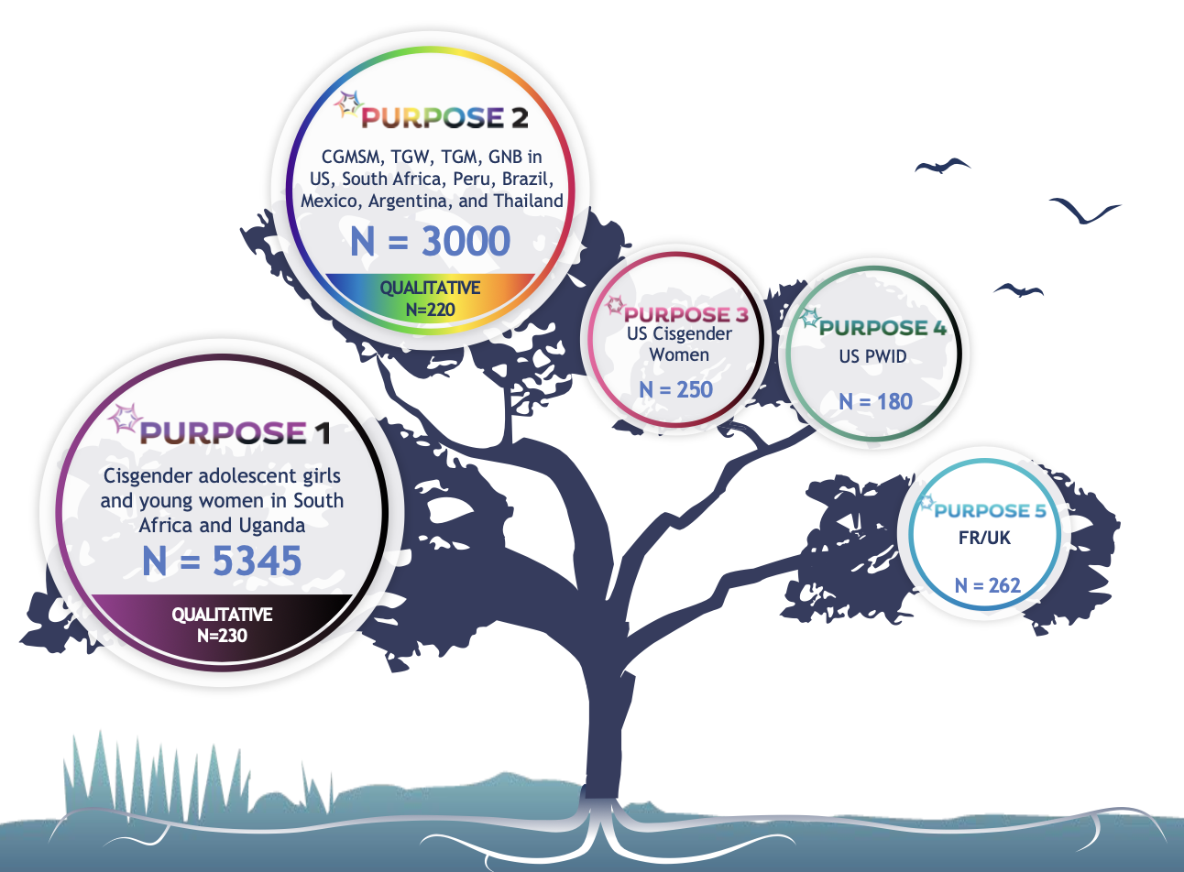
Lenacapavir: an HIV-1 capsid inhibitor
Lenacapavir (LEN) is a long-acting HIV-1 capsid inhibitor, available as an injectable administered twice a year, subcutaneously.
PURPOSE trials (1 to 5) investigate its use as pre-exposure prophylaxis (PrEP).
PURPOSE 1 among cisgender women in South Africa and Uganda – 100% efficacy compared to background HIV incidence
PURPOSE 2 among cisgender men, trans and gender diverse people in Argentina, Brazil, Mexico, Peru, South Africa, Thailand, and the United States – 96% efficacy compared to background HIV incidence.
WHO will convene a Guideline Development Group to develop and issue guidelines on LEN for HIV prevention.
Collaborating with international partners and generic manufacturers to ensure affordable, equitable access and scale-up of LEN in high-incidence regions and communities.

