Slide 1


Pre-Exposure Prophylaxis implementation in South Africa
Hasina Subedar, Senior Technical Advisor
National Department of Health South Africa

Slide 2
Presentation overview
PrEP in South Africa
Introduction of biomedical HIV prevention
Coordination of partners
  Mapping of studies
  Research priorities
  Standardised implementation
  Reporting and data collection
Summary data
Key insights

Slide 3

PrEP in South Africa

Slide 4
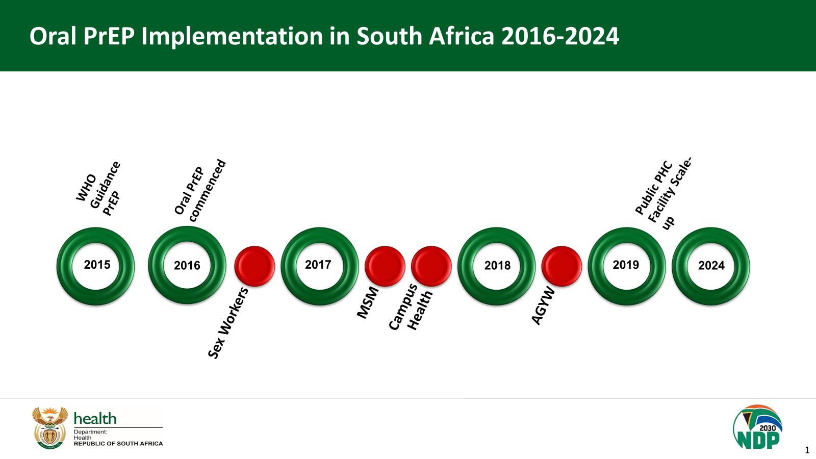
Progress with Oral PrEP implementation in South Africa
2016-2024
Timeframe from regulatory approval to implementation
5 months

Slide 5
Oral PrEP Scale-up progress in South Africa June 2016 to August 2024
PrEP initiations
1 606 075
95% public PHC facilities offer PrEP

Slide 6

Precision based methodology for determining annual oral PrEP initiation targets provided the framework for determining long-acting PrEP projections
DHIS catchment area data: 3505 PHC facilities
Males & females age >15 years within
catchment areas: 42.8m
INPUTS
OUTPUTS
ICL/UCT district level HIV prevalence applied to catchment population
HIV negative males and females
age >15 years: 35.3m
Demand generation
(adjustable input)
HIV negative males and females age >15 years, eligible for PrEP, reached with demand generation activities based on HIV incidence risk categorization: 7.7m
HIV testing target
(adjustable input)
HIV negative males and females age >15 years to be tested (in alignment with 95-95-95): 7.3m
National PrEP M&E data
(weighted average, 6.3%)
Oral PrEP targets calculated using national
oral PrEP data: 401 430
National PrEP M&E data
(20% of previous year’s targets)
Estimated continuations based on national oral PrEP data from previous year: 79 730

Slide 7
Introduction of biomedical HIV prevention products in South Africa

Slide 8
Biomedical PrEP Products: Process from regulatory approval to implementation
Regulatory Approval & Policy
Implementation & Financial Planning
Service Delivery Preparation
Communication and Social Mobilisation
WHO PQ approval
Demand Forecasts and Impact Models
Develop National and Provincial Implementation Plans
Dev Social Mobilisation & Demand Generation Strategy
SAHPRA approval
Investment Case
Identify and delivery sites and health care providers required for delivery
Effective Interventions for Uptake & Continued Use
National Policy and Guidelines
Costing and Budget
Develop M&E Indicators and Systems
Development of communication, education and social mobilisation materials
National Health Council Approval
Procurement/ Supply Chain/Tender
Develop implementation tools, job aids & Training Materials
Commence implementation

Slide 9
Implementation dapivirine vaginal ring (DVR)
2022
2023
2024
March
July
Sept
Dec
March
May
July
Aug
SAHPRA Approval
WHO
recommends DVR
Donation of DVR
DVR implementation
guideline approved
Procurement of DVR
Training of IS studies
Distribution of DVR
Implementation of DVR recommended
DVR: 16 months from regulatory approval to implementation
Implementation of cabotegravir long-acting injectable
(CAB-LA)
2022
2023
2024
July
Nov
Sept
Nov
Jan
Feb
Feb
WHO recommends CAB-LA
SAHPRA approves CAB-LA
CAB-LA implementation guidelines approved
Limited donation of CAB-LA received
Training of IS studies
Offer of CAB-LA donation
IS study sites commence CAB-LA implementation
CAB-LA: 14 months from regulatory approval to implementation

Slide 10
Coordination of introduction of long-acting PrEP products in South Africa

Slide 11
STAKEHOLDER MAP
Global Fund
AFSA, Beyond Zero, NACOSA
USAID
MATCH, RTC, Broadreach, Wits RHI*, Anova
Donors
CDC
TBHCA, SIN, Aurum
Unitaid
*Wits RHI
BMGF
*DTHF, *AHRI, *Ezintsha, *HSRC
Supporting Partners
*MOSAIC
Civil Society
UNFPA
HE²RO
SANAC
*MRC
WHO
UNICEF
CHAI
*Partners conducting research

Slide 12
PrEP Technical Working Group:
Working groups to support long-acting PrEP product introduction
Implementation guideline
Monitoring and evaluation
Commodity planning and procurement
Social mobilisation and demand creation
Implementation science
Training materials and resources

Slide 13
Overview of study and pilot sites

Slide 14
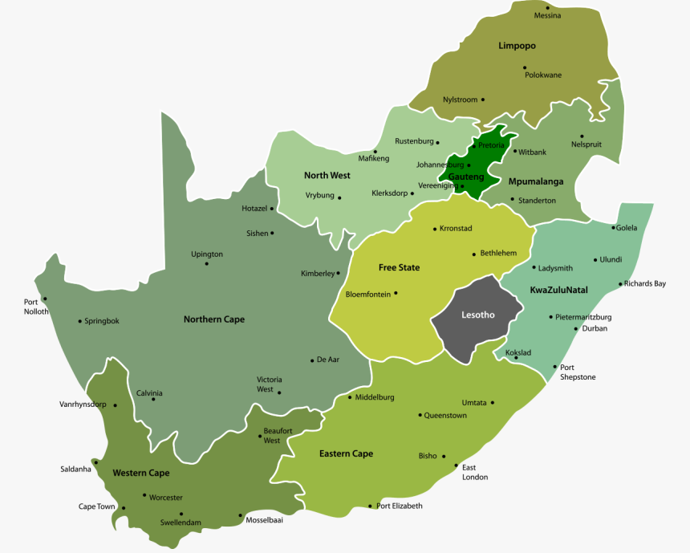
PrEP demonstration sites across regions in South Africa
The planned implementation science studies are spread across all 9 provinces and 18 districts representing a mix of urban, peri urban and rural settings.
Johannesburg Health District, Gauteng
Wits RHI, DREAMS
Wits RHI, CATALYST – Key Populations Sites (FSW and TNBP)
Wits RHI & Shandukani Research, Deliver & B-Protected
Tshwane, Gauteng
Wits RHI, Project PrEP
NACOSA, Global Fund*
Lejweleputswa (FS)
Wits RHI, CATALYST
Thabo Mofutsunyana (FS)
Beyond Zero, Global Fund*
Frances Baard (NC)
NACOSA, Global Fund*
Klipfontein Mitchell’s Plain, Cape Town (WC)
DTHF, FastPrEP
NACOSA, Global Fund*
UTC, UCLA & DTHF, PrEP-PP & SCOPE-PP
Gqeberha
Wits RHI, Project PrEP
King Cetshwayo & Zululand (KZN); Ehlanzeni and Gert Sibande (MP), Sekhukhune (LP)
AFSA & Beyond Zero, Global Fund*
Newcastle, KZN and Moretele, Northwest
SA MRC & NACOSA, Imagine
Hlabisa, uMkhanyakude (KZN)
AHRI, Let’s Talk & LAPIS
Msunduzi, Umgungundlovu (KZN) HSRC & MGH, DO PrEP
eThekwini (KZN)
Wits RHI, Project PrEP
Nelson Mandela & Oliver Tambo (EC)
Beyond Zero, Global Fund*
Nelson Mandela, King Dalindyebo (EC)
Wits RHI, Project PrEP
Mthatha (EC)
Wits RHI, Project PrEP
*Global Fund funded program MyJourney or National SWP
May, 2023

Slide 15
Research priorities for long-acting PrEP products

Slide 16
Research priorities across implementation studies
PLANNING & BUDGETING
What is an affordable price and cost of PrEP delivery across multiple PrEP products?
PREP DELIVERY PLATFORMS
Which delivery platforms and / or models will best reach populations who need PrEP?
What are the service readiness and delivery requirements for the new PrEP methods?
What are provider attitudes and beliefs about the new PrEP methods, and what are we learning about how to inform or shape them?
How should the new PrEP methods be integrated within oral PrEP provision and / or existing PrEP programming?
UPTAKE & EFFECTIVE USE
Which demand generation strategies are most effective to support uptake and effective use of the new PrEP methods?
What are end user preferences across PrEP methods and how are they making decisions between them?
How do key influencers affect the uptake and effective use of the new PrEP methods, and how can they effectively be engaged?
What evidence of social harms associated with PrEP use has emerged, particularly for the PrEP ring?
What tools effectively support choice between the PrEP methods?
What approaches are most effective to strengthen linkages between PEP and PrEP?
MONITORING, EVALUATION & LEARNING
What is the frequency and characteristics of seroconversion and HIV drug resistance for PrEP users across the new PrEP methods?
Key questions for the Essential Medicines Committee

Slide 17
Implementation resources for Dapivirine Vaginal Ring and Cabotegravir long acting injectable included:
Implementation guidelines
Job aids
IEC materials
Reporting tools
Training materials
Developed for use across all study and pilot sites

Slide 18
Standardised recording, capturing
& reporting tools
Combined PrEP method clinical form
Cohort tacker individual client record
Developed for use across all study and pilot sites
Summary data report submitted to the National Department of Health every month.

Slide 19
Summary data

Slide 20
Implementation Science and Pilot Sites Offering Oral PrEP and Long-acting PrEP Products

Slide 21
PrEP Uptake across sites
Oral PrEP: 19,362 (81%)
DVR: 1,490 (6%)
CAB-LA: 3,145 (13%)
Total PrEP: 23,997

Slide 22
Uptake of PrEP: Oral PrEP, Dapivirine Ring and CAB-LA at Implementation Science and Pilot Projects August 2023 – August 2024
Oral PrEP: 19,362 (81%)
DVR: 1,490 (6%)
CAB-LA: 3,145 (13%)
Total PrEP: 23,997

Slide 23
Uptake of PrEP at Sites offering 3 PrEP Products Feb'24 to Aug’24

Slide 24
Conclusion: insights from implement-tation science and pilot projects
Whilst is it is too early to draw any concrete conclusions data from pilot sites reveal some important early insights regarding PrEP uptake.
  PrEP uptake was notably higher at sites where all three PrEP options (oral PrEP, Ring, and CAB-LA) were available compared to sites with only one or two options. This does suggest that providing a variety of choices can improve accessibility and appeal to different user preferences.
  National guidelines for oral PrEP, the Ring, and CAB-LA—supported by job aids, social mobilization efforts, and reporting tools—has helped to standardize the delivery, messaging, and reporting across the 87 study and pilot sites.
  The early insights from these early implementation sites guide broader approaches to national-level programmatic rollouts of the new PrEP products.
  Monitoring of PrEP use, effectiveness, and adherence across all methods will require more time to draw reliable conclusions.

Slide 25
Q&A
Thank you!

