Slide 1

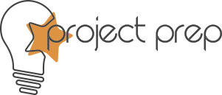

Early findings from a PrEP choice implementation science study
Saiqa Mullick, Wits RHI, University of the Witwatersrand, South Africa
Implementing PrEP Choice: Experiences from South Africa

Slide 2



HIV context in South Africa
There are 7.7 million
people in South Africa
who are living with HIV – approximately 150 000 new infections¹
In sub-Saharan Africa, adolescent girls and young women (AGYW) (15 – 24 years) accounted for more than 77% of new infections among young people²
Girls and young women
have a three-fold burden
of HIV compared to their
male peers²
National scale-up:
Oral pre-exposure prophylaxis (PrEP) has been available since 2016, with national scale-up in 2018³
Oral PrEP is provided in 4 014 primary healthcare public health facilities, with 1 322 867 individuals initiated on oral PrEP since 2016 (July 2024)⁵
References:
1. UNAIDS. Country factsheets: South Africa 2023. [cited 2024 1 October 2024]; Available from: https://www.unaids.org/en/regionscountries/countries/southafrica.
2. UNAIDS. FACT SHEET 2023 - Global HIV statistics. 2023 [cited 2023 27 Sept 2023]; Available from: https://www.unaids.org/sites/default/files/media_asset/UNAIDS_FactSheet_en.pdf.
3. Department of Health, 2021 UPDATED GUIDELINES FOR THE PROVISION OF ORAL PRE-EXPOSURE PROPHYLAXIS (PrEP) TO PERSONS AT SUBSTANTIAL RISK OF HIV INFECTION 2021, Department of Health Pretoria
4. Butler, V., et al., Implementing Differentiated and Integrated HIV Prevention Services for Adolescent Girls and Young Women: Experiences From Oral PrEP Rollout in Primary Care Services in South Africa. Journal of Adolescent Health, 2023. 73(6, Supplement): p. S58-S66.
5. PrEP Watch. Country Overview: South Africa. 2024 [cited 2024 July 2024]; Available from: https://www.prepwatch.org/countries/south-africa/.

Slide 3

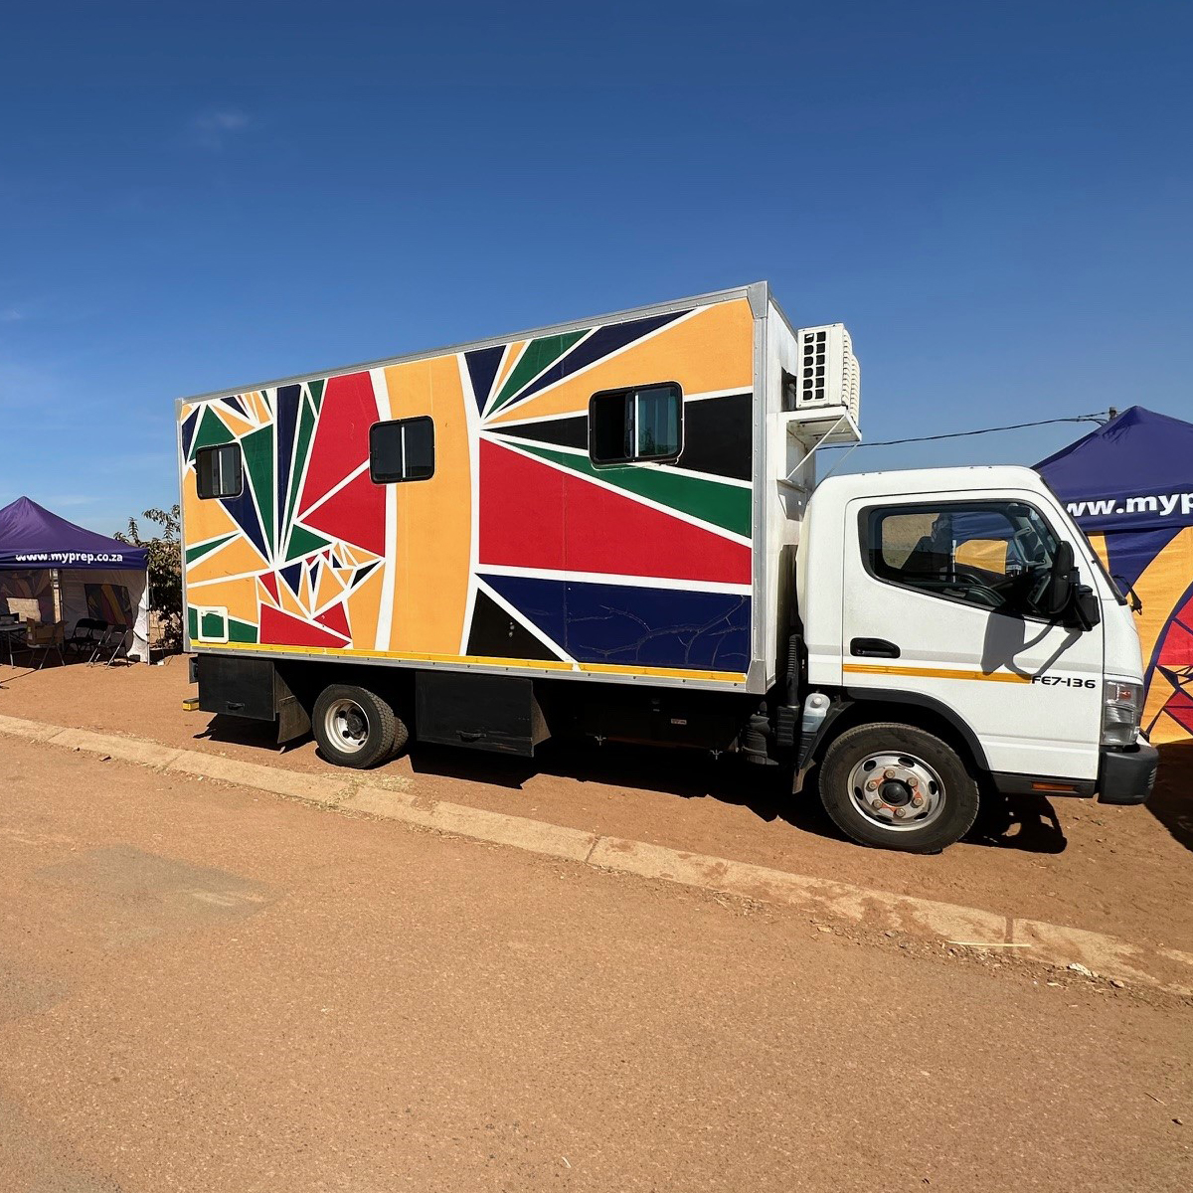
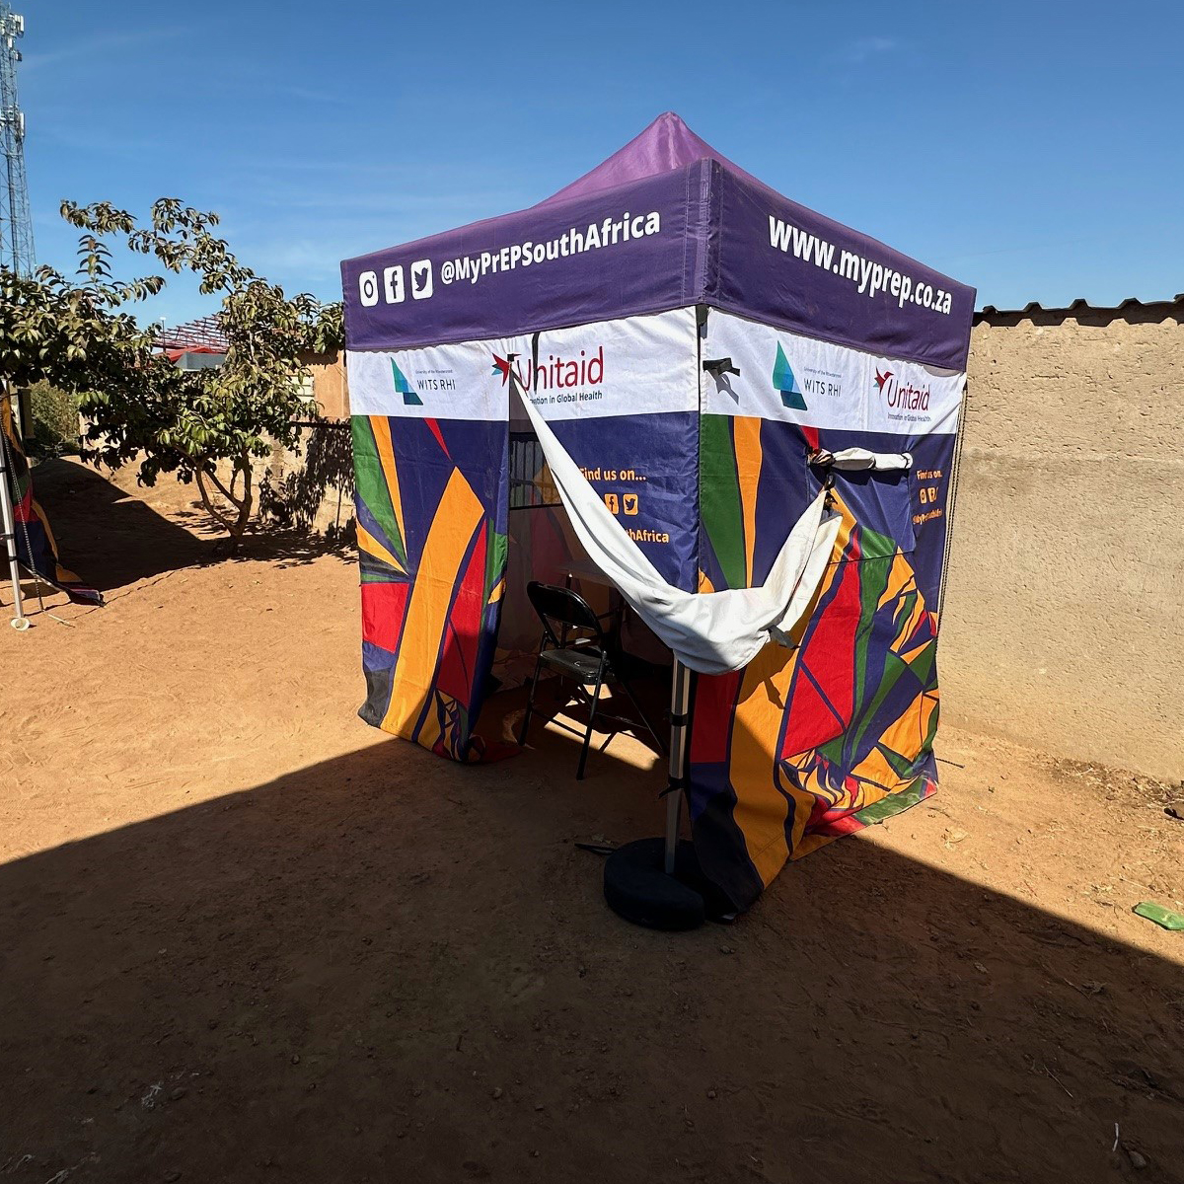
Through an implementation science study we introduced new PrEP methods, DVR and CAB-LA
Aim:
To improve understanding of PrEP use among AGYW in real world settings, and inform delivery models for integration, by expanding choice through the introduction of new PrEP methods
Objective 1:
To increase uptake & coverage of PrEP through the introduction of new prevention options.
Objective 2:
To improve the uptake of PrEP through the development and implementation of a decentralized service delivery model.
Objective 3:
To improve diagnosis and management of STIs among PrEP users, through an aetiological approach to STI management.
Objective 4:
To evaluate the cost-effectiveness of the different interventions and delivery models
6 – 10 October · Lima, Peru and virtual
hivr4p.org

Slide 4
PrEP introduction to
South Africa
2016
2018
JAN 2022
AUG 2023
APR 2024
OCT 2024
Introduction of oral PrEP among MSM and sex workers
Project PrEP supported introduction of oral PrEP among AGYW
Introduction of
dapivirine vaginal ring
(implementation study sites)
Introduction of CAB-LA (implementation study sites)
Introduction of oral PrEP among AGYW
Project PrEP supported introduction of new PrEP methods (ring in addition to oral PrEP)
Project PrEP supported introduction of new PrEP methods (ring + CAB-LA in addition to oral PrEP)
2017
Longitudinal cohort recruited from integrated SRH and AYFS services:
male, female, transgender
≥15 years
HIV negative
interested in HIV prevention services

Slide 5
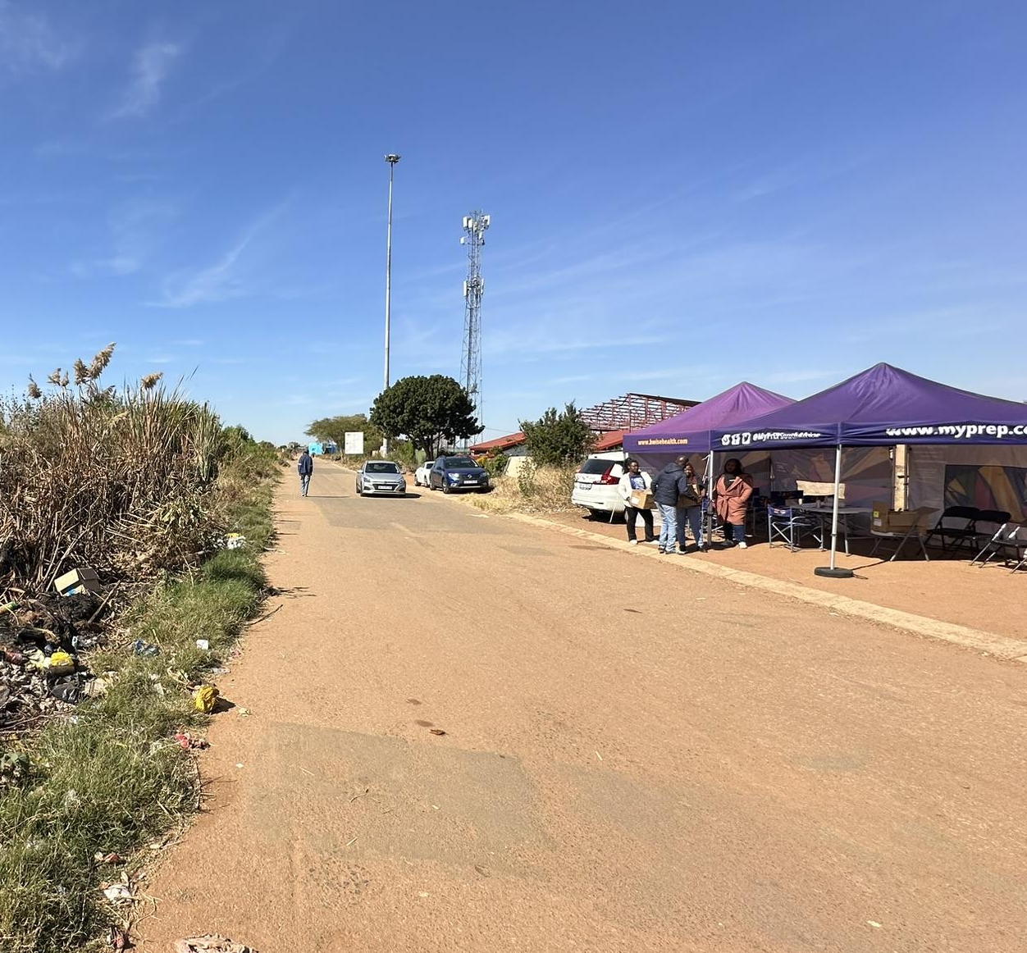
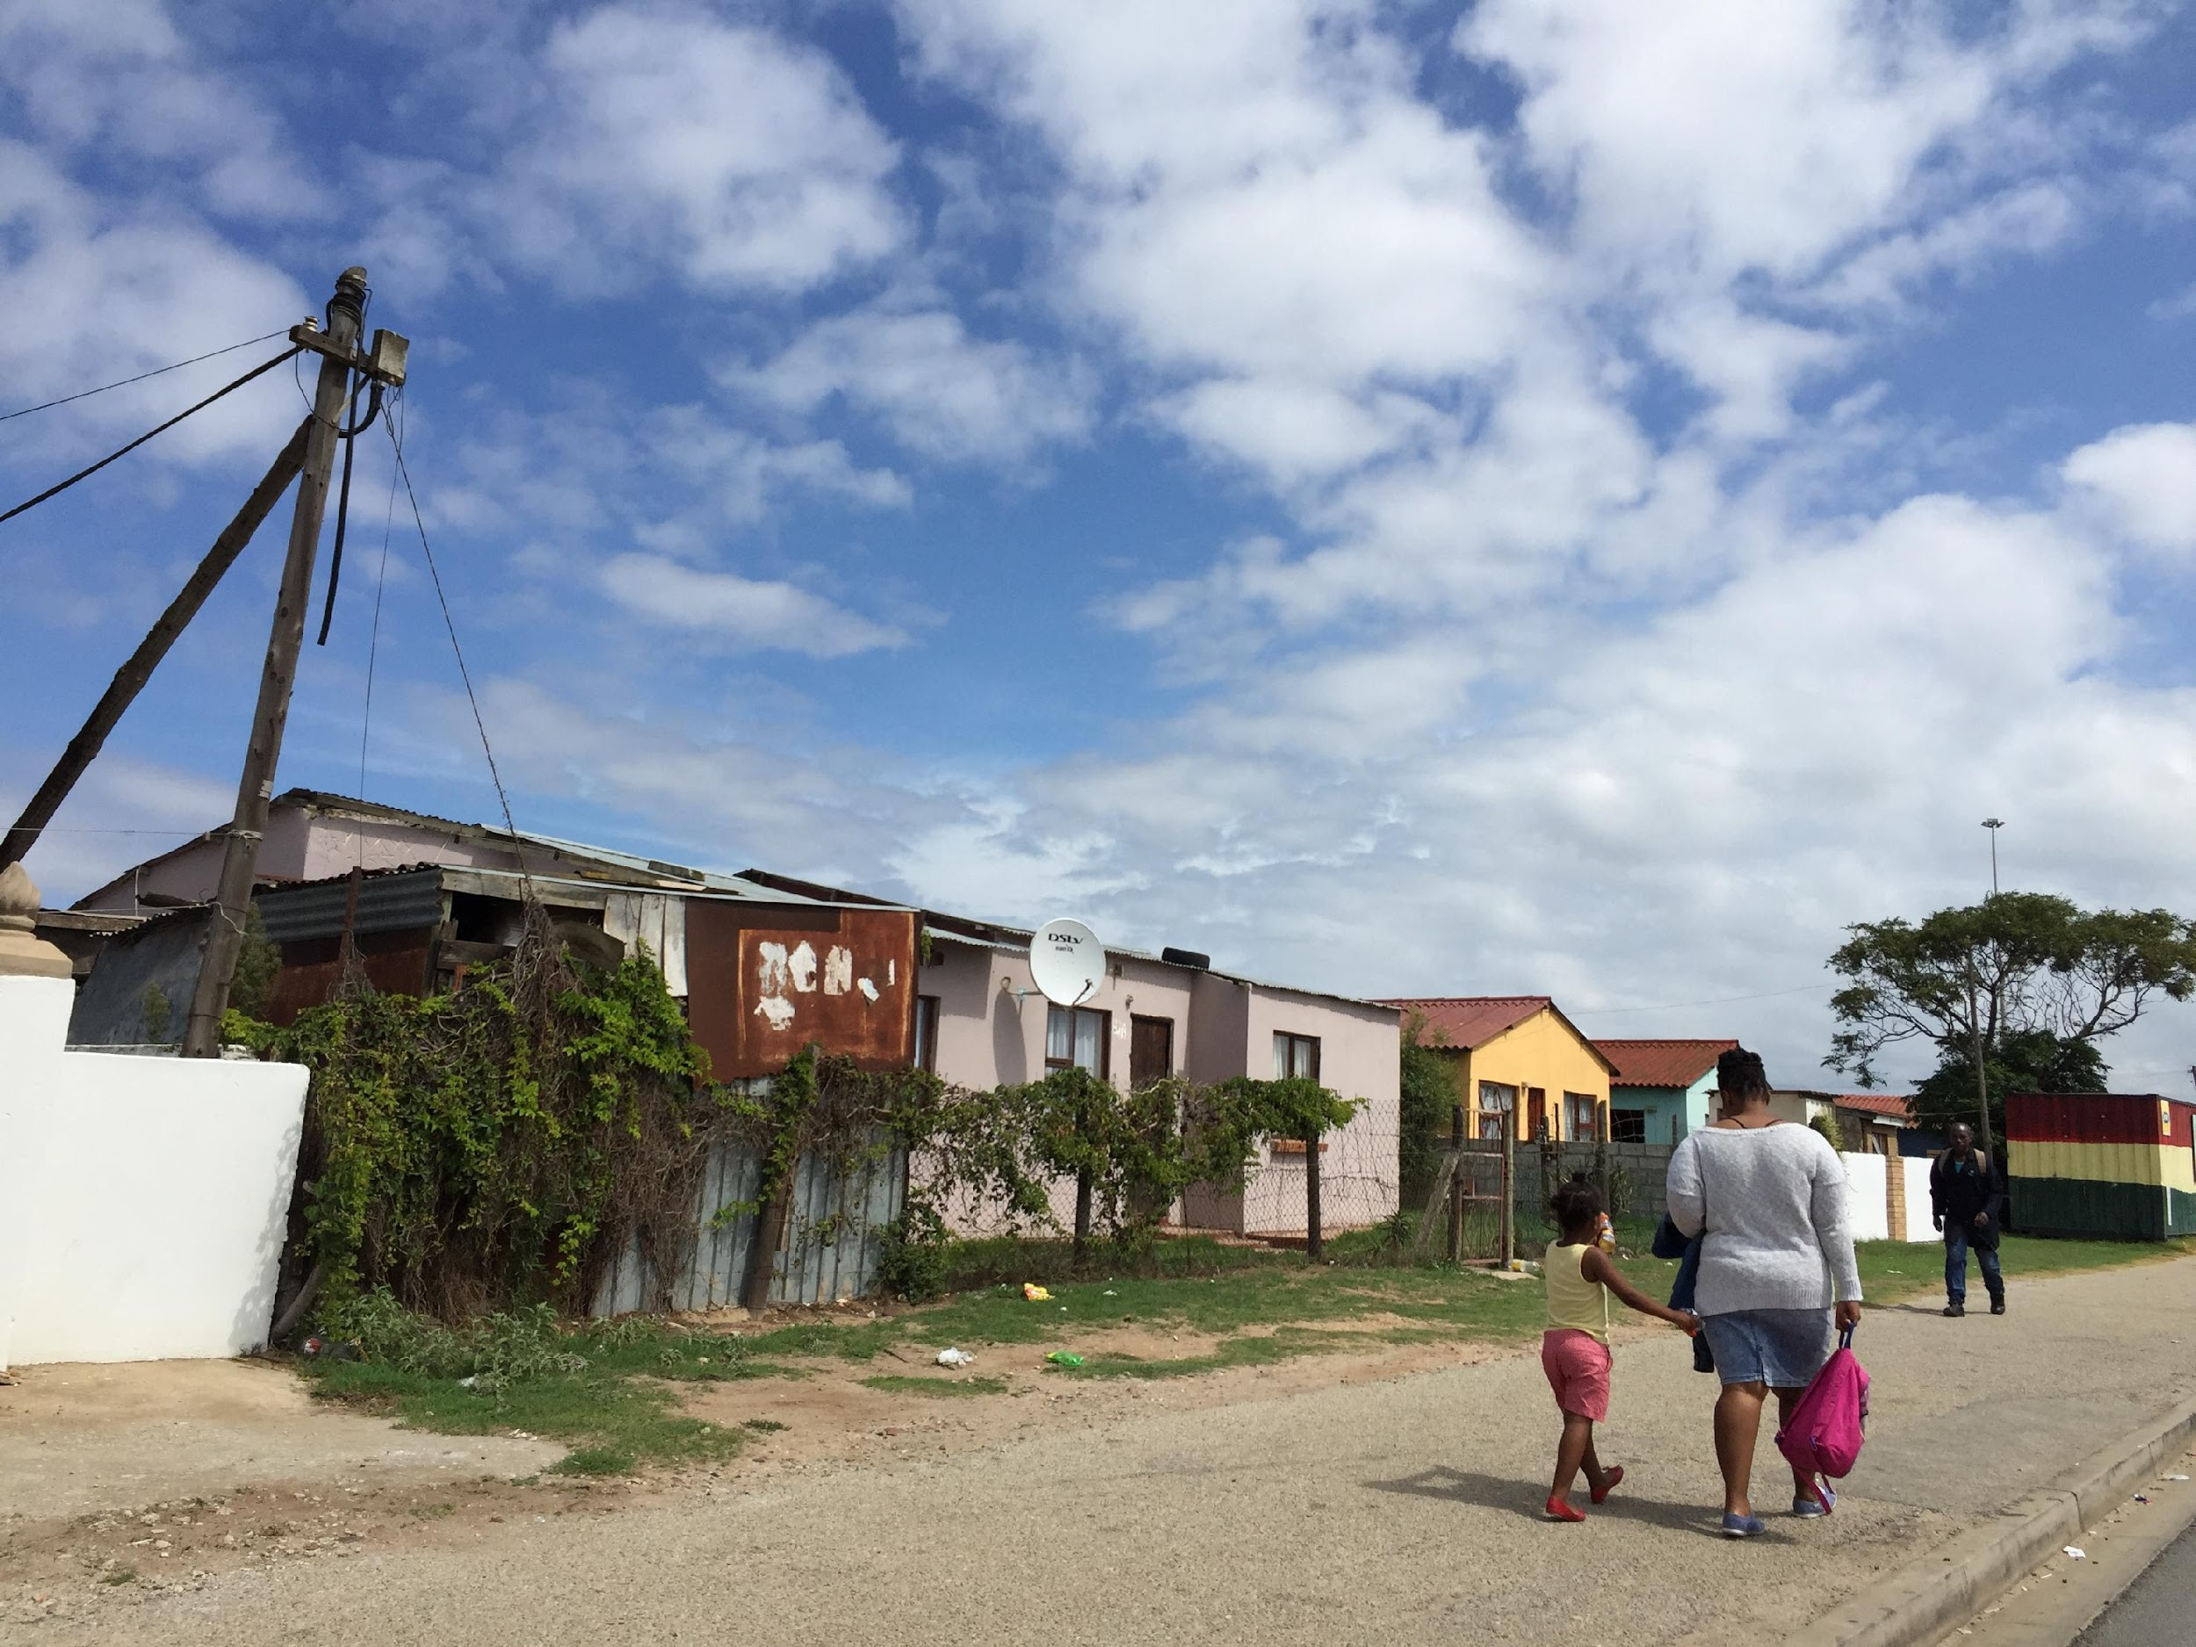
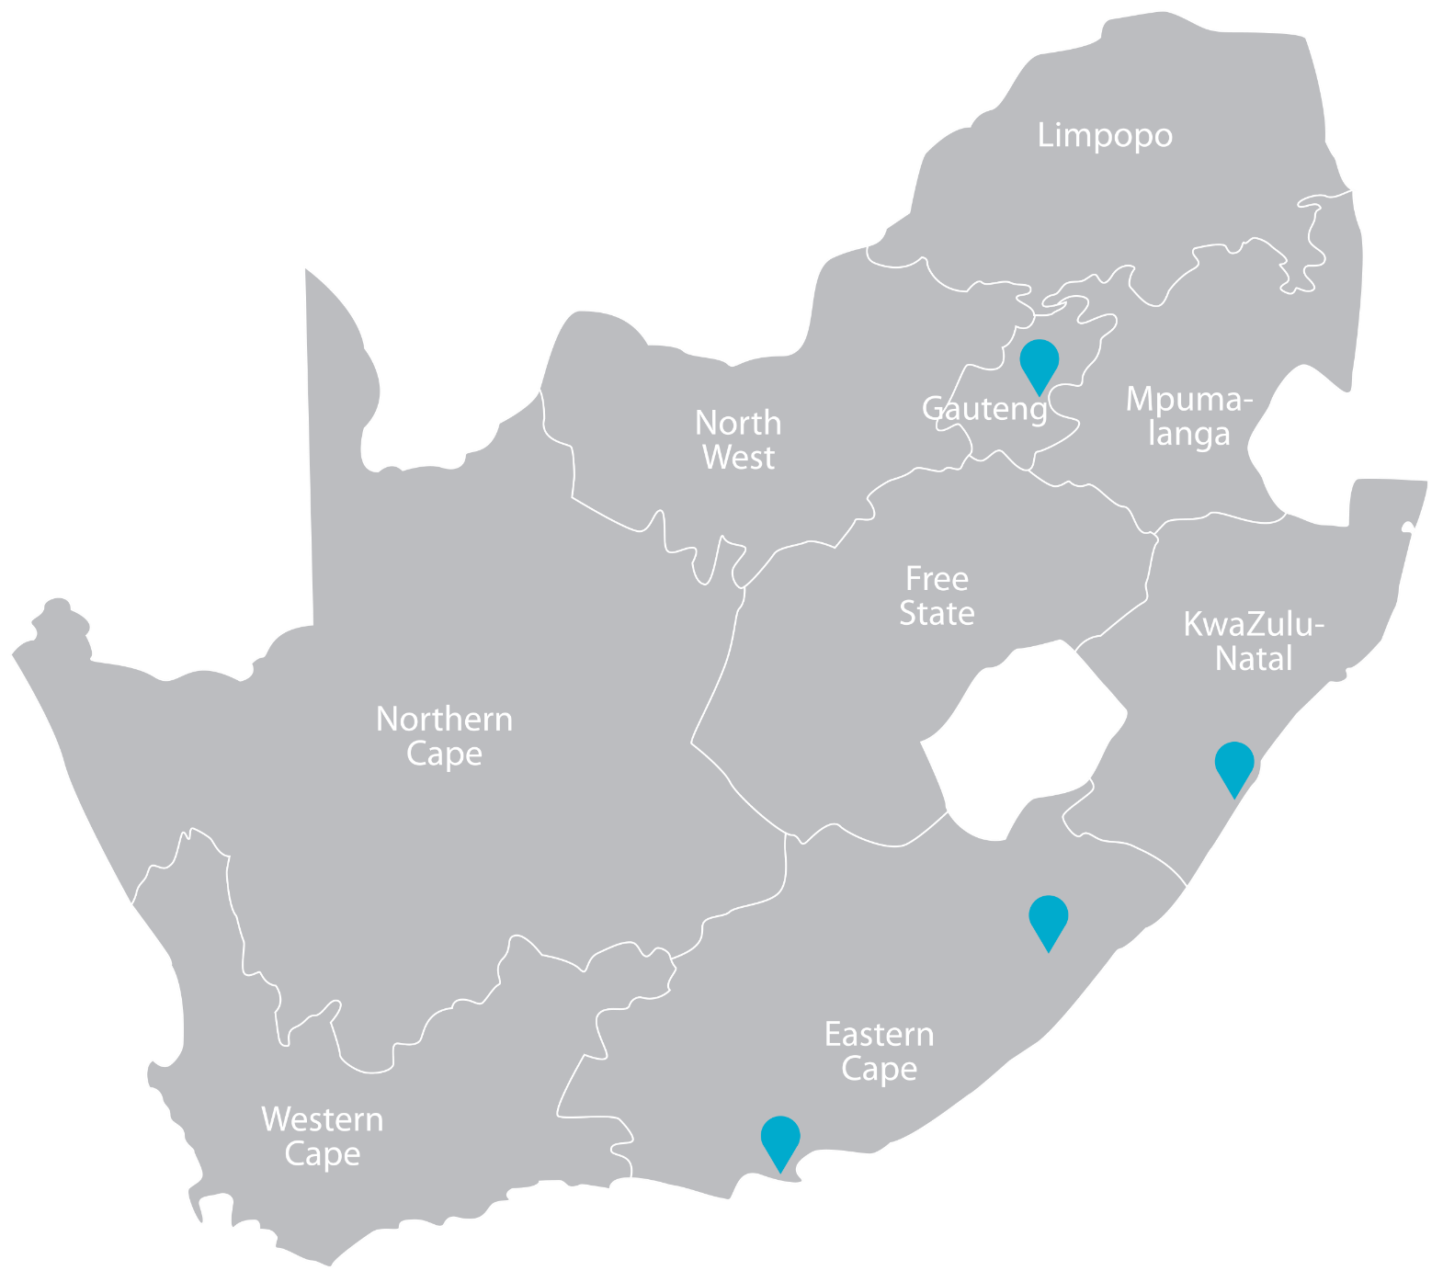

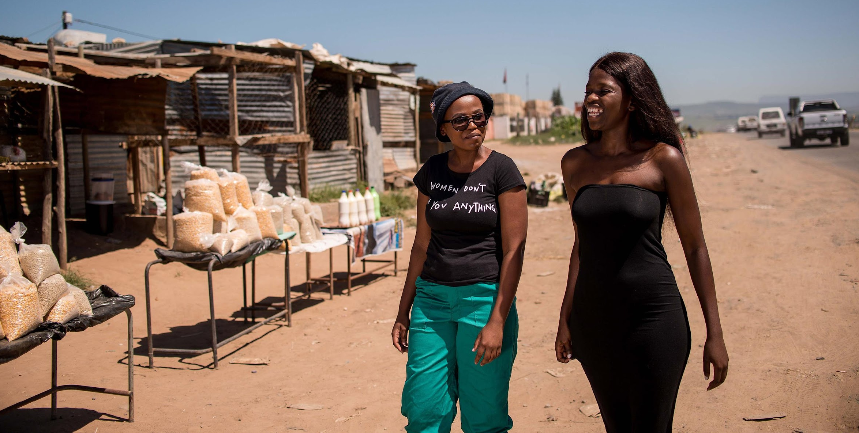
Project PrEP:
implementing in three provinces in South Africa since 2018
Tshwane, GP
Peri-urban
Motherwell, EC
Peri-urban
Tshwane,
GP
Tshwane,
GP
Wits RHI, in close collaboration with the National Department of Health, selected geographic areas with high HIV and STI prevalence and fixed facilities close to secondary schools, universities and/or other tertiary education institutions.
Motherwell Community Health Centre and Ikamvelihle Clinic:
74 985 TOTAL population of which 23.2% are girls and young women
Maria Rantho and Phedisong 1 clinics:
902 633 TOTAL population of which 23.7% are girls and young women
Mthatha, EC
Semi-rural
eThekwini, KZN
Urban
Ngangelizwe Health Centre and Stanford Terrace Clinic:
66 605 TOTAL population of which 23.2% are girls and young women
Lancers Road and Pinetown clinics:
2 188 896 TOTAL population of which 23.2% are girls and young women

Slide 6
Project PrEP cohort study timeline:
Aug 2023-Dec 2025
AUG 2023
APR 2024
OCT 2024
DEC 2025
Introduction of
dapivirine vaginal ring
(implementation study sites)
Introduction of CAB-LA (implementation study sites)
DVR / Oral Phase:
9 MONTHS
DVR / Oral / CAB-LA:
6 MONTHS
DVR / Oral / CAB-LA (Follow Up): 14 MONTHS
Enrolled = 2964
As of 31st July:
Total Enrolled = 2540
PrEP method choices offered:
Oral PrEP – male or female >35kg
PrEP ring – non-pregnant and non-breastfeeding females ≥18 years
CAB-LA male or female ≥35 kg
New = 1568
Reconsented = 972
6 – 10 October · Lima, Peru and virtual
hivr4p.org

Slide 7
Cohort enrolment updates for the oral/ring choice phase: August 2023 – April 2024

Slide 8
PrEP Choice at enrollment among non-pregnant or breastfeeding women ≥18 years (N=2325):
August 2023 – April 2024
1800
78.5%
1700
1600
1500
1511
Overall, choice of ring at enrollment was 14.9%
1400
higher (32.5%) among females ≥25 years
than among females 18–24 years (11.3%)
1300
1200
1100
1000
NUMBER OF FEMALES
900
800
11.3%
64.3%
700
32.5%
600
10.2%
500
400
3.3%
300
200
217
197
257
100
130
0
13
18-24 YEARS (n=1 925)
25+ YEARS (n=400)
Oral PrEP (n=1 768)
Ring PrEP (n=347)
None (n=210)

Slide 9
Cohort enrolment for the oral/ring/ CAB-LA choice phase: April 2024 – July 2024
Of all participants enrolled in this phase, 972 (38.3%) continued from the ring/oral phase

Slide 10

PrEP Choice at enrollment among female participants (N=2245): April 2024 – July 2024
Among females:
60.0% chose CAB-LA
30.1% chose oral PrEP
3.4% chose ring
at enrolment
54.6%
900
800
835
35.1%
700
74.5%
600
500
537
NUMBER OF FEMALES
2.7%
448
400
57%
16.8%
300
33.3%
7.6%
6%
200
0%
9.6%
2.7%
100
41
117
101
65
38
36
0
0
11
16
15-17 YEARS (n=114)
18-24 YEARS (n=1 530)
25+ YEARS (n=400)
CAB-LA (n=1 348, 60.0%)
Oral PrEP (n=676, 30.1%)
Ring PrEP (n=77, 3.4%)
None (n=144, 6.4%)
*Seven participants excluded from analysis due to incomplete data

Slide 11

PrEP Choice at enrollment among male participants (N=287):April 2024 – July 2024
Among males:
69.3% chose CAB-LA
26.0% chose oral PrEP
at enrolment
80.5%
57.1%
120
100
88.9%
36.1%
107
80
84
15.8%
60
53
6.8%
3.8%
40
11.1%
0%
20
21
0
8
0
10
5
1
15-17 YEARS (n=9)
18-24 YEARS (n=147)
25+ YEARS (n=133)
CAB-LA (n=199, 68.9%)
Oral PrEP (n=75, 26%)
None (n=15, 5.2%)
*One participant excluded from analysis due to incomplete data

Slide 12
Key Learnings
Clients are choosing PrEP methods, choice of CAB-LA has been high, across all ages and genders
Choice of DVR has declined since the introduction of
CAB-LA to <5%
For those who choose CAB-LA, month one return rates
are high.
Many oral PrEP users continued using oral PrEP
Healthcare providers are confident providing all PrEP methods at both fixed and mobile clinics
Nurses have needed to navigate providing multiple intra-muscular injections, i.e., CAB-LA, contraceptives, STI treatment
To date, no product related SAEs or complex cases encountered

Slide 13







As we continue follow up,
we will be exploring
What are the factors which influence choice and uptake of the different PrEP methods?
What are the
rates of PrEP continuation among PrEP users, what are the factors that affect this and how do they differ by PrEP product?
What are the frequency and reasons for switching between PrEP products?
How best can we integrate point of care syphilis testing within PrEP services?
How are new PrEP methods most effectively integrated into existing prevention services, and how are they best integrated with STI and contraceptive services?
What is the incidence of HIV infection, and associated HIV viral load and resistance pattern among PrEP users who seroconvert, by PrEP method?
What is the
most cost-effective service delivery model for prevention services?

Slide 14




Acknowledgements
Unitaid
The South African National Department of Health
All the adolescent girls and young women, their communities and our healthcare providers who help shape the implementation and real-world action of Project PrEP.
Hasina Subedar
The Project PrEP team!
IMPORTANT: Appearance in a photograph in this presentation does not indicate a person’s health status or gender/sexual identity.

