Slide 1



Preferences for delivery of HIV prevention services: a discrete choice experiment
Catherine E Martin, Wits RHI University of the Witwatersrand
Implementing PrEP Choice: Experiences from South Africa
Notes:
Good day, and thank you for the opportunity to present some findings from a study we conducted with healthcare users in South Africa, exploring their preferences for HIV prevention service delivery models using a discrete choice experiment.

Slide 2
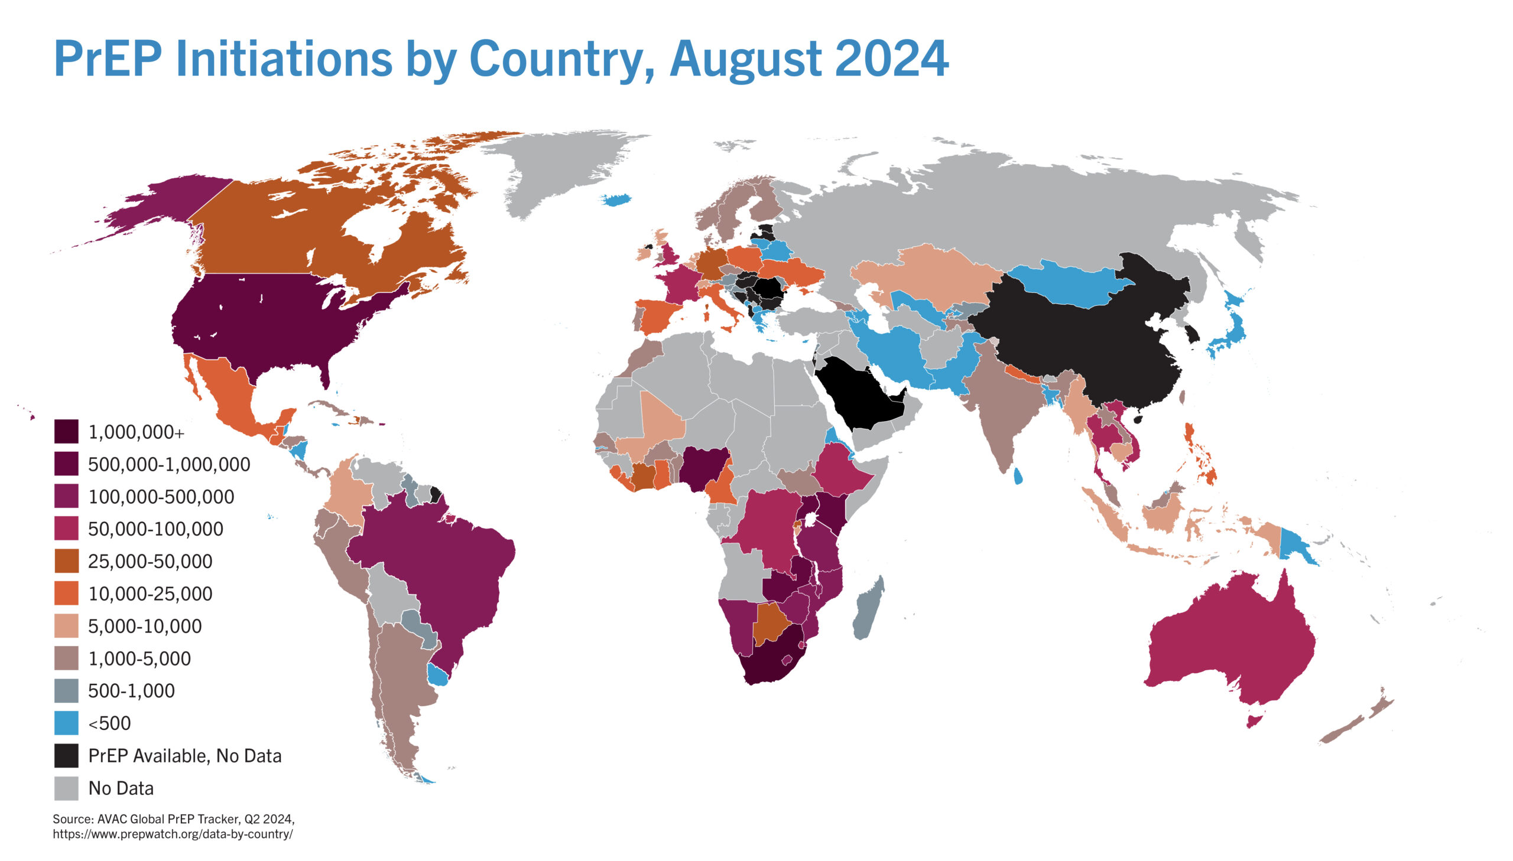
Progress has been made to scale PrEP services, with ~ 7,5 million PrEP initiations globally
AVAC. PrEP Initiations by Country Worldwide. 16 August 2024. https://avac.org/resource/infographic/prep-initiations-by-country-worldwide/
Notes:
As we are aware, much progress has been made to scale PrEP services, with approximately 7 ½ million PrEP users globally, and South Africa having among the highest PrEP initiations of any country in the world;
There is also much excitement about new PrEP methods, which hold great potential to improve uptake and use of PrEP.

Slide 3
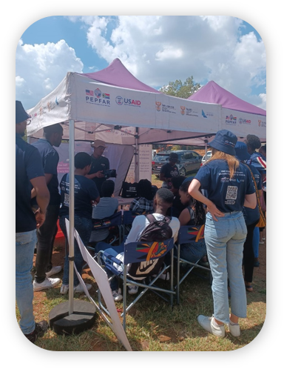
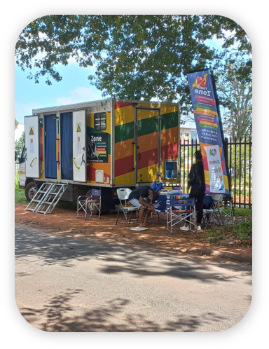
Barriers to accessing PrEP remain, but decentralized services hold the potential to address some of these issues
“I have stopped [PrEP] because of my job. That time, it was December. I didn't have a chance to be off, I was always working… So, that's why I didn't find time to come here.”
21‐year‐old male PrEP user, South Africa
“I would like to get service from mobile taking into consideration the convenience.”
20-year-old female PrEP user, South Africa
Cholo FA, Dada S, Martin CE, Mullick S. Experiences of oral pre-exposure prophylaxis use among heterosexual men accessing sexual and reproductive health services in South Africa: a qualitative study. J Int AIDS Soc. 2024 May;27(5):e26249. doi: 10.1002/jia2.26249.
Nongena P, Martin CE, Muhwava LS, Cholo FA, Chidumwa G, Mojapeple M, Butler V, Mullick S. Reaching young women through a decentralized mobile service delivery model for HIV prevention and PrEP services in South Africa. Global Health Science and Practice. Under review.
Notes:
However, there remain a number of structural barriers to PrEP access such as school and work scheduling conflicts, distance from service delivery sites, clinic operating hours, long waiting times and healthcare provider attitudes.
The promise of PrEP may not be fully realised if these are not addressed.
A quote from qualitative research we conducted with PrEP users highlights the challenge with work priorities, as a young male PrEP user states
“I have stopped [PrEP] because of my job. That time, it was December. I didn't have a chance to be off, I was always working… So, that's why I didn't find time to come here.”
Differentiated and decentralised services hold the potential to address some of these issues, with some successes reported through mobile clinics, pharmacy models, and scooter deliveries;
As highlighted by a young women accessing PrEP services in South Africa, whom I quote “I would like to get service from the mobile clinic taking into consideration the convenience”.

Slide 4
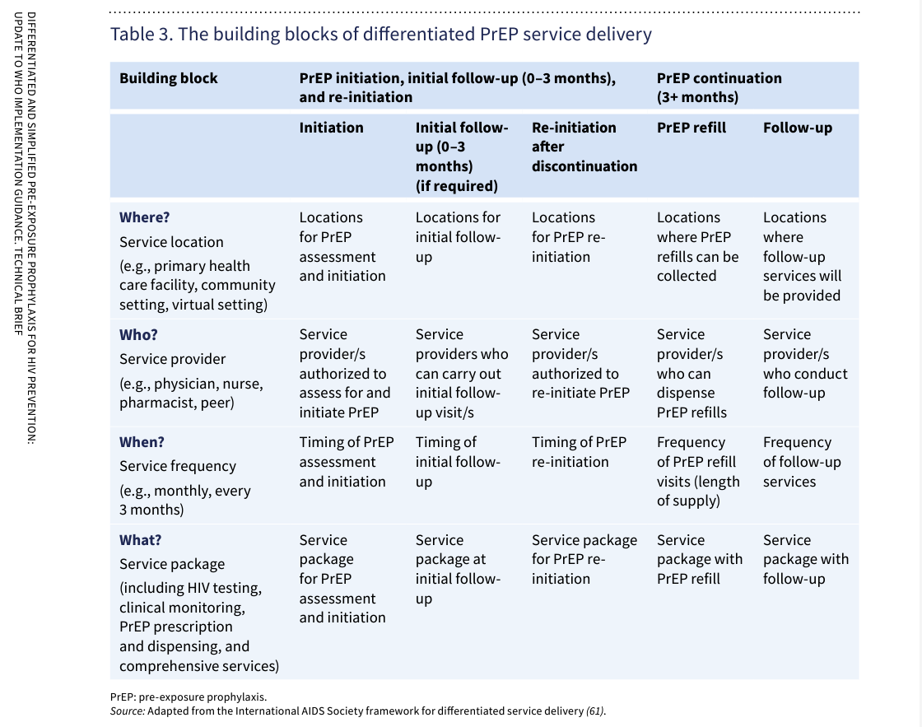
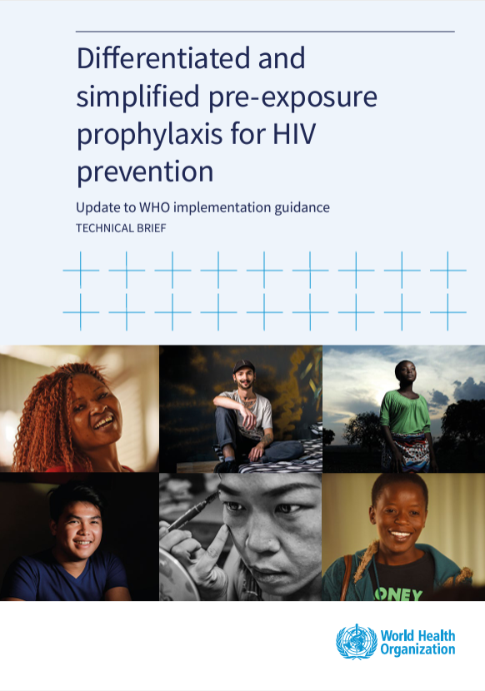
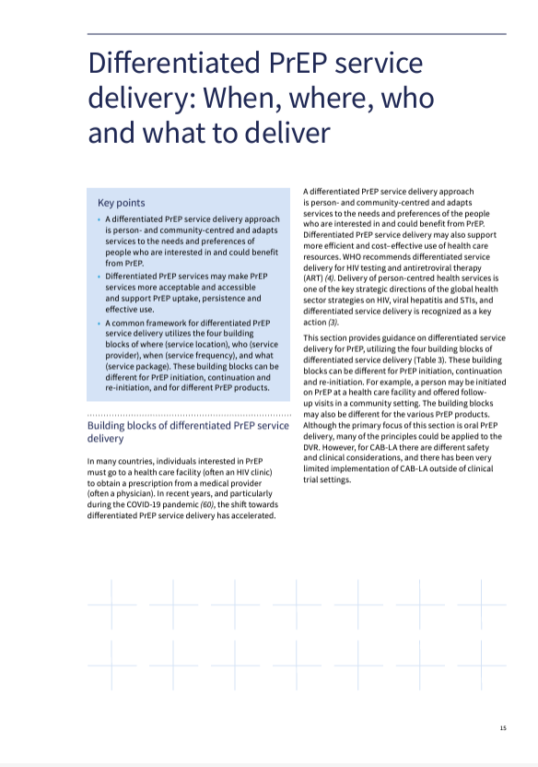
WHO outlines Building Blocks of a differentiated PrEP service delivery package
Notes:
The WHO has provided implementation guidance on differentiated and simplified PrEP for HIV prevention, outlining several building blocks for differentiated PrEP service delivery.
These are categorized into:
WHERE services are located – such a primary care facilities, community settings or virtual
WHO provides these services – for example nurses, pharmacists or peers
WHEN or HOW OFTEN services are provided
And WHAT is included in the service package at initiation, follow up and pick-ups.

Slide 5
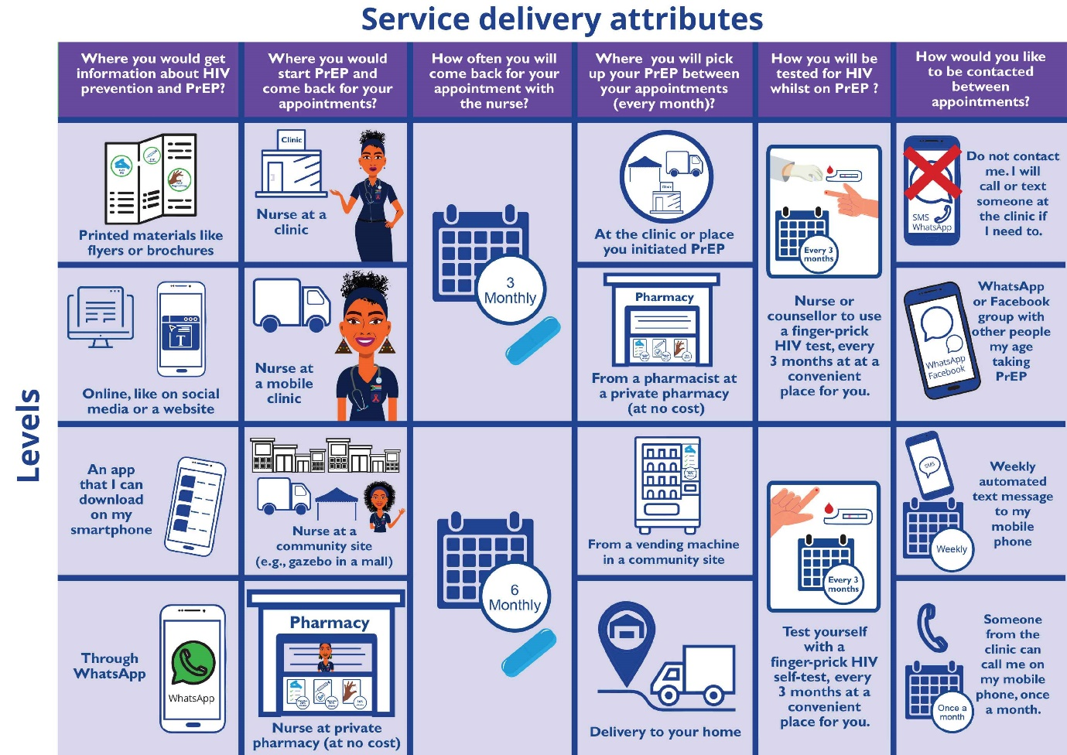
Wits RHI developed a Discrete Choice Experiment to explore health care user preferences for PrEP service delivery models
Service Attributes:
Source of information about HIV prevention and PrEP
PrEP initiation site and clinical follow-up
Frequency of follow-up appointments;
PrEP pick up point between clinical appointments
HIV testing method whilst using PrEP
Contact between appointments for general support for PrEP use
Notes:
Adapted from these building blocks, Wits RHI’s Unitaid funded Project PrEP designed a Discrete Choice Experiment to explore health care user preferences for PrEP service delivery models
Discrete Choice Experiments have been used in health research as a quantitative method to evaluate user preferences for health products and service delivery models.
They evaluate the key features or attributes of a product or service which are of value to an individual.
Potential users are asked to choose between different combinations of products or services, from where data is analyzed to determine the value and relative importance of each attribute, and which are most likely to influence decision making.
Within our DCE we explored the following service attributes
Source of information about HIV prevention and PrEP
The site of PrEP initiation and clinical follow-up
Frequency of follow-up appointments;
PrEP pick up point between clinical appointments
HIV testing method whilst using PrEP
Methods of contact between appointments for general support for PrEP use

Slide 6
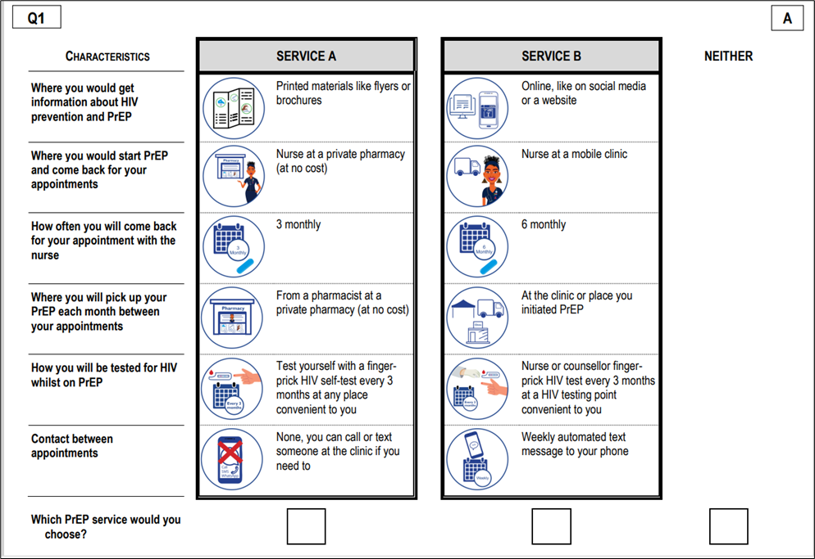
Example of the DCE Choice Set
Notes:
Here is an example of one of the choice sets that participants were presented with, which presents to the participant different combinations of each of the service delivery attributes.
Each choice set had three alternatives, with participants choosing either “Service A” or “Service B”, or an opt-out choice for those who preferred neither service option.
Participants were then presented with a series of these choice sets, and for each they select their preferred service delivery model.
We used a D-efficient DCE design with 16 choice sets in 2 blocks.

Slide 7
Between November 2022 and February 2023, we recruited participants from eight clinics in four areas of South Africa
Recruiting sites were primary care clinics supported by Wits RHI’s Project PrEP to integrate PrEP within routine primary care services since 2018
Participants were HIV negative men and women accessing sexual and reproductive health and related services
Potential participants were consecutively approached by study fieldworkers
Interviews were conducted in English and ~45mins
Data were captured on tablet devices using REDCap
Descriptive statistics were used to describe the participants
DCE data were analysed using generalised multinomial logistic models
Limpopo
Mpuma-langa
North West
Gauteng
Free
State
KwaZulu-Natal
Northern Cape
Eastern Cape
Western Cape
Notes:
Between November 2022 and February 2023, we recruited participants from eight clinics in four areas of South Africa
Recruiting sites were primary care clinics supported by Wits RHI’s Project PrEP to integrate PrEP within routine primary care services since 2018
Participants were HIV negative men and women accessing sexual and reproductive health and related services
Potential participants were consecutively approached by study fieldworkers
Interviews were conducted in English and ~45mins
Data were captured on tablet devices using REDCap
Descriptive statistics were used to describe participants
DCE data were analysed using generalised multinomial logistic models

Slide 8
The majority of the 307 participants were young women, who had completed secondary education but were unemployed
Notes:
Looking at the study population’s demographics:
Of the 307 participants, almost two thirds (63%) were female, and just over half were 15 – 24years;
Although more than half had completed secondary school education, 61% were unemployed;
Approximately ½ were currently using oral PrEP.

Slide 9
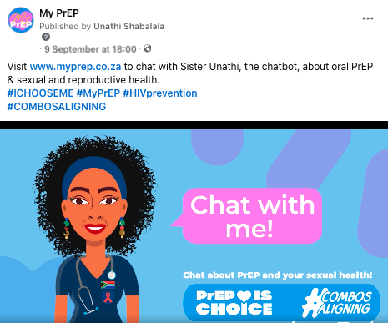

There was a strong preference for information about PrEP to be provided through online platforms
Notes:
With regards to how people wanted to received information, there was a strong preference for information to be provided through online platforms relative to printed materials.
As depicted in these odds ratios, participants were almost 8 times more likely to prefer online compared to printed materials

Slide 10
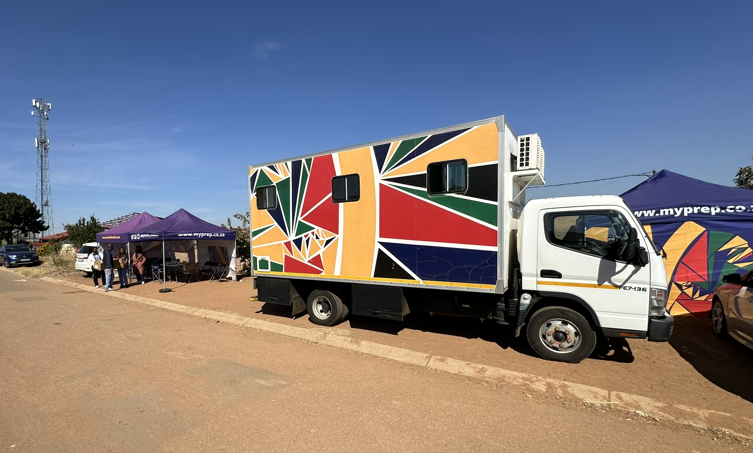
Participants showed some preference for PrEP initiation at mobile clinics, but did not prefer initiation at a pop-up community site over a fixed clinic
Notes:
We found that for PrEP initiation, there was some preference for PrEP initiation at a mobile compared to fixed clinics, but participants did not prefer PrEP initiation at a pop up gazebo in the community over a nurse at a fixed facility, as presented here in the negative direction of the odds ratio.

Slide 11
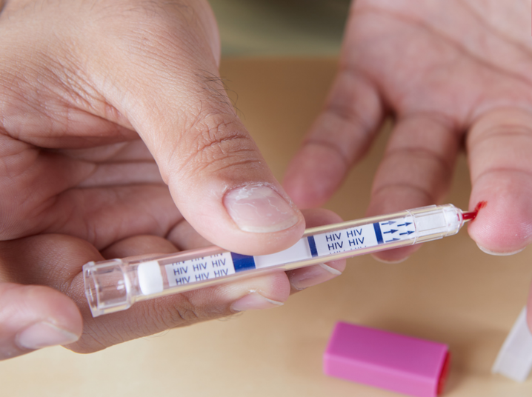
There was a strong preference for HIV self-testing, and 6-monthly compared to 3-monthly PrEP follow up
Photo by Domizia Salusest on aidsmap
Notes:
We found that healthcare users had a strong preference for HIV self-testing, and strongly preferred 6-monthly over 3-monthly follow up visits

Slide 12
Between clinic visits participants preferred contact through social media, although also accepted a monthly phone call or weekly SMS over no contact
Photo by Nathan Dumlao on Unsplash
Notes:
Participants also preferred some contact through social media, a monthly phone call or a weekly SMS compared to no contact between visits.

Slide 13
There was a strong preference for decentralized and out of facility PrEP pick up points
Notes:
We found a strong preference for out of facility PrEP pick up between clinical visits, with participants preferring a pharmacy, home delivery or vending machine over their PrEP initiation site.
The strongest preference was for a pharmacy.
We also explored preferences by sex and previous PrEP use; we did not find any marked differences, but there are some which are detailed in the full paper.
Just to note that the only significant difference related to previous PrEP experience was that those who had not used PrEP before were more enthusiastic about HIV self-testing.

Slide 14
Conclusion
These data are being used to inform the implementation of decentralized models within Project PrEP
The myprep.co.za, MyPrEP facebook page and the Sr Unathi chatbot are a component of the Project PrEP delivery model, with more than 35 million (reached multiple times) people reached through these platforms.
Our findings highlight a clear preference for out of facility options for PrEP pick up.
Project PrEP delivers services through mobiles and fixed facilities and is expanding the options of out of facility pick up points.
Longer follow up periods between PrEP visits were strongly desired by healthcare users.
There was a willingness and a preference to use HIV self-testing, which could enhance more self-led prevention.
In addition to choice of PrEP methods, offering choice within service delivery models could further improve access and acceptability.
Notes:
These data are being used to inform the implementation of decentralized models within Project PrEP
The myprep.co.za, MyPrEP facebook page and the Sr Unathi chatbot, which have been included in the Project PrEP delivery model could enhance and facilitate access to health information and support.
These platforms could also be used to provide support between clinic visits.
These platforms have had a reach of over 35 million since their inception.
Although preferences around PrEP initiation points were not as clear, there was a clear preference for out of facility options for PrEP pick up.
Project PrEP delivers services though both mobile and fixed facilities and is currently expanding these to include additional out of facility pick up points
Longer follow up periods between PrEP visits were strongly desired by healthcare users; this may bode well for longer-acting PrEP method options
Healthcare users indicated willingness and a preference to using HIV self-testing, which could enhance more self-led prevention.
In addition to offering a choice of PrEP methods, we need to offer a choice of service delivery models could improve access and acceptability.

Slide 15
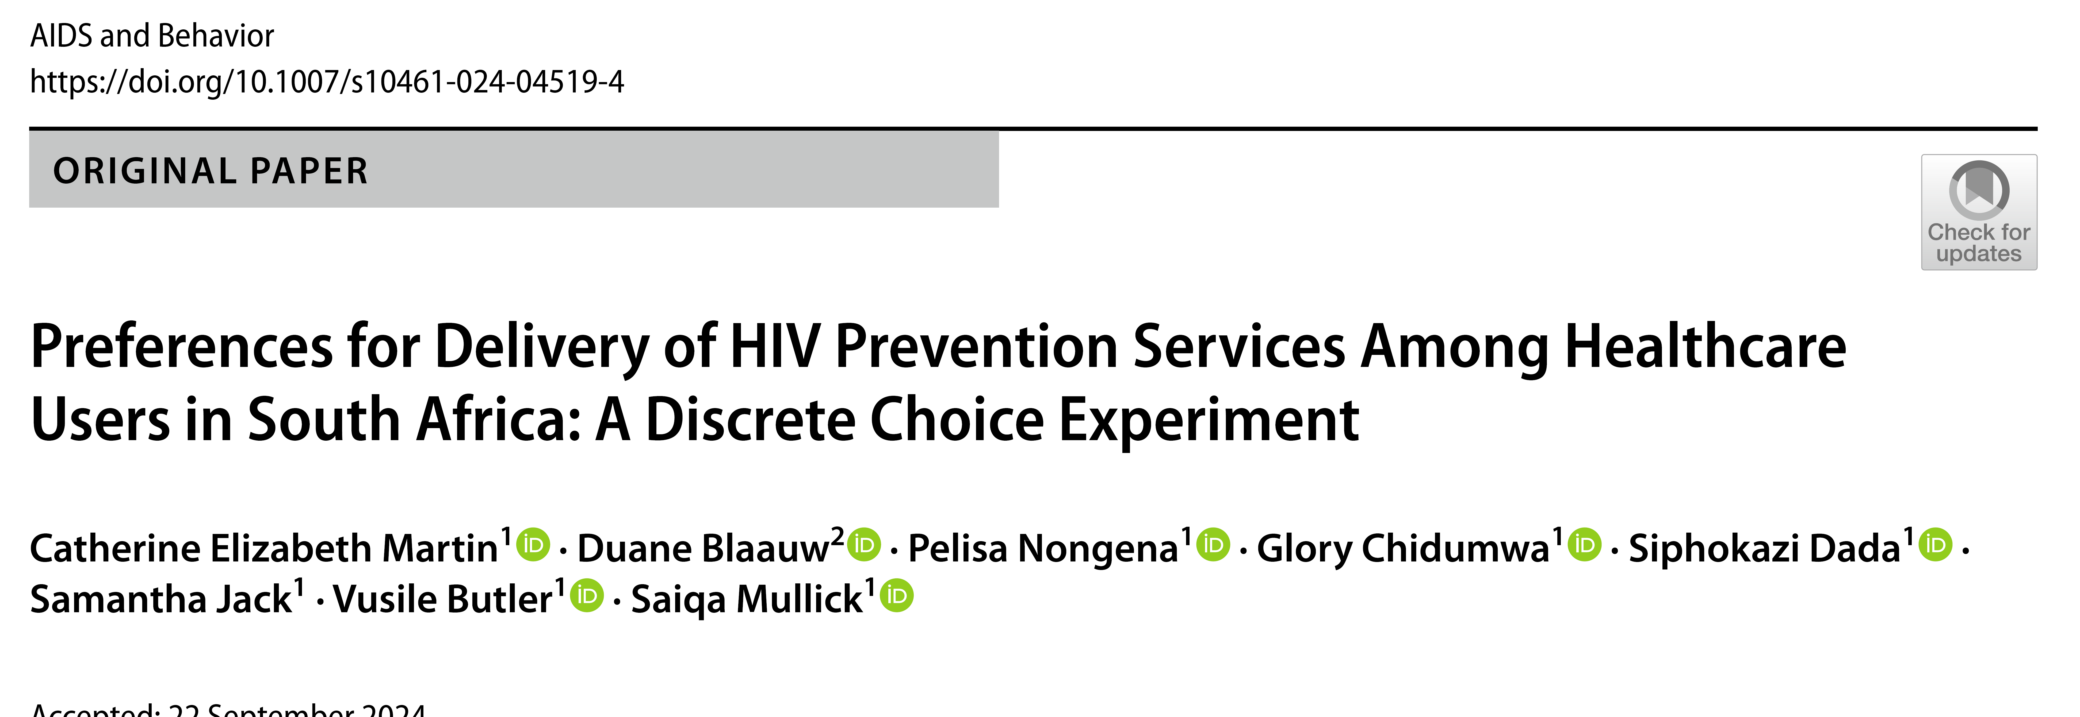
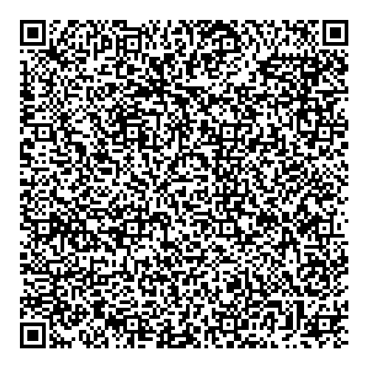
Acknowledgements
Unitaid, for funding this work
The South African National Department of Health​
All the participants who contributed their time and effort participating in this study
The Project PrEP team!
Full article available online
Notes:
I would like to acknowledge and thank the funders, the SA department of health, the participants who contributed their time and efforts in participating, the project PrEP team, and the co-authors of this paper.
The full paper is published in AIDS & Behavior and available through the link on the slide.

