Slide 1



CATALYST, a multi-country implementation science study of informed PrEP choice: Experiences from South Africa
Nicolette Prea Naidoo, Wits RHI, University of Witwatersrand South Africa
Satellite: Implementing PrEP Choice: Experiences from South Africa

Slide 2
Catalyzing access to new prevention products to stop HIV
The CATALYST study, under the MOSAIC project, uses mixed methods to characterize and assess the implementation of an enhanced service delivery package providing choice of PrEP products among women at PEPFAR delivery sites in Kenya, Lesotho, South Africa, Uganda, and Zimbabwe.
The enhanced service package offers PrEP products that have regulatory approval in each country
CATALYST includes a cohort study of HIV-negative women and a mixed-methods process evaluation
It uses quality improvement (QI) methods to refine implementation and identify a core service delivery package for PrEP choice
OBJECTIVE 1
Characterize the implementation of an enhanced service delivery package for PrEP choice and assess individual-, provider-, facility-, community- and health system-level facilitators and barriers of the implementation process
OBJECTIVE 2
Describe patterns of PrEP use and use effectiveness in the context of PrEP choice and assess sociodemographic and contraceptive use correlates of PrEP use patterns
OBJECTIVE 3
Describe clinically relevant indicators among PrEP users, including rates of HIV infection and drug resistance among PrEP users who acquire HIV following PrEP exposure

Slide 3
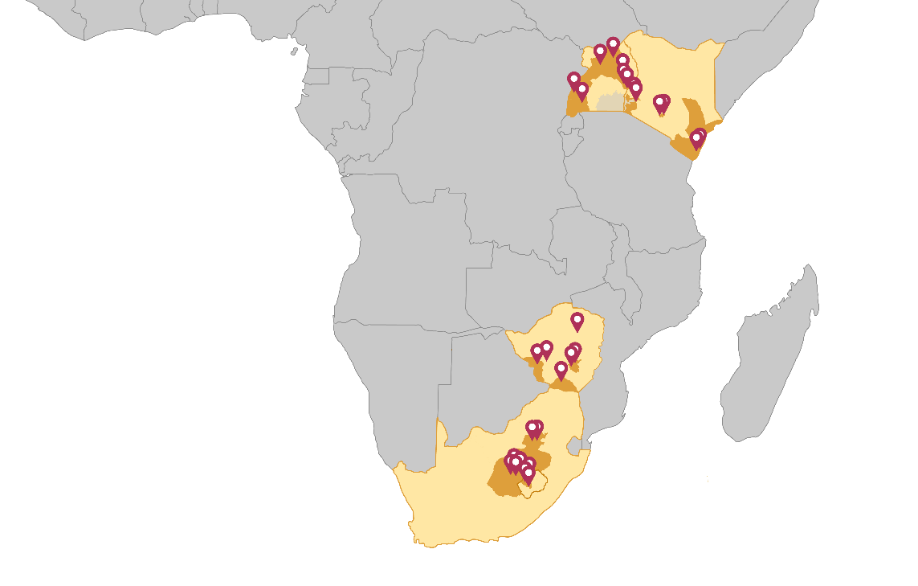
CATALYST Study Sites
Diverse mix of 28 public health delivery sites with PEPFAR PrEP targets
  6 in Kenya
  3 in Lesotho
  6 in South Africa
  7 in Uganda
  6 in Zimbabwe
Mix of populations with some sites focused on adolescents, sex workers or pregnant women

Slide 4
CATALYST South Africa
Implemented in 6 PEPFAR-supported sites
  4 primary health care (PHC) facilities
  2 partner-led key populations focused sites
Populations
  Women >18 years – note no upper age limit
  Transgender females
  Pregnant and breastfeeding populations
Stage I (oral PrEP and PrEP ring) – August 2023 to March 2024
Stage II (oral PrEP, PrEP ring and CAB PrEP)- April 2024 to present
  April - July 2024: Stage I participants reconsented to receive choice of all 3 methods
  August to date - open to new enrolments
All products are delivered in accordance with NDOH guidelines

Slide 5


CATALYST South Africa timeline
Protocol development incl. site assessment and selection
June-September 2022
IRB, SAHPRA, NHRD, UFS submissions and approvals (all versions) Nov 2022-Oct 2023
CATALYST Protocol Training
April 2023
National PrEP Ring Provider Training
May 2023
Finalisation of tools, amendments, recruitment and IEC materials
May-June 2023
Provider trainings, finalisation of implementation plans and activation checklists June-July 2023
CATALYST Stage I implemented
August-October 2023
National CAB PrEP Provider Training
February 2024
CATALYST Stage II launched
April 2024

Slide 6
Current enrollment as of June 30, 2024
Total enrollment in Stage I (choice between oral PrEP and PrEP ring): 3967
  South Africa – enrolled 557 participants
Total enrollment in Stage II (choice between oral PrEP, PrEP ring and CAB PrEP): 614
  South Africa – enrolled 268 participants
    242 (43%) are Stage I participants who reconsented to Stage II and 26 are new Stage II enrolments at a site serving transgender individuals
  Currently enrolling for Stage II in Lesotho, South Africa, Zimbabwe and Uganda
  Anticipate starting Stage II in Kenya in Q4 2024
Country-specific product use guidance varies
  PrEP Ring not approved for use in PBFW in South Africa; PrEP ring use allowed during pregnancy in Kenya and Lesotho; ring use allowed during breastfeeding in Kenya, Lesotho, and Zimbabwe
  CAB PrEP initiation and continuation allowed during pregnancy in South Africa; CAB PrEP continuation allowed during pregnancy in Zimbabwe

Slide 7
Participant characteristics at enrolment in South Africa
Participant characteristics | S. Africa (n=557)
Pregnant | 2.5%
Breastfeeding | 5.0%
Sex worker | 41.9%
Adolescent Girls & Young Women (15-24) | 30.3%
Age group
15-17 Years | 0%
18-24 Years | 30.3%
25+ years | 69.7%
Education
Less than primary | 1.3%
Completed primary | 2.5%
Some secondary | 37.5%
Completed secondary | 48.1%
More than secondary | 10.1%
Marital status
Never married | 84.0%
Married/living as married | 9.3%
Divorced/separated/widowed | 6.1%
Population: 42% of participants sex workers and about a third AGYW*
Age: Majority of participants >25 years
Education: Majority with some or completed secondary school
Marital status: Majority never married
*SA eligibility age >18 years
Columns may not sum to 100% due to non-response

Slide 8
Key takeaways from first interim analysis –
Stage I oral PrEP and PrEP ring (May-November 2023)
Participants take advantage of having choice; in Stage I, substantial numbers chose ring, particularly FSW and former oral PrEP users (not using at the time of enrollment).*
Continuation on PrEP varies by method, population, and site.
While PrEP choice counseling sessions can be lengthy, providers find delivery of PrEP choice counseling appropriate, feasible, and acceptable.
  Time and practice with onsite mentoring are necessary to master PrEP choice counseling.
  Staff turnover is a challenge; invest time in routinely training providers on choice counseling and new PrEP methods and refreshing on oral PrEP.
  Finding a balance between PrEP delivery and other services is a challenge, particularly were there are staff shortages and growing demand for PrEP.
  Address bottlenecks to client flow and waiting time (e.g., in-room dispensing of ring and oral PrEP instead of waiting in a pharmacy queue)
Gaps in integrated service delivery, especially GBV, have been observed.
Participants are comfortable with providers inserting the ring at initiation, and with instructional materials and videos provided to assist with follow-up self-insertion
Please join session on Delivering PrEP Choice, Thursday 10 October 1-2:30pm for CATALYST Stage I Results, by Dr Elizabeth Irungu

Slide 9
Early anecdotal insights from Stage II (oral PrEP, PrEP ring and CAB PrEP) in South Africa
*This is an active enrolment phase and therefore data not available to share at this time
High demand for CAB.
Dedicated users of products – affirms that the best PrEP method is a method that meets the client’s needs and fits into their lifestyle/circumstances.
Targeted demand creation activities to balance supply and staff availability - CAB uptake mainly driven by facility health talks, word of mouth, and community engagement efforts.
Participants have specific questions around CAB - side effects, blood tests, and post study access (opportunity to work with NDOH to identify sites for programmatic CAB rollout).
Reasons for choosing CAB include fits in with daily schedule (work or school); they forget to take tablets; especially for FSWs, it suits their line of work and provides the most protection; still unsure of ring – unfamiliar formulation.
PHC nurses trained on NDOH guidelines, job aids and study procedures successfully deliver PrEP choice; are comfortable with administering injections and conducting choice counseling.
However, shortage of Nurse Initiation and Management of ART (NIMART) trained nurses is a barrier to scaling PrEP; CATALYST supporting a bridging course for NIMART nurses at one site to allow them to initiate PrEP.

Slide 10

The importance of the QIC in understanding PrEP choice implementation
Quality Improvement (QI) is critical to helping understand how to effectively deliver PrEP choice at site level
At CATALYST’s 28 public sector PEPFAR-supported sites, QI helps identify context-specific strategies for delivering the enhanced service delivery package for PrEP choice, which will inform programmatic scale-up of PrEP choice across a diversity of sites and geographies
QI learnings may help explain patterns of PrEP use or behaviors among CATALYST participants that are observed in the study data
Notes:
Across the South African sites, change ideas being tested to increase PrEP demand, initiations, continuation on PrEP and GBV screening and linkage to care.
QI teams comprise MOH staff (providers, facility manager, CATALYST QI advisor and coach) and activities are implemented at a facility level to effect change for all clients and overarching health systems.

Slide 11
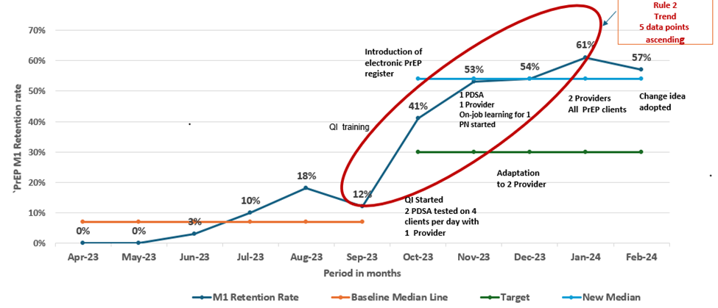
Quality Improvement Project facilitates better PrEP continuation at Month 1 at CATALYST site in South Africa
*PDSA= Plan-Do-Study-Act
Notes:
Following a root cause analysis at one of the sites, the team identified:
Client’s lack of knowledge about PrEP use
Clients fear reporting PrEP discontinuation at the facility
Providers poor adherence to PrEP guidelines; and poor record keeping by nurses.
PrEP services were only provided by USAID supported implementing partner
The QI project aimed to improve M1 PrEP retention from 7% to 30% from October 2023 to March 2024
QI training was conducted in September
The electronic PrEP register was introduced in October to capture and track M1 returns/retentions.
The same month, the QI project started.
The change idea tested was to counsel clients at initiation on the importance of HIV risk assessment at M1, whether continuing or discontinuing PrEP for a risk assessment and HIV test. Prior to this change idea, clients were just given a refill date.
The change idea was tested using multiple PDSA cycles
October, change was tested on a small scale with 4 clients and 1provider per day.
November, the scale was not increased; one 1provider was not coping with the workload as most of the clients were study participants, and she was the only one trained on the study protocol.
QI coach/site coordinator conducted onsite provider training sessions for one provider to reduce workload from one provider. One session per day for 45 minutes)
December change adapted to include 2 providers and 6 clients per day
In January, the scale was increased to include all PrEP clients, and in March, the change idea was adopted and became part of the system
PrEP M1 return post-intervention increased from a baseline median of 7% to 54% from 1 October 2023 to March 2024
There is a systematic way of assessing whether an improvement has occurred using the run chart rules.
Our Run chart shows the application of Rule 2 (shift)5 or more consecutive data points ascending.
When rule 1 or 2 is met, there is a 95% or more chance that the data pattern observed results from a change and not just a random occurrence.

Slide 12

In Summary
Women are taking advantage of PrEP choice.
Continuation rates vary by product.
Choice counseling is critical in supporting informed choice – balance key messages (side effects, efficacy, dosing schedules); remember clients’ preferences may change over time.
It is feasible to deliver PrEP choice in existing public health PrEP delivery sites in Africa, and providers are generally positive about offering PrEP choice counselling.
Need to reinforce components of the package – e.g., GBV screening and linkage to care, support systems for improving continuation for AGYW, etc.
Quality improvement methods can be used to tailor and strengthen the delivery of PrEP choice in each setting.

Slide 13

MOSAIC at HIVR4P 2024
Oral Abstract Sessions
Poster Presentations
Date/Time | Title
Thursday, Oct 10 1:05 – 1:15 pm PET | PrEP choice for women in Africa: Uptake of oral PrEP and PrEP ring
Thursday, Oct 10 1:15 – 1:25 pm PET | Provider and client perspectives on PrEP choice: Quality of PrEP choice and factors influencing its provision in the CATALYST implementation study
Date/Time | Title
Tuesday, Oct 8 5:00 – 6:30 pm PET | Optimizing the delivery of PrEP choice through a multi-country quality improvement collaborative approach
Wednesday, Oct 9 7:00 – 8:30 pm PET | Feasibility of assessing Prevention Effective Use (PEU) utilizing a phone-based, self-reporting system: Early CATALYST study findings
 | Patterns of PrEP use among women in the context of choice: Early results from CATALYST, an implementation study offering oral PrEP and PrEP ring across five African countries
 | PrEP method choice in the context of gender-based violence: Early observations from the CATALYST study in Kenya, Lesotho, South Africa, Uganda, and Zimbabwe
 | PrEP product acceptability and service satisfaction among CATALYST clients offered choice between oral PrEP and PrEP ring
 | Provider perceptions of offering PrEP choice: A quantitative assessment of early experiences in Eswatini
Visit the MOSAIC blog (mosaicproject.blog) for a complete list of our presence at HIVR4P 2024, including e-posters.

Slide 14

We would like to thank USAID, Department of Health (National, Provincial, District and Facilities), communities and participants who together, create the story of PrEP choice!

