Slide 1

LAPIS: Long-acting PrEP integrated with community based sexual reproductive health a cRCT
Professor Maryam Shahmanesh, Africa Health Research Institute and University College London
South Africa symposium update

Slide 2
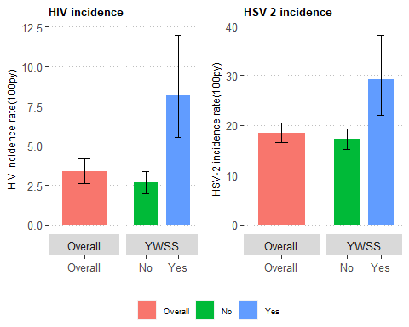
Prevention hasn’t translated into population effect¹
Young women who sell sex have 3x incidence of HIV in AHRI HDSS²
Identifying adolescent and young adults (AYA) for PrEP is a challenge³
Community-based care effective and safe⁴⁻⁶
Home-based STI self-sampling and SRH had 60% higher odds of linking to HIV prevention⁷
Mthiyane, et al AIDS 2022
Magu et al ICASA 2023
Chimbindi, et al AIDS Care 2021
Shahmanesh, et al BMC Public Health 2021
Barnabas, et al Lancet Global Health 2020
Schaefer, et al Lancet HIV 2022
Shahmanesh et al Lancet HIV in press

Slide 3
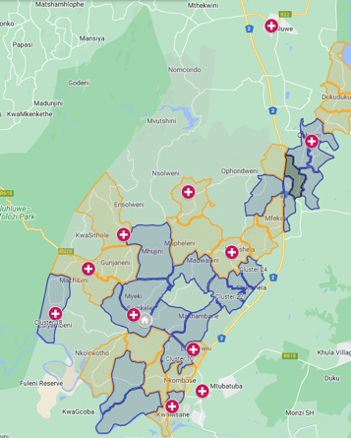
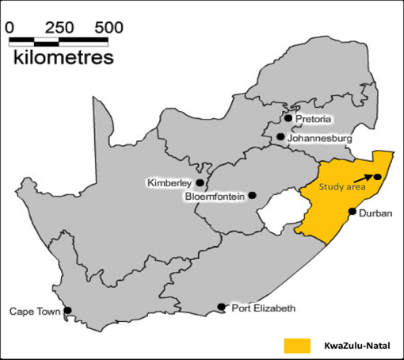
Base-line data in n=2092 15-30-year-olds randomly selected HDSS 2021-2022
Setting
Health and demographic
surveillance (HDSS)
in KwaZulu-Natal, South Africa
>85% youth unemployment
Prevalence of HIV amongst young women 21% compared to 7% in young men
127 (47%) of adolescents and youth living with HIV aren’t on effective treatment
Seven (0.4%) ever taken PrEP
Notes:
Building on this work we co-created Thetha Nami ngththe nawe (or let’s talk) to improve adolescents and youth resilience to HIV, which we are testing in a cRCT in the AHRI health and demographic site located in KwaZulu-Natal South Africa, and it is about 200 km north from Durban. The area is rural and poor with high unemployment – In a representative sample of 15-30 year olds prior to delivering Let’s talk we found that one in five women are living with HIV Half of 15-30 year olds weren’t on effective ART and only 7 had ever taken PrEP. This is in a context where 90:90:90 is reached amongst older men and women - We are testing the effectiveness of the intervention on reducing new HIV infections and increasing effective treatment in those adolescents and youth living with HIV in a cluster randomised controlled trial.

Slide 4
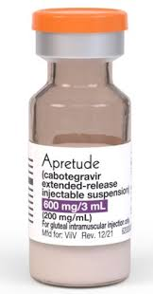
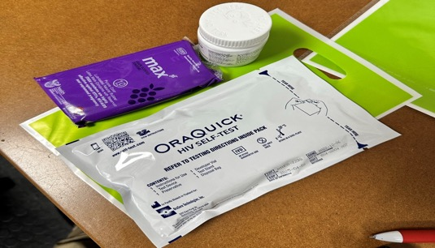
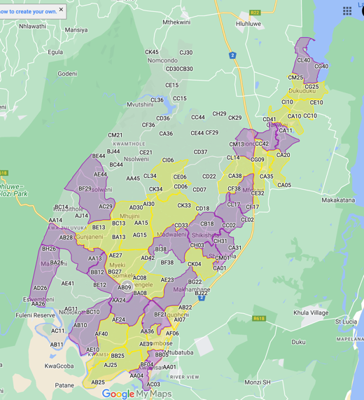
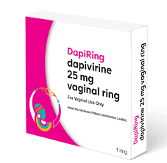
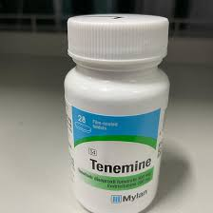

LAPIS: cRCT of choice
Intervention LAPIS:
1050 cable and 1400 overall
Peer navigators promote long-acting and oral PrEP
Sexual health clinics youth offer choice of oral PrEP or injectable CAB LA or vaginal Ring or PEP packs
Peer navigators support refills and follow-up injection appointments
Standard of care: Let’s Talk
~900
Peer navigators promote PrEP
Sexual health clinics youth will be offered oral PrEP only
Peer navigators support refills
Outcome
Uptake and retention
Prevalence of transmissible HIV
40 clusters
26000 AYA aged 15-30
Notes:
To overcome the challenge of oral PrEP we have re-randomised the clusters in the second stage of the SWT to receive choice – and see how this works in a real-world delivery. In the LAPIS cRCT we are comparing choice of HIV PrEP products across 20 clusters with oral PrEP alone. We are delivering choice through nurse-led mobile SRH clinics, supported by peers – we are phoning for appointment reminders and text x1 and phoning x3 for missed appt. Here you can see the choices - of oral PrEP or injectable CAB LA or vaginal Ring and post exposure packs to take away and use immediately after sex. The outcome will improve uptake and retention on PrEP at a population level

Slide 5
Before choice
 | Eligible for PrEP | Start PrEP | Discontinue | > = 1 refill | > =2 refills
Total | 1550 | 996 (64%) | 189 (19%) | 392 (39%) | 177 (18%)
Men | 728 | 502 (70%) | 89 (18%) | 171 (34%) | 69 (14%)
Women | 822 | 494 (60%) | 100 (20%) | 221 (45%) | 108 (22%)
Notes:
So what happens once we start them on PrEP? The blue bars, show that 60% of those offered start oral PrEP and only one in five remain on oral PrEP (similar in men and women – blue and red bars) - The main reasons for not taking up PrEP and/ or dropping out of PrEP is taking tablets – the challenge of taking tablets and a day, the HIV stigma attached to rattling antiretrovirals and the social censure of being outed as sexually active if found with tablets.

Slide 6
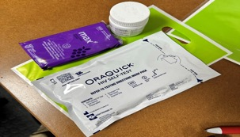

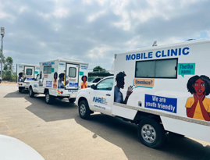
Early Learnings from LAPIS
Uptake higher when offered choice
  375 eligible/offered PrEP, 359 (96%) initiated PrEP or PEP, 259 women.
Majority choose injectable PrEP
  n=276 (76.9%) chose injectable cab, 186 women
  N=55 oral PrEP (15%) and 28 (8%) PEP in pocket
  None chose the ring.

Slide 7
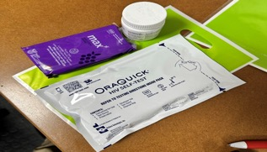
Early Learnings from LAPIS
One third had gonorrhoea or chlamydia at baseline
  Higher in those who chose cabla (33%) vs. oral PrEP (13%)
Retentions with just phone and text reminders high
  CABLA - 71% retained for one refill
2x pregnancies on cabla – both switched to oral

Slide 8
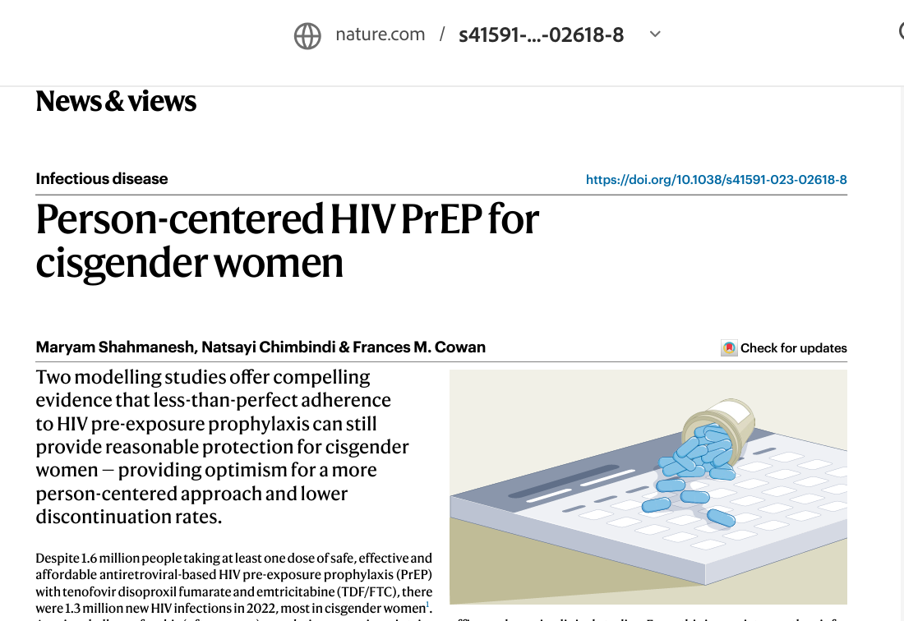
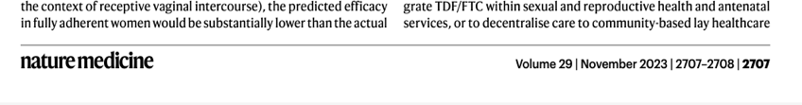
Early Learnings from LAPIS
Cabotegravir easy to transport over distances & no temp excursion even > 48’^{c}
Cabotegravir injections feasible in mobile clinic & familiar to providers & users
No HIV testing issues to date
  2x point of care test to start + blood and DBS ELISA sent
  1x patient was in window period and had POCT neg – elisa positive

Slide 9

Biosocial care with SRH supports PrEP choice
Integrating PrEP choice with community based peer support and sexual health services is feasible
Community based product choice that includes long-acting PrEP and PEP may improve uptake and retention
The majority of women and those with STIs choose the injectable option
One in four chose an oral option
Notes:
I have shown you that community based tailored HIV prevention that meets social and sexual health needs reaches those young men and women at greatest need. I’s feasible to add choice to this model and choice that includes long-acting PrEP but also PEP may improve uptake and retention. This model of biosocial care is simple and sustainable; it’s popular with department of health as it tackles teenage pregnancy; it’s popular with department of social welfare and development as it tackles wider youth development , it’s popular with the community leaders as it provides employment and training for youth. This contextually developed package of psychosocial support is a scalable way to provide effective person-centred differentiated HIV prevention

Slide 10






Implementation Scientists and clinical trialists: Lucky Mtoli Limakatso Lebina, Nkosinathi Ngcobo, Willem Hanekom, Maryam Shahmanesh
Social Scientists: Thembelihle Zuma, Janet Seeley.
Statistics and data management: Jacob Busang, Kathy Baisley, Andrew Copas, Kobus Herbst, Jaco Dreyer
Project Management, clinical and social work: Nonhlanhla Okesola, Carina Herbst, Sithembile Msane, Samke Ngubane, Thandeka Danisa, Theresa Smit.
di, Jaco Dreyer,

