Slide 1
c
HIVR4P 2024 Knowledge
Toolkit
Highlights of the 5th HIV
Research for Prevention Conference

Slide 2
Contents
3 PURPOSE 2 trial of long-acting lenacapavir for PrEP
8 Three-month dapivirine vaginal ring
11 Offering a choice of PrEP methods
15 Using local languages in HIV science reporting
17 bNAb vaccine strategies
20 Forcing the development of improbable bNAb mutations
23 T-cell vaccines
26 Viral vectors in therapeutic bNAb vaccines
These contents sections are hyperlinked

Slide 3
HIVR4P 2024 | PURPOSE 2 trial of long-acting lenacapavir for PrEP
PURPOSE 2 trial of long-acting lenacapavir for PrEP
Lenacapavir is a novel capsid inhibitor with a half-life of 8-12 weeks when administered by subcutaneous injection every six months.
Two large, double-blinded randomized controlled trials have evaluated long-acting lenacapavir against oral PrEP and against background HIV incidence.
The PURPOSE 1 study was conducted with cisgender women in South Africa and Uganda. Results were presented at AIDS 2024.
The PURPOSE 2 study was conducted with men and gender-diverse individuals who have sex with partners assigned male at birth. Results from the seven-country study were presented at HIVR4P 2024.
Kelley OA02
Notes:
In PURPOSE 1, lenacapavir reduced HIV incidence by 100% as compared with background HIV incidence and also by 100% as compared with F/TDF (there were zero HIV acquisitions in the lenacapavir arm). For more details, see the findings as published in The New England Journal of Medicine: https://www.nejm.org/doi/10.1056/NEJMoa2407001
In PURPOSE 2, eligible participants were cisgender gay, bisexual, and other men, transgender women, transgender men, and gender nonbinary persons who have condomless receptive anal sex with partners assigned male at birth; were at least 16 years of age; had unknown HIV status; and reported no HIV testing or PrEP use in the 3 months before screening. PURPOSE 2 findings have subsequently been published in The New England Journal of Medicine: https://www.nejm.org/doi/full/10.1056/NEJMoa2411858
Session: https://programme2024.hivr4p.org/Programme/Session/13

Slide 4
HIVR4P 2024 | PURPOSE 2 trial of long-acting lenacapavir for PrEP
The PURPOSE 2 researchers adopted an intentional approach to enrol historically underrepresented populations.
A Global Community Advisory Group advised on trial design, site selection, trial implementation, etc.
Site-specific recruitment plans and targets facilitated trial population diversity; site investigators and staff were representative of participant populations; and sites with experience in gender-affirming care were chosen.
Gallardo-Cartagena OA02
Notes:
Inclusion of diverse participant populations is important for understanding the efficacy of lenacapavir in communities disproportionately affected by HIV.
Session: https://programme2024.hivr4p.org/Programme/Session/13

Slide 5
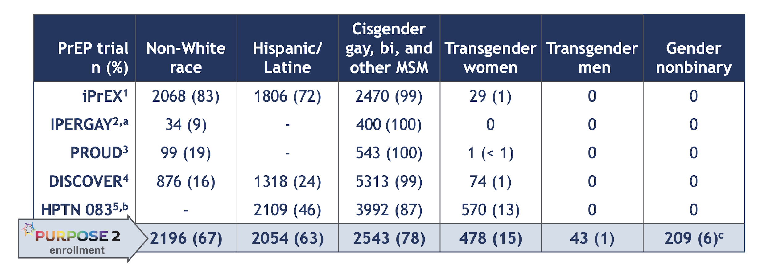
HIVR4P 2024 | PURPOSE 2 trial of long-acting lenacapavir for PrEP
3,273 participants from seven countries in Latin America, North America, Africa and Asia were randomized.
57% of all participants were in Latin America.
This was the first PrEP trial to include trans men and gender-nonbinary individuals.
PURPOSE 2 in comparison with previous PrEP trials
Gallardo-Cartagena OA02
Notes:
The seven countries were Brazil, Peru, Argentina, Mexico, United States, South Africa and Thailand.
Session: https://programme2024.hivr4p.org/Programme/Session/13

Slide 6
HIVR4P 2024 | PURPOSE 2 trial of long-acting lenacapavir for PrEP
Because oral PrEP is known to have high efficacy, it would have been highly unethical for some participants to only receive a placebo.
Primary analysis: this compared HIV incidence on subcutaneous lenacapavir (LEN SC) with the estimated background incidence in the screened population.
Secondary analysis: this compared HIV incidence with incidence in participants receiving emtricitabine/ tenofovir disporoxil fumarate (F/TDF).
PURPOSE 2 study design
Kelley OA02
Notes:
Potential participants who tested HIV positive at screening were assessed for recency of infection; these data were used to estimate the background HIV incidence.
After the conference, findings were published in The New England Journal of Medicine: https://www.nejm.org/doi/full/10.1056/NEJMoa2411858
Session: https://programme2024.hivr4p.org/Programme/Session/13

Slide 7
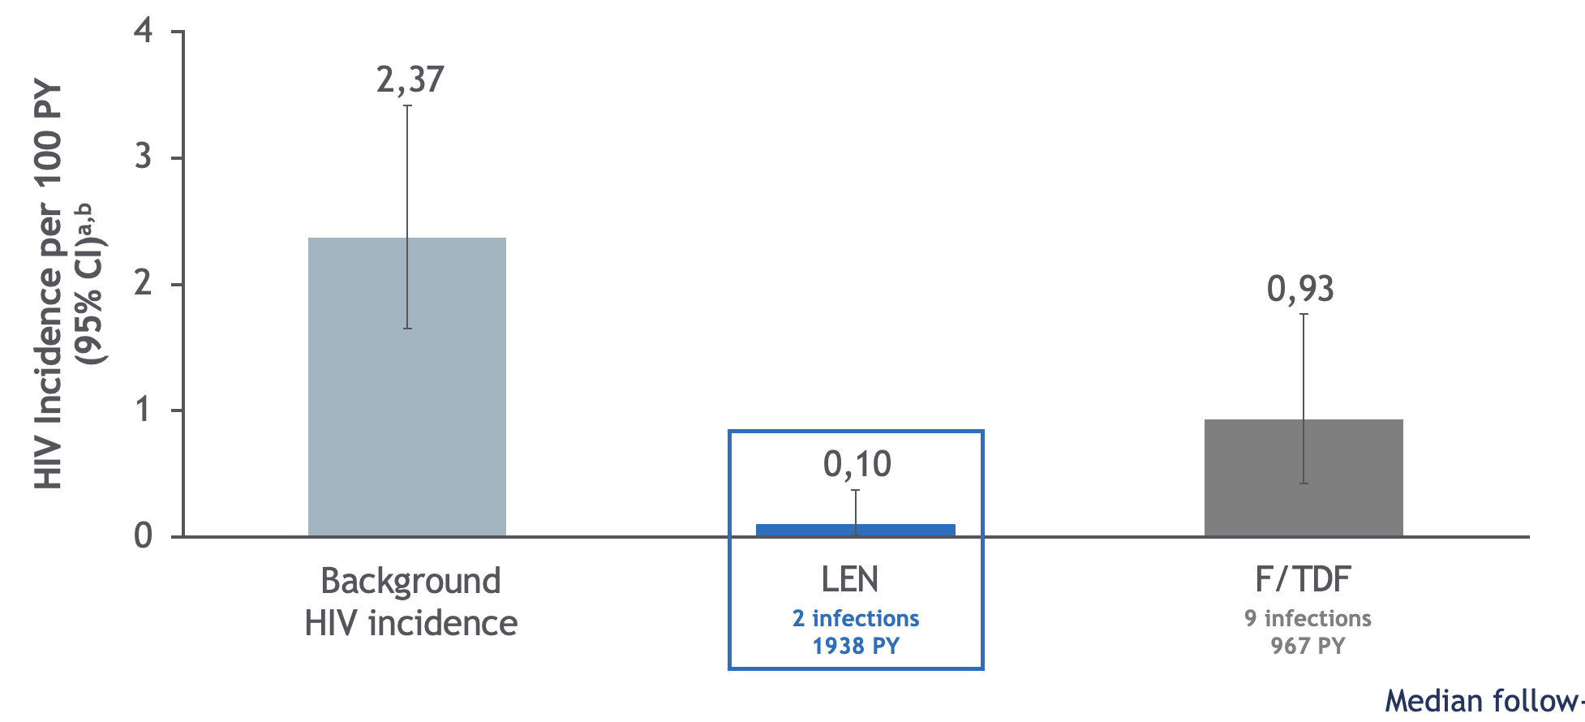
HIVR4P 2024 | PURPOSE 2 trial of long-acting lenacapavir for PrEP
Lenacapavir reduced HIV acquisitions by 96% compared with background HIV incidence, and by 89% compared with oral PrEP (F/TDF).
Lenacapavir was safe and well-tolerated, consistent with previous studies.
The findings suggest that long-acting lenacapavir could increase PrEP uptake, adherence and persistence in populations disproportionately affected by HIV.
x
Efficacy results
Kelley OA02
Notes:
Both forms of PrEP were safe and generally well tolerated with no new safety concerns. Side effects were uncommon and usually mild. Some study participants who received lenacapavir had injection site reactions, such as soreness. Lenacapavir injections form a long-lasting “depot” in the fat layer of the abdomen that slowly releases the drug over time, which can sometimes be felt as a nodule under the skin. The frequency of injection site reactions decreased over time.
Data on adherence were not presented at HIVR4P, but at HIV Glasgow some weeks later. This showed that over 90% of injections were received on time, but that adherence to oral PrEP was lower and declined over time.
After the conference, findings were published in The New England Journal of Medicine: https://www.nejm.org/doi/full/10.1056/NEJMoa2411858
Session: https://programme2024.hivr4p.org/Programme/Session/13

Slide 8
HIVR4P 2024 | Three-month dapivirine vaginal ring
Three-month dapivirine vaginal ring
The dapivirine vaginal ring is approved for use in 11 African countries.
Users remove and replace the ring once a month.
A new ring, designed to be used for three months at a time, has been developed.
It looks and feels the same as the one-month ring, but contains 100mg of dapivirine (rather than 25mg).
Potential advantages over the one-month ring include greater convenience, better adherence, 60% lower annual cost, and less environmental waste.
124 HIV-negative women in South Africa were randomly assigned to either use three one-month rings over three months and then switch to the three-month ring, or vice versa.
Nuttall OA0802LB
Notes:
Participants had a mean age of 28, 92% were Black and 80% single.
Abstract: https://programme2024.hivr4p.org/Abstract/Abstract/?abstractid=2343
Session: https://programme2024.hivr4p.org/Programme/Session/34

Slide 9
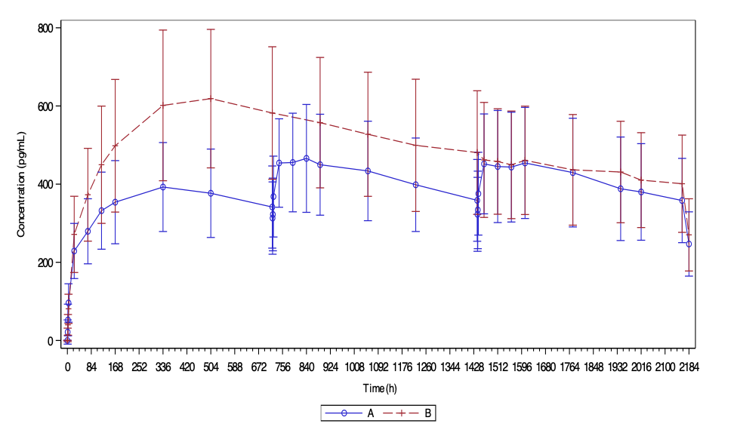
HIVR4P 2024 | Three-month dapivirine vaginal ring
The study’s primary endpoint was dapivirine concentrations in blood plasma.
The three-month ring met the criteria for superiority in comparison with the one-month ring.
During the first month of use, plasma levels were higher for the three-month ring than the one-month ring. During the second and third months, they were similar.
x
Mean (± SD) dapivirine concentrations in plasma
25mg ring
100mg ring
Nuttall OA0802LB
Notes:
In the graph, the blue line shows the one-month 25mg ring, and the red line shows the three-month 100mg ring.
Criteria for both non-inferiority and superiority were met for C₉₀ (90% CI of ratio: 1.06; 1.22) and AUC₆₀₋₉₀ (90% CI of ratio 1.02; 1.15).
Abstract: https://programme2024.hivr4p.org/Abstract/Abstract/?abstractid=2343
Session: https://programme2024.hivr4p.org/Programme/Session/34

Slide 10
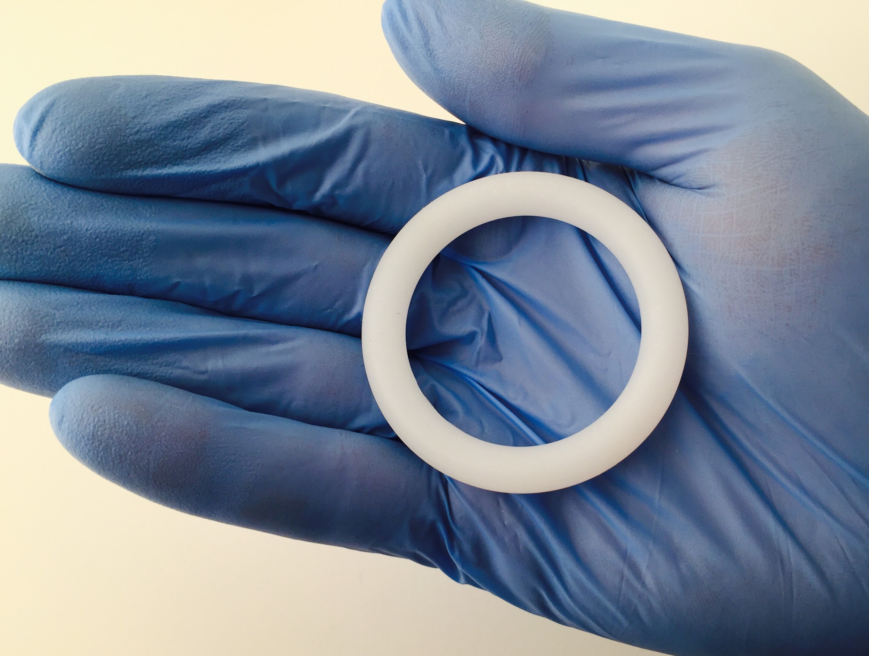
HIVR4P 2024 | Three-month dapivirine vaginal ring
Results were satisfactory for the secondary endpoints: concentrations in vaginal fluid, safety and the vaginal microenvironment.
The Population Council is now seeking regulatory approval for the three-month ring as a line extension to the one-month ring. This should not require a new application.
Feedback from study participants suggests mixed preferences for one-month and three-month rings. However, if only the three-month ring were available, most women would be willing to switch.
NIAID. CC BY 2.0.
Nuttall OA0802LB / Friedland WEPE118
Notes:
Poster WEPE118 (Friedland) explored study participants’ perceptions and the acceptability of the rings. Seventeen preferred the three-month ring, while 13 preferred the one-month ring and two had no preference.
Abstract (Nuttall): https://programme2024.hivr4p.org/Abstract/Abstract/?abstractid=2343
Session: https://programme2024.hivr4p.org/Programme/Session/34
Abstract (Friedland): https://programme2024.hivr4p.org/Abstract/Abstract/?abstractid=1902

Slide 11
HIVR4P 2024 | Offering a choice of PrEP methods
Offering a choice of PrEP methods
In several studies, women in African countries were provided with counselling on oral PrEP and the dapivirine ring, and could choose the method they preferred.
For example, the CATALYST study is assessing an enhanced service delivery package for informed PrEP choice for women over the age of 18 in Kenya, Uganda, South Africa, Lesotho and Zimbabwe.
An interim analysis reported on women’s initial choices between oral PrEP and the PrEP ring.
Future analyses will report on choices to switch between methods.
In the second phase of the study, injectable cabotegravir will also be available.
Irungu OA2402
Notes:
In addition to the CATALYST study highlighted here, choice was offered in the DREAMS PrEP Choice study in South Africa (Naidoo OA2406) and to young women aged 15-24 purchasing contraception at pharmacies in Kenya (Rono OA2404).
Abstract: https://programme2024.hivr4p.org/Abstract/Abstract/?abstractid=257
Session: https://programme2024.hivr4p.org/Programme/Session/20

Slide 12
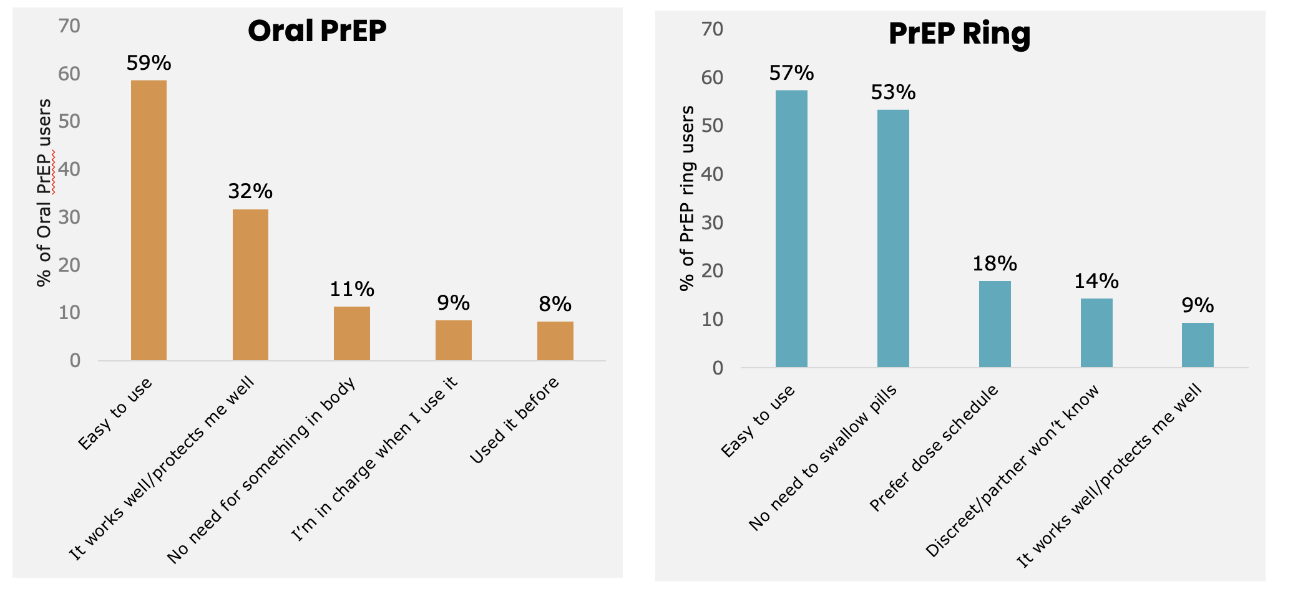
HIVR4P 2024 | Offering a choice of PrEP methods
The CATALYST study had 3,967 participants: 45% were aged under 24, 68% had not previously used PrEP, 26% reported sex work, and 33% reported condomless sex in the past month.
66% chose oral PrEP, 30% chose the ring, and 4% chose no method.
x
Top five reasons for choosing each method
Irungu OA2402
Notes:
Abstract: https://programme2024.hivr4p.org/Abstract/Abstract/?abstractid=257
Session: https://programme2024.hivr4p.org/Programme/Session/20

Slide 13
HIVR4P 2024 | Offering a choice of PrEP methods
Younger women, new PrEP users and pregnant and breastfeeding women were less likely to use the ring.
Women with more than one partner and women using contraceptives were more likely to use the ring.
Comparable results were seen in two separate studies.
Among women aged 15-24 years old buying contraceptives at retail pharmacies in Kenya, 79% chose oral PrEP and 21% chose the PrEP ring.
In South Africa, among women over the age of 18, 69% chose oral PrEP, 27% chose the PrEP ring, and 3% chose no method.
Younger women and new PrEP users were less likely to use the ring while those reporting transactional sex were more likely to use it.
Irungu OA2402 / Rono OA2404 / Naidoo OA2406
Notes:
In the Kenyan study, the 1139 participants were predominantly purchasing emergency contraception (51%), contraceptive injections (20%), oral contraceptives (14%) and condoms (12%). Use of long-acting contraceptives was not associated with choice of the ring.
There were 657 participants in the South African study.
Abstract (Irungu): https://programme2024.hivr4p.org/Abstract/Abstract/?abstractid=257
Abstract (Rono): https://programme2024.hivr4p.org/Abstract/Abstract/?abstractid=1549
Abstract (Naidoo): https://programme2024.hivr4p.org/Abstract/Abstract/?abstractid=1788
Session: https://programme2024.hivr4p.org/Programme/Session/20

Slide 14
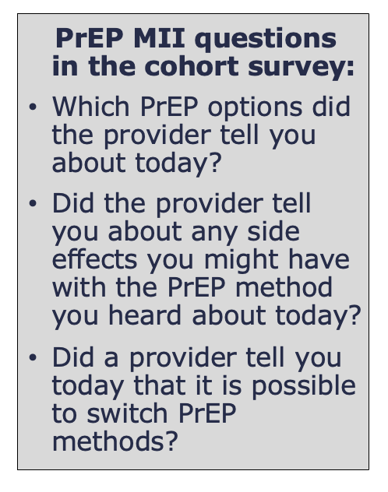
HIVR4P 2024 | Offering a choice of PrEP methods
The CATALYST study is also investigating whether healthcare providers can effectively deliver PrEP choice counselling.
2,548 clients completed surveys after counselling.
97% said they were told about both PrEP options.
91% said they were told about side effects.
95% knew they could switch methods.
87% had satisfactory answers for all three questions.
However, pregnant and breastfeeding women were less likely to report quality counselling.
Kiruki OA2403
Notes:
A PrEP method information index (PrEP MII) was adapted from family planning studies to assess the quality of PrEP choice counseling, using the three indicators shown in the visual.
Possible explanations for the poorer results for pregnant and breastfeeding women are that both PrEP options are not available for this group in two of the countries, and healthcare provider concerns about specific methods for this population.
Abstract: https://programme2024.hivr4p.org/Abstract/Abstract/?abstractid=1057
Session: https://programme2024.hivr4p.org/Programme/Session/20

Slide 15
HIVR4P 2024 | Using local languages in HIV science reporting
Using local languages in HIV science reporting
When sharing news about HIV prevention, journalists must simplify and explain complex scientific concepts for their audience.
This can be challenging, especially when translating into other languages.
In Kenya, Malawi, Tanzania, Uganda, Zambia and Zimbabwe, “media science cafés” are informal discussions between journalists, scientists, civil society and other experts.
They aim to help journalists gain a clearer understanding of timely issues in science, helping them provide more accurate reporting.
Nakkazi OA2504
Notes:
Abstract: https://programme2024.hivr4p.org/Abstract/Abstract/?abstractid=1767
Session: https://programme2024.hivr4p.org/Programme/Session/23

Slide 16
HIVR4P 2024 | Using local languages in HIV science reporting
Holding media science café discussions in local languages has enhanced journalists’ understanding of scientific concepts.
Café participants have created a translation index, covering 101 vaccine, science and health terms in eight African languages.
This approach helps journalists share accurate scientific information with broader audiences, especially in regions where radio broadcasts are exclusively in local languages.
x
Translation index for Luganda
Nakkazi OA2504
Notes:
The translation index can be found at https://avac.org/translation-index/
It currently includes translations into Bemba, Cichewa, Dholuo, Kiswahili, Luganda, Ndebele, Runyankore, Shona, Tonga and Tumbuka. The authors welcome additional translations and suggestions for other languages to include.
Abstract: https://programme2024.hivr4p.org/Abstract/Abstract/?abstractid=1767
Session: https://programme2024.hivr4p.org/Programme/Session/23

Slide 17
HIVR4P 2024 | bNAb vaccine strategies
bNAb vaccine strategies
In order to develop a vaccine that stimulates the production of effective broadly neutralizing antibodies (bNAbs), several different strategies are being worked on.
HIV is not very immunogenic and adapts rapidly to evade the usual immune responses to viruses.
Most approaches therefore involve “shepherding” the immune system with sequential vaccinations to produce an effective immune response.
x
Guiding B-cell maturation through the breadth pathway
Nduati PL03
Notes:
Session: https://programme2024.hivr4p.org/Programme/Session/49

Slide 18
HIVR4P 2024 | bNAb vaccine strategies
Approaches to induce bNAb responses include:
Sequential trimers: stimulates bNAbs to the whole HIV envelope protein (its “spikes”) with repeated vaccinations of a mix of proteins from different subtypes of HIV.
Cell lineage: “reverse engineers” effective bNAbs by observing how HIV evolves in people who have produced bNAbs and developing immunogens to anticipate such evolution.
Germline targeting: “forward engineers” the tiny minority of B-cells that have the genes to produce bNAbs by inducing “hypermutation” so that they produce bNAbs with more potency and efficacy against varied strains.
Epitope-focused vaccines: involves seeking out small sequences in the envelope protein that are highly conserved because HIV cannot replicate without them.
Nduati PL03
Notes:
The soluble form of the gp160 envelope protein, which was used in some of the earliest HIV vaccines, is not the developed form that appears on the surface of the matured viral particle. There, three gp160 proteins cluster together to form a complete unit – a trimer. In addition, the trimer protein is coated and partly shielded from the immune system by sugar molecules, as a so-called “glycoprotein”. Recently, scientists have found a way to create trimer glycoproteins which don't have to be attached to viral particles to maintain their shape, and use them as candidate vaccines.
Session: https://programme2024.hivr4p.org/Programme/Session/49

Slide 19
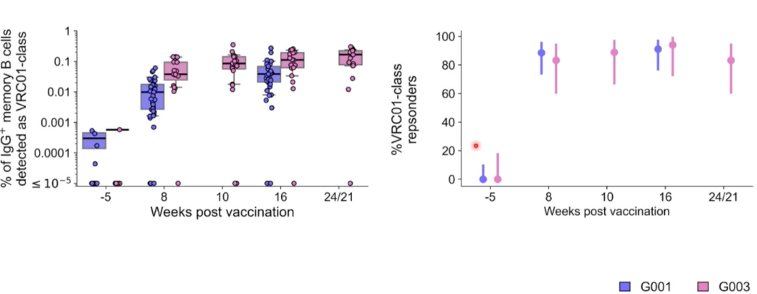
HIVR4P 2024 | bNAb vaccine strategies
The germline targeting approach is probably furthest along in human trials.
Proof of concept was provided by the IAVI G001 trial in the United States, which used a virus-like nanoparticle to elicit B-cells that can produce the VRC01 bNAb.
The G003 trial, in collaboration with Moderna, showed that similar results could be achieved using an RNA vaccine, in an African population with different HIV strains.
x
Responses in African and North American populations
Nduati PL03
Notes:
G001 results were published in Science in 2022: https://www.science.org/doi/10.1126/science.add6502. G003 results are not yet published but some information is available here: https://avac.org/trial/iavi-g003/
Session: https://programme2024.hivr4p.org/Programme/Session/49

Slide 20
HIVR4P 2024 | Forcing the development of improbable bNAb mutations
Forcing the development of improbable bNAb mutations
Kevin Wiehe of Duke University in the US illustrated the difficulty of inducing hypermutation in B-cells to produce bNAbs and different strategies to overcome this barrier.
He notes: “bNAbs have extraordinary numbers of mutations relative to conventional antibodies, and in particular many that are not typically made by the somatic hypermutation machinery… We apply ‘Mutation-guided Vaccine Design’, which aims to accelerate HIV bNAb induction by speeding up the slowest steps in bNAb maturation.”
x
Improbable antibody mutations
Wiehe OA12
Notes:
The mutations B-cells have to go through in order to be capable of producing bNAbs are called “hypermutations” because they are not favoured by the immune system and have to be “forced” by a careful selection of immunogens.
In the diagram, ARMADILLO is a tool which identifies improbable mutations. The horizontal axis is the sequence of amino acids in the “heavy chain” protein of a typical antibody, and the vertical axis lists the 20 essential amino acids. Green boxes show the most likely amino acids to occur at a position, red and brown tones the least likely. Hypermutation involves engineering the more unlikely amino acid substitutions.
Abstract: https://programme2024.hivr4p.org/Abstract/Abstract/?abstractid=1363
Session: https://programme2024.hivr4p.org/Programme/Session/27

Slide 21
HIVR4P 2024 | Forcing the development of improbable bNAb mutations
In mouse models, a prime-plus-boost strategy forced the acquisition by B-cells of three out of four mutations necessary for the production of bNAbs. But the “stubborn” S27Y mutation refused to develop.
x
Mutation-guided vaccine design for the V3 glycan DH270 lineage
Wiehe OA12
Notes:
For more on this study: https://www.cell.com/cell-host-microbe/abstract/S1931-3128(24)00126-4
Abstract: https://programme2024.hivr4p.org/Abstract/Abstract/?abstractid=1363
Session: https://programme2024.hivr4p.org/Programme/Session/27

Slide 22
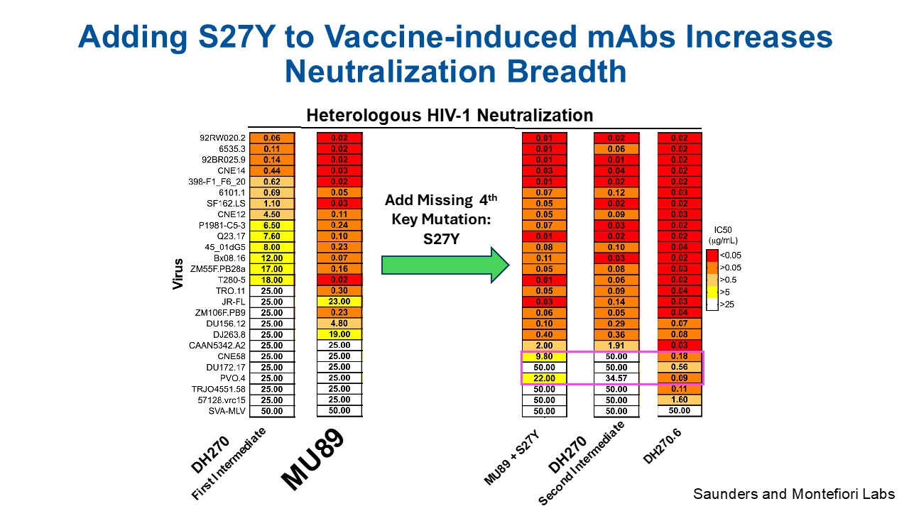
HIVR4P 2024 | Forcing the development of improbable bNAb mutations
Adding S27Y to the three-mutation bNAb called MU89 resulted in a new mutation that could neutralize 24 out of 26 viral strains. A novel immunogen called MCD5 was developed to force its mutation.
This strategy is now being tested in human trials. The first, HVTN 307, combines three nanoparticle primes (as in germline targeting) with the novel MCD5 protein boost.
The second, HVTN 312, will combine three RNA primes with two RNA boosts.
x
Adding S27Y to vaccine-induced mAbs increases neutralization breadth
Wiehe OA12
Notes:
HVTN 307 will produce results soon. HVTN 312 is recruiting now.
Abstract: https://programme2024.hivr4p.org/Abstract/Abstract/?abstractid=1363
Session: https://programme2024.hivr4p.org/Programme/Session/27

Slide 23
HIVR4P 2024 | T-cell vaccines
T-cell vaccines
A complete vaccine response to HIV will involve stimulating cellular, as well as humoral, immunity.
This is because while bNAbs should prevent the vast majority of susceptible cells from becoming infected with HIV, CD8 and CD4 T-cells will also be needed to destroy the minority of cells that are infected despite bNAbs.
Because T-cells act on cells that are already infected, T-cell stimulating vaccines have the potential to cure, as well as prevent, HIV. This has been demonstrated in monkey models and has been a goal of human vaccine studies for over a decade.
Hanke SAT05
Notes:
Session: https://programme2024.hivr4p.org/Programme/Session/67

Slide 24
HIVR4P 2024 | T-cell vaccines
T-cell vaccine studies in humans have used different prime and boost vaccines in sequence. They have often added other immunogens, such as passively administered bNAbs and immune modulators (such as vesatolimod, a TLR-7 agonist).
In AELIX002, a combination of two viral vector vaccines plus a DNA plasmid vaccine produced a lower viral “set point” in people with HIV.
x
T-cell vaccines without antibodies post-hoc AELIX 002
Hanke SAT05
Notes:
The viral set point is the viral load in the absence of ART.
For more on this study: https://www.nature.com/articles/s41591-022-02060-2
Session: https://programme2024.hivr4p.org/Programme/Session/67

Slide 25
HIVR4P 2024 | T-cell vaccines
Oxford University’s HIVconsvX vaccine concept is being tested in several trials.
Trials are using various mosaic immunogens, plus or minus other interventions, such as other vaccines and passively administered bNAbs.
This includes the IMPAACT 2039 trial in children with HIV aged 5-11, which follows on from IMPAACT P1115, in which 4/6 children were able to come off ART for a year or more without viral rebound.
x
HIVconsvX vaccine efficacy alone and in combination with other tools
Hanke SAT05
Notes:
For HIV-CORE 005.2, the first in this table, see https://www.thelancet.com/journals/lanmic/article/PIIS2666-5247(24)00209-X/fulltext
The HIVconsvX vaccine is a vaccine concept rather than a single one. It uses ChadOx1-MVA. This was a viral vector originally used in the first COVID vaccine, but in HIVconsvX it contains various “mosaic” immunogens. (Mosaic immunogens are artificial viral proteins or genetic sequences that consist of the most immunogenic, and most conserved (least variable) sequences from different strains of HIV.) These are “consensus” mosaics of different epitopes (short sequences that are parts of HIV proteins), which have elicited the strongest and broadest T-cell reactions to HIV. Because HIV is so variable, these mosaics need to be different for different populations. As with the HIVACAT vaccine concept, which is being developed by the IRSICaixa research team in Barcelona, the Oxford studies may involve HIVconsvX in combination with other “prime” or “boost” vaccine, passively administered bNAbs, of other immunogenic compounds.
Session: https://programme2024.hivr4p.org/Programme/Session/67

Slide 26
HIVR4P 2024 | Viral vectors in therapeutic bNAb vaccines
Viral vectors in therapeutic bNAb vaccines
Similar viral vectors can be used to induce bNAbs to reduce and sometimes completely control viral load in people with HIV.
Viral rebound is not often delayed, but instead, viral load settles down to a much lower and sometimes undetectable “set point” (similar to elite controllers).
In the US, the Ragon Institute’s programme has induced useful therapeutic bNAb responses in rhesus macaques.
Animals who received a vaccine based on the MVA vector plus vesatolimod and the passively infused bNAb PGT121 had a far lower viral set point (7/10 had an undetectable viral load for over three years).
x
Therapeutic efficacy of combined active and passive immunization in ART-suppressed, SHIV-infected rhesus macaques
Juelg SAT05
Notes:
Session: https://programme2024.hivr4p.org/Programme/Session/67

Slide 27
HIVR4P 2024 | Viral vectors in therapeutic bNAb vaccines
In this “heat map”, the colours indicate different types of immune response (yellow and orange = more activation).
This shows that the response to the vaccine peaked at six months after first administration and was still robust at nine months, though it started to tail off after that.
x
Robust expansion of functional antibody titers in vaccinated animals
Juelg SAT05
Notes:
This heatmap shows how the levels of specific immuno-regulatory proteins are raised or suppressed in the blood of monkeys receiving different combinations of vaccine, bNAb and TLR7 agonist (vesatolimod). The “families” of proteins are listed below the X axis (“Measuring IgG1-4, IgM, IgA, Fcy-Receptor 2A1-4 and 3 binding, ADCD, ADCP, ADNP and ANKA”). Different combinations of these proteins are shown on the X axis.
The Y axis shows which proteins are raised or suppressed in individual monkeys given placebo (“sham” – red bar on the Y axis), PGT121 plus the vesatolimod (“bNAb + TLR7” – green bar), the Ad26/MVA vaccine plus vesatolimod (yellow bar) and all three (blue bar).
Relating this to the vaccine schedule at the top of the slide, the pre-intervention levels are shown at week 24 when the first shot of the vaccine or its placebo was administered. An immediate immune boost can be seen in the monkeys given the Ad26 vaccine but not others. This peaks at week 50, six months after the first vaccine shot, and is still robust nearly nine months after the first shot. By the tenth month this immune response has started to fade, despite a last booster.
The vesatolimod (started at week 48) and the PGT121 (started at week 62) do not appear to contribute a lot to the immune response, though there may be some activation of previous non-responses in monkeys given PGT121 at week 68.
Session: https://programme2024.hivr4p.org/Programme/Session/67

Slide 28
HIVR4P 2024 | Viral vectors in therapeutic bNAb vaccines
The bNAb response to these vaccines did not correlate with a delay in viral rebound, but correlated very strongly with a lower post-rebound set point.
The graphic shows that while either the bNAb (PGT121) or the therapeutic vaccine (ad26/MVA) led to a viral load set point about 20 times lower than that seen in animals receiving placebos, combining both led to a set point about 200 times lower.
x
Viral load set points post rebound
Juelg SAT05
Notes:
The four asterisks indicate that this was a highly statistically significant finding, with only a 1/20,000 probability of it being due to chance.
Session: https://programme2024.hivr4p.org/Programme/Session/67

Slide 29
Thank you
Produced by IAS – the International AIDS Society Leading collective action on every front of the global HIV response through its membership base, scientific authority and convening power. www.iasociety.org
In collaboration with:
Gus Cairns, Amelia Jones, Roger Pebody, Beth Tunnicliffe

