Slide 1
PCC research collaborative
Assessing implementation
Wednesday, 19 February 2025

Slide 2
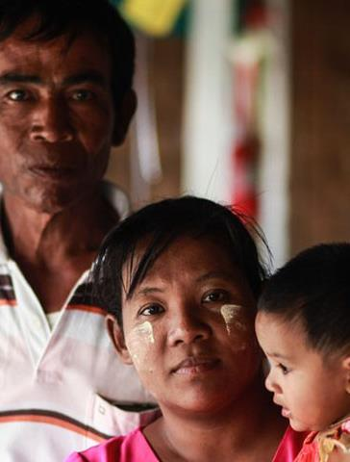
IAS Person-Centred Care programme
Prioritizes integrated, inclusive and responsive healthcare services
Focuses on changing needs, priorities and preferences of each person living with or affected by HIV
Empowers clients and is shaped by the many aspects of people’s intersectional identities
Notes:
This event has been facilitated by the IAS Person-Centred Care programme which is advocating for integrated, inclusive and responsive healthcare services that focus on the changing needs, priorities and preferences of individuals and empowers them to demand services that respect their identities.

Slide 3
What is the PCC research collaborative?
Mission: To work collectively and efficiently to fill evidence gaps around person-centred care for people living with HIV or vulnerable to HIV acquisition
Scope: Global
Meeting schedule: In-person (1x per year), Virtual (2x per year)
Participants: Researchers, clients and providers who are championing evidence generation related to client-provider relationships, participatory approaches that value experts by experience as well as specific research and policy gaps related to person-centred care within the HIV response
Notes:
PCC research collaborative has the mission of working collectively and efficiently at a global level to fill evidence gaps around person-centred care for people living with HIV or vulnerable to HIV acquisition. This collaborative will meet around three times a year and will convene researchers, clients and providers who are championing evidence generation related to client-provider relationships, participatory approaches that value experts by experience as well as specific research and policy gaps related to person-centred care within the HIV response

Slide 4
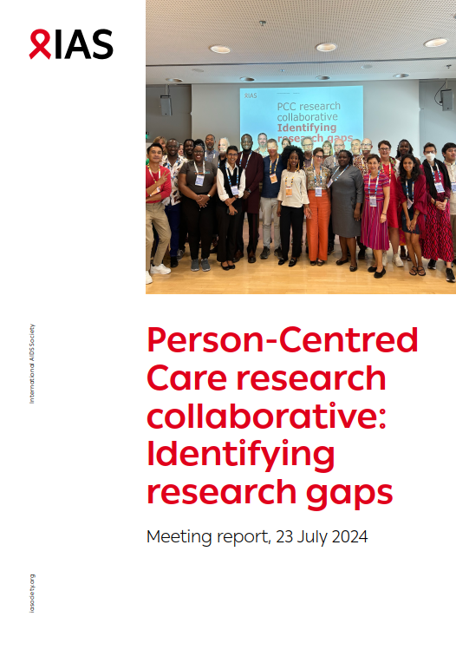

Please refer to meeting report on IAS+

Slide 5
Today’s programme
Topic | Presenter
Welcome and opening remarks
JSI Person-Centred Care Assessment Tool (PCC-AT) | Jessica Posner
Men’s PULSE Ngiyakuzwa: co-creating a new model of person-centred care with healthcare providers in South Africa | Shawn Malone
SHIP's Psycho-Socioeconomic Health Care Providers Network (PsySE-HCPN) project | Rodenie Olete
The Lancet Global Health Commission on people-centred care for universal health coverage | Todd Pollack
Person-centred interventions to improve patient−provider relationships for HIV services in low- and middle-income countries: a systematic review | Marie-Claude Lavoie
Q and A for each presenter after their presentation
Reflection on discussion questions
Any other updates from members

Slide 6
Assessing implementation: Discussion questions
What other tools exist to measure and assess PCC approaches, and for what contexts?
What additional evidence has been generated on the impact(s) of person-centred models of care on HIV treatment continuity, viral load coverage and viral suppression? Beyond these clinical outcomes, what are some other impacts from PCC approaches that are being measured?
What more needs to happen to foster community-academic partnerships to assess PCC implementation?

Slide 7

JSI Person-Centred Care Assessment Tool (PCC-AT)
Jessica Posner
Notes:
With over 20 years of experience managing complex public health programs, and until last week… Jessica provides technical assistance to JSI’s international HIV and infectious disease projects, leads JSI’s person-centered care work, and supports the use of data to enhance decision-making for improved performance and to identify and respond to capacity strengthening needs. She collaborates with local and international organizations, governments, funders, and private sector partners to collaboratively improve health systems and service delivery for better health outcomes. Jessica, who is fluent in French and Spanish, has lived in 10 countries and has an MPH from Tulane University’s School of Public Health and Tropical Medicine.

Slide 8

Person-Centered Care Assessment Tool
PCC-AT
Jessica E Posner
2025

Slide 9
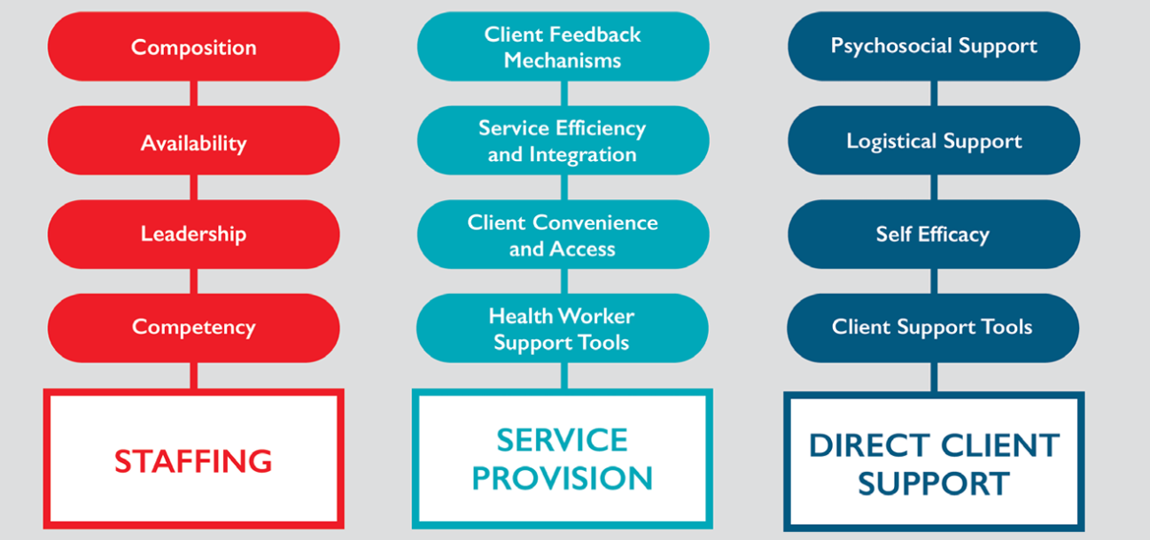
The PCC-AT Framework for HIV settings
Notes:
People living with HIV have been advocating for greater consideration of their context and whole personhood in medical settings for 40 years. Specific considerations relating to high quality, person-centered HIV service delivery.
Despite widespread acknowledgement of the value of person-centered care and a widely accepted framework, consistent approaches to operationalizing and measuring person-centered care remain elusive. We led a systematic review and developed a framework for the kinds of PCC interventions that focus on the health facility where HIV services are provided.

Slide 10
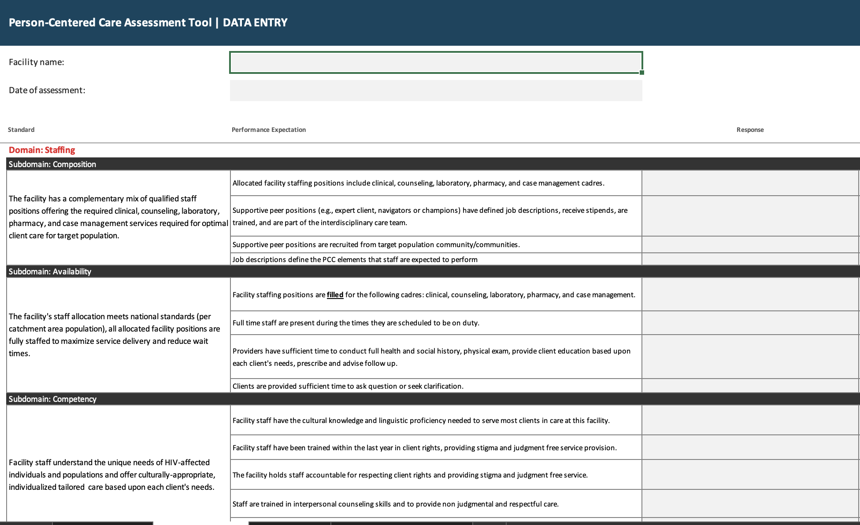
How the PCC-AT Works
PCC-AT is free Excel tool on JSI.com
Designed for HIV implementers and service providers
Facilitated discussion to collaboratively assess facility
  ability to provide person-centered HIV treatment
  demonstrate areas of strength
  inform action planning
Discrete performance expectations reduce ambiguity, simplify assessment
Notes:
Performance expectations are meant to be objective measures, but not necessarily comprehensive of everything that happens at a facility. The PCC-AT was designed to create a user-friendly tool to….
Drawn from QA approaches to assess performance against standards, JSI’s best practice benchmarking approach allows for a greater degree of flexibility in their use, improving specificity, reducing time investment, and facilitating performance measurement over time.
The approach used to develop the tool is founded on the understanding that discrete performance expectations reduce ambiguity, simplify assessment.
This tool is designed to enable learning, foster team sharing, and encourage reflective self-assessment within health facilities.

Slide 11
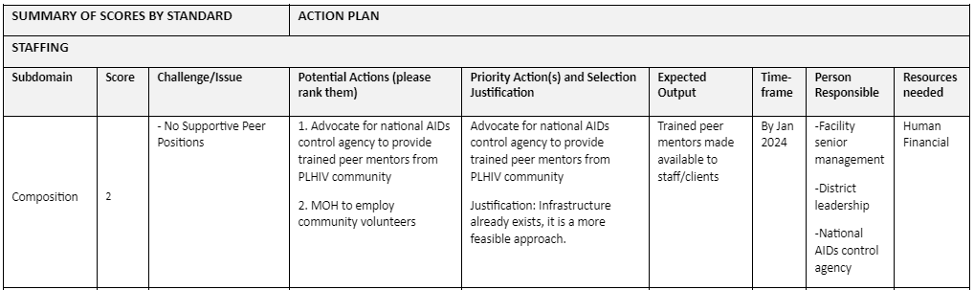
The PCC-AT
Translates to Action
Scores are designed to set priorities for action, not judge performance.
Action plans provide facilities a clear road map for improvement, recognizing that PCC is a process that can take time.
Tool can be repeated on a routine basis to monitor effectiveness of previous actions, and identify new areas in need of strengthening.
Notes:
Drawn from QA approaches to assess performance against standards, JSI’s best practice benchmarking approach allows for a greater degree of flexibility in their use, improving specificity, reducing time investment, and facilitating performance measurement over time.
The approach used to develop the tool is founded on the understanding that discrete performance expectations reduce ambiguity, simplify assessment.
The scores that are arrived at are designed to set priorities for action and are not used to judge performance.
PCC is a process and can take time, the use of the tool results in concrete action plans to provide facilities with a clear road map for improvement.
This tool is designed to enable learning, foster team sharing, and encourage reflective self-assessment within health facilities.
The tool can be repeated on a routine basis to monitor the effectiveness of previous actions, evaluate progress in PCC, and identify new areas in need of strengthening.

Slide 12
Building the Evidence Base
SYSTEMATIC REVIEW
Registered protocol Review Lit. search Abstract Full review 31 studies from 12 countries
DEVELOPMENT
Framework 3 domains 12 subdomains Tool Based on JSI benchmarking, performance expectation, and action plan approaches
VALIDATION
CONSULTATION Feedback from JSI teams AIDS 2022 FGD with 25 experts Google Survey filled out by 100 people | USE Ghana pilot 5 facilities FGD with staff KII with clients Zambia pilot 30 facilities Compare to clinical outcomes Ghana repeat
DISSEMINATION
Conference engagement ICASA 2021 AIDS 2022 ICASA 2023 AIDS 2024 Journal publications 7 published 2 under review

Slide 13
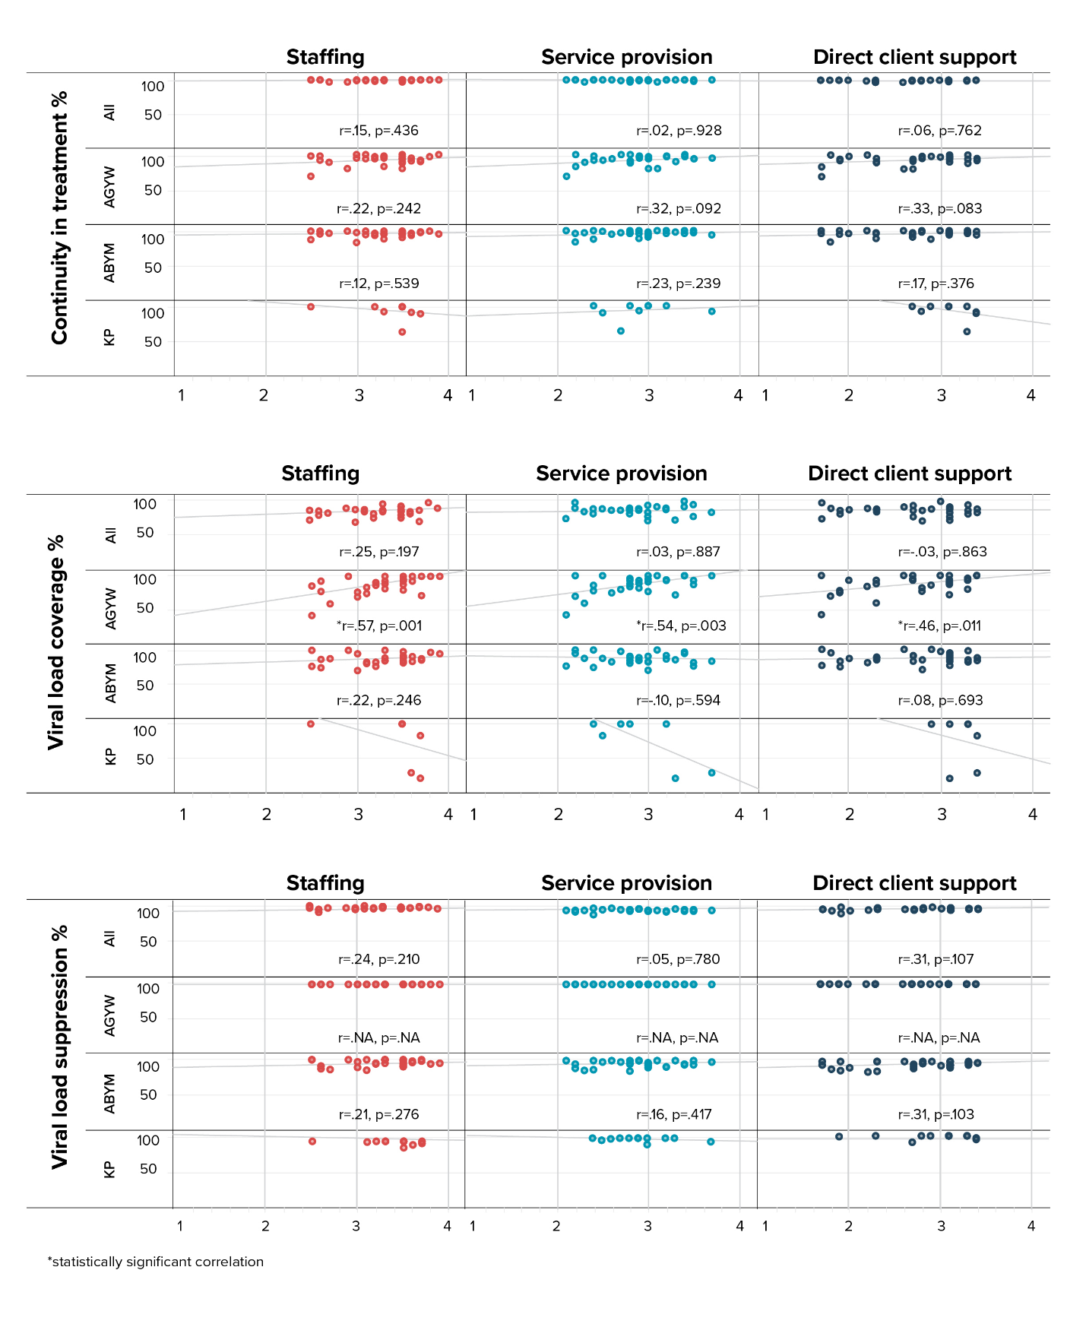
Relationship with Clinical Outcomes
In Zambia we looked at the correlation between PCC-AT domain scores and HIV outcome indicators by client population group.
Most facilities scored very high on all HIV outcome indicators, making it difficult to see correlations
We did see correlations for AGYW between viral load coverage across all 3 domains
We are eager to test this in other settings where indicator performance is more varied.

Slide 14
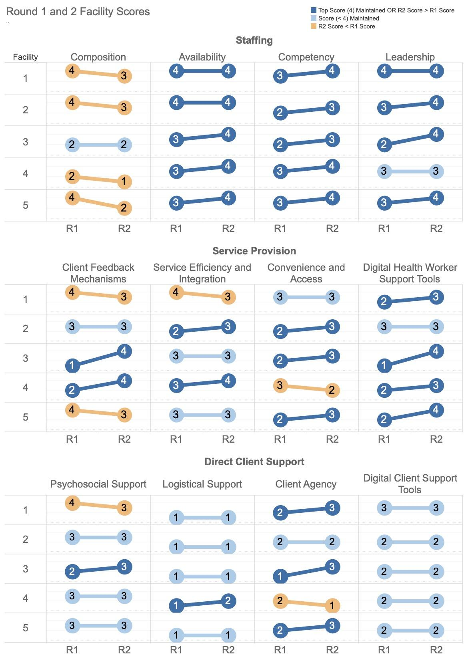
Repeat Measures for Quality Improvement
We returned to the 5 clinics in Ghana where we had previously piloted to repeat the tool
The changes in scores reflected changes in service delivery reported by staff, both positive and negative
Many of the improved changes came from the pilot action plan
This suggests that the PCC-AT is effective at measuring service delivery, and is a useful quality improvement tool.

Slide 15
Updating for Integrated Settings
We first developed and tested the PCC-AT for HIV-specific facility settings. In recognition of many countries’ plans to move towards more integrated services, we wanted to adapt the tool to be applicable in integrated settings.
To do this, we:
Conducted updated literature review- specific to HIV in integration
Gathered feedback from health care workers, client groups, facility administrators, and Ministry of Health staff in Zambia, Cameroon, Kenya, and South Africa

Slide 16
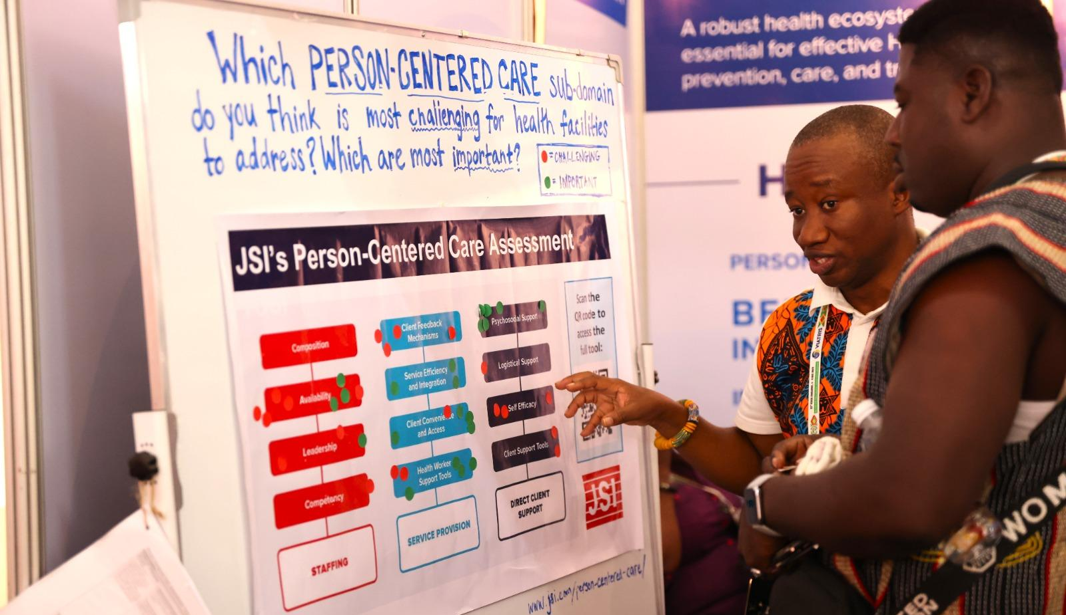
THANK YOU
Are there any questions?
Jessicaeposner@gmail.com
caitlin_madevu-matson@jsi.com

Slide 17

Co-creating a new model of person-centred care with healthcare providers in South Africa
Shawn Malone, PSI, South Africa

Slide 18






Co-creating a new model of
person-centred care with
healthcare providers in South Africa
"Assessing implementation"
Person-Centred Care (PCC) Research Collaborative
19 February 2025

Slide 19
Our starting point: Many patients cite the clinic experience and patient-provider interaction as barriers to care
Many men anticipate a negative experience in the clinic, even if they have not actually had one.
Counselling is often scripted, one-directional and overly technical. It does not surface or address individual issues.
The clinic can be an unfamiliar space that men feel incompetent to navigate.
Some providers view men as
‘a problem’, which can then reflect in their demeanor and communication style.
Healthcare providers may show empathy only up to the point that a patient is compliant.

Slide 20
But healthcare providers say the clinic is generally not a supportive or empowering place for them either
Understaffing
Ambitious targets
Stock-outs and shortages
Pressure to ‘push the bench’
Reporting & admin burden
Rigid guidance & processes
Poor teamwork
Inadequate training and capacity development
Lack of appreciation
Unreasonable patients
Personal stresses
Notes:
Letitia

Slide 21
Our ‘aha moment’: Person-centred care models rooted in audit and enforcement are unlikely to produce durable results
Healthcare providers already feel overburdened.
If we want better care for patients,
we need solutions that also support providers .
Our hypothesis:
Better resources and support
Better quality care for patients
Better patient experience
Better patient outcomes
More skilled and motivated providers
Notes:
Letitia

Slide 22
We set out to co-create a new model of person-centred care that feels supportive and empowering to both patients and providers. Our design questions:
How might we help healthcare providers…
…develop and practice greater empathy?
…discern a patient’s emotional state ‘behind the mask’?
…strengthen communication skills?
…manage and reduce stress?
…improve teamwork?
…strengthen supportive supervision and feedback?
…feel valued and appreciated for good work?
…tap into sources of motivation and fulfilment?
…access opportunities for learning and growth?
How might we help patients…
…empathize with the challenges and constraints faced by providers?
…engage with providers in ways that facilitate a positive interaction?
…understand the value that providers place on patient feedback?
…find ways to share both positive and negative feedback?

Slide 23
Adapted from a similar project developed by CIDRZ in Zambia, the model is based on an ongoing process of learning, practice, feedback, reflection, recognition, and planning, supported
by a roving nurse mentor in partnership with each facility manager and team.
Train providers on person-centred care principles and skills
Provide ongoing on-the-job coaching and mentoring
Measure clinical outcomes and patient and provider experience
Facilitate regular review and action planning by clinic teams
Provide recognition and celebrate progress

Slide 24
Training and mentoring focus on topics identified by providers as enablers of person-centred care
Mental health / Stress management
Empathy
Communication
Supportive supervision (for clinic managers)
Insights into patient barriers
Teamwork
Notes:
Thulani, then pass to Shawn

Slide 25
We piloted the model in 8 rural and peri-urban clinics in South Africa. What did we observe?
A complex picture of provider and patient experiences—the picture is not black-and-white
Variability across facilities around culture, leadership, performance, etc.
Appreciation for supportive, practical approaches—not the resistance or apathy that some had anticipated
Importance of creating opportunities to apply new knowledge and skills
Openness to engaging with the data and identifying areas for improvement, without defensiveness
Challenges in aligning training, mentoring and reflection with day-to-day routines
Notes:
The clinic picture is more complex than is sometimes portrayed. Many providers do feel motivated. Many patients do feel well cared for. But there is also room for improvement.
There is variability across facilities. Different facilities face different issues and challenges. Different clinic teams have different personalities and group dynamics.
Providers have appreciated supportive, practical approaches, which they characterise as rare.
Providing opportunities to practice and reinforce new knowledge and skills is essential.
Clinic teams have been open to engaging with the data and prioritizing areas for improvement.
Aligning training, mentoring and quarterly reviews with facility schedules and routines remains a challenge. Time is the scarcest resource.

Slide 26
Insights and lessons from training
It must be adapted to the clinic reality
One-hour sessions
Once a week
Delivered on-site
We won’t get everything right on the first try
Units adapted based on feedback
Moved to early morning
Broadened to include non-chronic and non-clinical staff
The delivery can be more challenging to get right than the content
Limited space for training sessions
Unreliable power supply
Staff rotation and leave
Staff turnover
Leadership transitions
Competing demands on time
Notes:
Entle

Slide 27
Insights and lessons from coaching and mentoring
Why do coaching and mentoring and not just training?
Reinforce key elements of the training
Confirm that staff grasp the concepts
Remind and correct where there are gaps
Provide opportunities to practice
Identify support needs
Give providers the source of connection and support that they are craving
What is the best way to conduct it?
Give staff time to settle after the training session
Dedicate adequate time to each staff member
Create a supportive, judgement-free space
Ask staff to self-reflect after each consultation
Provide feedback, starting with the positive
Let staff find their own solutions and make their own decisions as much as possible
Model the skills and behaviours you want to see
Notes:
Hlengiwe

Slide 28
We used a mixed-methods approach to assess providers’ and patients’ response to the model and its components
Qualitative
In-depth exit interviews with 25 male patients and 25 female patients at pilot midpoint
In-depth interviews with 40 providers at pilot midpoint
Focus group discussions with a total of 50 providers at pilot endline
In-depth interviews with 18 men participating in the B-OK pill case nudge
Quantitative
Survey of 577 patients at baseline, twice mid-pilot, and at endline
Survey of 80 providers at baseline, twice mid-pilot, and at endline
Survey of 90 men participating in the B-OK pill case nudge
Notes:
Abo

Slide 29
We saw some encouraging trends in the provider survey
Providers reported significant improvement in areas including job satisfaction, motivation, sense of accomplishment, receiving guidance and support, feeling recognised and appreciated, having their suggestions taken seriously, and having access to training opportunities.
Statement (agree or strongly agree) | Baseline | Endline
Overall, I feel satisfied with my job. | 58% | 82%
I feel motivated to work as hard as I can. | 69% | 83%
My job gives me a feeling of accomplishment. | 70% | 82%
I feel good about the team I work with. | 77% | 80%
I feel recognised and appreciated when I perform my work well. | 69% | 80%
Suggestions from team members on how to improve things in this clinic are usually taken seriously. | 36% | 63%
I have access to the training I need to perform well in my role. | 57% | 71%
I get good guidance and support from my supervisor. | 70% | 79%

Slide 30
However, we also saw areas of limited progress or even decline
Statement (% agree or strongly agree) | Baseline | Endline
Patient-centred care is not really possible given my work conditions. | 28% | 41%
If I am too nice, patients might take advantage of me. | 45% | 44%
I’m the health professional, so honestly the patient needs to listen to me more than I need to listen to them. | 17% | 20%
In exploring these issues with providers, we noted two sources of frustration in particular:
Many providers felt discouraged that their overall work environment did not enable the practice person-centred care, due to patient volume and limited time with each patient.
Some providers expressed dissatisfaction that the model supported provider behaviour change but did not produce a noticeable change in patient behaviour.

Slide 31
We saw encouraging trends in the patient survey
Patients reported improvements in providers making them feel welcome and comfortable, communicating clearly, asking questions, listening carefully, and respecting their privacy.
Statement (% yes) | Baseline | Endline
Did the nurse greet you in a way that made you feel welcome and comfortable? | 90% | 99%
Did the nurse talk to you using words you could easily understand? | 87% | 100%
Did the nurse introduce her/himself to you by name? | 49% | 75%
Did the nurse ask about how you are feeling today? | 77% | 94%
Did the nurse explain what they would be doing today before getting started? | 77% | 94%
Did the nurse ask if you had any questions or concerns? | 57% | 96%
Do you feel the nurse listened carefully to what was said? | 82% | 99%
Do you feel that your privacy was respected during your visit? | 81% | 98%
Did the nurse ask you if you are having any difficulties taking your medication? | 51% | 91%
Did the nurse explain your blood results in a way that was clear to you? | 45% | 96%

Slide 32
However, this did not translate into higher overall satisfaction
We explored this seeming disjuncture in exit interviews with patients, and for most, the improved quality of provider-patient interaction simply was not enough to counterbalance negative factors such as long waiting times, crowded facilities, etc.
Overall, how did you feel about the care you received today? | Happy | Neither happy nor unhappy | Unhappy
Baseline | 74% | 19% | 6%
Endline | 59% | 38% | 3%
Change | -15% | +19% | -3%
Our conclusion: Person-centred care initiatives that improve patients’ experience of care are necessary but not sufficient. Making clinic services more convenient is also essential.

Slide 33
Takeaways
Most healthcare providers want to provide quality care but need strategies and support for developing, maintaining, and practicing empathy in a challenging work environment.
Providers should be included in the design of person-centred care models. They are often well aware of where they are falling short and what resources and support they need.
Person-centred care models like Ngiyakuzwa that focus on support and empowerment over audit and enforcement can achieve high levels of acceptability among providers.
Models that pair training with ongoing coaching and mentoring may have more success in embedding person-centred attitudes and behaviours.
The Ngiyakuzwa model improved provider job satisfaction, motivation, sense of accomplishment, and feelings of appreciation, and also improved patient experience of care across various indicators.
Person-centred care is just one piece of a larger puzzle. It can play an important role in improving patients’ experience of care, but cannot solve structural challenges like long waiting times, crowded facilities, and inconvenient hours. A holistic health system strengthening approach is still needed.
Notes:
Abo, then pass back to Shawn

Slide 34
Acknowledgements
National Department of Health
KZN Department of Health
iLembe Health District Office
King Cetshwayo Health District Office
Centre for Infectious Disease Research in Zambia (CIDRZ)
Life Healthcare
The Bill & Melinda Gates Foundation (funder of this work)

Slide 35
Contacts
HLENGIWE NGUBANE
Mntase / Mentor
PSI
hngubane@psi-sa.org
+27 76 108 6551
THULANI GRENVILLE-GREY
Master Trainer & Facilitator
Matchboxology
thulani@matchboxology.com
+27 82 452 7871
LETITIA RAMBALLY-GREENER
Senior Learning & Adaptive Implementation Advisor
PSI
letitia@psi-sa.org
+27 79 883 6670
SHAWN MALONE
Project Director
PSI
smalone@psi.org
+27 81 038 1862
ABONGILE JIM
Senior M&E Advisor
PSI
abongile@psi-sa.org
+27 71 256 4273

Slide 36
Attribution
© 2025 Population Services International (PSI)
Any component of this document may be reproduced or adapted without permission, provided that:
PSI and Matchboxology are acknowledged, and
the material is made available free of charge.
Please send a copy of any adaptations and uses to Shawn Malone, smalone@psi.org.

Slide 37
PsySE-HCPN
Establishing health care providers network (HCPN) providing psycho-socioeconomic (PsySE) support for Filipinos living with HIV
”Rod” (He/him)
Rodenie Arnaiz Olete, MSc, RN
Technical Writer for Grants and Research | Program Manager
Sustained Health Initiatives of the Philippines (SHIP)

Slide 38
Background and Rationale
What is our motivation and purpose behind this program?

Slide 39
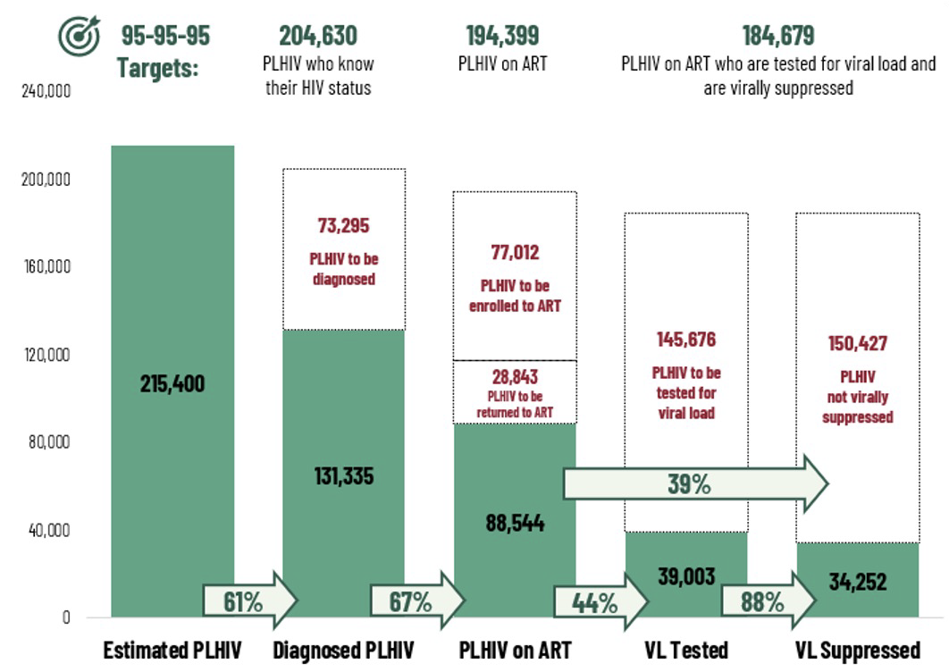
Continuum of HIV Care: Philippines (September 2024)
Notes:
One of the primary concerns in HIV care is treatment retention, as a significant number of people living with HIV (PLHIV) discontinue treatment at various points in the care continuum. While biomedical interventions such as antiretroviral therapy (ART) are critical for viral suppression, evidence indicates that non-biomedical factors contribute to treatment discontinuation. These include:
Mental health concerns such as depression and anxiety.
Economic instability, affecting access to healthcare and adherence to treatment.
Social barriers, including stigma and lack of support networks.

Slide 40
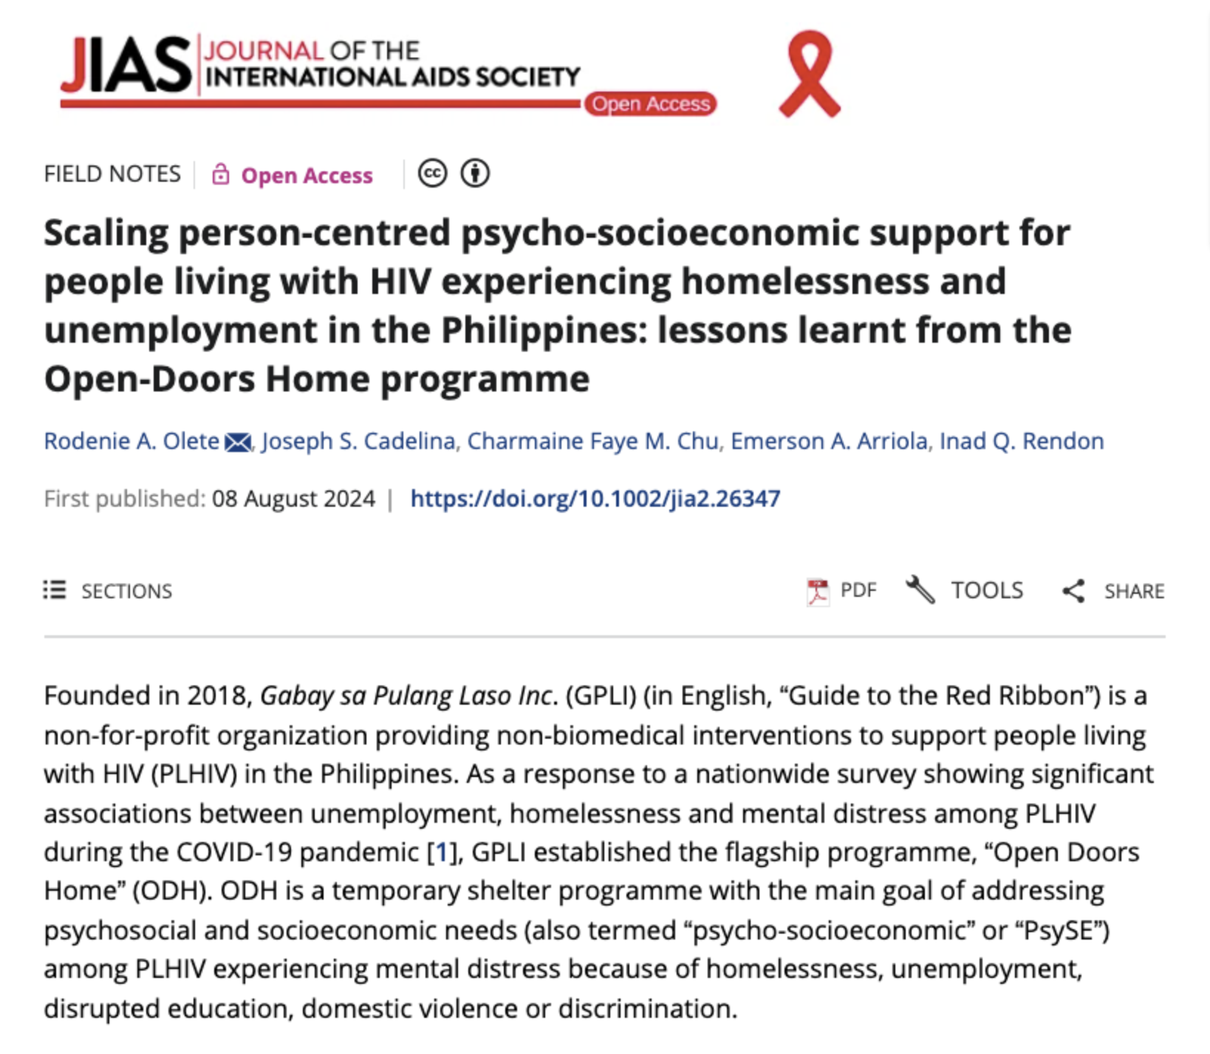
Building from Open Doors Home project, we said,
“Let’s try to expand this on a provincial scale...”
Notes:
The PsySE-HCPN builds upon the success of the Open Doors Home project, expanding it to a provincial level. By integrating mental health and social welfare services into the existing health system, we aim to provide holistic, person-centered care to PLHIV.

Slide 41
The PsySE-HCPN
How can this address the fragmented HIV care in the Philippines?

Slide 42
Components of PsySE-HCPN
mental health aspects of living with HIV
economic challenges PLHIV may face
PSYCHO
SOCIO
ECONOMIC
HCPN
social factors that impact PLHIV
Health Care Providers Network
Notes:
The PsySE-HCPN model is designed to integrate mental health and social welfare support within the HIV care framework, ensuring that these factors are systematically addressed.

Slide 43
This project aims to:
To equip professionals with skills to manage both the medical and non-biomedical needs of people living with HIV and design person-centered services in collaboration with key populations and stakeholders.
To enable professionals to assess local barriers, evaluate service outcomes, and build a national and local HCPN to integrate mental health and social welfare into HIV care.
DONE: October to November 2024
Notes:
The PsySE-HCPN Model and Its Objectives (1 minute)
The PsySE-HCPN builds upon the Open Doors Home project, expanding the approach at a provincial level. Its objectives include:
Training healthcare professionals to manage both medical and non-medical needs of PLHIV and implement person-centered services.
Establishing a Health Care Provider Network (HCPN) that integrates mental health and social welfare support into HIV care, reducing referral delays and improving service coordination.
Conducting needs assessments to evaluate local barriers and inform program development.

Slide 44



Pilot Batch 2024/10/16
Batch 2 2024/11/25
Batch 3 2024/11/30

Slide 45
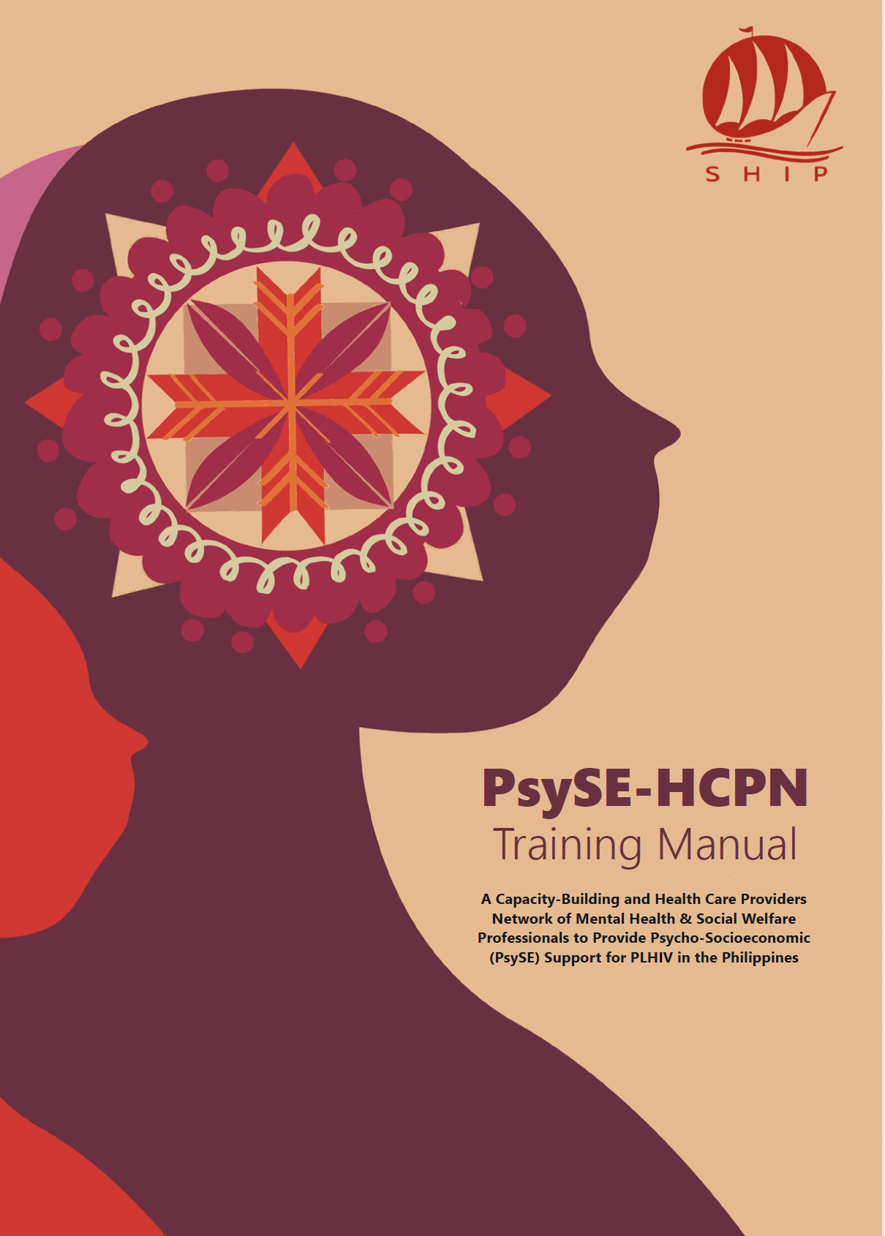
PsySE Nine (9) Training Modules:
Fundamentals of HIV and AIDS
Core Principles of PsySE Support in HIV
Fundamentals of Mental Health in Improving Quality of HIV Care
Screening and Management of Common Mental Health Issues in HIV
Addressing Complex PsySE Needs of Filipino People Living with HIV
Best Practices in Providing Social Welfare Support in the Philippines
Integrating Government-Led PsySE Programs into HIV Care
Ensuring Continuity of HIV Care and Effective Documentation of PsySE Support
Creating the Health Care Provider Network (HCPN) to Provide Integrated PsySE Support for Filipino PLHIV
Notes:
Integration of the IAS-PCC Consensus Statement (1.5 minutes)
The IAS Person-Centered Care (PCC) Consensus Statement provides a globally recognized framework for integrating holistic, person-centered approaches into HIV care. Its core principles emphasize:
Addressing the structural and psychosocial barriers that impact treatment retention.
Ensuring that HIV services are accessible, non-stigmatizing, and responsive to the diverse needs of PLHIV.
Fostering collaboration between health systems, social welfare programs, and community-based organizations to create a more comprehensive and sustainable HIV care model.
By aligning the PsySE-HCPN with these principles, the project is structured to enhance continuity of care, reduce treatment fallouts, and improve overall health outcomes for PLHIV in the Philippines.

Slide 46
What is a “Health Care Provider Network”?
Health Care Provider Network (HCPN)
A group of primary to tertiary care providers, whether public or private, offering people-centered and comprehensive care in an integrated and coordinated manner, with the primary care provider acting as the navigator and coordinator of health care within the network [UHC Act Implementing Rules and Regulations, Rule 4]. The terms HCPN and Network are used interchangeably in these guidelines.
References:
Philippine Health Insurance Corporation. (2024). Guidelines on contracting health care provider networks (HCPN) (PhilHealth Circular No. 2024-0025). Philippine Health Insurance Corporation.
Department of Health. (2020). Primary care policy framework and sectoral strategies (Administrative Order No. 2020-0024). Department of Health, Republic of the Philippines.
Department of Health. (2020). Guidelines on the service delivery design of health care provider networks (Administrative Order No. 2020-0019). Department of Health, Republic of the Philippines.

Slide 47












The current fragmentation in HIV care cascade
BIOMEDICAL NEEDS
SOCIAL WELFARE
MENTAL HEALTH
People living with and affected by HIV
NON-BIOMEDICAL
NEEDS
HIV CARE FACILITY

Slide 48
A more comprehensive and integrated HIV care (PsySE-HCPN)
BIOMEDICAL NEEDS
SOCIAL WELFARE
MENTAL HEALTH
People living with and affected by HIV
NON-BIOMEDICAL
NEEDS
HIV CARE FACILITY

Slide 49
Next step:
Pilot Implementation in Iloilo Province
Making our aims more tangible, specific, and meaningful

Slide 50
Proposed Iloilo Province Health Care Providers Network (HCPN)
in Providing Psycho-Socioeconomic (PsySE) Support for PLHIV
Calinog
Mayor
Iloilo
Governor
Guimbal
Mayor
Legend:
Governing / administrative body
PHO
HMO
Main PsySE-HCPN implementers
PsySE-HCPN extension
PsySE-HCPN pilot sites
PSWDO
PsySE-HCPN MoA signatories
Calinog
MSWDO
Guimbal
MSWDO
Calinog
Hospital
Calinog
RHU
RPGTMH
Guimbal
RHU
pilot site
SHIP
pilot site

Slide 51
We are hoping to...
Explore opportunities widen HCPN coverage in Iloilo province to include psycho-socioeconomic support for Ilonggo PLHIV
Assess barriers to a well-established HCPN for PLHIV by conducting a province-wide needs assessment survey
Set up a one-day regional meeting with the stakeholders of Iloilo Province, including policy-makers, health and social welfare agencies, health providers, and community-based organizations

Slide 52
Thank you.

Slide 53

The Lancet Global Health Commission on people-centred care for universal health coverage
Todd Pollack, Harvard Medical School, United States

Slide 54
Update on the Lancet Global Health Commission on People-Centered Care for Universal Health Coverage
IAS PCC Research Collaborative
19 February 2025

Slide 55



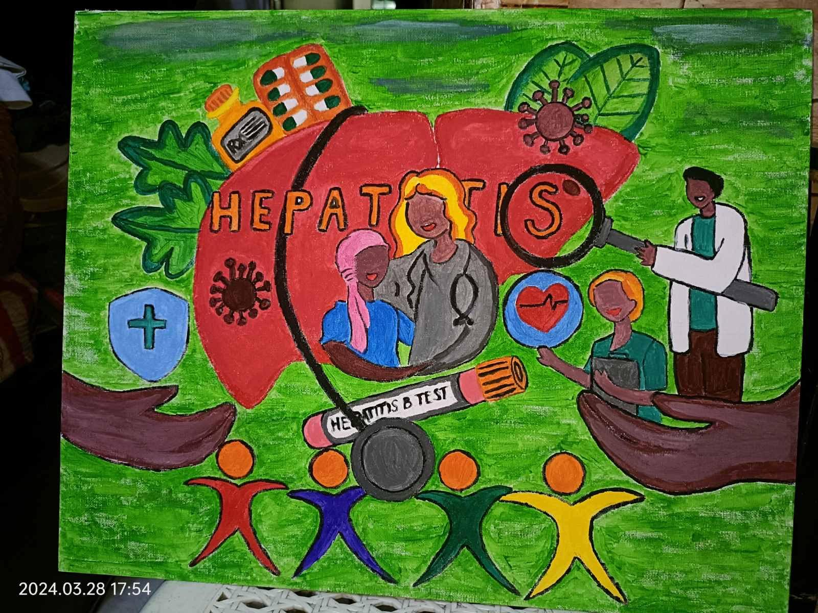
Commission announced in July 2024
Preliminary Research Aims
Propose an operational definition(s) and synthesize existing evidence on people-centered care
Summarize and evaluate measurement approaches and targets
Describe a spectrum of implementation strategies and evaluate their effectiveness
Model and promote systematic, meaningful community engagement in healthcare design and research
Artworks by lived experience advocates for Commission announcement event in Geneva, May 2024
Use participatory principles and practices to “walk the walk” of equity, inclusivity and meaningful engagement of diverse communities and ‘ways of knowing;
Preliminary Framework for the LGH Commission on PCC for UHC
Notes:
Examples of how we ‘walk the walk’
Transparent, equitable Commissioner selections
Participatory, community-engaged research and recommendations
Multisectoral and multi-sectoral collaboration and shared decision-making
Enable different ways of “knowing”

Slide 56


Advisors and Commissioners
Detailed bios can be found on the Commission Website

Slide 57
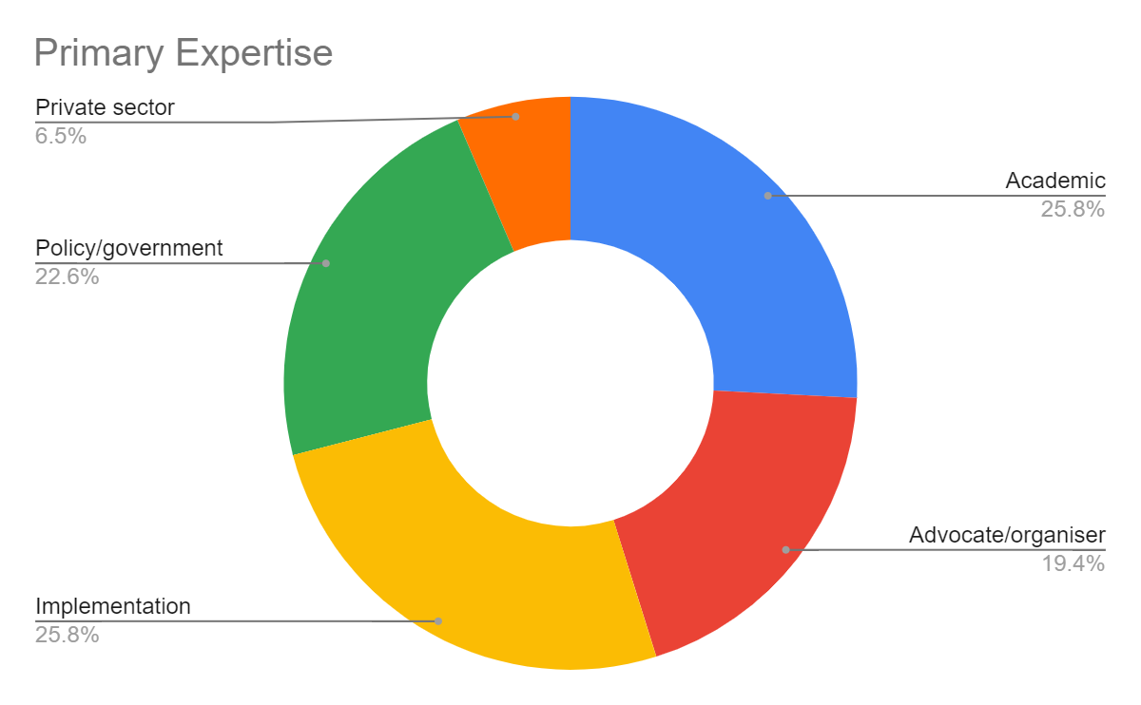
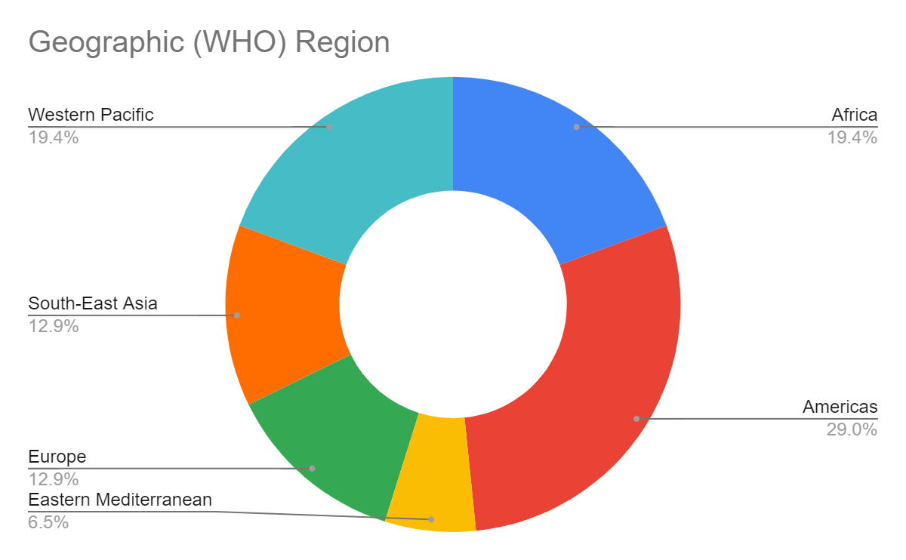
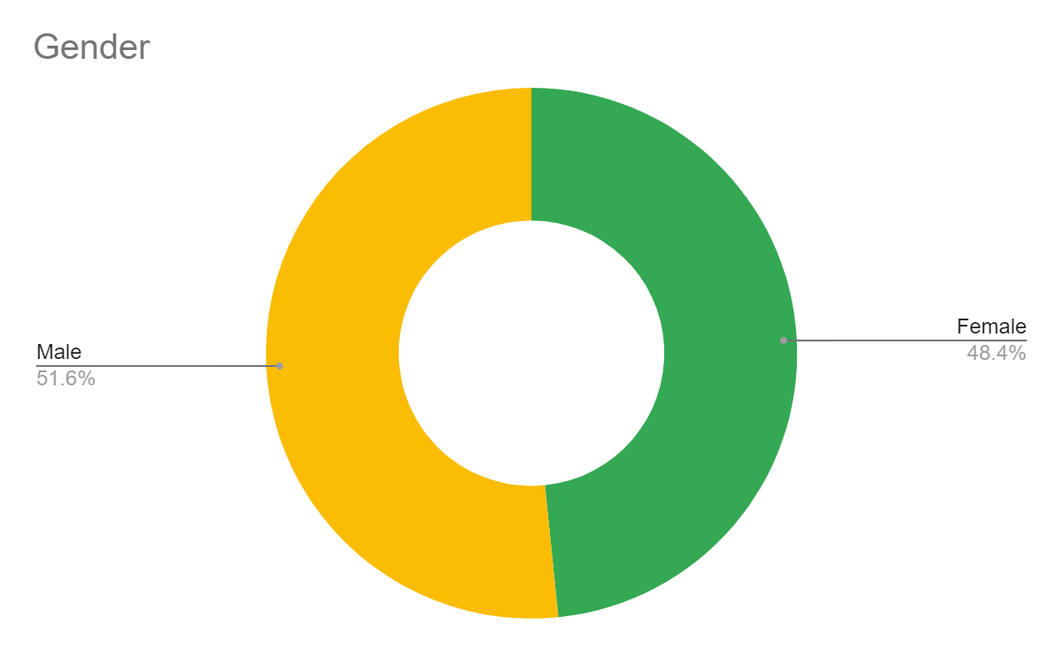
Commissioner diversity
Notes:
Need to say here that we EXCEED our goal of 30% of Commissioners with Lived Experience - we are at 39%!

Slide 58
Operational structure
Board of Advisors
Secretariat
Commissioners
Other key stakeholders (e.g., WHO, UHC CSEM)
Working groups
Commissioners’ institutions/networks
Broader Engagement of our Networks

Slide 59

Inaugural Convening / Boston, Jan. 21-22, 2025

Slide 60
Shared understanding of people-centered care
Recognition of personhood: People-centered care prioritizes the holistic needs, values, identities, and cultures of individuals and communities, recognizing and respecting their personhood—their intrinsic dignity, rights, and unique lived experiences—beyond their roles as patients.
Holistic approach: People-centered care integrates diverse perspectives, including caregivers and marginalized groups, and moves beyond clinical care to embrace broader concepts of health shaped by social, cultural, and economic factors.
Empowerment and shared partnership: People-centered care ensures individuals and communities’ active and meaningful participation in their own healthcare, as well as in designing, delivering, and evaluating healthcare while emphasizing equity, respect, active participation, and shared governance to address power dynamics.
Sustainable impact on health systems: People-centered care fosters equitable, sustainable, inclusive, responsive health systems that aligning health and social policies and support Universal Health Coverage.

Slide 61
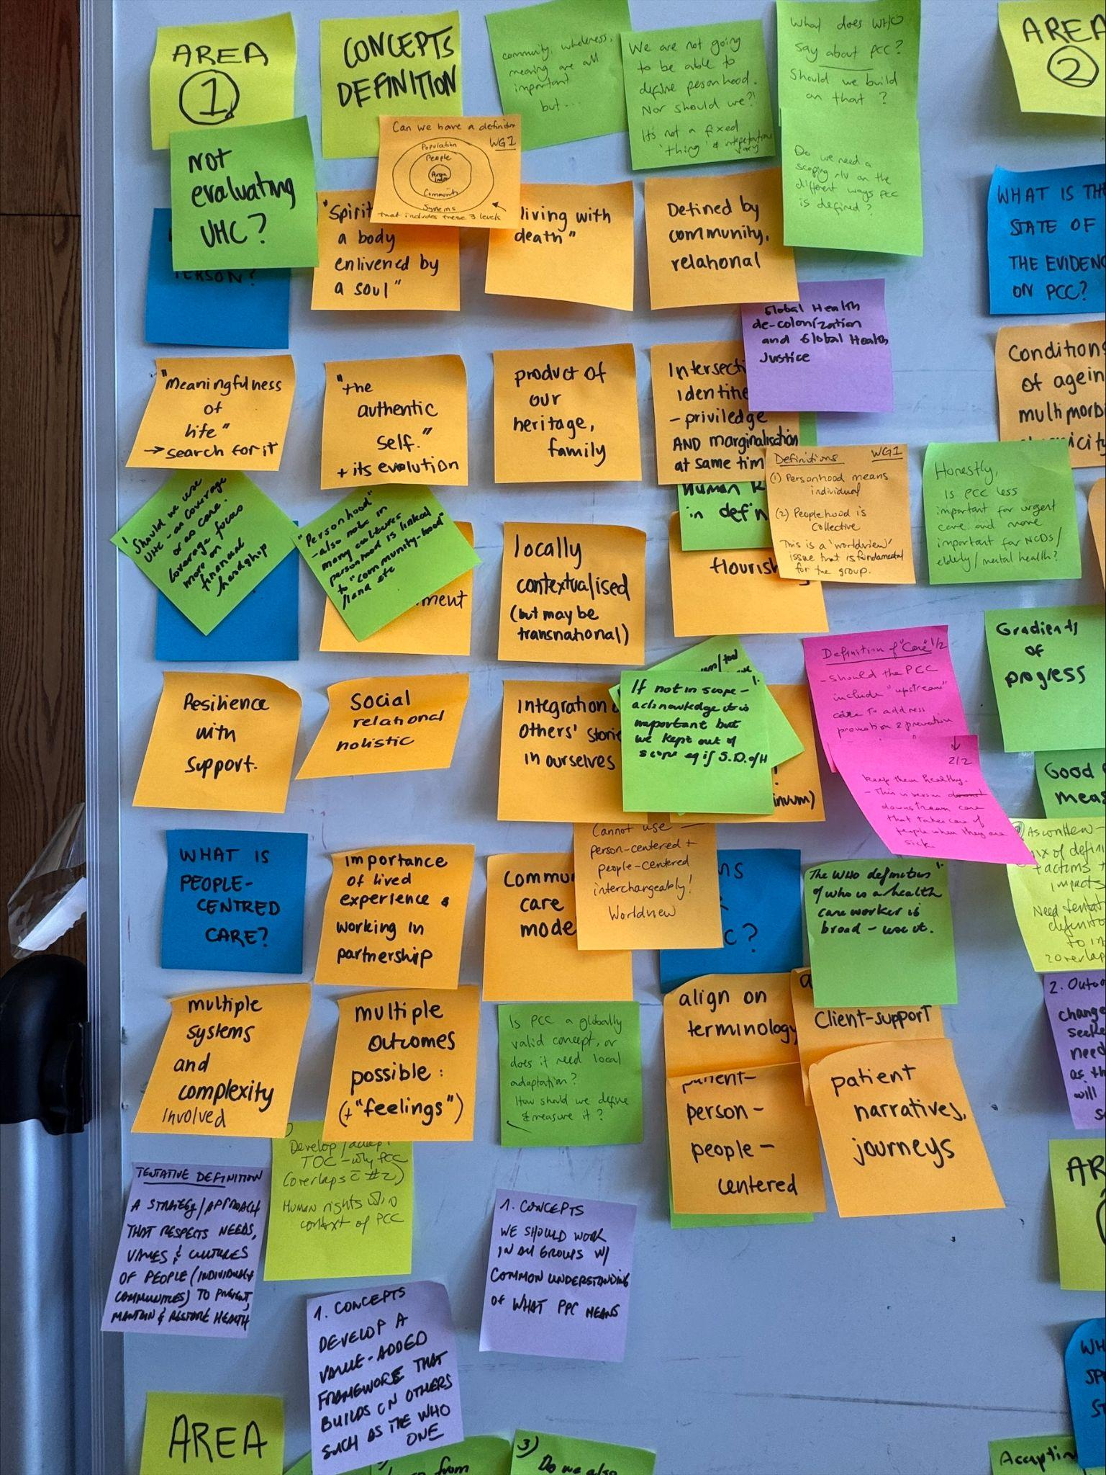
Refined research areas and working groups
Concepts, Definitions & Principles – Review existing definitions/frameworks; define essential principles and practical components
Measurement & Outcomes– Review metrics and tools for measuring PCC and what outcomes have been reported for PCC
Implementation Strategies – Identify evidenced-based and scalable PCC models and their enablers and barriers
Political, Social & Financial Enablers – Evaluate policy levers, governance structures, and financing mechanisms to enable PCC
Meaningful Engagement* – Establish best practices for embedding lived experience in health system design, governance, and evaluation.
*integrated across all areas

Slide 62
Our north star and ‘value add’ of the Commission
Establish HOW to do meaningful engagement of people with lived experience to enable UHC and health equity
Focus on Meso and Macro level enablers of PCC
Be actionable, globally relevant, and forward-looking, addressing Post-2030 SDG Priorities

Slide 63
Focus on Meso and Macro level enablers of PCC
Level | Description | Example
Micro Personal level | Individual actions and person/provider interactions | Individual empowerment, shared decision-making, and self-advocacy in care delivery
Meso Facility/ Community level | Group actions and relationships | Co-design of service delivery, engaging people in care team
Macro Health system level | Building blocks and processes of health system | Policy integration, governance mechanisms, and financing structures that institutionalize PCC.

Slide 64
Timeline
Phase | Timeframe
Phase 1: Preparation and Groundwork | October 2024 – January 2025
Phase 2: Research Question Development – 1st Convening: January 2025 | January 2025 – March 2025
Phase 3: Working Groups and Data Collection – 2nd Convening: August 2025 | April 2025 – December 2025
Phase 4: Drafting and Stakeholder Engagement – 3rd Convening March 2026 | January 2026 – July 2026
Phase 5: Manuscript Finalization and Submission – 4th Convening October 2026 | August 2026 – December 2026
Launch: Formal release of report at UNGA 2027 in NYC | September 2027

Slide 65
Next Steps
Refinement of research areas and questions
Map current networks and resources and identify gaps in capabilities/skills lived/professional experiences
Initial scoping and research within working groups
2nd Convening in Bangkok, Thailand, August 5-8, 2025
World Health Assembly Engagement

Slide 66




PCC at the World Health Assembly 2025:
‘A seat at the table’
DATE AND TIME: Wednesday, May 21 , 6:30-8:30 pm
LOCATION: at the International Red Cross & Red Crescent Museum, Geneva, just across the street from the Palais Des Nations.
OBJECTIVES:
Demonstrate the importance of people-centered care (PCC) as a key strategy in radically re-centering and strengthening health systems and primary healthcare.
Inspire attendees to participate in correcting the imbalance of power in which people with lived experiences of illness are too often left out of decision-making.
THEME:
A Seat at the Table reminds us that healthcare is a shared responsibility—built with the people it serves. It challenges us to see people with lived experience as essential collaborators in their care. This theme ensures diverse voices, particularly those from marginalized or vulnerable communities, are not only included but seen and heard at the table - they OWN a seat.
THE CALL TO ACTION: Inspire organizations and key global health stakeholders to commit to using a people-centered care approach.
Notes:
One large table will be in the center of the gallery, serving as the main focal point of the exhibition
The table will be an art installation made in collaboration with
all our partners. Each partner will bring something for the table.
The exhibition will feature speakers who will share what having a seat
at the table means to them—linking their stories to tangible system or policy changes to emphasize the value of lived experience in shaping healthcare.
Three advocates with lived experience from partner organizations will be chosen ahead of time and will work with the team to prepare their stories.

Slide 67

Thank you
To learn more about the Commission and its work, contact:
Todd Pollack, MD
todd_pollack@hms.harvard.edu

Slide 68

Person-centred interventions to improve patient−provider relationships for HIV services in low- and middle-income countries: a systematic review
Marie-Claude Lavoie, University of Maryland School of Medicine, United States

Slide 69
What is the evidence behind person-centred care in HIV care?

Slide 70
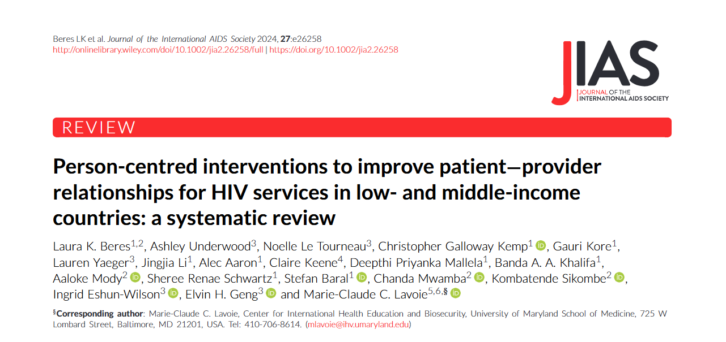
70

Slide 71
Person-centred care systematic review objectives
What types of person-centred care interventions have been used to improve patient-provider interactions?
What have been the effects of these interventions on HIV care cascade outcomes and person-reported outcomes?
What have been the experiences and perspectives of people living with HIV who received interventions targeting the patient-provider relationship?

Slide 72
Population, Intervention, Comparison, and Outcomes (PICO)
P | People living with HIV in low and middle-income countries
I | Person-centred interventions aimed at improving patient-provider relationships
C | Standard of care / Other Person-centred intervention
O | HIV Cascade outcomes: ART linkage, adherence, retention, viral suppression Person-reported outcomes: patient-provider communication or relationship; patient satisfaction, perceived quality of care, other
S | Primary studies of any design.

Slide 73
Review methods
Search
We searched Embase, Medline, Scopus, Cochrane, CINAHL and selected HIV-related conferences (e.g., IAS, ICASA)
Search up to January 2023
Synthesis
Narrative
Risk of bias
Cochrane Risk of Bias (RCT)
Newcastle-Ottawa Scale tool (non-RCT)
Joanna Briggs Institute (JBI) critical appraisal checklist (qualitative study)

Slide 74
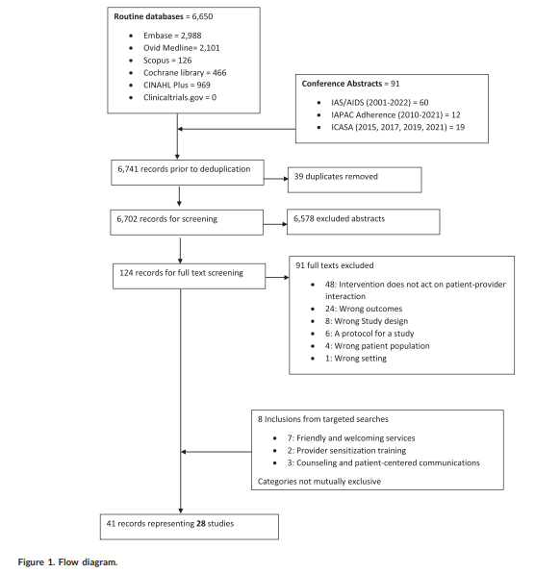
Study Selection
6650 screened
28 unique studies included

Slide 75
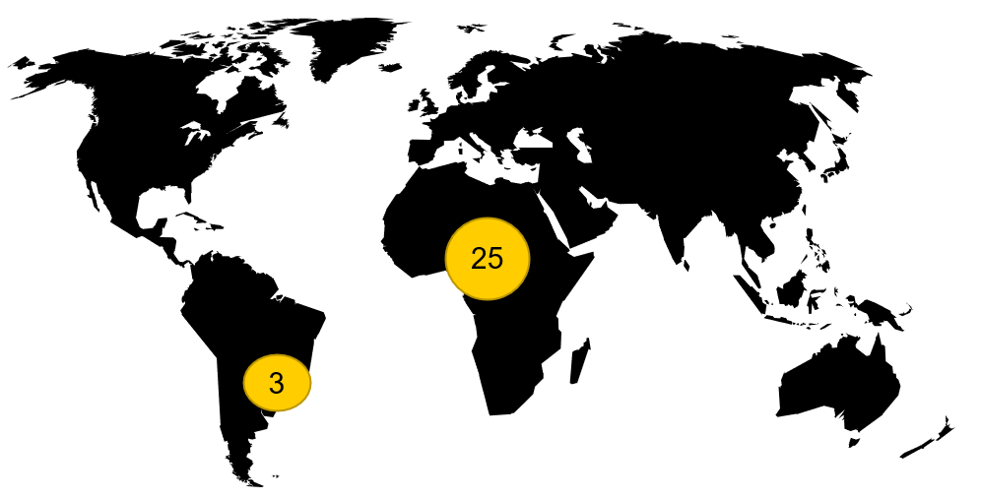
Population from included studies
Adults (46%)
Adolescents and young adults (29%)
Pregnant and breastfeeding women (11%)
Sex workers (7%)
Children and adults (7%)
Image Credits: Geralt, Pixabay

Slide 76
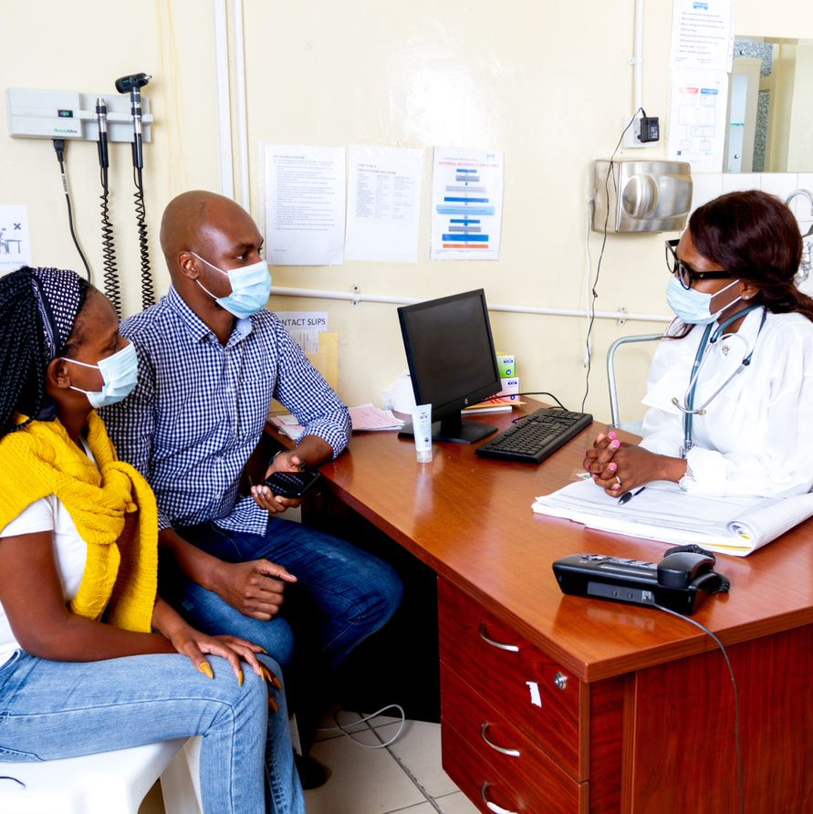
Included studies: Interventions
Individualized counselling and patient-centred communication
Provider sensitization training
Providing friendly and welcoming services
Training patients in empowerment and communication skills
Feedback to health workers regarding patient concerns and evaluation of services quality
Image credits: Ciheb

Slide 77
Person-centred care components by outcomes*
HIV Outcomes | Person-centred components
 | Individualized counselling and person-centred communication (n/N, %) | Provider sensitisation training (n/N, %) | Friendly services (n/N, %) | Patient empowerment (n/N, %) | Healthcare workers feedback (n/N, %)
Linkage | NA | Positive effect (1/1, 100.0) | Positive effect (2/2, 100.0) | NA | NA
ART initiation | No difference (0/1, 0.0) | NA | No difference (0/1, 0.0) | NA | NA
Adherence | Mixed findings (1/3, 33.3) | Positive effect (1/1, 100.0) | NA | No difference (0/1, 0) | NA
Retention | Mixed findings (1/4,25.0) | Positive effect (1/1, 100.0) | Positive effect (3/3, 100) | NA | No difference (0/2, 0.0)
Viral suppression | Mixed findings (1/5, 20.0) | No difference (0/1, 0.0) | Positive effect (6/6, 100.0) | NA | NA
Studies reporting a positive effect on at least one HIV care continuum outcome | 3/6 (50.0) | 1/1 (100.0) | 8/8 (100.0) | 0/1 (0.0) | 0/2 (0.0)
*for studies with a comparison arm

Slide 78
Qualitative findings
“I am better because I was listened to; I was helped. I was given advice, and so I left with something.” 37 year old female
Patients felt more comfortable discussing their care and concerns with providers.
Adolescents from a youth-friendly clinic reported a deeper connection and ability to communicate openly with staff.
“[At the paediatric clinic], they only asked you about your health, not how your life as a whole was going. [The adolescent clinic] helped me a lot because I could talk about anything with [names doctor and counsellors].” -21-year-old male.

Slide 79

Key points
63% of studies with a comparison group reported a significant positive effect of the intervention on at least one HIV care continuum.
100% reported a positive effect of the intervention on at least one of the included person-reported outcomes.

Slide 80
Implications for practice and research
Defining the intervention and mechanisms of actions
Tailoring person-centred care to different populations
Measuring the effects of person-centred care
Engaging healthcare workers

Slide 81






Acknowledgment
Laura Beres | Sheree Schwartz | Stefan Baral
Elvin Geng | Aaloke Mody | Deepthi Mallela
Ashley Underwood | Chanda Mwamba | Banda Khalifa
Noelle Le Tourneau | Jingjia Li | Kombatende Sikombe
Christopher Kemp | Alec Aaron | Gauri Kore
Lauren Yaeger | Claire Keene
Funding:
Bill and Melinda Gates Foundation, National Institute of Health and IAS

Slide 82
Assessing implementation: Discussion questions
What other tools exist to measure and assess PCC approaches, and for what contexts?
What additional evidence has been generated on the impact(s) of person-centred models of care on HIV treatment continuity, viral load coverage and viral suppression? Beyond these clinical outcomes, what are some other impacts from PCC approaches that are being measured?
What more needs to happen to foster community-academic partnerships to assess PCC implementation?

Slide 83
Next steps
Consolidate the information from today and disseminate
Convene next meeting (in-person meeting at IAS 2025 or virtually)
Please respond to poll shared next week on your IAS 2025 plans
When | Location
During 13-17 July 2025 | IAS 2025 (TBC)
~12 Nov 2024 | Virtual

Slide 84


Acknowledgements
The Person-Centred Care programme of IAS – the International AIDS Society – is implemented with financial support from, and in collaboration with, Gilead Sciences.
Gilead Sciences has nominated Megan Dunbar, Executive Director, Gilead Sciences to participate in the PCC research collaborative.
The IAS has full control over all the activities and decisions relating to, and forming part of, the Person-Centred Care programme.

