Slide 1



Slide 2
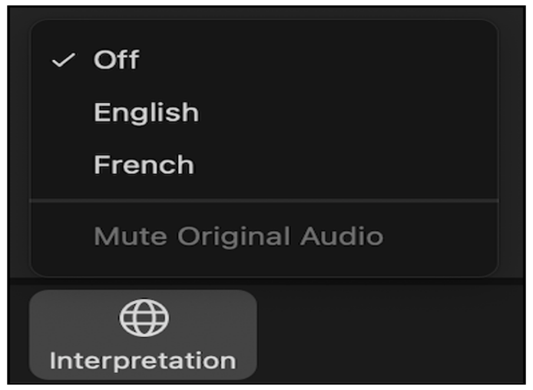
Une interprétation simultanée est disponible en français.
Pour y accéder, clickez l’icône au bas de votre écran, et sélectionnez la langue.

Slide 3

Housekeeping
Participants are muted. If you have questions, please use the Q&A box at the bottom of your screen (not the chatbox). There will be a Q&A session at the end.
Live interpretation is available in French. To access interpretation, click the icon at the bottom of your screen and select your preferred channel.
The recording will be available on the platform IAS+ after the webinar.

Slide 4


Programme:
Introducing the tool – Laura Davies (IAS)
Connecting to global initiatives
Alexandrina Iovita (Global Fund to Fight AIDS, TB and Malaria)
Simone Salem (Global Partnership for Action to Eliminate all Forms of HIV-related Stigma and Discrimination)
Panel Discussion and Q&A facilitated by Aditi Sharma (IAS)
John Mahama (Ghana AIDS Commission)
Sheilla Masasabi (Researcher, Kenya)
Jane Mukami, National Syndemic Diseases Control Council (NSDCC, Kenya)
Elsie Ayeh (NAP+ Ghana)

Slide 5


Slide 6


Slide 7
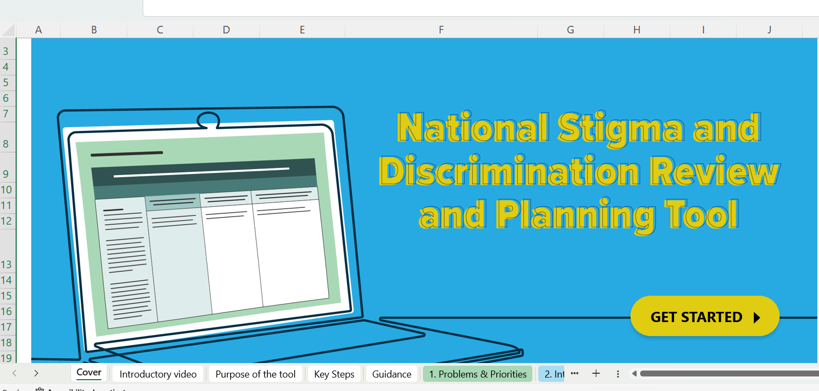

Slide 8


Slide 9
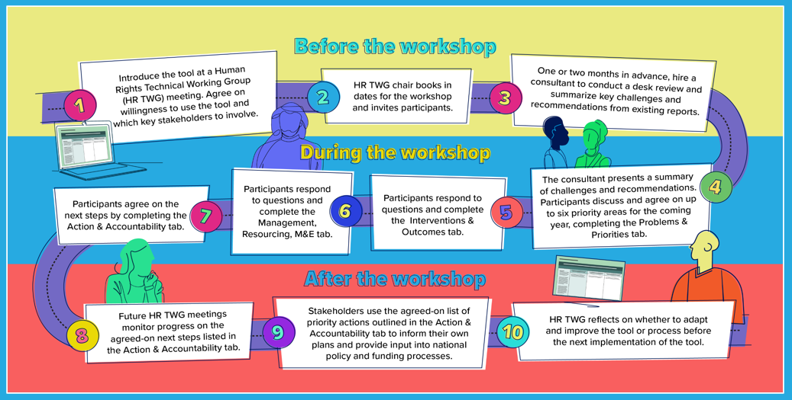

Slide 10
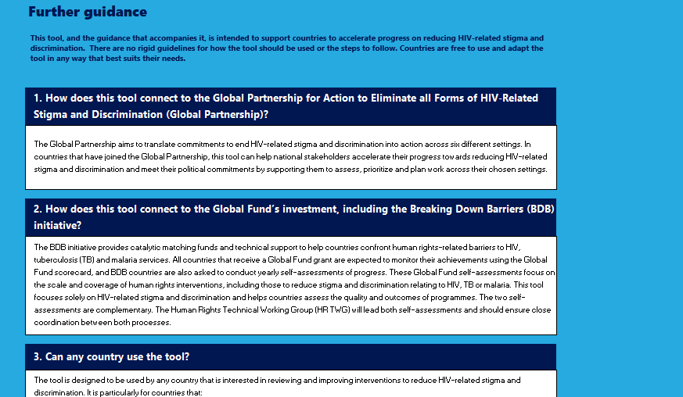

Slide 11
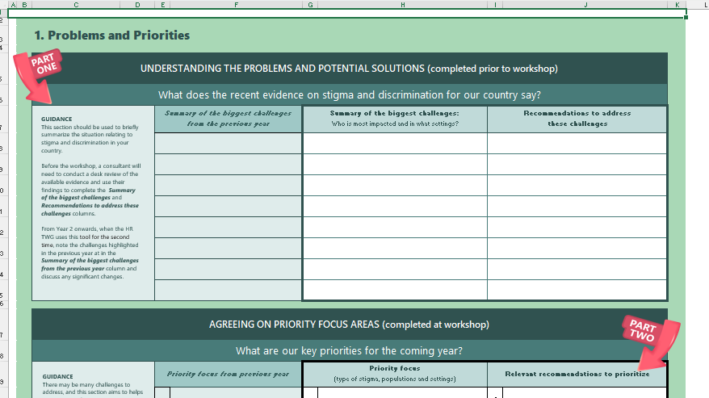

Slide 12
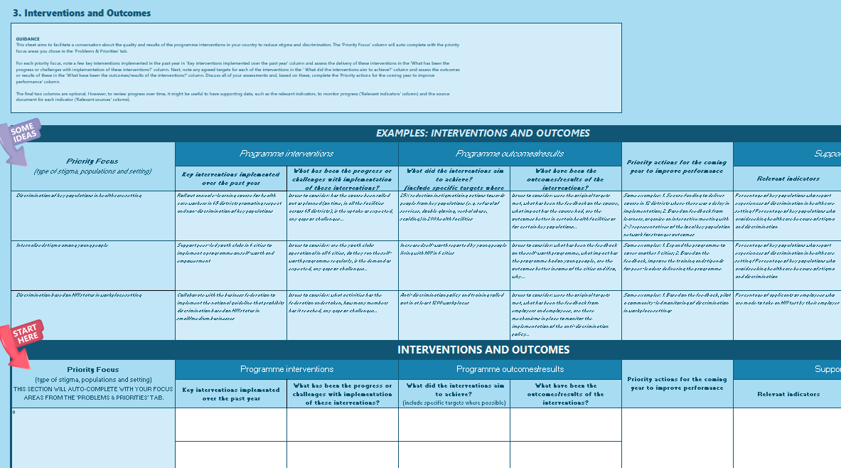

Slide 13
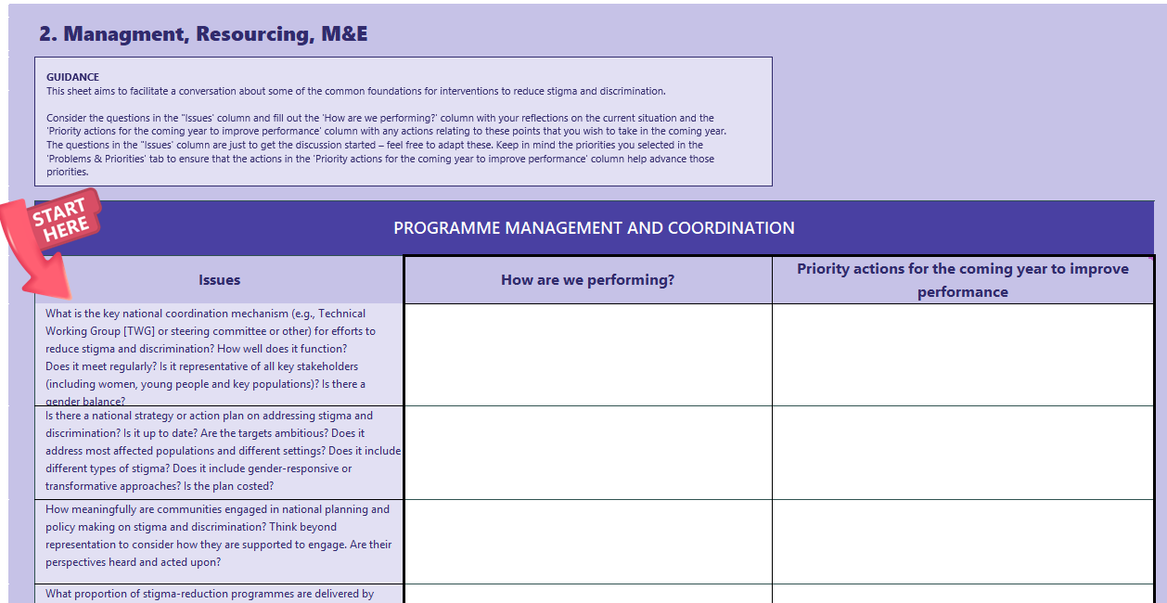

Slide 14
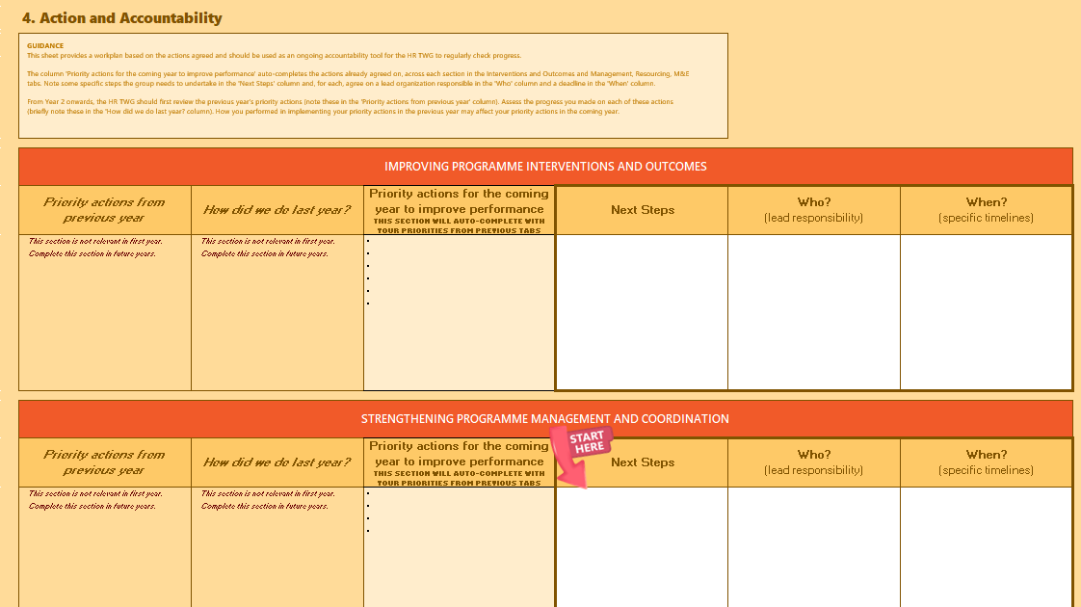

Slide 15
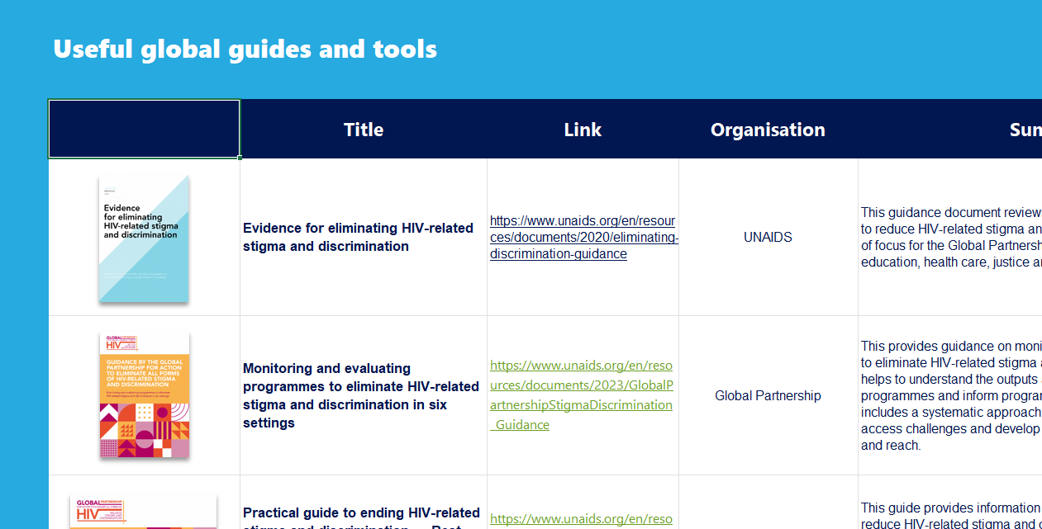

Slide 16


Slide 17
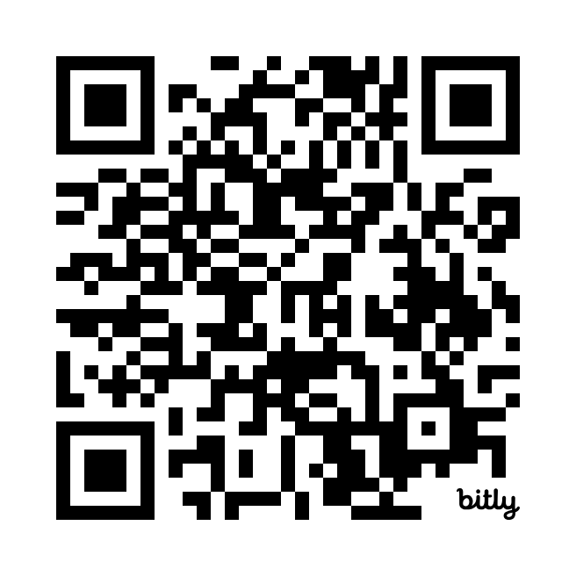
Thank you for joining!
Scan the code to access the tool and guidance!
The webinar will soon be available on IAS+

