Slide 1



Slide 2

5 March 2025
Ending HIV Criminalization - lessons from Zimbabwe

Slide 3
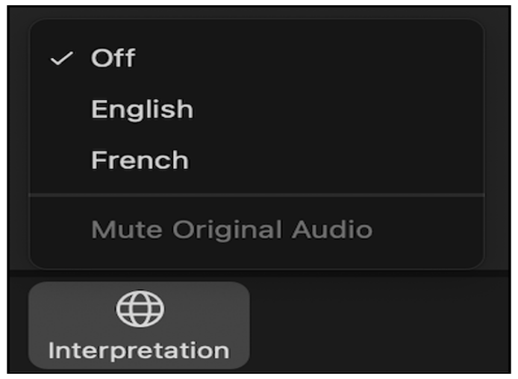
Une interprétation simultanée est disponible en français.
Pour y accéder, clickez l’icône au bas de votre écran, et sélectionnez la langue.

Slide 4

Housekeeping
Participants are muted. If you have questions, please use the Q&A box at the bottom of your screen (not the chatbox). There will be a 12-minute Q&A at the end.
Live interpretation is available in French. To access interpretation, click the earth icon at the bottom of your screen and select your preferred channel.
The recording will be available on the platform IAS+ after the webinar.

Slide 5

Opening remarks
Bringing science to Justice
Marlène Bras
Director,
HIV Programmes and Advocacy
International AIDS Society

Slide 6

Programme:
Introduction – Edwin Bernard (HJN)
Video: “It is Time!” – How Zimbabwe Decriminalised HIV
Panel Discussion and Q&A
Closing remarks – Edwin Bernard (HJN)

Slide 7
“It is Time!”
How Zimbabwe Decriminalised HIV
A video from the HIV Justice Network

Slide 8

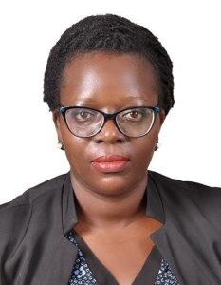

Panel Discussion
Dr Ruth Labode
Former chairperson of the Parliamentary Portfolio on Health, Zimbabwe
Immaculate Owomugisha
Lawyer and Human Rights activist, Uganda
Alison Symington
Senior Policy Analyst,
HIV Justice Network

Slide 9

academy.hivjustice.net

Slide 10
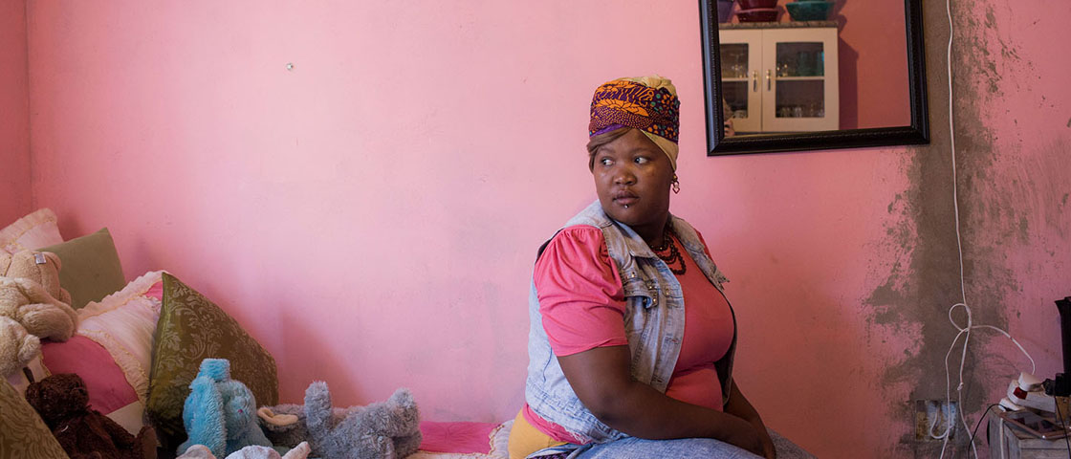
Thank you for joining!
The webinar will be available on IAS+
About the IAS Heart of Stigma: www.iasociety.org
About the HIV Justice Network:
www.hivjustice.net
Image: Sydelle Willow Smith

