Slide 1


Stigma leads to Substance Use
Among MSM and Transgender Women Living with HIV:
Insights from Vietnam
Minh T. Nguyen and Donn J. Colby
“I will not lower my voice": Experiences from trans and gender-diverse communities

Slide 2
Summary
What is your main question?
Does stigma exposure among men who have sex with men (MSM) and transgender women living with HIV predict the initiation of substance use (methamphetamine, ecstasy, and heroin)?
What did you find?
High-frequency stigma exposure, particularly physical violence, exclusion, and emotional trauma, significantly increases the risk of first-time substance use initiation among MSM and transgender women with HIV. Eliminating severe stigma could potentially prevent approximately one-third of new substance use persons.
Why is it important?
Reducing stigma may prevent the onset of substance use and improve health outcomes for vulnerable groups, particularly within HIV care settings.

Slide 3
Why Does This Matter?
HIV-related stigma could be a barrier to addressing the global HIV epidemic.
Stigma undermines HIV care and mental health
Minority Stress Theory: chronic stress → maladaptive coping
Escalating methamphetamine & ecstasy use in Vietnam with associated harms, including negative medical outcomes, poor ART adherence, and detriments to mental health, quality of life, and social well-being.
Notes:
Stigma remains a critical social determinant linking minority stress to mental health burdens. For MSM and transgender women, intersecting HIV‑related and identity‑based stigma increase vulnerability. In Vietnam, recreational stimulants are rising alongside the HIV epidemic, making it urgent to understand whether stigma precipitates first‑time drug use.

Slide 4
HIV epidemic in Vietnam
Population: 101.5 million (2025);
250,000 (0.25%) people are living with HIV;
6,100 new HIV transmissions in 2023.
Sexual transmission is now the main driver, accounting for 70.8% of newly identified transmissions (2024), increase from 47.5% (2010).
Notes:
Stigma remains a critical social determinant linking minority stress to mental health burdens. For MSM and transgender women, intersecting HIV‑related and identity‑based stigma increase vulnerability. In Vietnam, recreational stimulants are rising alongside the HIV epidemic, making it urgent to understand whether stigma precipitates first‑time drug use.

Slide 5
Objectives
To evaluate the association between stigma and initiation of substance use (methamphetamine, heroin, ecstasy).
To identify specific stigma dimensions contributing to substance use among MSM and TW.
Notes:
The main objectives of this study were to evaluate the association between stigma and the initiation of substances like methamphetamine, heroin, and ecstasy among MSM and TW living with HIV. We aimed to identify which forms of stigma are most predictive of substance use initiation and use these insights to inform stigma reduction strategies in HIV care.

Slide 6
Design & Setting
Prospective cohort | 2019–2022
2 outpatient HIV clinics: Ho Chi Minh City & Can Tho
N = 504 HIV‑positive MSM (383 | 76%); TW (121 | 24%)
Median follow‑up: 394 days (IQR: 366‑421)
Notes:
We recruited during routine ART visits at two large public clinics. Eligibility required no prior lifetime use of the study drugs so we could observe true initiations.

Slide 7
Exposure and outcome
Exposure (baseline): five dimensions since HIV diagnosis [Frequency: Never | 1–2 | Few | Many (High frequency)]
  Mockery
  Negative Judgment
  Physical Attack
  Sense of Exclusion
  Emotional/Mental Trauma
Outcome: Self‑reported first use of heroin, meth, or ecstasy at follow‑up
  Covariates: age, education, sexual partner number, income
Analysis: Poisson regression, Risk Ratio, Population Attributable Risk (PAR).
Notes:
We derived five items from formative work. Responses of 'many times' were classified as high‑frequency exposures, capturing the upper tail of chronic stigma experiences.
Substance initiation was strictly incident—only participants with no lifetime use at baseline were eligible. We controlled for key socio‑demographics and behavioral confounders in nested models.

Slide 8
Baseline Snapshot
Median age: 27 y | 6.5 M VND income
≥1 stigma dimension reported by 67%
High‑freq "physical attack": 23%
MSM more “Mockery” (54%)
TW reported more "Sense of Exclusion“ (54%)
Notes:
Even before follow‑up, stigma was pervasive: two‑thirds reported at least one form. Patterns differed by identity—physical violence was common for MSM, whereas TW reported greater emotional hurt.

Slide 9
A. MSM (100 new)
Follow‑up
Ecstasy (n=57)
30
27
Heroin
(n=4)
30% initiated any drug within 1 year.
Methamphetamine 22% | Ecstasy 17% | Heroin 1%
Higher among TW (52, 43%) vs MSM (100, 26%) (p<0.001)
3
1
39
Methamphetamine (n=67)
B. TW (52 new)
Ecstasy (n=26)
26
17
(33%)
9
Methamphetamine (n=43)
Notes:
Almost one‑third began using stimulants within a single year despite no prior history—underscoring how quickly risk profiles can change, especially for transgender women.

Slide 10
Stigma Elevates Risk
1A. MSM (n=383)
Notes:
After adjusting for age, education and partner number, three stigma dimensions remained significant. Physical violence was the strongest determinant, increasing initiation risk by nearly 50 percent.
High‑freq Physical Attack → aRR = 1.46 (95% CI 1.25–1.71)
Sense of Exclusion → aRR = 1.28 (1.11–1.46)
Emotional Trauma → aRR = 1.19 (1.03–1.37)
Mockery & Negative Judgment NS after adjustment

Slide 11
Stigma Elevates Risk
1B. Transgender Women (n=121)
Notes:
After adjusting for age, education and partner number, three stigma dimensions remained significant. Physical violence was the strongest determinant, increasing initiation risk by nearly 50 percent.
High‑freq Physical Attack → aRR = 1.46 (95% CI 1.25–1.71)
Sense of Exclusion → aRR = 1.28 (1.11–1.46)
Emotional Trauma → aRR = 1.19 (1.03–1.37)
Mockery & Negative Judgment NS after adjustment

Slide 12
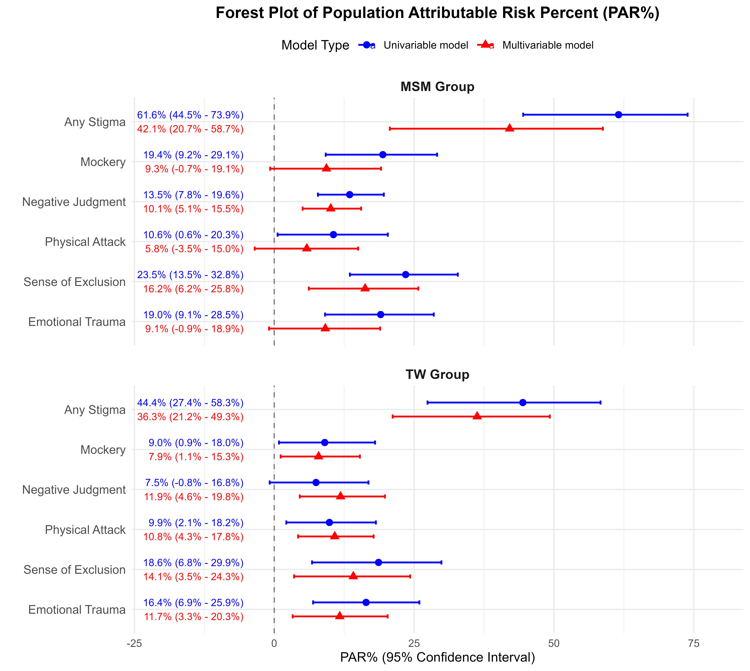
Population Attributable Risk
2A. MSM (n=383)
If high‑freq is stigma eliminated: 42.1% of initiations prevented among MSM.
Multivariable model adjusted for Age, Education, and Number of Sexual Partners.
Notes:
These AR percentages translate to one in three new drug users whose initiation could be averted by eradicating severe stigma—highlighting immense public‑health payoff.

Slide 13
Population Attributable Risk
2B. Transgender Women (n=121)
If high‑freq is stigma eliminated: 36.3% of initiations prevented among TW
Multivariable model adjusted for Age, Education, and Number of Sexual Partners.
Notes:
These AR percentages translate to one in three new drug users whose initiation could be averted by eradicating severe stigma—highlighting immense public‑health payoff.

Slide 14
Implications
Integrate stigma screening into HIV care visits
Multi‑level interventions: legal protection, staff training, peer support
Address physical safety & social inclusion.
Notes:
Clinical teams should routinely assess stigma exposure just as we do for viral load or depression. Programmatically, linking clients to legal aid, safe‑spaces, and cognitive‑behavioral coping programs may curb the progression from stress to substance use.

Slide 15
Take‑Home Messages
Stigma is a causal driver of first‑time drug use among MSM & TW living with HIV.
  Physical violence, exclusion, Emotional trauma are the most harmful.
Eradicating severe stigma could potentially prevent >1⁄3 of new substance use initiations.
Stigma reduction must be integral to HIV & substance‑use strategies.
Notes:
In closing, our prospective evidence strengthens the call for stigma‑free HIV services. Reducing violence and exclusion is not just a human‑rights imperative—it is a concrete pathway to avert substance use epidemics and improve continuum outcomes.

Slide 16
Thank you
Authors: Minh T. Nguyen^{1,2}, Donn J. Colby¹, Lan Anh Do^{1,3}, Tam Cong Le¹, Huu Thanh Tran¹, Binh Quoc Luong⁴, Phuong Kim Thi Doan⁵, Khang Quang Do⁶, Hung Van⁴, An Bao¹.
Affiliation: ¹Center for Applied Research on Men and Community Health (CARMAH), Ho Chi Minh City, Vietnam; ²University of Medicine and Pharmacy at Ho Chi Minh City, Ho Chi Minh City, Vietnam; ³Pham Ngoc Thach University of Medicine, Ho Chi Minh City, Vietnam; ⁴ HCMC Center for Disease Control, Ho Chi Minh City, Vietnam; ⁵ Can Tho Center for Disease Control, Can Tho Vietnam; ⁶ Galant Clinic, Ho Chi Minh City, Vietnam.
Acknowledgement
This study was supported by a grant from Gilead Sciences, Inc.

