Slide 1
Mpox awareness and access barriers among MSM, transgender and intersex communities in Kenya
Gachuche Charles and Jeffrey Walimbwa
Session title

Slide 2
Summary
What is your main question?
To what extent do MSM, transgender, and intersex individuals living in Nairobi understand Mpox, and what factors influence their willingness to seek healthcare services?
2. What did you find?
Most MSM, transgender, and intersex individuals in Nairobi’s expressed deep concern about stigma, isolation, and fear related to mpox. Access to accurate information was limited, with little formal education or public health messaging reaching these communities. Preferred sources of information included peer educators, social networks, social media platforms like Facebook and WhatsApp, and dating apps such as Tinder and Grindr.
3. Why is it important?
This is significant as it underscores the vital role community systems play in filling structural gaps during health crises like COVID-19 and Mpox. These networks are often more trusted and accessible for marginalized populations, making them essential in delivering timely and effective health information. Prioritizing person-centred approaches in health programming not only increases reach but also leads to more equitable and sustainable health outcomes.

Slide 3
Structural Barriers
_
Health Services Access
HIV Prevention
_
Criminalization
Mental Health
Individual Counseling
Sexual Stigma
ART
+
Health Care Provider Discrimination
Mpox information
PrEP
Resilience
+
Sexual Health
Condoms
Community Engagement- Peer education, outreaches, social media
Lubricants

Slide 4
Background
From July 2024,we conducted a short study to evaluate community awareness and preparedness regarding Mpox. Data was collected during monkey survey where we had over 100 responses regarding Mpox. The survey consisted of multiple choice and open ended questions
Sources of information on Mpox
Knowledge on Mpox symptoms and transmission
Awareness and preventive measures
Perceived community preparedness

Slide 5
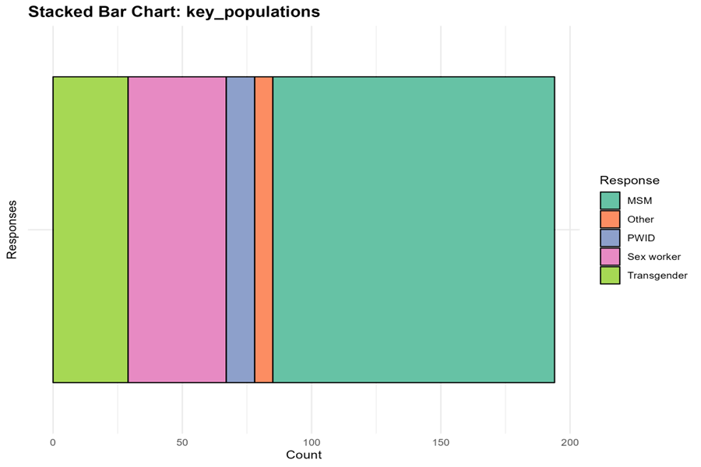
Which key population community do you identify with? (can check more than one)

Slide 7
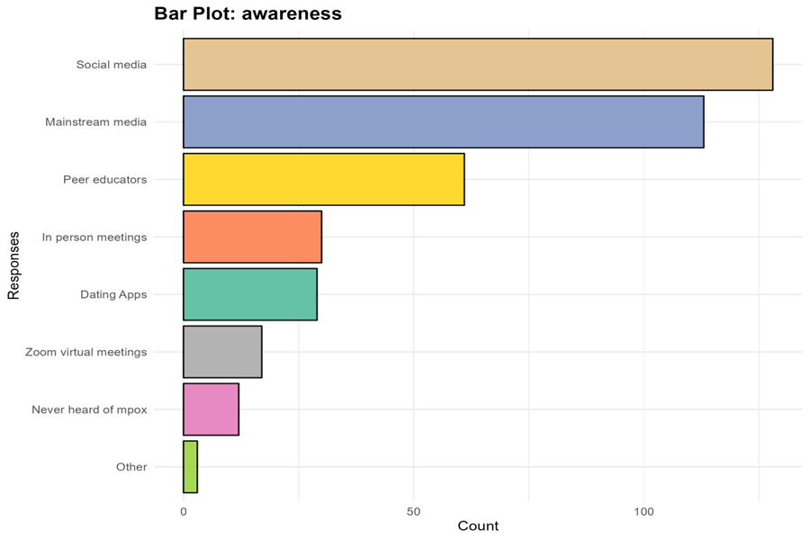
Where are all the places you have heard about mpox?

Slide 8
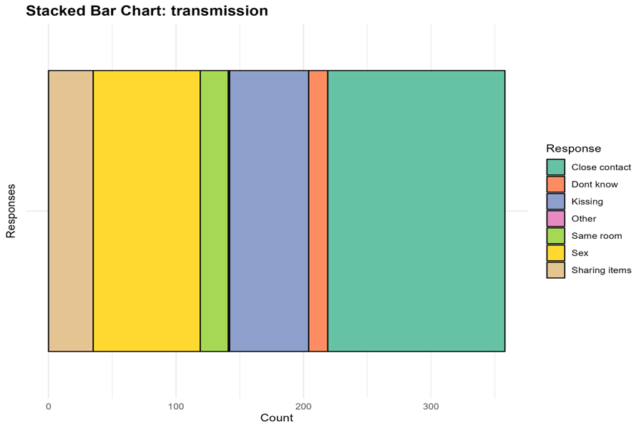
If someone has mpox rashes/bumps, in what ways do you think it can be passed on to another person?

Slide 9
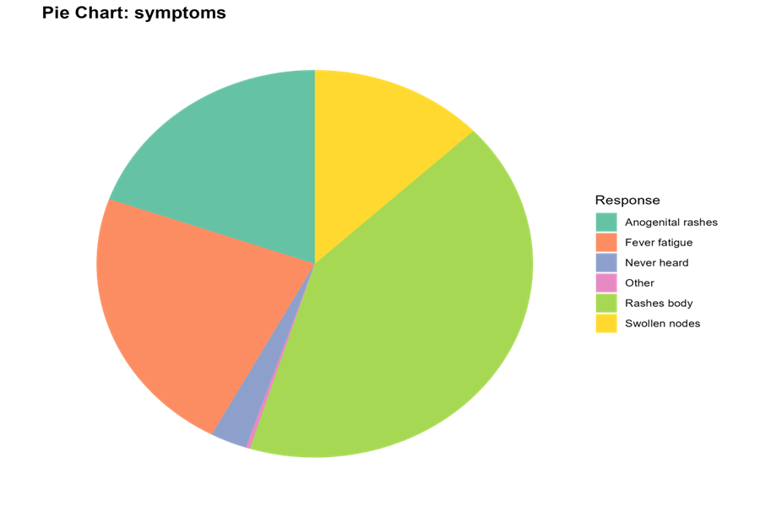
What symptoms are you aware of that are associated with mpox

Slide 10
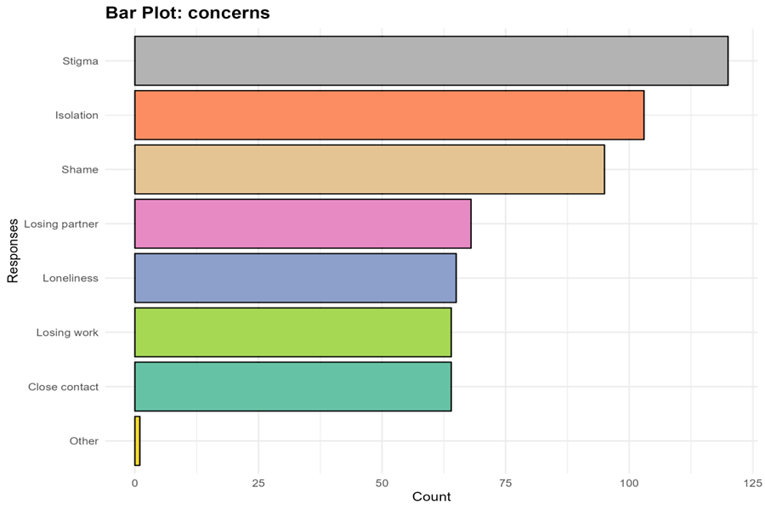
What worries you about mpox?

Slide 11
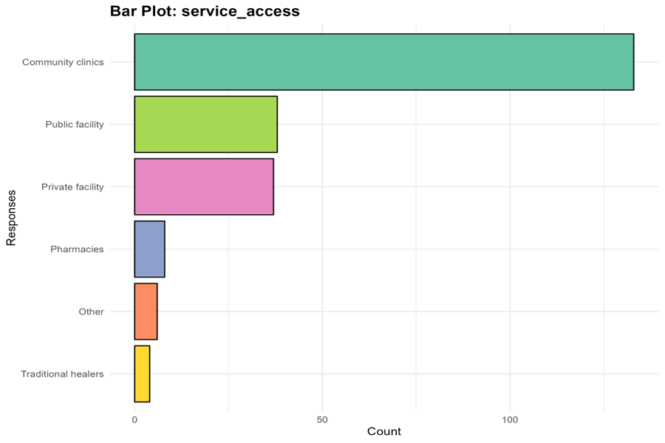
Now we would like to understand a little bit about how you access services: If you wanted to get tested for an STI this week, where would you go?

Slide 12
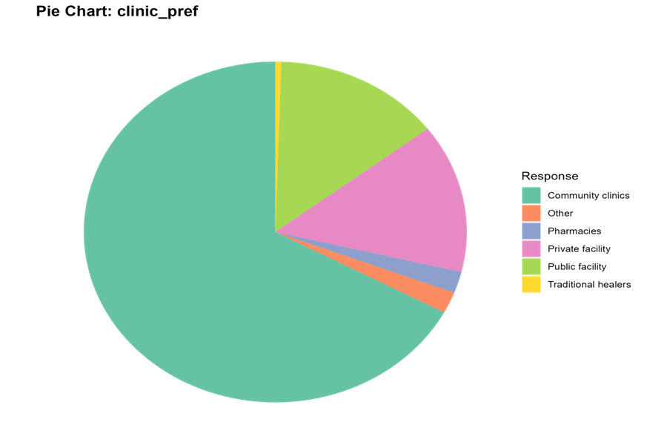
If you noticed a new rash/bump somewhere on your body or anogenital region (e.g. penis, vagina, anus), which clinic would you go to?

Slide 13
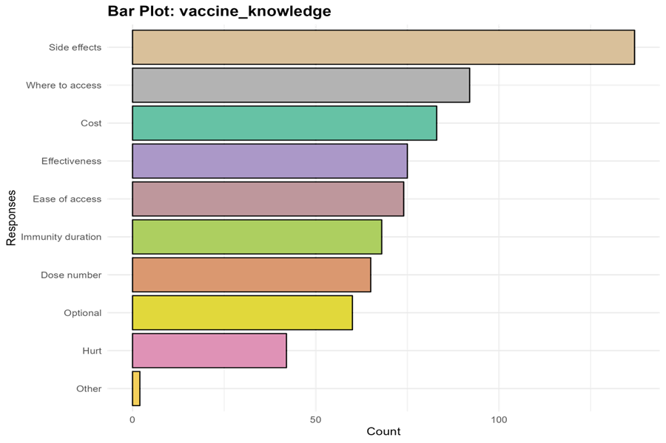
Work is underway for vaccines, so we would like to understand more about your thoughts on vaccines for mpox: What information would be important to know if you were to consider getting a vaccine for mpox?

Slide 14
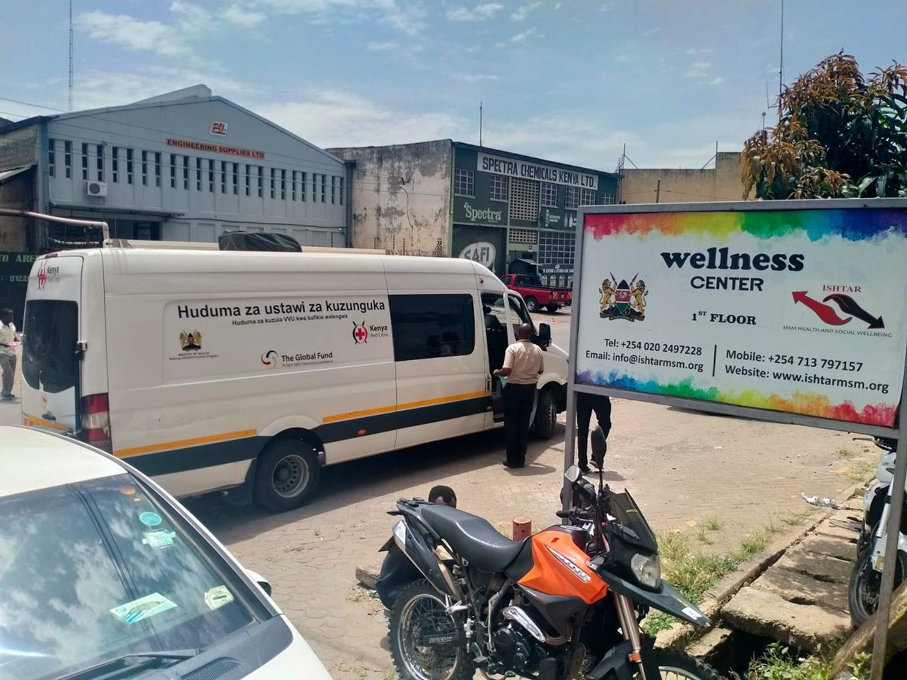
Conclusion
There needs to be clear infrmation on Mpox and health educations should include pandemics like Mpox.
Health care providers is also critical to give information on Mpox.
Community engagements is also important during pandemics for correct and consistent information.
There needs to be funding for community led initiatives especially during pandemics.

Slide 15
ACKNOWLEDGEMENT
Thank you to the HECKA programme research partnership a project led by community research and technicall support hub programme comprising of ISHTAR,HOYMAS,KYDESA,MAYGO,AMKENI AND Q-INITIATIVE.
With technical support from PROF.SHARMISTHA MISRA,NANCY THAMO-PHD Student,LISA LAZARUS,PROF ROB LORWAY.
Funding agency from AMREF ,NFRF

