Slide 1
Strengthening Health and Human Rights for People Living with HIV and Key Populations in Myanmar :
The Community Feedback Mechanism (2022–2024), by Puu Paung Swann Saung Myanmar
OAE01 – Advancing Equity in the HIV Response: Key Populations, Human Rights, and Quality Intervention
Presented by: : Khin Khin Win
(Puu Paung Swann Saung Myanmar – PPSSM)

Slide 2
Summary
What is your main question?
How can a community-led system like the Community Feedback Mechanism (CFM) improve access to health, justice, and social support for people living with HIV and key populations in Myanmar?
What did you find?
82% of reported issues were socially related; 82% of all valid cases were resolved. CFM engaged 449 users across six townships, with strong user satisfaction.
Why is it important?
The CFM empowers affected communities to report rights violations, improves service access, and supports rights-based, people-centered HIV responses—especially critical in fragile and under-resourced settings.

Slide 3
Today’s Roadmap
What's Next
Key Insights &
Impact
- Scaling and the
way forward
- What the data
tells us
What is CFM?
- The Community
Feedback
Mechanism
Myanmar's HIV
Landscape
- HIV trends and
challenges

Slide 4
What Is the Community Feedback Mechanism (CFM)?
A community-led system launched in 2014 by the Community Network Consortium on HIV (CNC), made up of 8 national networks.
Developed to document and respond to discrimination, rights violations, and service gaps experienced by PLHIV and key populations.
Focuses on health, legal, workplace, and social issues that affect access to care and justice.
Promotes equity, dignity, and accountability by ensuring the voices of affected communities are heard and addressed.

Slide 5
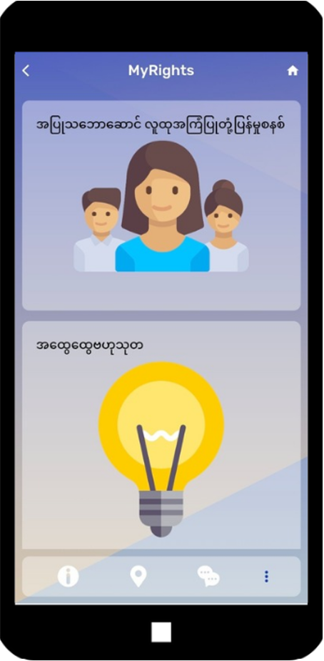
How It Works:
CFM in Practice
Feedback submitted via the MyRights App — by peers trained to collect and report cases from the ground.
Local CFM Committees (supported by the National AIDS Program) verify and respond to cases.
Support offered includes:
  Legal aid
  Emergency assistance (e.g., food, transport)
  Counseling and mediation
CFM is currently active in six townships, led by PPSSM (a member of the CNC), reaching highly vulnerable groups.

Slide 6
Myanmar’s HIV Crisis: Who Is Most Affected?
Estimated 283,000 people living with HIV in Myanmar
Majority of new infections among key populations:
People who inject drugs (PWID)
Gay men and other men who have sex with men (MSM) and transgender people (TG)
Female sex workers (FSW)
Stigma and barriers limit access to health and social services

Slide 7
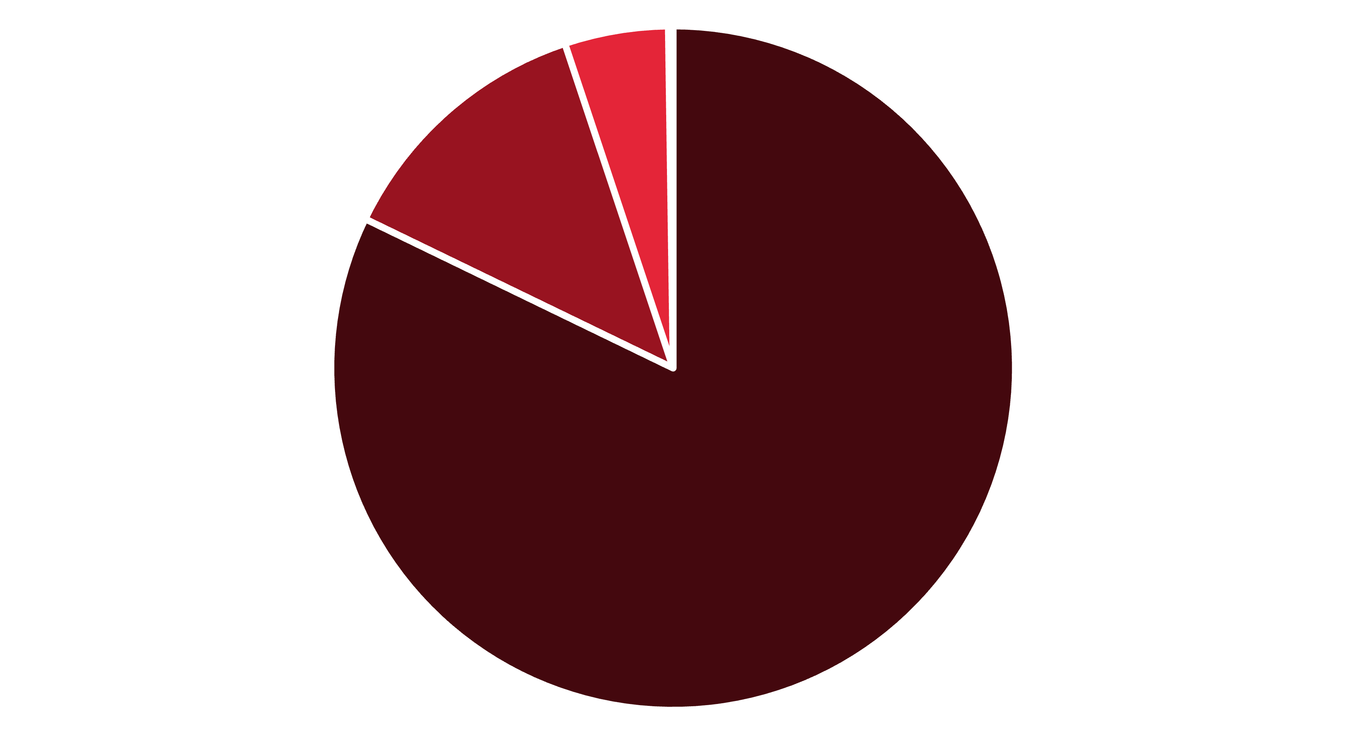
Who’s Most Affected by HIV in Myanmar?
What the Data Shows Us
82% of reported cases came from people living with HIV (PLHIV)
Female sex workers (FSW) and Men who have Sex with Men (MSM) make up most of the remaining cases
Data highlights urgent need for inclusive, community-led support systems
MSM
5%
PLHIV
82% (369 cases)
PWID 0.2%
FSW
13%
FSW
13% (57 cases)
PLHIV 82%
MSM
5% (22 cases)
PWID
0.2% (1 case)
Key Population Classification (n=449)

Slide 8
How the Community Feedback Mechanism Works
Barriers
Beyond Healthcare
82% of reported issues are social, not medical
Legal, workplace, and justice challenges remain
Discrimination limits access to care and rights
Cases reported through MyRights app by trained peers
Local committees verify and respond to feedback
Support includes legal aid, counseling, and emergency help

Slide 9
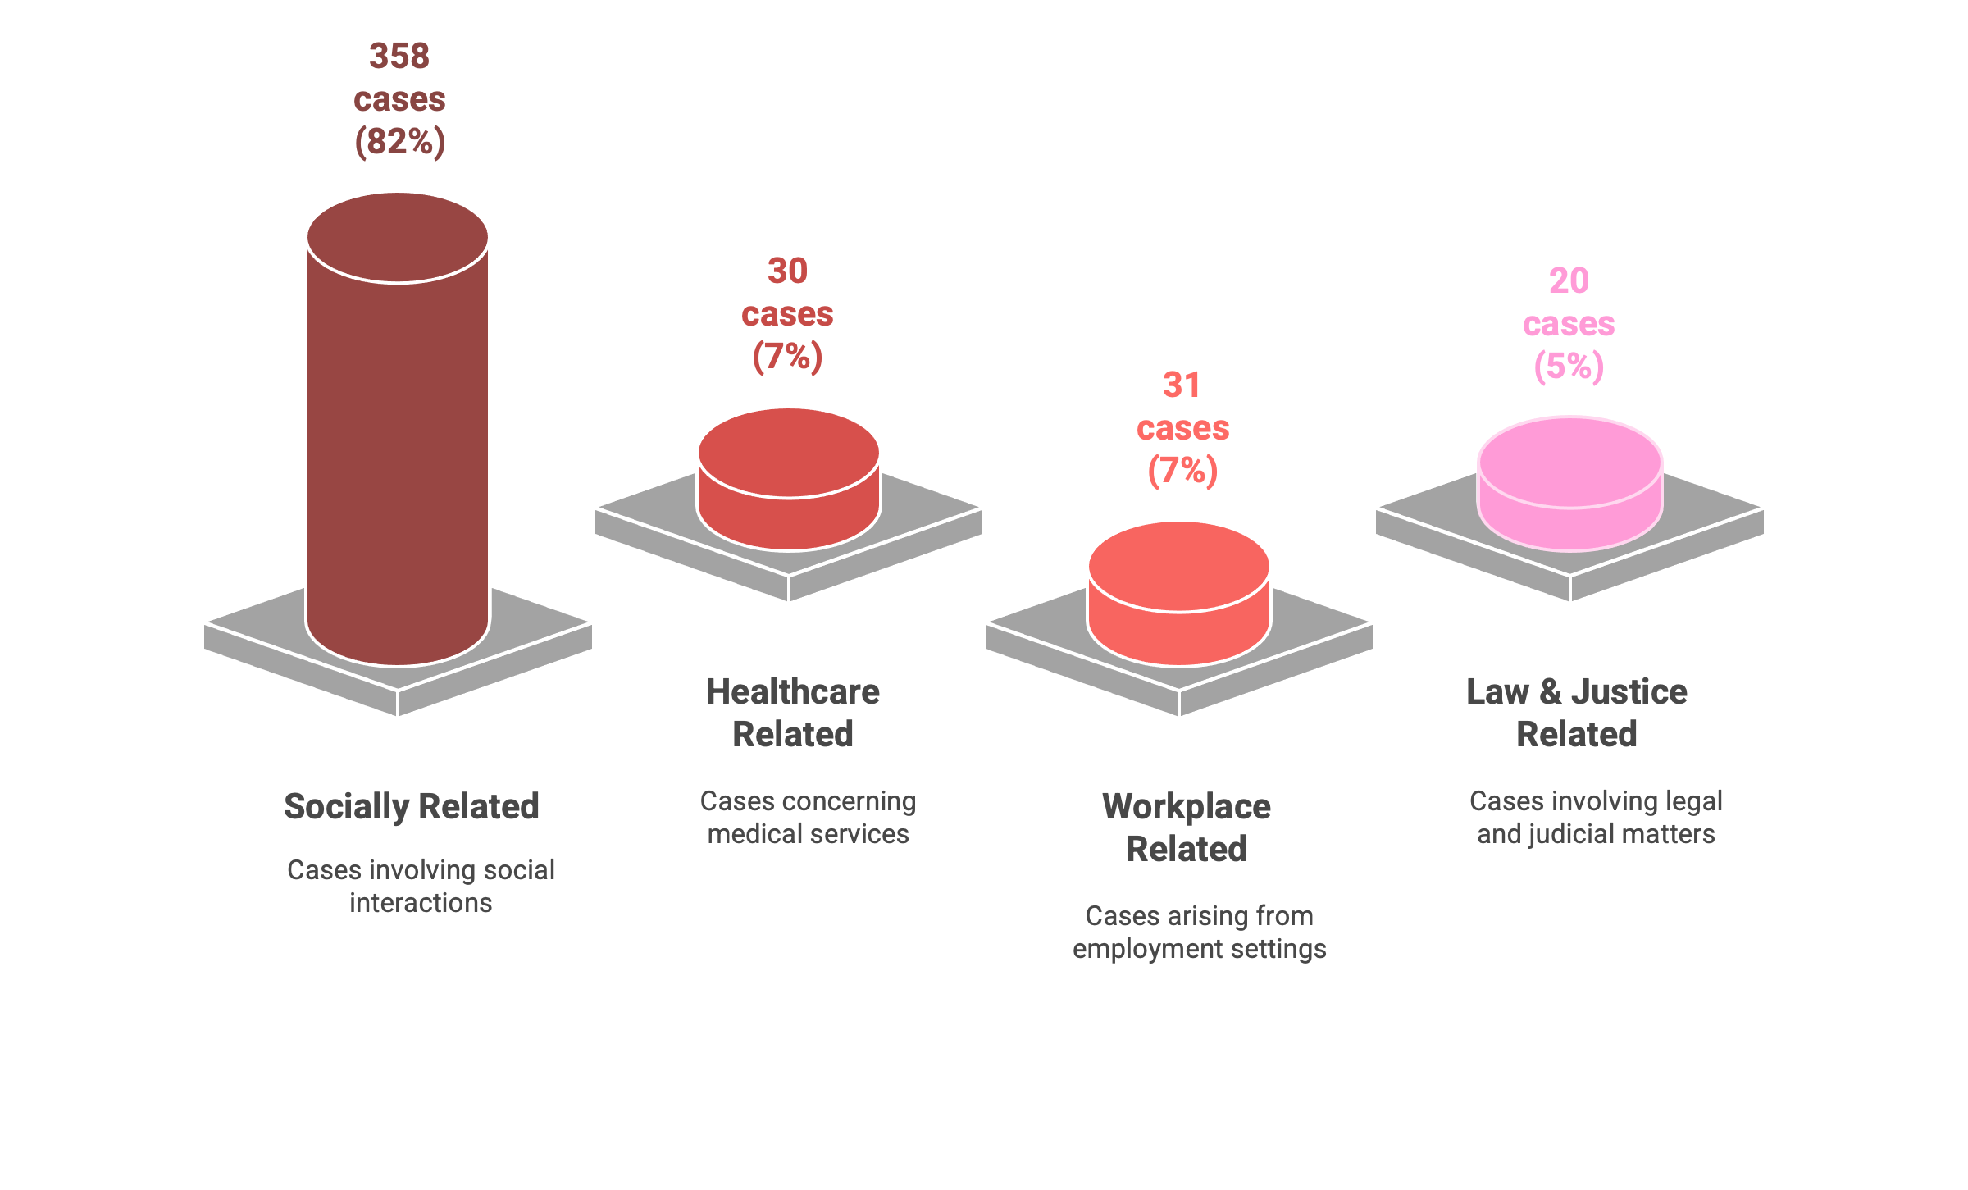
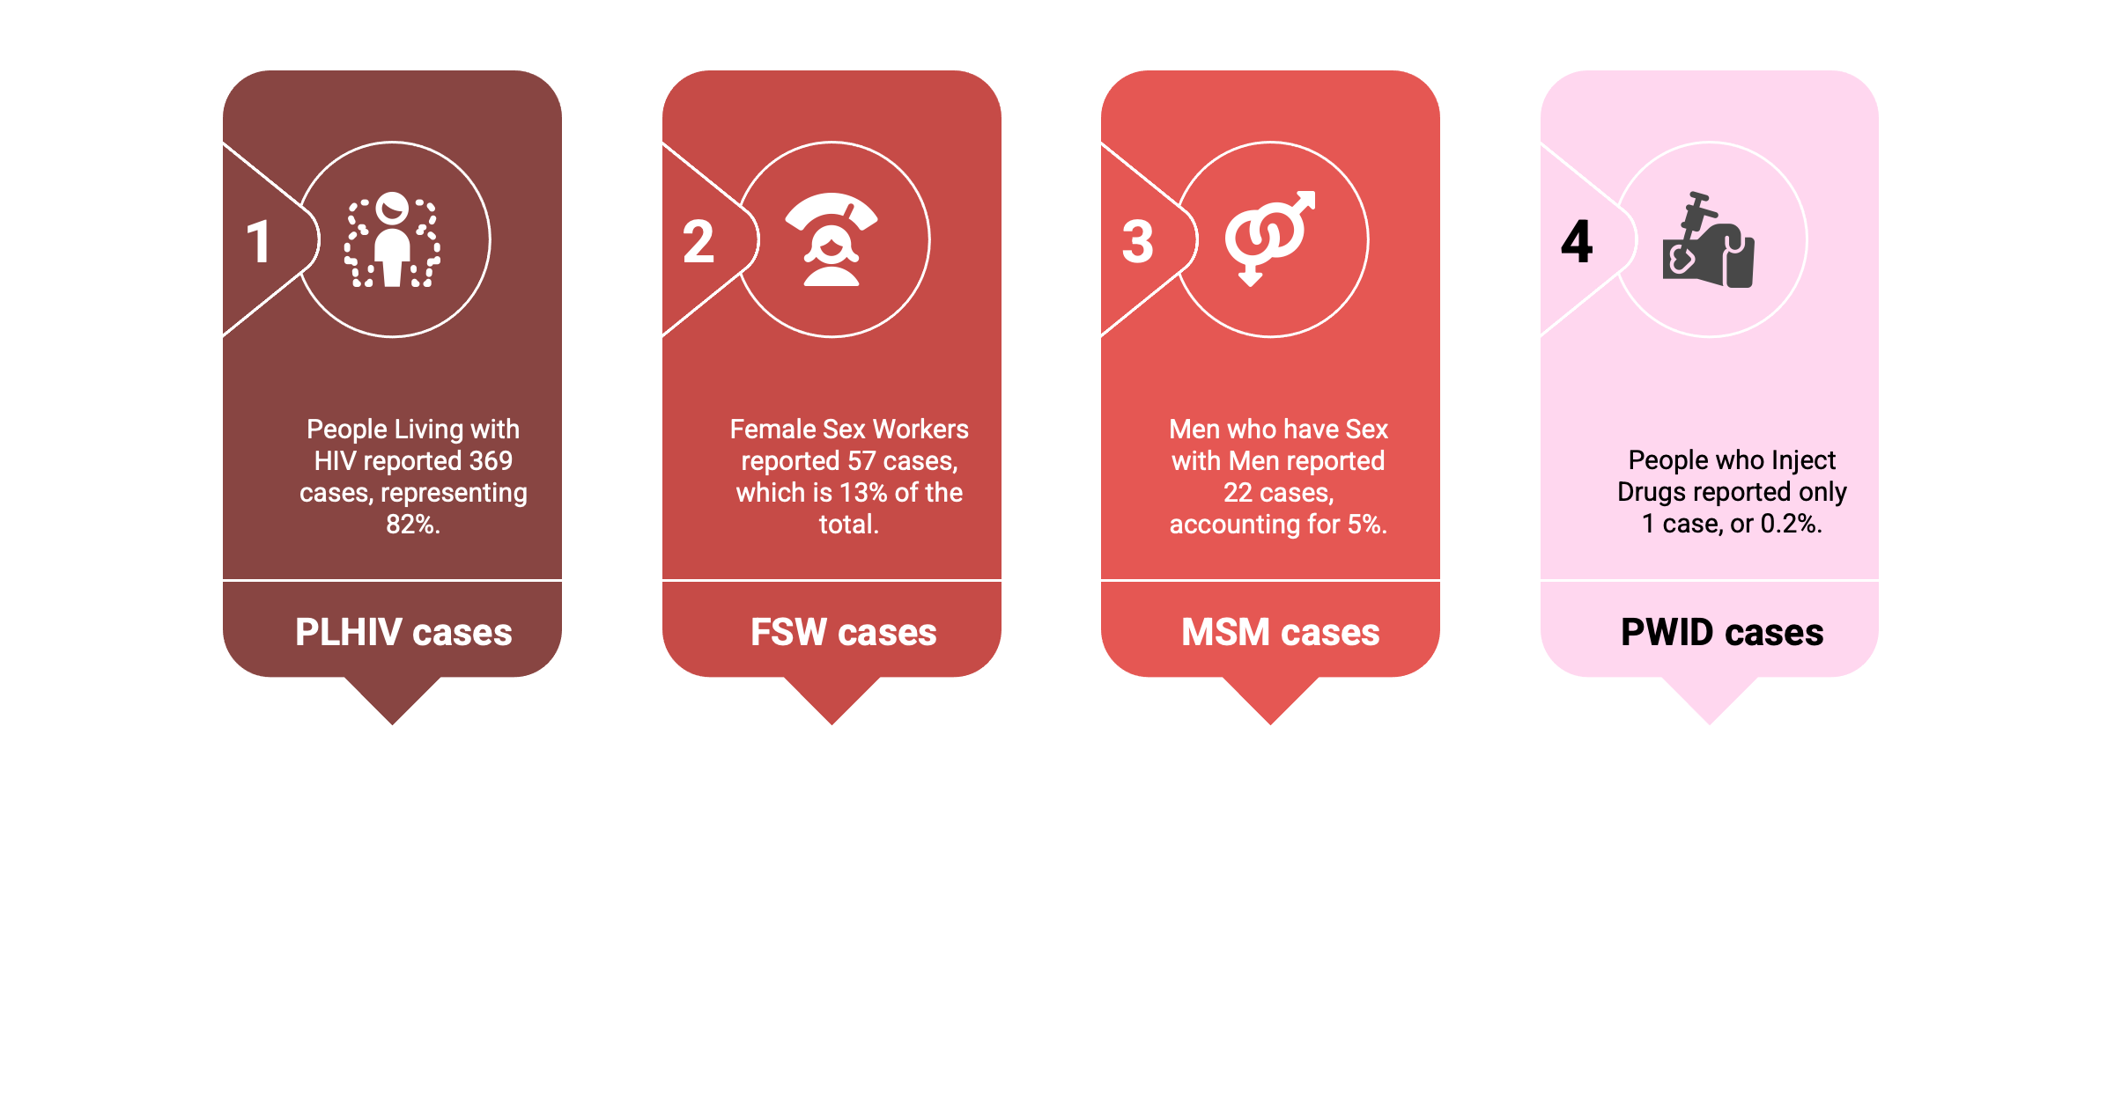
What Did We Hear?
Who Came Forward?
CASE TYPE BREAKDOWN
KEY POPULATION BREAKDOWN
“Most reports were related to social issues, followed by workplace and healthcare access.”
“PLHIV made up the overwhelming majority of users, showing strong community engagement.”

Slide 10
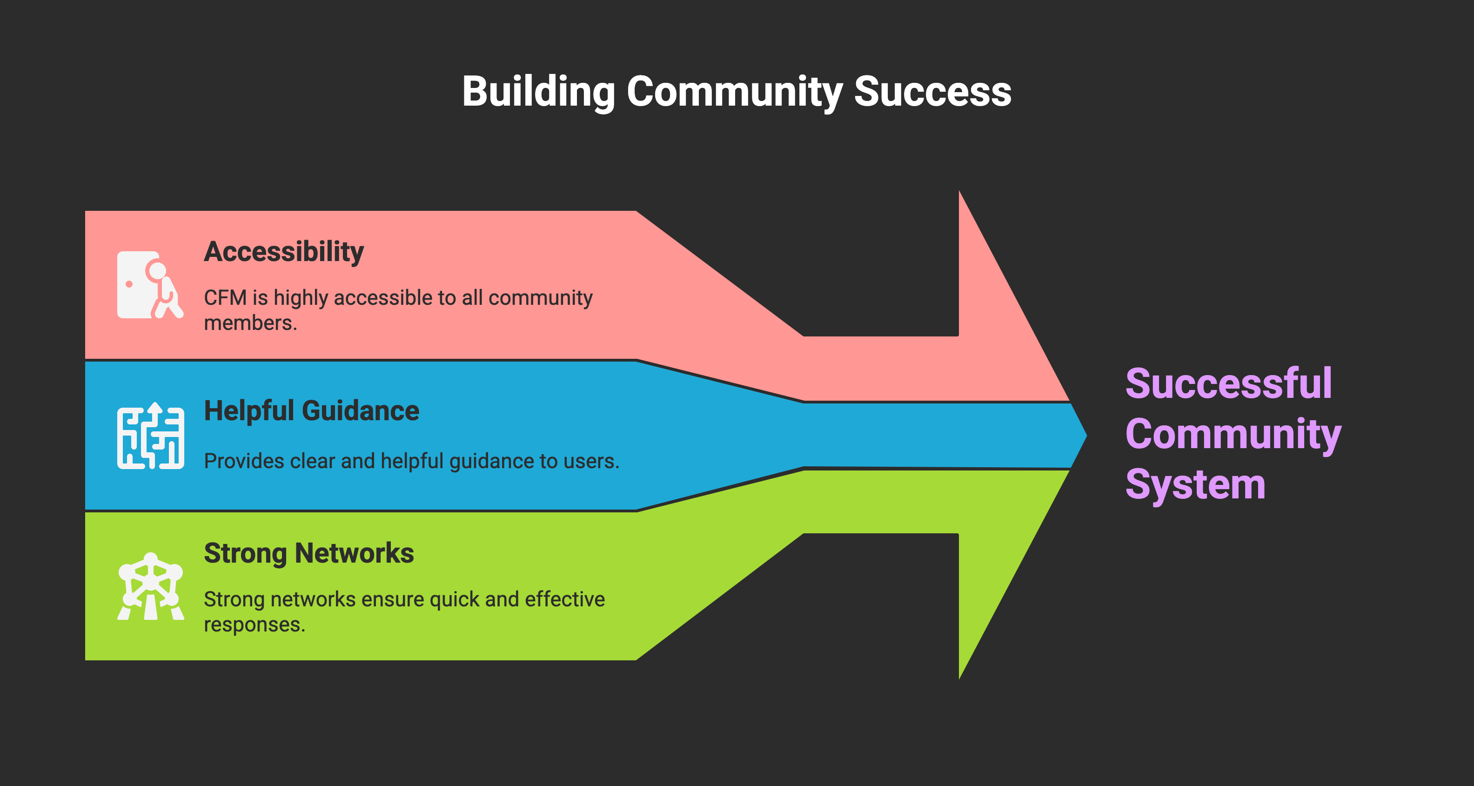
Lessons Learned: Power of Community-Led Action
CFM is Myanmar’s most successful community system
Users praise its accessibility and helpful guidance
Strong networks enable fast, effective responses

Slide 11
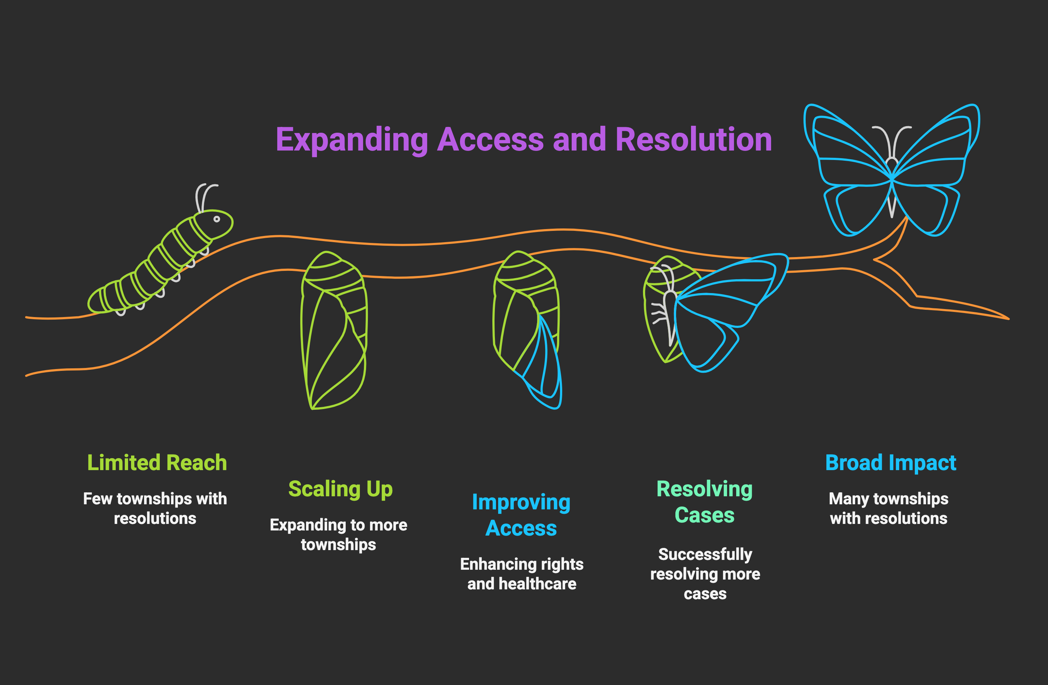
What’s Next: Scaling Up and Sustaining Impact
82% of cases successfully resolved
Expansion planned from 6 to 16 townships (2024–2026)
Continuing to improve rights and healthcare access

Slide 12
“The CFM in Myanmar is vital because it provides a community-driven, accessible, and effective platform for vulnerable populations affected by HIV to voice their concerns, seek resolution for critical issues, and receive essential support”
“Community Quote”
Community Member from CFM Project

Slide 13
Recommendations
“The percentage of emergency support cases (nutrition, transportation) might seem small, these interventions can be life-saving and critical for individuals facing immediate challenges.”
Strengthen the CFM’s reach through network expansion to underserved townships.
Institutionalize CFM learnings into national HIV strategies.
Provide sustainable funding for emergency support interventions.
Train local actors to reduce stigma and improve responsiveness.
Enhance the MyRights App with user feedback and multilingual access.

Slide 14


Thank You for attention & …
Let’s Stay Connected
💼 Presenter: : Khin Khin Win, Secretary,
Puu Paung Swann Saung Myanmar (PPSSM)
Email: : khinwin.jarnaki@gmail.com
Facebook: : http://www.facebook.com/ppssm.mina
“COMMUNITY VOICE IS THE FIRST STEP TO EQUITY.”

Slide 15

🙏✨ ကျေးဇူးတင်ပါတယ် ✨🙏

